Slide 1

Learning Python
Part 1: Essentials and variables

Slide 2
Why learning Python is a good idea?
Aside from web language (JavaScript), Python is the second most popular programming language. (Second, because HTML and CSS are, technically, not a programming languages)
It’s universal, meaning that it can be used in a different areas of programming – from web development to creation of machine learning models. One of the most popular machine learning model creation framework – PyTorch, uses Python.
It’s simple to learn (compared to older programming languages like Java and C++). That is because Python simplifies a lot of concepts, in order to make programming process much more enjoyable.

Slide 3
Default Python version
Default implementation of Python was written with C language. That is why Python downloaded from official website is, sometimes, called “Cpython”.
Nowadays there are a lot of different implementations (Jython (Java + Python), PyPy, Cython, etc)
In our lessons we will be covering only default implementation - CPython

Slide 4
Enough with history, let’s dive in into the Python concepts world! Let’s start with the variables!

Slide 5
Python Variables

Slide 6
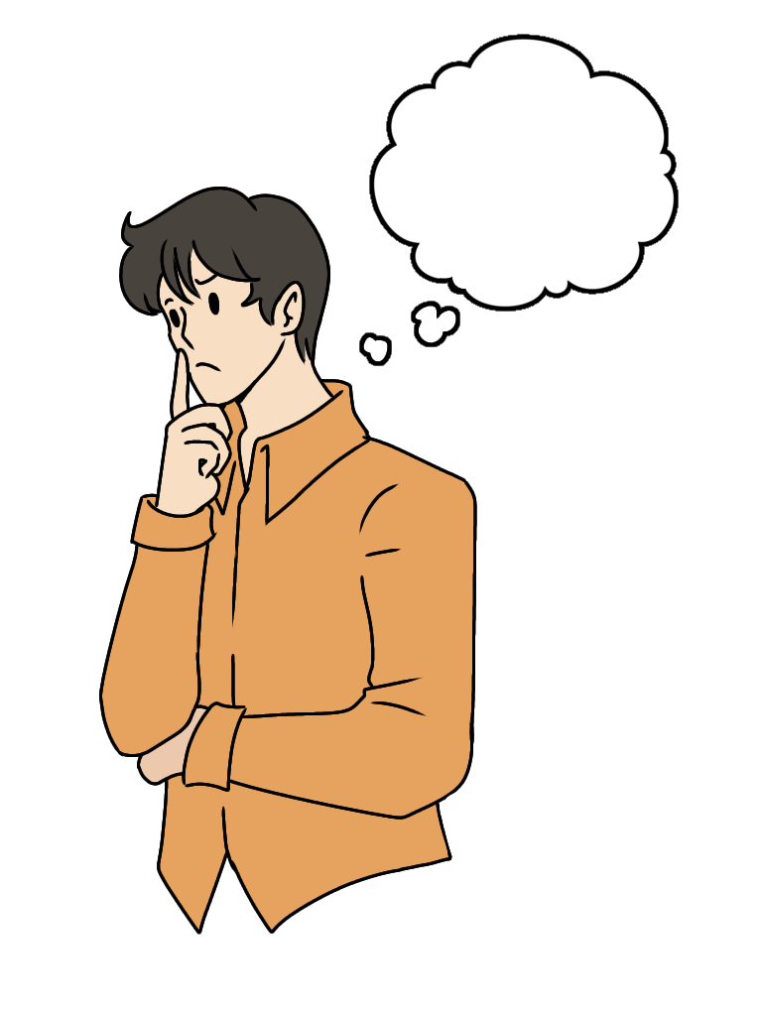
What is a variable?
Notes:
Image: FreyaSyauqila, CC BY 4.0 <https://creativecommons.org/licenses/by/4.0>, via Wikimedia Commons

Slide 7
Let’s try to answer this question!
One of the simplest, yet one of the most essential concepts!
If we put it simply, variable is our way to tell the computer to remember some data, in order to use it later.
Let’s compare it to the real world!

Slide 8

The closest concept to the variable in real life is a word
Each word in our language have the form (combination of letters) and the meaning:
Table
Word “form”
Word meaning (what we are imagining when saying it)
Notes:
Image: Smart Servier, CC BY-SA 3.0 <https://creativecommons.org/licenses/by-sa/3.0>, via Wikimedia Commons

Slide 9
In Python same concept can be applied!
Here is how we create variable:
variableName
variableValue
Assignment Operator

Slide 10
Real Python example:
Variable value. In this case we define it ourselves. Because Python assigning the type automatically intVar will have int type. Because it’s a number without decimal point
intVar = 23
Variable name. Defined by the user.
There are some rules for defining variable names, such as:
A variable name must start with a letter or the underscore character
A variable name cannot start with a number
A variable name can only contain alpha-numeric characters and underscores (A-z, 0-9, and _ )
Variable names are case-sensitive (age, Age and AGE are three different variables)
Notes:
Python variable names source: https://www.w3schools.com/python/python_variables_names.asp

Slide 11
How the RAM works (Simplified concept (Python version))
floatVar
boolVar
IMPORTANT!!!
If the variable exists in the memory, there is a high chance that there is a name connected to it
Otherwise – something is definitely wrong
Can be any name we want as long as it follows Python naming conventions
intVar
Variable1
Variable2
Variable6
The whole block is called “private heap”
someOtherVar
Variable3
Variable5
Variable10
varNameOne
varTwo
Notes:
https://docs.python.org/3/c-api/memory.html

Slide 12
Important Note!!!
Every variable in Python is an object!!!
Why is this important?
Because this concept differs from other programming languages. In Java and C# (and a lot of others), there is a stack and heap memory. Stack stores local variables and function calls (don’t worry, we will all learn that in the future lessons).
Python only have heap and it’s private (aka hidden)

Slide 13
Variable types

Slide 14
Types of variables in Python:
Numeric (int, float, complex)
Boolean (contains only 2 values - True or False) (bool)
Text type (sequence of characters or single character) (str)
NoneType (basically absence of value) (None)
Sequence (sequence of variables) (list, tuple, range)
Mapping (dict)
Binary (bytes, bytearray, memoryview)
The list of types is retrieved from: https://www.w3schools.com/python/python_datatypes.asp

Slide 15
If the value have an exact type, that does not mean that it can’t be converted
Syntaxis for the conversion:
variableName = newType(valueToConvert)
For example:
intVar = str(1) - converting integer 1 to string
However, you need to be careful with conversion!
strToInt = int(“123xyz”) - will produce error, because xyz is not numeric, hence, can’t be converted to number

Slide 16
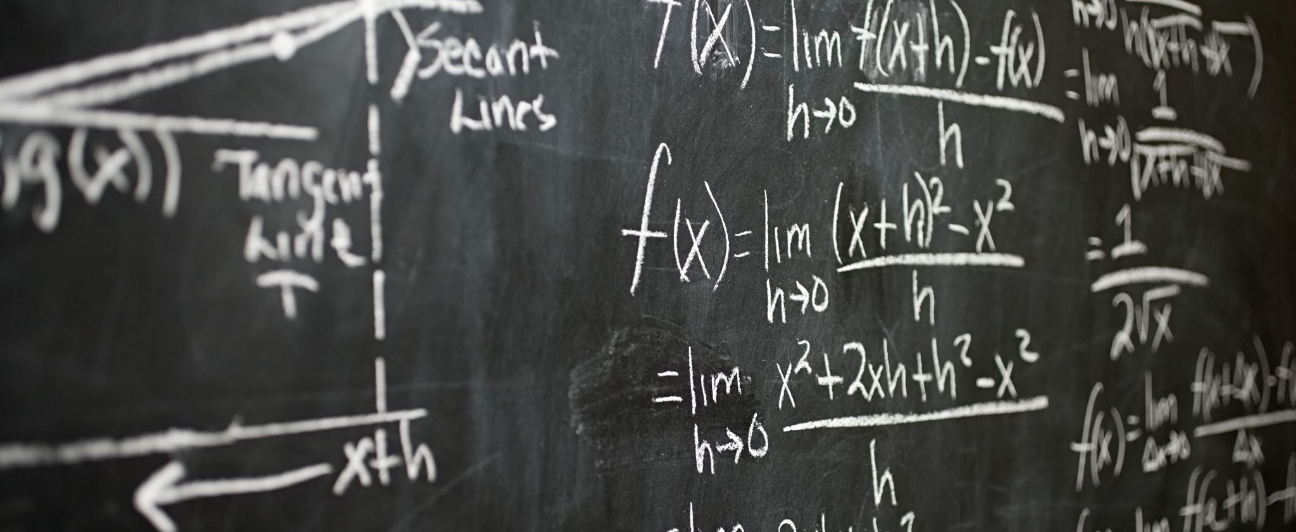




Functions

Slide 17
Functions
What you saw in the previous slide are a bunch of functions
Function is a predefined set of actions
It have following syntax:
functionName(dataToWorkWith1)
Inside the parenthesis is our data that we want to work with. It’s called function arguments
The function can contain multiple arguments or none (it depends on how it was developed).
Function argument

Slide 18

Exceptions (Errors)
Notes:
Image: OpenClipart-Vectors, CC0, via Wikimedia Commons. Link to the image: https://commons.wikimedia.org/wiki/File:Alert-Stop-Warning-Error_icon.svg , link to the license: https://creativecommons.org/publicdomain/zero/1.0/deed.en

Slide 19

Exceptions/errors
It’s always a great feeling when your program runs as intended. However, most of the times your code will not run smoothly during the first compilation, especially if you are a beginner.
If something is going wrong – you will see the exception with the appropriate message.
There are 3 types of error:
Syntax error
Logical error
Runtime errors

Slide 20
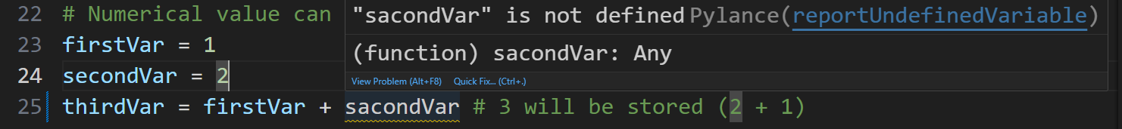
1. Syntax error
Usually the product of typo. This type of error is the easiest to handle since code editors are usually highlighting all the syntax error and providing a solution to them.
NOTE – if the syntax error exists – we won’t be able to compile our code at all
I mistyped “secondVar” and the mistyped variable is highlighted (zoom the slide to see more clearly)

Slide 21
2. Logical error
That is a mistake on the side of the programmer. We built the program successfully but there is a flaw in our logic.
The program compiles just fine but gives unexpected result.
Probably the hardest error to handle because it does not give any error messages at all.
Example:
Mistake in the logic of programmer. To get the average we need to divide the sum by the amount of variables (in this case 7) and not by 2

Slide 22

3. Runtime errors
Fatal errors for our programs. Usually, they occur when we are trying to make something that is not originally intended.
Example:
This code will give us an error, because string contains non numerical characters -> can’t be converted to int
When Runtime error occurs, if it’s not handled properly, the program automatically ends without going anywhere down the code.
Don’t worry, we will discuss how to deal with this type of error in the future lessons.

Slide 23
Garbage collector

Slide 24

IMPORTANT!!!
The variable exists until we don’t need it anymore. If we are reaching the point in our program where this variable will never be used – its erased from the RAM by garbage collector.
Notes:
Image: Painter06, CC0, via Wikimedia Commons

Slide 25
What is garbage collector?
Garbage collector (also known as gc) is essential part of Python.
It’s a process that manages PC resources to achieve the best performance for our program.
If the variable is no longer used – the gc will erase it from

Slide 26
Conclusion

Slide 27

Hint of the day
Python, as every modern programming language, evolve with each day it exists
Every day people are creating new libraries/frameworks and some of the old libraries/frameworks become obsolete
Because of that, it’s impossible to know ALL Python capabilities. Even though you can read about Python latest trends/updates every day, it’s nearly impossible to keep that much information in mind! Plus, it’s very frustrating!
Because of that, it’s never a bad idea to find a solution to the difficult tasks in the internet. After all, in IT industry you get paid for getting the job done and not for how well you know the theory.
Funnily enough, that statement contradicts with the interview process, where, sometimes, you are restricted from using the internet for solutions.
Notes:
Image: Videoplasty.com, CC BY-SA 4.0 <https://creativecommons.org/licenses/by-sa/4.0>, via Wikimedia Commons Creative Commons Attribution-ShareAlike 4.0

Slide 28

Useful websites for learning Python:
1. Official Python documentation
Number one friend for every developer. Although, for beginners it might seem too complicated. Even though it might seem like some cryptic notes, I suggest you to read it first when you are struggling with some Python features, because it will give you the idea of how professionals work. If documentation didn’t give you appropriate solution – move to the step 2.
2. StackOverflow
It’s a programmers forum where people are asking question related to different programming languages and their frameworks. It’s you number 2 best friend after official documentation. Although, be aware, that all the answers are written by people. And sometimes people make mistakes. Because of that, there is no 100% guarantee that the answer will be correct or be appropriate to your solution

