Slide 1

Udyam Digital
Making small businesses go digital in one sitting: on a phone, in their own language
YTL Hackathon 2026 · Enterprise Track A
AI advisor · transparent quote · smart KYC · order tracker
Notes:
Udyam Digital is a phone-first journey that takes a small-business owner from 'what do I need?' to a live connection: an AI advisor in their language recommends a bundle, a transparent quote follows, KYC is checked in minutes against the GSTIN and Udyam registries, and a tracker replaces the status-chasing calls. Everything you'll see is a working prototype.

Slide 2

93 of 100 leads are lost, a third to fixable friction
5,000 SMB leads, Apr–Jun 2026 (case data, smb_leads.csv)
1,485 drops (32%)
are fixable by a digital journey: no time for a visit 531, visit never scheduled 296, quote too complex 206 or too slow 179, paperwork and documents 273
17.6
3–5
3×
days lead to activation
days for a quote today
status chases per customer
₹15,000
1,594
blended cost to acquire one SMB
lost before first contact (34%)
Steepest drop: needs assessed → quote accepted (44%)
Notes:
Out of 5,000 leads only 368 activated: 7.4 percent. The biggest leak is between needs assessment and an accepted quote. When we grouped the 4,632 drop reasons, 1,485, about a third, are pure friction: owners with no time for a visit, visits never scheduled, quotes that were confusing or took days, and paperwork. Today it takes 17.6 days to activate, and every customer chases status three times. Those are exactly the steps a phone journey removes.

Slide 3
Start with professional offices: high conversion, low CAC
Conversion and economics by segment (case data)
Segment | Leads | Conv. | CAC | Bundle/mo | Churn
Professional offices | 1,247 | 11.1% | ₹10,695 | ₹6,796 | 13.8%
Small multi-site | 755 | 11.0% | ₹15,614 | ₹31,233 | 10.8%
Small manufacturers | 289 | 12.8% | ₹15,324 | ₹19,980 | 8.1%
Micro retail & services | 2,709 | 4.1% | ₹20,007 | ₹2,505 | 22.7%
Wave 1 · Professional offices
1
Clinics, CA firms, law offices, coaching centres: standard bundle, fully self-serve
2
Wave 2 · Multi-site & factories
Highest bundle value (₹31,233 and ₹19,980/month): digital quote, field sales close
Why not micro retail first? It is 54% of leads, but converts at 4.1%, costs the most to acquire and churns most. It stays self-serve only, with a light mobile + POS bundle.
3
Wave 3 · Micro retail
Self-serve, GSTIN-free options; GST registration unlocks more (9.6% vs 2.0% activation)
Notes:
We start where the economics already work. Professional offices convert at 11 percent with the lowest acquisition cost, and they buy a standard bundle that can be sold end to end on a phone. Multi-site businesses and manufacturers bring the biggest bundles, so the digital journey qualifies and quotes them and field sales closes. Micro retail is more than half the leads but converts at 4 percent and churns most, so it stays self-serve and light.

Slide 4
Clear bundles, honest prices, set by rules, never by the AI
Priced live by our quote engine inside each product's catalogue range
Office ready
Multi-site
Mobile quick path
6-person clinic · Tier 1
5-outlet restaurant chain
Owner who wants only SIMs
₹3,933
₹19,595
1-month
/month · ₹0 one-time · 12 months
/month · ₹43,000 one-time
contract · no forced bundle
Biz Fibre 300
Cloud email × 6
Cloud backup 1 TB
Endpoint security × 6
Optional 4G/5G failover
Fibre + failover per outlet
Cloud CCTV × 10
Cloud POS per outlet
Guest Wi-Fi
One bill for all sites
Business postpaid lines
Upgrade later in one tap
Soft upsell, never pushed
✓
Minutes, not 3–5 days
✓
No sales visit needed
✓
“Too expensive” handled
for a quote: the advisor prices live, in the owner's language
removes the top drop reason (531 leads had no time for a visit)
cheaper eligible tier shown with the total contract cost
Notes:
Here are three real quotes from the prototype. A six-person clinic gets fibre, email for everyone, backup and device security for 3,933 rupees a month with no setup fee. A five-outlet restaurant chain gets per-site connectivity with failover, CCTV and POS on one bill. An owner who only wants SIMs gets a one-month mobile plan, no forced bundle. Prices are calculated by deterministic rules from the catalogue, so the AI can explain them but never make them up.

Slide 5
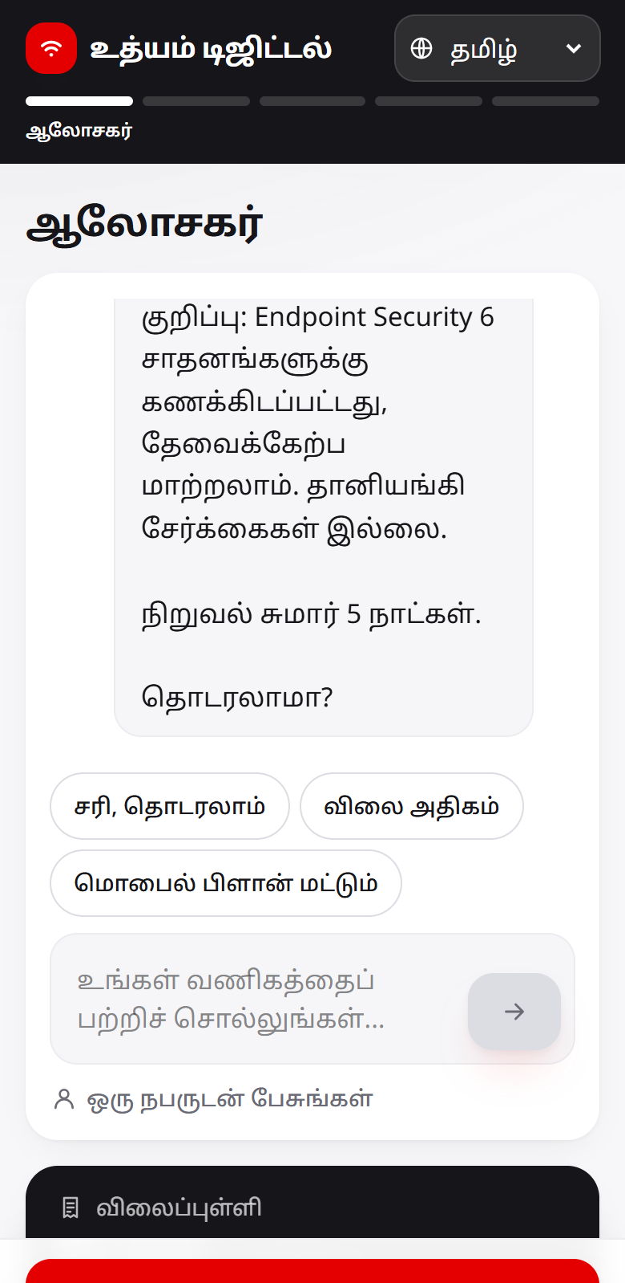
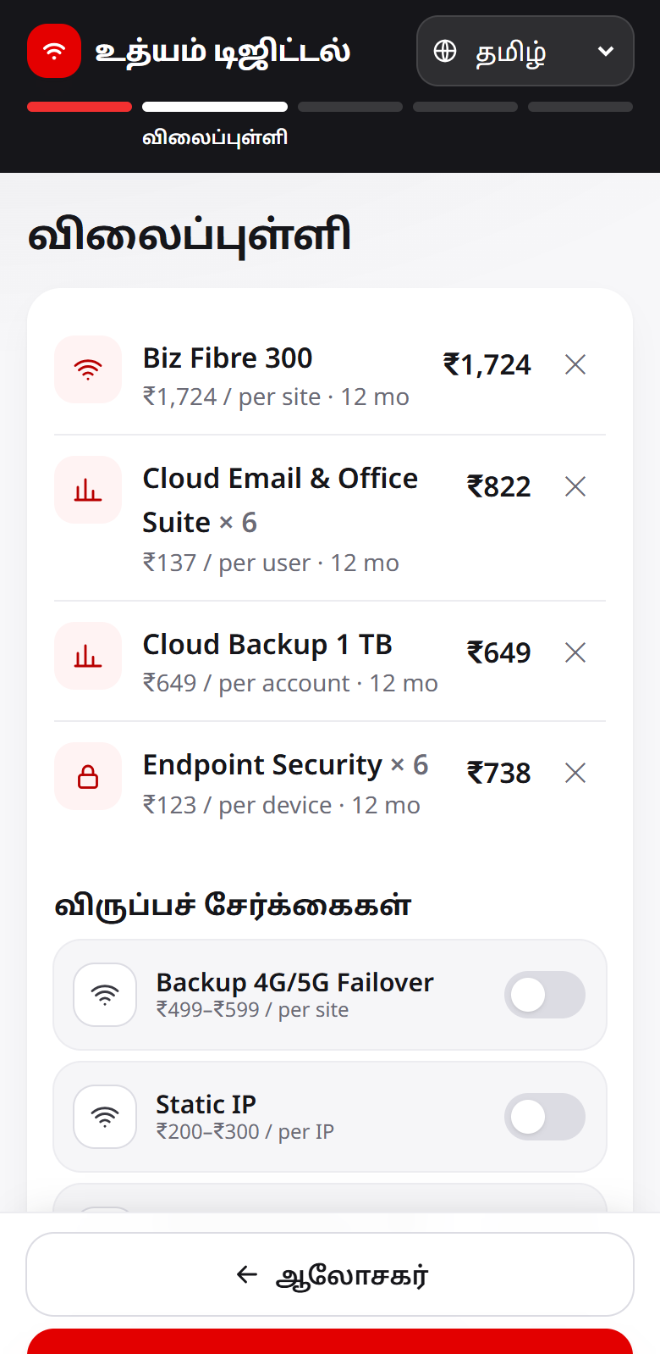
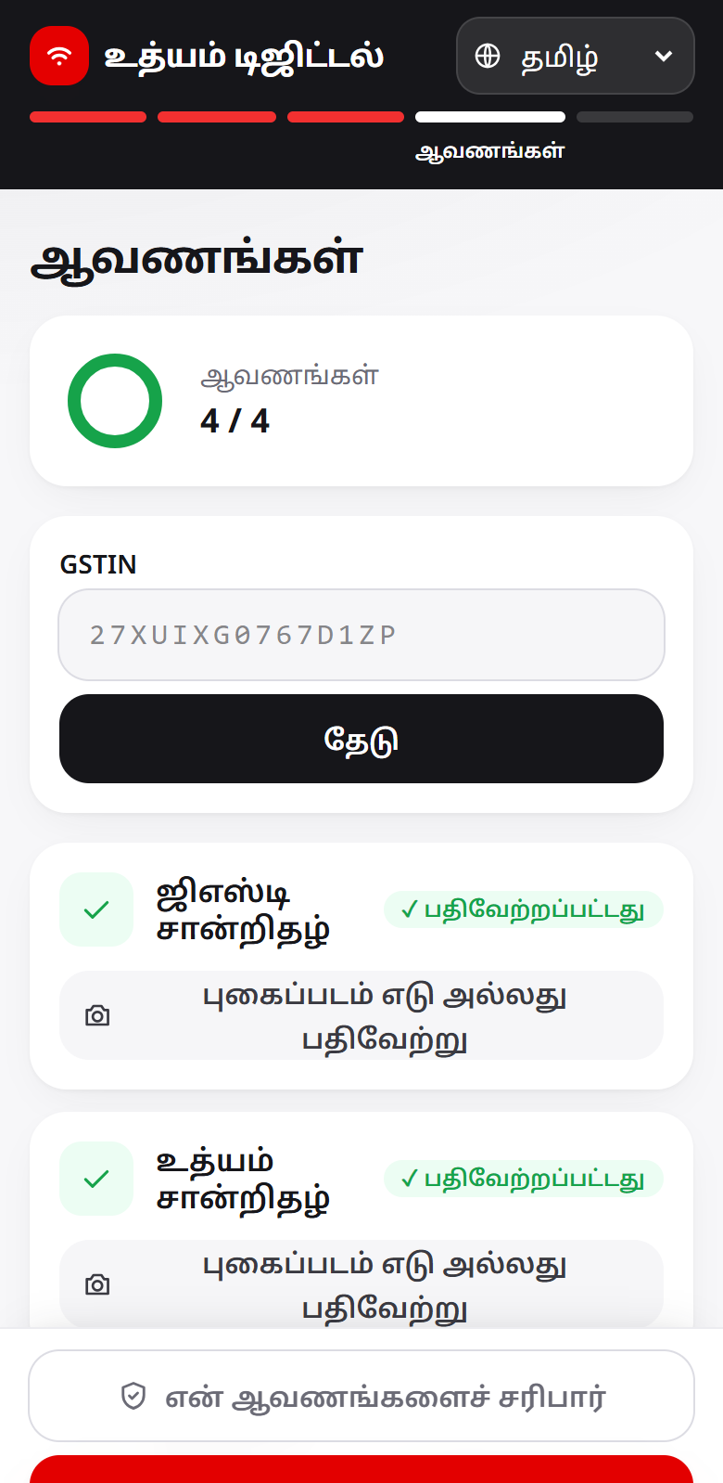
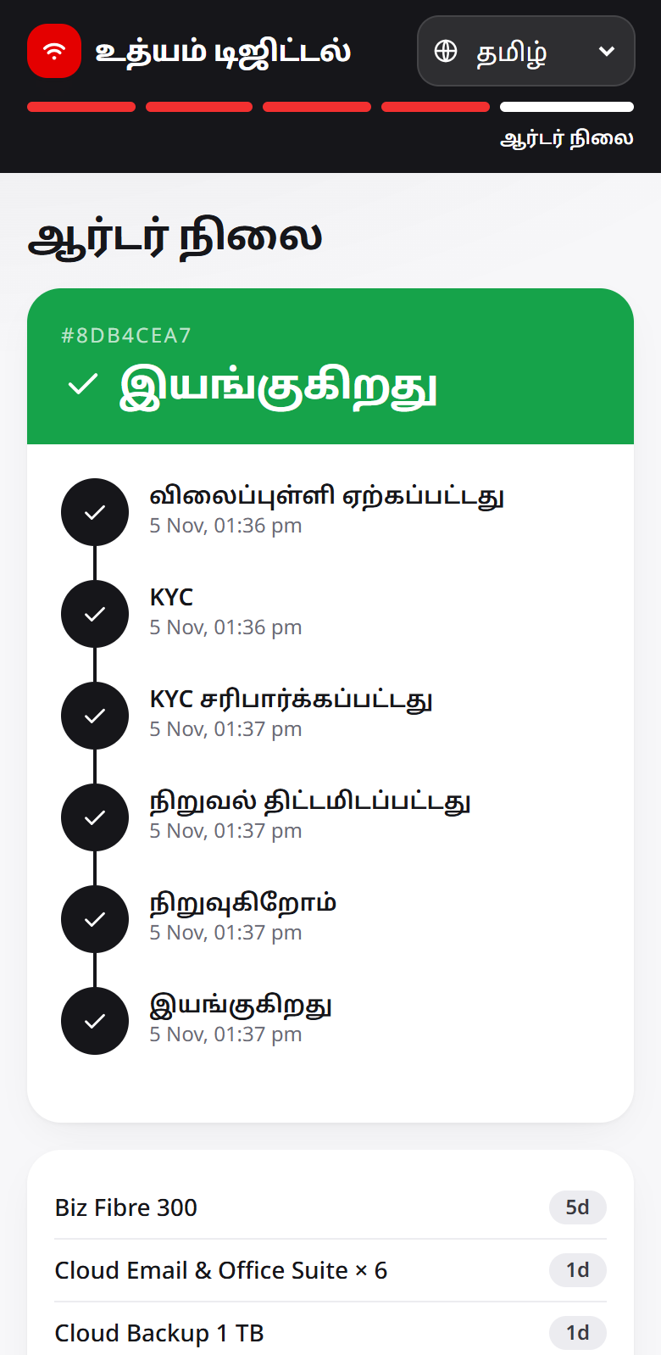
One phone session replaces the sales visit
Language → AI advisor → quote → consent → smart KYC → order tracker
27/27
advisor eval conversations pass (DeepSeek), incl. 11 multilingual
10
languages + Hinglish and Tanglish; Noto fonts, low-end phones
0
invented products or prices: a guard blocks any number the services didn't return
33/33
user-story scenarios pass on the live system
1
Advisor in Tamil
2
Transparent quote
3
Smart KYC
4
Live tracker
Notes:
This is the whole journey on a phone. The owner picks a language and chats with the advisor, which asks only what it needs and recommends within six turns. The quote shows one monthly price with add-ons to toggle. Consent comes before any upload, then KYC, then a tracker that messages the owner at every milestone. On our evaluation set every conversation passed, across ten languages including code-mixed Hinglish and Tanglish, and all 33 user-story scenarios pass against the running system.

Slide 6
KYC in minutes that respects the DPDP Act 2023
Consent first · purpose limitation · minimisation · deletion on withdrawal
1
Consent per purpose
12 / 12
verification, provisioning, messages; no upload without it
2
Instant image checks
specimen applicants come out exactly as expected
blur and skew caught on upload; pages straightened before OCR
Cancelled GSTIN → reject
Blurred / missing → re-upload
Stale bill (> 90 days) → fresh one
Name or checksum mismatch → human review, never a silent reject
Skewed page → auto-corrected, passes
5 clean applicants → pass
3
Registry-verified
GSTIN checksum + registry status, Udyam lookup, O/0 OCR fixes
4
Cross-document checks
names, address, bill age (90 days), signatory ID validity
5
Minimal & deletable
4 documents; images deleted at decision or 30 days; one-tap withdrawal
Notes:
KYC is where onboarding usually stalls. Consent is recorded per purpose before anything is uploaded. Blur and skew are caught the moment a photo is taken. OCR reads the certificates and every identifier is verified against the GSTIN and Udyam registries, then names, address, bill age and ID validity are cross-checked. Ambiguous cases go to a human reviewer. All twelve test applicants, including the planted problems, come out as expected, and images are deleted as soon as a decision is made.

Slide 7
Field sales and partners get warm leads, not cold lists
Conversion by lead source today (case data)
Digital does
discovery, quote and KYC for every lead, 24×7, in 10 languages
Field sales does
multi-site and manufacturers, where a ₹24,335 CAC pays back
Partners get
leads the advisor can't close, with a summary, ranked by score
2.4×
more activations in the top 10% of scored leads than random
Digital channels convert worst today because there is no journey behind them. Udyam Digital is that journey.
Notes:
The digital journey adds to the field force and partners instead of competing with them. Referrals convert best; website and WhatsApp leads convert worst because nothing happens after the click. Now the journey handles discovery, quote and KYC for every lead. Field sales focuses on high-value multi-site and manufacturing accounts. When the advisor can't close, the lead goes to a partner with a summary, ranked by a propensity score that finds 2.4 times more buyers in its top decile than random calling.

Slide 8
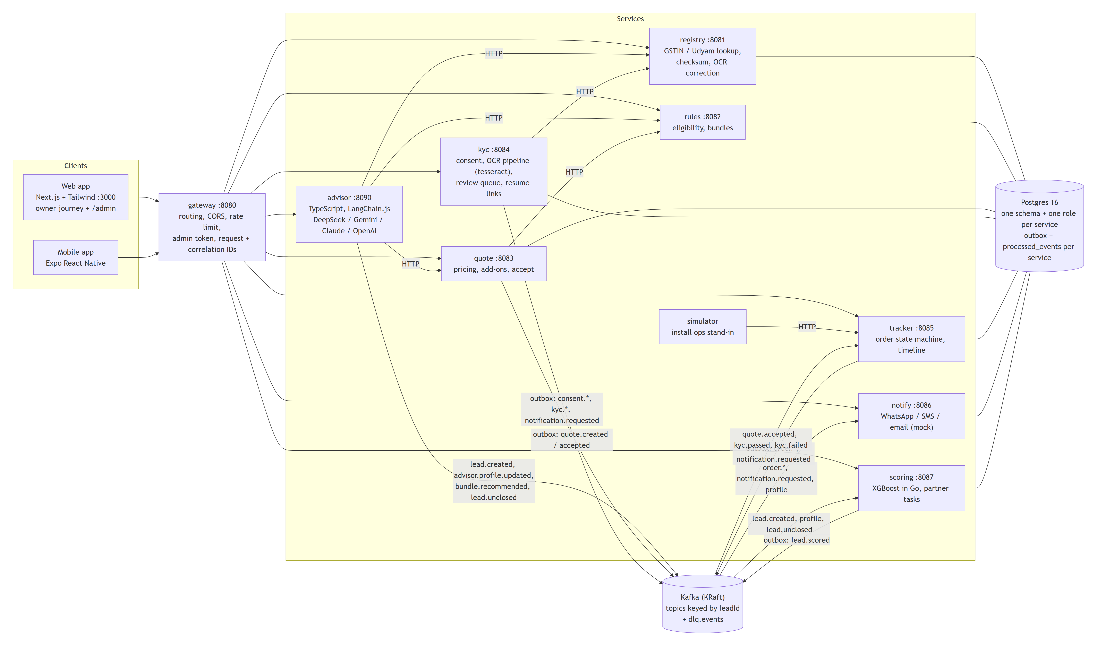
Built like a production system, sized for a national rollout
Demo topology (docker compose) · full diagram: docs/architecture.md
1
Decisions are code
eligibility, pricing and KYC verdicts are deterministic Go; the LLM only talks and explains
2
Nothing is lost
transactional outbox + idempotent consumers + dead-letter topic; Kafka or a service down: no event lost (drills pass)
3
Private by design
one schema + DB role per service; masked IDs; chat transcripts back-office only; owner OTP + partner ReBAC next
4
National scale
regional gateways, Kafka partitioned by lead, multi-region DB with data residency
Notes:
Under the hood it's built like a production system. Web and mobile talk to one gateway; eight services own their own data; events flow over Kafka with a transactional outbox, so in our failure drills, stopping Kafka, a service or the database lost nothing. Eligibility, pricing and KYC are deterministic code: the language model never decides what is sold. Each service has its own database role, chat transcripts are back-office only, and owner OTP login with partner access rules is next. The same design scales nationally with regional gateways, partitioned Kafka and a multi-region database.

Slide 9
Three-wave rollout with targets we can measure every week
Targets are proposals to agree with Accel Business sales leadership
1
Weeks 0–8
2
Weeks 9–20
3
Week 21+
Pilot
Wave 2
Scale
Professional offices · 8 Tier 1 cities · English, Hindi, Tamil
Multi-site + manufacturers with field close · all 10 languages · partner handoff
Micro retail self-serve · Tier 2 cities · WhatsApp entry point
KPIs: baseline → pilot target
Lead → activation
Fixable drops (share)
Quote → KYC complete
Lead to activation time
CAC, prof. offices
11.1%
32%
68.3%
17.6 days
₹10,695
15%
< 15%
85%
< 10 days
< ₹7,500
target
target
target
target
target
Notes:
We roll out in three waves. An eight-week pilot with professional offices in the eight Tier 1 cities and three languages, then multi-site and manufacturers with field sales closing and all ten languages, then micro retail self-serve and Tier 2 cities. We'd measure five things weekly: lead-to-activation from 11 to 15 percent, the share of drops a digital journey can fix from 32 to under 15 percent, quote-to-KYC completion to 85 percent, activation time under ten days, and acquisition cost under 7,500 rupees.

Slide 10
Risks we've designed for, and what we need to launch
Udyam Digital: from 7.4% to a journey owners finish on their phone
AI wrong or tricked
Language quality
Asks
prices are code; reply guard blocked 6/6 prompt-injection attacks; eval ≥ 90%
per-language evals; native-speaker review of UI and messages
Sales leadership: approve the professional-offices pilot and targets
Field & partners: handoff workflow and partner credit
Compliance / DPO: consent text and retention periods
KYC & risk: review-queue SLAs and routing policy
Network ops: fibre feasibility data, install dates
Billing & support: one bill, tracker for 'where is my order'
DPDP compliance
Score bias
consent per purpose, deletion, masked IDs; DPO sign-off on retention
score only orders call lists; fairness review by language and city tier
Channel conflict
Fibre not feasible
partners get ranked warm leads and credit for handoffs
automatic 5G AirFiber offer instead of a dropped order
Notes:
We've designed for the main risks: the AI can't make up products or prices because those are code, and it can't be talked into one either: a reply guard blocked all six prompt-injection attacks we tried. Every language is evaluated, privacy follows the DPDP Act, the score only orders call lists, partners are credited for handoffs, and an infeasible fibre site gets a 5G offer instead of a lost order. To launch, we need sales leadership to approve the pilot, compliance to sign off consent and retention, and network and billing to plug in feasibility and one-bill invoicing. Thank you.

