Slide 1

Udyam Digital
Making small businesses go digital in one sitting: on a phone, in their own language
YTL Hackathon 2026 · Enterprise Track A
AI advisor · transparent quote · smart KYC · order tracker
Notes:
Udyam Digital is a phone-first journey that takes a small-business owner from 'what do I need?' to a live connection: an AI advisor in their language recommends a bundle, a transparent quote follows, KYC is checked in minutes against the GSTIN and Udyam registries, and a tracker replaces the status-chasing calls. Everything you'll see is a working prototype.

Slide 2

93 of 100 leads are lost, a third to fixable friction
5,000 SMB leads, Apr–Jun 2026 (case data, smb_leads.csv)
1,485 drops (32%)
are fixable by a digital journey: no time for a visit 531, visit never scheduled 296, quote too complex 206 or too slow 179, paperwork and documents 273
17.6
3–5
3×
days lead to activation
days for a quote today
status chases per customer
₹15,000
1,594
blended cost to acquire one SMB
lost before first contact (34%)
Steepest drop: needs assessed → quote accepted (44%)
Notes:
Out of 5,000 leads only 368 activated: 7.4 percent. The biggest leak is between needs assessment and an accepted quote. When we grouped the 4,632 drop reasons, 1,485, about a third, are pure friction: owners with no time for a visit, visits never scheduled, quotes that were confusing or took days, and paperwork. Today it takes 17.6 days to activate, and every customer chases status three times. Those are exactly the steps a phone journey removes.

Slide 3
Start with professional offices: high conversion, low CAC
Conversion and economics by segment (case data)
Segment | Leads | Conv. | CAC | Bundle/mo | Churn
Professional offices | 1,247 | 11.1% | ₹10,695 | ₹6,796 | 13.8%
Small multi-site | 755 | 11.0% | ₹15,614 | ₹31,233 | 10.8%
Small manufacturers | 289 | 12.8% | ₹15,324 | ₹19,980 | 8.1%
Micro retail & services | 2,709 | 4.1% | ₹20,007 | ₹2,505 | 22.7%
Wave 1 · Professional offices
1
Clinics, CA firms, law offices, coaching centres: standard bundle, fully self-serve
2
Wave 2 · Multi-site & factories
Highest bundle value (₹31,233 and ₹19,980/month): digital quote, field sales close
Why not micro retail first? It is 54% of leads, but converts at 4.1%, costs the most to acquire and churns most. It stays self-serve only, with a light mobile + POS bundle.
3
Wave 3 · Micro retail
Self-serve, GSTIN-free options; GST registration unlocks more (9.6% vs 2.0% activation)
Notes:
We start where the economics already work. Professional offices convert at 11 percent with the lowest acquisition cost, and they buy a standard bundle that can be sold end to end on a phone. Multi-site businesses and manufacturers bring the biggest bundles, so the digital journey qualifies and quotes them and field sales closes. Micro retail is more than half the leads but converts at 4 percent and churns most, so it stays self-serve and light.

Slide 4
Clear bundles, honest prices, set by rules, never by the AI
Priced live by our quote engine inside each product's catalogue range
Office ready
Multi-site
Mobile quick path
6-person clinic · Tier 1
5-outlet restaurant chain
Owner who wants only SIMs
₹3,933
₹19,595
1-month
/month · ₹0 one-time · 12 months
/month · ₹43,000 one-time
contract · no forced bundle
Biz Fibre 300
Cloud email × 6
Cloud backup 1 TB
Endpoint security × 6
Optional 4G/5G failover
Fibre + failover per outlet
Cloud CCTV × 10
Cloud POS per outlet
Guest Wi-Fi
One bill for all sites
Business postpaid lines
Upgrade later in one tap
Soft upsell, never pushed
✓
Minutes, not 3–5 days
✓
No sales visit needed
✓
“Too expensive” handled
for a quote: the advisor prices live, in the owner's language
removes the top drop reason (531 leads had no time for a visit)
cheaper eligible tier shown with the total contract cost
Notes:
Here are three real quotes from the prototype. A six-person clinic gets fibre, email for everyone, backup and device security for 3,933 rupees a month with no setup fee. A five-outlet restaurant chain gets per-site connectivity with failover, CCTV and POS on one bill. An owner who only wants SIMs gets a one-month mobile plan, no forced bundle. Prices are calculated by deterministic rules from the catalogue, so the AI can explain them but never make them up.

Slide 5
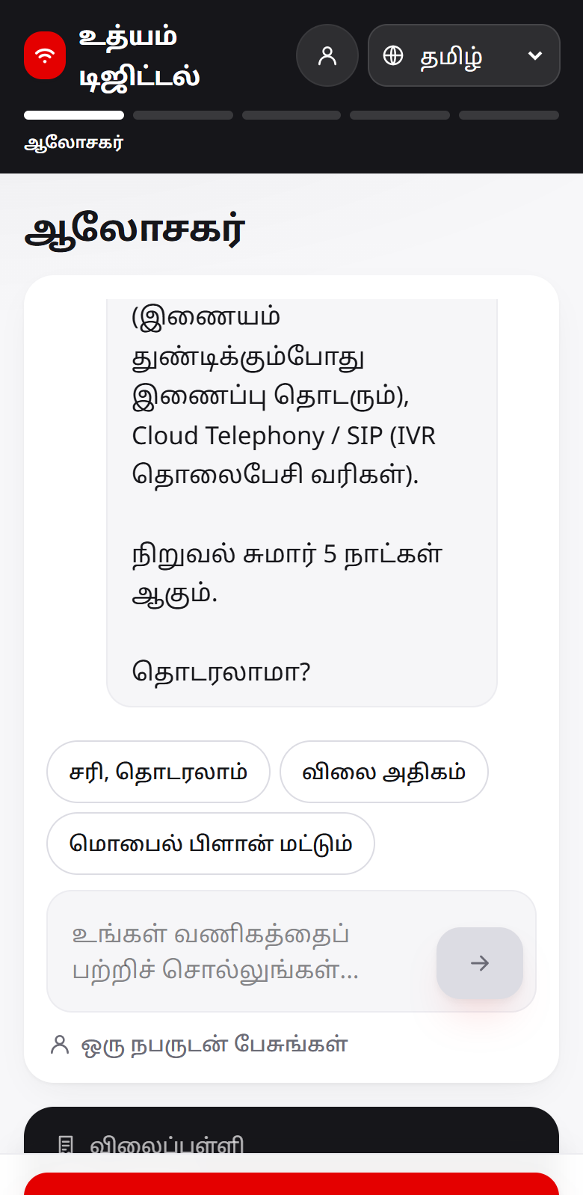
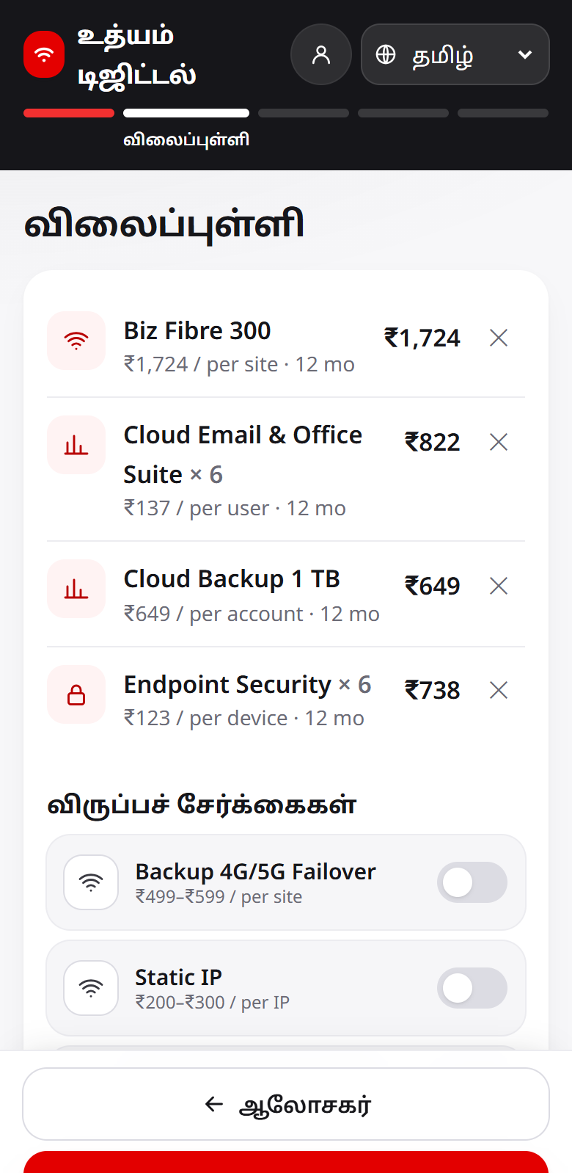
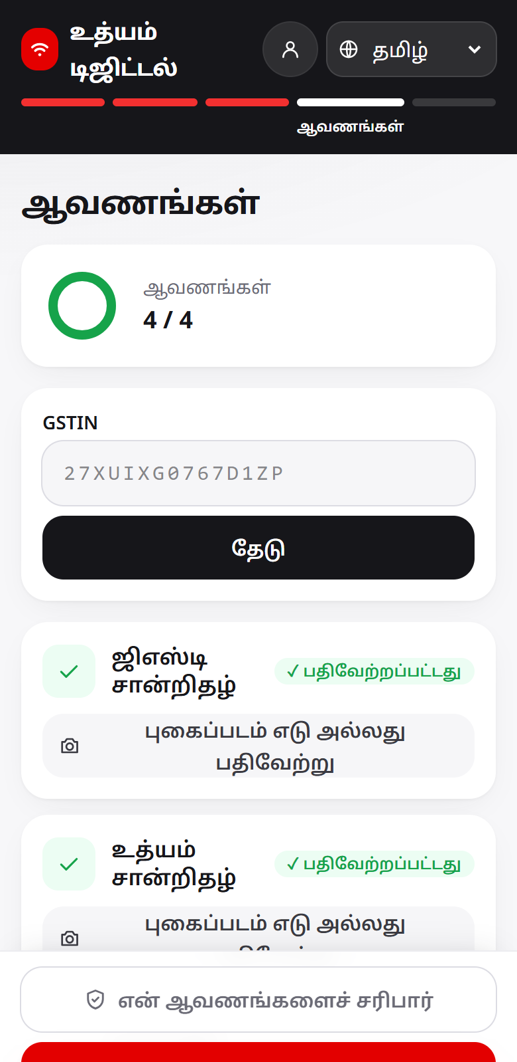
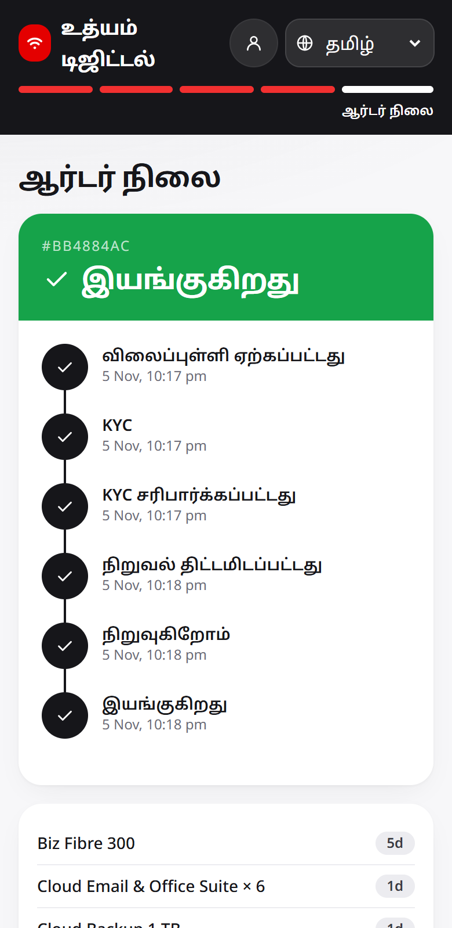
One phone session replaces the sales visit, KYC included
Language → AI advisor → quote → consent → smart KYC → order tracker
27/27
advisor eval conversations pass, 11 of them multilingual
10
languages, plus Hinglish and Tanglish
12/12
KYC specimen applicants give the expected verdict (pass, re-upload, review, reject)
1
Advisor in Tamil
2
Clear quote
3
Smart KYC
4
Live tracker
0
invented products or prices: a guard blocks any number the services didn't return
KYC under the DPDP Act 2023: consent per purpose before upload · blur/skew caught instantly · GSTIN and Udyam registry checks · names, address, bill age cross-checked · unclear cases go to a human · images deleted at decision or 30 days
Notes:
This is the whole journey on a phone. The owner picks a language and chats with the advisor, which recommends within six turns. The quote shows one monthly price. Consent comes before any upload; blur and skew are caught on the spot; GSTIN and Udyam are verified against the registries and the documents are cross-checked. Unclear cases go to a human reviewer, never a silent reject, and images are deleted once a decision is made. Then a tracker messages the owner at every milestone. All 27 evaluation conversations and all 12 KYC test applicants come out as expected.

Slide 6
Built like a production system, sized for a national rollout
Simplified view · full diagrams in the repo: docs/architecture.md
Owner · web
Owner · mobile
Back office
1
Decisions are code
Next.js, 10 languages
Expo React Native
sales & partners
eligibility, pricing and KYC verdicts are deterministic Go; the LLM only talks and explains
Gateway · routing, rate limits, sign-in tokens, request IDs
2
Nothing is lost
transactional outbox + idempotent consumers + dead-letter topic; Kafka or a service down: no event lost (drills pass)
AI advisor
Rules + Quote
KYC + Registry
Tracker + Notify
Scoring
LLM: chats in the owner's language
eligibility, bundles, prices
OCR, GSTIN/Udyam, consent, sign-in
order steps, WhatsApp / SMS
lead score, partner handoff
3
Private by design
own schema + DB role per service; masked IDs; owner OTP sign-in; transcripts back-office only
talks only; never decides
Deterministic Go: decides eligibility, price and KYC
4
National scale
Kafka every event saved with its write (outbox); none lost
Postgres 16 one schema + role per service; KYC images auto-deleted
regional gateways, Kafka partitioned by lead, Postgres per region (data residency)
Notes:
Under the hood it's built like a production system. Web and mobile talk to one gateway; eight services own their own data; events flow over Kafka with a transactional outbox, so in our failure drills, stopping Kafka, a service or the database lost nothing. Eligibility, pricing and KYC are deterministic code: the language model never decides what is sold. Each service has its own database role, chat transcripts are back-office only, and owners sign in with a one-time code; partner access rules are next. The same design scales nationally with regional gateways, partitioned Kafka and a multi-region database.

Slide 7
Rollout, weekly KPIs and what we need to launch
Targets are proposals to agree with Accel Business sales leadership
1
Pilot · wk 0–8
2
Wave 2 · wk 9–20
3
Scale · wk 21+
Asks
Professional offices · 8 Tier 1 cities · English, Hindi, Tamil
Multi-site + factories: field sales close · partners get scored warm leads (2.4× in top decile)
Micro retail self-serve · Tier 2 cities · WhatsApp entry point
Sales leadership: approve the professional-offices pilot and targets
Field & partners: handoff workflow and partner credit
Compliance / DPO: consent text and retention periods
KYC & risk: review-queue SLAs and routing policy
Network ops: fibre feasibility data, install dates
Billing & support: one bill, tracker for 'where is my order'
Lead → activation
Fixable drops
Quote → KYC done
Days to activate
CAC, prof. offices
11.1% now
32% now
68.3% now
17.6 now
₹10,695 now
15%
< 15%
85%
< 10
< ₹7,500
Risks designed for: prices are code and a reply guard blocked 6/6 prompt-injection attacks · per-language evals · DPDP consent, deletion, masked IDs · score only orders call lists · partners credited for handoffs · no fibre → automatic 5G AirFiber offer
Notes:
We roll out in three waves: an eight-week pilot with professional offices in Tier 1 cities, then multi-site businesses and manufacturers with field sales closing and partners receiving scored warm leads, then micro retail self-serve. We'd track five KPIs weekly, from 11 to 15 percent lead-to-activation and from 17.6 to under 10 days to activate. The main risks are designed for: the AI can't invent prices, every language is evaluated, privacy follows the DPDP Act. To launch we need the pilot approved, compliance sign-off on consent and retention, and network and billing to plug in feasibility and one-bill invoicing. Thank you.

