Slide 1
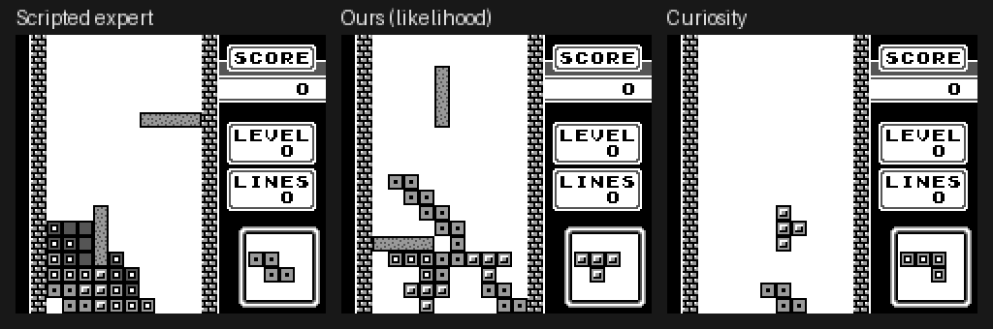
TetrisFormer
Learning rewards from machine state
A small transformer learns what competent Game Boy Tetris looks like from the console's RAM alone.
Its likelihood of the next memory state becomes the reward for an RL agent that also acts on RAM.
No hand-written reward, no pixels, no action labels.
Notes:
Two-day proof of concept on Game Boy Tetris; the full plan targets Super Mario Land and Pokémon. The image shows the scripted expert, our agent and a curiosity agent on the same piece sequence.

Slide 2
A transformer that reads RAM byte by byte
1
2
3
4
Game Boy RAM
Byte tokens
Causal transformer
Predict next state
8 KB work RAM every 24 frames; 289 bytes that vary are kept
value + address + time embeddings, d = 128
4 layers, 4 heads; step t sees all bytes of steps ≤ t
256-way softmax for every byte of step t+1
0.9M
2,312
Σ log p
parameters
tokens per window (289 bytes × 8 steps)
of the next state = the reward signal
Notes:
Each RAM byte is a token. The block-causal mask lets every byte of step t attend to the whole history up to t, and predict the same address at t+1. The summed log-probability of the real next state is the reward.

Slide 3
Trained only on RAM traces of expert play
1
Expert plays
A scripted placement heuristic plays 100 games, 53 lines per game
Held-out evaluation
90 / 10
2
Keep only RAM
183k steps of memory states; actions and pixels are thrown away
games for train / held-out validation, split by episode
3
Mask the noise
0 labels
Bytes that churn regardless of input (sound driver, stack) are removed
4
Train
no rewards, actions or pixels ever seen
3,000 AdamW steps, one-cycle LR 1e-3, batch 32; about 15 min on a laptop RTX 5060
Notes:
The expert is a hand-written placement search with a standard linear board heuristic. Only its RAM is recorded. Validation games are whole held-out episodes.

Slide 4
It predicts expert RAM almost perfectly
12×
better than copying the last state
~10×
less likely per byte for random play than for expert play
Notes:
0.040 nats per byte on 10 held-out expert games. The model trained without the volatile-byte mask reaches the same validation loss.

Slide 5
RL loop: the frozen transformer is the reward
RAM state
Policy
policy update
MLP over one-hot RAM
action
Emulator
PPO
PyBoy, Game Boy Tetris
+ RND exploration bonus
Reward transformer
RAM history (8 steps)
frozen, trained on expert RAM
r = norm(Σ log p) + β·RND
Notes:
The agent sees only RAM and acts with buttons, or with 40 placement actions (rotation × column) in the placement variant. Each step the frozen transformer scores how likely the real next RAM state is given the last 8; that log-likelihood, normalised, plus an RND exploration bonus, is the reward PPO maximises.

Slide 6
The learned reward ranks behaviour sensibly
Exploit resisted
Both hand-written rewards were hacked by pausing the game.
The learned reward scores pausing worst of all.
94%
of steps paused when the sign is flipped (curiosity)
Notes:
Online, unseen seeds, 3 seeds each for ours and the hand-reward agent. The comparison uses the same reward model that trained our agent, so the ordering of ours over hand is partly circular; the expert and random endpoints are not.

Slide 7
Placement actions: the ranking still holds
RAM is easy to model
0.9M parameters reach 0.04 nats/byte
Reward without labels
orders expert > agents > random
Interpretable
every gap maps to a few RAM bytes
Scales out cheaply
1M placements in ~4 h on a 5090
Notes:
Placement variant: 40 actions (4 rotations × 10 columns) executed by the expert's button logic, 1M placements per agent. The same frozen transformer, scored per placement over 8 games, orders the policies expert > hand-reward agent > our agent > random placements.

