Slide 1
DEPARTMENT OF INFORMATION SCIENCE & ENGINEERING
MINI PROJECT (PROJ22IS49)
“Serene Sphere”
A Full-Stack Mental Health Web Application
Presented by:
Under the guidance of:
Nisarga S Reddy
Prachi Choudhary
1DS23IS109
1DS231S118
Dr. Bhavani K (BK) Designation
Dept. of ISE, DSCE, Bangalore
Nishanth P Ouseph 1DS231S110
1DS23IS071
KVS Sri Krishna

Slide 2
ABSTRACT
Mental health-focused full-stack web application
2. Features AI therapist, mood tracker, journaling & anonymous sharing
3.Provides a personalized, private, and accessible platform
4. Supports emotional well-being through digital tools

Slide 3
CONTENTS
Introduction
Problem statement
Literature survey
System design & Methodology
Expected outcome
References

Slide 4
INTRODUCTION
Introduction
Mental health issues are rising globally, especially among youth and working professionals
Many individuals lack access to affordable, stigma-free mental health support
Traditional therapy can be impersonal, expensive, or hard to access
Existing mental health apps often miss key elements like privacy, personalization, and emotional intelligence
Serene Sphere aims to address these gaps using modern web technologies to create a supportive, interactive, and secure platform

Slide 5
PROBLEM STATEMENT
1. Lack of affordable and anonymous mental health platforms
Many individuals cannot access mental health support due to high costs or fear of being identified, highlighting the need for low-cost, anonymous platforms that offer privacy without compromising on care.
2. Stigma around professional mental health help
Cultural and societal stigmas often prevent people from seeking therapy or counseling, as they fear being judged or misunderstood, leading to untreated mental health issues.
3. Limited access to personalized and secure self-reflection tools
Current mental health tools often fail to adapt to individual needs or ensure data privacy, making it difficult for users to engage in meaningful and safe self-reflection.
4 Existing apps don’t effectively track user emotional history
Many mental health apps lack features that monitor and analyze long-term emotional patterns, making it harder for users and professionals to understand progress or recurring issues.

Slide 6
LITERATURE SURVEY
1. AI-Based Psychological Health Assessment – 2021, K. Patel, A. Menon
Developed an AI model trained on mental health surveys to evaluate psychological well-being, aligning with the AI-driven features of your platform.
2. Gamification in Mental Health Apps – 2022, M. Brown, R. Singh
Explored how gamified elements improve engagement in mental health applications, relevant for enhancing user interaction in your app.
3. AI Chatbots for Mental Health – 2023, Nidhi Sharma & Group
Introduced a chatbot using Cognitive Behavioral Therapy (CBT) principles to support emotional wellness—similar to your AI therapist feature.
4. AI-Personalized Therapy Recommendations – 2024, I. Ramesh, V. Alok
Focused on AI-based personalization of therapy based on user behavior, supporting the adaptive and customized aspect of your platform.
5. Digital Therapeutics for Depression – 2024, Samantha Paul
Demonstrated the effectiveness of app-based CBT modules for treating depression, which aligns with your app’s goal of supporting emotional well-being through digital tools.

Slide 7
SYSTEM DESIGN & METHODOLOGY
Frontend:
Built with Vite + React
Styled using Tailwind CSS
Hosted on Vercel
2. Backend:
Node.js + Express.js
MongoDB Atlas for cloud database
bcrypt for password encryption
multer for image uplAoads
passport.js for session management
Hosted on Render
3. Testing & Tools:
Postman for API testing
Git & GitHub for source control
AI api key from openrouter.ai

Slide 8
SYSTEM DESIGN & METHODOLOGY
Features:
AI Therapist (Serai)
Mood Tracker
Quiz (survey-based mood detection)
Anonymous Article Sharing
Personal Journal
User Profile Management
Authentication (Sign-up/Login)

Slide 9
System Architecture
Frontend (React) handles UI, quiz, chatbot interactions
Backend (Express.js) processes logic, routes, API calls
Database (MongoDB Atlas) stores user data securely
Sessions managed by Passport.js
Image uploads handled by multer
Deployment: Vercel (frontend), Render (backend)

Slide 10
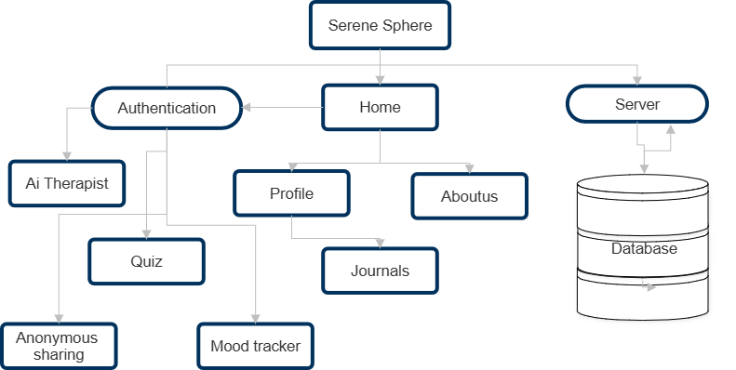
FLOW CHART

Slide 11
EXPECTED OUTCOME
Accessible AI-driven mental health support
Encourages journaling and self-reflection
Private, secure, and stigma-free experience
Engages users with interactive UI and smart tracking

Slide 12
REFERENCES
Tailwindcss documentation
Reactcomponents.com
Openrouter.ai
Vite documentation
Github.com

Slide 13
THANK YOU

