Slide 1
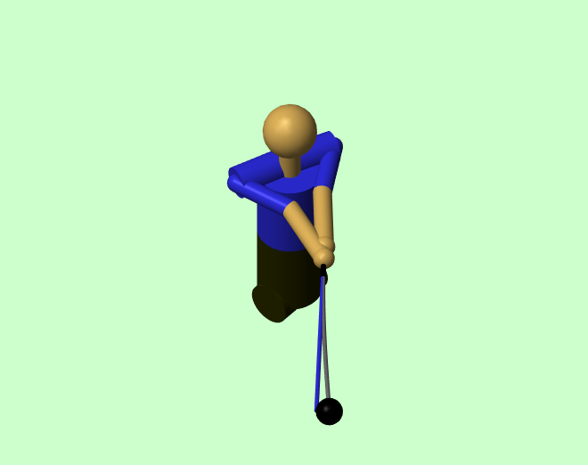
Evaluation of the Effect of Momentum on Interaction Forces in a Linked System
Dieter Olson
WSCG / ISEA 2024

Slide 2
Questions
How much do momentum and other passive effects influence the forces seen at the joints in linked systems?
Can commonly seen patterns in forces be attributed these effects?

Slide 3

Newton’s First Law and Linked Systems
Knowing what happens when there are no forces present provides a reference point to solve from. In a linked system can this ever really be the case?
In a “freewheeling” linked system, all segments cannot necessarily continue along the same path with the same velocity as they are constrained.
Applying torques at the joints can create forces that act on segments in the system, but so can:
Momentum of Linked Segments
Gravity
Shaft Flex
Even with zero joint torques, the interaction forces do not go to zero
Zero Joint Torques ≠ Zero Interaction Forces

Slide 4
Sources of Interaction Forces
Active
Joint Torques
Passive
Momentum
Gravity
Shaft Flex
Total Effect = Active Effect + Passive Effect
Passive Effect = Total Effect – Active Effect

Slide 5
Computing the “Zero Torque Counterfactual”
The combined passive effects were termed the “Zero Torque Counterfactual” based on how they were computed.
Represents the forces at the joints that would occur if all joint torque inputs were turned off.
Procedure:
Implement “kill switches” in model to turn the applied joint torques to zero
Repeat for multiple runs at varying kill switch times
Compile data at the times in which the step changes are made

Slide 6
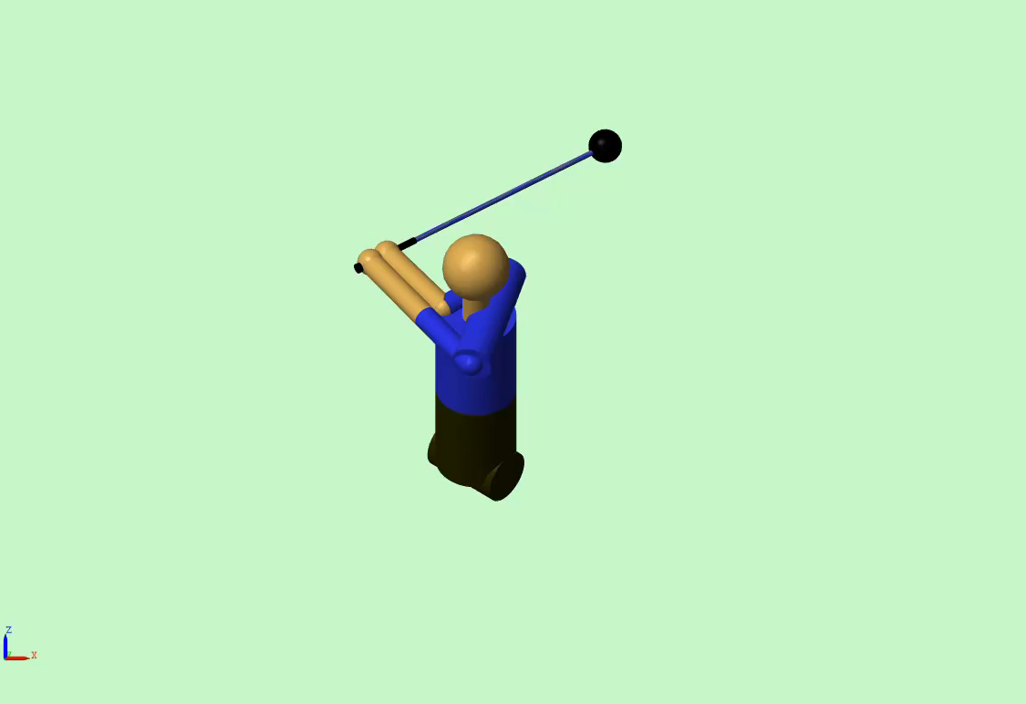
Forward Dynamics Model Construction
Two-hand planar model with flexible beam shaft
Joint torque driven model
Kinematics roughly matched to kinematic sequence
Matlab Simulink Model: “Two Hand Golf Swing Model” https://www.mathworks.com/matlabcentral/fileexchange/169071-two-hand-golf-swing-model

Slide 7
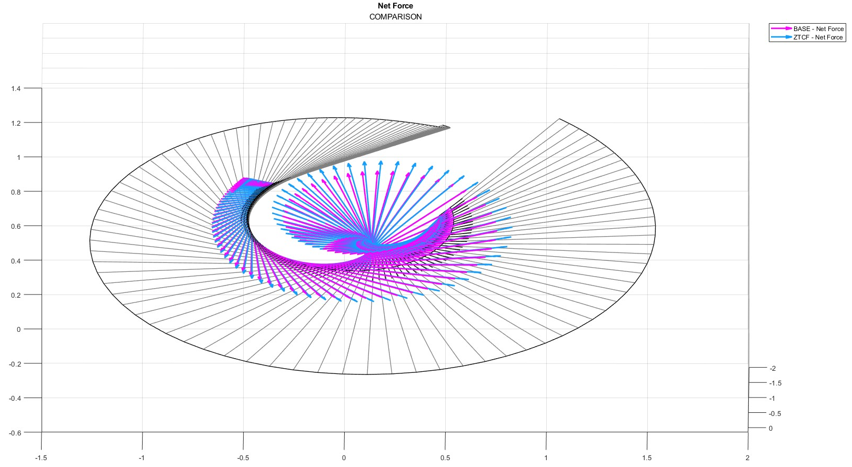

Slide 8
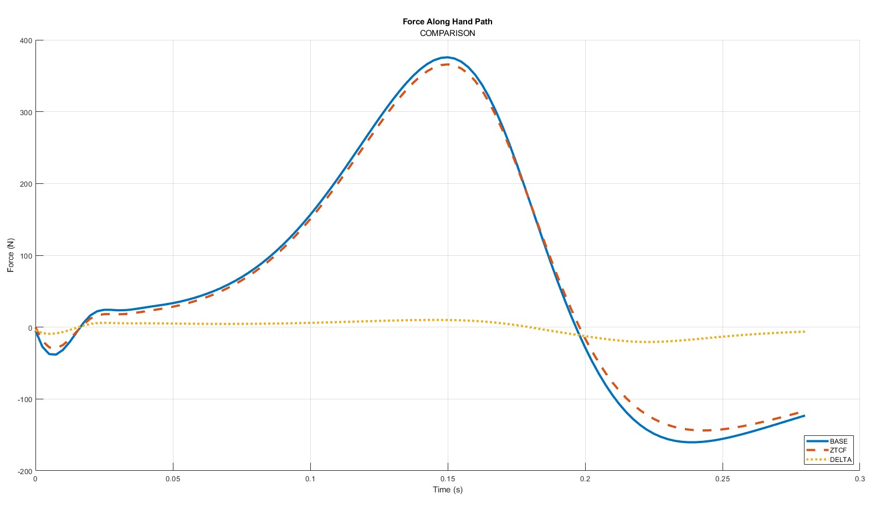

Slide 9
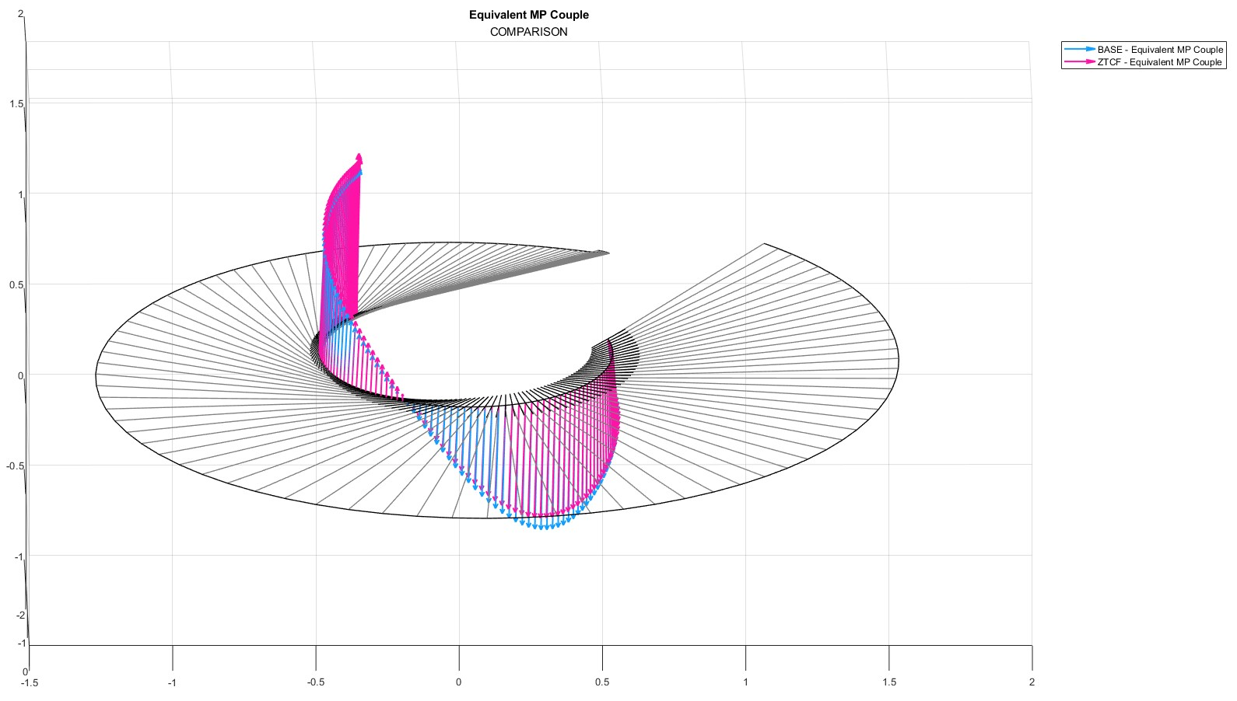

Slide 10
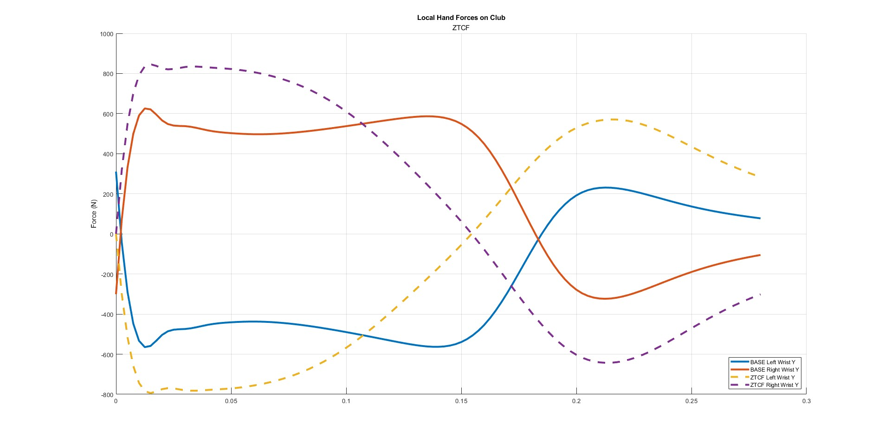

Slide 11
Conclusions
Momentum and other passive components contribute to forces seen between joints and equivalent couple applied to club in a two-hand model.
Net force on the club is similar to net force contribution from passive interactions.
Equivalent couple reversal near impact can plausibly arise from interaction forces due to momentum in the system.

