Slide 1
Dash Warning
Group Name: AutoTek
Roisin McPhillips, Kingsley Osemwenkhae, Aisling Smith, Yahya Angawi

Slide 2
Names & roles of each team member
Roisin McPhillips
Team Roles: Lead Frontend Developer, Backend Assist, GitHub Control Master & Team Mahara Management
Aisling Smith
Team Roles: Lead Tester, Frontend support & Documentation
Yahya Angawi
Team Roles: Scrum Master, User Interface (UI) Design and Lead User Experience (UX)
Kingsley Osemwenkhae
Team Roles: Team Lead, Lead Backend Development & Security

Slide 3
Overview of the application
Dash Warning App allow users to scan the symbols that appears on their vehicle dashboard and displays what each symbol means. Apart from displaying what the symbols means, it shows or recommends nearby repair shops in situations when a mechanic is needed. The app may also display phone numbers for road side assistance if the user has broken down or has a serious dashboard warning light appear.
Focus Group: Anyone with a car, new or old models.
Partnership: Seeking.

Slide 4
Requirements
Must Have
Scan the dashboard symbols.
Analyse the the dashboard symbols.
Display symbols relative information.
Should Have
Display locations of nearby repair shops nearby.
Phone numbers for road side repair services/assistance.
Most common error symbols displayed when device is offline.
Could Have
Display possible repair cost
Login account for managing user history

Slide 5
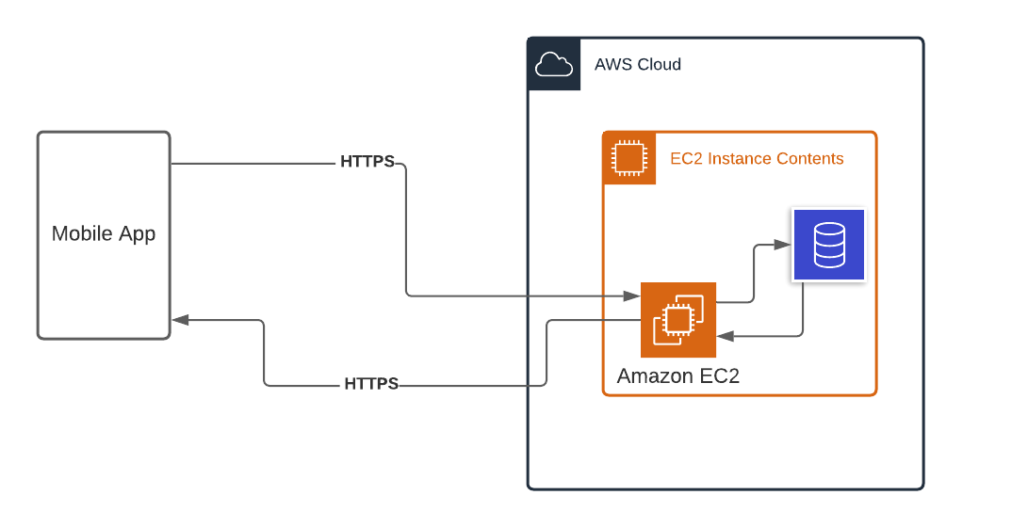
Supporting visuals Architectural Diagram

Slide 6
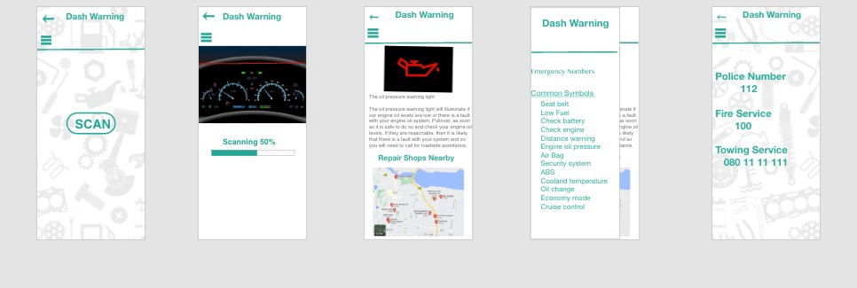
Supporting visuals Paper Prototype

Slide 7

User Personas
Jenny’s Goals:
To learn more about cars.
To understand what warning symbols that are appearing on her dashboard mean.
Interface Requirements:
To be able to access roadside assistance where necessary.
Be able to navigate through the app with ease.
Receive relevant information about the warning symbols that appear on her dashboard.
Name: Jenny
Age: 19
Occupation: Student
Technical Experience: Excellent

Slide 8

User Personas
John’s Goals:
To understand what warning symbols that are appearing on his dashboard mean.
To understand what level of urgency the colour of the warning symbols mean.
Interface Requirements:
To be able to access roadside assistance where necessary.
Be able to navigate through the app with ease.
Receive relevant information about the warning symbols that appear on her dashboard.
Name: John
Age: 35
Occupation: Doctor
Technical Experience: Average

Slide 9

User Personas
Tim’s Goals:
To be able to fully understand the application and how to use it properly.
To understand what warning symbols that are appearing on his dashboard mean.
Interface Requirements:
To be able to access roadside assistance where necessary.
Be able to navigate through the app with ease.
Receive relevant information about the warning symbols that appear on her dashboard.
Name: Tim
Age: 65
Occupation: Retired
Technical Experience: Very little

