Slide 1

Dash Warning
Group Name: AutoTek
Sub-Team: TeamR
Roisin McPhillips

Slide 2

Names & Roles
Name: Roisin McPhillips
Roles: Scrum Master, Frontend Developer, GitHub & Testing
Team Name: AutoTek / Sub-Team: Team RA
Technical Specialism: Frontend Development & GitHub
Scrumwise Link: https://www.scrumwise.com/scrum/#/sprints/project/l8-sd4-2021-auto-tek/id-31429-70635-94
Individual Mahara Page: https://mahara.dkit.ie/view/view.php?t=y7hL5PAFSzb2O9w06ufa
GitHub Link: https://github.com/D00219161/DashWarningTeamRA.git

Slide 3
Overview of The Application
Dash Warning allows users to scan the symbols that appear on their vehicle's dashboard and displays what each symbol means. Apart from displaying what the symbols mean, it shows or recommends nearby repair shops in situations when a mechanic is needed using GPS location. The app will also recommend phone numbers to various roadside assistance personnel as the users request when they have broken down.
Focus Group: People who drive Toyota & Volkswagen cars (new or old).
Partnership: Mechanic located in Granard, County Longford, Ireland.

Slide 4
Requirements – Major Elements
Must Haves
Scan the dashboard symbols
Analyze the dashboard symbols
Display symbols relative information
Login account for managing user history
Should Haves
Phone numbers for roadside repair services/assistance
Most common error symbols displayed when device is offline & Sub pages
Detect Fault Q&A to display back the type of fault
Enter Details user input to detect fault quicker

Slide 5
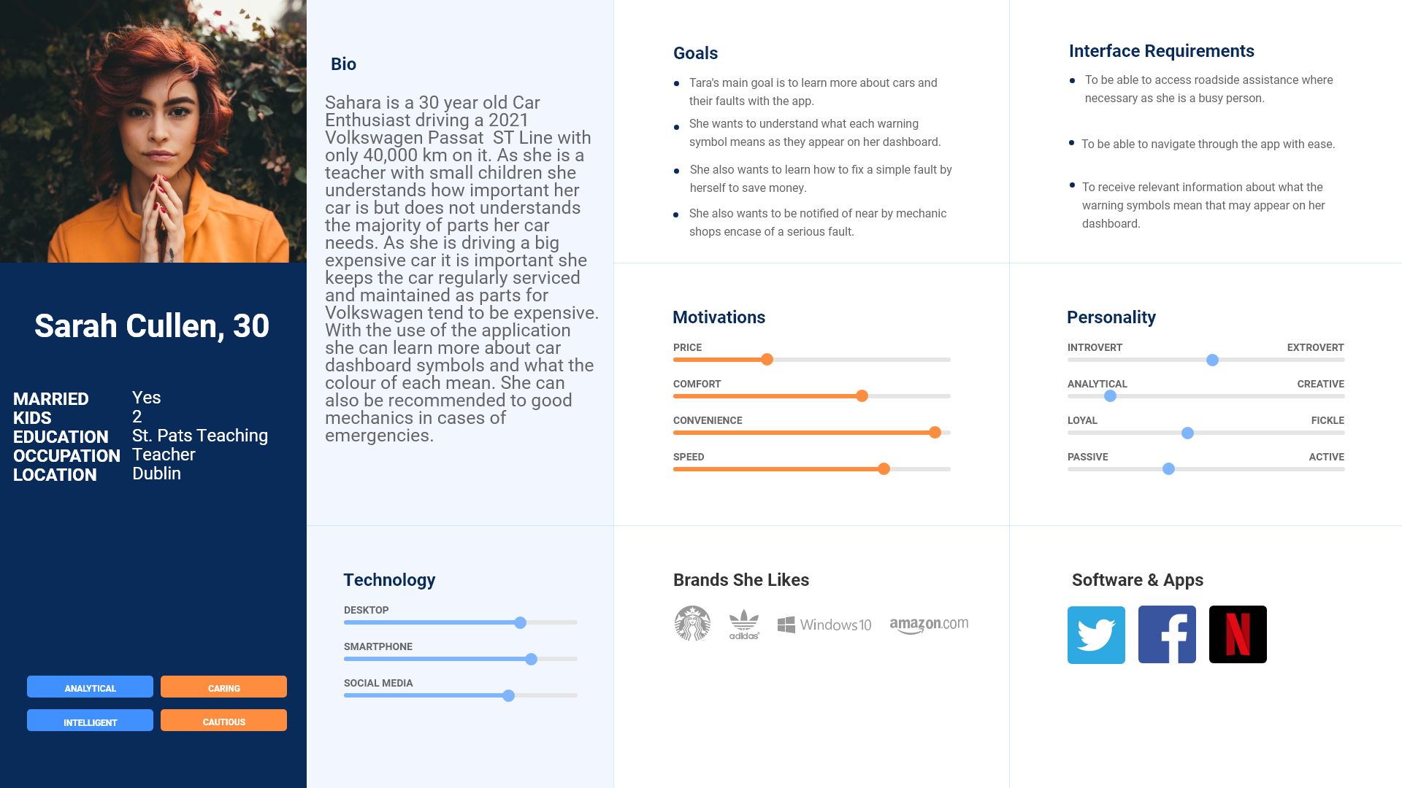
User Persona

Slide 6
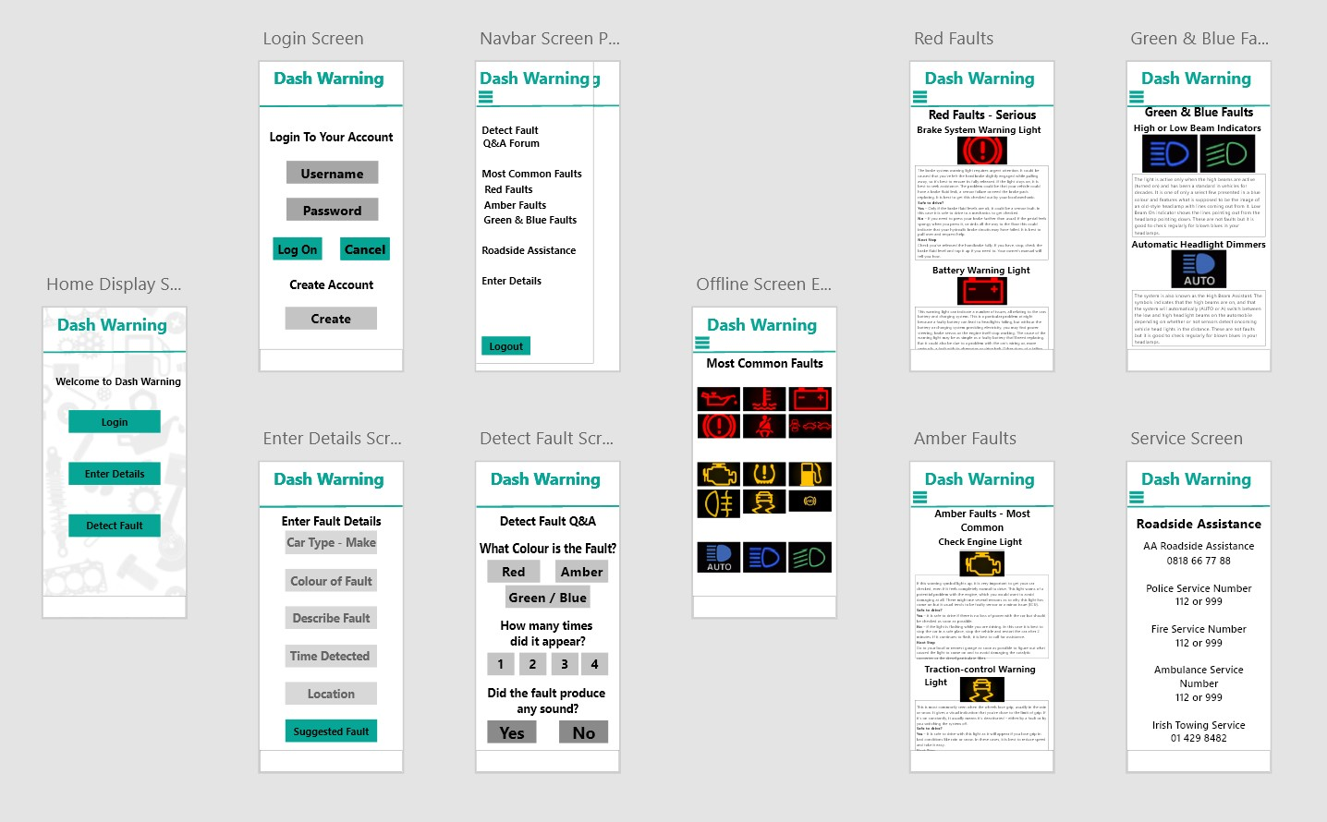

Slide 7
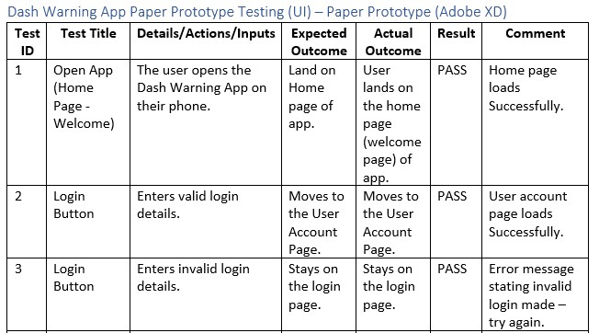
UI Prototype Testing

Slide 8
Progress & Issues
Home Page
Login Page (Integration)
Navbar Implemented
Roadside Assistance Page
Most Common Faults
Fault Sub Pages Half Completed
Detect Fault & Enter Details Half Implemented
Development Slower than expected
Some elements harder to implement i.e., Forum Input & Images - taking longer
Time (2 weeks lost)
Underestimating complexity of features – Images / Input Forum

Slide 9
Targets & Features T-CA4 (Final Release)
Complete Fault Screens Fully
Fix layout / Styling Issues / Colour
Fix bug issues
User Testing
Integration i.e., Login / Create Account / Scanner
Expo Preparation
Complete Enter Details Screen
Complete Detect Fault Screen

Slide 10
Release 2 Demo

