Slide 1




Dash Warning
Group Name: AutoTek
Sub-Team: TeamRA
Roisin McPhillips

Slide 2
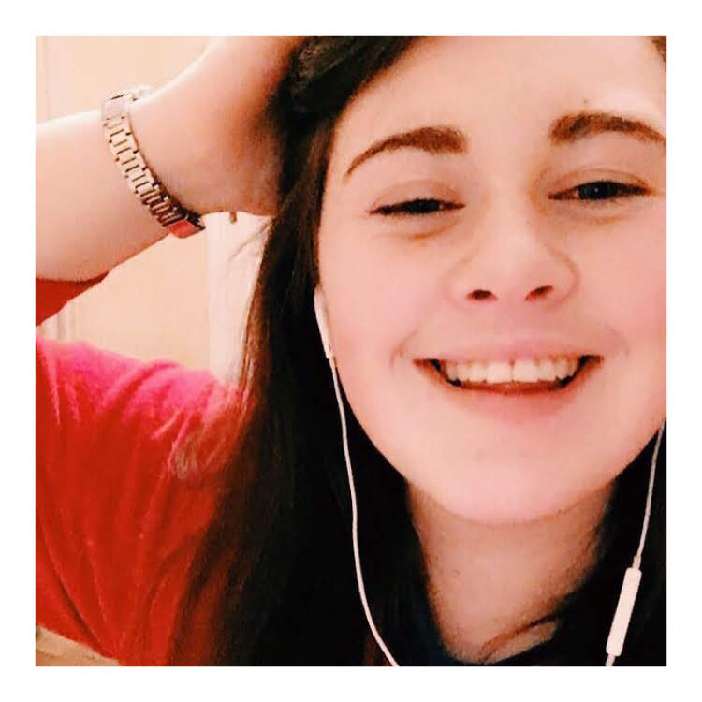
Names & Roles
Name: Roisin McPhillips
Roles: Scrum Master, Frontend Developer, GitHub & Testing
Team Name: AutoTek / Sub-Team: Team RA
Technical Specialism: Frontend Development & GitHub
Scrumwise Link: https://www.scrumwise.com/scrum/#/sprints/project/l8-sd4-2021-auto-tek/id-31429-70635-94
Individual Mahara Page: https://mahara.dkit.ie/view/view.php?t=y7hL5PAFSzb2O9w06ufa
GitHub Link: https://github.com/D00219161/DashWarningTeamRA.git

Slide 3
Overview of The Application
Dash Warning allows users to scan the symbols that appear on their vehicle's dashboard and displays what each symbol means. Apart from displaying what the symbols mean, it shows or recommends nearby repair shops in situations when a mechanic is needed using GPS location. The app will also recommend phone numbers to various roadside assistance personnel as the users request when they have broken down.
Focus Group: People who drive Toyota & Volkswagen cars (new or old).
Partnership: A Mechanic who is in Granard, County Longford, Ireland.

Slide 4
Requirements – Major Elements
Must Haves
Scan the dashboard symbols
Analyse the the dashboard symbols
Display symbols relative information
Login account for managing user history
Should Haves
Display locations of nearby repair shops nearby
Phone numbers for roadside repair services/assistance
Most common error symbols displayed when device is offline
Could Haves
Forum (Post Fault / Read other users faults)
Facial Recognition to login
Drowsiness Detection
Won’t Haves
Display possible repair cost
Message system so user can message mechanic ( PU & SU)
Receive notification ( PU & SU)

Slide 5
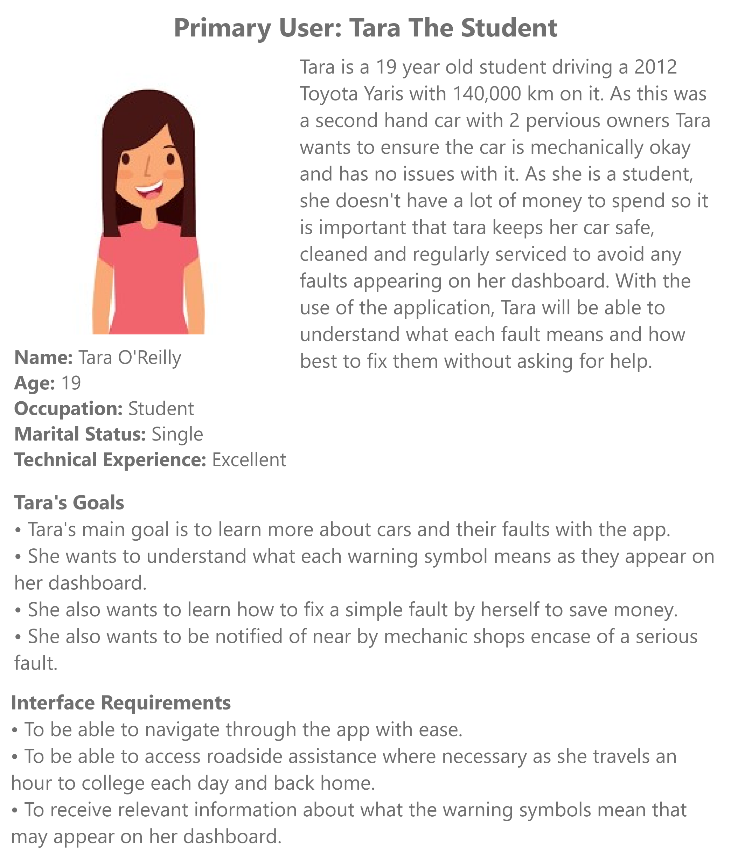
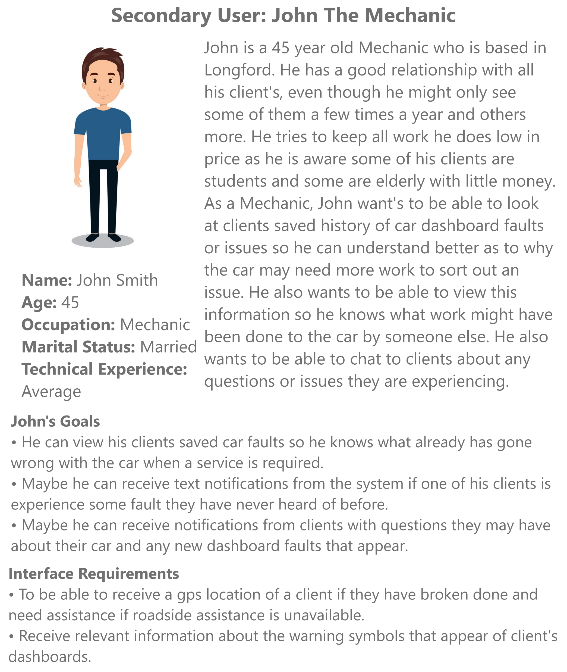
User Personas

Slide 6

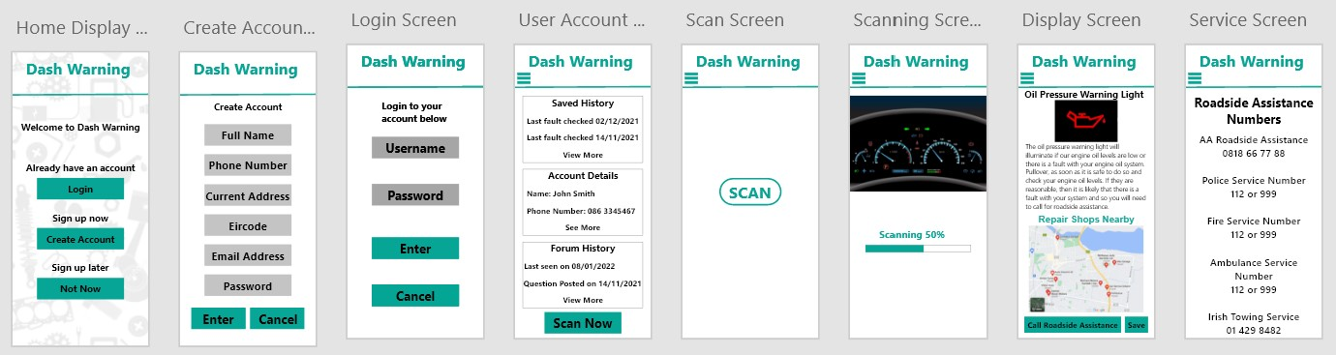

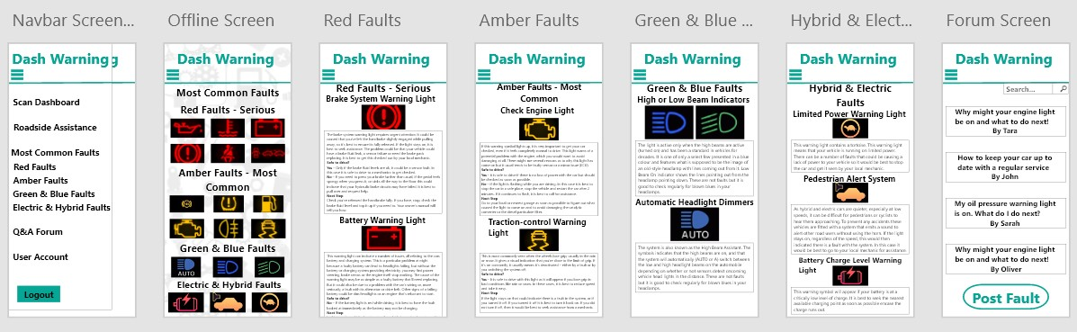
UI Prototype

Slide 7

Process & Issues
Home Display Page
Service Page
All pages linked together & Buttons
Navbar Implemented 80%
User Personas (UX) Completed & Tested
UI Completed & User Tested
Team of 4 – 2 – 1
UI Development Started Late
Work Relocated – Now Testing
Release 1 - Redefined

Slide 8
Release 1 Demo
UI Prototype Demo
https://youtu.be/n4SEaCKa-wI
UI Code Demo
https://youtu.be/03XPqvuQ8m8

Slide 9
Targets & Features T-CA3
Login / Create Account Implemented
User Account Implemented
Scanner Implemented

