Slide 1
U-Vote Secure Online Voting System
Presented by Luke Doyle (D00255656) & Hafsa Moin (D00256764)

Slide 2
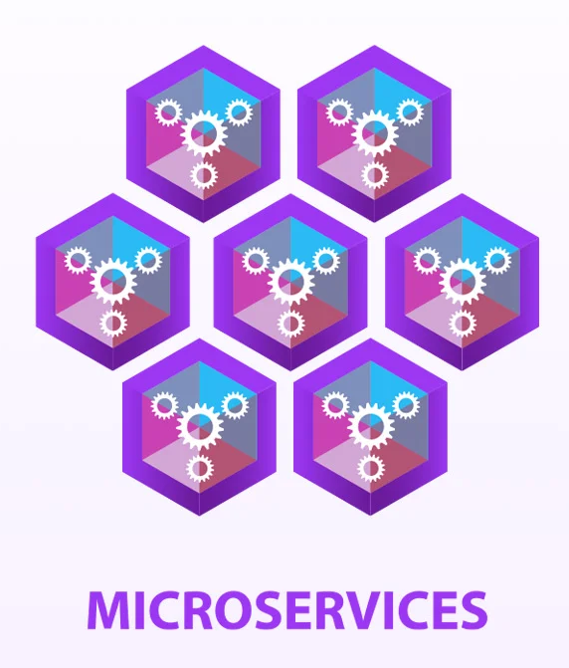
What is U-Vote?
A microservices-based election platform built for small-scale organisations. Designed for verifiability, anonymity, and auditability.
6 Services:
auth-service: JWT authentication, MFA (phone OTP), blind ballot issuance
election-service: Election lifecycle, scheduled open/close, voter management
voting-service: Voter-facing ballot submission, receipt verification
results-service: Vote tallying, winner calculation, audit log
admin-service: Voter CSV import, token generation, GDPR erasure
frontend-service: Organiser dashboard and election management UI
Notes:
Image Link, Recorded as Fig 1: https://eagleeye.com/hubfs/images/featured/monolithic-to-microservices.jpg

Slide 3
Continuous Integration Pipeline

Slide 4

GitHub Actions
Job 1 | Lint | ruff check across all Python source files
Job 2 | Unit Tests | pytest matrix: 6 services in parallel 121 tests · JUnit XML artifacts uploaded per service fail-fast: false (all services tested even if one
Job 3 | Shared tests | tests/test_shared.py & tests/test_logging_config.py
Job 4 | Integration Tests | Docker Compose full stack spin-up NGINX gateway on port 80 HTTP flows: register --> login --> dashboard Tears down with docker compose down -v on completion
Job 5 | Docker Build | docker compose build Verifies all 6 Dockerfiles build cleanly
Job 6 | Trivy CVE Scan | Matrix scan:all 6 images CRITICAL and HIGH severity CVEs SARIF uploaded to GitHub Security tab
Job 7 | Trivy FS Scan | Scans source code for: Hardcoded secrets Exposed credentials Infrastructure misconfigurations
Notes:
https://www.streamlinehq.com/icons/download/github-2--22599

Slide 5
Kubernetes Platform - Kind (Kubernetes IN Docker)

Slide 6

Cluster Topology:
1 control-plane node
2 worker nodes
Pod subnet: 192.168.0.0/16 (Calico)
Namespaces:
uvote-dev Development and feature testing Active
uvote-test Integration testing, mirrors prod Active
uvote-prod Production-grade deployment Reserved

Slide 7

Network Policies
Policy 00 Default deny all traffic
Policy 01 Allow DNS resolution
Policy 02 Allow service --> PostgreSQL (per service)
Policy 03 Allow ingress controller --> services
Policy 04 Allow audit service access
Policy 05 Allow MailHog SMTP (Testing Environment Only)
Policy 06 Allow Prometheus scraping

Slide 8

Observability Stack
Fluent Bit: Collects container logs from all pods
Elasticsearch: Indexes logs (uvote-logs*)
Kibana: Live dashboards: error volume, auth failures, vote rate, log stream
Prometheus: Scrapes /metrics from all 6 services every 15s
Grafana: SLI dashboard: request rate, p95 latency, 5xx error rate, availability

Slide 9

Deployment Process
Step 1: python setup_venv.py
Creates .venv, installs all deps for 6 services + platform scripts + test suites
Step 2: python boot_test_platform.py Internally runs in order:
a. setup_k8s_platform.py Kind cluster --> Calico CNI --> namespaces --> PostgreSQL --> schema.sql --> create_roles.sql --> seed_data.sql --> network policies --> NGINX ingress
b. deploy_platform.py Docker build (6 images) --> kind load --> secrets --> kubectl apply --> pod readiness --> network policy tests --> health endpoint tests
c. ELK Stack helm install elasticsearch --> kibana --> fluent-bit (monitoring namespace) create_dashboard.py --> Kibana dashboard auto-created
d. deploy_test_platform.py MailHog deployed to uvote-dev + uvote-test (SMTP capture)
Total time: ~8-12 minutes
Result: 13/13 pods running · 6/6 health checks · 7/7 network tests

Slide 10

Testing Results
121 pytest unit tests 6 services, all passing
11/11 database tests schema, triggers, indexes, roles, network
28/28 API integration full voter journey end-to-end
13/13 pods running 6 services × 2 replicas + PostgreSQL
6/6 health checks all services responding
7/7 network policy tests zero-trust enforcement verified

Slide 11
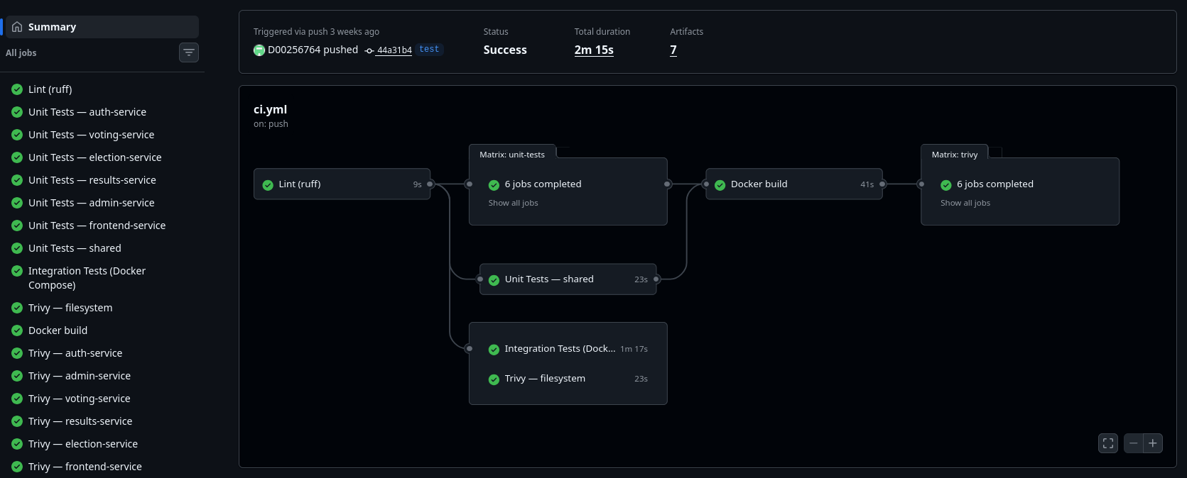

Slide 12
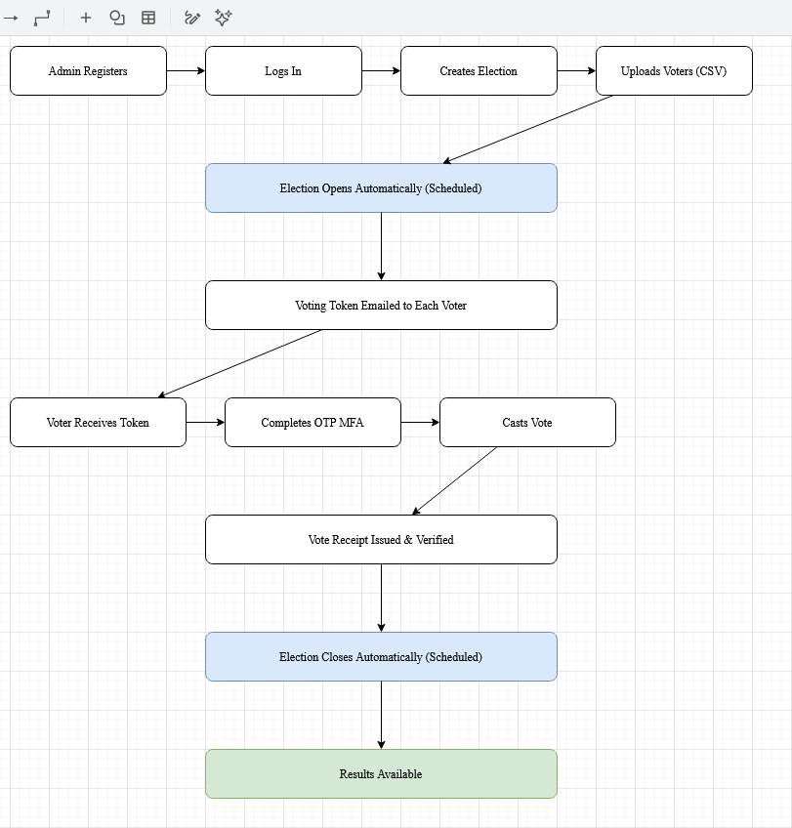

Voting Journey

Slide 13

Security
Authentication
JWT tokens · bcrypt password hashing
Ballot Anonymity
Blind ballot tokens · voter identity decoupled from vote
Vote Integrity
Immutable ballots · SHA-256 hash chain audit log
Double-Vote Prevention
UNIQUE constraint on ballot token · rejected on resubmission
Least Privilege
Per-service PostgreSQL users · each service sees only its data
Network Isolation
Calico zero-trust · default-deny · explicit allow per service pair
This Photo by Unknown Author is licensed under CC BY-SA

