Slide 1
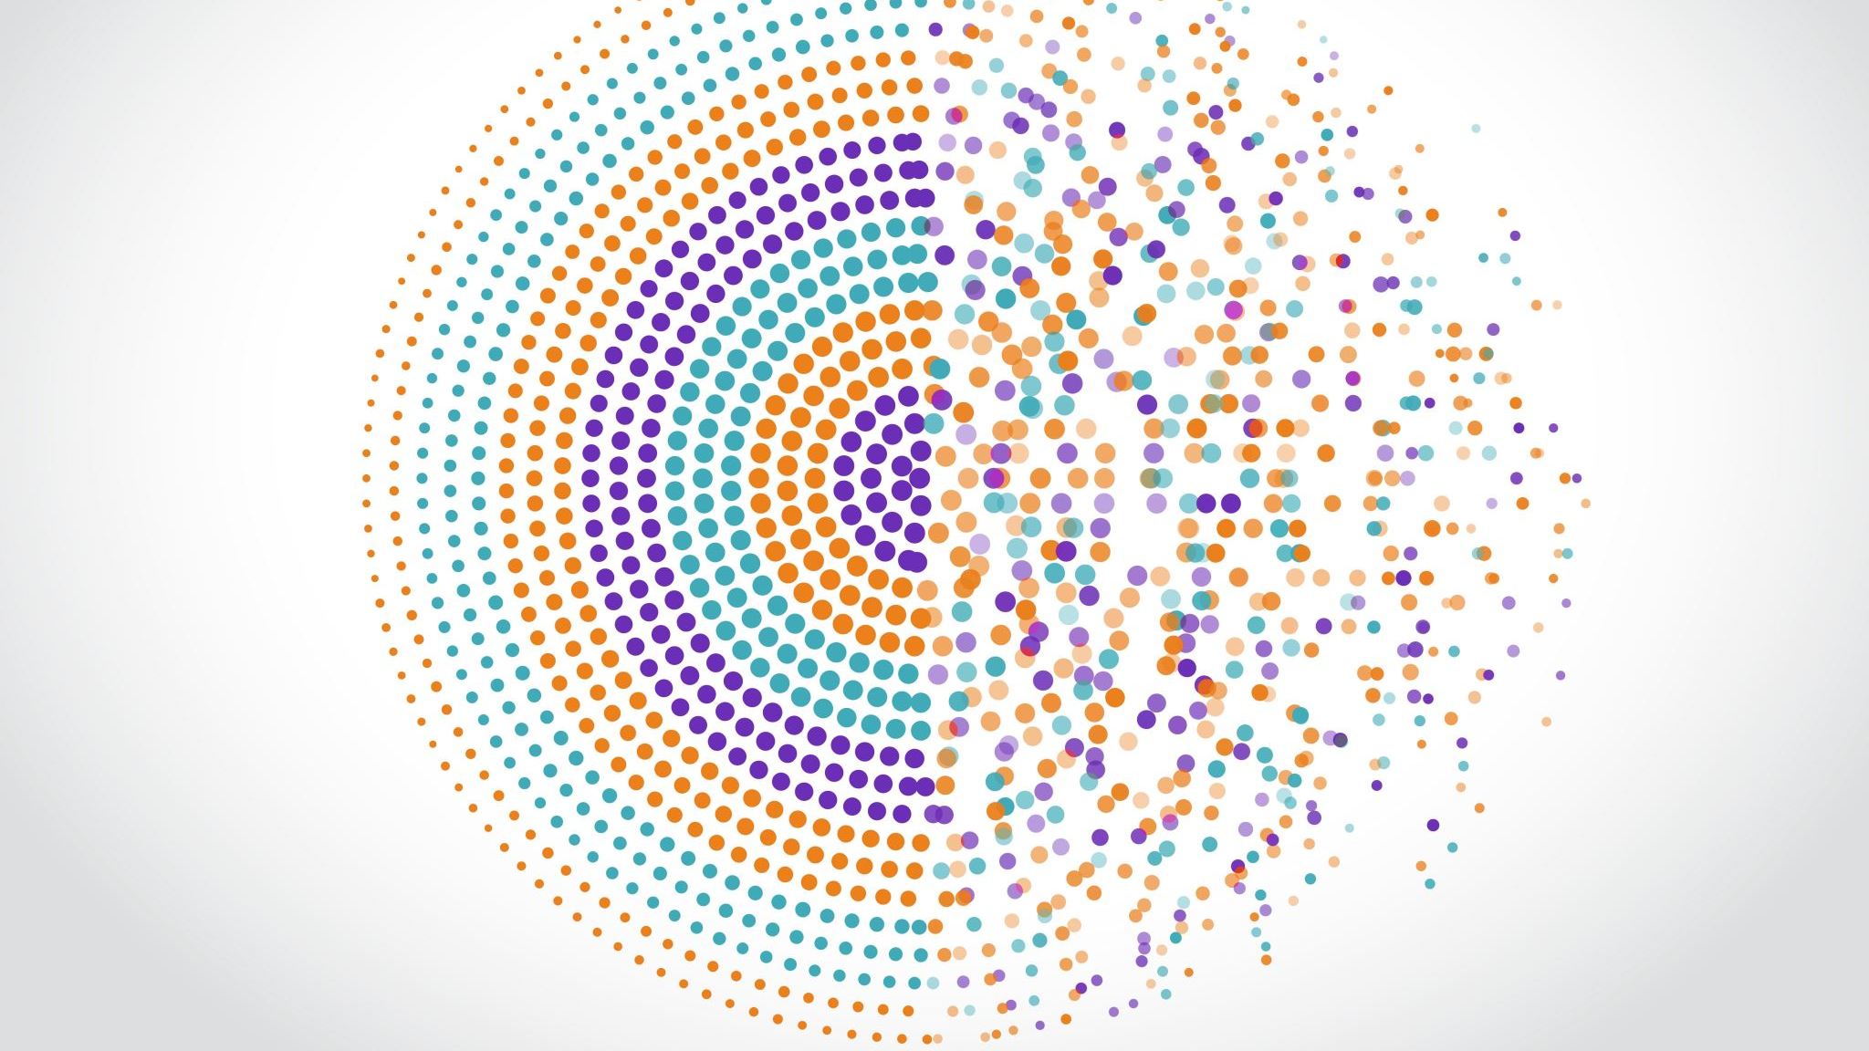
AI-Powered License Plate Detection System
Course: ITAI 1378 – Computer Vision and AI
Student: Jeremy Okyere
Tier: Tier 2 (Project with custom dataset and model fine-tuning)

Slide 2
The Problem
Real-World Issue:
Law enforcement officers spend hours manually reviewing footage to identify vehicles linked to crimes or terror-related activities.
Who Cares:
Law enforcement agencies
Security and border control organizations
Smart city traffic management teams
Why It Matters:
Faster and more reliable license-plate detection allows authorities to prevent attacks, locate suspects quickly, and strengthen public safety.

Slide 3
Proposed Solution
Goal:
Develop an AI-based license-plate detection system capable of identifying and localizing plates from images and videos.
How It Works:
Camera → Image Input → YOLOv8 Model → Detected Plate → Output (Bounding Box / Cropped Plate)

Slide 4
Technical Approach
Component | Details
CV Technique | Object Detection
Model | YOLOv8 (SOTA real-time detector)
Framework | TensorFlow + Ultralytics
Why YOLOv8? | Combines speed and accuracy — ideal for real-time surveillance and mobile deployment
Development Env. | Google Colab + Python 3.10 + OpenCV + Matplotlib
Colab Link | https://colab.research.google.com/drive/1a2aEJMculwLyhtg0kpIgxojlu5RtDsIO

Slide 5
Data Plan
Dataset Source:
Kaggle “License Plate Detection Dataset”
Supplement with web-scraped vehicle images for diversity
Size & Type:
~500 images of vehicles (urban & highway scenes)
YOLO-formatted labels with bounding boxes
Preparation Steps:
Clean and resize images to 640×640 px
Augment dataset (rotation, brightness, blur) via Roboflow
Split into train / validation / test sets (70 / 20 / 10)

Slide 6
System Architecture
[Vehicle Image / Video Frame]
↓
[Preprocessing]
(resize, normalize)
↓
[YOLOv8 Model]
(detect license plate)
↓
[Bounding Box Coordinates]
↓
[Cropped Plate / Output Visualization]

Slide 7
Success Metrics
Metric | Target | Purpose
mAP@0.5 | ≥ 90 % | Measure detection accuracy
FPS | ≥ 20 frames/sec | Ensure real-time processing
False Positives | ≤ 5 % | Maintain reliability in diverse lighting
Latency | ≤ 1 s/image | Guarantee fast response for video feeds

Slide 8
Week-by-Week Plan
Week | Task | Milestone
Week 10 | Gather dataset, set up Colab | Dataset ready
Week 11 | Train YOLOv8 model | Model initialized
Week 12 | Evaluate and tune parameters | Accuracy >85%
Week 13 | Integrate into demo app (streamlit or video) | Demo functional
Week 14 | Final testing and polish slides | Model finalized
Week 15 | Present | Project complete

Slide 9
Challenges & Backup Plans
Challenge | Impact | Mitigation Plan
Limited data diversity | Lower accuracy | Use Roboflow augmentation / collect web data
GPU limitations on Colab | Slower training | Use Kaggle Notebook / Heidi server
Low performance in night scenes | Reduced recall | Add low-light images / adjust brightness in training

Slide 10
Resources Needed
Compute: Google Colab (GPU T4 / A100)
Libraries: TensorFlow, Ultralytics, OpenCV, Matplotlib
Data Tools: Kaggle, Roboflow
Cost: $0 (fully open-source)
Estimated Training Time: ~3 hours per epoch on Colab GPU

