Slide 1
AWS Bootcamp Dallas 2016

Slide 2


Introductions
Brett Gillett,
AWS Practice Lead
Richard Finlay,
Business Development

Slide 3
House Keeping
Handouts - IAM Console Access
Putty & PuttyGen (Windows Only)
GitHub: https://github.com/brettg98/aws-bootcamp
Login: first name Password: bootcamp!S0ftchoice

Slide 4
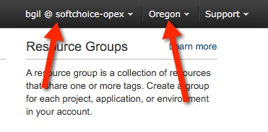
Rules of Engagement
Lets all use the same region:
Oregon (US-WEST)
EC2 (Size and Type): t2.micro / AWS Linux
RDS (Size and Type): db.t2.micro / MySQL
Notes:
Poll Question:
1. How many of you are already using AWS?

Slide 5
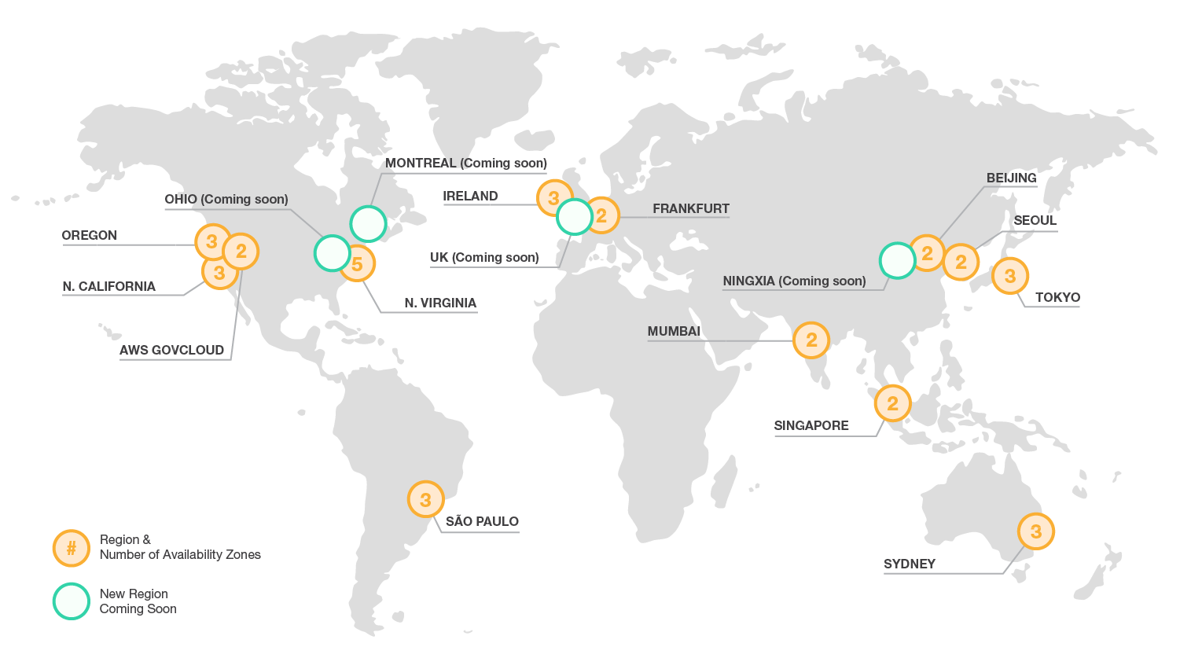
Global Infrastructure
Notes:
Regions are completely isolated from each other.
AZ’s are isolated from each other, but connected through low latency links.

Slide 6
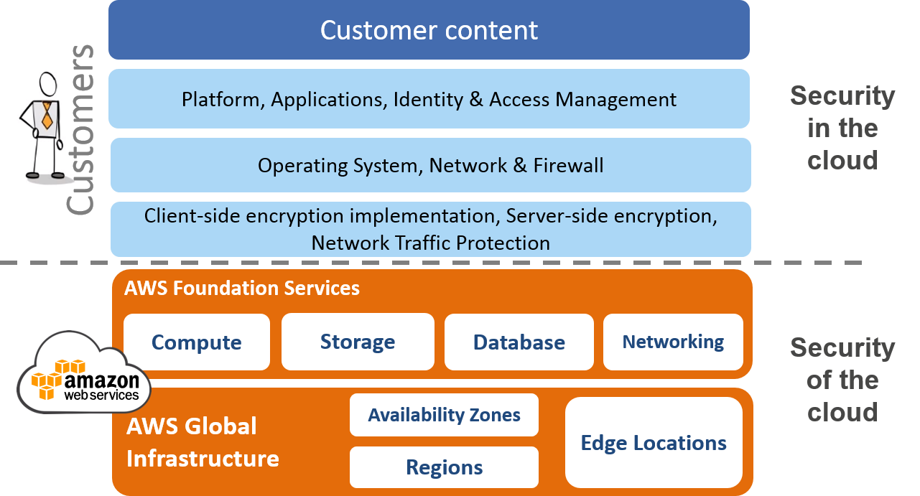
Shared Security Model

Slide 7
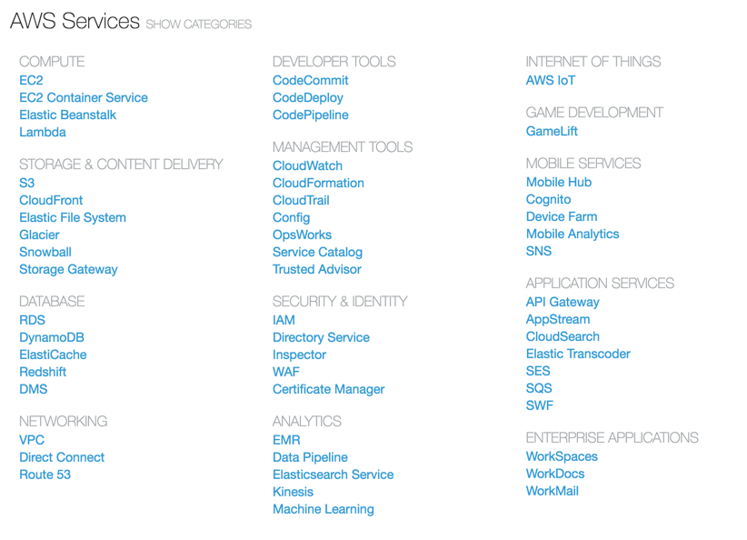
AWS Services
Notes:
Regions are completely isolated from each other.
AZ’s are isolated from each other, but connected through low latency links.

Slide 8
Agenda
Let’s Build some Stuff!

Slide 9
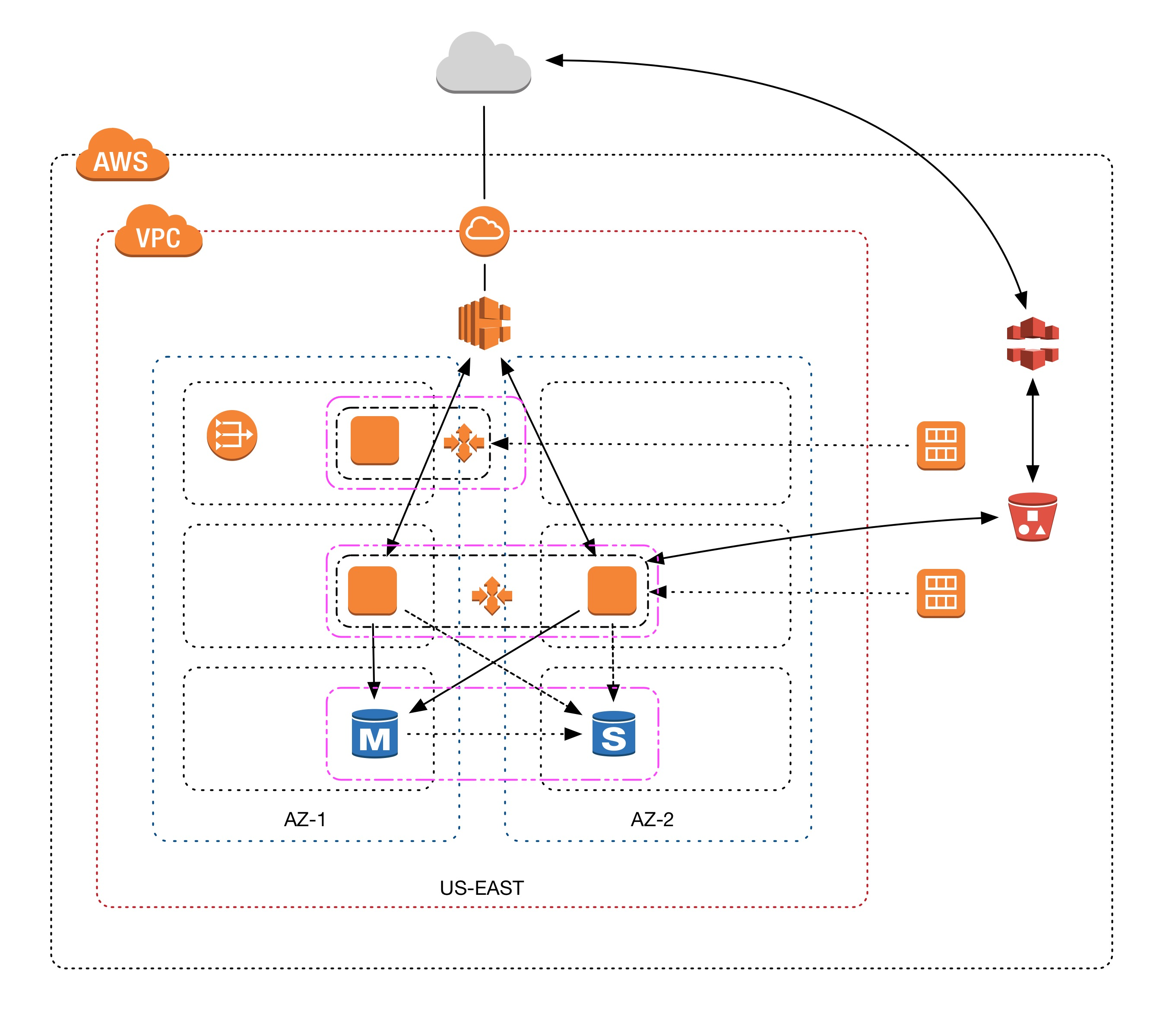
What we’re going to Build
Highly Secure
Highly Available
Fault Tolerant
Scalable

Slide 10
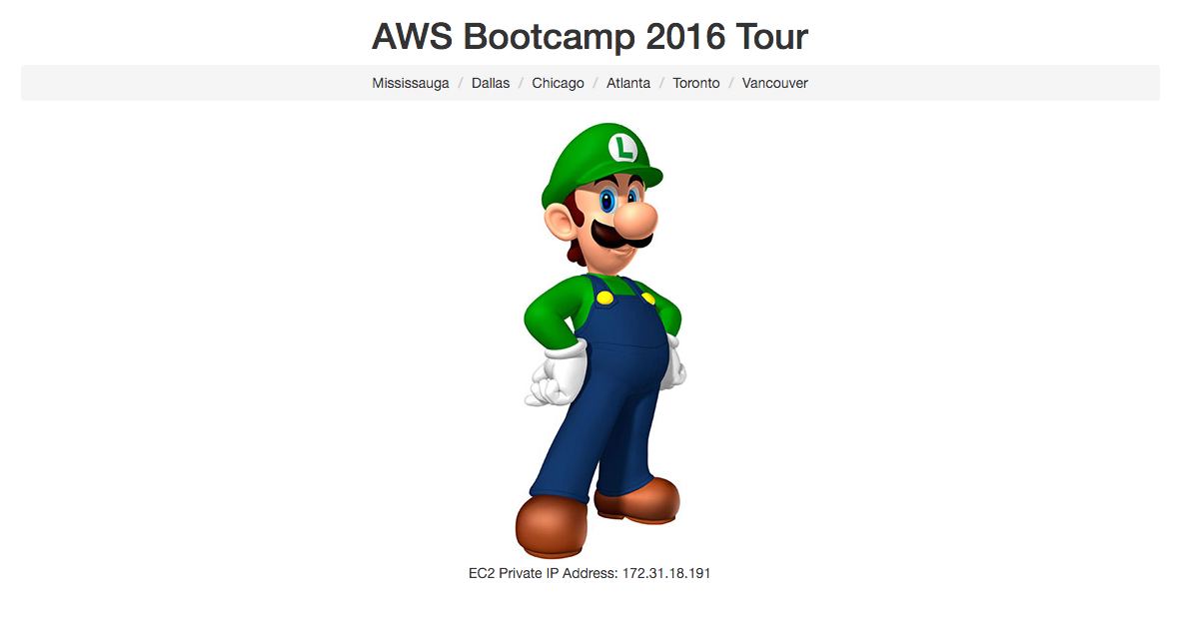
Luigi Plumbing

Slide 11
Secure Your AWS Account
Secure your AWS account using Identity and Access Management (IAM)
EC2 Roles
Review best practices
Enable CloudTrail
Enable AWS Config
Create EC2 Key Pairs (1x Bastion, 1x Web Server)
https://d0.awsstatic.com/whitepapers/compliance/AWS_Auditing_Security_Checklist.pdf

Slide 12
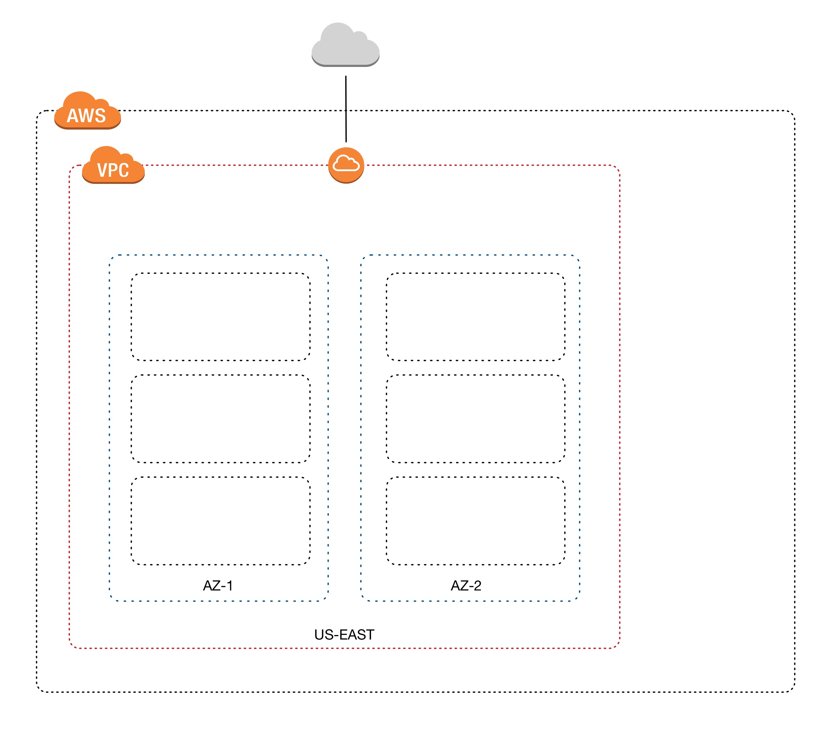
Creating a Virtual Network
Virtual Private Cloud (VPC)
Create a network - /16
Create 2x public subnets (public IP)
Create 4x private subnets
2x webservers
2x databases
Create an Internet Gateway (IGW)
Create route tables
1x public + associate with IGW
1x private + associate with NG
Deploy NAT Gateway
Use /24 for all subnets
Notes:
/28 = 14 / 9 usable
/20 = 4,096 / 4,091 usable
Each subnet loses 5 address (network, broadcast, 3x AWS reserved)
We’re going to use public IP addresses with our bastion hosts today, but in a real world deployment you would want to assign EIP.

Slide 13
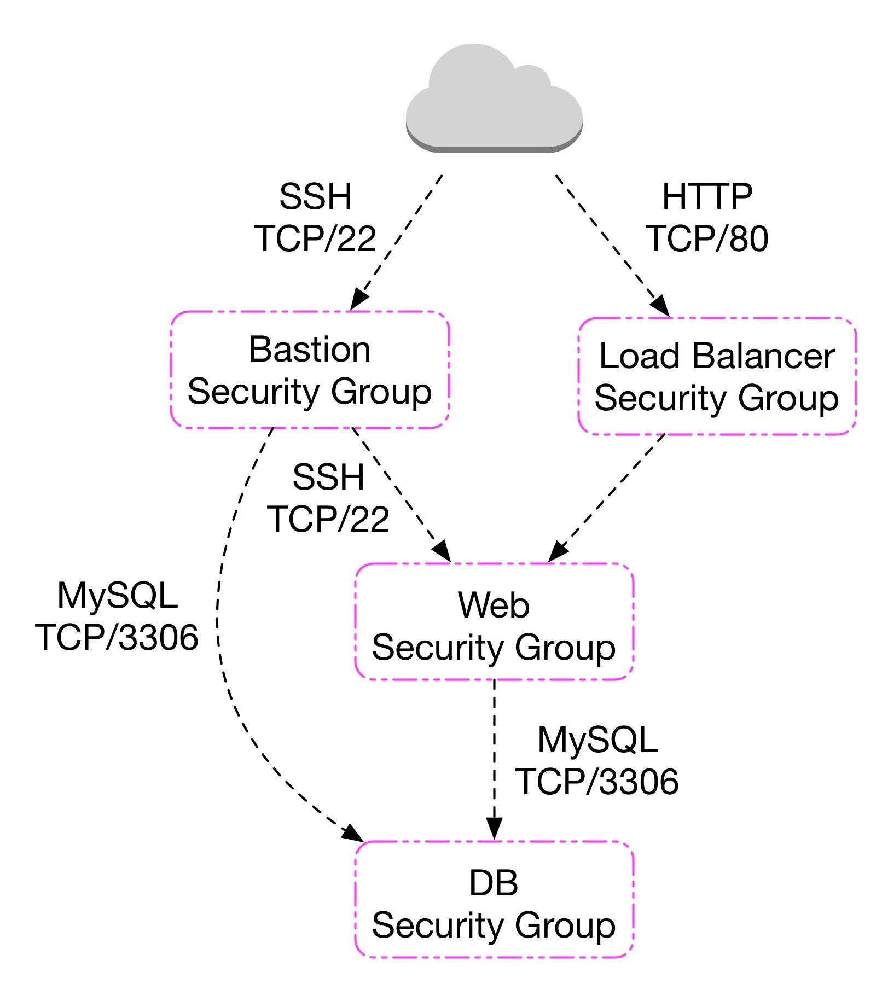
Securing a Virtual Network
Virtual Private Cloud (VPC)
Create Security Groups
Bastion Hosts
Elastic Load Balancer
Web Servers
Database Servers
What’s the difference between a Security Group and a Network Access Control List (NACL)?
Notes:
Use the VPC console to create these

Slide 14

Storage Built for the Internet
Simple Storage Service (S3)
Create an S3 bucket in Oregon
Copy files from GitHub (web-server) into bucket
Let’s update our EC2 role
Other Features to Consider
Lifecycle Management Rules
Events
Static Website / Content Delivery

Slide 15

Leveraging Multiple Availability Zones
Elastic Load Balancer (ELB)
Create a Load Balancer
Associate it with the two public subnets (ignore the warning)
Adjust the health checks (TCP and shorter)

Slide 16

Autoscaling and Launch Configurations - Bastion
Launch Configuration
Create Launch Configuration & Autoscaling group for the Bastion Host
Use AWS Linux
Update user-data (yum update –y)
Add security group
Auto Scaling Group
Set group size to 1
Select correct VPC and Subnets
Leave scaling policy
Add tags (Name)

Slide 17

Bootstrapping
Using Amazon Machine Images (AMI)
Create a ‘gold image’ for our web servers. Later, we’ll associate it with a launch configuration and autoscaling group.
Create a new t2.micro AWS Linux EC2 instance
Associate it one of your public subnets
Update the user-data script (from GitHub)
Test!
Good? Create an image

Slide 18
Autoscaling and Launch Configurations – Web Server
Launch Configuration
Create Launch Configuration & Autoscaling group for the WebHost
Use your Amazon Machine Image
Add security group
Auto Scaling Group
Set group size to 2
Select correct VPC and Subnets
Leave scaling policy
Add tags (Name)
Test!

Slide 19


Databases on the AWS Platform
Platform-as-a-Service (RDS)
Create an option group
Create a parameter group
Create a subnet group (select the correct subnets!)
Plan Ahead – there are a ton of options!
SQL or NoSQL?

Slide 20

Content Delivery
CloudFront
Deliver content from over 50 edge locations around the globe to improve customer experience.
Create a CloudFront Web Distribution and point it at your S3 bucket
Modify the index.php file to point to the new CloudFront URL
Update S3
Create new Launch Configuration (bootstrap?)
Update Auto scaling group

Slide 21
We Made It!

