Slide 1

Python
Go to python.org and download the latest version for your operating system
Run the downloaded installer
(Windows only) Before you click install, check the box "Add python.exe to PATH" at the very bottom of the first window
Click "Install Now" and wait for the setup to finish

Slide 2
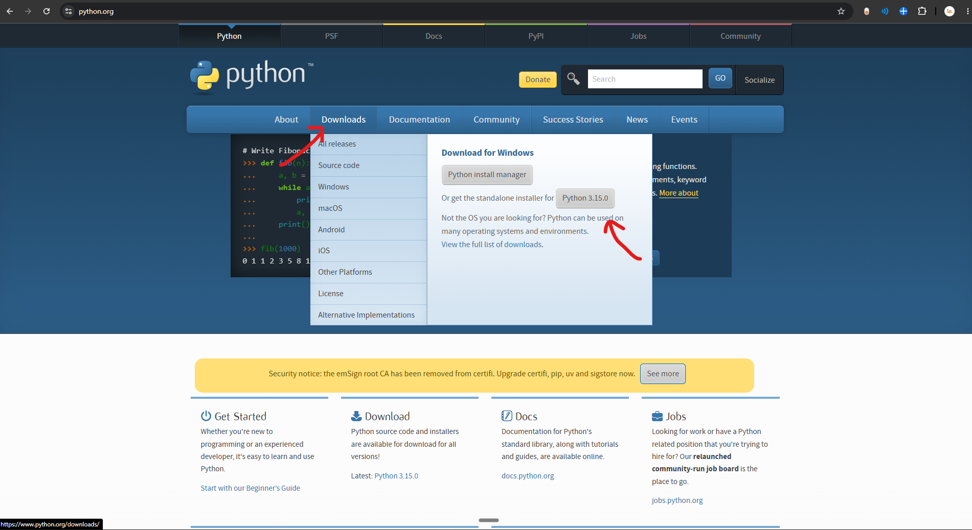
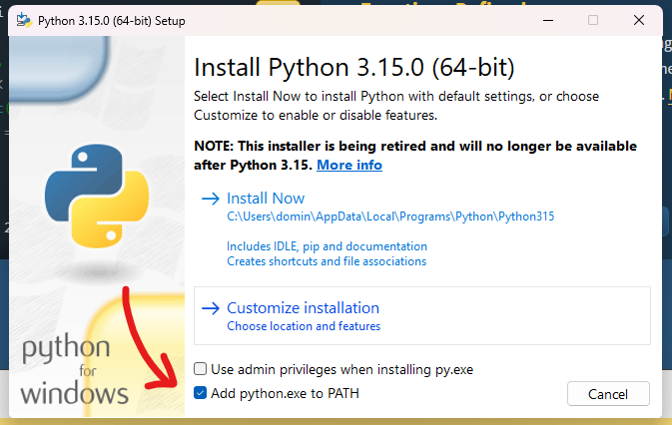

Slide 3
GitHub Desktop
Go to desktop.github.com and download the app
Run the installer (it installs automatically without asking many questions)
Click "Sign in to GitHub.com" and log in with your browser
Click "Finish" on the configuration screen (your name and email are filled in automatically)

Slide 4
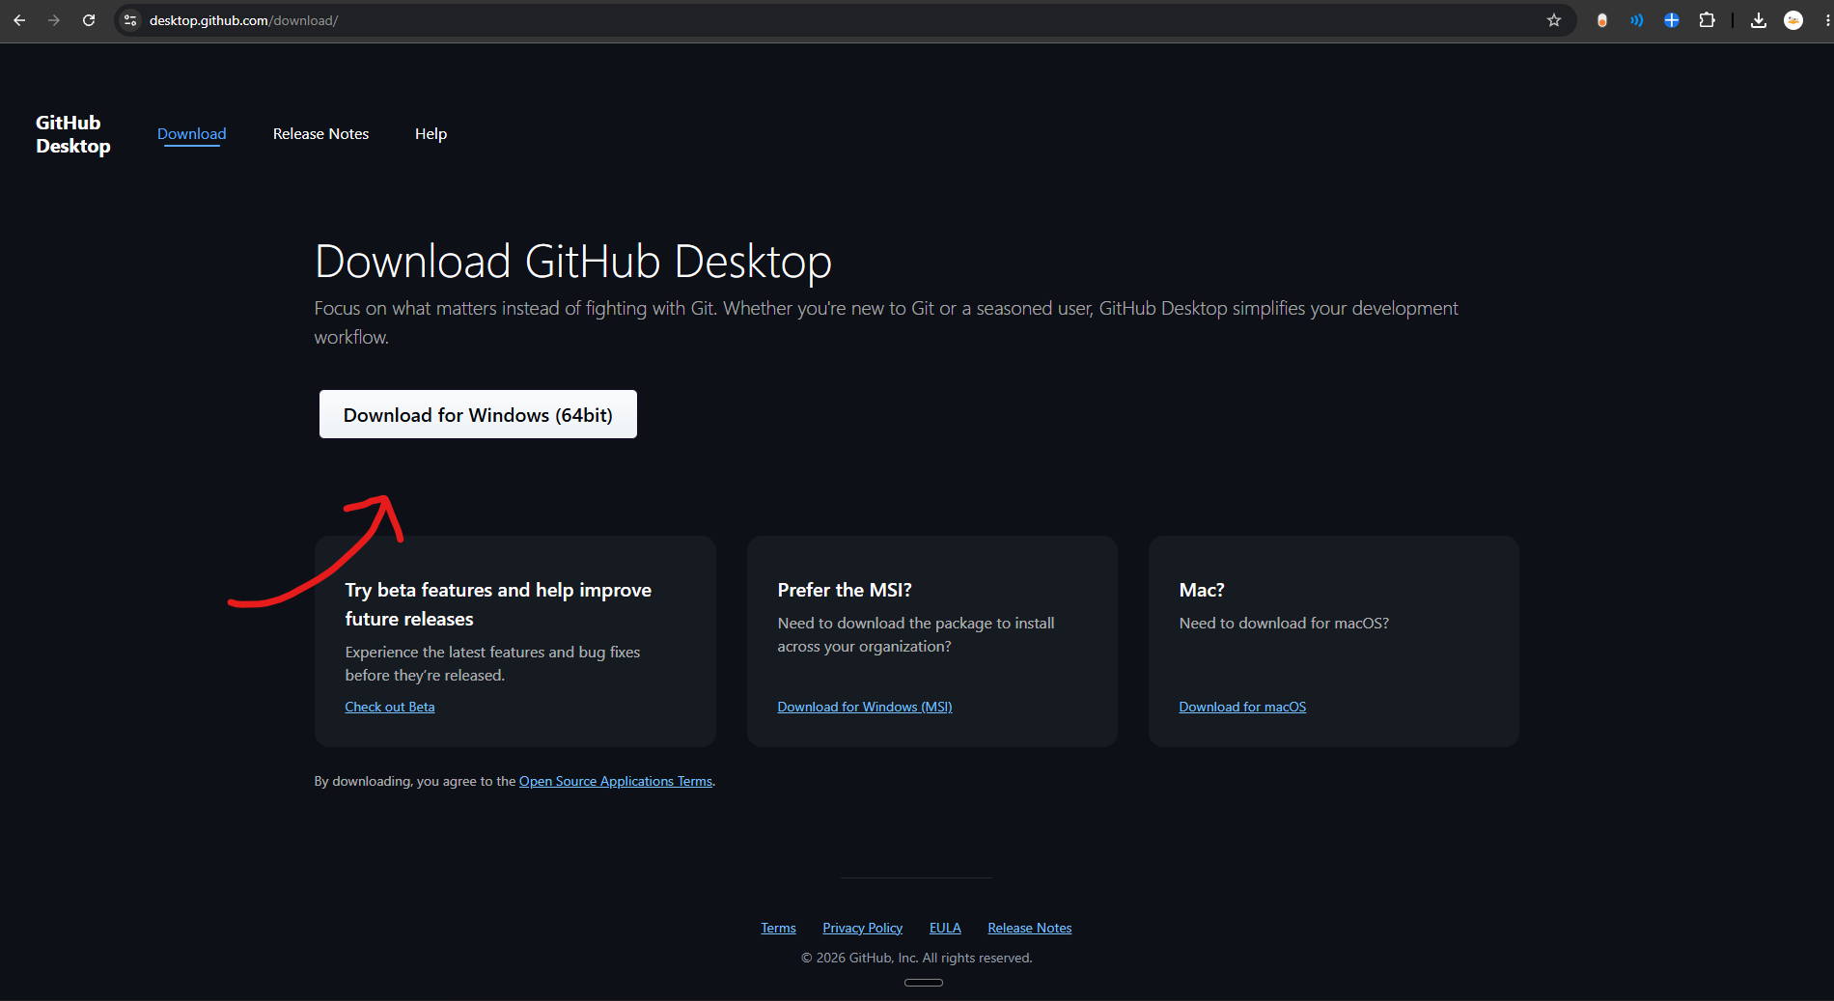

Slide 5
Visual Studio Code (VSC)
Go to code.visualstudio.com and install the program
Open VS Code and click the "Extensions" icon on the left menu (the four squares)
Type "Python" into the search bar
Click "Install" on the official extension provided by Microsoft (it has millions of downloads)

Slide 6
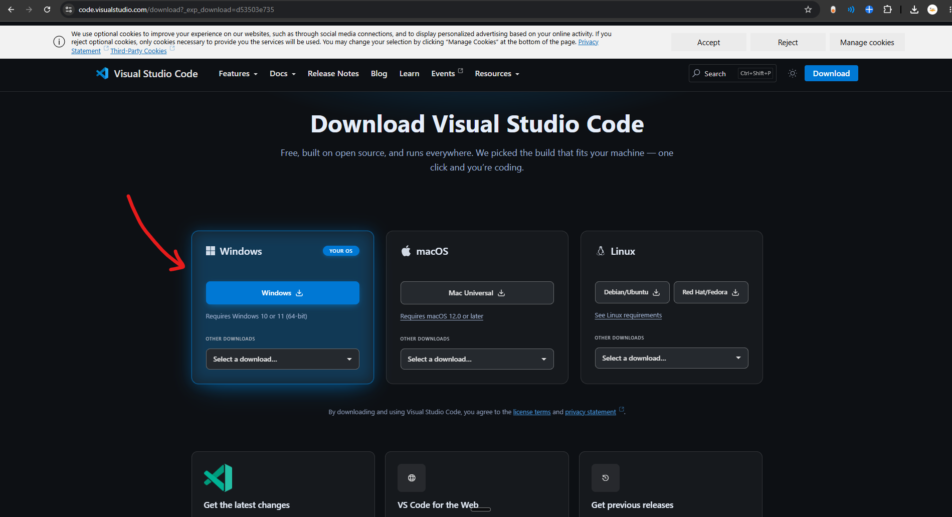
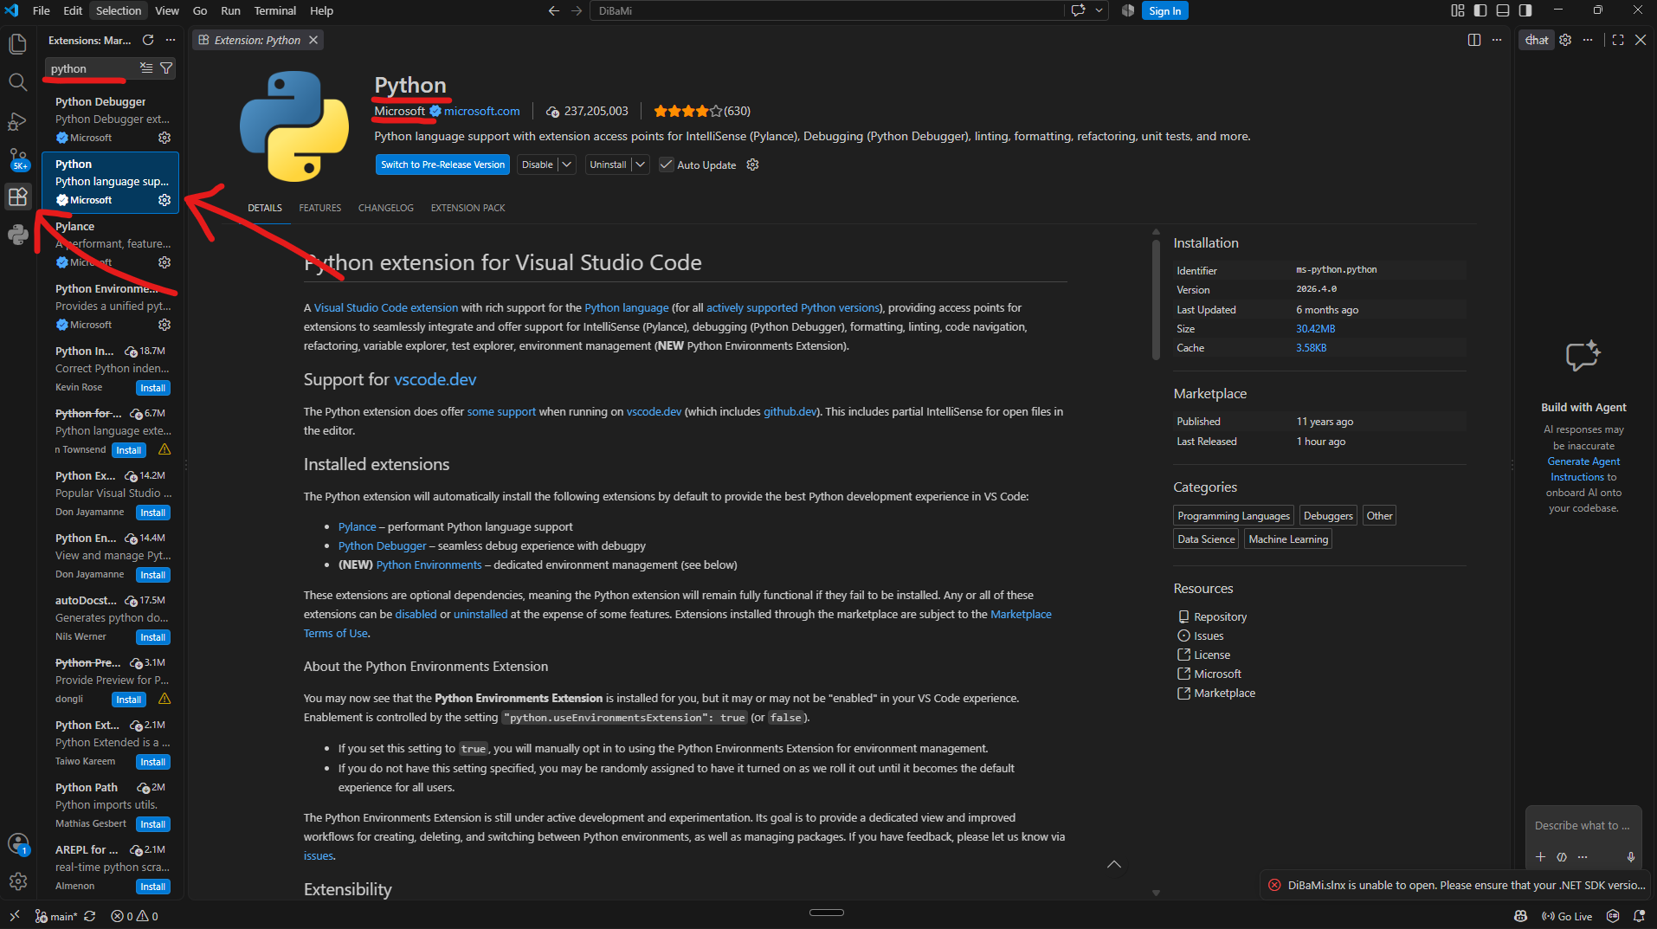

Slide 7
Create Repository
Open GitHub in your web browser and log in
Go to your profile by clicking your profile picture in the top right corner
Click on "Repositories" and then click on the green button saying "New"
Give your repo a name, scroll down, and click "Create repository"

Slide 8
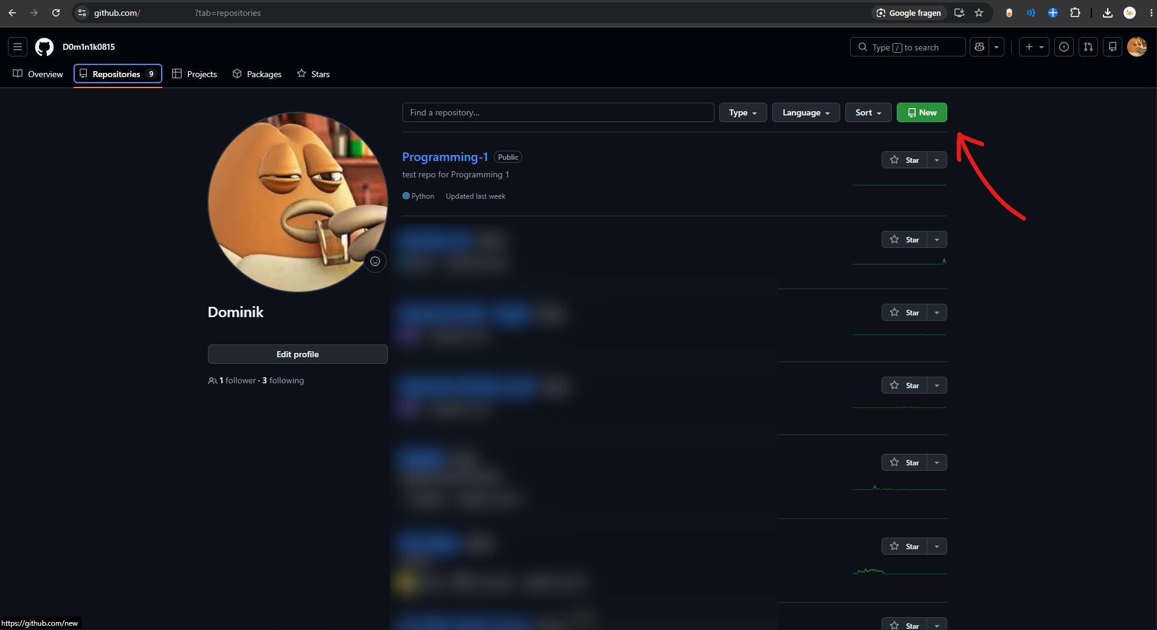

Slide 9
Clone Repository
Open GitHub Desktop
Click on "File" in the top left corner, then "Clone repository...“
  Or Click "Clone a Repository from the Internet…"
Select your Project
Choose a safe folder on your PC under "Local Path" (e.g., Documents/University)
Click "Clone"
Once finished, click the big button "Open in Visual Studio Code" in the center of GitHub Desktop

Slide 10
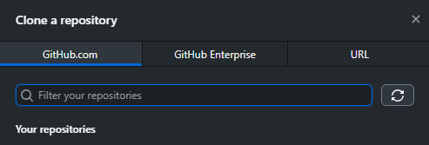
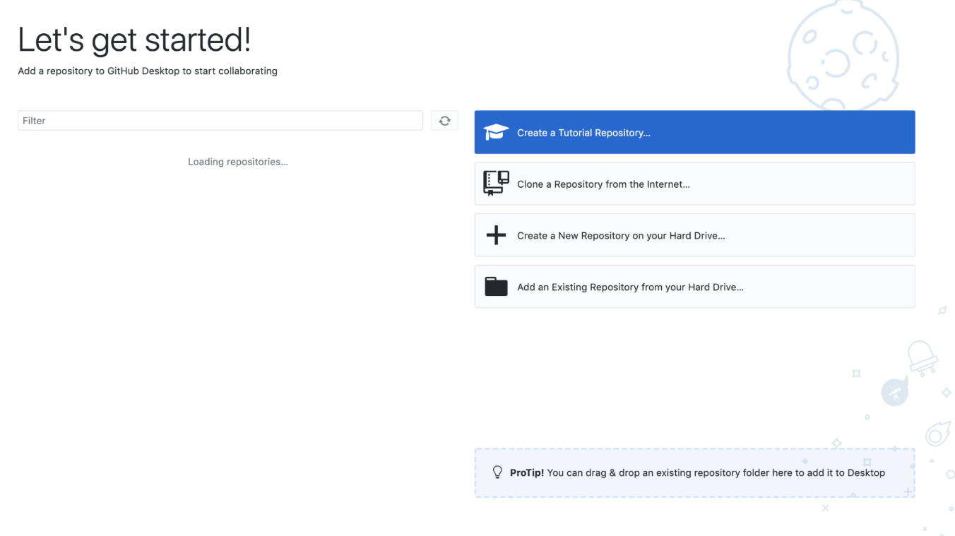

Slide 11
Create a Virtual Environment
In VS Code, open the top menu and click "Terminal" -> "New Terminal"
Type the following command exactly as shown and press Enter:
  Windows: python -m venv venv
  Mac/Linux: python3 -m venv venv
Wait a few seconds. A new folder named "venv" will appear on the left side
In the same terminal, type this command and press Enter:
  Windows: .\venv\Scripts\activate
  Mac/Linux: source venv/bin/activate
Important Check: You must now see a green (venv) text at the very beginning of your terminal line!
Look at the bottom right corner of VS Code: If it says "venv(3.15.0)" You are good to go

Slide 12
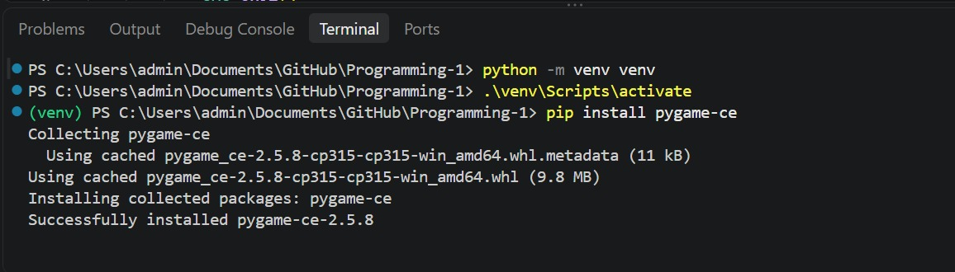

Slide 13
Install Pygame
Make sure the green (venv) is still visible in your terminal
Type this command and press Enter:
  Windows: pip install pygame-ce
  Mac: pip3 install pygame-ce
Wait until the loading bar finishes and you see "Successfully installed"

Slide 15
Create and Run Test-Code
Click the "New File" icon in the left explorer menu
Name the file main.py (Warning: Never name it pygame.py!)
Write your first line of code: print("Hello World")
Press Ctrl + S (or Cmd + S on Mac) to save the file. (Look at the file tab at the top: A white dot means unsaved, an 'X' means saved)
How to run: Make sure your main.py tab is actively selected in the middle of the screen! Then click the Play Button in the top right corner
  If the Code wont run, click at the bar at the top and select main.py
Look at the terminal, read through the text. What happened?

Slide 16
