Slide 1

SpinalHDL
An alternative to standard HDL

Slide 2
Summary
Why a new language
Language introduction / dissection / comparison
Examples (a lot)

Slide 3
Why a new language
Because of current HDL :
Verbosity, endless wiring, copy paste
Wire level, can’t define abstractions
Broken features
Can’t parameterize records/struct
Can’t define record’s elements directions individually
SystemVerilog interface
No hardware «meta-description» capabilities
They were initially designed for simulation
Heavy legacy

Slide 4
Language introduction
Open source , started in december 2014
Focus on only on RTL
Compatibility/interoperability is fine
It generate VHDL/Verilog files
It can integrate VHDL/Verilog IP as blackbox
Abstraction level :
Start at the same level than VHDL
Finish between VHDL and HLS
The user can create new abstraction levels

Slide 5
Language dissection
Spinal language is «integrated» in Scala
You can use all the Scala syntax / library
Scala IDE are helpfull and free
Object oriented and functional paradigms
2 layers
Core : Low level RTL
Lib : High level RTL, based on the Core layer
How it work
Use Spinal syntax to describe your RTL,
Run Scala,
VHDL/Verilog is generated.

Slide 6
At this point it’s very important :
To be open minded.
To forget pessimism as there is no logic overhead in the generated code.
Not to be disturbed by the fact that Spinal HDL is only a RTL language. That’s not a problem.
Not to be afraid by the fact that you will have to simulate/synthesize a VHDL/Verilog file, while the specification is written in Spinal. That too isn’t a problem.
Justification :
There is many good verification solutions for the generated VHDL/Verilog (SystemVerilog, Formal verification, cocotb)
The component hierarchy and all names are preserved durring the VHDL/Verilog generation. This make the navigation between the Scala code and the generated one easy.

Slide 7

A simple component
class MyComponent extends Component { val io = new Bundle { val a = in Bool val result = out Bool } io.result := io.a }
Notes:
It’s scala, but with some pretty things (in Bool in this case)
New Bundle is the definition of a new datatype, a little bit like records in VHDL or struct in Verilog, but with individual element direction specification
This code wire io.a to io.output

Slide 8


Combinatorial, Latch/Loop
class MyComponent extends Component { val io = new Bundle { val a = in Bool val b = in Bool val c = in Bool val result = out Bool } io.result := (io.a & io.b) | (!io.c) }
class MyComponent extends Component { //…
//Latch/Loop detected, not allowed by Spinal io.result := io.a | io.result }
Notes:
Like in VHDL you can do combinatorial things.
Spinal check if there is combinatorial loop and print a error when one is detected.
Anyway you can read the value each out signal, like a VHDL buffer.

Slide 9
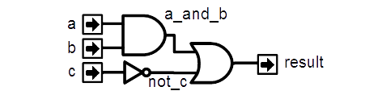
Signals
class MyComponent extends Component { val io = new Bundle { val a = in Bool val b = in Bool val c = in Bool val output = out Bool } val a_and_b = Bool
a_and_b := io.a & io.b val not_c = ! io.c io.output := a_and_b | not_c }
Notes:
Declare what you need where you need and directly affect the value that you want (not_c signal).
For example if you don’t assigne a_and_b to any value, spinalHDL tell you.

Slide 10
Generated VHDL
class MyComponent extends Component { val io = new Bundle { val a = in Bool val b = in Bool val c = in Bool val output = out Bool } val a_and_b = io.a & io.b val not_c = !io.c io.output := a_and_b | not_c }
entity MyComponent is port( io_a : in std_logic; io_b : in std_logic; io_c : in std_logic; io_output : out std_logic ); end MyComponent; architecture arch of MyComponent is signal a_and_b : std_logic; signal not_c : std_logic; begin io_output <= (a_and_b or not_c); a_and_b <= (io_a and io_b); not_c <= (not io_c); end arch;
Notes:
As you can see you can avoid the split between the signal declaration and the signal logic.

Slide 11
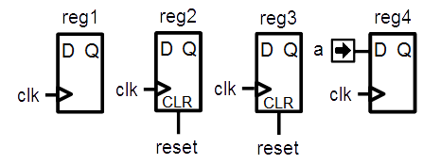
Registers
class MyComponent extends Component { val io = new Bundle { val a = in Bool } val reg1 = Reg(Bool) val reg2 = Reg(Bool) init(False) val reg3 = RegInit(False) val reg4 = RegNext(io.a) }
Notes:
You don’t need for each register to specify his clock, it’s implicit (next clock)
There is no process !
Reg1 is a simple register with no reset
Reg2 is a register with a reset value at false
Reg3 is the same than Reg2 with a more compact syntax
Reg4 is a register that take the io.a value at each clock. You can add the init(XXX) to specify a reset value.

Slide 12
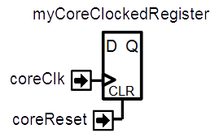
ClockDomains
class MyTopLevel extends Component { val io = new Bundle { val coreClk = in Bool val coreReset = in Bool }
val coreClockDomain = ClockDomain( clock = io.coreClk, reset = io.coreReset, config = ClockDomainConfig( clockEdge = RISING, resetKind = ASYNC, resetActiveLevel = HIGH ) ) val coreArea = new ClockingArea(coreClockDomain) { val myCoreClockedRegister = Reg(UInt(4 bit)) //... } }
Notes:
In this example, there is 2 ClockDomain created by using input signals.
Then 2 ClockingArea are created. Each ClockingArea has a specified ClockDomain. All register inside use this specified ClockDomain (implicit).
myPeripheralClockedRegister := coreArea.myCoreClockedRegister is not allowed because it cross ClockDomain (safe). You must add a special tag to myPeripheralClockedRegister or use the BufferCC function that add 2 register (default) syncronisation stages.

Slide 13
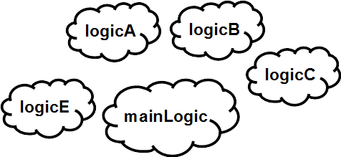
Organize things
class UartCtrlTx extends Component { val io = new Bundle { // io definition } val timer = new Area { // emit a pulse that is used as time reference
// in the state machine } val stateMachine = new Area { // some logic } }
Notes:
In VHDL you have to define sub component (overkill) or for each area, define internal signal with the same prefix each time (weak)

Slide 14
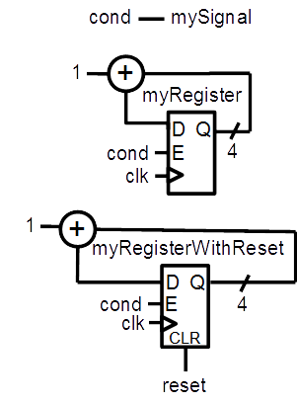
Unify logic and FF
val cond = Bool val mySignal = Bool val myRegister = Reg(UInt(4 bits)) val myRegisterWithReset = Reg(UInt(4 bits)) init (0) mySignal := False when(cond) { mySignal := True myRegister := myRegister + 1 myRegisterWithReset := myRegisterWithReset + 1 }
Notes:
In VHDL you need to split the logic between combinatoral / sequancial with reset / sequancial without reset

Slide 15
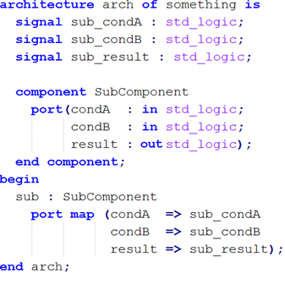
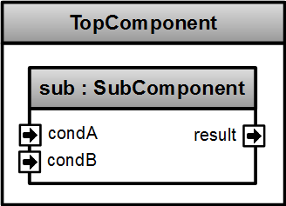
No more component binding
class TopComponent extends Component{ val sub = new SubComponent }
Notes:
By making the consideration that an component instance is like an object, you can directly access its inputs/outpus by typing instanceName.portName

Slide 16
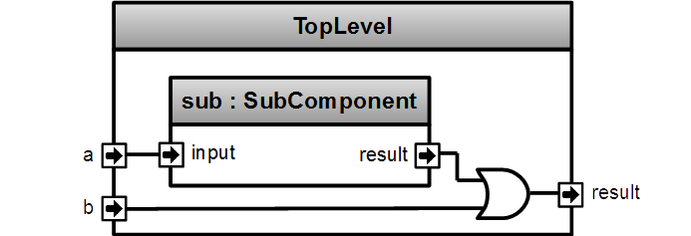
Component instance
class SubComponent extends Component{ val io = new Bundle { val input = in Bool val result = out Bool } ... } class TopLevel extends Component { val io = new Bundle { val a = in Bool val b = in Bool val output = out Bool } val sub = new SubComponent sub.io.input := io.a io.output := sub.io.result | io.b }
Notes:
No declaration of components instances io. You directly wire it with «componentInstance.io.XXX»

Slide 17

UInt, Vec, When
class MyComponent extends Component { val io = new Bundle { val conds = in Vec(Bool,2) val result = out UInt(4 bits) } when(io.conds(0)){ io.result := 2 when(io.conds(1)){ io.result := 1 } } otherwise { io.result := 0 } }
Notes:
You can define a array of data elements by using Vec(numberOfElement,dataType)
For hardware conditional blocks, you can use the when(cond){}.elsewhen(cond){}.otherwise {} The dot before the elsewhen is mandatory, but not for the otherwise. It’s because of scala.
N.B. En each when, you can mix assignement of syncronous and asyncronous logic. You don’t have the VHDL process barrier

Slide 18
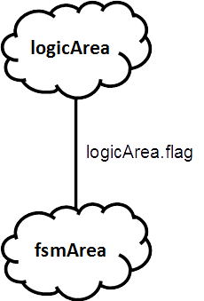
Enum, Area, switch
class TopLevel extends Component {
//… val logicArea = new Area { val flag = Bool //… }
val fsmArea = new Area { val state = RegInit(MyEnum.state0) switch(state) { is(MyEnum.state0) { when(logicArea.flag) { state := MyEnum.state1 }
} default {
//… } } } }
object MyEnum extends SpinalEnum { val state0, state1, anotherState = newElement }
Notes:
I agree that the SpinalEnum syntax is not the best. Probable this syntax is subject to change (not the concept).
There is the concept of Area, that allow you to define some sub part into a component. That help you to keep a good structure.
You can use the switch statement to.

Slide 19
For, Variable, Generics
class CarryAdder(size: Int) extends Component { val io = new Bundle { val a = in UInt (size bits) val b = in UInt (size bits) val result = out UInt (size bits) } var c = False for (i <- 0 until size) { val a = io.a(i) val b = io.b(i) io.result(i) := a ^ b ^ c c \= (a & b) | (a & c) | (b & c); } }
Notes:
This component has a construction parameter (size). It’s like generics in VHDL.
The carry adder use a carry variable (c) . Variable in spinal play with scala var.
If you totaly override the value of the variable, you can use the = assignement.
If you do a incremental assignement, (for example a conditional (when) assignement), you must use the \= assignement operator.
You can declare intermediate value (a,b) in the for. It’s as you want.

Slide 20
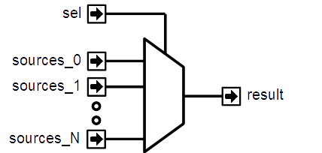
Bundle, Generics, Vec, Packing
case class Color(channelWidth : Int) extends Bundle{ val r = UInt(channelWidth bit) val g = UInt(channelWidth bit) val b = UInt(channelWidth bit) } class ColorSelector(sourceCount : Int,channelWidth: Int) extends Component { val io = new Bundle { val sel = in UInt(log2Up(sourceCount) bits) val sources = in Vec(Color(channelWidth), sourceCount) val result = out Bits (3*channelWidth bit) }
io.result := io.sources(io.sel).asBits }
Notes:
You can define parametrized (or not) data structure by using the Bundle class. Then you can use it where you want, even in component IO !
Sources is a parametrized vector on a paremetrized data structure in a IO definition. In VHDL you can’t.
There is a builtin log2Up function to give how many bit you need to encode a given number of state.
You can pack a data structure into a Bits value, just use the toBits function. (you can unpack to by using «assignFromBits» function)

Slide 21
Memory
//Memory of 1024 Bool val mem = Mem(Bool, 1024) //Write it mem(5) := True //Read it val read0 = mem.readAsync(4) val read1 = mem.readSync(6)

Slide 22
Less scope limitations
val valid = Bool val regA = Reg(UInt(4 bit)) def doSomething(value : Int) = { valid := True regA := value } when(???){ doSomething(4) }
Notes:
In VHDL you can’t create a function that assign combinatoral and sequancial logic

Slide 23
Function, User utils (1)
case class Color(channelWidth: Int) extends Bundle { val r = UInt(channelWidth bit) val g = UInt(channelWidth bit) val b = UInt(channelWidth bit) def +(that: Color): Color = { val result = cloneOf(this) result.r := this.r + that.r result.g := this.g + that.g result.b := this.b + that.b return result } }
Notes:
You can extend a bundle definition with all user function that you want. Here is a example where the plus operator is provided for Color Bundle(with overflow protection).
You can define inner function (channelAdd)
AdderAndCarry return 2 things, the sum of 2 Uint and the carry value. (scala allow return mutiple value in the same type by using Tuple)

Slide 24
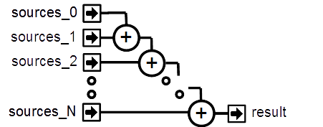
Function, User utils (2)
class ColorSumming(sourceCount: Int, channelWidth: Int) extends Component { val io = new Bundle { val sources = in Vec(sourceCount, Color(channelWidth)) val result = out(Color(channelWidth)) } var sum = io.sources(0) for (i <- 1 until sourceCount) { sum \= sum + io.sources(i) } io.result := sum // But you can do all this stuff by this way // io.result := io.sources.reduce((a,b) => a + b) }
Notes:
Here is a example of a block with N Color input, and a result output that is the sum of all colors by using the precedent slide plus operator.

Slide 25
Basic abstractions
val timeout = Timeout(1000) when(timeout){ //implicit conversion to Bool timeout.clear() //Clear the flag and the internal counter } //Create a counter of 10 states (0 to 9) val counter = Counter(10) counter.clear() //When called it reset the counter. It's not a flag counter.increment() //When called it increment the counter. It's not a flag counter.value //current value counter.valueNext //Next value counter.willOverflow //Flag that indicate if the counter overflow this cycle when(counter === 5){ …}
Notes:
Some basics abstraction are defined in the Spinal Lib.

Slide 26
Flow, Stream
case class Flow[T <: Data](dataType: T) extends Bundle { val valid = Bool val data: T = cloneOf(dataType) } case class Stream[T <: Data](dataType: T) extends Bundle { val valid = Bool val ready = Bool val data: T = cloneOf(dataType) }
val myStreamOfRGB= Stream(RGB(8,8,8))
Notes:
The spinal lib define 3 basics bus for a general usage : Flow, Stream, Fragment. Stream is like each channel of one AXI bus.
Fragment is not really a bus, it’s the concept that you have a big packet of data, and you need to serialize it into multiple fragment. For example a VGA frame buffer where each pixel are one Fragment, or for example a configuration register of 32 bits can be represented by using 4 fragment of 8 bits. You create a «Flow of Fragment of a given dataType» or a «Stream of Fragment of a given dataType».

Slide 27
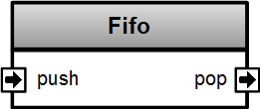
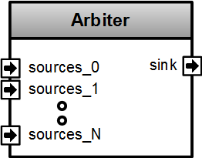
Stream components
class Fifo[T <: Data](dataType: T, depth: Int) extends Component { val io = new Bundle { val push = slave Stream (dataType) val pop = master Stream (dataType) }
//… } class Arbiter[T <: Data](dataType: T, portCount: Int) extends Component { val io = new Bundle { val sources = Vec(slave(Stream(dataType)), portCount) val sink = master(Stream(dataType)) } //... }
Notes:
VHDL => pack/unpack + 2D things packed into a single std_logic_vector

Slide 28
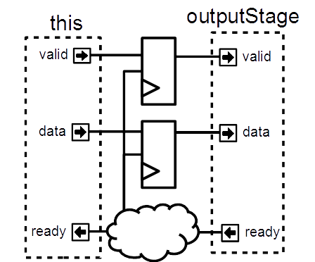
Stream functions
case class Stream[T <: Data](dataType: T) extends Bundle { // ... def connectFrom(that: Stream[T]) = { // some connections between this and that } def m2sPipe(): Stream[T] = { val outputStage = cloneOf(this) val validReg = RegInit(False) val dataReg = Reg(dataType) // some logic return outputStage } def << (that: Stream[T]) = this.connectFrom(that) def <-< (that: Stream[T]) = this << that.m2sPipe() } val myStreamA,myStreamB = Stream(UInt(8 bit)) myStreamA <-< myStreamB
Notes:
In system verilog, even if you can define interface, you can’t define function/task inside it that will generate flops and logic.
This is the breaking point with systemverilog, some application of that will come in next slides

Slide 29
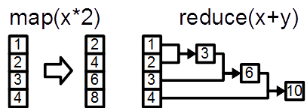
Functional programming
Case class LineTag extends Bundle { val valid = Bool val address = UInt(32 bit) val dirty = Bool def hit(targetAddress : UInt) : Bool = valid && address === targetAddress } val lineTags = Vec(LineTag(), 8) val lineHits = lineTags.map(lineTag => lineTag.hit(targetAddress)) val lineHitValid = lineHits.reduce((a,b) => a || b) val lineHitIndex = OHToUInt(lineHits)
Notes:
VHDL => pack/unpack + 2D things packed into a single std_logic_vector

Slide 30
Scala is here to help you
class SinusGenerator(resolutionWidth : Int,sampleCount : Int) extends Component { val io = new Bundle { val sin = out SInt (resolutionWidth bits) } def sinTable = (0 until sampleCount).map(sampleIndex => { val sinValue = Math.sin(2 * Math.PI * sampleIndex / sampleCount) S((sinValue * ((1 << resolutionWidth) / 2 - 1)).toInt, resolutionWidth bits) }) val rom = Mem(SInt(resolutionWidth bit), initialContent = sinTable) val phase = CounterFreeRun(sampleCount) val sin = rom.readSync(phase) }
Notes:
VHDL => pack/unpack + 2D things packed into a single std_logic_vector

Slide 31
Netlist analyser / Latency analysis
class MyComponentWithLatencyAssert extends Component { val io = new Bundle { val slavePort = slave Stream (UInt(8 bits)) val masterPort = master Stream (UInt(8 bits)) } //These 3 line are equivalent to io.slavePort.queue(16) >/-> io.masterPort val fifo = new StreamFifo((UInt(8 bits)),16) fifo.io.push << io.slavePort // << is a connection operator without decoupling fifo.io.pop >/-> io.masterPort //>/-> is a connection operator with decoupling assert(3 == latencyAnalysis(io.slavePort.data,io.masterPort.data)) assert(2 == latencyAnalysis(io.masterPort.ready,io.slavePort.ready)) }
Notes:
Because spinal build a netlist in the memory, you can use it to extract some information, for example latency (in cycle) between some points of you design.
To do that, call LatencyAnalysis and give to it as argument some the start point, some check point and the end point of you path. It look for the shortest path and return how many cycle there is.

Slide 32
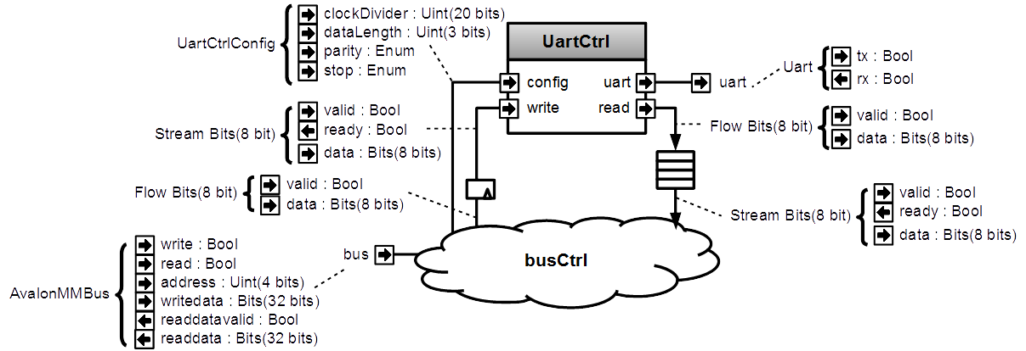
Meta-hardware description

Slide 33
Name | Type | Access | Address | Description
clockDivider | UInt | RW | 0 | Set the UartCtrl clock divider
frame | UartCtrlFrameConfig | RW | 4 | Set the dataLength, the parity and the stop bit configuration
writeCmd | Bits | W | 8 | Send a write command to the UartCtrl
writeBusy | Bool | R | 8 | Bit 0 => zero when a new writeCmd could be sent
read | Bits ## Bool | R | 12 | Bit 0 => read data valid Bit 8 downto 1 => read data

Slide 34
class AvalonUartCtrl(uartCtrlConfig : UartCtrlGenerics, rxFifoDepth : Int) extends Component{ val io = new Bundle{ val bus = slave(AvalonMM(AvalonMMUartCtrl.getAvalonMMConfig)) val uart = master(Uart()) } val uartCtrl = new UartCtrl(uartCtrlConfig) io.uart <> uartCtrl.io.uart val busCtrl = AvalonMMSlaveFactory(io.bus)
//Make clockDivider register busCtrl.driveAndRead(uartCtrl.io.config.clockDivider, address = 0)
//Make frame register busCtrl.driveAndRead(uartCtrl.io.config.frame, address = 4)
//Make writeCmd register val writeFlow = busCtrl.createAndDriveFlow(Bits(uartCtrlConfig.dataWidthMax bits), address = 8) writeFlow.toStream.stage() >> uartCtrl.io.write
//Make writeBusy register busCtrl.read(uartCtrl.io.write.valid, address = 8)
//Make read register busCtrl.readStreamNonBlocking(uartCtrl.io.read.toStream.queue(rxFifoDepth), address = 12) }
Notes:
Apb3SlaveController isn’t a component, it’s a logic generator.
You can call functon on it (writeOnlyReg, writeStream, readStream) and it will generate the corresponding hardware to make the APB bus able to access the given data.
Apb3SlaveController is not something from spinalHDL, it’s something that you as user of the spinalHDL, you can create very easly.

Slide 35
About Scala
Free Scala IDE (eclipse, intelij)
Highlight syntax error
Renaming flexibility
Intelligent auto completion
Code’s structure overview
Navigation tools
Allow you to extend the language
Provide many libraries

Slide 36
Spinal work perfectly on FPGA
RISCV CPU, 5 stages, 1.15 DMIPS/Mhz
MUL/DIV
Instruction/Data cache
Interrupts
JTAG debugging
Avalon/APB UART
Avalon VGA
Pipelined and multi-core fractal accelerator
Notes:
Apb3SlaveController isn’t a component, it’s a logic generator.
You can call functon on it (writeOnlyReg, writeStream, readStream) and it will generate the corresponding hardware to make the APB bus able to access the given data.
Apb3SlaveController is not something from spinalHDL, it’s something that you as user of the spinalHDL, you can create very easly.

Slide 37
About Spinal project
Completely open source :
https://github.com/SpinalHDL/SpinalHDL
Online documentation :
https://spinalhdl.github.io/SpinalDoc/
Ready to use base project :
https://github.com/SpinalHDL/SpinalBaseProject
Communication channels :
spinalhdl@gmail.com
https://gitter.im/SpinalHDL/SpinalHDL
https://github.com/SpinalHDL/SpinalHDL/issues
Notes:
Apb3SlaveController isn’t a component, it’s a logic generator.
You can call functon on it (writeOnlyReg, writeStream, readStream) and it will generate the corresponding hardware to make the APB bus able to access the given data.
Apb3SlaveController is not something from spinalHDL, it’s something that you as user of the spinalHDL, you can create very easly.

Slide 38
?

Slide 39
Component instance
class MySubComponent extends Component{ val io = new Bundle { val subIn = in Bool val subOut = out Bool } ... } class MyComponent extends Component { val io = new Bundle { val a = in Bool val b = in Bool val output = out Bool } val compInstance = new MySubComponent compInstance.io.subIn := io.a io.output := compInstance.io.subOut | io.b }
Notes:
No declaration of components instances io. You directly wire it with «componentInstance.io.XXX»

Slide 40
Flow, Stream, Fragment
case class Flow[T <: Data](dataType: T) extends Bundle { val valid = Bool val data: T = cloneOf(dataType) //.. } case class Stream[T <: Data](dataType: T) extends Bundle { val valid = Bool val ready = Bool val data: T = cloneOf(dataType) //.. } case class Fragment[T <: Data](dataType: T) extends Bundle { val last = Bool val data: T = cloneOf(dataType) //.. }
Notes:
The spinal lib define 3 basics bus for a general usage : Flow, Stream, Fragment. Stream is like each channel of one AXI bus.
Fragment is not really a bus, it’s the concept that you have a big packet of data, and you need to serialize it into multiple fragment. For example a VGA frame buffer where each pixel are one Fragment, or for example a configuration register of 32 bits can be represented by using 4 fragment of 8 bits. You create a «Flow of Fragment of a given dataType» or a «Stream of Fragment of a given dataType».

Slide 41
Stream functions
val cond = Bool val inPort = Stream(Bits(32 bit)) val outPort = Stream(Bits(32 bit)) outPort << inPort outPort <-< inPort outPort </< inPort outPort <-/< inPort val haltedPort = inPort.haltWhen(cond) val filteredPort = inPort.throwWhen(inPort.data === 0) val outPortWithMsb = inPort.translateWith(inPort.data.msb) val mem = Mem(Bool, 1024) val memReadCmd = Stream(UInt(10 bit)) val memReadPort = mem.streamReadSync(memReadCmd, memReadCmd.data) memReadPort.valid //arbitration memReadPort.ready //arbitration memReadPort.data.value //Readed value memReadPort.data.linked //Linked value (memReadCmd.data)
Notes:
By using Stream, some utils are free.
<< is a direct connection
<-< is a connection with flipflop that cut master to slave data path (pipelining)
</< is a connection with flipflop that cut slave to master data path (pipelining)
<-/< is a connection with flipflip that cut all path between the master and the slave (pipelining)
StreamReadSync take as parameter a Stream of address to read, and a « context »
It return a Stream of «readed value and its «context» value»

Slide 42
Flow of Fragment example
case class LogicAnalyserConfig() extends Bundle{ val trigger = new Bundle{ val delay = UInt(32 bit) //... } val logger = new Bundle{ val samplesLeftAfterTrigger = UInt(8 bit) //... } } class LogicAnalyser extends Component { val io = new Bundle { val cfgPort = slave Flow Fragment(Bits(8 bit)) } val waitTrigger = io.cfgPort filterHeader (0x01) toRegOf (Bool) init (False) val userTrigger = io.cfgPort pulseOn (0x02) val configs = io.cfgPort filterHeader (0x0F) toRegOf(LogicAnalyserConfig()) }
Notes:
Here is the example of a hardware logic analyser implementation.
LogicAnalyserConfig define all configs of this logic analyser.
By using the cfgPort, all internal register created/loaded.
filterHeader look the first fragment of each packet. If the value doesn’t match with the parameter, the rest of the packet is not transmited behind
toRegOf translate a packet of Bits into a register of the given dataType
pulseOn emit a one clock pulse if the first fragment of one packet match with the argument

Slide 43
Generator, Logic Analyser
val logicAnalyser = LogicAnalyserBuilder() .setSampleCount(256) .exTrigger(somewhere.inThe.hierarchy.trigger) .probe(somewhere.inThe.hierarchy.signalA) .probe(somewhere.inThe.hierarchy.signalB) .probe(somewhere.signalC) .build val uartCtrl = new UartCtrl() uartCtrl.read >> logicAnalyser.io.slavePort uartCtrl.write << logicAnalyser.io.masterPort
Notes:
In spinal there is a library that provide a hardware logic analyser, like SignalTape II from Altera.
To create one, you can use the LogicAnalyserBuilder, give all your wish and the call build function. It’s a «builder pattern».
As you can see, you can give signals that are somewhere into the hierarchy, Spinal provide the possibility to «pull» each signal throug the design. It’ could be usefull for FPGA design in the developpment phase.

