Slide 1

SpinalHDL
An alternative to standard HDL

Slide 2
Summary
Language introduction / flow
Simple examples
Advanced examples
Meta-hardware description examples

Slide 3
Language introduction
Open source , started in december 2014
Focus on RTL description
Thinked to be interoperable with existing tools
It generate VHDL/Verilog files
It can integrate VHDL/Verilog IP as blackbox
Abstraction level :
You can design things similary to VHDL/Verilog
If you want to, you can use many abstraction utils and also define new ones

Slide 4
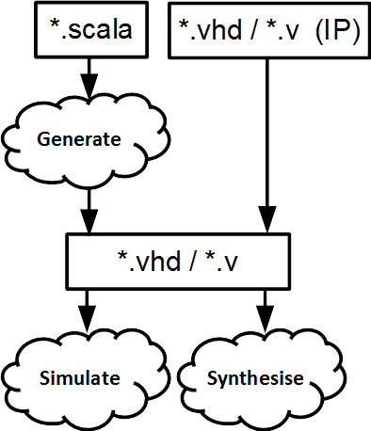
Language flow
Describe your RTL
Generate the VHDL/Verilog
Simulate and synthesize

Slide 5
Some points about Spinal
There is no logic overhead in the generated code. (I swear !)
Spinal HDL is a RTL language. But the generated VHDL/Verilog is simulatable with all standards EDA tools.
The component hierarchy and all names are preserved during the VHDL/Verilog generation.

Slide 6
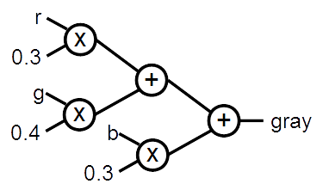

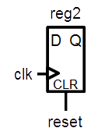
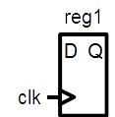

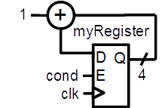
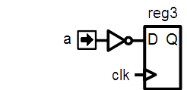
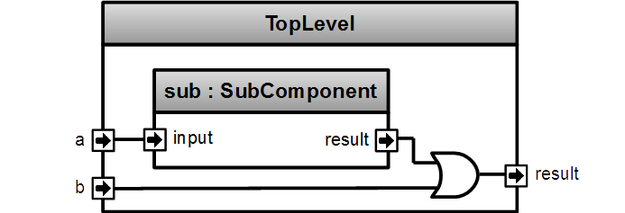
Simple examples

Slide 7
A simple component
class MyComponent extends Component { val io = new Bundle { val a = in Bool val result = out Bool } io.result := io.a }
Notes:
It’s scala, but with some pretty things (in Bool in this case)
New Bundle is the definition of a new datatype, a little bit like records in VHDL or struct in Verilog, but with individual element direction specification
This code wire io.a to io.output

Slide 8
Combinatorial logic
class MyComponent extends Component { val io = new Bundle { val a = in Bool val b = in Bool val c = in Bool val result = out Bool } io.result := (io.a & io.b) | (!io.c) }
Notes:
Like in VHDL you can do combinatorial things.
Anyway you can read the value each out signal, like a VHDL buffer.

Slide 9
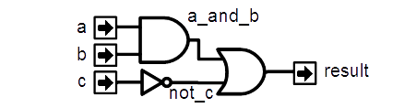
Signals
class MyComponent extends Component { val io = new Bundle { val a = in Bool val b = in Bool val c = in Bool val result = out Bool } val a_and_b = Bool
a_and_b := io.a & io.b
val not_c = ! io.c
io.result := a_and_b | not_c }
Notes:
Declare what you need where you need and directly affect the value that you want (not_c signal).
For example if you don’t assigne a_and_b to any value, spinalHDL tell you.

Slide 10
Generated VHDL
class MyComponent extends Component { val io = new Bundle { val a = in Bool val b = in Bool val c = in Bool val result = out Bool } val a_and_b = io.a & io.b val not_c = !io.c io.result := a_and_b | not_c }
entity MyComponent is port( io_a : in std_logic; io_b : in std_logic; io_c : in std_logic; io_result : out std_logic ); end MyComponent; architecture arch of MyComponent is signal a_and_b : std_logic; signal not_c : std_logic; begin io_result <= (a_and_b or not_c); a_and_b <= (io_a and io_b); not_c <= (not io_c); end arch;
Notes:
As you can see you can avoid the split between the signal declaration and the signal logic.

Slide 11
Registers
class MyComponent extends Component { val io = new Bundle { val a = in Bool } val reg1 = Reg(Bool)
val reg2 = Reg(Bool) init (False)
val reg3 = Reg(Bool) reg3 := ! io.a }
Notes:
You don’t need for each register to specify his clock, it’s implicit (next clock)
There is no process !
Reg1 is a simple register with no reset
Reg2 is a register with a reset value at false
Reg3 is the same than Reg2 with a more compact syntax
Reg4 is a register that take the io.a value at each clock. You can add the init(XXX) to specify a reset value.

Slide 12
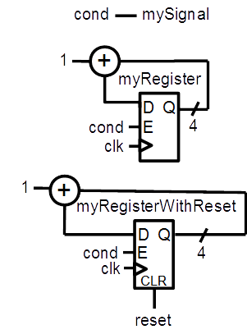
No more Process/Always blocks
val mySignal = Bool val myRegister = Reg(UInt(4 bits)) val myRegisterWithReset = Reg(UInt(4 bits)) init(0) mySignal := False when(cond) { mySignal := True myRegister := myRegister + 1 myRegisterWithReset := myRegisterWithReset + 1 }
Notes:
In VHDL you need to split the logic between combinatoral / sequancial with reset / sequancial without reset

Slide 13
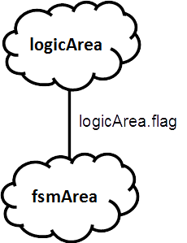
Component internal organisation
class TopLevel extends Component {
//… val logicArea = new Area { val flag = Bool }
val fsmArea = new Area { when(logicArea.flag) {
//…
} } }
Notes:
There is the concept of Area, that allow you to define some sub part into a component. That help you to keep a good structure.
You can use the switch statement to.

Slide 14
Component instance
class SubComponent extends Component{ val io = new Bundle { val input = in Bool val result = out Bool } ... } class TopLevel extends Component { val io = new Bundle { val a = in Bool val b = in Bool val result = out Bool } val sub = new SubComponent sub.io.input := io.a io.result := sub.io.result | io.b }
Notes:
No declaration of components instances io. You directly wire it with «componentInstance.io.XXX»

Slide 15

UInt, Vec, When
class MyComponent extends Component { val io = new Bundle { val conds = in Vec(Bool,2) val result = out UInt(4 bits) } when(io.conds(0)){ io.result := 2 when(io.conds(1)){ io.result := 1 } } otherwise { io.result := 0 } }
Notes:
You can define a array of data elements by using Vec(numberOfElement,dataType)
For hardware conditional blocks, you can use the when(cond){}.elsewhen(cond){}.otherwise {} The dot before the elsewhen is mandatory, but not for the otherwise. It’s because of scala.
N.B. En each when, you can mix assignement of syncronous and asyncronous logic. You don’t have the VHDL process barrier

Slide 16
Enum, Switch
object MyEnum extends SpinalEnum { val state0, state1 = newElement() } class MyComponent extends Component { val state = Reg(MyEnum) init(MyEnum.state0)
switch(state) { is(MyEnum.state0) { } is(MyEnum.state1) { } default{ } } }
Notes:
There is the concept of Area, that allow you to define some sub part into a component. That help you to keep a good structure.
You can use the switch statement to.

Slide 17
For, Variable, Generics
class CarryAdder(size: Int) extends Component { val io = new Bundle { val a = in UInt (size bits) val b = in UInt (size bits) val result = out UInt (size bits) } var c = False for (i <- 0 until size) { val x = io.a(i) val y = io.b(i) io.result(i) := x ^ y ^ c c \= (x & y) | (x & c) | (y & c); } }
Notes:
This component has a construction parameter (size). It’s like generics in VHDL.
The carry adder use a carry variable (c) . Variable in spinal play with scala var.
If you totaly override the value of the variable, you can use the = assignement.
If you do a incremental assignement, (for example a conditional (when) assignement), you must use the \= assignement operator.
You can declare intermediate value (a,b) in the for. It’s as you want.

Slide 18

Latch/Loop
val a = Bool val result = Bool
result := a | result //Loop detected
val result = Bool
when(cond){ //result is not assigned in all cases => Latch detected result := True }
Notes:
Spinal check if there is combinatorial loop and print a error when one is detected.

Slide 19
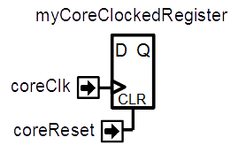
ClockDomains
class MyTopLevel extends Component { val io = new Bundle { val coreClk = in Bool val coreReset = in Bool }
val coreClockDomain = ClockDomain( clock = io.coreClk, reset = io.coreReset, config = ClockDomainConfig( clockEdge = RISING, resetKind = ASYNC, resetActiveLevel = HIGH ) ) val coreArea = new ClockingArea(coreClockDomain) { val myCoreClockedRegister = Reg(UInt(4 bit)) //... } }

Slide 20
Memory
//Memory of 1024 Bool val syncRam = Mem(Bool, 1024) val asyncRam = Mem(Bool, 1024) //Write them syncRam(5) := True asyncRam(5) := True //Read them val syncRam = mem.readSync(6) val asyncRam = mem.readAsync(4)

Slide 21
Function
// Input RGB color val r,g,b = UInt(8 bits) // Define a function to multiply a UInt by a scala Float value. def coefMul(value : UInt,by : Float) : UInt = (value * U((255*by).toInt,8 bits) >> 8) //Calculate the gray level val gray = coefMul(r, 0.3f) + coefMul(g, 0.4f) + coefMul(b, 0.3f)
Notes:
In VHDL you can’t create a function that assign combinatoral and sequancial logic

Slide 22
Function, User utils (1)
case class Color(channelWidth: Int) extends Bundle { val r,g,b = UInt(channelWidth bits) def +(that: Color): Color = { val result = Color(channelWidth)
result.r := this.r + that.r result.g := this.g + that.g result.b := this.b + that.b return result } }
Notes:
You can extend a bundle definition with all user function that you want. Here is a example where the plus operator is provided for Color Bundle(with overflow protection).
You can define inner function (channelAdd)
AdderAndCarry return 2 things, the sum of 2 Uint and the carry value. (scala allow return mutiple value in the same type by using Tuple)

Slide 23
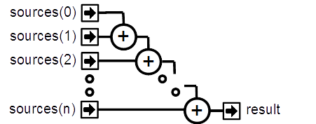
Function, User utils (2)
class ColorSumming(sourceCount : Int, channelWidth : Int) extends Component { val io = new Bundle { val sources = in Vec(Color(channelWidth), sourceCount) val result = out(Color(channelWidth)) } var sum = io.sources(0) for (i <- 1 until sourceCount) { sum \= sum + io.sources(i) } io.result := sum }
Notes:
Here is a example of a block with N Color input, and a result output that is the sum of all colors by using the precedent slide plus operator.

Slide 24
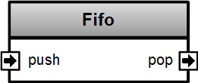
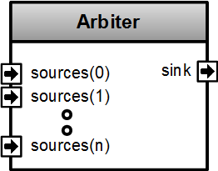
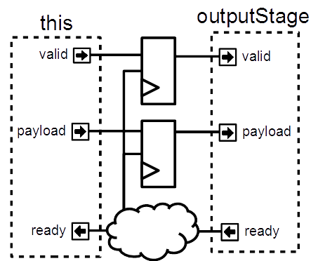
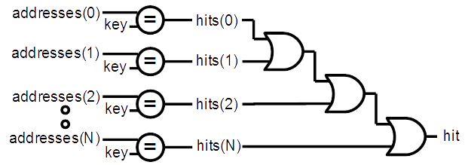
Advanced examples

Slide 25
Functional programming
val addresses = Vec(UInt(8 bits),4) val key = UInt(8 bits) val hits = addresses.map(address => address === key) val hit = hits.reduce((a,b) => a || b)

Slide 26
Basic abstractions
val timeout = Timeout(1000) when(timeout){ //implicit conversion to Bool timeout.clear() //Clear the flag and the internal counter } //Create a counter of 10 states (0 to 9) val counter = Counter(10) counter.clear() //When called it reset the counter. It's not a flag counter.increment() //When called it increment the counter. It's not a flag counter.value //current value counter.valueNext //Next value counter.willOverflow //Flag that indicate if the counter overflow this cycle when(counter === 5){ …}
Notes:
Some basics abstraction are defined in the Spinal Lib.

Slide 27
Flow, Stream
case class Flow[T <: Data](payloadType: T) extends Bundle { val valid = Bool val payload : T = payloadType.clone() } case class Stream[T <: Data](payloadType: T) extends Bundle { val valid = Bool val ready = Bool val payload : T = payloadType.clone() }
val myStreamOfRGB= Stream(RGB(8,8,8))

Slide 28
Stream components
class Fifo[T <: Data](payloadType: T, depth: Int) extends Component { val io = new Bundle { val push = slave Stream (payloadType) val pop = master Stream (payloadType) }
//… } class Arbiter[T <: Data](payloadType: T, portCount: Int) extends Component { val io = new Bundle { val sources = Vec(slave(Stream(payloadType)), portCount) val sink = master(Stream(payloadType)) } //... }

Slide 29
Stream functions
case class Stream[T <: Data](payloadType: T) extends Bundle { // ... def connectFrom(that: Stream[T]) = { // some connections between this and that } def stage(): Stream[T] = { val outputStage = Stream(dataType) val validReg = RegInit(False) val payloadReg = Reg(payloadType) // some logic return outputStage } def << (that: Stream[T]) = this.connectFrom(that) def <-< (that: Stream[T]) = this << that.stage() } val myStreamA,myStreamB = Stream(UInt(8 bits)) myStreamA <-< myStreamB
Notes:
In system verilog, even if you can define interface, you can’t define function/task inside it that will generate flops and logic.
This is a breaking point with systemverilog, some application of that will come in next slides

Slide 30
Scala is here to help you
class SinusGenerator(resolutionWidth : Int,sampleCount : Int) extends Component { val io = new Bundle { val sin = out SInt (resolutionWidth bits) } def sinTable = (0 until sampleCount).map(sampleIndex => { val sinValue = Math.sin(2 * Math.PI * sampleIndex / sampleCount) S((sinValue * ((1 << resolutionWidth) / 2 - 1)).toInt, resolutionWidth bits) }) val rom = Mem(SInt(resolutionWidth bits), initialContent = sinTable) val phase = CounterFreeRun(sampleCount) io.sin := rom.readSync(phase) }

Slide 31
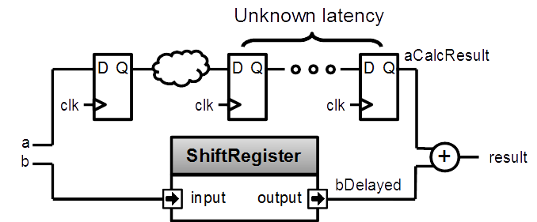
Design introspection
val a = UInt(8 bits) val b = UInt(8 bits) val aCalcResult = complicatedLogic(a) val aCalcResultLatency = LatencyAnalysis(a,aCalcResult) val bDelayed = Delay(b,cycleCount = aCalcResultLatency) val result = aCalcResult + bDelayed
Notes:
Because spinal build a netlist in the memory, you can use it to extract some information, for example latency (in cycle) between some points of you design.
To do that, call LatencyAnalysis and give to it as argument some the start point, some check point and the end point of you path. It look for the shortest path and return how many cycle there is.

Slide 32
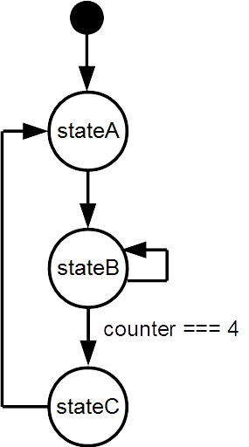
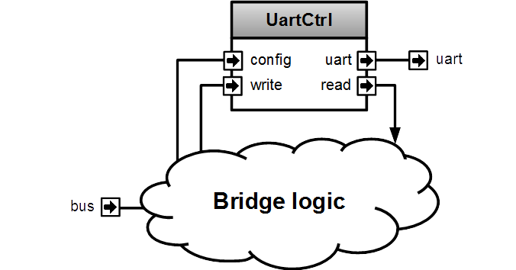
Meta-hardware description examples

Slide 33
FSM
They could be defined with regular syntax (Enum,Switch)
You can also use a much more friendly syntax, fully integrated, with following features :
onEntry / onExit / whenIsActive / whenIsNext blocs
State with inner FSM
State with multiple inner FSM (parallel execution)
Delay state
You can extends the syntax by defining new state types

Slide 34
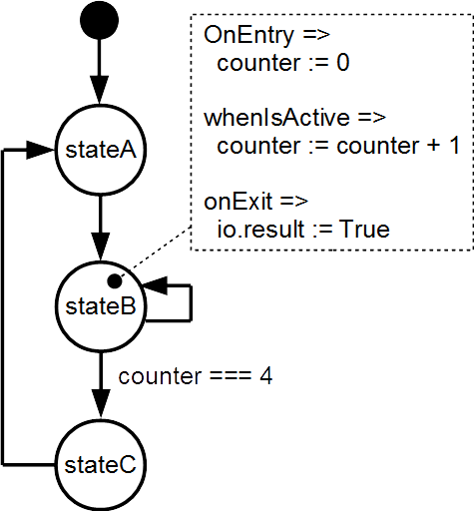
FSM style A
val fsm = new StateMachine{ io.result := False val counter = Reg(UInt(8 bits)) init (0)
val stateA : State = new State with EntryPoint{ whenIsActive (goto(stateB)) }
val stateB : State = new State{ onEntry(counter := 0) whenIsActive { counter := counter + 1 when(counter === 4){ goto(stateC) } } onExit(io.result := True) }
val stateC : State = new State{ whenIsActive (goto(stateA)) } }
val io = new Bundle{ val result = out Bool }

Slide 35
FSM style B
val fsm = new StateMachine{ val stateA = new State with EntryPoint val stateB = new State val stateC = new State val counter = Reg(UInt(8 bits)) init (0) io.result := False stateA .whenIsActive (goto(stateB)) stateB .onEntry(counter := 0) .whenIsActive { counter := counter + 1 when(counter === 4){ goto(stateC) } } .onExit(io.result := True) stateC .whenIsActive (goto(stateA)) }
val io = new Bundle{ val result = out Bool }

Slide 36
Bus Slave Factory
Imagine you want to control an UART controller from a bus (for example AMBA-APB), you will have to implement a “bridge logic”.

Slide 37
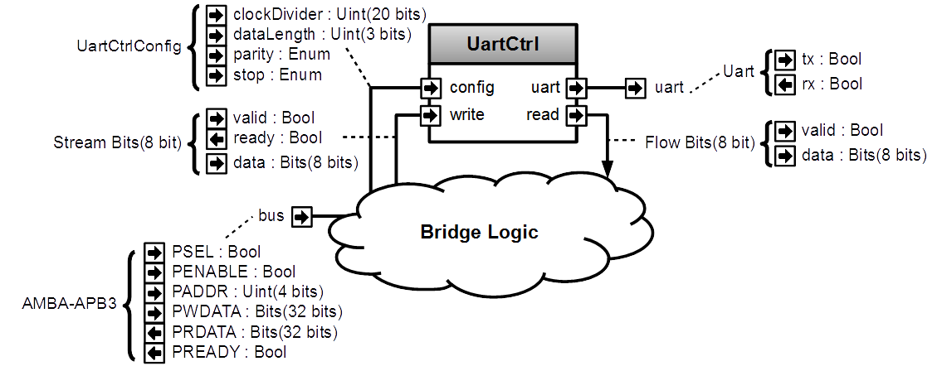
Bus Slave Factory
Let’s detail the situation

Slide 38
Bus Slave Factory
IO / instances / direct connections
class Apb3UartCtrl(rxFifoDepth : Int) extends Component { val io = new Bundle { val bus = slave(Apb3(addressWidth = 4, dataWidth = 32)) val uart = master(Uart()) } // Instantiate an simple UART controller val uartCtrl = new UartCtrl() //Connect its UART bus io.uart <> uartCtrl.io.uart //Here we have to implement the “bridge logic”.
//All the code of next slides should be inserted there
//…
}

Slide 39
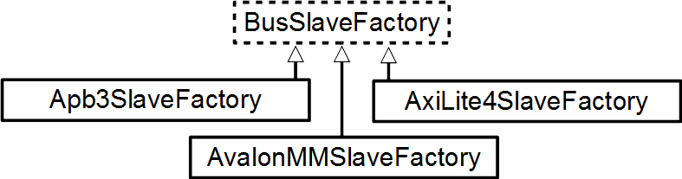
Bus Slave Factory
Apb3SlaveFactory is able to create some “bridge logic” by using an abstract way. Let’s use it !
val busCtrl = Apb3SlaveFactory(io.bus)

Slide 40
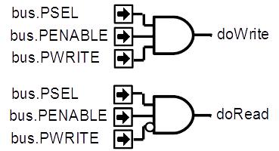
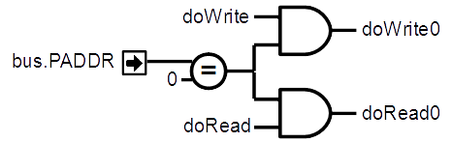
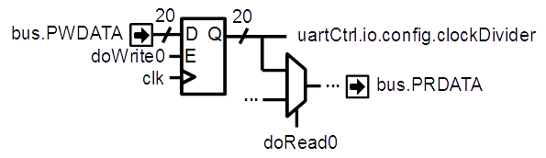
Bus Slave Factory
Make the clockDivider readable/writable by the bus
// Ask the busCtrl to create a readable/writable register at the address 0 // and drive uartCtrl.io.config.clockDivider with this register busCtrl.driveAndRead(uartCtrl.io.config.clockDivider,address = 0)

Slide 41
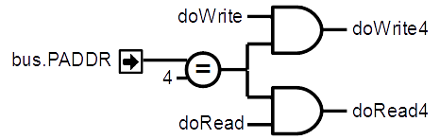
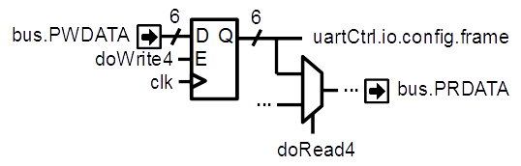
Bus Slave Factory
Make the frame config readable/writable by the bus
// Do the same thing than previously but for uartCtrl.io.config.frame at the address 4 busCtrl.driveAndRead(uartCtrl.io.config.frame,address = 4)

Slide 42

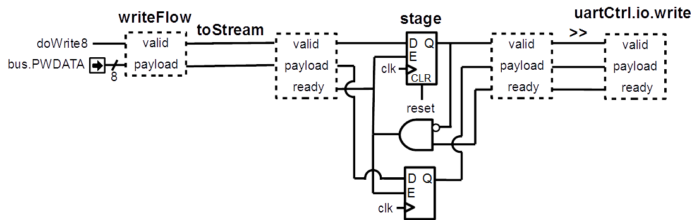
Bus Slave Factory
Allow the bus to emit UART write requests
// Ask the busCtrl to create a writable Flow[Bits] (valid/payload) at the address 8. // Then convert it into a stream, add a register register stage and connect it to the uartCtrl.io.write
val writeFlow = busCtrl.createAndDriveFlow(Bits(8 bits),address = 8) writeFlow.toStream.stage >> uartCtrl.io.write

Slide 43

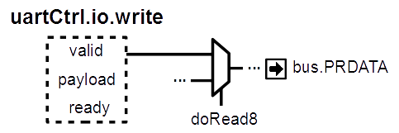
Bus Slave Factory
Allow the bus to get the occupancy of the write buffer
// To avoid losing writes commands between the Flow to Stream transformation just above, // make the occupancy of the uartCtrl.io.write readable at address 8 busCtrl.read(uartCtrl.io.write.valid,address = 8)

Slide 44

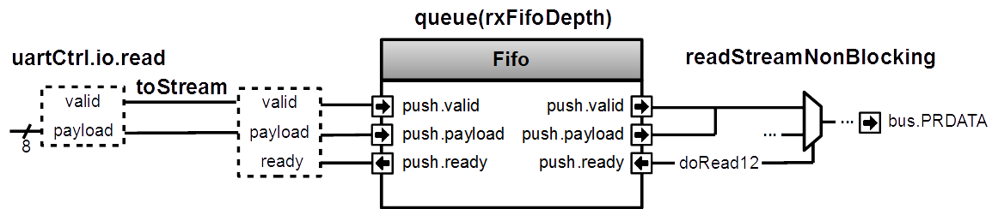
Bus Slave Factory
Allow the bus to read received UART frames through a FIFO
// Take uartCtrl.io.read, convert it into a Stream, then connect it to the input of a FIFO // Then make the output of the FIFO readable at the address 12 by using a non blocking protocol // (bit 31 => data valid, bits 7 downto 0 => data) val readStream = uartCtrl.io.read.toStream.queue(rxFifoDepth) busCtrl.readStreamNonBlocking(readStream,address = 12,validBitOffset = 31,payloadBitOffset = 0)

Slide 45
About FSM and Apb3SlaveFactory
Both aren’t part of Spinal core but are implemented on the top of it in the Spinal lib. Which mean these tools were created without any special interaction or special knowledge of the Spinal compiler.
They are only a mix of Scala OOP/FP with some Spinal basic syntax to generate the right hardware !

Slide 46
About Scala
Free Scala IDE (eclipse, intelij)
Highlight syntax error
Renaming flexibility
Intelligent auto completion
Code’s structure overview
Navigation tools
Allow you to extend the language
Provide many libraries

Slide 47
Spinal work perfectly on FPGA
RISCV CPU, 5 stages, 1.15 DMIPS/Mhz
MUL/DIV
Instruction/Data cache
Interrupts
JTAG debugging
Avalon/APB UART
Avalon VGA
Pipelined and multi-core fractal accelerator

Slide 48
About Spinal project
Completely open source :
https://github.com/SpinalHDL/SpinalHDL
Online documentation :
https://spinalhdl.github.io/SpinalDoc/
Ready to use base project :
https://github.com/SpinalHDL/SpinalBaseProject
Communication channels :
spinalhdl@gmail.com
https://gitter.im/SpinalHDL/SpinalHDL
https://github.com/SpinalHDL/SpinalHDL/issues

Slide 49
End / reserve slides

Slide 50
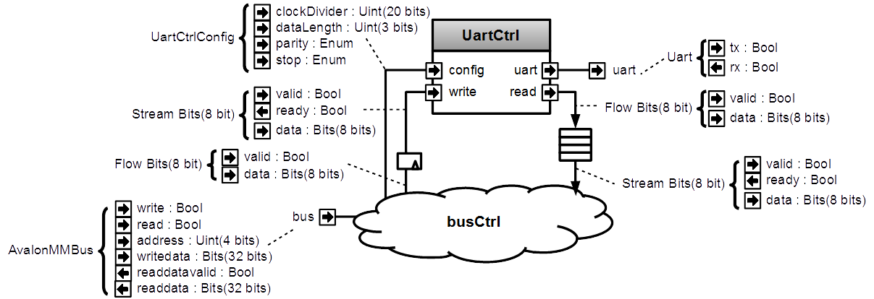
Meta-hardware description

Slide 51
Name | Type | Access | Address | Description
clockDivider | UInt | RW | 0 | Set the UartCtrl clock divider
frame | UartCtrlFrameConfig | RW | 4 | Set the dataLength, the parity and the stop bit configuration
writeCmd | Bits | W | 8 | Send a write command to the UartCtrl
writeBusy | Bool | R | 8 | Bit 0 => zero when a new writeCmd could be sent
read | Bool / Bits | R | 12 | Bit 7 downto 0 => fifo pop payload Bit 31 => fifo pop valid

Slide 52
class AvalonUartCtrl(uartCtrlConfig : UartCtrlGenerics, rxFifoDepth : Int) extends Component{ val io = new Bundle{ val bus = slave(AvalonMM(…)) val uart = master(Uart()) } val uartCtrl = new UartCtrl(uartCtrlConfig) io.uart <> uartCtrl.io.uart val busCtrl = AvalonMMSlaveFactory(io.bus)
//Make clockDivider register busCtrl.driveAndRead(uartCtrl.io.config.clockDivider, address = 0)
//Make frame register busCtrl.driveAndRead(uartCtrl.io.config.frame, address = 4)
//Make writeCmd register val writeFlow = busCtrl.createAndDriveFlow(Bits(uartCtrlConfig.dataWidthMax bits), address = 8) writeFlow.toStream.stage() >> uartCtrl.io.write
//Make writeBusy register busCtrl.read(uartCtrl.io.write.valid, address = 8)
//Make read register busCtrl.readStreamNonBlocking(uartCtrl.io.read.toStream.queue(rxFifoDepth),
address = 12,validBitOffset = 31,payloadBitOffset = 0) }

