Slide 1
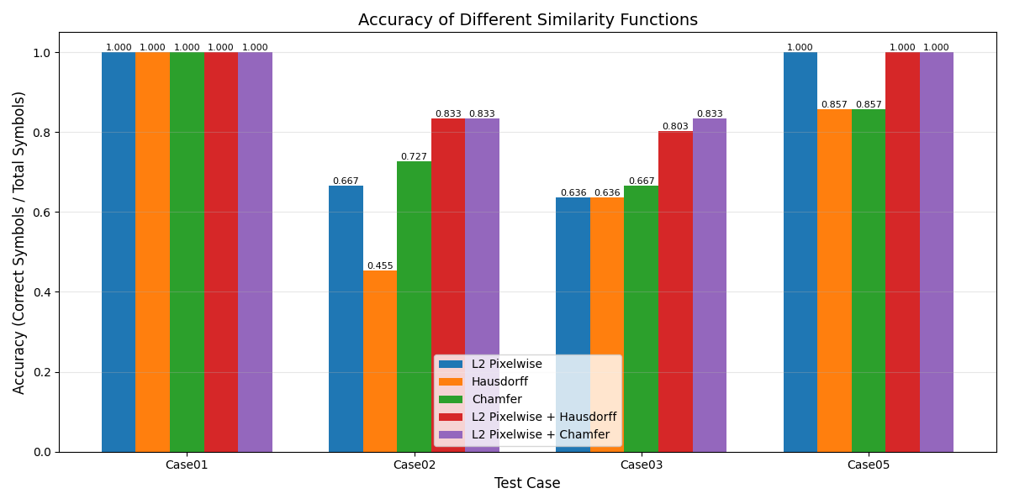
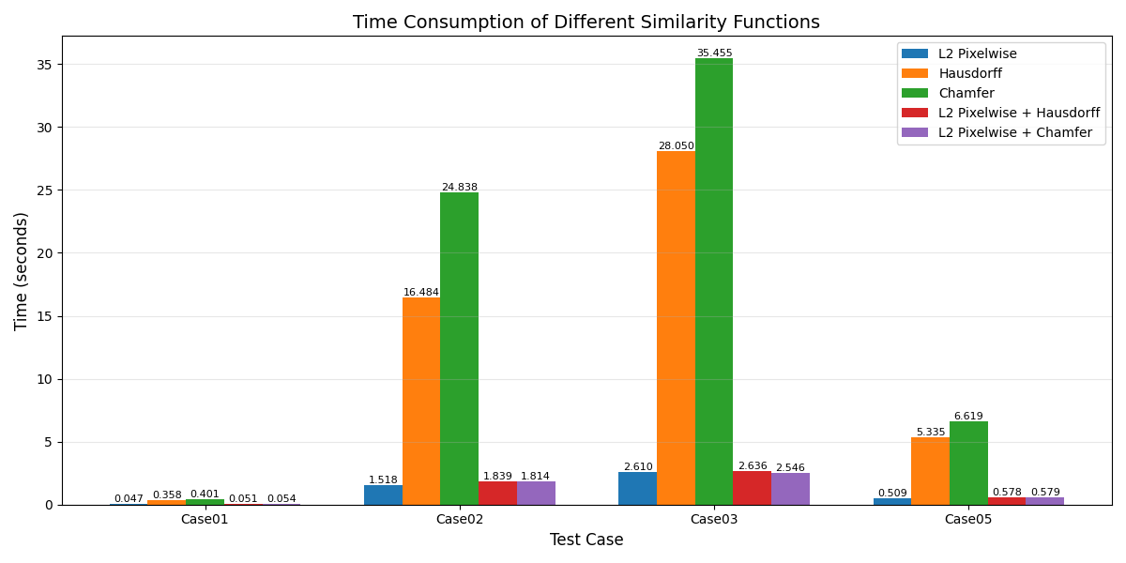

Robust Mathematical Symbol Recognition via Metric-Based Template Matching
Yu-Hsiang Chan, Kuan-Ting Wu, Hui-Yu Chou
① The Study
② Findings
🧩
Problem: Converting math images to LaTeX is hard due to 2D structure, fragmented symbols, and large character sets. Classical CCA fails when strokes break (e.g., ∫) or multi-part glyphs separate (e.g. i, ÷, ≈).
Hybrid metrics yield the best trade-off: L2 filters quickly, Chamfer handles fragmentation, and together they deliver higher accuracy with far lower latency.
⚙️
Solution: An Adaptive Recursive Clustering framework that re-groups components using recognition-driven feedback instead of static segmentation.
L2 + Chamfer achieves the highest accuracy
📐
Core Theory: Similarity is evaluated in a normalized metric space using L2, Hausdorff, and Chamfer measures.
📚
Gap: Little research compares these metrics inside a recursive clustering loop.
🎯
Objective: Identify which metric best guides reconstruction of fragmented math symbols, with the hypothesis that Chamfer is most robust.
Hybrid metrics cut computation time by using L2 as a fast pre-filter
③ Research in context
Before this study
Added value
Implications
Rule-based Math-OCR lacked reliable handling of fragmented symbols and had no metric-level performance comparison.
We benchmarked L2, Hausdorff, and Chamfer inside an adaptive clustering pipeline across desktop and mobile hardware.
Hybrid metrics—especially L2 + Chamfer—offer accurate, light-weight, and mobile-feasible recognition of complex math symbols.
Key limitation: Sensitive to poor image quality, rotation, and noise, and template matching does not scale efficiently to larger symbol libraries without advanced indexing.

