Slide 1
Introduction

Slide 2
Definition of information retrieval
Information retrieval (IR) is finding material (usually documents) of an unstructured nature (usually text) that satisfies an information need within large collections (usually stored on computers)

Slide 3
Structured vs unstructured data
Structured data : information in “tables”
Employee
Manager
Salary
Smith
Jones
50000
Chang
Smith
60000
Ivy
Smith
50000
Typically allows numerical range and exact match
(for text) queries, e.g.,
Salary < 60000 AND Manager = Smith.

Slide 4
Unstructured data
Typically refers to free text
Allows
  Keyword-based queries including operators
  More sophisticated “concept” queries, e.g.,
    find all web pages dealing with drug abuse

Slide 5
Semi-structured data
In fact almost no data is “unstructured”
E.g., this slide has distinctly identified zones such as the Title and Bullets
    … to say nothing of linguistic structure
Facilitates “semi-structured” search such as
  Title contains data AND Bullets contain search
Or even
  Title is about Object Oriented Programming AND Author something like stro*rup
  where * is the wild-card operator

Slide 6
Ultimate Focus of IR
Satisfying user information need
  Emphasis is on retrieval of information (not data)
Predicting which documents are relevant, and then linearly ranking them.
Notes:
facetious

Slide 7
Basic assumptions of Information Retrieval
Collection: Fixed set of documents
Goal: Retrieve documents with information that is relevant to user’s information need and helps him complete a task
SIGIR 2005

Slide 8
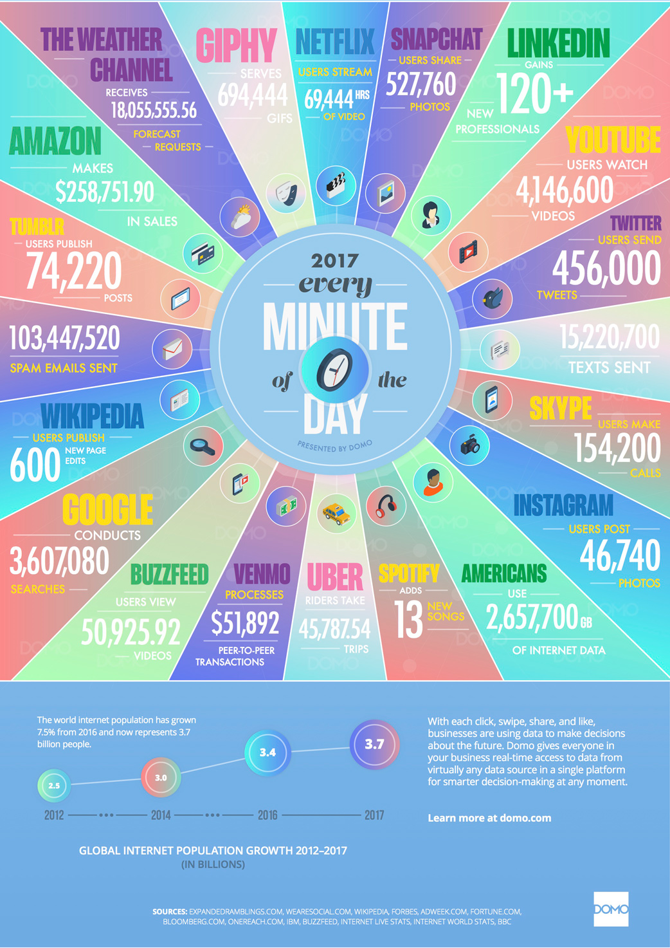

Slide 9
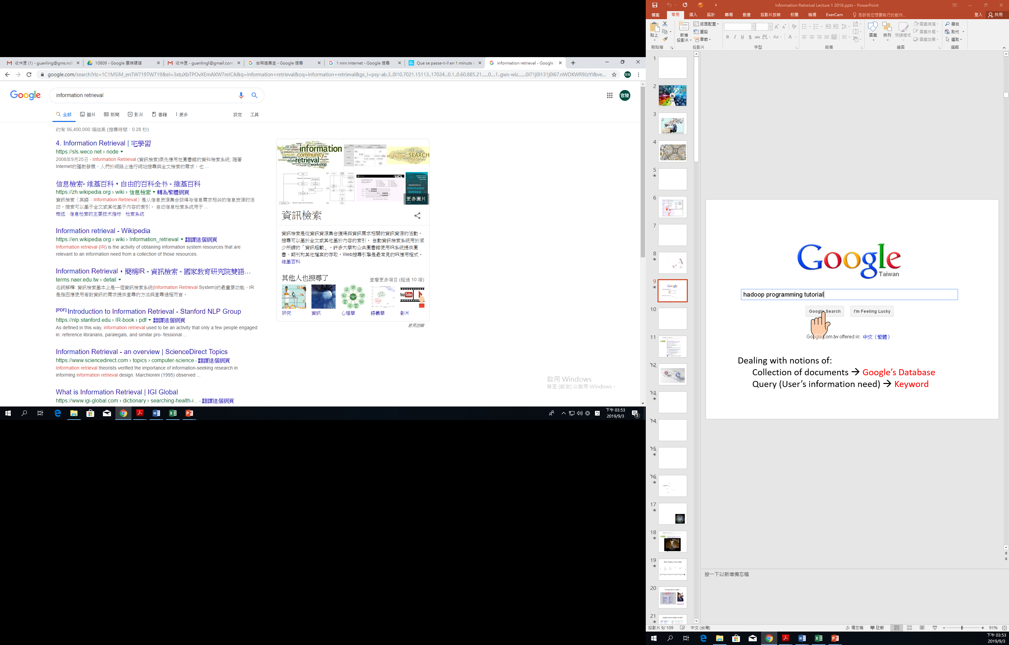
Efficiency
Effectiveness
Scalability

Slide 10
Topics
Basic concepts I
  Boolean Retrieval
  Inverted index
  Determine the vocabulary of terms
  Dictionary
    Index
    Tolerant retrieval
ch1 ch2 ch3

Slide 11

Topics
Basic concepts II
  Index construction
  Index compression
    Dictionary compression
    Posting compression
Basic concept III
  Vector space model
    Tf-idf
  Rank the results
    Scores computing
ch4 ch5
ch6 ch7

Slide 12
Topics
Evaluation in IR
  Precision, Recall, …
  Evaluation of unranked and ranked results
Relevance feedback and query expansion
ch8
ch9

Slide 13

Topics
Ch13 14 16 17
Construct topic directories automatically
  Topic directories
    In 1994, Jerry Yang and David Filo, Ph.D. students at Stanford University, created the yahoo! Directory to help their friends locate useful Web sites.
  Topic directories built with human effort raise a question
    Can they be constructed automatically out of an amorphous corpus of web pages?
  Clustering and classification!

Slide 14
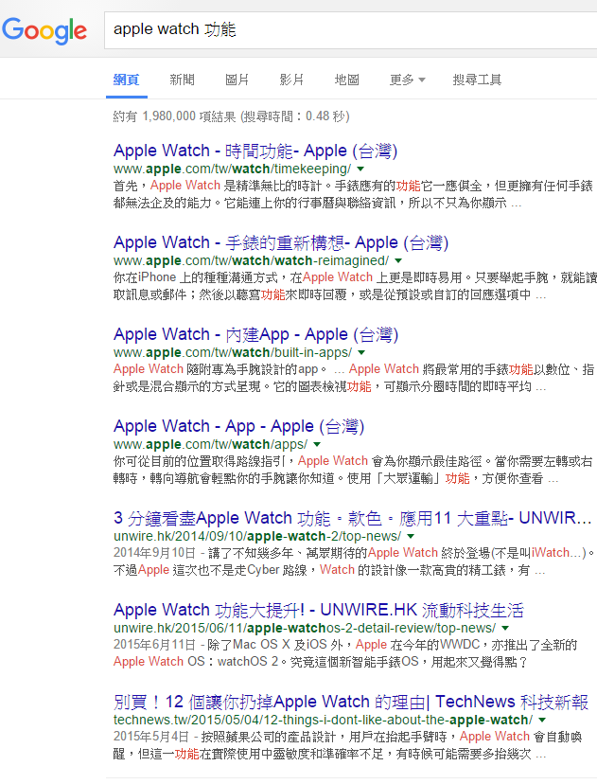
Topics
Ch 19~21
Hyperlink Analysis
  Relevance-ranking techniques from classic IR were not sufficient for web searching.
    Web queries were very short (two to three terms) compared with IR benchmark (dozens of terms).
    Sometimes missed the best responses because there was no direct keyword match.
  Take advantage of the structure of the Web graph
    Link structure of hypertext graph analysis

