Slide 1
Data Mining:
Concepts and Techniques
— Chapter 2 —
Jiawei Han, Micheline Kamber, and Jian Pei
University of Illinois at Urbana-Champaign
Simon Fraser University
©2011 Han, Kamber, and Pei. All rights reserved.

Slide 2
Chapter 2: Getting to Know Your Data
Data Objects and Attribute Types
Basic Statistical Descriptions of Data
Measuring Data Similarity and Dissimilarity
Summary

Slide 3
Data Objects
Data sets are made up of data objects.
A data object represents an entity.
Examples:
  sales database: customers, store items, sales
  medical database: patients, treatments
  university database: students, professors, courses
Data objects are described by attributes.
Database rows -> data objects; columns ->attributes.

Slide 4
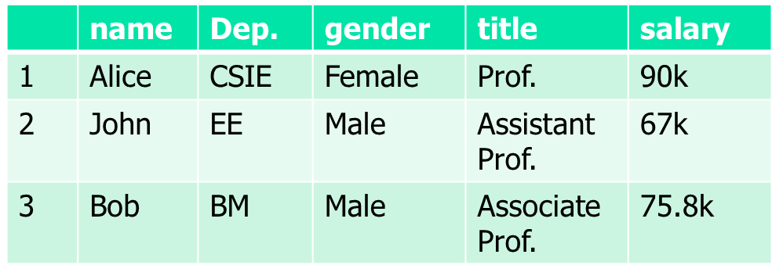
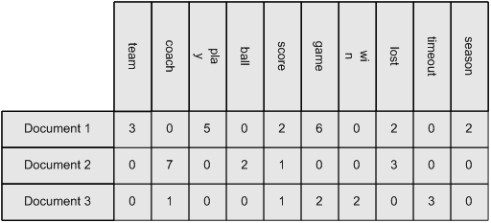
Data Objects

Slide 5
Discrete vs. Continuous Attributes
Discrete Attribute
  Has only a finite or countably infinite set of values
    E.g., zip codes, profession, or the set of words in a collection of documents
  Sometimes, represented as integer variables
  Note: Binary attributes are a special case of discrete attributes
Continuous Attribute
  Has real numbers as attribute values
    E.g., temperature, height, or weight
  Practically, real values can only be measured and represented using a finite number of digits
  Continuous attributes are typically represented as floating-point variables

Slide 6
HIV testing
  {Positive, Negative}
Genders
  {Male, Female}
Department
  {CS, EE, Math, BM}
Number of observations
  X : {1, 2, 3, 4, 5,……}
Height
  {x: x is a number, 0<x<272}
discrete
continuous

Slide 7



Attributes
Attribute (or dimensions, features, variables): a data field, representing a characteristic or feature of a data object.
Types:
  Nominal
  Binary
  Ordinal
  Numeric: quantitative
    Interval-scaled
    Ratio-scaled
 | name | Dep. | gender | title | salary
1 | Alice | CSIE | Female | Prof. | 90k
2 | John | EE | Male | Assistant Prof. | 67k
3 | Bob | BM | Male | Associate Prof. | 75.8k

Slide 8
Attribute Types
D₁ | 1 | 1 | 0 | 0 | 0 | 0 | 0 | 0 | 0 | 0 | 0
D₂ | 1 | 1 | 1 | 1 | 1 | 1 | 1 | 0 | 0 | 0 | 0
D₃ | 0 | 0 | 0 | 0 | 1 | 0 | 0 | 0 | 0 | 0 | 0
Nominal: categories, states, or “names of things”
  Hair_color = {auburn, black, blond, brown, grey, red, white}
Binary
  Nominal attribute with only 2 states (0 and 1)
  Symmetric binary: both outcomes equally important
    e.g., gender
  Asymmetric binary: outcomes not equally important.
    e.g., medical test (positive vs. negative)
    Convention: assign 1 to most important outcome (e.g., HIV positive)
Ordinal
  Values have a meaningful order (ranking) but magnitude between successive values is not known.
  Size = {small, medium, large}, grades, army rankings

Slide 9
Numeric Attribute Types
Quantity (integer or real-valued)
Interval
    Measured on a scale of equal-sized units
    Values have order
      E.g., temperature in C˚or F˚, calendar dates
Ratio
  A positive measurement on a nonlinear scale, approximately at exponential scale, such as Ae^{Bt} or Ae^{-Bt}
    Bacteria population, decay of radioactive element
      Ex: 1, 2, 4, 8, 16, 32, 64, 128, 256…

Slide 10
Chapter 2: Getting to Know Your Data
Data Objects and Attribute Types
Basic Statistical Descriptions of Data
Measuring Data Similarity and Dissimilarity
Summary

Slide 11
Basic Statistical Descriptions of Data
Motivation
  To better understand the data: central tendency, variation and spread
Data dispersion characteristics
  median, max, min, quantiles, outliers, variance, etc.

Slide 12
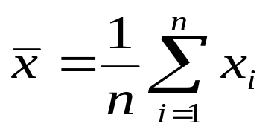


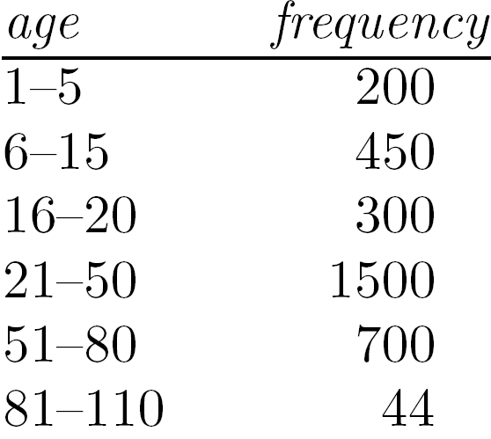
Measuring the Central Tendency
Mean (algebraic measure) (sample vs. population):
  Note: n is sample size and N is population size.
  Weighted arithmetic mean:
  Trimmed mean: chopping extreme values
Median:
  Middle value if odd number of values, or average of the middle two values otherwise
Mode
  Value that occurs most frequently in the data
  Unimodal, bimodal, trimodal

Slide 13



Symmetric vs. Skewed Data
Median, mean and mode of symmetric, positively and negatively skewed data
symmetric
positively skewed
negatively skewed
Data Mining: Concepts and Techniques

Slide 14
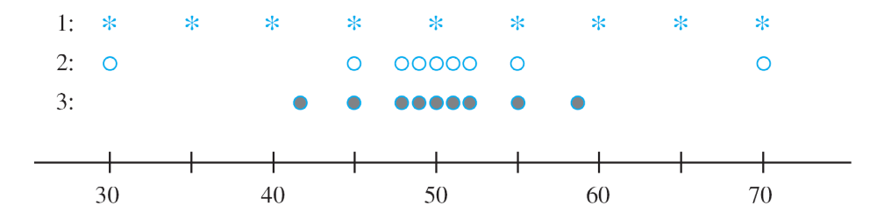
Measures of Variability
Reporting a measure of center gives only partial information about a data set or distribution.
Different samples or populations may have identical measures of center yet differ from one another in other important ways.
Samples with identical measures of center but different amounts of variability

Slide 15


Measuring the Dispersion of Data
Variance and standard deviation (sample: s, population: σ)
  Variance: (algebraic, scalable computation)
  Standard deviation s (or σ) is the square root of variance s² ⁽or σ²⁾
Quartiles, outliers and boxplots
  Quartiles: Q₁ (25th percentile), Q₃ (75th percentile)
  Inter-quartile range: IQR = Q₃ – Q₁
  Five number summary: min, Q₁, median, Q₃, max
  Boxplot: ends of the box are the quartiles; median is marked; add whiskers, and plot outliers individually
  Outlier: usually, a value higher/lower than 1.5 x IQR

Slide 16
Graphic Displays of Basic Statistical Descriptions
Boxplot: graphic display of five-number summary
Histogram: x-axis are values, y-axis repres. frequencies
Quantile plot: each value x_{i} is paired with f_{i} indicating that approximately 100 f_{i} % of data are ≤ x_{i}
Quantile-quantile (q-q) plot: graphs the quantiles of one univariant distribution against the corresponding quantiles of another
Scatter plot: each pair of values is a pair of coordinates and plotted as points in the plane

Slide 17
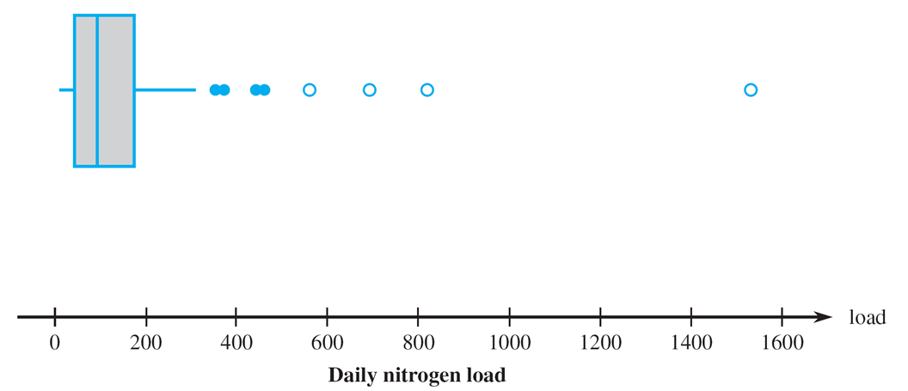
Boxplot

Slide 18
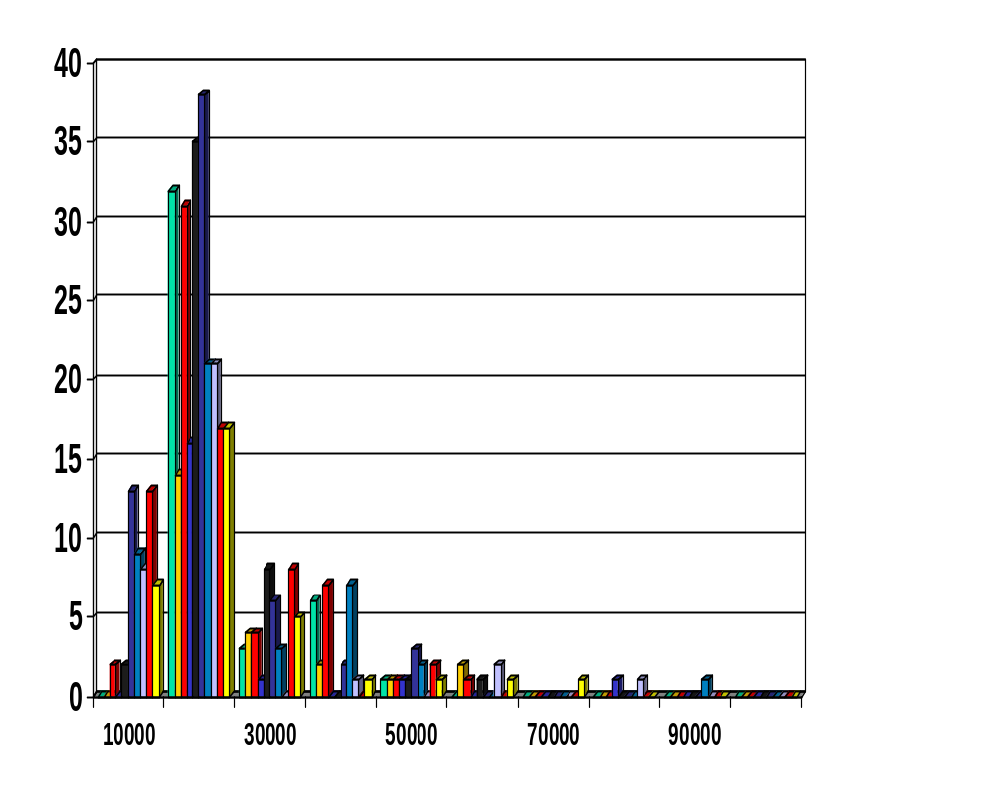
Histogram Analysis
Histogram: Graph display of tabulated frequencies, shown as bars
The categories are usually specified as non-overlapping intervals of some variable. The categories (bars) must be adjacent
Class width
  Equal class width
  Unequal class width

Slide 19
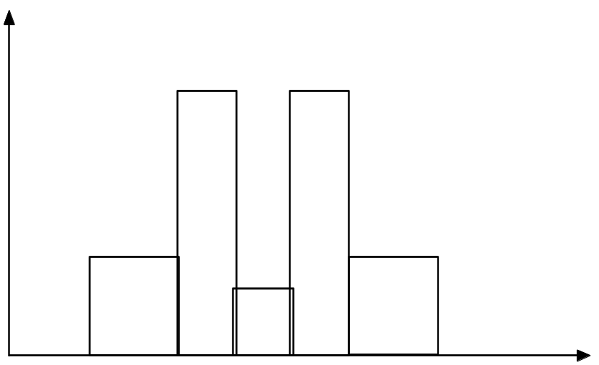
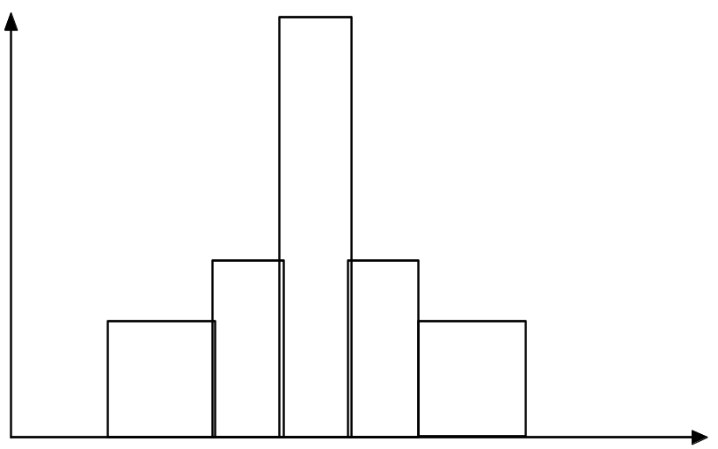
Histograms Often Tell More than Boxplots
The two histograms shown in the left may have the same boxplot representation
  The same values for: min, Q1, median, Q3, max
But they have rather different data distributions

Slide 20
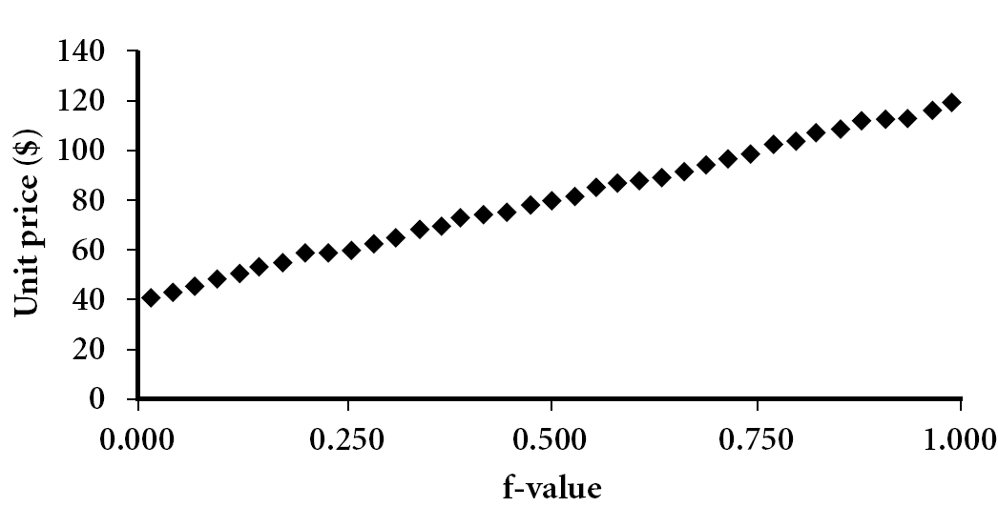
Quantile Plot
Displays all of the data (allowing the user to assess both the overall behavior and unusual occurrences)
Plots quantile information
  For a data x_{i} data sorted in increasing order, f_{i} indicates that approximately 100 f_{i}% of the data are below or equal to the value x_{i}
Data Mining: Concepts and Techniques

Slide 21
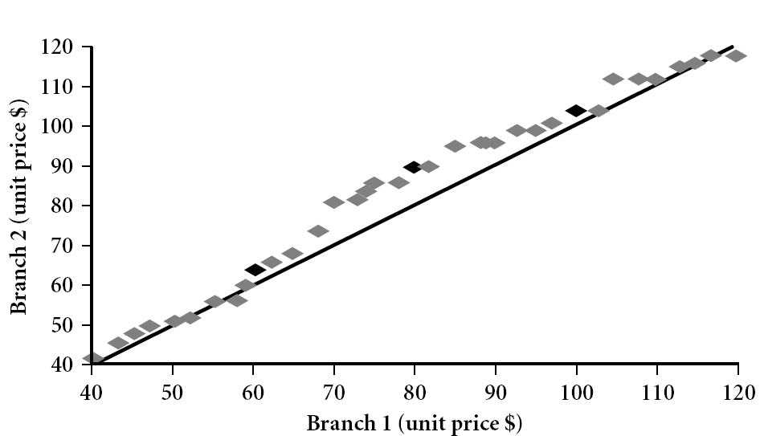
Quantile-Quantile (Q-Q) Plot
Graphs the quantiles of one univariate distribution against the corresponding quantiles of another
View: Is there is a shift in going from one distribution to another?
Example shows unit price of items sold at Branch 1 vs. Branch 2 for each quantile. Unit prices of items sold at Branch 1 tend to be lower than those at Branch 2.
Q₁
Notes:
Note: We need to label the dark plotted points as Q1, Median, Q3 – that would help in understanding this graph.
Tell audience: There is a shift in distribution of branch 1 WRT branch 2 in that the unit prices of items sold at branch 1 tend to be lower than those at branch 2.

Slide 22
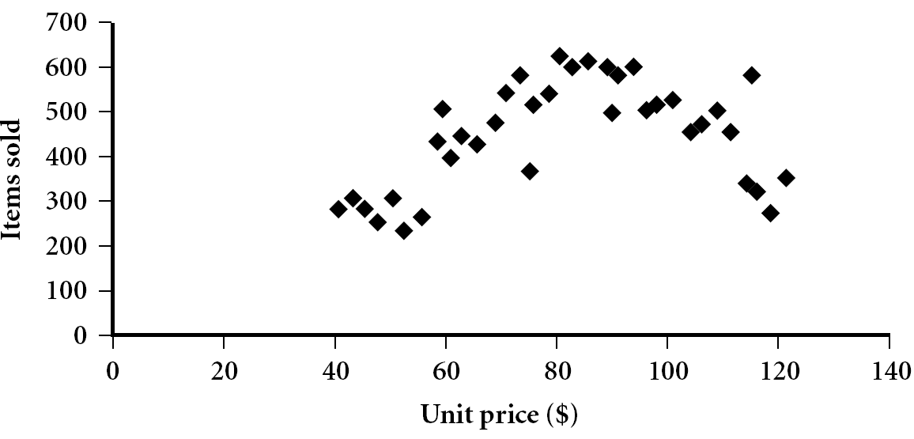
Scatter plot
Provides a first look at bivariate data to see clusters of points, outliers, etc
Each pair of values is treated as a pair of coordinates and plotted as points in the plane

Slide 23


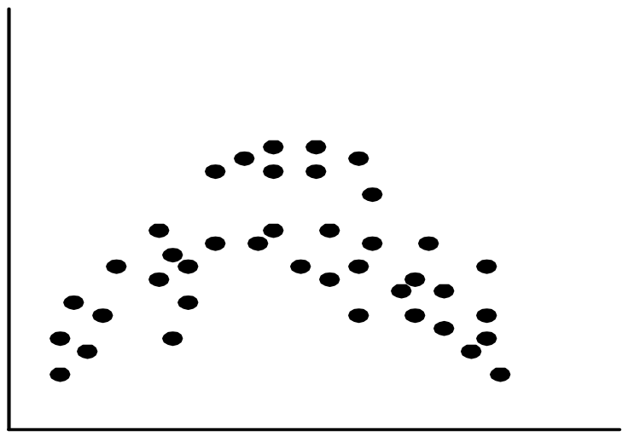
Positively and Negatively Correlated Data
The left half fragment is positively correlated
The right half is negative correlated

Slide 24


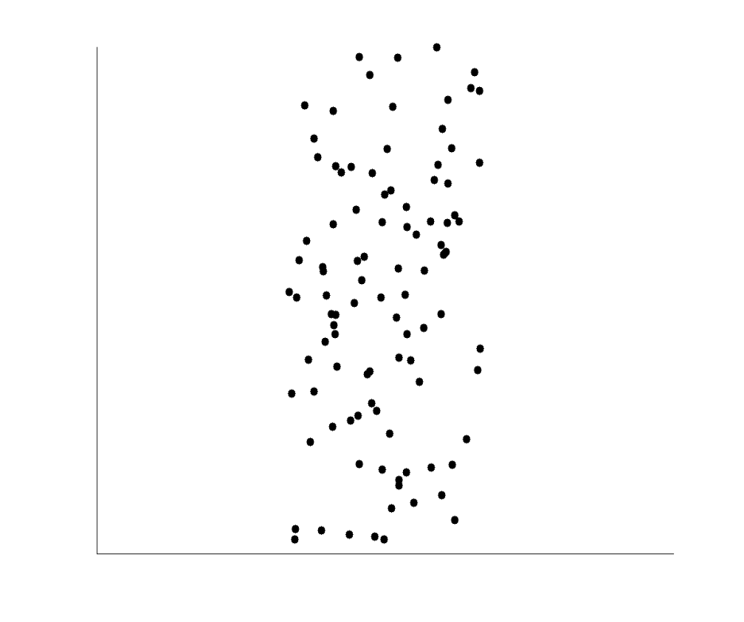
Uncorrelated Data

Slide 25
Chapter 2: Getting to Know Your Data
Data Objects and Attribute Types
Basic Statistical Descriptions of Data
Measuring Data Similarity and Dissimilarity
Summary

Slide 26
Similarity and Dissimilarity
Similarity
  Numerical measure of how alike two data objects are
  Value is higher when objects are more alike
  Often falls in the range [0,1]
Dissimilarity (e.g., distance)
  Numerical measure of how different two data objects are
  Lower when objects are more alike
  Minimum dissimilarity is often 0
  Upper limit varies
Proximity refers to a similarity or dissimilarity

Slide 27


Data Matrix and Dissimilarity Matrix
Data matrix
  n data points with p dimensions
Dissimilarity matrix
  n data points, but registers only the distance
  A triangular matrix

Slide 28
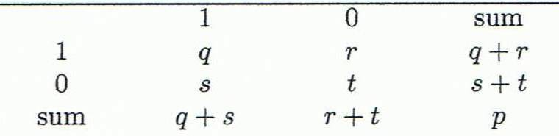
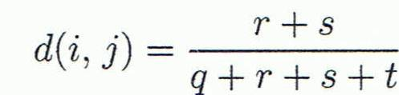
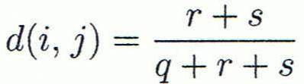

Object i | 1 | 0 | 0 | 1 | …. | 0
Object j | 1 | 1 | 0 | 0 | …. | 0
Object j
A contingency table for binary data
Distance measure for symmetric binary variables:
Distance measure for asymmetric binary variables:
Jaccard coefficient (similarity measure for asymmetric binary variables):
Object i

Slide 29
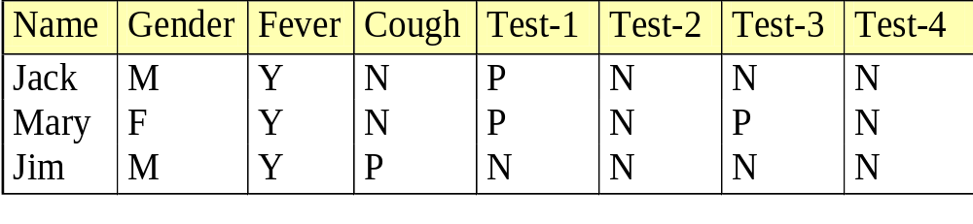

Dissimilarity between Binary Variables
Example
  Gender is a symmetric attribute
  The remaining attributes are asymmetric binary
  Let the values Y and P be 1, and the value N 0

Slide 30

Proximity Measure for Nominal Attributes
Can take 2 or more states, e.g., red, yellow, blue, green (generalization of a binary attribute)
Method 1: Simple matching
  m: # of matches, p: total # of variables
Method 2: Use a large number of binary attributes
  creating a new binary attribute for each of the M nominal states
  asymmetric

Slide 31
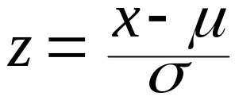
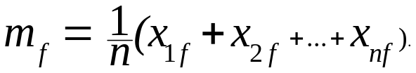
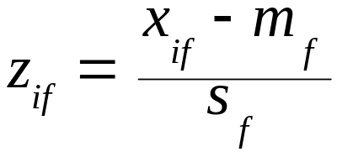
Standardizing Numeric Data
Z-score:
  X: raw score to be standardized, μ: mean of the population, σ: standard deviation
  the distance between the raw score and the population mean in units of the standard deviation
  negative when the raw score is below the mean, “+” when above
An alternative way: Calculate the mean absolute deviation
  where
  standardized measure (z-score):
Using mean absolute deviation is more robust than using standard deviation

Slide 32
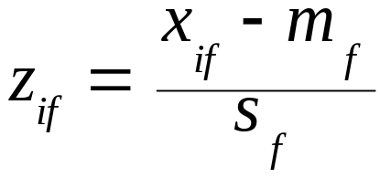
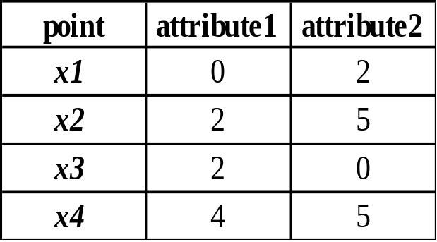
Example:
Data Matrix and Dissimilarity Matrix
Data Matrix
Mean of att1 : (0+2+2+4)/4=2
Mean absolute deviation of att1:
(|0-2|+|2-2|+|2-2|+|4-2|)/4=1
Mean of att2 : 3
Mean absolute deviation of att1:2
X1 -> ((0-2)/1, (2-3)/2) => (-2,-0.5)
X2 -> ((2-2)/1, (5-3)/2) => (0,1)

Slide 33
Distance on Numeric Data: Minkowski Distance
Minkowski distance: A popular distance measure
  where i = (x_{i1}, x_{i2}, …, x_{ip}) and j = (x_{j1}, x_{j2}, …, x_{jp}) are two p-dimensional data objects, and h is the order (the distance so defined is also called L-h norm)
Properties
  d(i, j) > 0 if i ≠ j, and d(i, i) = 0 (Positive definiteness)
  d(i, j) = d(j, i) (Symmetry)
  d(i, j) ≤ d(i, k) + d(k, j) (Triangle Inequality)
A distance that satisfies these properties is a metric

Slide 34


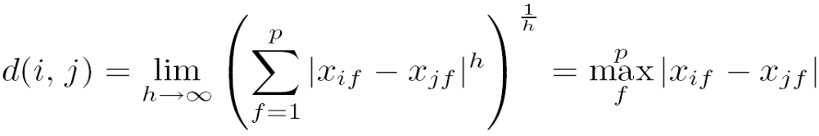
Special Cases of Minkowski Distance
h = 1: Manhattan (city block, L₁ norm) distance
  E.g., the Hamming distance: the number of bits that are different between two binary vectors
h = 2: (L₂ norm) Euclidean distance
h → ∞. “supremum” (L_{max} norm, L∞ norm) distance.
  This is the maximum difference between any component (attribute) of the vectors

Slide 35
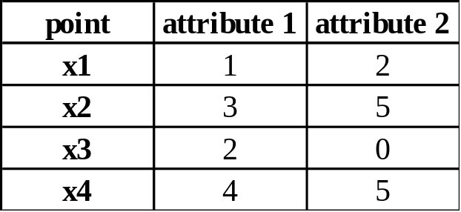
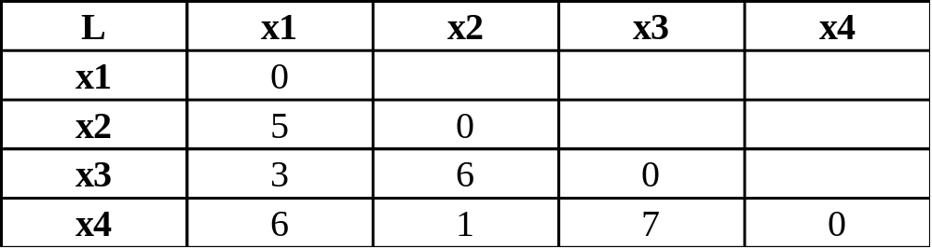
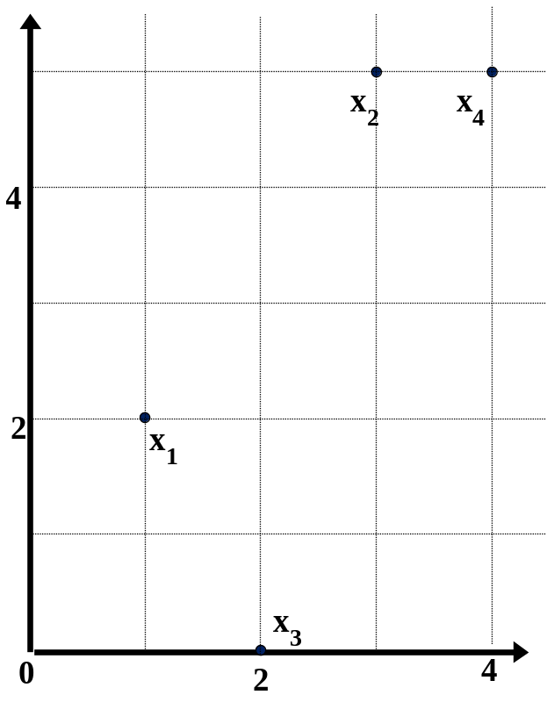
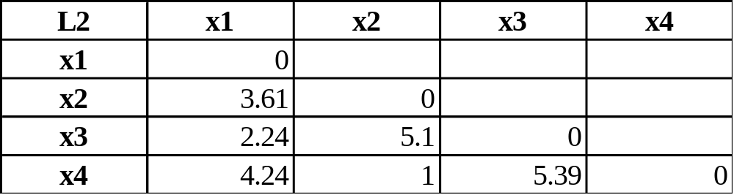
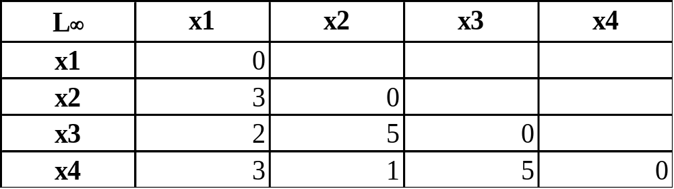
Example: Minkowski Distance
Dissimilarity Matrices
Manhattan (L₁)
Euclidean (L₂)
Supremum

Slide 36
Ratio-Scaled Variables
Ratio-scaled variable: a positive measurement on a nonlinear scale, approximately at exponential scale, such as Ae^{Bt} or Ae^{-Bt}
  Bacteria population, decay of radioactive element
Methods:
  method1: treat them like interval-scaled variables—not a good choice! (why?—the scale can be distorted)
  method2: apply logarithmic transformation
y_{if} = log(x_{if})
二〇二六年十一月八日

Slide 37
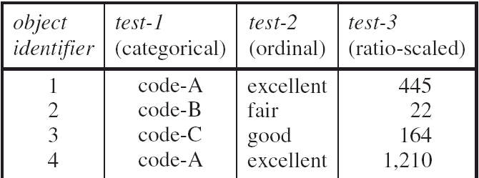
Example
Logarithmic transformation
  For object 1 to 4
    2.65, 1.34, 2.21, 3.03
Euclidean distance on the transformed values
  d(1,2)=1.31, d(1,3)=0.44, d(1,4)=0.38 etc

Slide 38


Ordinal Variables
Order is important, e.g., rank
Can be treated like interval-scaled
  replace x_{if} by their rank
  map the range of each variable onto [0, 1] by replacing i-th object in the f-th variable by
  compute the dissimilarity using methods for interval-scaled variables

Slide 39
Example
M_{f}=3
  fair->1, good->2, excellent->3
  After , fair->0, good->0.5, excellent->1
  If Euclidean distance is used
    d(1,2)=1, d(1,3)=0.5, d(1,4)=0;
二〇二六年十一月八日

Slide 40

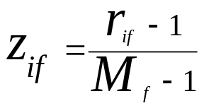
Attributes of Mixed Type
A database may contain all attribute types
  Nominal, symmetric binary, asymmetric binary, numeric, ordinal
One may use a weighted formula to combine their effects
  f is binary or nominal:
    d_{ij}^{(f)} = 0 if x_{if} = x_{jf} , or d_{ij}^{(f)} = 1 otherwise
  f is numeric: use the normalized distance
  f is ordinal
    Compute ranks r_{if} and
    Treat z_{if} as interval-scaled

Slide 41
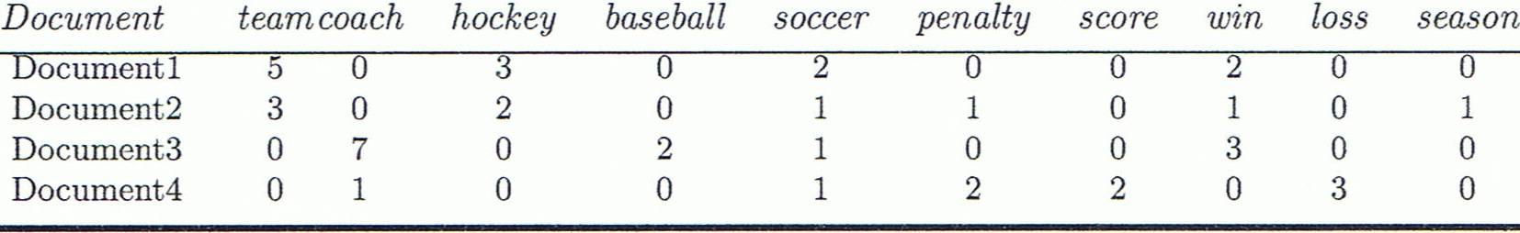
Cosine Similarity
A document can be represented by thousands of attributes, each recording the frequency of a particular word (such as keywords) or phrase in the document.
Other vector objects: gene features in micro-arrays, …
Applications: information retrieval, gene feature mapping, ...

Slide 42
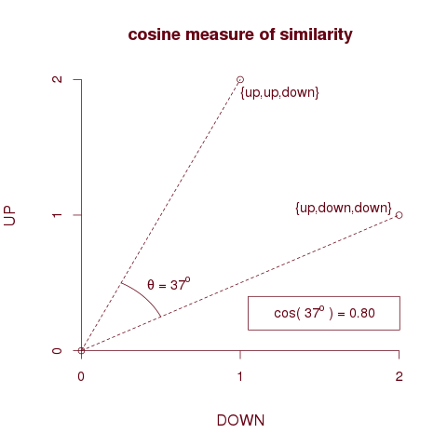

Cosine measure
Dot product
Unit vectors
cos(q,d) is the cosine similarity of q and d … or,
equivalently, the cosine of the angle between q and d.

Slide 43
Example: Cosine Similarity
Ex: Find the similarity between documents 1 and 2.
  d₁ = (5, 0, 3, 0, 2, 0, 0, 2, 0, 0)
  d₂ = (3, 0, 2, 0, 1, 1, 0, 1, 0, 1)
  d₁•d₂ = 5*3+0*0+3*2+0*0+2*1+0*1+0*1+2*1+0*0+0*1 = 25
  |d₁|= (5*5+0*0+3*3+0*0+2*2+0*0+0*0+2*2+0*0+0*0)^{0.5}=(42)^{0.5} = 6.481
  |d₂|= (3*3+0*0+2*2+0*0+1*1+1*1+0*0+1*1+0*0+1*1)^{0.5}=(17)^{0.5} = 4.12
  cos(d₁, d₂ ) = 0.94

Slide 44
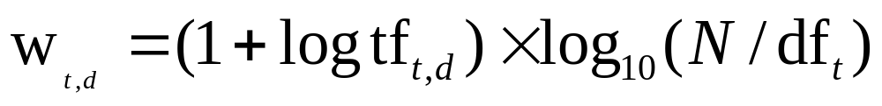
tf-idf weighting
The tf-idf weight of a term is the product of its tf weight and its idf weight.
Best known weighting scheme in information retrieval
Increases with the number of occurrences within a document
Increases with the rarity of the term in the collection

Slide 45
Term frequency tf
The term frequency tf_{t,d} of term t in document d is defined as the number of times that t occurs in d.
Raw term frequency is not what we want:
  A document with 10 occurrences of the term is more relevant than a document with one occurrence of the term.
  But not 10 times more relevant.
Relevance does not increase proportionally with term frequency.

Slide 46
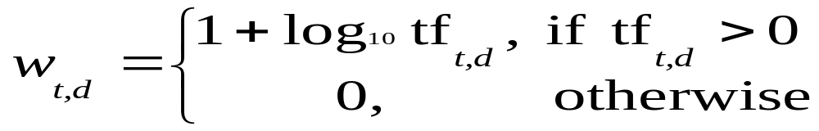
Log-frequency weighting
The log frequency weight of term t in d is
0 → 0, 1 → 1, 2 → 1.3, 10 → 2, 1000 → 4, etc.

Slide 47
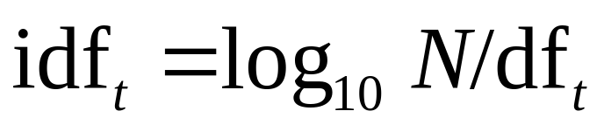
idf weight
df_{t} is the document frequency of t: the number of documents that contain t
  df is a measure of the informativeness of t
We define the idf (inverse document frequency) of t by
  We use log N/df_{t} instead of N/df_{t} to “dampen” the effect of idf.
N=1000
df_{t}=10
idf_{t}= log₁₀1000/10 = 2
Will turn out the base of the log is immaterial.

Slide 48
tf-idf weighting
1+log₁₀5=1.699
w_{1,d1}=1.699*2=3.398
  d₁ = (5, 0, 3, 0, 2, 0, 0, 2, 0, 0)
  N=1000, df₁=10 =>idf₁=2
The tf-idf weight of a term is the product of its tf weight and its idf weight.
Best known weighting scheme in information retrieval
Increases with the number of occurrences within a document
Increases with the rarity of the term in the collection

Slide 49
Chapter 2: Getting to Know Your Data
Data Objects and Attribute Types
Basic Statistical Descriptions of Data
Measuring Data Similarity and Dissimilarity
Summary

Slide 50
Summary
Data attribute types: nominal, binary, ordinal, interval-scaled, ratio-scaled
Many types of data sets, e.g., numerical, text, graph, Web, image.
Gain insight into the data by:
  Basic statistical data description: central tendency, dispersion, graphical displays
  Measure data similarity
Above steps are the beginning of data preprocessing.
Many methods have been developed but still an active area of research.

Slide 51
References
W. Cleveland, Visualizing Data, Hobart Press, 1993
T. Dasu and T. Johnson. Exploratory Data Mining and Data Cleaning. John Wiley, 2003
U. Fayyad, G. Grinstein, and A. Wierse. Information Visualization in Data Mining and Knowledge Discovery, Morgan Kaufmann, 2001
L. Kaufman and P. J. Rousseeuw. Finding Groups in Data: an Introduction to Cluster Analysis. John Wiley & Sons, 1990.
H. V. Jagadish, et al., Special Issue on Data Reduction Techniques. Bulletin of the Tech. Committee on Data Eng., 20(4), Dec. 1997
D. A. Keim. Information visualization and visual data mining, IEEE trans. on Visualization and Computer Graphics, 8(1), 2002
D. Pyle. Data Preparation for Data Mining. Morgan Kaufmann, 1999
S. Santini and R. Jain,” Similarity measures”, IEEE Trans. on Pattern Analysis and Machine Intelligence, 21(9), 1999
E. R. Tufte. The Visual Display of Quantitative Information, 2nd ed., Graphics Press, 2001
C. Yu , et al., Visual data mining of multimedia data for social and behavioral studies, Information Visualization, 8(1), 2009

Slide 52
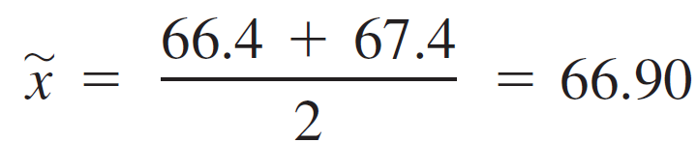
Example
Given the following data set :
62.3 62.8 63.6 65.2 65.7 66.4 67.4 68.4 68.8 70.8 75.7 79.0
n = 12 is even
the sample median is the average of the n/2 = 6th and (n/2 + 1) = 7th values from the ordered list:

Slide 53

Example
Given the following data set :
62.8 63.6 65.2 65.7 66.4 67.4 68.4 68.8 70.8 75.7 79.0
n = 11 is odd
the sample median is (n/2 + 1) = 6th values from the ordered list:
=67.4

Slide 54
Example
Given the following data set
1 2 6 7 7 9 11 11 11 19
A trimmed mean with a trimming percentage of 10% (10*10%=1) results from eliminating the smallest and largest observations; this gives
  X_{tri(10)}=(2+6+7+7+9+11+11+11)/8 = 8

Slide 55
Exercises
Given the following data set
  1 2 6 7 7 9 11 11 11 19
Calculate x_{tri(20)}
  10*20%=2
  x_{tri(20)}= (6+7+7+9+11+11)/6=8.5

Slide 56
Exercises
Given the following data set
  1 2 6 7 7 9 11 11 11 19
Ex2: Calculate x_{tri(14)}
  We have x_{tri(10)}=8 and x_{tri(20)}=8.5
  Interpolation!!
  x_{tri(14)}= x_{tri(10)}+(( x_{tri(20)}-x_{tri(10)} )/10 ) *(14-10) = 8.2
8
???
8.5
tri(10)
tri(14)
tri(20)

Slide 57
A trimmed mean with a moderate trimming
percentage—someplace between 5% and 25%—will yield a measure of center that is neither as sensitive to outliers as is the mean nor as insensitive as the median.

Slide 58

Boxplots
The simplest boxplot is based on the following five-number summary:
smallest x_{i} lower fourth median upper fourth largest x_{i}
Q₁
Q₃

Slide 59

Boxplot
1 3 8 9 10 11 12 12 16 31
  Q₁ (lower fourth) = 8
  Q₃ (Upper fourth) =12
  IQR=Q₃-Q₁=12-8=4 => 1.5*IQR=6
  Q₁-1.5IQR=8-6=2 Q₃+1.5IQR=12+6=18

Slide 60

Example
The whiskers in the boxplot extend out to the smallest observation, 9.69, on the low end and 312.45, the largest observation that is not an outlier, on the upper end.

Slide 61
Example
Color={Blue, Red, White}
Style= {A, B, C}
d(O1,O2)=(2-1)/2
d(O1,O3)=(2-0)/2
 | Color | Style
O1 | Blue | A
O2 | Blue | B
O3 | Red | C

Slide 62
Example
Color={Blue, Red, White}
Style= {A, B, C}
d(O1,O2)=2/3
d(O1,O3)=4/4
 | Color | Style
O1 | Blue | A
O2 | Blue | B
O3 | Red | C
 | Blue | Red | White | A | B | C
O1 | 1 | 0 | 0 | 1 | 0 | 0
O2 | 1 | 0 | 0 | 0 | 1 | 0
O3 | 0 | 1 | 0 | 0 | 0 | 1

Slide 63
Example
 | gender | test1 | test2 | test3 | test4 | height | rank
X₁ | F | 0 | 1 | 0 | 1 | 145 | Good
X₂ | F | 1 | 1 | 0 | 1 | 155 | Fair
gender : symmetric binary variable
test1~test4 : asymmetric binary variable
weight : mean=149, σ=4
rank : {Excellent, Good, Fair}
D(X₁,X₂)=?
Weight
Gender : 0.1
Test1~test4 : 0.5
Height: 0.2
Rank: 0.2
(0*0.1 + 1/3 * 0.5 + 2.5*0.2 + 0.5 *0.2)/ (0.1+0.5+0.2+0.2)

Slide 64
Example
 | A₁ | A₂
X₁ | 1 | 0
X₂ | 6 | 2
X₃ | 0 | 1
Given a new data point x=(3,1) as a query, rank the database points based on similarity with the query using Manhattan distance, Euclidean distance and cosine similarity.
Manhattan distance : d(x, X₁)=3, d(x,X₂)=4, d(x, X₃)=3 => X₁=X₃ X₂
Euclidean distance : d(x, X₁)=(5)^{1/2}, d(x,X₂)=(10)^{1/2}, d(x, X₃)=3 => X₁, X₃, X₂
Cosine similarity : s(x, X₁)=3/(10)^{1/2}, s(x,X₂)=1, s(x, X₃)=1/(10)^{1/2} => X₂, X_{1,} X₃

