Slide 1
Data Mining:
Concepts and Techniques
(3rd ed.)
— Chapter 3 —
Jiawei Han, Micheline Kamber, and Jian Pei
University of Illinois at Urbana-Champaign &
Simon Fraser University
©2011 Han, Kamber & Pei. All rights reserved.

Slide 2
Data Quality: Why Preprocess the Data?
Measures for data quality: A multidimensional view
  Accuracy: correct or wrong, accurate or not
  Completeness: not recorded, unavailable, …
  Consistency: some modified but some not, …
  Timeliness: timely update?

Slide 3
Major Tasks in Data Preprocessing
Data cleaning
  Fill in missing values, smooth noisy data, identify or remove outliers, and resolve inconsistencies
Data integration
  Integration of multiple databases
Data reduction
  Dimensionality reduction
  Numerosity reduction
Data transformation
  Normalization
  data discretization

Slide 4
How to Handle Missing Data?
Age | Income | Team | Gender
23 | 24,200 | Red Sox | M
39 | ? | Yankees | F
45 | 45,390 | ? | F
Fill missing values using aggregate functions (e.g., average) or probabilistic estimates on global value distribution
E.g., put the average income here, or put the most probable income based on the fact that the person is 39 years old
E.g., put the most frequent team here
二〇二六年十一月八日

Slide 5
How to Handle Missing Data?
Ignore the tuple: usually done when class label is missing (when doing classification)
Fill in the missing value manually: tedious + infeasible?
Fill in it automatically with
  a global constant : e.g., “unknown”, a new class?!
  the attribute mean
  the attribute mean for all samples belonging to the same class: smarter
  the most probable value: inference-based such as Bayesian formula or decision tree

Slide 6
How to Handle Noisy Data?
Noise: random error or variance in a measured variable
Binning
  first sort data and partition into (equal-frequency) bins
  then one can smooth by bin means, smooth by bin median, smooth by bin boundaries, etc.
Clustering
  detect and remove outliers
Combined computer and human inspection
  detect suspicious values and check by human (e.g., deal with possible outliers)

Slide 7
Handling Redundancy in Data Integration
Redundant data occur often when integration of multiple databases
  Object identification: The same attribute or object may have different names in different databases
  Derivable data: One attribute may be a “derived” attribute in another table
Redundant attributes may be able to be detected by correlation analysis

Slide 8

Correlation Analysis (Nominal Data)
Χ² (chi-square) test
The larger the Χ² value, the more likely the variables are related
The cells that contribute the most to the Χ² value are those whose actual count is very different from the expected count
Correlation does not imply causality
  # of hospitals and # of car-theft in a city are correlated
  Both are causally linked to the third variable: population

Slide 9

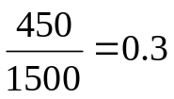
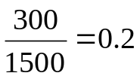
Chi-Square Calculation: An Example
 | Play chess | Not play chess | Sum (row)
Like science fiction | 250(90) | 200(360) | 450
Not like science fiction | 50(210) | 1000(840) | 1050
Sum(col.) | 300 | 1200 | 1500
Χ² (chi-square) calculation (numbers in parenthesis are expected counts calculated based on the data distribution in the two categories)
It shows that like_science_fiction and play_chess are correlated in the group

Slide 10
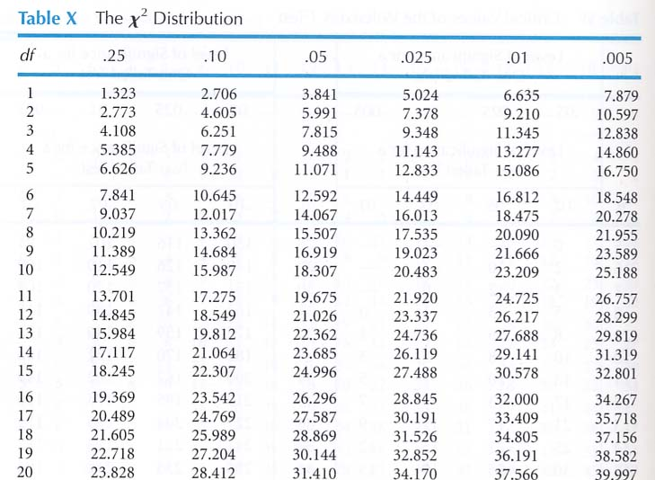
Data Mining: Concepts and Techniques

Slide 11



Covariance (Numeric Data)
Covariance is similar to correlation
  where n is the number of tuples, and are the respective mean or expected values of A and B, σ_{A} and σ_{B} are the respective standard deviation of A and B.
Positive covariance: If Cov_{A,B} > 0, then A and B both tend to be larger than their expected values.
Negative covariance: If Cov_{A,B} < 0 then if A is larger than its expected value, B is likely to be smaller than its expected value.
Independence: Cov_{A,B} = 0 but the converse is not true:
  Some pairs of random variables may have a covariance of 0 but are not independent.
Correlation coefficient:

Slide 12

Co-Variance: An Example
It can be simplified in computation as
Suppose two stocks A and B have the following values in one week: (2, 5), (3, 8), (5, 10), (4, 11), (6, 14).
Question: If the stocks are affected by the same industry trends, will their prices rise or fall together?
  E(A) = (2 + 3 + 5 + 4 + 6)/ 5 = 20/5 = 4
  E(B) = (5 + 8 + 10 + 11 + 14) /5 = 48/5 = 9.6
  Cov(A,B) = (2×5+3×8+5×10+4×11+6×14)/5 − 4 × 9.6 = 4
Thus, A and B rise together since Cov(A, B) > 0.

Slide 13
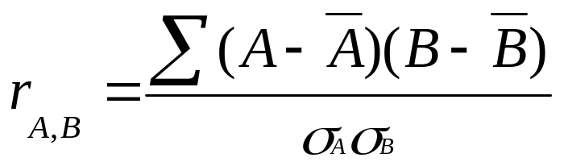
Correlation Analysis (Numerical Data)
Correlation coefficient
For any two rv’s A and B, –1 ≤ Corr(A, B) ≤ 1.
If r_{A,B} > 0, A and B are positively correlated (A’s values increase as B’s). The higher, the stronger correlation.
r_{A,B} = 0: not linear independent; r_{A,B} < 0: negatively correlated

Slide 14

Visually Evaluating Correlation
Scatter plots showing the similarity from –1 to 1.

Slide 15
Chapter 3: Data Preprocessing
Data Preprocessing: An Overview
  Data Quality
  Major Tasks in Data Preprocessing
Data Cleaning
Data Integration
Data Reduction
Data Transformation
Summary

Slide 16
Data Reduction Strategies
Why data reduction?
  A database/data warehouse may store terabytes of data
Data reduction
  Obtain a reduced representation of the data set that is much smaller in volume but yet produce the same (or almost the same) analytical results

Slide 17
Data Reduction Strategies
Data reduction strategies
  Dimensionality reduction — e.g., remove unimportant attributes
  Numerosity reduction

Slide 18
Data Reduction 1: Dimensionality Reduction
Curse of dimensionality
  When dimensionality increases, data becomes increasingly sparse
  Density and distance between points, which is critical to clustering, outlier analysis, becomes less meaningful
Dimensionality reduction
  Avoid the curse of dimensionality
  Help eliminate irrelevant features and reduce noise
  Reduce time and space required in data mining
  Allow easier visualization
Dimensionality reduction techniques
  Principal Component Analysis
  Supervised and nonlinear techniques (e.g., feature selection)

Slide 19
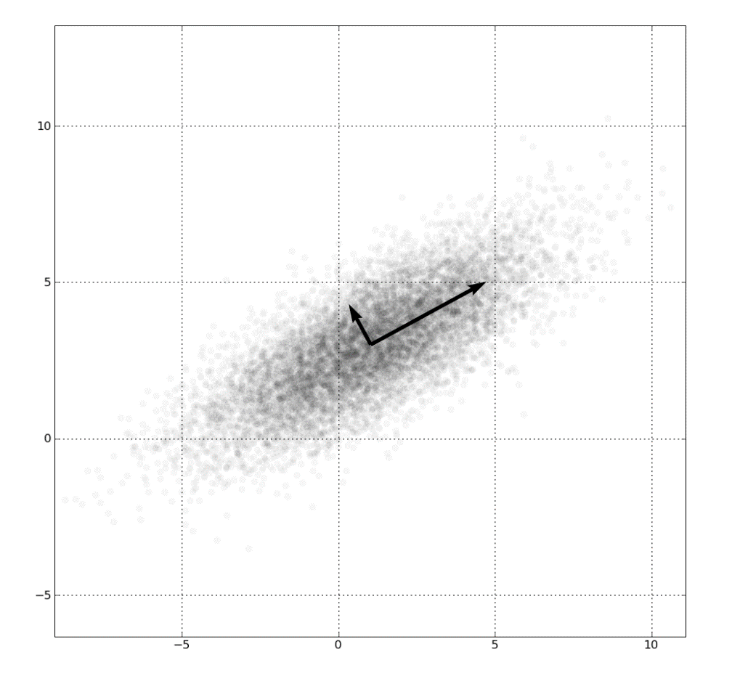
Principal Component Analysis (PCA)
Find a projection that captures the largest amount of variation in data
The original data are projected onto a much smaller space, resulting in dimensionality reduction. We find the eigenvectors of the covariance matrix, and these eigenvectors define the new space

Slide 20
Principal Component Analysis (Steps)
Given N data vectors from n-dimensions, find k ≤ n orthogonal vectors (principal components) that can be best used to represent data
  Normalize input data: Each attribute falls within the same range
  Compute k orthonormal (unit) vectors, i.e., principal components
  Each input data (vector) is a linear combination of the k principal component vectors
  The principal components are sorted in order of decreasing “significance” or strength
  Since the components are sorted, the size of the data can be reduced by eliminating the weak components, i.e., those with low variance (i.e., using the strongest principal components, it is possible to reconstruct a good approximation of the original data)
Works for numeric data only

Slide 21
Attribute Subset Selection
Another way to reduce dimensionality of data
Irrelevant attributes
  Contain no information that is useful for the data mining task at hand
    E.g., students' ID is often irrelevant to the task of predicting students' GPA

Slide 22
Heuristic Search in Attribute Selection
There are 2^{d} possible attribute combinations of d attributes
Typical heuristic attribute selection methods:
  Best step-wise feature selection:
    The best single-attribute is picked first
    Then next best attribute condition to the first, ...
  Step-wise attribute elimination:
    Repeatedly eliminate the worst attribute
  Best combined attribute selection and elimination

Slide 23
Example of Decision Tree Induction
Initial attribute set:
{A1, A2, A3, A4, A5, A6}
A4 ?
A1?
A6?
Class 1
Class 2
Class 1
Class 2
>
Reduced attribute set: {A1, A4, A6}

Slide 24
Data Reduction 2: Numerosity Reduction
Reduce data volume by choosing alternative, smaller forms of data representation

Slide 25

Histogram Analysis
Divide data into buckets and store average (sum) for each bucket
Partitioning rules:
  Equal-width: equal bucket range
  Equal-frequency (or equal-depth)

Slide 26
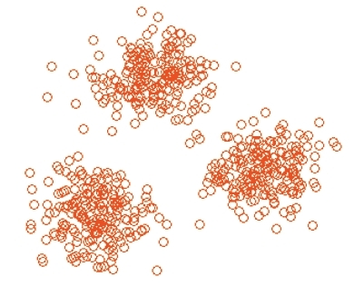
Clustering
Partition data set into clusters based on similarity, and store cluster representation (e.g., centroid and diameter) only
Can have hierarchical clustering and be stored in multi-dimensional index tree structures
There are many choices of clustering definitions and clustering algorithms
Cluster analysis will be studied in depth in Chapter 10

Slide 27
Sampling
Sampling: obtaining a small sample s to represent the whole data set N
Allow a mining algorithm to run in complexity that is potentially sub-linear to the size of the data
Key principle: Choose a representative subset of the data
  Simple random sampling may have very poor performance in the presence of skew
  Develop adaptive sampling methods, e.g., stratified sampling

Slide 28
Types of Sampling
Simple random sampling
  There is an equal probability of selecting any particular item
Sampling without replacement
  Once an object is selected, it is removed from the population
Sampling with replacement
  A selected object is not removed from the population
Stratified sampling:
  Partition the data set, and draw samples from each partition (proportionally, i.e., approximately the same percentage of the data)
  Used in conjunction with skewed data

Slide 29
Sampling: With or without Replacement
SRSWOR
(simple random
sample without
replacement)
SRSWR
Raw Data

Slide 30
Sampling: Cluster or Stratified Sampling
Raw Data
Cluster/Stratified Sample

Slide 31
Chapter 3: Data Preprocessing
Data Preprocessing: An Overview
  Data Quality
  Major Tasks in Data Preprocessing
Data Cleaning
Data Integration
Data Reduction
Data Transformation and Data Discretization
Summary

Slide 32
Data Transformation
A function that maps the entire set of values of a given attribute to a new set of replacement values s.t. each old value can be identified with one of the new values
Methods
  Normalization: Scaled to fall within a smaller, specified range
    min-max normalization
    z-score normalization
    normalization by decimal scaling
  Discretization

Slide 33





Normalization
Min-max normalization: to [new_min_{A}, new_max_{A}]
  Ex. Let income range $12,000 to $98,000 normalized to [0.0, 1.0]. Then $73,000 is mapped to
Z-score normalization (μ: mean, σ: standard deviation):
  Ex. Let μ = 54,000, σ = 16,000. Then
Normalization by decimal scaling
  Ex. {12, 33, 420} => j=3 {0.012, 0.033,0.42}
Where j is the smallest integer such that Max(|ν’|) < 1

Slide 34
Discretization
Three types of attributes
  Nominal—values from an unordered set, e.g., color, profession
  Ordinal—values from an ordered set, e.g., military or academic rank
  Numeric—real numbers, e.g., integer or real numbers
Discretization: Divide the range of a continuous attribute into intervals
  Interval labels can then be used to replace actual data values
  Reduce data size by discretization
  Supervised vs. unsupervised
  Discretization can be performed recursively on an attribute
  Prepare for further analysis, e.g., classification

Slide 35

Data Discretization Methods
Typical methods: All the methods can be applied recursively
  Histogram analysis
    Top-down split, unsupervised
  Clustering analysis
    unsupervised, top-down split or bottom-up merge
  Decision-tree analysis
    supervised, top-down split

Slide 36
Discretization by Classification & Correlation Analysis
Classification (e.g., decision tree analysis)
  Supervised: Given class labels
  Using entropy to determine split point (discretization point)
  Top-down, recursive split
  Details to be covered in Chapter 7
Age | att₁ | att₂ | Class label
5 | … | … | N
10 | … | … | N
20 | … | … | Y
38 | … | … | Y
52 | … | … | Y
1~15 : R₁ , 16~60 : R₂
1~30 : R₁ , 31~60 : R₂

Slide 37
Age | att₁ | att₂ | Class label
5 | … | … | N
10 | … | … | N
20 | … | … | Y
38 | … | … | Y
52 | … | … | Y
Age | att₁ | att₂ | Class label
R₁ | … | … | N
R₁ | … | … | N
R₂ | … | … | Y
R₂ | … | … | Y
R₂ | … | … | Y
1~15 : R₁ , 16~60 : R₂
Age | att₁ | att₂ | Class label
R₁ | … | … | N
R₁ | … | … | N
R₁ | … | … | Y
R₂ | … | … | Y
R₂ | … | … | Y
1~30 : R₁ , 31~60 : R₂

Slide 38
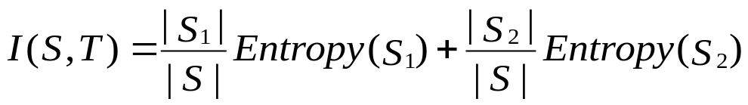
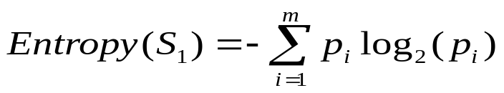
Entropy-Based Discretization
Given a set of samples S, if S is partitioned into two intervals S₁ and S₂ using boundary T, the expected information requirement after partitioning is
Entropy is calculated based on class distribution of the samples in the set. Given m classes, the entropy of S₁ is
  where p_{i} is the probability of class i in S₁

Slide 39
The boundary that minimizes the entropy function over all possible boundaries is selected as a binary discretization
The process is recursively applied to partitions obtained until some stopping criterion is met
Such a boundary may reduce data size and improve classification accuracy

Slide 40
Chapter 3: Data Preprocessing
Data Preprocessing: An Overview
  Data Quality
  Major Tasks in Data Preprocessing
Data Cleaning
Data Integration
Data Reduction
Data Transformation and Data Discretization
Summary

Slide 41
Summary
Data quality: accuracy, completeness, consistency, timeliness, believability, interpretability
Data cleaning: e.g. missing/noisy values, outliers
Data integration from multiple sources:
  Entity identification problem
  Remove redundancies
  Detect inconsistencies
Data reduction
  Dimensionality reduction
  Numerosity reduction
Data transformation and data discretization

Slide 42
References
D. P. Ballou and G. K. Tayi. Enhancing data quality in data warehouse environments. Comm. of ACM, 42:73-78, 1999
A. Bruce, D. Donoho, and H.-Y. Gao. Wavelet analysis. IEEE Spectrum, Oct 1996
T. Dasu and T. Johnson. Exploratory Data Mining and Data Cleaning. John Wiley, 2003
J. Devore and R. Peck. Statistics: The Exploration and Analysis of Data. Duxbury Press, 1997.
H. Galhardas, D. Florescu, D. Shasha, E. Simon, and C.-A. Saita. Declarative data cleaning: Language, model, and algorithms. VLDB'01
M. Hua and J. Pei. Cleaning disguised missing data: A heuristic approach. KDD'07
H. V. Jagadish, et al., Special Issue on Data Reduction Techniques. Bulletin of the Technical Committee on Data Engineering, 20(4), Dec. 1997
H. Liu and H. Motoda (eds.). Feature Extraction, Construction, and Selection: A Data Mining Perspective. Kluwer Academic, 1998
J. E. Olson. Data Quality: The Accuracy Dimension. Morgan Kaufmann, 2003
D. Pyle. Data Preparation for Data Mining. Morgan Kaufmann, 1999
V. Raman and J. Hellerstein. Potters Wheel: An Interactive Framework for Data Cleaning and Transformation, VLDB’2001
T. Redman. Data Quality: The Field Guide. Digital Press (Elsevier), 2001
R. Wang, V. Storey, and C. Firth. A framework for analysis of data quality research. IEEE Trans. Knowledge and Data Engineering, 7:623-640, 1995

Slide 43
Example
gender | age | salary | Class label
M | ? | High | Y
M | ? | Low | Y
F | 38 | Medium | N
F | 20 | Medium | Y
M | 26 | Low | Y
M | 42 | High | N
Unknown
age=Unknow -> Class label =Y

Slide 44
Example
gender | age | salary | Class label
M | ? | High | Y
M | ? | Low | Y
F | 38 | Medium | N
F | 22 | Medium | Y
M | 26 | Low | Y
M | 42 | High | N
(38+22+26+42)/4 = 32

Slide 45
Example
gender | age | salary | Class label
M | ? | High | Y
M | ? | Low | Y
F | 38 | Medium | N
F | 22 | Medium | Y
M | 26 | Low | Y
M | 42 | High | N
(22+26)/2 = 24

Slide 46
Binning
Equal-width (distance) partitioning
  Divides the range into N intervals of equal size: uniform grid
  if A and B are the lowest and highest values of the attribute, the width of intervals will be: W = (B –A)/N.
  The most straightforward, but outliers may dominate presentation
  Skewed data is not handled well
Equal-depth (frequency) partitioning
  Divides the range into N intervals, each containing approximately same number of samples
  Good data scaling

Slide 47
Simple Discretization Methods: Binning
number
of values
Example: customer ages
Equi-width binning:
0-10
10-20
20-30
30-40
40-50
50-60
60-70
70-80
Equi-depth binning:
0-22
22-31
48-55
62-80
38-44
32-38
44-48
55-62

Slide 48
Binning Methods for Data Smoothing
Sorted data for price (in dollars): 4, 8, 9, 15, 21, 21, 24, 25, 26, 28, 29, 45
* Partition into equal-frequency (equi-depth) bins:
- Bin 1: 4, 8, 9, 15
- Bin 2: 21, 21, 24, 25
- Bin 3: 26, 28, 29, 45
* Smoothing by bin means:
- Bin 1: 9, 9, 9, 9
- Bin 2: 23, 23, 23, 23
- Bin 3: 32, 32, 32, 32
* Smoothing by bin boundaries:
- Bin 1: 4, 4, 4, 15
- Bin 2: 21, 21, 25, 25
- Bin 3: 26, 26, 26, 45

Slide 49
Cluster Analysis
二〇二六年十一月八日
Data Mining: Concepts and Techniques

Slide 50
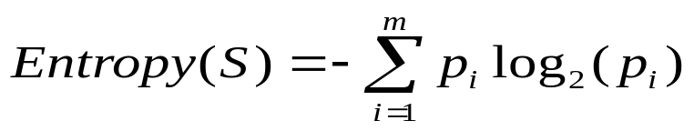
Entropy
Category : a, b
  S₁={a, a, a, a, a, a}
  S₂={a, a, a, b, b, b}

Slide 51
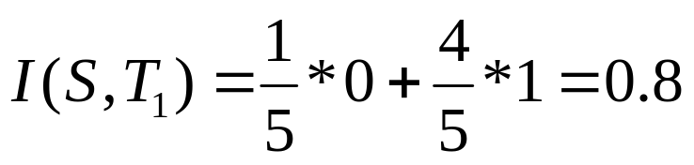
Example
Age | att₁ | att₂ | Class label
5 | … | … | N
10 | … | … | N
20 | … | … | Y
38 | … | … | Y
52 | … | … | N

Slide 52
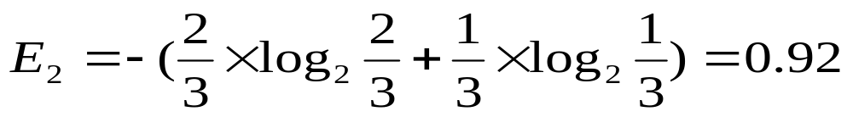
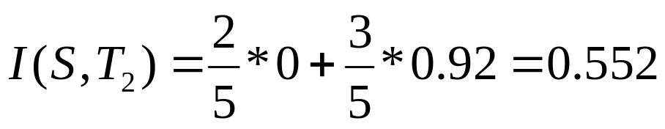
Example
Age | att₁ | att₂ | Class label
5 | … | … | N
10 | … | … | N
20 | … | … | Y
38 | … | … | Y
52 | … | … | N

