Slide 1
Data Mining:
Concepts and Techniques
(3rd ed.)
— Chapter 6 —
Jiawei Han, Micheline Kamber, and Jian Pei
University of Illinois at Urbana-Champaign &
Simon Fraser University
©2011 Han, Kamber & Pei. All rights reserved.

Slide 2
Chapter 5: Mining Frequent Patterns, Association and Correlations: Basic Concepts and Methods
Basic Concepts
Frequent Itemset Mining Methods
Which Patterns Are Interesting?—Pattern Evaluation Methods
Summary

Slide 3
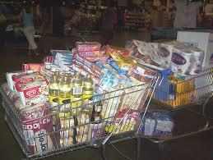
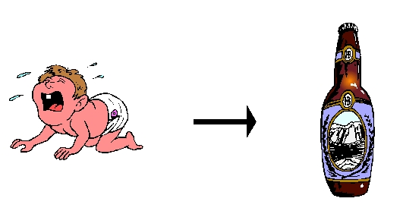
Data Mining Function: (1) Association and Correlation Analysis
Frequent patterns (or frequent itemsets)
  What items are frequently purchased together in your Walmart?
Association, correlation vs. causality
  A typical association rule
    Diaper → Beer [0.5%, 75%] (support, confidence)
  Are strongly associated items also strongly correlated?
How to mine such patterns and rules efficiently in large datasets?

Slide 4
What Is Frequent Pattern Analysis?
Frequent pattern: a pattern (a set of items, subsequences, substructures, etc.) that occurs frequently in a data set
First proposed by Agrawal, Imielinski, and Swami [AIS93] in the context of frequent itemsets and association rule mining
Motivation: Finding inherent regularities in data
  What products were often purchased together?— Beer and diapers?!
  What are the subsequent purchases after buying a PC?
  What kinds of DNA are sensitive to this new drug?
  Can we automatically classify web documents?
Applications
  Basket data analysis, Web log (click stream) analysis, recommendation and DNA sequence analysis.

Slide 5
Basic Concepts: Frequent Patterns
Tid | Items bought
10 | Beer, Nuts, Diaper
20 | Beer, Coffee, Diaper
30 | Beer, Diaper, Eggs
40 | Nuts, Eggs, Milk
50 | Nuts, Coffee, Diaper, Eggs, Milk
itemset: A set of one or more items
  {Beer}, {Beer, Nuts}, …
k-itemset X = {x₁, …, x_{k}}
(absolute) support, or, support count of X: Frequency or occurrence of an itemset X
  {Beer}: 3, {Beer, Nuts}=1
(relative) support, s, is the fraction of transactions that contains X (i.e., the probability that a transaction contains X)
  {Beer}: 3/5, {Beer, Nuts}=1/5
Customer
buys both
Customer
buys diaper
Customer
buys beer

Slide 6

Basic Concepts: Frequent Patterns
Tid | Items bought
10 | Beer, Nuts, Diaper
20 | Beer, Coffee, Diaper
30 | Beer, Diaper, Eggs
40 | Nuts, Eggs, Milk
50 | Nuts, Coffee, Diaper, Eggs, Milk
An itemset X is frequent if X’s support is no less than a minsup threshold
  minsup=0.5
    {Beer} is a frequent(large) itemset
Confidence of a rule X->Y
  conditional probability that a transaction having X also contains Y
    Eggs->Nuts
      2/3
Customer
buys both
Customer
buys diaper
Customer
buys beer

Slide 7
Basic Concepts: Association Rules
Tid
Items bought
Find all the rules X → Y with minimum support and confidence
  support, s, probability that a transaction contains X ∪ Y
  confidence, c, conditional probability that a transaction having X also contains Y
Let minsup = 50%, minconf = 50%
Freq. Pat.: Beer:3, Nuts:3, Diaper:4, Eggs:3, {Beer, Diaper}:3
10
Beer, Nuts, Diaper
20
Beer, Coffee, Diaper
30
Beer, Diaper, Eggs
40
Nuts, Eggs, Milk
50
Nuts, Coffee, Diaper, Eggs, Milk
Customer
buys both
Customer
buys diaper
Customer
buys beer
Association rules: (many more!)
  Beer → Diaper (60%, 100%)
  Diaper → Beer (60%, 75%)

Slide 8
Basic Concepts: Association Rules
Two steps
  Finding frequent itemsets
  Generating association rules

Slide 9
Chapter 5: Mining Frequent Patterns, Association and Correlations: Basic Concepts and Methods
Basic Concepts
Frequent Itemset Mining Methods
Which Patterns Are Interesting?—Pattern Evaluation Methods
Summary

Slide 10
Scalable Frequent Itemset Mining Methods
Apriori: A Candidate Generation-and-Test Approach
Improving the Efficiency of Apriori
FPGrowth: A Frequent Pattern-Growth Approach
ECLAT: Frequent Pattern Mining with Vertical Data Format

Slide 11
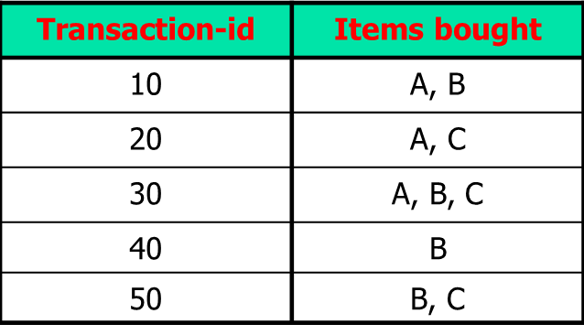
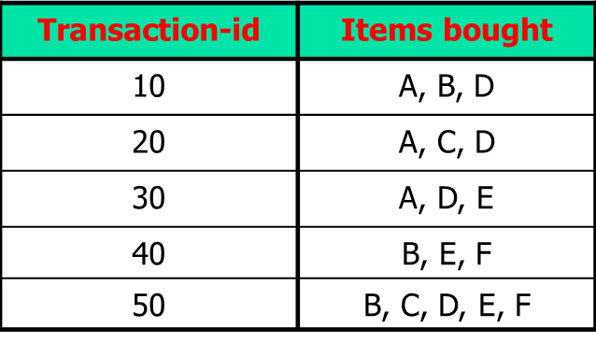
Scalable Frequent Itemset Mining Methods
Counters
A, B, C, AB, AC, BC, ABC
Counters
A, B, C, D, E, F, AB, AC,…, ABCDEF
n items ??

Slide 12
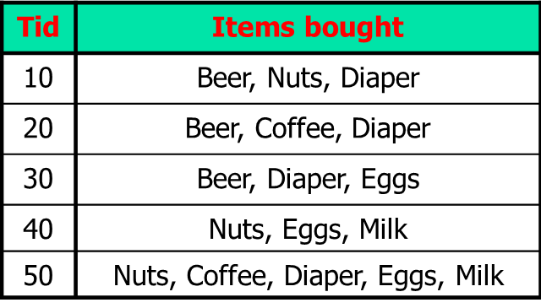
The Downward Closure Property and Scalable Mining Methods
The downward closure property of frequent patterns
  Any subset of a frequent itemset must be frequent
  If {beer, diaper} is frequent, so is {beer}, {diaper}
  i.e., every transaction having {beer, diaper} also contains {beer}, {diaper}

Slide 13
Apriori: A Candidate Generation & Test Approach
Apriori pruning principle: If there is any itemset which is infrequent, its superset should not be generated/tested! (Agrawal & Srikant @VLDB’94, Mannila, et al. @ KDD’ 94)
Method:
  Initially, scan DB once to get frequent 1-itemset
  Generate length (k+1) candidate itemsets from length k frequent itemsets
  Test the candidates against DB
  Terminate when no frequent or candidate set can be generated

Slide 14
The Apriori Algorithm—An Example
Sup_{min} = 2
Itemset | sup
{A} | 2
{B} | 3
{C} | 3
{D} | 1
{E} | 3
Database TDB
Itemset | sup
{A} | 2
{B} | 3
{C} | 3
{E} | 3
L₁
Tid | Items
10 | A, B, C, D
20 | B, C, E
30 | A, B, C, E
40 | B, E
C₁
1st scan
C₂
Itemset | sup
{A, B} | 1
{A, C} | 2
{A, E} | 1
{B, C} | 2
{B, E} | 3
{C, E} | 2
C₂
L₂
Itemset
{A, B}
{A, C}
{A, E}
{B, C}
{B, E}
{C, E}
Itemset | sup
{A, C} | 2
{B, C} | 2
{B, E} | 3
{C, E} | 2
2nd scan
C₃
Itemset
{B, C, E}
3rd scan
L₃
Itemset | sup
{B, C, E} | 2

Slide 15
The Apriori Algorithm (Pseudo-Code)
C_{k}: Candidate itemset of size k
L_{k} : frequent itemset of size k
L₁ = {frequent items};
for (k = 1; L_{k} !=∅; k++) do begin
C_{k+1} = candidates generated from L_{k};
for each transaction t in database do
  increment the count of all candidates in C_{k+1} that are contained in t
L_{k+1} = candidates in C_{k+1} with min_support
end
return ∪_{k} L_{k};

Slide 16
Implementation of Apriori
How to generate candidates?
  Step 1: self-joining L_{k}
  Step 2: pruning
Example of Candidate-generation
  L₃={abc, abd, acd, ace, bcd}
  Self-joining: L₃*L₃
    abcd from abc and abd
    acde from acd and ace
  Pruning:
    acde is removed because ade is not in L₃
  C₄ = {abcd}

Slide 17
How to Count Supports of Candidates?
Why counting supports of candidates a problem?
  The total number of candidates can be very huge
  One transaction may contain many candidates
Method:
  Candidate itemsets are stored in a hash-tree
  Leaf node of hash-tree contains a list of itemsets and counts
  Interior node contains a hash table
  Subset function: finds all the candidates contained in a transaction
T: {a, b, c, e, f, h, j, k, p, s, t , w}
Candidates: {a, b, p} {a, b, t} {a, b, u} …{c, m, s}…

Slide 18
Counting Supports of Candidates Using Hash Tree
Subset function
{1,2,4}, {1,2,5}, {1,3,6}, {1,4,5}, {1,5,9}, {2,3,4}…
3,6,9
1,4,7
2,5,8
{1,2,4}

Slide 19
Counting Supports of Candidates Using Hash Tree
Subset function
{1,2,4}, {1,2,5}, {1,3,6}, {1,4,5}, {1,5,9}, {2,3,4}…
3,6,9
1,4,7
2,5,8
{1,2,4}
{1,2,4}
{1,2,5}

Slide 20
Counting Supports of Candidates Using Hash Tree
Subset function
{1,2,4}, {1,2,5}, {1,3,6}, {1,4,5}, {1,5,9}, {2,3,4}…
3,6,9
1,4,7
2,5,8
{1,3,6}
{1,2,4}
{1,2,5}
{1,2,4}
{1,2,5}

Slide 21
Counting Supports of Candidates Using Hash Tree
Subset function
Transaction: 1 2 3 5 6
3,6,9
1,4,7
2,5,8
1 + 2 3 5 6
1 3 + 5 6
2 3 4
5 6 7
1 4 5
3 4 5
3 5 6
3 5 7
6 8 9
3 6 7
3 6 8
1 3 6
1 2 + 3 5 6
1 2 4
4 5 7
1 2 5
4 5 8
1 5 9

Slide 22
Scalable Frequent Itemset Mining Methods
Apriori: A Candidate Generation-and-Test Approach
Improving the Efficiency of Apriori
FPGrowth: A Frequent Pattern-Growth Approach
ECLAT: Frequent Pattern Mining with Vertical Data Format
Mining Close Frequent Patterns and Maxpatterns

Slide 23
Further Improvement of the Apriori Method
Major computational challenges
  Multiple scans of transaction database
  Huge number of candidates
  Tedious workload of support counting for candidates
Improving Apriori: general ideas
  Reduce passes of transaction database scans
  Shrink number of candidates
  Facilitate support counting of candidates

Slide 24
Partition: Scan Database Only Twice
Any itemset that is potentially frequent in DB must be frequent in at least one of the partitions of DB
  Scan 1: partition database and find local frequent patterns
  Scan 2: consolidate global frequent patterns
A. Savasere, E. Omiecinski and S. Navathe, VLDB’95
DB₁
+
DB₂
+
+
DB_{k}
= DB
sup₁(i) < σDB₁
sup₂(i) < σDB₂
sup_{k}(i) < σDB_{k}
sup(i) < σDB

Slide 25
DIC: Reduce Number of Scans
ABCD
Once both A and D are determined frequent, the counting of AD begins
Once all length-2 subsets of BCD are determined frequent, the counting of BCD begins
ABC
ABD
ACD
BCD
AB
AC
BC
AD
BD
CD
Transactions
1-itemsets
A
B
C
D
Apriori
2-itemsets
…
{}
Itemset lattice
1-itemsets
2-items
S. Brin R. Motwani, J. Ullman, and S. Tsur. Dynamic itemset counting and implication rules for market basket data. SIGMOD’97
DIC
3-items

Slide 26
DHP: Reduce the Number of Candidates
A k-itemset whose corresponding hashing bucket count is below the threshold cannot be frequent
  Candidates: a, b, c, d, e
  Hash entries
    {ab, ad, ae}
    {bd, be, de}
    …
  Frequent 1-itemset: a, b, d, e
  ab ad ae are not candidate 2-itemsets because the sum of count of {ab, ad, ae} is below support threshold
J. Park, M. Chen, and P. Yu. An effective hash-based algorithm for mining association rules. SIGMOD’95
count
itemsets
35
{ab, ad, ae}
88
{bd, be, de}
76
{ac, be}
32
{cd, ce}
Min_sup count =40
Hash Table

Slide 27
Pattern-Growth Approach: Mining Frequent Patterns Without Candidate Generation
Bottlenecks of the Apriori approach
  Breadth-first (i.e., level-wise) search
  Candidate generation and test
    Often generates a huge number of candidates
The FPGrowth Approach (J. Han, J. Pei, and Y. Yin, SIGMOD’ 00)
  Depth-first search
  Avoid explicit candidate generation
Major philosophy: Grow long patterns from short ones using local frequent items only
  “abc” is a frequent pattern
  Get all transactions having “abc”, i.e., project DB on abc: DB|abc
  “d” is a local frequent item in DB|abc → abcd is a frequent pattern

Slide 28
Construct FP-tree from a Transaction Database
TID Items bought (ordered) frequent items
100 {f, a, c, d, g, i, m, p} {f, c, a, m, p}
200 {a, b, c, f, l, m, o} {f, c, a, b, m}
300 {b, f, h, j, o, w} {f, b}
400 {b, c, k, s, p} {c, b, p}
500 {a, f, c, e, l, p, m, n} {f, c, a, m, p}
min_support = 3
{}
Header Table
Item frequency head
f 4
c 4
a 3
b 3
m 3
p 3
Scan DB once, find frequent 1-itemset (single item pattern)
Sort frequent items in frequency descending order, f-list
Scan DB again, construct FP-tree
f:4
c:1
c:3
b:1
b:1
a:3
p:1
m:2
b:1
F-list = f-c-a-b-m-p
p:2
m:1

Slide 29
Partition Patterns and Databases
Frequent patterns can be partitioned into subsets according to f-list
  F-list = f-c-a-b-m-p
  Patterns containing p
  Patterns having m but no p
  …
  Patterns having c but no a nor b, m, p
  Pattern f
Completeness and non-redundency

Slide 30
Find Patterns Having P From P-conditional Database
Starting at the frequent item header table in the FP-tree
Traverse the FP-tree by following the link of each frequent item p
Accumulate all of transformed prefix paths of item p to form p’s conditional pattern base
{}
Header Table
Item frequency head
f 4
c 4
a 3
b 3
m 3
p 3
f:4
c:1
Conditional pattern bases
item cond. pattern base
c f:3
a fc:3
b fca:1, f:1, c:1
m fca:2, fcab:1
p fcam:2, cb:1
c:3
b:1
b:1
a:3
p:1
m:2
b:1
p:2
m:1

Slide 31
From Conditional Pattern-bases to Conditional FP-trees
For each pattern-base
  Accumulate the count for each item in the base
  Construct the FP-tree for the frequent items of the pattern base
m-conditional pattern base:
  fca:2, fcab:1
{}
Header Table
Item frequency head
f 4
c 4
a 3
b 3
m 3
p 3
f:4
c:1
All frequent patterns relate to m
m,
fm, cm, am,
fcm, fam, cam,
fcam
{}
c:3
b:1
b:1

f:3

a:3
p:1
m:2
b:1
c:3
p:2
m:1
a:3
m-conditional FP-tree

Slide 32
Recursion: Mining Each Conditional FP-tree
{}
{}
Cond. pattern base of “am”: (fc:3)
f:3
c:3
f:3
am-conditional FP-tree
c:3
{}
Cond. pattern base of “cm”: (f:3)
a:3
f:3
m-conditional FP-tree
cm-conditional FP-tree
{}
Cond. pattern base of “cam”: (f:3)
f:3
cam-conditional FP-tree

Slide 33
A Special Case: Single Prefix Path in FP-tree
Suppose a (conditional) FP-tree T has a shared single prefix-path P
Mining can be decomposed into two parts
  Reduction of the single prefix path into one node
  Concatenation of the mining results of the two parts
{}
a₁:n₁
a₂:n₂
a₃:n₃
{}
r₁
b₁:m₁
C₁:k₁
a₁:n₁
+

r₁
=
b₁:m₁
C₁:k₁
a₂:n₂
C₂:k₂
C₃:k₃
a₃:n₃
C₂:k₂
C₃:k₃

Slide 34
Benefits of the FP-tree Structure
Completeness
  Preserve complete information for frequent pattern mining
  Never break a long pattern of any transaction
Compactness
  Reduce irrelevant info—infrequent items are gone
  Items in frequency descending order: the more frequently occurring, the more likely to be shared
  Never be larger than the original database (not count node-links and the count field)

Slide 35
The Frequent Pattern Growth Mining Method
Idea: Frequent pattern growth
  Recursively grow frequent patterns by pattern and database partition
Method
  For each frequent item, construct its conditional pattern-base, and then its conditional FP-tree
  Repeat the process on each newly created conditional FP-tree
  Until the resulting FP-tree is empty, or it contains only one path—single path will generate all the combinations of its sub-paths, each of which is a frequent pattern

Slide 36

Performance of FPGrowth in Large Datasets
Data set T25I20D10K
FP-Growth vs. Apriori

Slide 37
Advantages of the Pattern Growth Approach
Divide-and-conquer:
  Decompose both the mining task and DB according to the frequent patterns obtained so far
  Lead to focused search of smaller databases
Other factors
  No candidate generation, no candidate test
  Compressed database: FP-tree structure
  No repeated scan of entire database
  Basic ops: counting local freq items and building sub FP-tree, no pattern search and matching
A good open-source implementation and refinement of FPGrowth
  FPGrowth+ (Grahne and J. Zhu, FIMI'03)

Slide 38
Further Improvements of Mining Methods
AFOPT (Liu, et al. @ KDD’03)
  A “push-right” method for mining condensed frequent pattern (CFP) tree
Carpenter (Pan, et al. @ KDD’03)
  Mine data sets with small rows but numerous columns
  Construct a row-enumeration tree for efficient mining
FPgrowth+ (Grahne and Zhu, FIMI’03)
  Efficiently Using Prefix-Trees in Mining Frequent Itemsets, Proc. ICDM'03 Int. Workshop on Frequent Itemset Mining Implementations (FIMI'03), Melbourne, FL, Nov. 2003
TD-Close (Liu, et al, SDM’06)

Slide 39
Scalable Frequent Itemset Mining Methods
Apriori: A Candidate Generation-and-Test Approach
Improving the Efficiency of Apriori
FPGrowth: A Frequent Pattern-Growth Approach
Frequent Pattern Mining with Vertical Data Format
Mining Close Frequent Patterns and Maxpatterns

Slide 40
Mining by Exploring Vertical Data Format
Bit vector
  A = <11100>
  B = <10011>
  AB=<10000>
Inverted list
  A={10, 20, 30}
  B={10, 40, 50}
  AB={10}
Transaction-id | Items bought
10 | A, B, D
20 | A, C, D
30 | A, D, E
40 | B, E, F
50 | B, C, D, E, F

Slide 41
ECLAT: Mining by Exploring Vertical Data Format
Reduce the cost of registering long TID_sets
  Using diffset to accelerate mining
  Only keep track of differences of tids
  t(X) = {T₁, T₂, T_{3,} T₅, T₆, T₁₀, T₁₂}, t(XY) = {T₁, T_{3 ,} T₅, T₆, T₁₀, T₁₂}
  Diffset (XY, X) = {T₂}
When the data set contains many dense and long patterns, this technique can substantially reduce the total cost of vertical format mining of frequent itemsets.
Eclat (Zaki et al. @KDD’97)

Slide 42
Compute support with diffsets
p:prefix
σ(X) :support of X
t(X): the set of tid contains X
d(PX): the diffset of PX with prefix P
a
<1,2,3,4,5,6>
<1,2,3,4>
d(ab): <5,6>
ab
ac
<1,2,3,5,6>
d(ac):<4>
abc
<1,2,3>
d(abc) : <4>
σ(PXY)=σ(PX)-|d(PXY)|
d(PXY)=t(PX)-t(PY)
=t(PX)-t(PY)+t(P)-t(P)
=(t(P)-t(PY))-(t(P)-t(PX))
=d(PY)-d(PX)
σ(abc)=σ(ab)-|d(abc)|
=σ(ab)-|d(ac)-d(ab)|
=4-|<4>|=4-1=3

Slide 43
Long pattern problem
Frequent pattern {A, B, C}
  {A}, {B}, {C}, {A, B}, {A, C}, {B, C}
A long pattern contains a combinatorial number of sub-patterns, e.g., {a₁, …, a₁₀₀} contains (₁₀₀¹) + (₁₀₀²) + … + (₁¹₀⁰₀⁰) = 2¹⁰⁰ – 1 = 1.27*10³⁰ sub-patterns!
Solution: Mine max-patterns and closed patterns instead

Slide 44
Max-Patterns and Closed Patterns
An itemset X is a max-pattern if X is frequent and there exists no frequent super-pattern Y כ X (proposed by Bayardo @ SIGMOD’98)
  {A}, {B}, {C}, {D}, {E}, {A, B}, {A, C}, {B, C}, {A, D}, {A, B, C}
  {E}, {A, D}, {A, B, C}
Lossy or Lossless compression?

Slide 45
Max-Patterns and Closed Patterns
An itemset X is closed if X is frequent and there exists no super-pattern Y כ X, with the same support as X (proposed by Pasquier, et al. @ ICDT’99)
  {A}:5, {B}:5, {C}:8, {A,B}:5, {A, C}:5, {B, C}:5, {A, B, C}:5
  {C}:8, {A, B, C}:5
Closed pattern is a lossless compression of freq. patterns
  Reducing the # of patterns and rules

Slide 46
Closed Patterns and Max-Patterns
Exercise. DB = {<a₁, …, a₁₀₀>, < a₁, …, a₅₀>}
  Min_sup = 1.
What is the set of max-pattern?
  <a₁, …, a₁₀₀>: 1
What is the set of closed itemset?
  <a₁, …, a₁₀₀>: 1
  < a₁, …, a₅₀>: 2
What is the set of all patterns?
  !!

Slide 47
Practice
tid | items
1 | a b c e
2 | a b c
3 | b c d
4 | a
Frequent patterns:
a:3 b:3 c:3
ab:2 ac:2 bc:3
abc:2
Maxpatterns
abc:2
Closed patterns
abc:2
bc:3
a:3
min_sup=0.5
Frequent patterns?
Maxpatterns?
Closed patterns?

Slide 48
MaxMiner: Mining Max-Patterns
1st scan: find frequent items
  A, B, C, D, E
2nd scan: find support for
  AB, AC, AD, AE, ABCDE
  BC, BD, BE, BCDE
  CD, CE, CDE, DE
Since BCDE is a max-pattern, no need to check BCD, BDE, CDE in later scan
R. Bayardo. Efficiently mining long patterns from databases. SIGMOD’98
Tid | Items
10 | A, B, C, D, E
20 | B, C, D, E,
30 | A, C, D, F
Min_sup count=2
Potential max-patterns

Slide 49
CHARM: Mining by Exploring Vertical Data Format
Vertical format: t(AB) = {T₁₁, T₂₅, …}
  tid-list: list of trans.-ids containing an itemset
Deriving closed patterns based on vertical intersections
  t(X) = t(Y): X and Y always happen together
  t(X) ⊂ t(Y): transaction having X always has Y
Using diffset to accelerate mining
  Only keep track of differences of tids
  t(X) = {T₁, T₂, T₃}, t(XY) = {T₁, T₃}
  Diffset (XY, X) = {T₂}
Eclat/MaxEclat (Zaki et al. @KDD’97), VIPER(P. Shenoy et al.@SIGMOD’00), CHARM (Zaki & Hsiao@SDM’02)

Slide 50
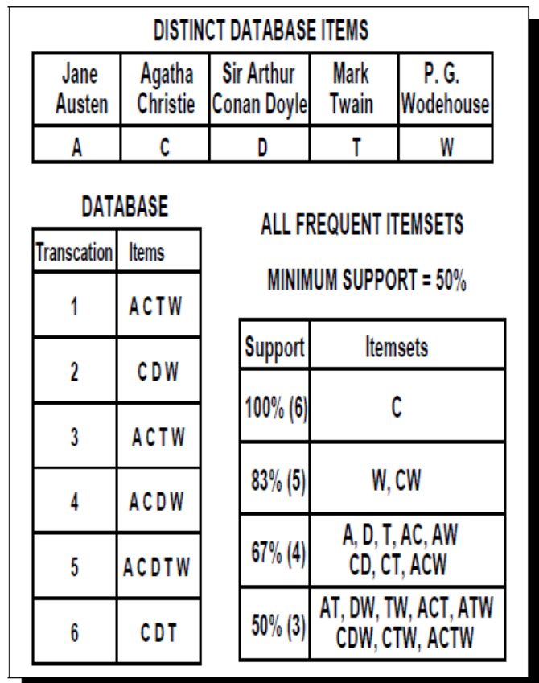
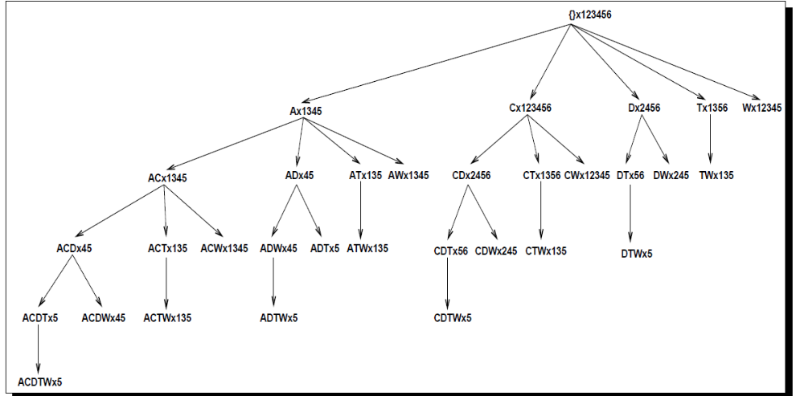

Slide 51
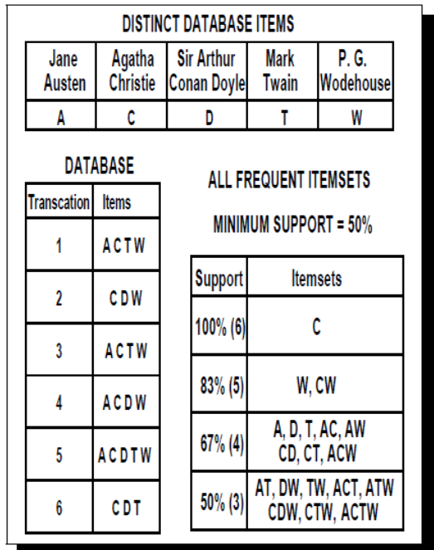


Properties
1. If t(X_{i})=t(X_{j})
c(X_{i} U X_{j})=c(X_{i})=c(X_{j})
ex: TAC <1, 3, 5> TWC<1, 3, 5>
TAWC <1, 3, 5>
2. If t(X_{i}) t(X_{j})
c(X_{i})≠c(X_{j}) but c(X_{i})=c(X_{i} U X_{j})
ex: D <2, 4 ,5, 6> C<1, 2, 3, 4, 5, 6>
DC <2, 4, 5, 6>
3. If t(X_{i}) t(X_{j})
c(X_{i})≠c(X_{j}) but c(X_{j})=c(X_{i} U X_{j})
4. If t(X_{i}) ≠t(X_{j})
c(X_{i})≠c(X_{j})≠c(X_{i} U X_{j})

Slide 52
Search Process using Tidsets
Minsup=3
{}
DC(2456)
D(2456)
TC(1356)
T(1356)
A(1345)
W(12345)
C(123456)
TAC(135)
TA(135)
TW(135)
TWC(135)
DT(56)
DA(45)
DWC(245)
DW(245)
TAWC(135)
根據規則四，t(T)<>t(W),所以新增TW
根據規則二，t(D)⊂t(DC),所以將D取代成DC
根據規則四，t(T)<>t(A),所以新增TA
根據規則二，t(T) ⊂ t(C)，所以更新所有節點。
根據規則四，t(D) <>t(W),所以新增DW

Slide 53
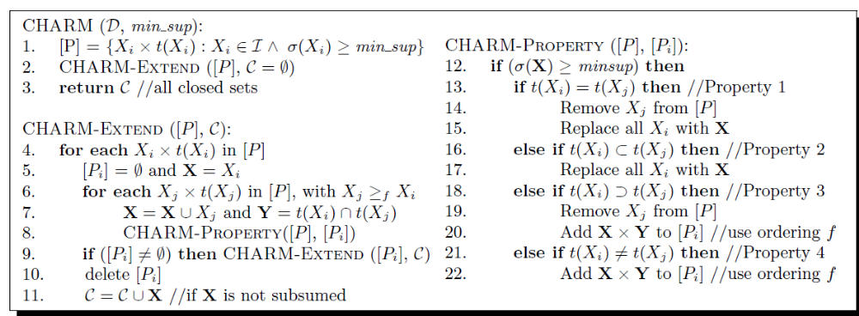
Subsumption checking
Hashing by tidset
Checking support when collision

