Slide 1
Bayesian Classification

Slide 2
Bayesian Classification: Why?
A statistical classifier: performs probabilistic prediction, i.e., predicts class membership probabilities
Foundation: Based on Bayes’ Theorem.
Performance: A simple Bayesian classifier, naïve Bayesian classifier, has comparable performance with decision tree and selected neural network classifiers
Incremental: Each training example can incrementally increase/decrease the probability that a hypothesis is correct — prior knowledge can be combined with observed data
Standard: Even when Bayesian methods are computationally intractable, they can provide a standard of optimal decision making against which other methods can be measured

Slide 3
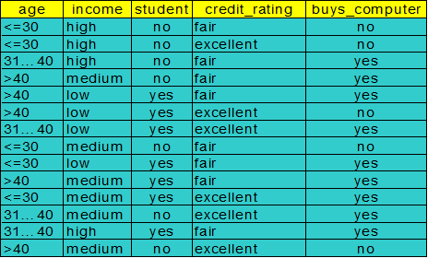
Bayesian Theorem: Basics
Let X be a data sample (“evidence”): class label is unknown
Let H be a hypothesis that X belongs to class C
Classification is to determine P(H|X), (posteriori probability), the probability that the hypothesis holds given the observed data sample X
P(yes|X) > P(no|X)
X => yes
P(yes|X) < P(no|X)
X => no

Slide 4
Bayesian Theorem: Basics
P(H) (prior probability), the initial probability
E.g., X will buy computer, regardless of age, income, …
P(X): probability that sample data is observed
P(X|H) (likelyhood), the probability of observing the sample X, given that the hypothesis holds
E.g., Given that X will buy computer, the prob. that X is 31..40, medium income

Slide 5
Recall a few probability basics
For events a and b:
Bayes’ Rule
Prior
Posterior
Likelihood

Slide 6
Bayesian Theorem
Given training data X, posteriori probability of a hypothesis H, P(H|X), follows the Bayes theorem
Informally, this can be written as
posteriori = likelihood x prior/evidence
Predicts X belongs to C_{i} iff the probability P(C_{i}|X) is the highest among all the P(C_{k}|X) for all the k classes
Practical difficulty: require initial knowledge of many probabilities, significant computational cost

Slide 7
Towards Naïve Bayesian Classifier
Let D be a training set of tuples and their associated class labels, and each tuple is represented by an n-D attribute vector X = (x₁, x₂, …, x_{n})
Suppose there are m classes C₁, C₂, …, C_{m}.
Classification is to derive the maximum posteriori, i.e., the maximal P(C_{i}|X)
This can be derived from Bayes’ theorem
Since P(X) is constant for all classes, only
needs to be maximized

Slide 8

Derivation of Naïve Bayes Classifier
A simplified assumption: attributes are conditionally independent (i.e., no dependence relation between attributes):
MLE

Slide 9
Naïve Bayesian Classifier: Training Dataset
Class:
C1:buys_computer = ‘yes’
C2:buys_computer = ‘no’
Data sample
X = (age <=30,
Income = medium,
Student = yes
Credit_rating = Fair)

Slide 10

Naïve Bayesian Classifier: An Example
X = (age <=30, Income = medium, Student = yes, Credit_rating = Fair)
P(yes|X)
P(yes) * P(age <=30|yes)*P(I=m|yes)*P(S=yes|yes)*P(CR=Fair|yes)
P(no|X)
P(no) * P(age <=30|no)*P(I=m|no)*P(S=yes|no)*P(CR=Fair|no)

Slide 11
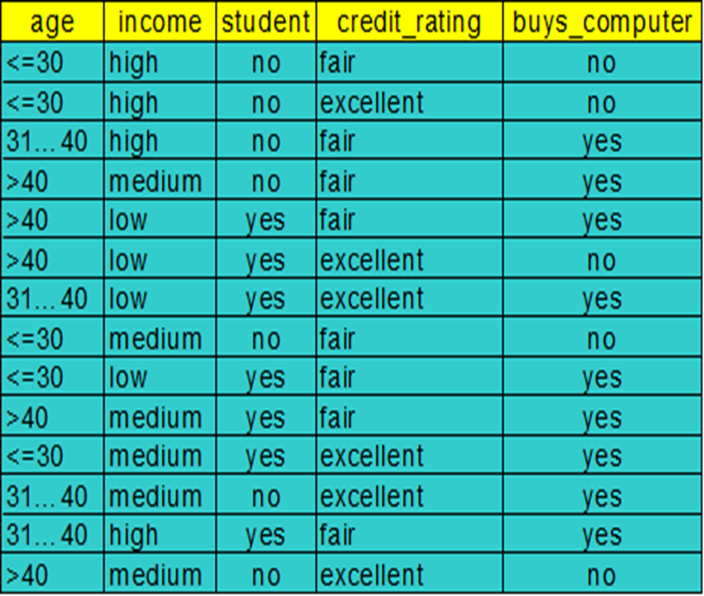
Naïve Bayesian Classifier: An Example
P(yes|X)
P(yes) * P(age <=30|yes) *P(I=m|yes)*P(S=yes|yes)*P(CR=Fair|yes)
P(yes)=9/14=0.643
P(age<=30|yes)=2/9
P(I=m|yes)=
P(S=yes|yes)=
P(CR=Fair|yes)=

Slide 12
Naïve Bayesian Classifier: An Example
P(C_{i}): P(buys_computer = “yes”) = 9/14 = 0.643
Compute P(X|yes) for each class
P(age = “<=30” | buys_computer = “yes”) = 2/9 = 0.222
P(income = “medium” | buys_computer = “yes”) = 4/9 = 0.444
P(student = “yes” | buys_computer = “yes) = 6/9 = 0.667
P(credit_rating = “fair” | buys_computer = “yes”) = 6/9 = 0.667
X = (age <= 30 , income = medium, student = yes, credit_rating = fair)
P(X|yes) : P(X|buys_computer = “yes”) = 0.222 x 0.444 x 0.667 x 0.667 = 0.044
P(yes|X)
P(X|C_{i})*P(C_{i}) : P(X|buys_computer = “yes”) * P(buys_computer = “yes”) = 0.028

Slide 13
Naïve Bayesian Classifier: An Example
P(C_{i}): P(buys_computer = “no”) = 5/14= 0.357
Compute P(X|no) for each class
P(age = “<= 30” | buys_computer = “no”) = 3/5 = 0.6
P(income = “medium” | buys_computer = “no”) = 2/5 = 0.4
P(student = “yes” | buys_computer = “no”) = 1/5 = 0.2
P(credit_rating = “fair” | buys_computer = “no”) = 2/5 = 0.4
X = (age <= 30 , income = medium, student = yes, credit_rating = fair)
P(X|no) : P(X|buys_computer = “yes”) = 0.222 x 0.444 x 0.667 x 0.667 = 0.044
P(X|buys_computer = “no”) = 0.6 x 0.4 x 0.2 x 0.4 = 0.019
P(no|X)
P(X|no)*P(no) : P(X|buys_computer = “no”) * P(buys_computer = “no”) = 0.007
P(yes|X)=0.028
Therefore, X belongs to class (“buys_computer = yes”)

Slide 14
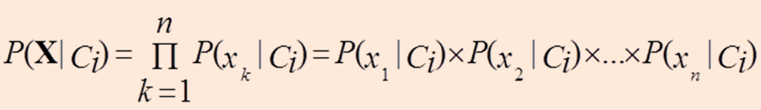
Smoothing to Avoid Overfitting
To eliminate zeros, we use add-one or Laplace smoothing
Ex. Suppose a dataset with 1000 tuples, income=low (0), income= medium (990), and income = high (10)
Use Laplacian correction (or Laplacian estimator)
Adding 1 to each case
Prob(income = low) = 1/1003
Prob(income = medium) = 991/1003
Prob(income = high) = 11/1003

Slide 15
Smoothing to Avoid Overfitting
P(yes|X)
P(yes) * P(age <=30|yes) *P(I=m|yes)*P(S=yes|yes)*P(CR=Fair|yes)
P(age<=30|yes)=(2+1)/(9+3)
P(I=m|yes)=(4+1)/(9+3)
P(S=yes|yes)=
P(CR=Fair|yes)=

Slide 16
Practice
student | Gender | Rating | Class label
Yes | M | Excellent | Y
Yes | M | Fair | Y
Yes | F | Fair | Y
Yes | F | Good | N
No | M | Fair | Y
No | M | Excellent | N
<student=yes, gender=F, Rating=Fair>
Class label=?

Slide 17
Underflow Prevention: log space
Multiplying lots of probabilities, which are between 0 and 1 by definition, can result in floating-point underflow.
Since log(xy) = log(x) + log(y), it is better to perform all computations by summing logs of probabilities rather than multiplying probabilities.
Class with highest final un-normalized log probability score is still the most probable.
Note that model is now just max of sum of weights…

Slide 18
Text classification
Model 1: Bernoulli
One feature X_{w} for each word in dictionary
X_{w} = true in document d if w appears in d
Naive Bayes assumption:
Given the document’s topic, appearance of one word in the document tells us nothing about chances that another word appears
This is the model used in the binary independence model in classic probabilistic relevance feedback in hand-classified data

Slide 19
Example

Slide 20
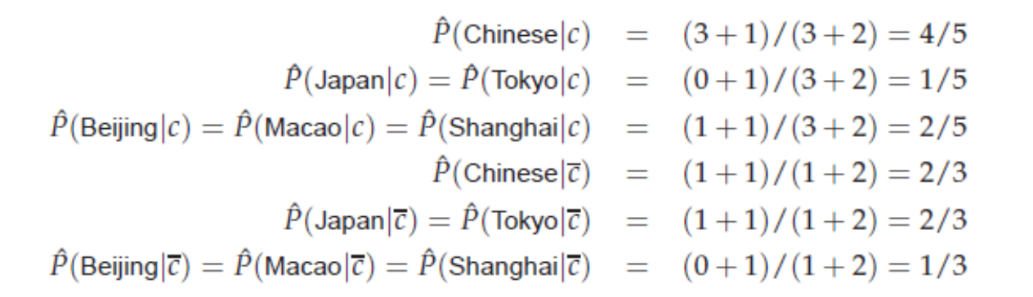

Slide 21
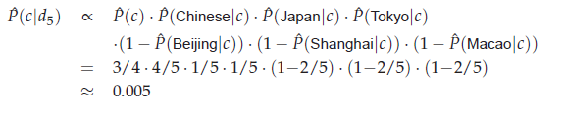

Slide 22

Text classification example(Bernoulli model)

Slide 23
Text classification
for all positions i,j, word w, and class c
Model 2: Multinomial = Class conditional unigram
One feature X_{i} for each word pos in document
feature’s values are all words in dictionary
Value of X_{i} is the word in position i
Naïve Bayes assumption:
Given the document’s topic, word in one position in the document tells us nothing about words in other positions
Word appearance does not depend on position
Just have one multinomial feature predicting all words

Slide 24
Using Multinomial Naive Bayes Classifiers to Classify Text: Basic method
Attributes are text positions, values are words.
Assume that classification is independent of the positions of the words
Use same parameters for each position
Result is bag of words model (over tokens not types)

Slide 25
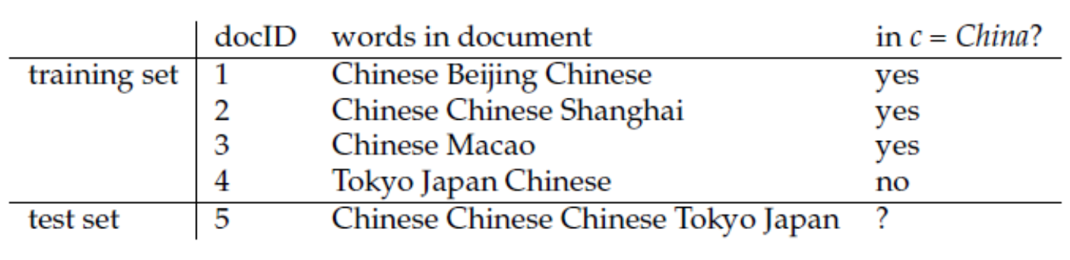
8
3
 | Beijing | Chinese | Macao | Japan | Tokyo | Shanghai
yes | 1 | 5 | 1 | 0 | 0 | 1
no | 0 | 1 | 0 | 1 | 1 | 0
P(c)=3/4, P(~c)=1/4
P(chinese|c)=(5+1)/(8+6)=3/7
P(Tokyo|c)=(0+1)/(8+6)=1/14
P(Japan|c)=(0+1)/(8+6)=1/14
P(chinese|~c)=(1+1)/(3+6)=2/9
P(tokyo|~c)=(1+1)/(3+6)=2/9
p(Japan|~c)=(1+1)/(3+6)=2/9
d5
c : (3/4)*(3/7)³*(1/14)*(1/14)=0.0003
~c:(1/4)*(2/9)³*(2/9)*(2/9)=0.0001

Slide 26
Naïve Bayesian Classifier: Comments
Advantages
Easy to implement
Good results obtained in most of the cases
Disadvantages
Assumption: class conditional independence, therefore loss of accuracy
Practically, dependencies exist among variables
E.g., hospitals: patients: Profile: age, family history, etc.
Symptoms: fever, cough etc., Disease: lung cancer, diabetes, etc.
Dependencies among these cannot be modeled by Naïve Bayesian Classifier
How to deal with these dependencies?
Bayesian Belief Networks

Slide 27
Bayesian Belief Networks
Bayesian belief network allows a subset of the variables conditionally independent
A graphical model of causal relationships
Represents dependency among the variables
Gives a specification of joint probability distribution
Nodes: random variables
Links: dependency
X and Y are the parents of Z, and Y is the parent of P
No dependency between Z and P
Has no loops or cycles
X
Y
Z
P

Slide 28
Bayesian Belief Network: An Example
Family
History
Smoker
The conditional probability table (CPT) for variable LungCancer:
(FH, S)
(FH, ~S)
(~FH, S)
(~FH, ~S)
LC
0.8
0.5
0.7
0.1
LungCancer
Emphysema
~LC
0.2
0.5
0.3
0.9
CPT shows the conditional probability for each possible combination of its parents
PositiveXRay
Dyspnea
Derivation of the probability of a particular combination of values of X, from CPT:
Bayesian Belief Networks

