Slide 1
Data Mining: Concepts and Techniques Classification
Jiawei Han, Micheline Kamber, and Jian Pei
University of Illinois at Urbana-Champaign &
Simon Fraser University
©2011 Han, Kamber & Pei. All rights reserved.
1
Notes:
1

Slide 2
Classification
Classification
predicts categorical class labels (discrete or nominal)
classifies data (constructs a model) based on the training set and the values (class labels) in a classifying attribute and uses it in classifying new data

Slide 3
Classification—A Two-Step Process
Model construction: describing a set of predetermined classes
Each tuple/sample is assumed to belong to a predefined class, as determined by the class label attribute
The set of tuples used for model construction is training set
The model is represented as classification rules, decision trees, or mathematical formulae
Model usage: for classifying future or unknown objects
Estimate accuracy of the model
The known label of test sample is compared with the classified result from the model
Accuracy rate is the percentage of test set samples that are correctly classified by the model
Test set is independent of training set, otherwise over-fitting will occur
If the accuracy is acceptable, use the model to classify data tuples whose class labels are not known

Slide 4
Process (1): Model Construction
Classification
Algorithms
Training
Data
Classifier
(Model)
IF rank = ‘professor’
OR years > 6
THEN tenured = ‘yes’

Slide 5
Process (2): Using the Model in Prediction
IF rank = ‘professor’
OR years > 6
THEN tenured = ‘yes’
Classifier
Testing
Data
Unseen Data
(Jeff, Professor, 4)
Tenured?

Slide 6
Supervised vs. Unsupervised Learning
Supervised learning (classification)
Supervision: The training data (observations, measurements, etc.) are accompanied by labels indicating the class of the observations
New data is classified based on the training set
Unsupervised learning (clustering)
The class labels of training data is unknown
Given a set of measurements, observations, etc. with the aim of establishing the existence of classes or clusters in the data

Slide 7
Evaluating Classification Methods
Accuracy
classifier accuracy: predicting class label
Speed
time to construct the model (training time)
time to use the model (classification/prediction time)
Robustness: handling noise and missing values
Scalability: efficiency in disk-resident databases
Interpretability
understanding and insight provided by the model
Other measures, e.g., goodness of rules, such as decision tree size or compactness of classification rules

Slide 8
Decision Tree Induction: An Example
Training data set: Buys_computer
Resulting tree:
[age>40, income=high, student=yes, c_r=fair]
age?
<=30
overcast
>40
31..40
student?
yes
credit rating?
no
yes
excellent
fair
no
yes
no
yes

Slide 9
Algorithm for Decision Tree Induction
Basic algorithm (a greedy algorithm)
Tree is constructed in a top-down recursive divide-and-conquer manner
At start, all the training examples are at the root
Attributes are categorical (if continuous-valued, they are discretized in advance)
Examples are partitioned recursively based on selected attributes
Test attributes are selected on the basis of a heuristic or statistical measure (e.g., information gain)
Conditions for stopping partitioning
All samples for a given node belong to the same class
There are no samples left
There are no remaining attributes for further partitioning – majority voting is employed for classifying the leaf

Slide 10
Attribute Selection Measure: Information Gain (ID3/C4.5)
Select the attribute with the highest information gain
Let p_{i} be the probability that an arbitrary tuple in D belongs to class C_{i}, estimated by |C_{i, D}|/|D|
Expected information (entropy) needed to classify a tuple in D:
Information needed (after using A to split D into v partitions) to classify D:
Information gained by branching on attribute A
Notes:
I : the expected information needed to classify a given sample
E (entropy) : expected information based on the partitioning into subsets by A

Slide 11
Attribute Selection: Information Gain
Class P: buys_computer = “yes”
Class N: buys_computer = “no”
Similarly,

Slide 12
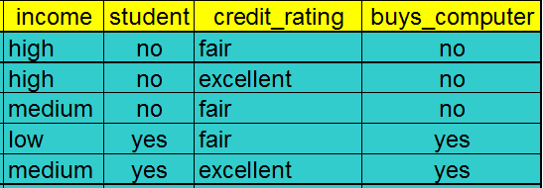
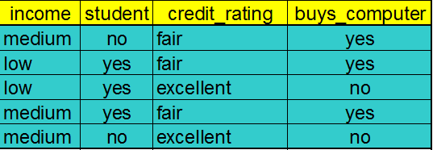
Decision tree
age?
<=30
>40
31..40
yes

Slide 13
Output: A Decision Tree for “buys_computer”
age?
<=30
overcast
>40
31..40
student?
yes
credit rating?
no
yes
excellent
fair
no
yes
no
yes

Slide 14
Practice
student | Gender | Rating | Class label
Yes | M | Excellent | Y
Yes | M | Fair | Y
Yes | F | Fair | Y
Yes | F | Good | N
No | M | Fair | N
No | F | Excellent | N

Slide 15
Gain Ratio for Attribute Selection (C4.5)
Information gain measure is biased towards attributes with a large number of values
C4.5 (a successor of ID3) uses gain ratio to overcome the problem (normalization to information gain)
GainRatio(A) = Gain(A)/SplitInfo(A)
Ex.
gain_ratio(income) = 0.029/1.557 = 0.019
The attribute with the maximum gain ratio is selected as the splitting attribute
Income
High 4
Medium 6
Low 4

Slide 16
Example
Student ID | Gender | Rating | Class label
01 | M | Excellent | Y
02 | M | Fair | Y
03 | F | Fair | Y
04 | F | Good | N
05 | M | Fair | N
06 | F | Excellent | N

Slide 17
Gini Index (CART, IBM IntelligentMiner)
If a data set D contains examples from n classes, gini index, gini(D) is defined as
where p_{j} is the relative frequency of class j in D
If a data set D is split on A into two subsets D₁ and D₂, the gini index gini(D) is defined as
Reduction in Impurity:
The attribute provides the smallest gini_{split}(D) (or the largest reduction in impurity) is chosen to split the node (need to enumerate all the possible splitting points for each attribute)

Slide 18
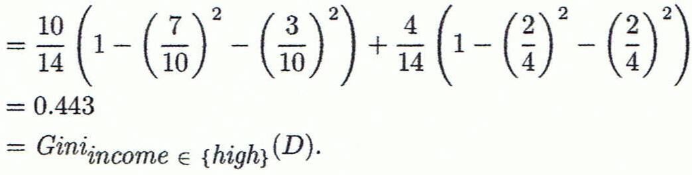
Computation of Gini Index
Ex. D has 9 tuples in buys_computer = “yes” and 5 in “no”
Suppose the attribute income partitions D into 10 in D₁: {low, medium} and 4 in D₂
Gini_{{low,high}} is 0.458; Gini_{{medium,high}} is 0.450. Thus, split on the {low,medium} (and {high}) since it has the lowest Gini index

Slide 19

{(low, high), medium} 0.458
{(medium, high), low} 0.450
income?
Low, medium
high
no
yes
no
yes

Slide 20
Comparing Attribute Selection Measures
The three measures, in general, return good results but
Information gain:
biased towards multivalued attributes
Gain ratio:
tends to prefer unbalanced splits in which one partition is much smaller than the others
Gini index:
biased to multivalued attributes
tends to favor tests that result in equal-sized partitions and purity in both partitions

Slide 21
Overfitting and Tree Pruning
Overfitting: An induced tree may overfit the training data
Too many branches, some may reflect anomalies due to noise or outliers
Poor accuracy for unseen samples
Two approaches to avoid overfitting
Prepruning: Halt tree construction early ̵ do not split a node if this would result in the goodness measure falling below a threshold
Difficult to choose an appropriate threshold
Postpruning: Remove branches from a “fully grown” tree—get a sequence of progressively pruned trees
Use a set of data different from the training data to decide which is the “best pruned tree”

Slide 22
Classification in Large Databases
Classification—a classical problem extensively studied by statisticians and machine learning researchers
Scalability: Classifying data sets with millions of examples and hundreds of attributes with reasonable speed
Why is decision tree induction popular?
relatively faster learning speed (than other classification methods)
convertible to simple and easy to understand classification rules
comparable classification accuracy with other methods

Slide 23
Entropy
Category : a, b
S₁={a, a, a, a, a, a}
S₂={a, a, a, b, b, b}

Slide 24
Example
Age | att₁ | att₂ | Class label
5 | … | … | N
10 | … | … | N
20 | … | … | Y
38 | … | … | Y
52 | … | … | N

Slide 25
Example
Age | att₁ | att₂ | Class label
5 | … | … | N
10 | … | … | N
20 | … | … | Y
38 | … | … | Y
52 | … | … | N

Slide 26
Computing Information-Gain for Continuous-Valued Attributes
Let attribute A be a continuous-valued attribute
Must determine the best split point for A
Sort the value A in increasing order
Typically, the midpoint between each pair of adjacent values is considered as a possible split point
(a_{i}+a_{i+1})/2 is the midpoint between the values of a_{i} and a_{i+1}
The point with the minimum expected information requirement for A is selected as the split-point for A
Split:
D1 is the set of tuples in D satisfying A ≤ split-point, and D2 is the set of tuples in D satisfying A > split-point

