Slide 1
Rule-Based Classification

Slide 2
Using IF-THEN Rules for Classification
precondition
Represent the knowledge in the form of IF-THEN rules
R: IF age = youth AND student = yes THEN buys_computer = yes
Assessment of a rule: coverage and accuracy
n_{covers} = # of tuples covered by R’s precondition
n_{correct} = # of tuples correctly classified by R
coverage(R) = n_{covers} /|D| /* D: training data set */
accuracy(R) = n_{correct} / n_{covers}
consequent
A | B | C | Label
1 | 0 | L | Y
1 | 0 | M | Y
0 | 1 | L | N
0 | 1 | M | Y
1 | 0 | H | N
IF A=1 AND B=0 Then Label=Y
coverage=3/5
accuracy=2/3

Slide 3
Using IF-THEN Rules for Classification
If more than one rule are triggered, need conflict resolution
Size ordering: assign the highest priority to the triggering rules that has the “toughest” requirement (i.e., with the most attribute tests)
Class-based ordering: decreasing order of prevalence or misclassification cost per class
Rule-based ordering (decision list): rules are organized into one long priority list, according to some measure of rule quality or by experts

Slide 4
Rule Extraction from a Decision Tree
age?
<=30
31..40
>40
Rules are easier to understand than large trees
One rule is created for each path from the root to a leaf
Each attribute-value pair along a path forms a conjunction: the leaf holds the class prediction
Rules are mutually exclusive and exhaustive
student?
yes
credit rating?
no
yes
excellent
fair
no
yes
no
yes
Example: Rule extraction from our buys_computer decision-tree
IF age = young AND student = no THEN buys_computer = no
IF age = young AND student = yes THEN buys_computer = yes
IF age = mid-age THEN buys_computer = yes
IF age = old AND credit_rating = excellent THEN buys_computer = no
IF age = old AND credit_rating = fair THEN buys_computer = yes

Slide 5
Rule Induction: Sequential Covering Method
Sequential covering algorithm: Extracts rules directly from training data
Typical sequential covering algorithms: FOIL, AQ, CN2, RIPPER
Rules are learned sequentially, each for a given class C_{i} will cover many tuples of C_{i} but none (or few) of the tuples of other classes
Steps:
Rules are learned one at a time
Each time a rule is learned, the tuples covered by the rules are removed
The process repeats on the remaining tuples unless termination condition, e.g., when no more training examples or when the quality of a rule returned is below a user-specified threshold
Comp. w. decision-tree induction: learning a set of rules simultaneously

Slide 6
Sequential Covering Algorithm
while (enough target tuples left)
generate a rule
remove positive target tuples satisfying this rule
Examples covered
by Rule 2
Examples covered
by Rule 1
Examples covered
by Rule 3
Positive examples

Slide 7
Rule Generation
To generate a rule
while(true)
find the best predicate p
if foil-gain(p) > threshold then add p to current rule
else break
A3=1
A3=1&&A1=2
A3=1&&A1=2
&&A8=5
Positive examples
Negative examples

Slide 8
How to Learn-One-Rule?
Start with the most general rule possible: condition = empty
Adding new attributes by adopting a greedy depth-first strategy
Picks the one that most improves the rule quality
Rule-Quality measures: consider both coverage and accuracy
Foil-gain (in FOIL & RIPPER): assesses info_gain by extending condition
favors rules that have high accuracy and cover many positive tuples
R: A₁=“red” && A₃=“high”
Pos’:95, neg’: 5
-0.074
95*(-0.074+0.263)=17.955
R: A₁=“red”
Pos:100, neg:20
= -0.263

Slide 9
Other Classfiers

Slide 10
Genetic Algorithms (GA)
Genetic Algorithm: based on an analogy to biological evolution
An initial population is created consisting of randomly generated rules
Each rule is represented by a string of bits
E.g., if A₁ and ¬A₂ then C₂ can be encoded as 100
If an attribute has k > 2 values, k bits can be used
Based on the notion of survival of the fittest, a new population is formed to consist of the fittest rules and their offsprings
The fitness of a rule is represented by its classification accuracy on a set of training examples
Offsprings are generated by crossover and mutation
The process continues until a population P evolves when each rule in P satisfies a prespecified threshold
Slow but easily parallelizable

Slide 11
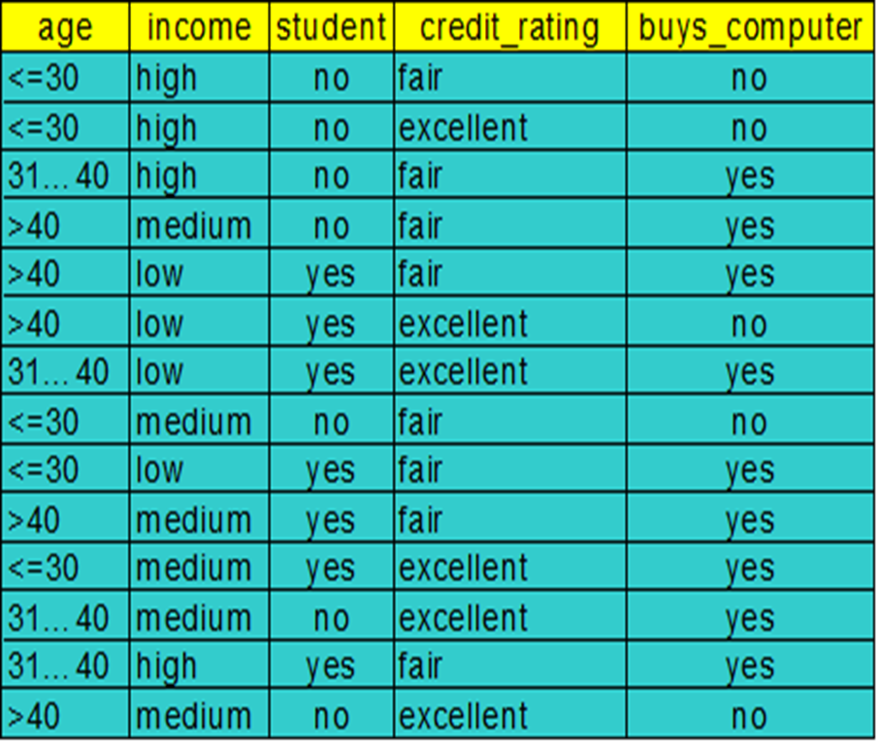
1 - - - 1
4/4
- 0 1 - 0
….

Slide 12
1 - - - 1
4/4
- 0 1 - 0
1/4
….

Slide 13
Example
Crossover
1 0 – 1 1 and 2 – 1 1 1
=> 2 0 – 1 1
Mutation
1 0 – 1 1 => 1 - - 1 1

Slide 14
Lazy Learner: Instance-Based Methods
Instance-based learning:
Store training examples and delay the processing (“lazy evaluation”) until a new instance must be classified
Typical approaches
k-nearest neighbor approach
Instances represented as points in a Euclidean space.
Locally weighted regression
Constructs local approximation
Case-based reasoning
Uses symbolic representations and knowledge-based inference

Slide 15
The k-Nearest Neighbor Algorithm
All instances correspond to points in the n-D space
The nearest neighbor are defined in terms of Euclidean distance, dist(X₁, X₂)
Target function could be discrete- or real- valued
For discrete-valued, k-NN returns the most common value among the k training examples nearest to x_{q}
Vonoroi diagram: the decision surface induced by 1-NN for a typical set of training examples
_
.
_
_
.
+
_
.
+
.
.
_
x_{q}
+
_
.
+

Slide 16
Discussion on the k-NN Algorithm
k-NN for real-valued prediction for a given unknown tuple
Returns the mean values of the k nearest neighbors
Distance-weighted nearest neighbor algorithm
Weight the contribution of each of the k neighbors according to their distance to the query x_{q}
Give greater weight to closer neighbors
Robust to noisy data by averaging k-nearest neighbors
Curse of dimensionality: distance between neighbors could be dominated by irrelevant attributes
To overcome it, elimination of the least relevant attributes

Slide 17
Lazy vs. Eager Learning
Lazy vs. eager learning
Lazy learning (e.g., instance-based learning): Simply stores training data (or only minor processing) and waits until it is given a test tuple
Eager learning (the above discussed methods): Given a set of training set, constructs a classification model before receiving new (e.g., test) data to classify
Lazy: less time in training but more time in predicting

Slide 18
Model Evaluation and Selection

Slide 19
Model Evaluation and Selection
Use test set of class-labeled tuples instead of training set when assessing accuracy
Classifier Evaluation Metrics
Accuracy
Error Rate
Sensitivity
Specificity
Precision
Recall
F measure
…
19

Slide 20
Classifier Evaluation Metrics: Confusion Matrix
Confusion Matrix:
Actual class\Predicted class | C₁ | ¬ C₁
C₁ | True Positives (TP) | False Negatives (FN)
¬ C₁ | False Positives (FP) | True Negatives (TN)
Example of Confusion Matrix:
Actual class\Predicted class | buy_computer = yes | buy_computer = no | Total
buy_computer = yes | 6954 | 46 | 7000
buy_computer = no | 412 | 2588 | 3000
Total | 7366 | 2634 | 10000
Given m classes, an entry, CM_{i,j} in a confusion matrix indicates # of tuples in class i that were labeled by the classifier as class j
May have extra rows/columns to provide totals
20

Slide 21
Classifier Evaluation Metrics: Accuracy, Error Rate, Sensitivity and Specificity
A\P | C | ¬C
C | TP | FN | P
¬C | FP | TN | N
 | P’ | N’ | All
Class Imbalance Problem:
One class may be rare, e.g. fraud, or HIV-positive
Significant majority of the negative class and minority of the positive class
Sensitivity: True Positive recognition rate
Sensitivity = TP/P
Specificity: True Negative recognition rate
Specificity = TN/N
Classifier Accuracy, or recognition rate: percentage of test set tuples that are correctly classified
Accuracy = (TP + TN)/All
Error rate: 1 – accuracy, or
Error rate = (FP + FN)/All
21

Slide 22
Example
Actual class\Predicted class | buy_computer = yes | buy_computer = no | Total
buy_computer = yes | 6954 | 46 | 7000
buy_computer = no | 412 | 2588 | 3000
Total | 7366 | 2634 | 10000
Classifier Accuracy, or recognition rate: percentage of test set tuples that are correctly classified
Accuracy = (TP + TN)/All
Error rate: 1 – accuracy, or
Error rate = (FP + FN)/All
Accuracy
(6954+2588)/10000
=9542/10000=0.9542
Error rate
1-0.9542=0.0458

Slide 23
Example
Actual class\Predicted class | buy_computer = yes | buy_computer = no | Total
buy_computer = yes | 6954 | 46 | 7000
buy_computer = no | 412 | 2588 | 3000
Total | 7366 | 2634 | 10000
Sensitivity: True Positive recognition rate
Sensitivity = TP/P
Specificity: True Negative recognition rate
Specificity = TN/N
Sensitivity
6954/7000
=0.9934
Specificity
2588/3000
=0.8627

Slide 24
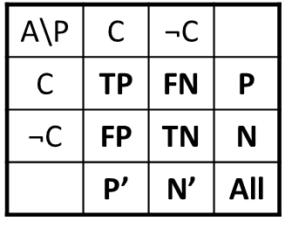
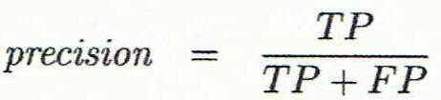
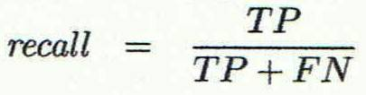
Classifier Evaluation Metrics: Precision and Recall, and F-measures
Precision: exactness – what % of tuples that the classifier labeled as positive are actually positive
Recall: completeness – what % of positive tuples did the classifier label as positive?
Inverse relationship between precision & recall
24

Slide 25
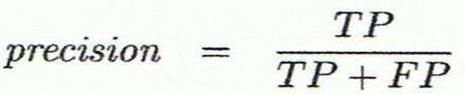
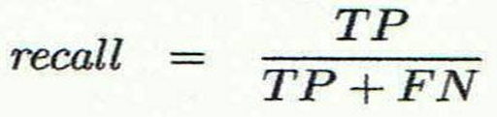
Example
Actual class\Predicted class | buy_computer = yes | buy_computer = no | Total
buy_computer = yes | 6954 | 46 | 7000
buy_computer = no | 412 | 2588 | 3000
Total | 7366 | 2634 | 10000
Precision: exactness
Recall: completeness
Precision
6954/7366
=0.9441
Recall
6954/7000
=0.9934

Slide 26
Precision/Recall
You can get high recall (but low precision) by retrieving all docs for all queries!
Recall is a non-decreasing function of the number of docs retrieved
A system that returns all docs has 100% recall!
In a good system, precision decreases as either the number of docs retrieved or recall increases
This is not a theorem, but a result with strong empirical confirmation

Slide 27
A combined measure: F
Combined measure that assesses precision/recall tradeoff is F measure (weighted harmonic mean):
People usually use balanced F₁ measure
i.e., with β = 1 or α = ½

Slide 28
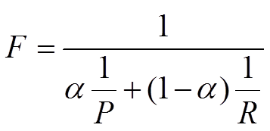
Classifier Evaluation Metrics: Example
Actual Class\Predicted class | cancer = yes | cancer = no | Total | Recognition(%)
cancer = yes | 90 | 210 | 300 | 30.00 (sensitivity)
cancer = no | 140 | 9560 | 9700 | 98.56 (specificity)
Total | 230 | 9770 | 10000 | 96.40 (accuracy)
Precision = 90/230 = 39.13% Recall = 90/300 = 30.00%
F1=
28

Slide 29
Model Evaluation and Selection
How to select test data?
Methods for estimating a classifier’s accuracy:
Holdout method, random subsampling
Cross-validation
Bootstrap
29

Slide 30
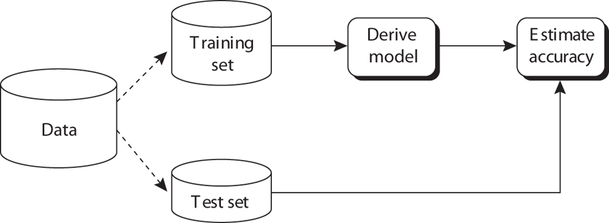
Evaluating Classifier Accuracy: Holdout
Holdout method
Given data is randomly partitioned into two independent sets
Training set (e.g., 2/3) for model construction
Test set (e.g., 1/3) for accuracy estimation
Random sampling: a variation of holdout
Repeat holdout k times, accuracy = avg. of the accuracies obtained
30

Slide 31
Evaluating Classifier Accuracy: Cross-Validation Methods
Cross-validation (k-fold, where k = 10 is most popular)
Randomly partition the data into k mutually exclusive subsets, each approximately equal size
At i-th iteration, use D_{i} as test set and others as training set
Leave-one-out: k folds where k = # of tuples, for small sized data
31

Slide 32

Evaluating Classifier Accuracy: Bootstrap
Bootstrap
Works well with small data sets
Samples the given training tuples uniformly with replacement
i.e., each time a tuple is selected, it is equally likely to be selected again and re-added to the training set
Several bootstrap methods, and a common one is .632 boostrap
A data set with d tuples is sampled d times, with replacement, resulting in a training set of d samples. The data tuples that did not make it into the training set end up forming the test set. About 63.2% of the original data end up in the bootstrap, and the remaining 36.8% form the test set (since (1 – 1/d)^{d} ≈ e⁻¹ = 0.368)
Repeat the sampling procedure k times, overall accuracy of the model:
32

Slide 33
Model Evaluation and Selection
Suppose we have 2 classifiers, M₁ and M₂, which one is better?
33

Slide 34


Estimating Confidence Intervals: Classifier Models M₁ vs. M₂
Use 10-fold cross-validation to obtain and
These mean error rates are just estimates of error on the true population of future data cases
What if the difference between the 2 error rates is just attributed to chance?
Use a test of statistical significance
Obtain confidence limits for our error estimates
34

Slide 35
Estimating Confidence Intervals: Null Hypothesis
Perform 10-fold cross-validation
Assume samples follow a t distribution with k–1 degrees of freedom (here, k=10)
Use t-test (or Student’s t-test)
Null Hypothesis: M₁ & M₂ are the same
If we can reject null hypothesis, then
we conclude that the difference between M₁ & M₂ is statistically significant
Chose model with lower error rate
35

Slide 36
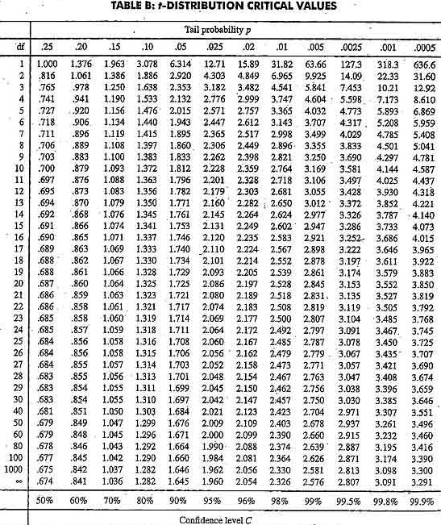
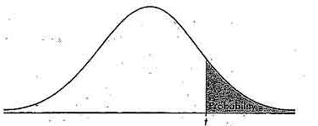
Estimating Confidence Intervals: Table for t-distribution
Symmetric
Significance level, e.g., sig = 0.05 or 5% means M₁ & M₂ are significantly different for 95% of population
Confidence limit, z = sig/2
36

Slide 37
Estimating Confidence Intervals: Statistical Significance
Are M₁ & M₂ significantly different?
Compute t. Select significance level (e.g. sig = 5%)
Consult table for t-distribution: Find t value corresponding to k-1 degrees of freedom (here, 9)
t-distribution is symmetric: typically upper % points of distribution shown → look up value for confidence limit z=sig/2 (here, 0.025)
If t > z or t < -z, then t value lies in rejection region:
Reject null hypothesis that mean error rates of M₁ & M₂ are same
Conclude: statistically significant difference between M₁ & M₂
Otherwise, conclude that any difference is chance
37

Slide 38
Issues Affecting Model Selection
Accuracy
classifier accuracy: predicting class label
Speed
time to construct the model (training time)
time to use the model (classification/prediction time)
Robustness: handling noise and missing values
Scalability: efficiency in disk-resident databases
Interpretability
understanding and insight provided by the model
Other measures, e.g., goodness of rules, such as decision tree size or compactness of classification rules
38
Notes:
38

Slide 39
Techniques to Improve Classification Accuracy

Slide 40
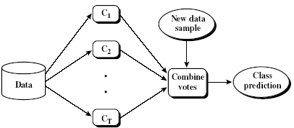
Ensemble Methods: Increasing the Accuracy
Ensemble methods
Use a combination of models to increase accuracy
Combine a series of k learned models, M₁, M₂, …, M_{k}, with the aim of creating an improved model M*
Popular ensemble methods
Bagging: averaging the prediction over a collection of classifiers
Boosting: weighted vote with a collection of classifiers
40

Slide 41
Bagging: Boostrap Aggregation
Analogy: Diagnosis based on multiple doctors’ majority vote
Training
Given a set D of d tuples, at each iteration i, a training set D_{i} of d tuples is sampled with replacement from D (i.e., bootstrap)
A classifier model M_{i} is learned for each training set D_{i}
Classification: classify an unknown sample X
Each classifier M_{i} returns its class prediction
The bagged classifier M* counts the votes and assigns the class with the most votes to X
Prediction: can be applied to the prediction of continuous values by taking the average value of each prediction for a given test tuple
Accuracy
Often significantly better than a single classifier derived from D
For noise data: not considerably worse, more robust
Proved improved accuracy in prediction
41

Slide 42
Boosting
Analogy: Consult several doctors, based on a combination of weighted diagnoses—weight assigned based on the previous diagnosis accuracy
How boosting works?
Weights are assigned to each training tuple
A series of k classifiers is iteratively learned
After a classifier M_{i} is learned, the weights are updated to allow the subsequent classifier, M_{i+1}, to pay more attention to the training tuples that were misclassified by M_{i}
The final M* combines the votes of each individual classifier, where the weight of each classifier's vote is a function of its accuracy
Boosting algorithm can be extended for numeric prediction
Comparing with bagging: Boosting tends to have greater accuracy, but it also risks overfitting the model to misclassified data
42

Slide 43
Adaboost (Freund and Schapire, 1997)
Given a set of d class-labeled tuples, (X₁, y₁), …, (X_{d}, y_{d})
Initially, all the weights of tuples are set the same (1/d)
Generate k classifiers in k rounds. At round i,
Tuples from D are sampled (with replacement) to form a training set D_{i} of the same size
Each tuple’s chance of being selected is based on its weight
A classification model M_{i} is derived from D_{i}
Its error rate is calculated using D_{i} as a test set
If a tuple is misclassified, its weight is increased, o.w. it is decreased
Error rate: err(X_{j}) is the misclassification error of tuple X_{j}. Classifier M_{i} error rate is the sum of the weights of the misclassified tuples:
The weight of classifier M_{i}’s vote is

Slide 44
Classification of Class-Imbalanced Data Sets
Class-imbalance problem: Rare positive example but numerous negative ones, e.g., medical diagnosis, fraud, oil-spill, fault, etc.
Traditional methods assume a balanced distribution of classes and equal error costs: not suitable for class-imbalanced data
Typical methods for imbalance data in 2-class classification:
Oversampling: re-sampling of data from positive class
Under-sampling: randomly eliminate tuples from negative class
Threshold-moving: moves the decision threshold, t, so that the rare class tuples are easier to classify, and hence, less chance of costly false negative errors
Ensemble techniques: Ensemble multiple classifiers introduced above
Still difficult for class imbalance problem on multiclass tasks
44

Slide 45
Summary
Classification is a form of data analysis that extracts models describing important data classes.
Effective and scalable methods have been developed for decision tree induction, Naive Bayesian classification, rule-based classification, and many other classification methods.
Evaluation metrics include: accuracy, sensitivity, specificity, precision, recall, F measure, and F_{ß} measure.
Bagging and boosting can be used to increase overall accuracy by learning and combining a series of individual models.
Significance tests are useful for model selection.
No single method has been found to be superior over all others for all data sets
45

Slide 46
Reference: Books on Classification
E. Alpaydin. Introduction to Machine Learning, 2nd ed., MIT Press, 2011
L. Breiman, J. Friedman, R. Olshen, and C. Stone. Classification and Regression Trees. Wadsworth International Group, 1984.
C. M. Bishop. Pattern Recognition and Machine Learning. Springer, 2006.
R. O. Duda, P. E. Hart, and D. G. Stork. Pattern Classification, 2ed. John Wiley, 2001
T. Hastie, R. Tibshirani, and J. Friedman. The Elements of Statistical Learning: Data Mining, Inference, and Prediction. Springer-Verlag, 2001
H. Liu and H. Motoda (eds.). Feature Extraction, Construction, and Selection: A Data Mining Perspective. Kluwer Academic, 1998T. M. Mitchell. Machine Learning. McGraw Hill, 1997
S. Marsland. Machine Learning: An Algorithmic Perspective. Chapman and Hall/CRC, 2009.
J. R. Quinlan. C4.5: Programs for Machine Learning. Morgan Kaufmann, 1993
J. W. Shavlik and T. G. Dietterich. Readings in Machine Learning. Morgan Kaufmann, 1990.
P. Tan, M. Steinbach, and V. Kumar. Introduction to Data Mining. Addison Wesley, 2005.
S. M. Weiss and C. A. Kulikowski. Computer Systems that Learn: Classification and Prediction Methods from Statistics, Neural Nets, Machine Learning, and Expert Systems. Morgan Kaufman, 1991.
S. M. Weiss and N. Indurkhya. Predictive Data Mining. Morgan Kaufmann, 1997.
I. H. Witten and E. Frank. Data Mining: Practical Machine Learning Tools and Techniques, 2ed. Morgan Kaufmann, 2005.

Slide 47
Reference: Decision-Trees
M. Ankerst, C. Elsen, M. Ester, and H.-P. Kriegel. Visual classification: An interactive approach to decision tree construction. KDD'99
C. Apte and S. Weiss. Data mining with decision trees and decision rules. Future Generation Computer Systems, 13, 1997
C. E. Brodley and P. E. Utgoff. Multivariate decision trees. Machine Learning, 19:45–77, 1995.
P. K. Chan and S. J. Stolfo. Learning arbiter and combiner trees from partitioned data for scaling machine learning. KDD'95
U. M. Fayyad. Branching on attribute values in decision tree generation. AAAI’94
M. Mehta, R. Agrawal, and J. Rissanen. SLIQ : A fast scalable classifier for data mining. EDBT'96.
J. Gehrke, R. Ramakrishnan, and V. Ganti. Rainforest: A framework for fast decision tree construction of large datasets. VLDB’98.
J. Gehrke, V. Gant, R. Ramakrishnan, and W.-Y. Loh, BOAT -- Optimistic Decision Tree Construction. SIGMOD'99.
S. K. Murthy, Automatic Construction of Decision Trees from Data: A Multi-Disciplinary Survey, Data Mining and Knowledge Discovery 2(4): 345-389, 1998
J. R. Quinlan. Induction of decision trees. Machine Learning, 1:81-106, 1986
J. R. Quinlan and R. L. Rivest. Inferring decision trees using the minimum description length principle. Information and Computation, 80:227–248, Mar. 1989
S. K. Murthy. Automatic construction of decision trees from data: A multi-disciplinary survey. Data Mining and Knowledge Discovery, 2:345–389, 1998.
R. Rastogi and K. Shim. Public: A decision tree classifier that integrates building and pruning. VLDB’98.
J. Shafer, R. Agrawal, and M. Mehta. SPRINT : A scalable parallel classifier for data mining. VLDB’96
Y.-S. Shih. Families of splitting criteria for classification trees. Statistics and Computing, 9:309–315, 1999.

Slide 48
Reference: Neural Networks
C. M. Bishop, Neural Networks for Pattern Recognition. Oxford University Press, 1995
Y. Chauvin and D. Rumelhart. Backpropagation: Theory, Architectures, and Applications. Lawrence Erlbaum, 1995
J. W. Shavlik, R. J. Mooney, and G. G. Towell. Symbolic and neural learning algorithms: An experimental comparison. Machine Learning, 6:111–144, 1991
S. Haykin. Neural Networks and Learning Machines. Prentice Hall, Saddle River, NJ, 2008
J. Hertz, A. Krogh, and R. G. Palmer. Introduction to the Theory of Neural Computation. Addison Wesley, 1991.
R. Hecht-Nielsen. Neurocomputing. Addison Wesley, 1990
B. D. Ripley. Pattern Recognition and Neural Networks. Cambridge University Press, 1996

Slide 49
Reference: Support Vector Machines
C. J. C. Burges. A Tutorial on Support Vector Machines for Pattern Recognition. Data Mining and Knowledge Discovery, 2(2): 121-168, 1998
N. Cristianini and J. Shawe-Taylor. An Introduction to Support Vector Machines and Other Kernel-Based Learning Methods. Cambridge Univ. Press, 2000.
H. Drucker, C. J. C. Burges, L. Kaufman, A. Smola, and V. N. Vapnik. Support vector regression machines, NIPS, 1997
J. C. Platt. Fast training of support vector machines using sequential minimal optimization. In B. Schoelkopf, C. J. C. Burges, and A. Smola, editors, Advances in Kernel Methods|Support Vector Learning, pages 185–208. MIT Press, 1998
B. Schl¨okopf, P. L. Bartlett, A. Smola, and R. Williamson. Shrinking the tube: A new support vector regression algorithm. NIPS, 1999.
H. Yu, J. Yang, and J. Han. Classifying large data sets using SVM with hierarchical clusters. KDD'03.

Slide 50
Reference: Pattern-Based Classification
H. Cheng, X. Yan, J. Han, and C.-W. Hsu, Discriminative Frequent Pattern Analysis for Effective Classification, ICDE'07
H. Cheng, X. Yan, J. Han, and P. S. Yu, Direct Discriminative Pattern Mining for Effective Classification, ICDE'08
G. Cong, K.-L. Tan, A. K. H. Tung, and X. Xu. Mining top-k covering rule groups for gene expression data. SIGMOD'05
G. Dong and J. Li. Efficient mining of emerging patterns: Discovering trends and differences. KDD'99
H. S. Kim, S. Kim, T. Weninger, J. Han, and T. Abdelzaher. NDPMine: Efficiently mining discriminative numerical features for pattern-based classification. ECMLPKDD'10
W. Li, J. Han, and J. Pei, CMAR: Accurate and Efficient Classification Based on Multiple Class-Association Rules, ICDM'01
B. Liu, W. Hsu, and Y. Ma. Integrating classification and association rule mining. KDD'98
J. Wang and G. Karypis. HARMONY: Efficiently mining the best rules for classification. SDM'05

Slide 51
References: Rule Induction
P. Clark and T. Niblett. The CN2 induction algorithm. Machine Learning, 3:261–283, 1989.
W. Cohen. Fast effective rule induction. ICML'95
S. L. Crawford. Extensions to the CART algorithm. Int. J. Man-Machine Studies, 31:197–217, Aug. 1989
J. R. Quinlan and R. M. Cameron-Jones. FOIL: A midterm report. ECML’93
P. Smyth and R. M. Goodman. An information theoretic approach to rule induction. IEEE Trans. Knowledge and Data Engineering, 4:301–316, 1992.
X. Yin and J. Han. CPAR: Classification based on predictive association rules. SDM'03
51

Slide 52
References: K-NN & Case-Based Reasoning
A. Aamodt and E. Plazas. Case-based reasoning: Foundational issues, methodological variations, and system approaches. AI Comm., 7:39–52, 1994.
T. Cover and P. Hart. Nearest neighbor pattern classification. IEEE Trans. Information Theory, 13:21–27, 1967
B. V. Dasarathy. Nearest Neighbor (NN) Norms: NN Pattern Classication Techniques. IEEE Computer Society Press, 1991
J. L. Kolodner. Case-Based Reasoning. Morgan Kaufmann, 1993
A. Veloso, W. Meira, and M. Zaki. Lazy associative classification. ICDM'06

Slide 53
References: Bayesian Method & Statistical Models
A. J. Dobson. An Introduction to Generalized Linear Models. Chapman & Hall, 1990.
D. Heckerman, D. Geiger, and D. M. Chickering. Learning Bayesian networks: The combination of knowledge and statistical data. Machine Learning, 1995.
G. Cooper and E. Herskovits. A Bayesian method for the induction of probabilistic networks from data. Machine Learning, 9:309–347, 1992
A. Darwiche. Bayesian networks. Comm. ACM, 53:80–90, 2010
A. P. Dempster, N. M. Laird, and D. B. Rubin. Maximum likelihood from incomplete data via the EM algorithm. J. Royal Statistical Society, Series B, 39:1–38, 1977
D. Heckerman, D. Geiger, and D. M. Chickering. Learning Bayesian networks: The combination of knowledge and statistical data. Machine Learning, 20:197–243, 1995
F. V. Jensen. An Introduction to Bayesian Networks. Springer Verlag, 1996.
D. Koller and N. Friedman. Probabilistic Graphical Models: Principles and Techniques. The MIT Press, 2009
J. Pearl. Probabilistic Reasoning in Intelligent Systems. Morgan Kauffman, 1988
S. Russell, J. Binder, D. Koller, and K. Kanazawa. Local learning in probabilistic networks with hidden variables. IJCAI'95
V. N. Vapnik. Statistical Learning Theory. John Wiley & Sons, 1998.
53

Slide 54
Refs: Semi-Supervised & Multi-Class Learning
O. Chapelle, B. Schoelkopf, and A. Zien. Semi-supervised Learning. MIT Press, 2006
T. G. Dietterich and G. Bakiri. Solving multiclass learning problems via error-correcting output codes. J. Articial Intelligence Research, 2:263–286, 1995
W. Dai, Q. Yang, G. Xue, and Y. Yu. Boosting for transfer learning. ICML’07
S. J. Pan and Q. Yang. A survey on transfer learning. IEEE Trans. on Knowledge and Data Engineering, 22:1345–1359, 2010
B. Settles. Active learning literature survey. In Computer Sciences Technical Report 1648, Univ. Wisconsin-Madison, 2010
X. Zhu. Semi-supervised learning literature survey. CS Tech. Rep. 1530, Univ. Wisconsin-Madison, 2005

Slide 55
Refs: Genetic Algorithms & Rough/Fuzzy Sets
D. Goldberg. Genetic Algorithms in Search, Optimization, and Machine Learning. Addison-Wesley, 1989
S. A. Harp, T. Samad, and A. Guha. Designing application-specific neural networks using the genetic algorithm. NIPS, 1990
Z. Michalewicz. Genetic Algorithms + Data Structures = Evolution Programs. Springer Verlag, 1992.
M. Mitchell. An Introduction to Genetic Algorithms. MIT Press, 1996
Z. Pawlak. Rough Sets, Theoretical Aspects of Reasoning about Data. Kluwer Academic, 1991
S. Pal and A. Skowron, editors, Fuzzy Sets, Rough Sets and Decision Making Processes. New York, 1998
R. R. Yager and L. A. Zadeh. Fuzzy Sets, Neural Networks and Soft Computing. Van Nostrand Reinhold, 1994

Slide 56
References: Model Evaluation, Ensemble Methods
L. Breiman. Bagging predictors. Machine Learning, 24:123–140, 1996.
L. Breiman. Random forests. Machine Learning, 45:5–32, 2001.
C. Elkan. The foundations of cost-sensitive learning. IJCAI'01
B. Efron and R. Tibshirani. An Introduction to the Bootstrap. Chapman & Hall, 1993.
J. Friedman and E. P. Bogdan. Predictive learning via rule ensembles. Ann. Applied Statistics, 2:916–954, 2008.
T.-S. Lim, W.-Y. Loh, and Y.-S. Shih. A comparison of prediction accuracy, complexity, and training time of thirty-three old and new classification algorithms. Machine Learning, 2000.
J. Magidson. The Chaid approach to segmentation modeling: Chi-squared automatic interaction detection. In R. P. Bagozzi, editor, Advanced Methods of Marketing Research, Blackwell Business, 1994.
J. R. Quinlan. Bagging, boosting, and c4.5. AAAI'96.
G. Seni and J. F. Elder. Ensemble Methods in Data Mining: Improving Accuracy Through Combining Predictions. Morgan and Claypool, 2010.
Y. Freund and R. E. Schapire. A decision-theoretic generalization of on-line learning and an application to boosting. J. Computer and System Sciences, 1997
56

Slide 57
Maximum Likelihood Estimation

Slide 58
Example
1, 0, 1, 0, 0, 0, 0, 0, 0, 1
Suppose observations are independent of one another.
The joint pmf evaluated at the observed X_{i}’s is
f (x₁, . . . , x₁₀; p) = p(1 – p)p . . . p = p³(1 – p)⁷

Slide 59
Example
f (x₁, . . . , x₁₀; p) = p(1 – p)p . . . p = p³(1 – p)⁷
Suppose that p = .25.
The probability of observing the sample that we actually obtained is (.25)³(.75)⁷ = .002086.
If instead p = .50
The probability is (.50)³(.50)⁷ = .000977.

Slide 60
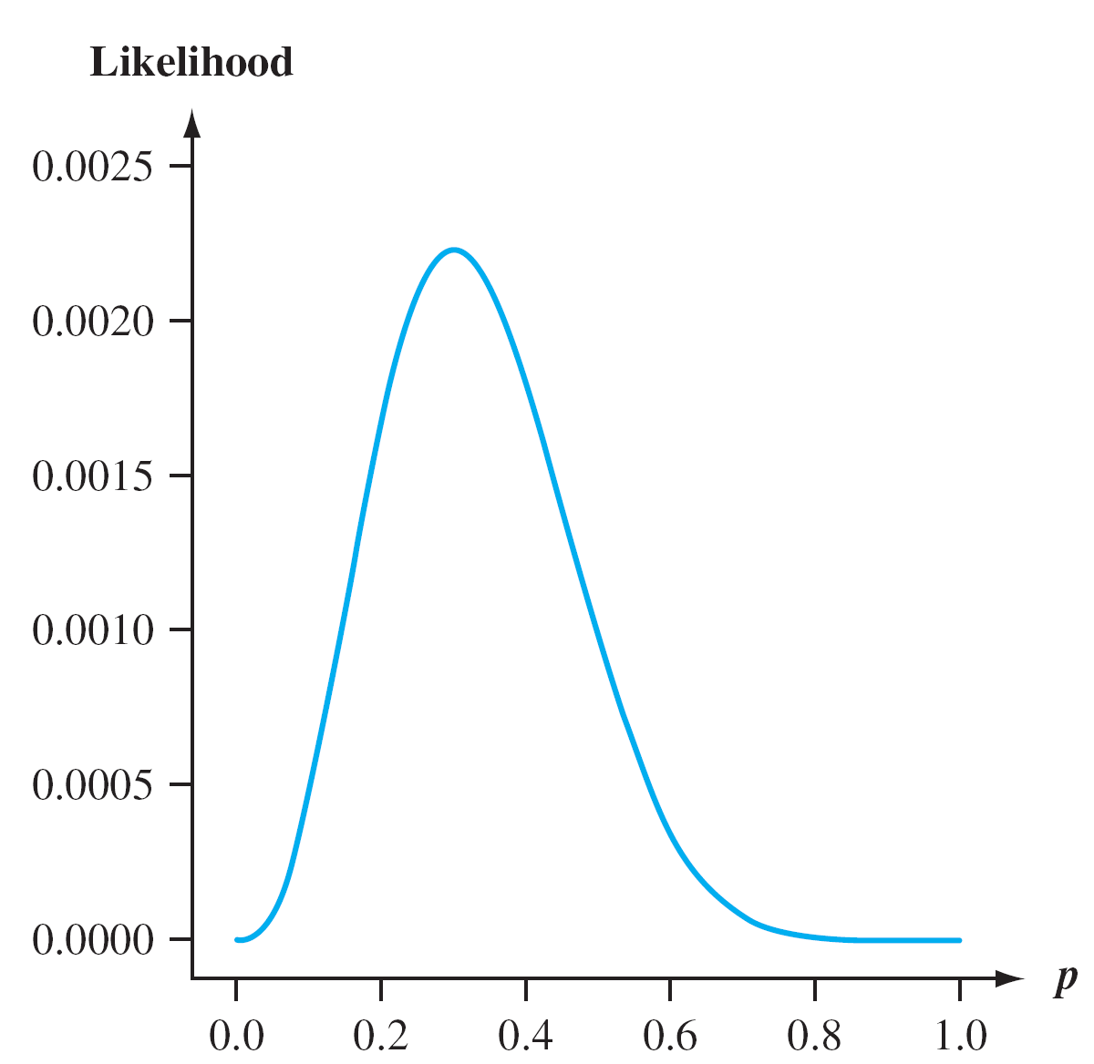
Example
It appears that the graph reaches its peak above p = .3
The proportion of flawed helmets in the sample.
Graph of the likelihood (joint pmf)

Slide 61
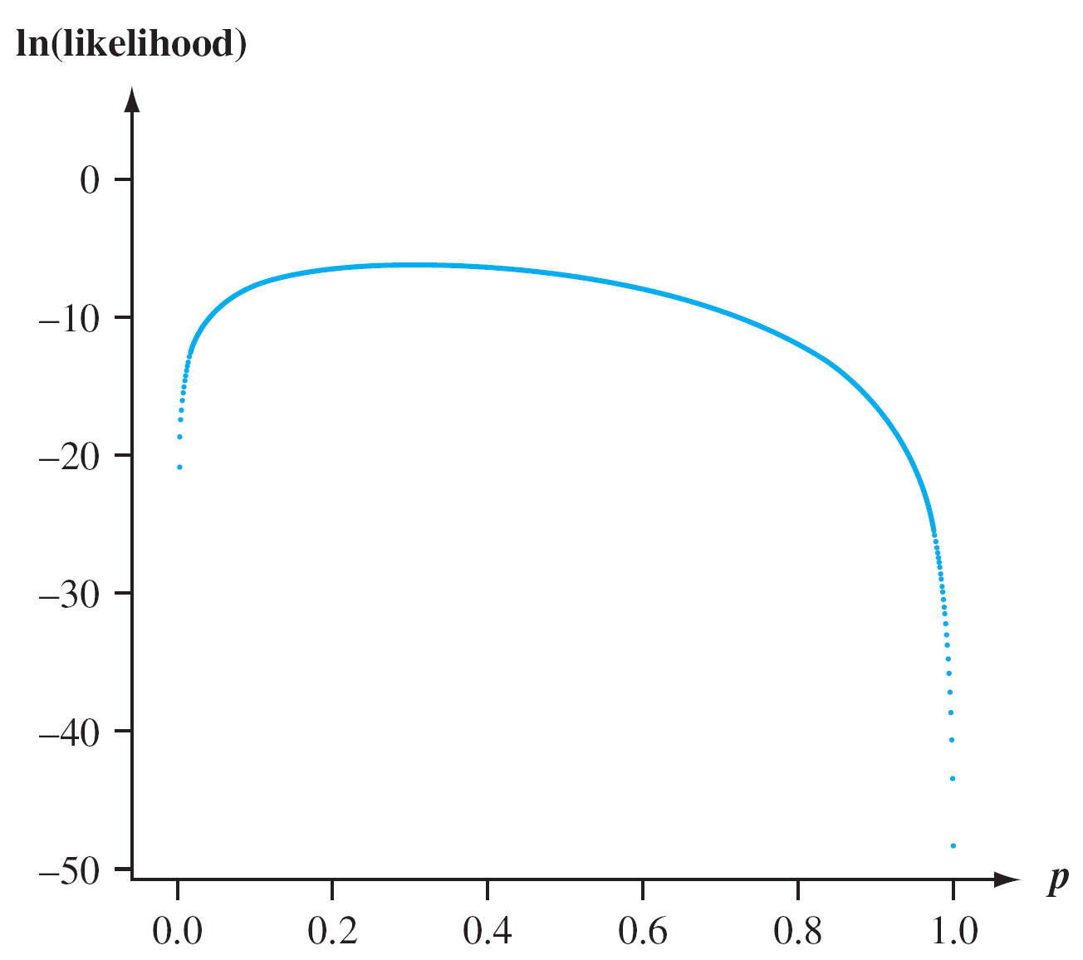
Example
ln[g(u)] is a strictly increasing function of g(u), finding u to maximize the function g(u) is the same as finding u to maximize ln[g(u)].
Graph of the natural logarithm of the likelihood

Slide 62
Example
Use calculus to find the value of p that maximizes the joint pmf
Working with the natural log of the joint pmf is often easier than working with the joint pmf itself
The joint pmf is typically a product so its logarithm will be a sum.
Here
ln[ f (x₁, . . . , x₁₀; p)] = ln[p³(1 – p)⁷] = 3ln(p) + 7ln(1 – p)

Slide 63
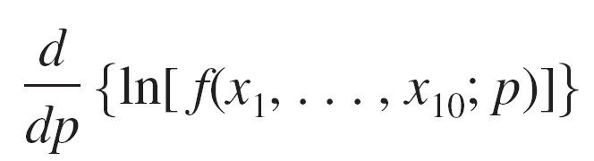
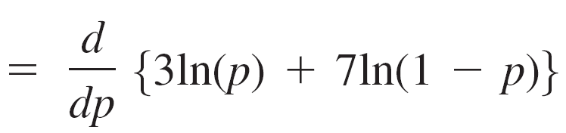
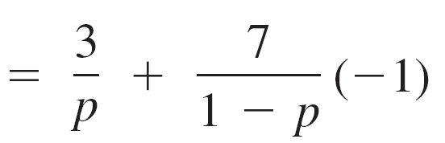
Example
Thus
Equating this derivative to 0 and solving for p gives 3(1 – p) = 7p, and so p = 3/10 = .30

