Slide 1
Information Retrieval

Slide 2
Definition of information retrieval
Information retrieval (IR) is finding material (usually documents) of an unstructured nature (usually text) that satisfies an information need within large collections (usually stored on computers)

Slide 3
Databases vs. IR
Format of data:
  DB: Structured data. Clear semantics based on a formal model.
  IR: Mostly unstructured. Free text.
Queries:
  DB: Formal (like SQL)
  IR: often expressed in natural language (keywords search)
Result:
  DB: exact result
  IR: Sometimes relevant, often not

Slide 4
Ultimate Focus of IR
Satisfying user information need
  Emphasis is on retrieval of information (not data)
Predicting which documents are relevant, and then linearly ranking them.
Notes:
facetious

Slide 5
Types of Information Needs
Retrospective
  “Searching the past”
  Different queries posed against a static collection
Prospective (Filtering)
  “Searching the future”
  Static query posed against a dynamic collection
  Time dependent

Slide 6
Basic assumptions of Information Retrieval
Collection: Fixed set of documents
Goal: Retrieve documents with information that is relevant to user’s information need and helps him complete a task
SIGIR 2005

Slide 7


Abstract Search Engine Architecture
Documents
Query
document acquisition
(e.g., web crawling)
online
offline
Representation
Function
Representation
Function
Brutus OR NOT Caesar
Query Representation
Document Representation
Index
Comparison
Function
Hits

Slide 8
Topics
Boolean Query Model
Inverted index
Determine the vocabulary of terms
Dictionary
  Index
  Tolerant retrieval

Slide 9
Boolean Retrieval
Some simple query examples
  Documents containing the word “Java”
  Documents containing the word “Java” but not the word “coffee”
  Documents containing the phrase “Java beans” or the term “API”
  Documents where “Java” and “island” occur in the same sentence
The last two queries are called proximity queries

Slide 10
Boolean queries: Exact match
Sec. 1.3
The Boolean retrieval model is being able to ask a query that is a Boolean expression:
  Boolean Queries are queries using AND, OR and NOT to join query terms
    Views each document as a set of words
    Is precise: document matches condition or not.
  Perhaps the simplest model to build an IR system on
Primary commercial retrieval tool for 3 decades.
Many search systems you still use are Boolean:
  Email, library catalog

Slide 11
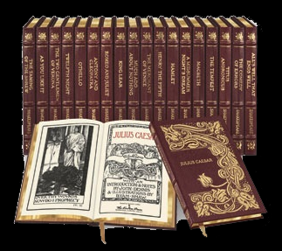
Example
Sec. 1.1
Collection
Query
- Which plays of Shakespeare contain the words Brutus AND Caesar but NOT Calpurnia?
One could grep all of Shakespeare’s plays for Brutus and Caesar, then strip out lines containing Calpurnia?
Why is that not the answer?
  Slow (for large corpora)
  Other operations
    proximity queries
    Tolerant retrieval
  Ranked retrieval (best documents to return)
Notes:
Grep is line-oriented; IR is document oriented.

Slide 12
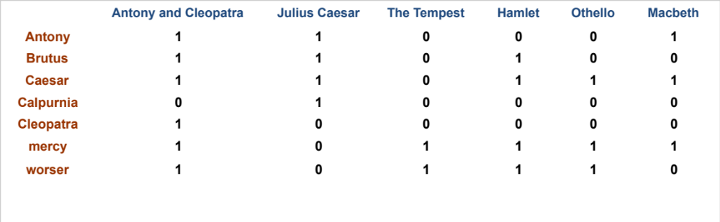
Term-document incidence matrices
Sec. 1.1
1 if play contains word, 0 otherwise
Brutus AND Caesar BUT NOT Calpurnia

Slide 13
Incidence vectors
Sec. 1.1
So we have a 0/1 vector for each term.
To answer query: take the vectors for Brutus, Caesar and Calpurnia (complemented) ➔ bitwise AND.
  110100 AND 110111 AND 101111
  100100

Slide 14
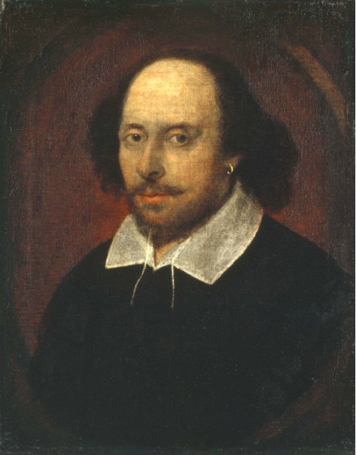
Answers to query
Sec. 1.1
Antony and Cleopatra, Act III, Scene ii
Agrippa [Aside to DOMITIUS ENOBARBUS]: Why, Enobarbus,
When Antony found Julius Caesar dead,
He cried almost to roaring; and he wept
When at Philippi he found Brutus slain.
Hamlet, Act III, Scene ii
Lord Polonius: I did enact Julius Caesar I was killed i’ the
Capitol; Brutus killed me.
Notes:
Wikimedia commons picture of Shake

Slide 15
Bigger collections
Sec. 1.1
Consider N = 1 million documents, each with about 1000 words.
Avg 6 bytes/word including spaces/punctuation
  6GB of data in the documents.
    1,000,000 * 1,000 * 6 bytes
Say there are M = 500K distinct terms among these.

Slide 16
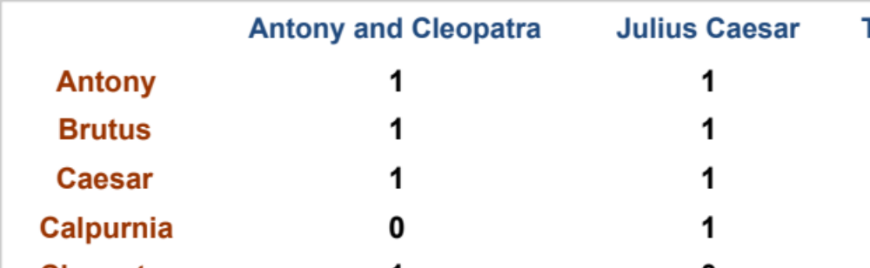
Can’t build the matrix
Sec. 1.1
1M
500K
500K x 1M matrix has half-a-trillion 0’s and 1’s.
But it has no more than one billion 1’s.
  matrix is extremely sparse.
What’s a better representation?
  We only record the 1 positions.

Slide 17
Inverted index
Sec. 1.2
For each term t, we must store a list of all documents that contain t.
  Identify each doc by a docID, a document serial number
Posting
Brutus
1
2
4
11
31
45
173
174
Caesar
1
2
4
5
6
16
57
132
Calpurnia
2
31
54
101
Dictionary
Postings
Sorted by docID (more later on why).
Notes:
Linked lists generally preferred to arrays
Dynamic space allocation
Insertion of terms into documents easy
Space overhead of pointers

Slide 18

Inverted index construction
Sec. 1.2
Documents to
be indexed
Friends, Romans, countrymen.
Tokenizer
Token stream
Friends
Romans
Countrymen
Linguistic modules
Modified tokens
friend
roman
countryman
Indexer
friend
2
4
roman
1
2
Inverted index
countryman
13
16
Notes:
Document icons from free icon set: http://www.icojoy.com/articles/44/

Slide 19
Initial stages of text processing
Tokenization
  Cut character sequence into word tokens
    Deal with “John’s”, a state-of-the-art solution
Normalization
  Map text and query term to same form
    You want U.S.A. and USA to match
Stemming
  We may wish different forms of a root to match
    authorize, authorization
Stop words
  We may omit very common words (or not)
    the, a, to, of

Slide 20

Indexer steps: Token sequence
Sec. 1.2
Sequence of (Modified token, Document ID) pairs.
Doc 1
Doc 2
I did enact Julius
Caesar I was killed
i’ the Capitol;
Brutus killed me.
So let it be with
Caesar. The noble
Brutus hath told you
Caesar was ambitious

Slide 21

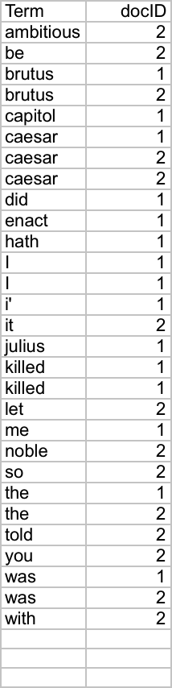
Indexer steps: Sort
Sec. 1.2
Sort by terms
  And then docID
Core indexing step

Slide 22

Indexer steps: Dictionary & Postings
Sec. 1.2
Multiple term entries in a single document are merged.
Split into Dictionary and Postings
Doc. frequency information is added.
Why frequency?
Will discuss later.

Slide 23
Where do we pay in storage?
Sec. 1.2
Lists of docIDs
Terms and counts
IR system implementation
How do we index efficiently?
How much storage do we need?
Pointers

Slide 24
The index we just built
Sec. 1.3
How do we process a query?
  Later - what kinds of queries can we process?
Our focus

Slide 25
Inverted index
Linked lists generally preferred to arrays
  Dynamic space allocation
  Insertion of terms into documents easy
  Space overhead of pointers
Posting
Brutus
2
4
8
16
32
64
128
Calpurnia
1
2
3
5
8
13
21
34
Caesar
13
16
Dictionary
Postings lists
Sorted by docID

Slide 26
Query processing: AND
Consider processing the query:
  Brutus AND Caesar
  Locate Brutus in the Dictionary;
    Retrieve its postings.
  Locate Caesar in the Dictionary;
    Retrieve its postings.
  “Merge” the two postings:
2
4
8
16
32
64
128
Brutus
1
2
3
5
8
13
21
34
Caesar

Slide 27
The merge
Walk through the two postings simultaneously, in time linear in the total number of postings entries
2
2
4
4
8
8
16
16
32
64
128
32
64
128
Brutus
2
8
1
Caesar
1
2
2
3
5
5
8
8
13
13
21
21
34
3
34
If the list lengths are x and y, the merge takes O(x+y)
operations.
Crucial: postings sorted by docID.

Slide 28

Intersecting two postings lists
(a “merge” algorithm)

Slide 29
Boolean queries:
More general merges
Sec. 1.3
Exercise: Adapt the merge for the query:
Brutus AND NOT Caesar
Can we still run through the merge in time O(x+y)?

Slide 30
Exercise

Slide 31
Merging
Sec. 1.3
What about an arbitrary Boolean formula?
(Brutus OR Caesar) AND NOT
(Antony OR Cleopatra)
Can we always merge in “linear” time?
  Linear in what?
Can we do better?

Slide 32
Query optimization
Sec. 1.3
What is the best order for query processing?
Consider a query that is an AND of n terms.
For each of the n terms, get its postings, then AND them together.
Brutus
2
4
8
16
32
64
128
Caesar
1
2
3
5
8
16
21
34
Calpurnia
13
16
Query: Brutus AND Calpurnia AND Caesar

Slide 33
Query optimization example
Sec. 1.3
Process in order of increasing freq:
  start with smallest set, then keep cutting further.
This is why we kept
document freq. in dictionary
Brutus
2
4
8
16
32
64
128
Caesar
1
2
3
5
8
16
21
34
Calpurnia
13
16
Execute the query as (Calpurnia AND Brutus) AND Caesar.

Slide 34
More general optimization
Sec. 1.3
e.g., (madding OR crowd) AND (ignoble OR strife)
Get doc. freq.’s for all terms.
Estimate the size of each OR by the sum of its doc. freq.’s (conservative).
Process in increasing order of OR sizes.

Slide 35
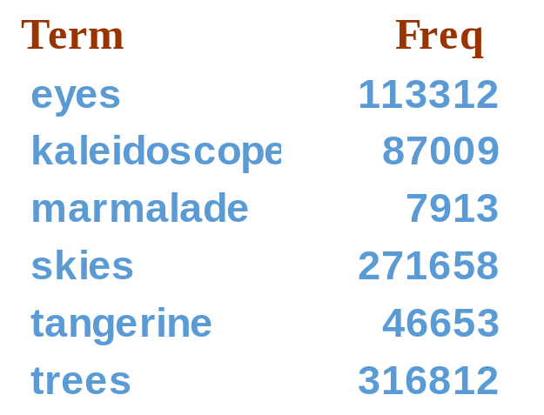
Exercise
Recommend a query processing order for
46653+316812=363465
(tangerine OR trees) AND
(marmalade OR skies) AND
(kaleidoscope OR eyes)
7913+271658=279571
87009+113312=200321

Slide 36
Recall basic merge
Sec. 2.3
Walk through the two postings simultaneously, in time linear in the total number of postings entries
2
4
8
41
48
64
128
Brutus
2
8
1
2
3
8
11
17
21
31
Caesar
If the list lengths are m and n, the merge takes O(m+n)
operations.
Can we do better?
Yes (if the index isn’t changing too fast).

Slide 37
Augment postings with skip pointers (at indexing time)
Sec. 2.3
41
128
2
4
8
41
48
64
128
11
31
1
2
3
8
11
17
21
31
Why?
To skip postings that will not figure in the search results.
How?
Where do we place skip pointers?

Slide 38
Query processing with skip pointers
Sec. 2.3
41
128
2
4
8
41
48
64
128
11
31
1
2
3
8
11
17
21
31
Suppose we’ve stepped through the lists until we process 8 on each list. We match it and advance.
We then have 41 and 11 on the lower. 11 is smaller.
But the skip successor of 11 on the lower list is 31, so
we can skip ahead past the intervening postings.

Slide 39
Where do we place skips?
Sec. 2.3
Tradeoff:
  More skips → shorter skip spans ⇒ more likely to skip. But lots of comparisons to skip pointers.
  Fewer skips → few pointer comparison, but then long skip spans ⇒ few successful skips.

Slide 40
Placing skips
Sec. 2.3
Simple heuristic: for postings of length L, use √L evenly-spaced skip pointers [Moffat and Zobel 1996]
Easy if the index is relatively static; harder if L keeps changing because of updates.
This definitely used to help; with modern hardware it may not unless you’re memory-based [Bahle et al. 2002]
  The I/O cost of loading a bigger postings list can outweigh the gains from quicker in memory merging!

Slide 41
Phrase queries
Sec. 2.4
We want to be able to answer queries such as “stanford university” – as a phrase
Thus the sentence “I went to university at Stanford” is not a match.
  Many more queries are implicit phrase queries
For this, it no longer suffices to store only
<term : docs> entries

Slide 42
A first attempt: Biword indexes
Sec. 2.4.1
Index every consecutive pair of terms in the text as a phrase
For example the text “Friends, Romans, Countrymen” would generate the biwords
  friends romans
  romans countrymen
Each of these biwords is now a dictionary term
Two-word phrase query-processing is now immediate.

Slide 43
Longer phrase queries
Sec. 2.4.1
Longer phrases can be processed by breaking them down
stanford university palo alto can be broken into the Boolean query on biwords:
stanford university AND university palo AND palo alto
Without the docs, we cannot verify that the docs matching the above Boolean query do contain the phrase.
Can have false positives!

Slide 44
Issues for biword indexes
Sec. 2.4.1
False positives, as noted before
Index blowup due to bigger dictionary
Biword indexes are not the standard solution (for all biwords) but can be part of a compound strategy

Slide 45
Solution 2: Positional indexes
Sec. 2.4.2
In the postings, store, for each term the position(s) in which tokens of it appear:
  <term, number of docs containing term;
  doc1: position1, position2 … ;
  doc2: position1, position2 … ;
  etc.>

Slide 46
Positional index example
Sec. 2.4.2
<be: 993427;
1: 7, 18, 33, 72, 86, 231;
2: 3, 149;
4: 17, 191, 291, 430, 434;
5: 363, 367, …>
Which of docs 1,2,4,5
could contain “to be
or not to be”?
For phrase queries, we use a merge algorithm recursively at the document level
But we now need to deal with more than just equality

Slide 47
Processing a phrase query
Sec. 2.4.2
Extract inverted index entries for each distinct term: to, be, or, not.
Merge their doc:position lists to enumerate all positions with “to be or not to be”.
  to:
    2:1,17,74,222,551; 4:8,16,190,429,433; 7:13,23,191; ...
  be:
    1:17,19; 4:17,191,291,430,434; 5:14,19,101; ...
Same general method for proximity searches

Slide 48
Positional index size
Sec. 2.4.2
Need an entry for each occurrence, not just once per document
Index size depends on average document size
Consider a term with frequency 0.1%
Document size
Postings
Positional postings
1000
1
1
100,000
1
100

Slide 49
Positional index size
Sec. 2.4.2
A positional index expands postings storage substantially
  Even though indices can be compressed
Nevertheless, a positional index is now standardly used because of the power and usefulness of phrase and proximity queries

Slide 50
Rules of thumb
Sec. 2.4.2
A positional index is 2–4 as large as a non-positional index
Positional index size 35–50% of volume of original text
  Caveat: all of this holds for “English-like” languages

Slide 51
Combination schemes
Sec. 2.4.3
These two approaches can be profitably combined
  For particular phrases (“Michael Jackson”, “Michael Jordan”) it is inefficient to keep on merging positional postings lists

Slide 52
Recall the basic indexing pipeline
Documents to
be indexed
Friends, Romans, countrymen.
Tokenizer
Token stream
Friends
Romans
Countrymen
Linguistic modules
Modified tokens
friend
roman
countryman
Indexer
friend
2
4
roman
1
2
Inverted index
countryman
13
16
Notes:
Circle documents

Slide 53
Before index construction…
Documents in the collection should be tokenized in a suitable manner
We need to decide what terms should be put in the index
  token : an instance of a sequence of characters
  type : the class of all tokens containing the same character sequence
  term :a type that is included in the IR system’s dictionary
5 tokens
4 types
3 terms (if “to” is omitted from the index)
to sleep perchance to dream

Slide 54
Initial stages of text processing
Tokenization
  Cut character sequence into word tokens
    Deal with “John’s”, a state-of-the-art solution
Stop words
  We may omit very common words (or not)
    the, a, to, of
Normalization
  Map text and query term to same form
    You want U.S.A. and USA to match
Stemming
  We may wish different forms of a root to match
    authorize, authorization

Slide 55
Tokenization
Sec. 2.2.1
Input: “Friends, Romans and Countrymen”
Output: Tokens
  Friends
  Romans
  Countrymen
A token is an instance of a sequence of characters
Each such token is now a candidate for an index entry, after further processing

Slide 56
Why tokenization is difficult – even in English
Example: Mr. O’Neill thinks that the boys’ stories about Chile’s capital aren’t amusing.
Tokenize this sentence
If no preprocessing of a query is done
Processing the query with the same tokenizer
neill
Oneill
O’neill
O’ neill
O neill
O’neill AND capital
neill AND capital
query

Slide 57
Tokenization
Sec. 2.2.1
hyphen
  One word or several words
    state-of-the-art
    co-education
    cheap San Francisco-Los Angeles fares
  Complex
    Can be handled as a classification problem
  Or more commonly by some heuristic rules

Slide 58
Stop words(1)
stop words = extremely common words which would appear to be of little value in helping select documents matching a user need
  They have little semantic content
  Examples: a, an, and, are, as, at, be, by, for, from, has, he, in, is, it, its, of, on, that, the, to, was, were, will, with
Without suitable compression techniques, it needs a lot of space to index stop words.
Stop word elimination used to be standard in older IR systems.

Slide 59
Stop words(2)
But the trend is away from doing this:
  Good compression techniques mean the space for including stopwords in a system is very small
  Good query optimization techniques mean you pay little at query time for including stop words.
  You need them for:
    Phrase queries: “King of Denmark”
    Various song titles, etc.: “Let it be”, “To be or not to be”
Most web search engines index stop words

Slide 60
Normalization to terms
Sec. 2.2.3
We may need to “normalize” words in indexed text as well as query words into the same form
  We want to match U.S.A. and USA
Result is terms: a term is a (normalized) word type, which is an entry in our IR system dictionary
We most commonly implicitly define equivalence classes of terms by, e.g.,
  deleting periods to form a term
    U.S.A., USA ⎝ USA
  deleting hyphens to form a term
    anti-discriminatory, antidiscriminatory ⎝ antidiscriminatory

Slide 61
Case folding
Sec. 2.2.3
Reduce all letters to lower case
  exception: upper case in mid-sentence?
    e.g., General Motors
    Fed vs. fed
    SAIL vs. sail
  Often best to lower case everything, since users will use lowercase regardless of ‘correct’ capitalization…

Slide 62
Normalization to terms
Sec. 2.2.3
An alternative to equivalence classing is to do asymmetric expansion
An example of where this may be useful
  Enter: window Search: window, windows
  Enter: windows Search: Windows, windows, window
  Enter: Windows Search: Windows
Potentially more powerful, but less efficient
Notes:
Why not the reverse?

Slide 63
Lemmatization
Sec. 2.2.4
Reduce inflectional/variant forms to base form
E.g.,
  am, are, is → be
  car, cars, car's, cars' → car
the boy's cars are different colors → the boy car be different color
Lemmatization implies doing “proper” reduction to dictionary headword form

Slide 64
Stemming
Sec. 2.2.4
Reduce terms to their “roots” before indexing
“Stemming” suggests crude affix chopping
  language dependent
  e.g., automate(s), automatic, automation all reduced to automat.
for example compressed
and compression are both
accepted as equivalent to
compress.
for exampl compress and
compress ar both accept
as equival to compress

Slide 65
Porter’s algorithm
Sec. 2.2.4
Commonest algorithm for stemming English
  Results suggest it’s at least as good as other stemming options
Typical rules in porter
  sses → ss
  ies → i
  ational → ate
  tional → tion
  Weight of word sensitive rules
    (m>1) EMENT →
      replacement → replac
      cement → cement

Slide 66
Does stemming help?
Sec. 2.2.4
English: very mixed results. Helps recall for some queries but harms precision on others
  E.g., operative ⇒ oper
Definitely useful for Spanish, German, Finnish, …
  30% performance gains for Finnish!

Slide 67
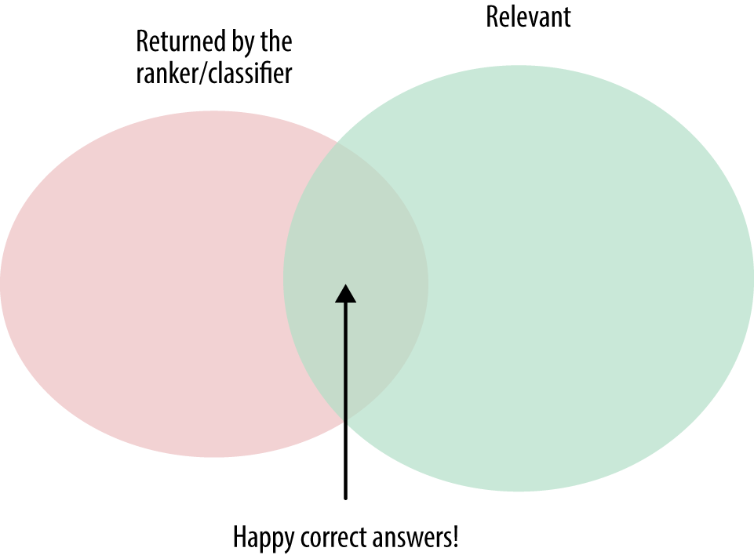
Exercise
Are the following statements true or false?
Stemming increases the size of the vocabulary
Stemming should be invoked at indexing time, but not while processing a query
In a Boolean retrieval system, stemming never lowers precision.
In a Boolean retrieval system, stemming never lowers recall.
Precision :
number of correct answers/number of returned documents
Recall:
number of correct answers/number of relevant documents

Slide 68
Thesauri and soundex
Do we handle synonyms and homonyms?
  E.g., by hand-constructed equivalence classes
    car = automobile color = colour
  We can rewrite to form equivalence-class terms
    When the document contains automobile, index it under car-automobile (and vice-versa)
  Or we can expand a query
    When the query contains automobile, look under car as well
What about spelling mistakes?
  One approach is Soundex, which forms equivalence classes of words based on phonetic heuristics

