Slide 1
Topics
Ranked retrieval
Term frequency
Collection statistics
Vector space scoring
Speeding up vector space ranking
Putting together a complete search system

Slide 2
Ranked retrieval
Ch. 6
Thus far, our queries have all been Boolean.
  Documents either match or don’t.
Good for expert users with precise understanding of their needs and the collection.
Not good for the majority of users.
Most users don’t want to wade through 1000s of results.
    This is particularly true of web search.

Slide 3
Problem with Boolean search: feast or famine
Ch. 6
Boolean queries often result in either too few (=0) or too many (1000s) results.
Query 1: “standard user dlink 650” → 200,000 hits
Query 2: “standard user dlink 650 no card found”: 0 hits
It takes a lot of skill to come up with a query that produces a manageable number of hits.
  AND gives too few; OR gives too many
Notes:
Cf. our discussion of how Westlaw Boolean queries didn’t actually outperform free text querying

Slide 4
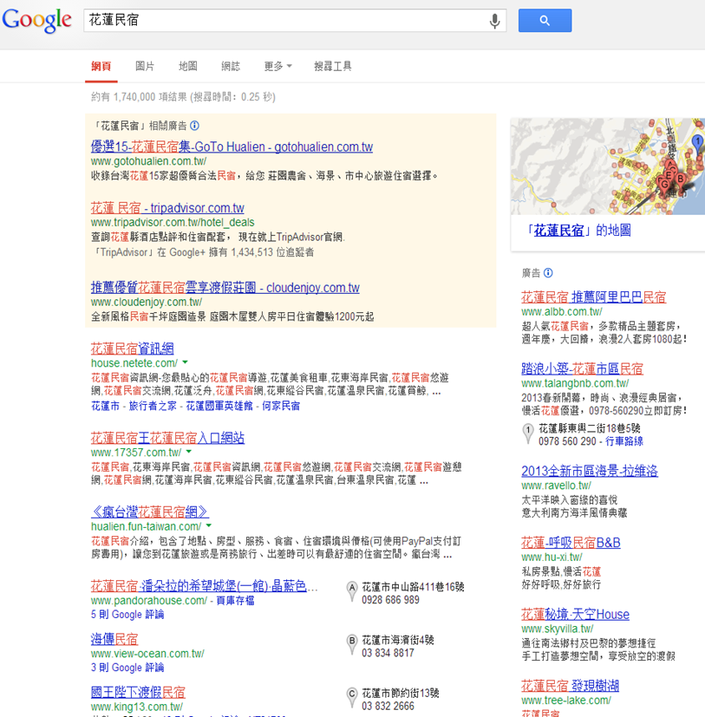


Feast or famine: not a problem in ranked retrieval
Ch. 6
When a system produces a ranked result set, large result sets are not an issue
  We just show the top k ( ≈ 10) results
  Premise: the ranking algorithm works

Slide 5
Query-document matching scores
Ch. 6
We need a way of assigning a score to a query/document pair
Let’s start with a one-term query
  If the query term does not occur in the document: score should be 0
The more frequent the query term in the document, the higher the score (should be)

Slide 6
Take 1: Jaccard coefficient
Ch. 6
A commonly used measure of overlap of two sets A and B
jaccard(A,B) = |A ∩ B| / |A ∪ B|
  jaccard(A,A) = 1
  jaccard(A,B) = 0 if A ∩ B = 0
A and B don’t have to be the same size.
Always assigns a number between 0 and 1.

Slide 7
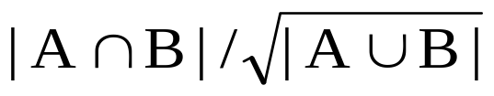
Jaccard coefficient: Scoring example
Ch. 6
What is the query-document match score that the Jaccard coefficient computes for each of the two documents below?
Query: ides of march
Document 1: march ides is the best known as Document 2: of course
2/8
1/4
normalizing for length
(Jaccard) for length normalization.

Slide 8
Issues with Jaccard for scoring
Ch. 6
It doesn’t consider term frequency (how many times a term occurs in a document)
Rare terms in a collection are more informative than frequent terms. Jaccard doesn’t consider this information

Slide 9

Recall (Lecture 1): Binary term-document incidence matrix
Sec. 6.2
Each document is represented by a binary vector ∈ {0,1}^{|V|}

Slide 10
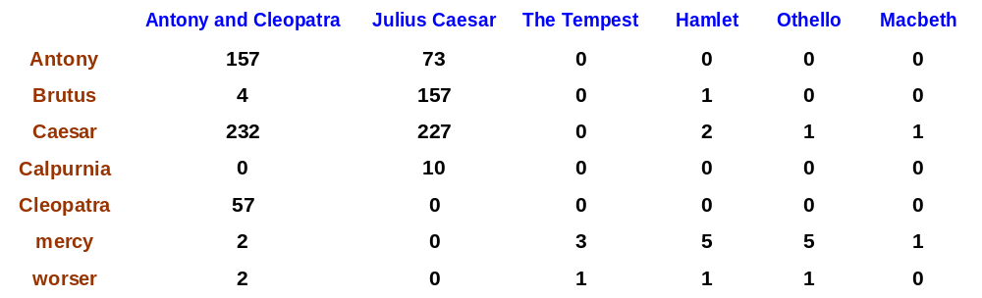
Term-document count matrices
Sec. 6.2
Consider the number of occurrences of a term in a document:
  Each document is a count vector in ℕ^{v}: a column below

Slide 11
Bag of words model
Vector representation doesn’t consider the ordering of words in a document
John is quicker than Mary and Mary is quicker than John have the same vectors
This is called the bag of words model.
In a sense, this is a step back: The positional index was able to distinguish these two documents.

Slide 12
Term frequency tf
The term frequency tf_{t,d} of term t in document d is defined as the number of times that t occurs in d.
We want to use tf when computing query-document match scores. But how?
Raw term frequency is not what we want:
  A document with 10 occurrences of the term is more relevant than a document with 1 occurrence of the term.
  But not 10 times more relevant.
Relevance does not increase proportionally with term frequency.

Slide 13
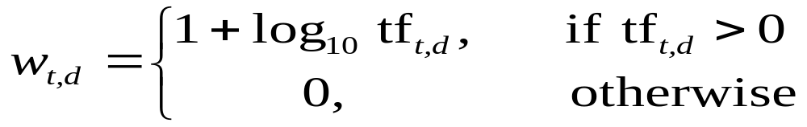

Log-frequency weighting
Sec. 6.2
The log frequency weight of term t in d is
0 → 0, 1 → 1, 2 → 1.3, 10 → 2, 1000 → 4, etc.
Score for a document-query pair: sum over terms t in both q and d:
score
The score is 0 if none of the query terms is present in the document.

Slide 14
Document frequency
Sec. 6.2.1
Rare terms are more informative than frequent terms
  Recall stop words
  the vs asycronization
Consider a term in the query that is rare in the collection (e.g., spooling)
  A document containing this term is very likely to be relevant to the query spooling
→ We want a high weight for rare terms like spooling.
Query : spooling definition
D1: spooling is a process in which
D2: the definition of data mining

Slide 15
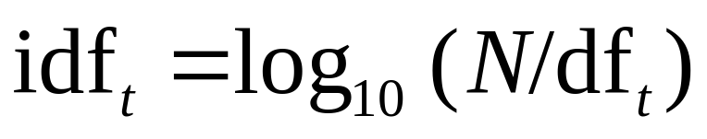
idf weight
Sec. 6.2.1
df_{t} is the document frequency of t: the number of documents that contain t
  df_{t} is an inverse measure of the informativeness of t
  df_{t} ≤ N
We define the idf (inverse document frequency) of t by
  We use log (N/df_{t}) instead of N/df_{t} to “dampen” the effect of idf.
Will turn out the base of the log is immaterial.

Slide 16
idf example, suppose N = 1 million
Sec. 6.2.1
term | df_{t} | idf_{t}
calpurnia | 1 | 6
animal | 100 | 4
sunday | 1,000 | 3
fly | 10,000 | 2
under | 100,000 | 1
the | 1,000,000 | 0
There is one idf value for each term t in a collection.
Notes:
6 4 3 2 1 0

Slide 17
Effect of idf on ranking
Does idf have an effect on ranking for one-term queries, like
  iPhone
  idf has no effect on ranking one term queries
idf affects the ranking of documents for queries with at least two terms
  For the query capricious person, idf weighting makes occurrences of capricious count for much more in the final document ranking than occurrences of person.

Slide 18
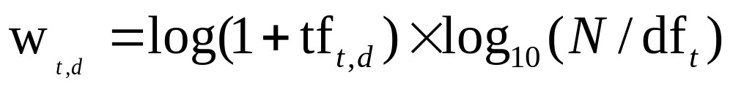
tf-idf weighting
Sec. 6.2.2
The tf-idf weight of a term is the product of its tf weight and its idf weight.
Best known weighting scheme in information retrieval
  Note: the “-” in tf-idf is a hyphen, not a minus sign!
  Alternative names: tf.idf, tf x idf
Increases with the number of occurrences within a document
Increases with the rarity of the term in the collection

Slide 19

Binary → count → weight matrix
Sec. 6.3
Each document is now represented by a real-valued vector of tf-idf weights ∈ R^{|V|}

Slide 20
Documents as vectors
Sec. 6.3
We have a |V|-dimensional vector space
  Terms are axes of the space
  Documents are points or vectors in this space
Very high-dimensional: tens of millions of dimensions when you apply this to a web search engine
  These are very sparse vectors - most entries are zero.

Slide 21
Queries as vectors
Sec. 6.3
Key idea 1: Do the same for queries: represent them as vectors in the space
Key idea 2: Rank documents according to their proximity to the query in this space
  proximity = similarity of vectors
  proximity ≈ inverse of distance

Slide 22
Formalizing vector space proximity
Sec. 6.3
First cut: distance between two points
  ( = distance between the end points of the two vectors)
Euclidean distance?
Euclidean distance is a bad idea . . .
. . . because Euclidean distance is large for vectors of different lengths.

Slide 23

Why distance is a bad idea
Sec. 6.3
The Euclidean distance between q
and d₂ is large even though the
distribution of terms in the query q and the distribution of
terms in the document d₂ are
very similar.

Slide 24
From angles to cosines
Sec. 6.3
The following two notions are equivalent.
  Rank documents in decreasing order of the angle between query and document
  Rank documents in increasing order of cosine(query,document)
Cosine is a monotonically decreasing function for the interval [0º, 180º]

Slide 25
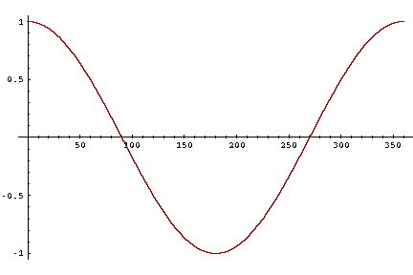
From angles to cosines
Sec. 6.3
But how – and why – should we be computing cosines?

Slide 26
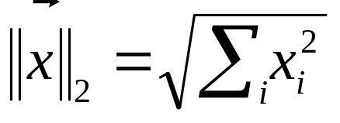
Length normalization
Sec. 6.3
A vector can be (length-) normalized by dividing each of its components by its length – for this we use the L₂ norm:
Dividing a vector by its L₂ norm makes it a unit (length) vector (on surface of unit hypersphere)
Long and short documents now have comparable weights

Slide 27

cosine(query,document)
Sec. 6.3
Dot product
Unit vectors
q_{i} is the tf-idf weight of term i in the query
d_{i} is the tf-idf weight of term i in the document
cos(q,d) is the cosine similarity of q and d … or,
equivalently, the cosine of the angle between q and d.
Notes:
See Law of Cosines (Cosine Rule) wikipedia page

Slide 28
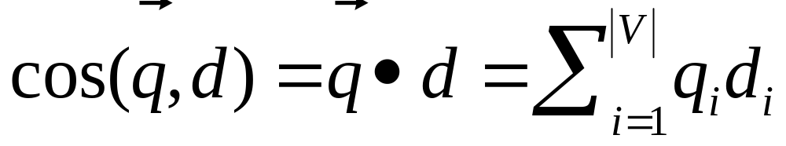
Cosine for length-normalized vectors
For length-normalized vectors, cosine similarity is simply the dot product (or scalar product):
for q, d length-normalized.

Slide 29
Cosine similarity amongst 3 documents
Sec. 6.3
How similar are
the novels
SaS: Sense and
Sensibility
PaP: Pride and
Prejudice, and
WH: Wuthering
Heights?
term | SaS | PaP | WH
affection | 115 | 58 | 20
jealous | 10 | 7 | 11
gossip | 2 | 0 | 6
wuthering | 0 | 0 | 38
Term frequencies (counts)
Note: To simplify this example, we don’t do idf weighting.

Slide 30
3 documents example contd.
Sec. 6.3
Log frequency weighting
After length normalization
term | SaS | PaP | WH
affection | 3.06 | 2.76 | 2.30
jealous | 2.00 | 1.85 | 2.04
gossip | 1.30 | 0 | 1.78
wuthering | 0 | 0 | 2.58
term | SaS | PaP | WH
affection | 0.789 | 0.832 | 0.524
jealous | 0.515 | 0.555 | 0.465
gossip | 0.335 | 0 | 0.405
wuthering | 0 | 0 | 0.588
cos(SaS,PaP) ≈
0.789 × 0.832 + 0.515 × 0.555 + 0.335 × 0.0 + 0.0 × 0.0
≈ 0.94
cos(SaS,WH) ≈ 0.79
cos(PaP,WH) ≈ 0.69

Slide 31

Computing cosine scores
Sec. 6.3

Slide 32
Exercises
Following table shows the term frequencies for two documents(doc1 and doc2). Assume N=10,000, and df of auto, car and insurance are 100, 1000 and 1, respectively. Compute cos(doc1, doc2)
 | doc1 | doc2
auto | 10 | 1
car | 100 | 100
insurance | 0 | 1

Slide 33

tf-idf weighting has many variants
Sec. 6.4
Notes:
n default is just term frequency
ltc is best known form of weighting

Slide 34

Weighting may differ in queries vs documents
Sec. 6.4
Many search engines allow for different weightings for queries vs. documents
SMART Notation: denotes the combination in use in an engine, with the notation ddd.qqq, using the acronyms from the previous table
A very standard weighting scheme is: lnc.ltn
Document: logarithmic tf (l as first character), no idf and cosine normalization
Query: logarithmic tf (l in leftmost column), idf (t in second column), no normalization …
Notes:
Leaving off idf weighting on documents is good for both efficiency and system effectiveness reasons.

Slide 35
Summary – vector space ranking
Represent the query as a weighted tf-idf vector
Represent each document as a weighted tf-idf vector
Compute the cosine similarity score for the query vector and each document vector
Rank documents with respect to the query by score
Return the top K (e.g., K = 10) to the user

Slide 36
Computing cosine scores
Sec. 6.3.3

Slide 37
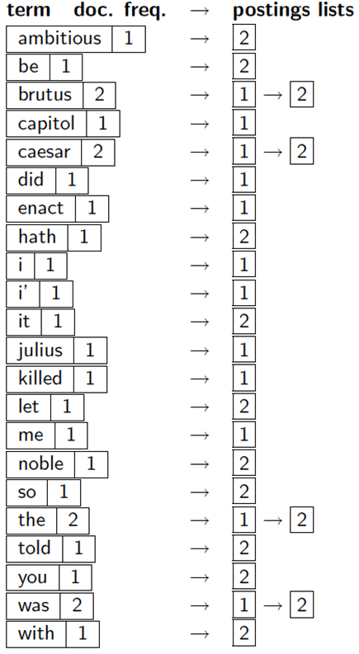
Query :
catcher in the rye
W_{t,d} *W_{q,d}
 | d₀ | d₁ | d₂ | d₃ | …
score |  |  |  |  | …
Top k
results

Slide 38
Computing the K largest cosines: selection vs. sorting
Sec. 7.1
Typically we want to retrieve the top K docs (in the cosine ranking for the query)
  not to totally order all docs in the collection
Can we pick off docs with K highest cosines?
Let J = number of docs with nonzero cosines
  We seek the K best of these J

Slide 39
Use heap for selecting top K
Sec. 7.1
Binary tree in which each node’s value > the values of children
Takes 2J operations to construct, then each of K “winners” read off in 2log J steps.
For J=1M, K=100, this is about 10% of the cost of sorting.
1
.9
.3
.3
.8
.1
.2
.1

Slide 40
Bottlenecks
Sec. 7.1.1
Primary computational bottleneck in scoring: cosine computation
Can we avoid all this computation?
Yes, but may sometimes get it wrong
  a doc not in the top K may creep into the list of K output docs

Slide 41
Generic approach
Sec. 7.1.1
Find a set A of contenders, with K < |A| << N
  A does not necessarily contain the top K, but has many docs from among the top K
  Return the top K docs in A
Think of A as pruning non-contenders
The same approach is also used for other (non-cosine) scoring functions

Slide 42
Index elimination
Sec. 7.1.2
Basic algorithm cosine computation algorithm only considers docs containing at least one query term
Take this further:
  Only consider high-idf query terms
  Only consider docs containing many query terms

Slide 43
High-idf query terms only
Sec. 7.1.2
For a query such as catcher in the rye
  Only accumulate scores from catcher and rye
Intuition: in and the contribute little to the scores and so don’t alter rank-ordering much
Benefit:
  Postings of low-idf terms have many docs
  → these (many) docs get eliminated from set A of contenders

Slide 44
Docs containing many query terms
Sec. 7.1.2
Any doc with at least one query term is a candidate for the top K output list
For multi-term queries, only compute scores for docs containing several of the query terms
  Say, at least 3 out of 4
  Imposes a “soft conjunction” on queries seen on web search engines (early Google)

Slide 45
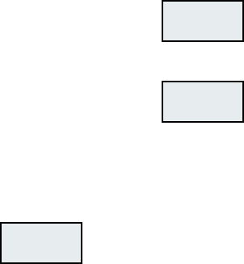
3 of 4 query terms
Sec. 7.1.2
Antony
3
4
8
16
32
64
128
Brutus
2
4
8
16
32
64
128
Caesar
1
2
3
5
8
13
21
34
Calpurnia
13
16
32
Scores only computed for docs 8, 16 and 32.

Slide 46
Champion lists
Precompute for each dictionary term t, the r docs of highest weight in t’s postings
  Call this the champion list for t
  (aka fancy list or top docs for t)
Note that r has to be chosen at index time
At query time, take the union of the champion lists for each of the terms comprising q.
  Pick the K top-scoring docs from amongst these

Slide 47
Static quality scores
Sec. 7.1.4
We want top-ranking documents to be both relevant and authoritative
Relevance is being modeled by cosine scores
Authority is typically a query-independent property of a document
Examples of authority signals
  Wikipedia among websites
  Articles in certain newspapers
  A paper with many citations
  Pagerank
Quantitative

Slide 48
Modeling authority
Sec. 7.1.4
Assign to each document a query-independent quality score in [0,1] to each document d
  Denote this by g(d)
Thus, a quantity like the number of citations is scaled into [0,1]

Slide 49
Net score
Sec. 7.1.4
Consider a simple total score combining cosine relevance and authority
net-score(q,d) = g(d) + cosine(q,d)
  Can use some other linear combination
  Indeed, any function of the two “signals” of user happiness
Now we seek the top K docs by net score

Slide 50
Tiered indexes
Sec. 7.2.1
Break postings up into a hierarchy of lists
  Most important
  …
  Least important
Can be done by g(d) or another measure
Inverted index thus broken up into tiers of decreasing importance
At query time use top tier unless it fails to yield K docs
  If so drop to lower tiers

Slide 51
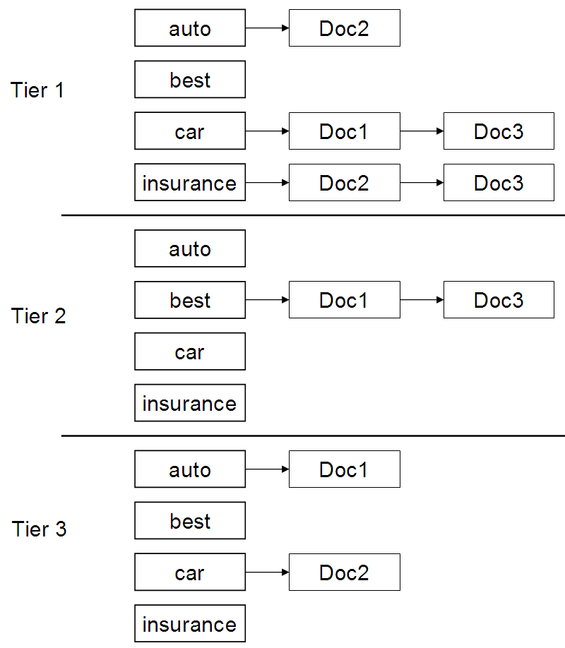
Example tiered index
Sec. 7.2.1

Slide 52
Top K by net score – fast methods
Sec. 7.1.4
First idea: Order all postings by g(d)
  Key: this is a common ordering for all postings
Under g(d)-ordering, top-scoring docs likely to appear early in postings traversal
In time-bound applications (say, we have to return whatever search results we can in 50 ms), this allows us to stop postings traversal early

Slide 53
Cluster pruning: preprocessing
Sec. 7.1.6
Pick √N docs at random: call these leaders
For every other doc, pre-compute nearest leader
  Docs attached to a leader: its followers;
  Likely: each leader has ~ √N followers.

Slide 54
Cluster pruning: query processing
Sec. 7.1.6
Process a query as follows:
  Given query Q, find its nearest leader L.
  Seek K nearest docs from among L’s followers.

Slide 55
Visualization
Sec. 7.1.6
Query
Leader
Follower

Slide 56
General variants
Sec. 7.1.6
Have each follower attached to b1=3 (say) nearest leaders.
From query, find b2=4 (say) nearest leaders and their followers.
Can recurse on leader/follower construction.

Slide 57
Exercises
To find the nearest leader in step 1, how many cosine computations do we do?
What is the effect of the constants b1, b2 on the previous slide?
Devise an example where this is likely to fail – i.e., we miss one of the K nearest docs.

Slide 58
Parametric and zone indexes
Sec. 6.1
Thus far, a doc has been a sequence of terms
In fact documents have multiple parts, some with special semantics:
  Author
  Title
  Date of publication
  Language
  Format
  etc.
These constitute the metadata about a document

Slide 59
Fields
Sec. 6.1
We sometimes wish to search by these metadata
  E.g., find docs authored by William Shakespeare in the year 1601, containing alas poor Yorick
Year = 1601 is an example of a field
Also, author last name = shakespeare, etc.
Field or parametric index: postings for each field value
  Sometimes build range trees (e.g., for dates)
Field query typically treated as conjunction
  (doc must be authored by shakespeare)

Slide 60
Zone
Sec. 6.1
A zone is a region of the doc that can contain an arbitrary amount of text, e.g.,
  Title
  Abstract
  References …
Build inverted indexes on zones as well to permit querying
E.g., “find docs with merchant in the title zone and matching the query gentle rain”

Slide 61
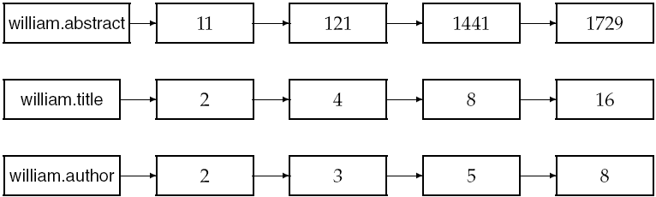
Example zone indexes
Sec. 6.1
Encode zones in dictionary vs. postings.

Slide 62
Query term proximity
Free text queries: just a set of terms typed into the query box – common on the web
Users prefer docs in which query terms occur within close proximity of each other
Let w be the smallest window in a doc containing all query terms, e.g.,
For the query strained mercy the smallest window in the doc The quality of mercy is not strained is 4 (words)
Would like scoring function to take this into account – how?

Slide 63
Query parsers
Sec. 7.2.3
Free text query from user may in fact spawn one or more queries to the indexes, e.g., query rising interest rates
  Run the query as a phrase query
  If <K docs contain the phrase rising interest rates, run the two phrase queries rising interest and interest rates
  If we still have <K docs, run the vector space query rising interest rates
  Rank matching docs by vector space scoring
This sequence is issued by a query parser

Slide 64
Aggregate scores
We’ve seen that score functions can combine cosine, static quality, proximity, etc.
How do we know the best combination?
Some applications – expert-tuned
Increasingly common: machine-learned

Slide 65
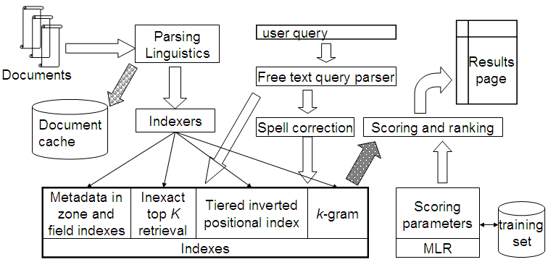
Putting it all together
Sec. 7.2.4

