Slide 1
EDA: Easy Data Augmentation Techniques for Boosting Performance on Text Classification Tasks EMNLP-IJCNLP 2019 Jason Wei, Kai Zou
610721204 陳克威
2020/03/11
Notes:
NLP - Conference

Slide 2
Introduction
Text classification is a fundamental task in natural language processing (NLP).
Machine learning and deep learning have achieved high accuracy on tasks ranging from sentiment analysis to topic classification.
but high performance often depends on the size and quality of training data.

Slide 3
Introduction
Automatic data augmentation is commonly used in computer vision and speech and can help train more robust models.
Previous work (in NLP) :
1. One popular study generated new data by translating sentences into French and back into English (Yu et al., 2018).
2. Predictive language models for synonym replacement (Kobayashi, 2018).

Slide 4
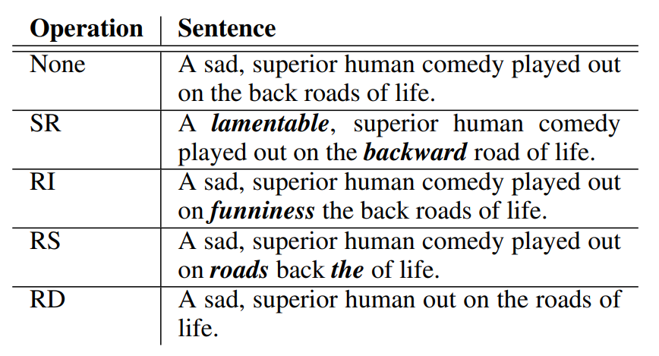
EDA - Easy Data Augmentation
1. Synonym Replacement (SR):
Randomly choose n words from the sentence that are not stop words.
Replace each of these words with one of its synonyms chosen at random.

Slide 5
EDA - Easy Data Augmentation
2. Random Insertion (RI):
Find a random synonym of a random word in the sentence that is not a stop word.
Insert that synonym into a random position in the sentence.
Do this n times.

Slide 6
EDA - Easy Data Augmentation
3. Random Swap (RS):
Randomly choose two words in the sentence and swap their positions.
Do this n times.

Slide 7
EDA - Easy Data Augmentation
4. Random Deletion (RD):
Randomly remove each word in the sentence with probability p.

Slide 8
EDA - Easy Data Augmentation
n = αl, for SR, RI, RD
l = sentence length
a = percent of the words in a sentence
p=α, for RD

Slide 9
Experimental Setup
Benchmark text classification tasks:
(1) SST-2: Stanford Sentiment Treebank (Socher et al., 2013),
(2) CR: customer reviews (Hu and Liu, 2004; Liu et al., 2015),
(3) SUBJ: subjectivity/objectivity dataset (Pang and Lee, 2004),
(4) TREC: question type dataset (Li and Roth, 2002), and
(5) PC: Pro-Con dataset (Ganapathibhotla and Liu, 2008).
N_train = { 500, 2,000, 5,000, all available data }

Slide 10
Experimental Setup
We run experiments for two popular models in text classification.
(1) Recurrent neural networks (RNNs) are suitable for sequential data.We use a LSTM-RNN (Liu et al., 2016).
(2) Convolutional neural networks (CNNs) have also achieved high performance for text classification.
We average results from five different random seeds.

Slide 11
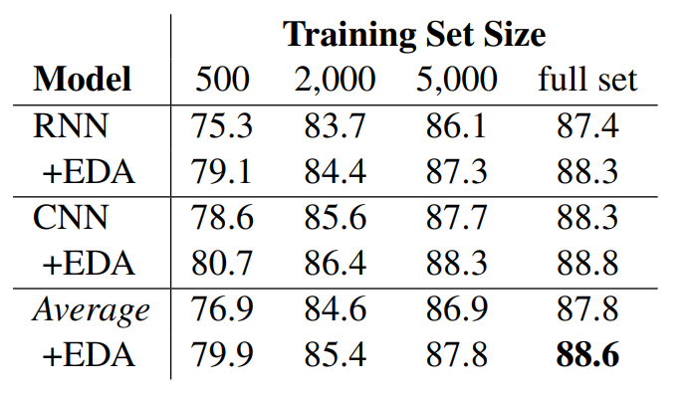
Result - EDA Makes Gains
Average performances (%)
+3 %
+0.8 %

Slide 12
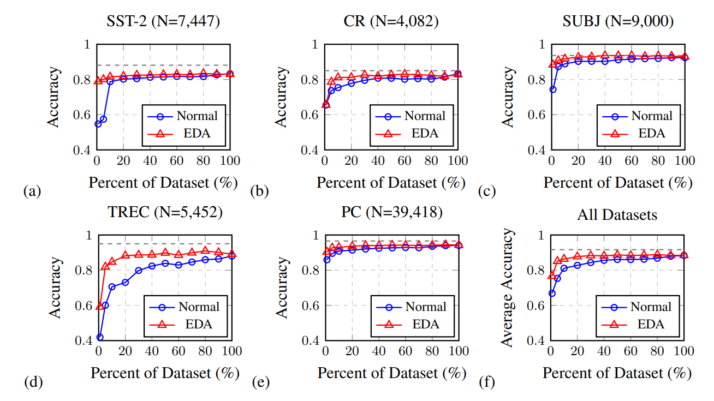
Result - Training Set Sizing
Normal 100% dataset : 88.3% AUC
EDA 50% dataset : 88.6% AUC

Slide 13
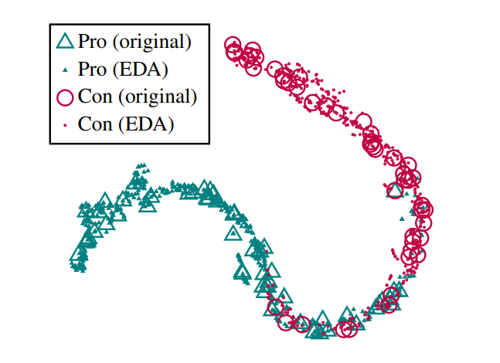
Does EDA conserve true labels?
Notes:
用原始資料訓練RNN，之後將9個EDA句子與原始句子一起丟進RNN。
取最後的dense-layer，套用t-SNE轉成二維資料。

Slide 14
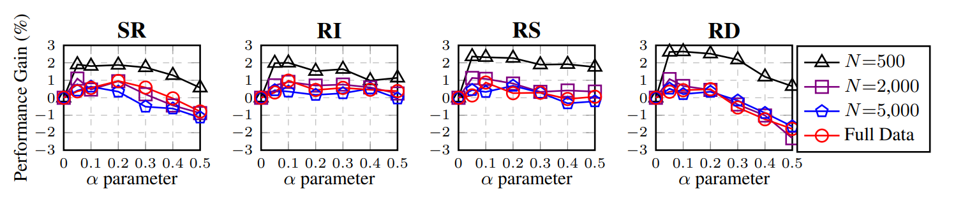
Ablation Study: EDA Decomposed
SR: 少量a有幫助，太大會造成反效果。
RI: 相對穩定
RS: a <= 0.2有幫助，a >= 0.3效果不太好。
RD: 低a有幫助，高a反效果很嚴重。
a = 0.1 似乎是最全面的選擇。

Slide 15
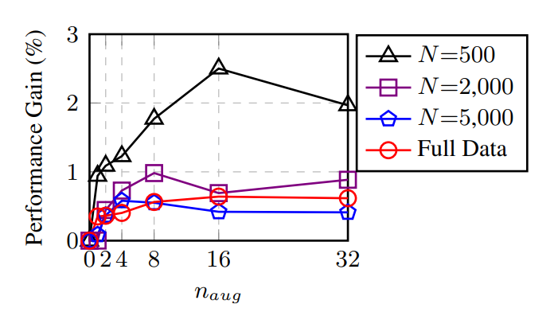
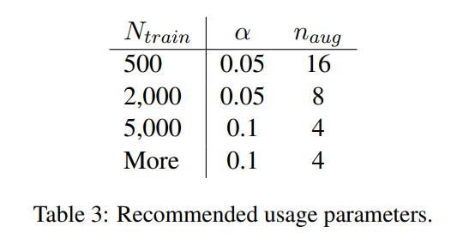
How much augmentation?

Slide 16
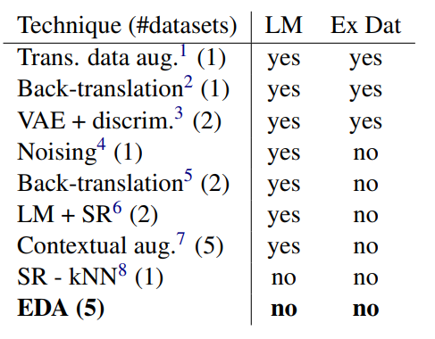
Comparison with Related Work
LM: requires training a language model or deep learning.
Ex Dat: requires an external dataset.

Slide 17
Conclusions
We have shown that simple data augmentation operations can boost performance on text classification tasks.
Although improvement is at times marginal, EDA substantially boosts performance and reduces overfitting when training on smaller datasets.
Notes:
2. 儘管有時改進很少

Slide 18
Links
EDA: Easy Data Augmentation Techniques for Boosting Performance on Text Classification Tasks
https://github.com/jasonwei20/eda_nlp
NLP中数据增强的实现 (EDA_NLP_for_Chinese)
https://github.com/zhanlaoban/EDA_NLP_for_Chinese
jieba: https://github.com/fxsjy/jieba
Synonyms: https://github.com/huyingxi/Synonyms
Notes:
2. 儘管有時改進很少

