Slide 1
Data Mining:
Concepts and Techniques
(3rd ed.)
— Chapter 1 —
Jiawei Han, Micheline Kamber, and Jian Pei
University of Illinois at Urbana-Champaign &
Simon Fraser University
©2011 Han, Kamber & Pei. All rights reserved.

Slide 2
Why Data Mining?
The Explosive Growth of Data: from terabytes to petabytes
  Data collection and data availability
    Automated data collection tools, database systems, Web, computerized society
  Major sources of abundant data
    Business: Web, e-commerce, transactions, stocks, …
    Science: Remote sensing, bioinformatics, scientific simulation, …
    Society and everyone: news, digital cameras, YouTube
We are drowning in data, but starving for knowledge!
“Necessity is the mother of invention”—Data mining—Automated analysis of massive data sets

Slide 3
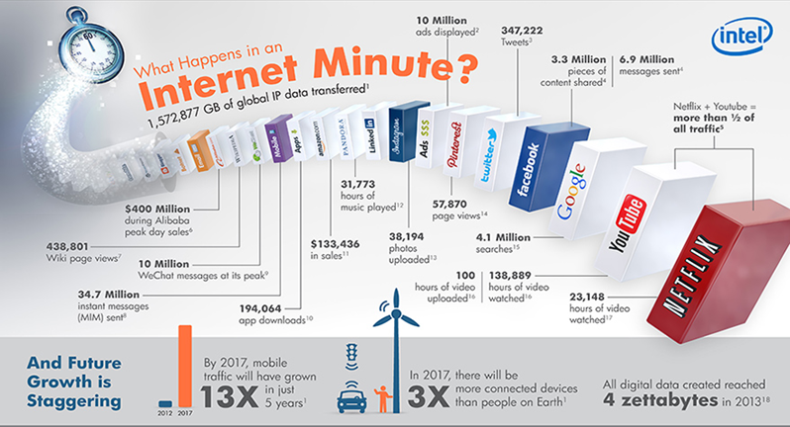
Examples of Large Datasets

Slide 4


What Is Data Mining?
Data mining (knowledge discovery from data)
  Extraction of interesting (non-trivial, previously unknown and potentially useful) patterns or knowledge from huge amount of data
Alternative names
  Knowledge discovery (mining) in databases (KDD), knowledge extraction, data/pattern analysis, information harvesting, business intelligence, etc.
Watch out: Is everything “data mining”?
  Simple search and query processing

Slide 5
KDD Process: A Typical View from ML and Statistics
Pattern
Information
Knowledge
Input Data
Data Pre-Processing
Data Mining
Post-Processing
Data integration
Normalization
Feature selection
Dimension reduction
Pattern discovery
Association & correlation
Classification
Clustering
Outlier analysis
… … … …
Pattern evaluation
Pattern selection
Pattern interpretation
Pattern visualization
This is a view from typical machine learning and statistics communities

Slide 6

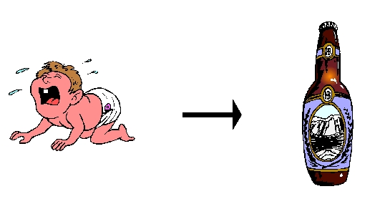
Data Mining Function: (1) Association and Correlation Analysis
Frequent patterns (or frequent itemsets)
  What items are frequently purchased together in your Walmart?
Association, correlation vs. causality
  A typical association rule
    Diaper → Beer [0.5%, 75%] (support, confidence)
  Are strongly associated items also strongly correlated?
How to mine such patterns and rules efficiently in large datasets?

Slide 7
Data Mining Function: (2) Classification
Classification and label prediction
  Construct models (functions) based on some training examples
  Describe and distinguish classes or concepts for future prediction
  Predict some unknown class labels
Typical methods
  Decision trees, naïve Bayesian classification, support vector machines, neural networks, rule-based classification, pattern-based classification, logistic regression, …

Slide 8
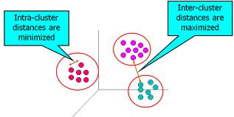
Data Mining Function: (3) Cluster Analysis
Unsupervised learning (i.e., Class label is unknown)
Group data to form new categories (i.e., clusters)
Principle: Maximizing intra-class similarity & minimizing interclass similarity
Many methods and applications

Slide 9
Time and Ordering: Sequential Pattern, Trend and Evolution Analysis
Sequence, trend and evolution analysis
  Sequential pattern mining
    e.g., first buy digital camera, then buy large SD memory cards
  Periodicity analysis
Mining data streams
  Ordered, time-varying, potentially infinite, data streams

Slide 10
Privacy preserving data mining
Data privacy V.S. Information privacy
  Data privacy
  Information privacy

Slide 11
A Brief History of Data Mining Society
1989 IJCAI Workshop on Knowledge Discovery in Databases
  Knowledge Discovery in Databases (G. Piatetsky-Shapiro and W. Frawley, 1991)
1991-1994 Workshops on Knowledge Discovery in Databases
  Advances in Knowledge Discovery and Data Mining (U. Fayyad, G. Piatetsky-Shapiro, P. Smyth, and R. Uthurusamy, 1996)
1995-1998 International Conferences on Knowledge Discovery in Databases and Data Mining (KDD’95-98)
  Journal of Data Mining and Knowledge Discovery (1997)
ACM SIGKDD conferences since 1998 and SIGKDD Explorations
More conferences on data mining
  PAKDD (1997), PKDD (1997), SIAM-Data Mining (2001), (IEEE) ICDM (2001), etc.
ACM Transactions on KDD starting in 2007

Slide 12
Conferences and Journals on Data Mining
KDD Conferences
  ACM SIGKDD Int. Conf. on Knowledge Discovery in Databases and Data Mining (KDD)
  SIAM Data Mining Conf. (SDM)
  (IEEE) Int. Conf. on Data Mining (ICDM)
  European Conf. on Machine Learning and Principles and practices of Knowledge Discovery and Data Mining (ECML-PKDD)
  Pacific-Asia Conf. on Knowledge Discovery and Data Mining (PAKDD)
  Int. Conf. on Web Search and Data Mining (WSDM)
Other related conferences
  DB conferences: ACM SIGMOD, VLDB, ICDE, EDBT, ICDT, …
  Web and IR conferences: WWW, SIGIR, WSDM
  ML conferences: ICML, NIPS
  PR conferences: CVPR,
Journals
  Data Mining and Knowledge Discovery (DAMI or DMKD)
  IEEE Trans. On Knowledge and Data Eng. (TKDE)
  KDD Explorations
  ACM Trans. on KDD

Slide 13
Where to Find References? DBLP, CiteSeer, Google
Data mining and KDD (SIGKDD: CDROM)
  Conferences: ACM-SIGKDD, IEEE-ICDM, SIAM-DM, PKDD, PAKDD, etc.
  Journal: Data Mining and Knowledge Discovery, KDD Explorations, ACM TKDD
Database systems (SIGMOD: ACM SIGMOD Anthology—CD ROM)
  Conferences: ACM-SIGMOD, ACM-PODS, VLDB, IEEE-ICDE, EDBT, ICDT, DASFAA
  Journals: IEEE-TKDE, ACM-TODS/TOIS, JIIS, J. ACM, VLDB J., Info. Sys., etc.
AI & Machine Learning
  Conferences: Machine learning (ML), AAAI, IJCAI, COLT (Learning Theory), CVPR, NIPS, etc.
  Journals: Machine Learning, Artificial Intelligence, Knowledge and Information Systems, IEEE-PAMI, etc.
Web and IR
  Conferences: SIGIR, WWW, CIKM, etc.
  Journals: WWW: Internet and Web Information Systems,
Statistics
  Conferences: Joint Stat. Meeting, etc.
  Journals: Annals of statistics, etc.
Visualization
  Conference proceedings: CHI, ACM-SIGGraph, etc.
  Journals: IEEE Trans. visualization and computer graphics, etc.

Slide 14
Summary
Data mining: Discovering interesting patterns and knowledge from massive amount of data
A natural evolution of database technology, in great demand, with wide applications
A KDD process includes data cleaning, data integration, data selection, transformation, data mining, pattern evaluation, and knowledge presentation
Mining can be performed in a variety of data
Data mining functionalities: association, classification, clustering, outlier and trend analysis, etc.

Slide 15



Process (1): Model Construction
Classification
Algorithms
Training
Data
Classifier
(Model)
IF rank = ‘professor’
OR years > 6
THEN tenured = ‘yes’

Slide 16




Process (2): Using the Model in Prediction
IF rank = ‘professor’
OR years > 6
THEN tenured = ‘yes’
Classifier
Testing
Data
Unseen Data
(Jeff, Professor, 4)
Tenured?

