Slide 1
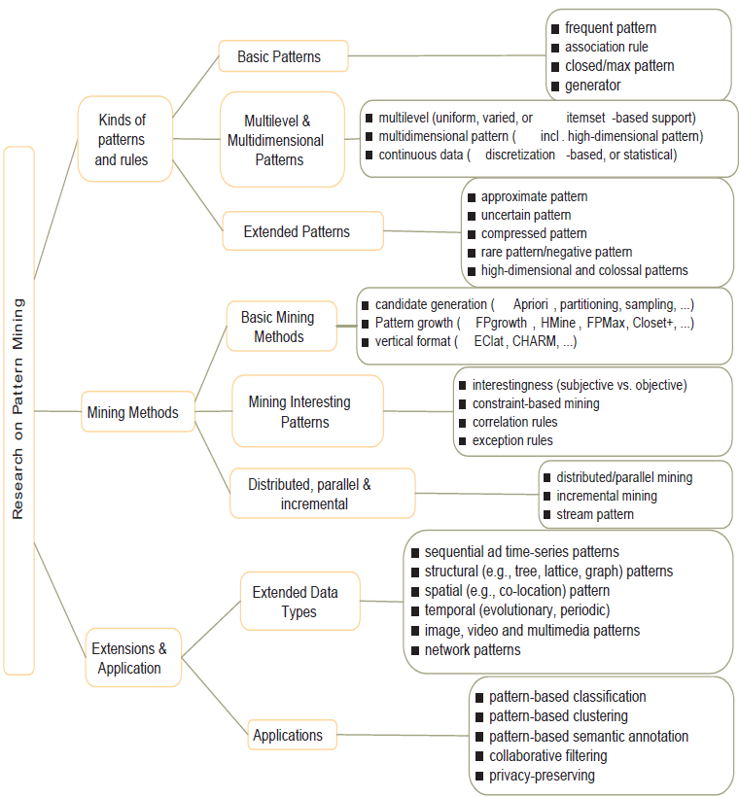
Research on Pattern Mining: A Road Map

Slide 2
Other issues
Multi-level patterns
Sequential patterns
Fault tolerance patterns
  Fix
  Proportion
High utility patterns
Data Sanitization

Slide 3
Mining Multiple-Level Association Rules
Items often form hierarchies
Flexible support settings
  Items at the lower level are expected to have lower support
uniform support
reduced support
Level 1
min_sup = 5%
Milk
[support = 10%]
Level 1
min_sup = 5%
Level 2
min_sup = 5%
2% Milk
[support = 6%]
Skim Milk
[support = 4%]
Level 2
min_sup = 3%

Slide 4
Multi-level Association: Flexible Support and Redundancy filtering
Flexible min-support thresholds: Some items are more valuable but less frequent
  Use non-uniform, group-based min-support
  E.g., {diamond, watch, camera}: 0.05%; {bread, milk}: 5%; …

Slide 5
Multi-level Association: Flexible Support and Redundancy filtering
Redundancy Filtering: Some rules may be redundant due to “ancestor” relationships between items
  milk ⇒ bread [support = 8%, confidence = 70%]
    2% milk ⇒ wheat bread [support = 2%, confidence = 72%]
    2% milk ⇒ white bread [support = 2%, confidence = 90%]
    Skim milk ⇒ wheat bread [support = 4%, confidence = 78%]
A rule is redundant if its support is close to the “expected” value, based on the rule’s ancestor
Milk
Bread
2% Milk
Skim Milk
wheat bread
white bread

Slide 6
Sequence Databases
A sequence database consists of ordered elements or events
Transaction databases vs. sequence databases
A transaction database
A sequence database
TID | itemsets
10 | a, b, d
20 | a, c, d
30 | a, d, e
40 | b, e, f
SID | sequences
10 | <a(abc)(ac)d(cf)>
20 | <(ad)c(bc)(ae)>
30 | <(ef)(ab)(df)cb>
40 | <eg(af)cbc>

Slide 7
Applications
Applications of sequential pattern mining
  Customer shopping sequences:
    First buy computer, then CD-ROM, and then digital camera, within 3 months.
  Medical treatments, natural disasters (e.g., earthquakes), science & eng. processes, stocks and markets, etc.
  Telephone calling patterns, Weblog click streams
  DNA sequences and gene structures

Slide 8
Subsequence vs. super sequence
A sequence is an ordered list of events, denoted < e₁ e₂ … e_{l} >
Given two sequences α=< a₁ a₂ … a_{n} > and β=< b₁ b₂ … b_{m} >
α is called a subsequence of β, denoted as α⊆ β, if there exist integers 1≤ j₁ < j₂ <…< j_{n} ≤m such that a₁ ⊆ b_{j1}, a₂ ⊆ b_{j2},…, a_{n} ⊆ b_{jn}
β is a super sequence of α
  E.g.α=< (ab), d> and β=< (abc), (de)>

Slide 9
What Is Sequential Pattern Mining?
Given a set of sequences and support threshold, find the complete set of frequent subsequences
A sequence : < (ef) (ab) (df) c b >
A sequence database
SID | sequence
10 | <a(abc)(ac)d(cf)>
20 | <(ad)c(bc)(ae)>
30 | <(ef)(ab)(df)cb>
40 | <eg(af)cbc>
An element may contain a set of items.
Items within an element are unordered
and we list them alphabetically.
<a(bc)dc> is a subsequence of <a(abc)(ac)d(cf)>
Given support threshold min_sup =2, <(ab)c> is a sequential pattern

Slide 10
Studies on Sequential Pattern Mining
Concept introduction and an initial Apriori-like algorithm
  Agrawal & Srikant. Mining sequential patterns, [ICDE’95]
Apriori-based method: GSP (Generalized Sequential Patterns: Srikant & Agrawal [EDBT’96])
Pattern-growth methods: FreeSpan & PrefixSpan (Han et al.KDD’00; Pei, et al. [ICDE’01])
Vertical format-based mining: SPADE (Zaki [Machine Leanining’00])
Constraint-based sequential pattern mining (SPIRIT: Garofalakis, Rastogi, Shim [VLDB’99]; Pei, Han, Wang [CIKM’02])
Mining closed sequential patterns: CloSpan (Yan, Han & Afshar [SDM’03])

Slide 11
Methods for sequential pattern mining
Apriori-based Approaches
Pattern-Growth-based Approaches

Slide 12
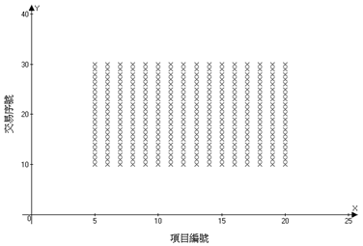
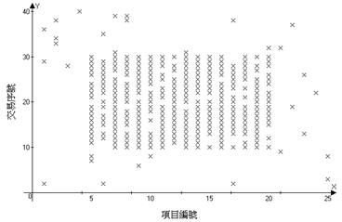
Fault tolerance patterns

Slide 13
Initial idea
[YFB01]: Discovering of groups of similar transactions that share most items.
    Focusing on transactions, not items
    Sparse pattern problem:
For example, for p = 0.15, δ = 0.8, N =1,000,000, D = 500, the probability of finding an ETI with 5 items by chance is approximately 10⁻⁹³⁰⁰
tid; item | 1 | 2 | 3 | 4 | 5 | 6
010 | 1 | 1 | 1 | 1 | 0 | 0
020 | 1 | 1 | 1 | 1 | 0 | 0
030 | 1 | 1 | 1 | 1 | 0 | 0
040 | 1 | 1 | 1 | 1 | 0 | 1
050 | 0 | 0 | 0 | 0 | 1 | 0
060 | 0 | 0 | 0 | 0 | 1 | 0
δ= 0.8
min_sup = 4

Slide 14
Problem description
-definition
A transaction t FT-contains pattern X iff t contains x, where x is sub-pattern of X and |X|-|x|<=δ
  sup^{FT}(X) = # of transactions FT-contains X.
  sup^{item}_{B(X)}(x) = # of transactions contains x in the transactions which FT-contains X.
tid | items
010 | c d e
020 | b d e
030 | a d e
040 | a b c
050 | a b c
X = {abcd}, δ=1
sup^{FT}(X) = |{040, 050}| = 2
sup^{item}_{B(X)}(a) = |{040, 050}| = 2
sup^{item}_{B(X)}(d) = 0

Slide 15
Fix fault tolerance pattern
A pattern X is a FT-pattern iff:
  1. sup^{FT}(X) >= min_sup^{FT}
  2. For each item x in X,
    sup^{item}_{B(X)}(x) >= min_ sup^{item}
X = {abcd}, δ=1, min_sup^{FT}=0.6, min_sup^{item}=0.4
sup^{FT}(X) = |{020, 030, 040, 050}| = 4
sup^{item}_{B(X)}(a) = |{020,030,040,050}| = 4
sup^{item}_{B(X)}(b) = |{020,030,040,050}| = 4
sup^{item}_{B(X)}(c) = |{040,050}| = 2
sup^{item}_{B(X)}(d) =|{020,030}|=2
tid | items
010 | c d e
020 | a b d e
030 | a b d e
040 | a b c
050 | a b c

Slide 16
Proportional fault tolerance patterns
Proportional fault-tolerant pattern mining:
Finding such patterns as X, while items in each sub-pattern of X with length (|X|*δ) frequently occur together.
  For example:
X ={a b c d } , delta=0.75,
X is a FT pattern => {a b c}, {a b d}, {a c d}, {b c d} frequently occur

Slide 17
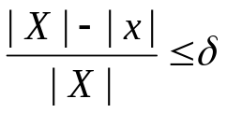
Proportional fault tolerance patterns
A transaction t FT-contains pattern X iff t contains x, where x is sub-pattern of X and (δ is a fault-tolerant parameter)
sup^{FT}(X) = # of transactions FT-contains X.
sup^{item}_{B(X)}(x) = # of transactions contains x in the transactions which FT-contains X.
X = {abcd}, δ=0.75
sup^{FT}(X) = |{040, 050}| = 2
sup^{item}_{B(X)}(a) = |{040, 050}| = 2
sup^{item}_{B(X)}(d) = 0
tid | items
010 | c d e
020 | b d e
030 | a d e
040 | a b c
050 | a b c

Slide 18
Problem description
-definition
A pattern X is a FT-pattern iff:
  1. sup^{FT}(X) >= min_sup^{FT}
  2. For each item x in X,
    sup^{item}_{B(X)}(x) >= min_ sup^{item}

Slide 19
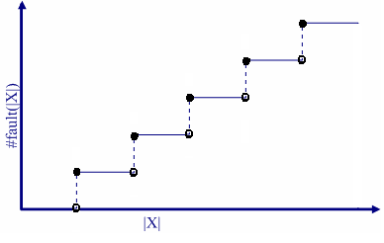

Problem description
-observation
gap

Slide 20
Problem description
-challenge
The sets of patterns separated by the gap are independent. i.e., the anti-monotonic property does not exist.
c d e
b d e
a d e
a b c
a b c
δ=0.6
min_sup^{FT}=5
min_sup^{item}=2
#fault(3)=1
#fault(4)=1
#fault(5)=2
C5:
abcde: 5, (3, 2, 3, 3, 3)

Slide 21
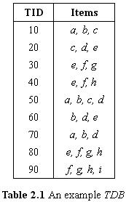
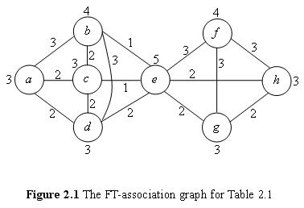
Example

Slide 22
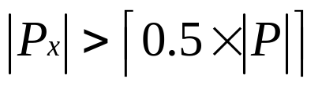
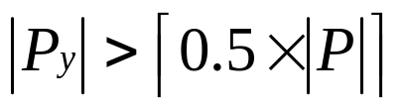
Property
Lemma 2.1 If an item y is away from x for the distance greater than 2 in the FT-association graph, then a pattern P which contains both x and y can not be a frequent FT-pattern.
or
The transactions which contain P_{y} will never FT-contain P => sup^{item}_{B(P)}(y) = 0
P:
x…………
+
y…………
i

Slide 23
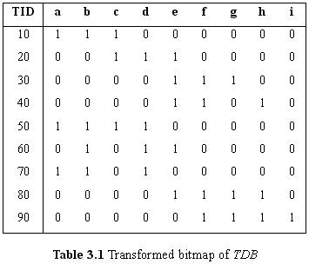
Data Preprocessing
In order to avoid scanning the whole database when checking candidates, the original database is transformed into a bitmap

Slide 24
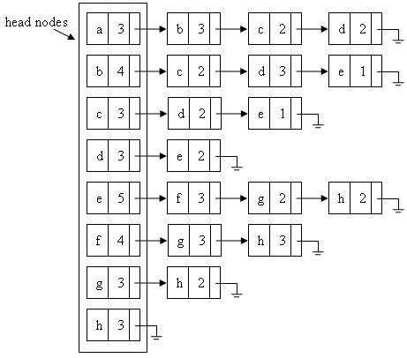
Candidate generation and pruning
The data structure of FT-association graph

Slide 25
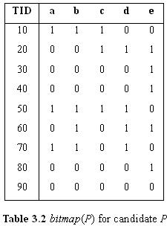

Checking candidates
Extract bitmap(P) for a candidate P
Calculate the sup^{FT} of P and the sup^{item}_{B(P)}(i) of each item i of P
  Let candidate P = abcde, the bitmap(P) is shown below
If the number of 1s is more than
, T is FT-containing P
If the number of 1s is less than
min_sup^{item}, P is not a frequent
FT-pattern

Slide 26
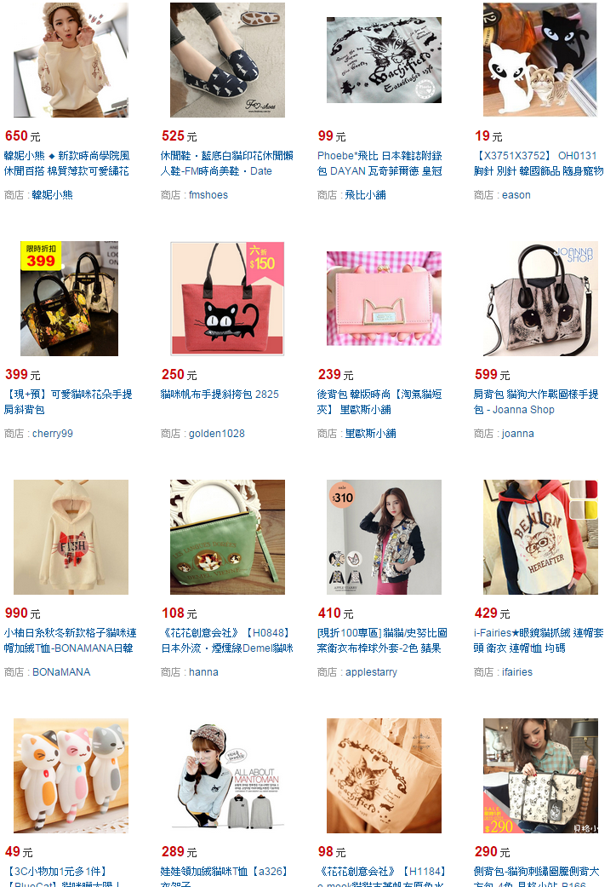
High Utility Itemset Mining
Mining high utility itemsets from the databases refers to finding the itemsets with high utilities.
Notes:
Pruning candidate itemsets. Up tree

Slide 27
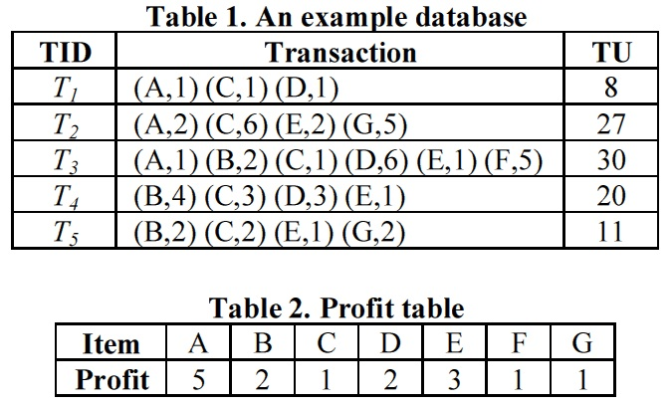
Problem definition
Transaction database and profit table.
Notes:
[ˋprɑfɪt]

Slide 28
(Cont.)
Definition 1. u(ip, Td) = p(ip)*q(ip, Td)
E.g. u({A}, T1) = 5*1 = 5

Slide 29

(Cont.)
Definition 2. u(X, Td) =
E.g. u({AD}, T1) = u({A}, T1) + u({D}, T1)
= 5*1 + 2*1 = 7

Slide 30

(Cont.)
Definition 3. u(X) =
E.g. u({AD}, T1)+u({AD}, T3)=(5*1+2*1) + (5*1+2*6)=24
Notes:
T1 跟 T3

Slide 31
(Cont.)
Definition 4.
Utility < min_utility ≤ Utility
low utility itemset high utility itemset

Slide 32
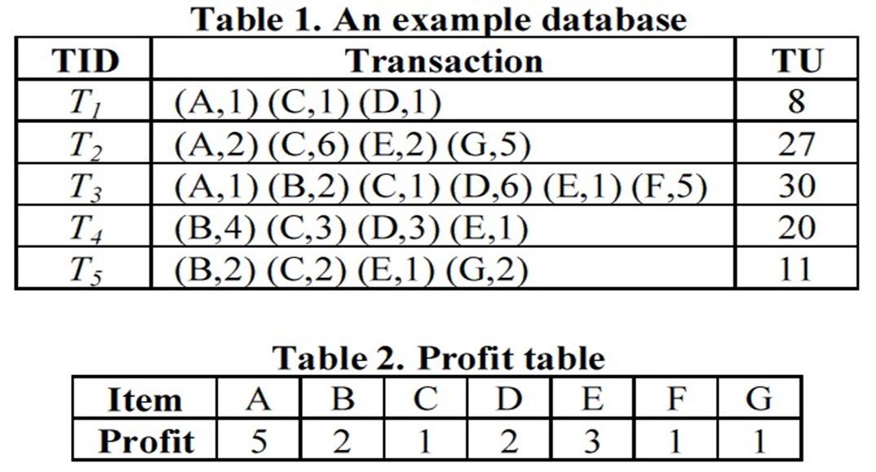
Goal
Find all high utility itemsets
However
Min_utility=26
U({CD})=1*1+2*1+1*1+2*6
+1*3+2*3=25
U({ACD})=
5*1+1*1+2*1
+5*1+1*1+2*6=26
115/11/08

Slide 33
Goal
Find all high utility itemsets
However
Min_utility=26
U({CD})=1*1+2*1+1*1+2*6
+1*3+2*3=25
U({ACD})=
5*1+1*1+2*1
+5*1+1*1+2*6=26
115/11/08

Slide 34
(Cont.)
Definition 5. TU(Td) = u(Td, Td)
E.g. TU(T2) = (5*2) + (1*6) + (3*2) + (1*5) = 27
2013/01/03
Notes:
T1 跟 T3

Slide 35

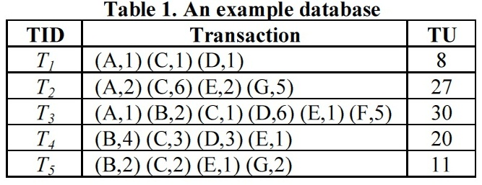
(Cont.)
Definition 6. TWU(X) =
E.g. TWU({AD}) = TU(T1) + TU(T3) = 8 + 30 = 38
If min_utility ≤ TWU(X), X is called a high transaction-weighted utilization itemset (HTWUI).
2013/01/03
Notes:
T1 跟 T3

Slide 36
(Cont.)
Definition 7. transaction-weighted downward closure (TWDC)
E.g.
Any superset of {AD} is a low utility itemset since {AD} is not a HTWUI.
(5+1+2)+(5+1+12)=26<40
2013/01/03
Notes:
T1 跟 T3 {AD} is not a HTWUI

Slide 37
Sensitive itemsets hiding
Consider a supermarket and two beer suppliers A and B.
  The database of the supermarket is released to the suppliers for exchanging a lower price of goods, and thus, supplier A can mine the association rules related to his products for the purpose of sales promotion.
  If supplier A finds that most customers who buy diapers also buy B’s beers
    Run a coupon for giving a 10 percent discount when buying A’s beers together with diapers. As a result, the amount of sales on B’s beers decreases and B can not give a low price to the supermarket as before. Finally, supplier A monopolizes the beer market and is unwilling to give a low price to the supermarket any more.
  From this aspect, releasing the database is bad for the supermarket.
115/11/08

Slide 38
Problem definition
Sensitive itemsets: The itemsets belong to the frequent itemsets with privacy or security concern that have to be hidden in the database
Non-sensitive itemsets: The itemsets belong to the frequent itemsets without privacy or security concern that do not have to be hidden in the database
115/11/08

Slide 39
Problem definition
The problem of hiding sensitive itemsets
  Sensitive itemsets: The frequencies of sensitive itemsets have to be decreased in the database
      How to choose the transactions with sensitive itemsets?
  Non-sensitive itemsets: The non-sensitive itemsets have to be protected in the database
    Side effects: The frequent itemsets become non-frequent itemsets after hiding process
      How to reduce side effects?
  Quality of database: The difference between the original database and the sanitized one have to be minimized
      How to measure the quality of database?
115/11/08

Slide 40
Four classes
Heuristic based approaches
Border based approaches
Constraint-satisfaction problem approaches
Database reconstruction approaches
115/11/08

Slide 41
Border Based Approaches
Border based approaches used the notion of borders presented to track the impact of altering transactions by greedy selecting those modifications whilst minimizing the side effects.
Formally
115/11/08

Slide 42
Example
Let SI = {AB, ABC} and F ' = {A, B, C, D, BC, BD, CD, BCD}.
  B⁺(F’) = {A, BCD} and B⁻(SI)={AB}.
115/11/08

Slide 43


The degree of vulnerability of a border element B is computed by the following equation:
  Sup_{B} denotes the support of B in D
  λ is an integer larger than |B⁺(F’)|
  denotes the support of B in D”, where D” is the database during the process of sanitization.
115/11/08

Slide 44

Border Based Approaches
After getting w(B) of each border element, the effect of deleting item u from transaction T can be regarded as the sum of the weights of border elements that will be affected by deleting u.
115/11/08

Slide 45
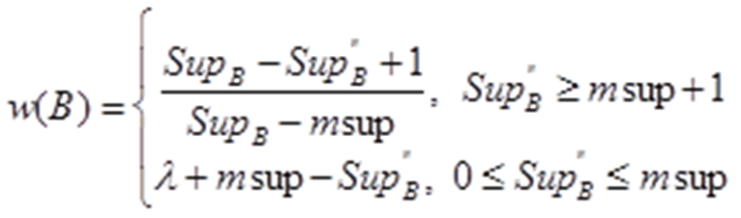
Assume msup=2
  Let SI = {AB} and F ' = {A, B, C, D, BC, BD, CD, BCD}.
    B⁺(F’) = {A, BCD} and B⁻(SI)={AB}.
  Assume λ=3, the weight of each element in the positive border can be calculated as:
    w(A)= (3-3+1)/(3-2)=1
    w(BCD)=3+2-2=3
A | B | C | D
0 | 1 | 1 | 1
0 | 0 | 1 | 0
0 | 0 | 0 | 1
1 | 1 | 1 | 1
1 | 1 | 0 | 0
1 | 0 | 0 | 0
115/11/08

Slide 46
Γ(AB)={T₄, T₅}
  To hide sensitive itemset AB, the impacts of removing item A/B from T₄/T₅ are computed
    I(T₄,A)=w(A)=1
    I(T_{4,}B)=w(BCD)=3
    I(T₅,A)=w(A)=1
    I(T₅,B)=0
w(A)= (3-3+1)/(3-2)=1
w(BCD)=3+2-2=3
A | B | C | D
0 | 1 | 1 | 1
0 | 0 | 1 | 0
0 | 0 | 0 | 1
1 | 1 | 1 | 1
1 | 1 | 0 | 0
1 | 0 | 0 | 0
115/11/08

Slide 47
Constraint Satisfaction Problem Model
115/11/08

Slide 48
Preliminaries
F: frequent itemsets( the frequency in database is larger than or equal to msup )
  Ex: F={A,B,C,D,AB,AC,AD,CD,ACD}
SI: sensitive itemsets
  Ex: SI={AB}
SS: superset of sensitive itemsets in F
  EX: SS={AB}
F’: frequent itemsets in sanitized database (F’=F-SS)
  Ex: F’={A,B,C,D,AC,AD,CD,ACD}
 | A | B | C | D
T1 | 1 | 0 | 1 | 0
T2 | 1 | 0 | 1 | 1
T3 | 0 | 0 | 1 | 1
T4 | 0 | 1 | 0 | 0
T5 | 1 | 1 | 1 | 1
T6 | 0 | 0 | 0 | 1
T7 | 0 | 0 | 1 | 0
T8 | 1 | 1 | 0 | 0
Transaction database
115/11/08

Slide 49
Preliminaries (cont.)
The concept of border in [DV06] :
  B⁺(F) (Positive border): set of all maximally frequent itemsets
ex: B⁺ (F)={AD,BD,ABC}
null
frequent
A
B
C
D
AB
AC
AD
BC
BD
CD
ABC
ABD
ACD
BCD
ABCD
infrequent
border
115/11/08

Slide 50



CSP
Constraint Satisfaction Problem (CSP): A solution of a CSP is a complete assignment of values to the variables that satisfies all the constraints
Ex:
minsup=0.2, msup count=6×0.2=1.2
SI={AB}, SS={AB},
  F’=F-SS={A,B,C,D,BC,BD,CD,BCD}
  B⁺(F’)={A,BCD}
 | A | B | C | D
T1 | 0 | 1 | 1 | 1
T2 | 0 | 0 | 1 | 0
T3 | 0 | 0 | 0 | 1
T4 | 1 | 1 | 1 | 1
T5 | 1 | 1 | 0 | 0
T6 | 1 | 0 | 0 | 0
u₄₁
u₄₂
A: frequent
u₅₁
u₅₂
BCD: frequent
AB: infrequent
Transaction database
Maximize(u₄₁+u₄₂+u₅₁+u₅₂)
115/11/08

Slide 51
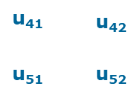
CSP
Distance: The number of variant bits between the original and the sanitized database
    The lower distance means the better hiding performance
 | A | B | C | D
T1 | 0 | 1 | 1 | 1
T2 | 0 | 0 | 1 | 0
T3 | 0 | 0 | 0 | 1
T4 | 1 | 1 | 1 | 1
T5 | 1 | 1 | 0 | 0
T6 | 1 | 0 | 0 | 0
solution | u₄₁ | u₄₂ | u₅₁ | u₅₂
l1 | 0 | 1 | 1 | 1
l2 | 1 | 1 | 0 | 1
l3 | 1 | 1 | 1 | 0
Distance=1
115/11/08

Slide 52

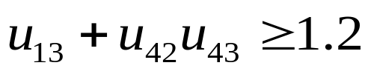


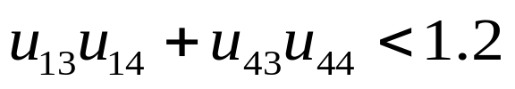
CSP
CSP is infeasible: Remove the maximal size and minimum support itemsets in B⁺(F’) until CSP is feasible
Ex:
minf=0.2, msup=6×0.2=1.2
SI={AB,CD}, SS={AB,CD,BCD},
F’=F-SS={A,B,C,D,BC,BD}
B⁺(F’)={A,BC,BD}
 | A | B | C | D
T1 | 0 | 1 | 1 | 1
T2 | 0 | 0 | 1 | 0
T3 | 0 | 0 | 0 | 1
T4 | 1 | 1 | 1 | 1
T5 | 1 | 1 | 0 | 0
T6 | 1 | 0 | 0 | 0
u₁₃
u₁₄
A: frequent
BC: frequent
u₄₁
u₄₂
u₄₃
u₄₄
BD: frequent
u₅₁
u₅₂
AB: infrequent
CD: infrequent
Transaction database
Maximize(u₁₃+u₁₄+u₄₁+u₄₂+u₅₁+u₅₂)

Slide 53
CSP
Solution | u₄₁ | u₄₂ | u₅₁ | u₅₂ | u₁₃ | u₁₄ | u₄₃ | u₄₄
l₁ | 0 | 1 | 1 | 1 | 1 | 1 | 0 | 1
l₂ | 1 | 1 | 0 | 1 | 1 | 1 | 0 | 1
l₃ | 1 | 1 | 1 | 0 | 1 | 1 | 0 | 1
l₄ | 0 | 1 | 1 | 1 | 0 | 1 | 1 | 1
l₅ | 1 | 1 | 0 | 1 | 0 | 1 | 1 | 1
l₆ | 1 | 1 | 1 | 0 | 0 | 1 | 1 | 1
l₇ | 0 | 1 | 1 | 1 | 1 | 0 | 1 | 1
l₈ | 1 | 1 | 0 | 1 | 1 | 0 | 1 | 1
l₉ | 1 | 1 | 1 | 0 | 1 | 0 | 1 | 1
l₁₀ | 0 | 1 | 1 | 1 | 1 | 1 | 1 | 0
l₁₁ | 1 | 1 | 0 | 1 | 1 | 1 | 1 | 0
l₁₂ | 1 | 1 | 1 | 0 | 1 | 1 | 1 | 0
BC: infrequent
BD: infrequent

Slide 54
 |  | Execution time | Scalability | Hiding Failure | Information loss | Modification degree
Heuristic approaches | Sensitive transactions identification methods | moderate | low | low | moderate | moderate
 | Sensitive associations clustering methods | moderate | moderate | none | moderate | moderate
 | Sanitization matrix multiplication methods | fast | good | Very low | bad | bad
Border based approaches |  | moderate | moderate | none | good | good
Constraint-satisfaction problem approaches |  | slow | low | none | none(for the case that CSP is feasible) | Very good
Database reconstruction approaches |  | slow | low | none | good | moderate

Slide 55
Summary
Basic concepts: association rules, support-confident framework, closed and max-patterns
Scalable frequent pattern mining methods
  Apriori (Candidate generation & test)
  Projection-based (FPgrowth, CLOSET+, ...)
  Vertical format approach (ECLAT, CHARM, ...)

Slide 56
Frequent-Pattern Mining: Research Problems
Negative
Fault tolerance patterns
  Fix
  Proportion
High utility patterns
Sequential patterns

Slide 57
Ref: Mining Multi-Level and Quantitative Rules
Y. Aumann and Y. Lindell. A Statistical Theory for Quantitative Association Rules, KDD'99
T. Fukuda, Y. Morimoto, S. Morishita, and T. Tokuyama. Data mining using two-dimensional optimized association rules: Scheme, algorithms, and visualization. SIGMOD'96.
J. Han and Y. Fu. Discovery of multiple-level association rules from large databases. VLDB'95.
R.J. Miller and Y. Yang. Association rules over interval data. SIGMOD'97.
R. Srikant and R. Agrawal. Mining generalized association rules. VLDB'95.
R. Srikant and R. Agrawal. Mining quantitative association rules in large relational tables. SIGMOD'96.
K. Wang, Y. He, and J. Han. Mining frequent itemsets using support constraints. VLDB'00
K. Yoda, T. Fukuda, Y. Morimoto, S. Morishita, and T. Tokuyama. Computing optimized rectilinear regions for association rules. KDD'97.

Slide 58
Ref: Mining Other Kinds of Rules
F. Korn, A. Labrinidis, Y. Kotidis, and C. Faloutsos. Ratio rules: A new paradigm for fast, quantifiable data mining. VLDB'98
Y. Huhtala, J. Kärkkäinen, P. Porkka, H. Toivonen. Efficient Discovery of Functional and Approximate Dependencies Using Partitions. ICDE’98.
H. V. Jagadish, J. Madar, and R. Ng. Semantic Compression and Pattern Extraction with Fascicles. VLDB'99
B. Lent, A. Swami, and J. Widom. Clustering association rules. ICDE'97.
R. Meo, G. Psaila, and S. Ceri. A new SQL-like operator for mining association rules. VLDB'96.
A. Savasere, E. Omiecinski, and S. Navathe. Mining for strong negative associations in a large database of customer transactions. ICDE'98.
D. Tsur, J. D. Ullman, S. Abitboul, C. Clifton, R. Motwani, and S. Nestorov. Query flocks: A generalization of association-rule mining. SIGMOD'98.

Slide 59
Ref: Freq. Pattern Mining Applications
T. Dasu, T. Johnson, S. Muthukrishnan, and V. Shkapenyuk. Mining Database Structure; or How to Build a Data Quality Browser. SIGMOD'02
M. Khan, H. Le, H. Ahmadi, T. Abdelzaher, and J. Han. DustMiner: Troubleshooting interactive complexity bugs in sensor networks., SenSys'08
Z. Li, S. Lu, S. Myagmar, and Y. Zhou. CP-Miner: A tool for finding copy-paste and related bugs in operating system code. In Proc. 2004 Symp. Operating Systems Design and Implementation (OSDI'04)
Z. Li and Y. Zhou. PR-Miner: Automatically extracting implicit programming rules and detecting violations in large software code. FSE'05
D. Lo, H. Cheng, J. Han, S. Khoo, and C. Sun. Classification of software behaviors for failure detection: A discriminative pattern mining approach. KDD'09
Q. Mei, D. Xin, H. Cheng, J. Han, and C. Zhai. Semantic annotation of frequent patterns. ACM TKDD, 2007.
K. Wang, S. Zhou, J. Han. Profit Mining: From Patterns to Actions. EDBT’02.

Slide 60
Ref: Apriori and Its Improvements
R. Agrawal and R. Srikant. Fast algorithms for mining association rules. VLDB'94
H. Mannila, H. Toivonen, and A. I. Verkamo. Efficient algorithms for discovering association rules. KDD'94
A. Savasere, E. Omiecinski, and S. Navathe. An efficient algorithm for mining association rules in large databases. VLDB'95
J. S. Park, M. S. Chen, and P. S. Yu. An effective hash-based algorithm for mining association rules. SIGMOD'95
H. Toivonen. Sampling large databases for association rules. VLDB'96
S. Brin, R. Motwani, J. D. Ullman, and S. Tsur. Dynamic itemset counting and implication rules for market basket analysis. SIGMOD'97
S. Sarawagi, S. Thomas, and R. Agrawal. Integrating association rule mining with relational database systems: Alternatives and implications. SIGMOD'98

Slide 61
Ref: Depth-First, Projection-Based FP Mining
R. Agarwal, C. Aggarwal, and V. V. V. Prasad. A tree projection algorithm for generation of frequent itemsets. J. Parallel and Distributed Computing, 2002.
G. Grahne and J. Zhu, Efficiently Using Prefix-Trees in Mining Frequent Itemsets, Proc. FIMI'03
B. Goethals and M. Zaki. An introduction to workshop on frequent itemset mining implementations. Proc. ICDM’03 Int. Workshop on Frequent Itemset Mining Implementations (FIMI’03), Melbourne, FL, Nov. 2003
J. Han, J. Pei, and Y. Yin. Mining frequent patterns without candidate generation. SIGMOD’ 00
J. Liu, Y. Pan, K. Wang, and J. Han. Mining Frequent Item Sets by Opportunistic Projection. KDD'02
J. Han, J. Wang, Y. Lu, and P. Tzvetkov. Mining Top-K Frequent Closed Patterns without Minimum Support. ICDM'02
J. Wang, J. Han, and J. Pei. CLOSET+: Searching for the Best Strategies for Mining Frequent Closed Itemsets. KDD'03

Slide 62
Ref: Vertical Format and Row Enumeration Methods
M. J. Zaki, S. Parthasarathy, M. Ogihara, and W. Li. Parallel algorithm for discovery of association rules. DAMI:97.
M. J. Zaki and C. J. Hsiao. CHARM: An Efficient Algorithm for Closed Itemset Mining, SDM'02.
C. Bucila, J. Gehrke, D. Kifer, and W. White. DualMiner: A Dual-Pruning Algorithm for Itemsets with Constraints. KDD’02.
F. Pan, G. Cong, A. K. H. Tung, J. Yang, and M. Zaki , CARPENTER: Finding Closed Patterns in Long Biological Datasets. KDD'03.
H. Liu, J. Han, D. Xin, and Z. Shao, Mining Interesting Patterns from Very High Dimensional Data: A Top-Down Row Enumeration Approach, SDM'06.

Slide 63
Ref: Mining Correlations and Interesting Rules
S. Brin, R. Motwani, and C. Silverstein. Beyond market basket: Generalizing association rules to correlations. SIGMOD'97.
M. Klemettinen, H. Mannila, P. Ronkainen, H. Toivonen, and A. I. Verkamo. Finding interesting rules from large sets of discovered association rules. CIKM'94.
R. J. Hilderman and H. J. Hamilton. Knowledge Discovery and Measures of Interest. Kluwer Academic, 2001.
C. Silverstein, S. Brin, R. Motwani, and J. Ullman. Scalable techniques for mining causal structures. VLDB'98.
P.-N. Tan, V. Kumar, and J. Srivastava. Selecting the Right Interestingness Measure for Association Patterns. KDD'02.
E. Omiecinski. Alternative Interest Measures for Mining Associations. TKDE’03.
T. Wu, Y. Chen, and J. Han, “Re-Examination of Interestingness Measures in Pattern Mining: A Unified Framework", Data Mining and Knowledge Discovery, 21(3):371-397, 2010

