Slide 1
Interestingness Measure: Correlations
min_sup=30%
min_conf=60%
play basketball ⇒ eat cereal [40%, 66.7%] is misleading
  The overall % of students eating cereal is 75% > 66.7%.
play basketball ⇒ not eat cereal [20%, 33.3%] is more accurate, although with lower support and confidence
 | Basketball | Not basketball | Sum (row)
Cereal | 2000 | 1750 | 3750
Not cereal | 1000 | 250 | 1250
Sum(col.) | 3000 | 2000 | 5000

Slide 2



Interestingness Measure: Correlations (Lift)
play basketball ⇒ eat cereal [40%, 66.7%] is misleading
  The overall % of students eating cereal is 75% > 66.7%.
play basketball ⇒ not eat cereal [20%, 33.3%] is more accurate, although with lower support and confidence
Measure of dependent/correlated events: lift
 | Basketball | Not basketball | Sum (row)
Cereal | 2000 | 1750 | 3750
Not cereal | 1000 | 250 | 1250
Sum(col.) | 3000 | 2000 | 5000

Slide 3

Which Measures Should Be Used?
Support and confidence are not good to indicate correlations
Over 20 interestingness measures have been proposed (see Tan, Kumar, Sritastava @KDD’02)
Which are good ones?

Slide 4
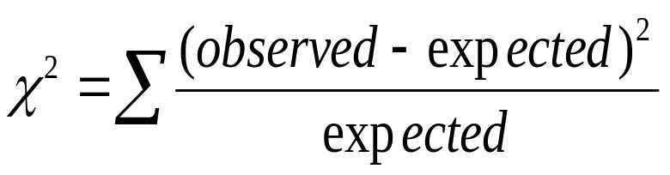
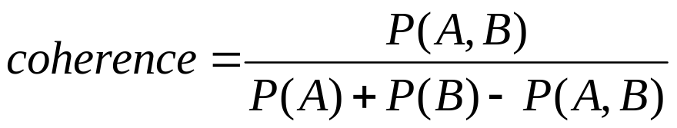
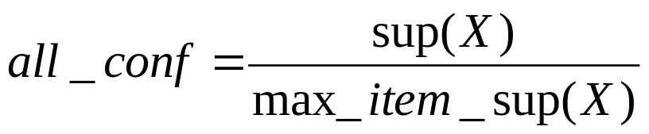
Interestingness Measure
 | game | game’ | sum
video | 4000 (4500) | 3500 (3000) | 7500
video’ | 2000 (1500) | 500 (1000) | 2500
sum | 6000 | 4000 | 10000
0.4/(0.75*0.6)=0.89
P(video)=0.75
P(game)=0.6
P(video and game)=0.4

Slide 5
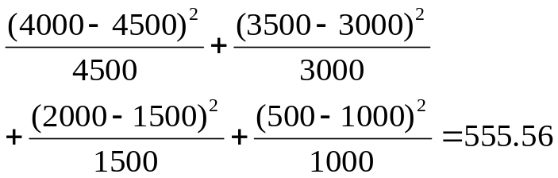
Interestingness Measure
 | game | Game’ | sum
video | 4000 (4500) | 3500 (3000) | 7500
Video’ | 2000 (1500) | 500 (1000) | 2500
sum | 6000 | 4000 | 10000
P(video)=0.75
P(game)=0.6
P(video and game)=0.4

Slide 6
Interestingness Measure
Degrees of Freedom (df) | Probability (p)
 | 0.95 | 0.90 | 0.80 | 0.70 | 0.50 | 0.30 | 0.20 | 0.10 | 0.05 | 0.01 | 0.001
1 | 0.004 | 0.02 | 0.06 | 0.15 | 0.46 | 1.07 | 1.64 | 2.71 | 3.84 | 6.64 | 10.83
2 | 0.10 | 0.21 | 0.45 | 0.71 | 1.39 | 2.41 | 3.22 | 4.60 | 5.99 | 9.21 | 13.82
3 | 0.35 | 0.58 | 1.01 | 1.42 | 2.37 | 3.66 | 4.64 | 6.25 | 7.82 | 11.34 | 16.27
4 | 0.71 | 1.06 | 1.65 | 2.20 | 3.36 | 4.88 | 5.99 | 7.78 | 9.49 | 13.28 | 18.47
5 | 1.14 | 1.61 | 2.34 | 3.00 | 4.35 | 6.06 | 7.29 | 9.24 | 11.07 | 15.09 | 20.52
6 | 1.63 | 2.20 | 3.07 | 3.83 | 5.35 | 7.23 | 8.56 | 10.64 | 12.59 | 16.81 | 22.46
7 | 2.17 | 2.83 | 3.82 | 4.67 | 6.35 | 8.38 | 9.80 | 12.02 | 14.07 | 18.48 | 24.32
8 | 2.73 | 3.49 | 4.59 | 5.53 | 7.34 | 9.52 | 11.03 | 13.36 | 15.51 | 20.09 | 26.12
9 | 3.32 | 4.17 | 5.38 | 6.39 | 8.34 | 10.66 | 12.24 | 14.68 | 16.92 | 21.67 | 27.88
10 | 3.94 | 4.86 | 6.18 | 7.27 | 9.34 | 11.78 | 13.44 | 15.99 | 18.31 | 23.21 | 29.59
 | Nonsignificant |  |  |  |  |  |  |  | Significant

Slide 7
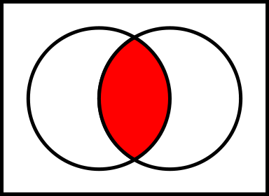
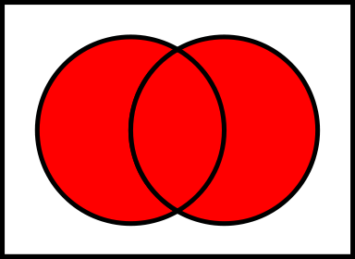
Interestingness Measure
 | game | Game’ | sum
video | 4000 (4500) | 3500 (3000) | 7500
Video’ | 2000 (1500) | 500 (1000) | 2500
sum | 6000 | 4000 | 10000
0.4/(0.75+0.6-0.4)
=0.42
P(video)=0.75
P(game)=0.6
P(video and game)=0.4

Slide 8
Interestingness Measure
 | game | Game’ | sum
video | 4000 (4500) | 3500 (3000) | 7500
Video’ | 2000 (1500) | 500 (1000) | 2500
sum | 6000 | 4000 | 10000
P(video)=0.75
P(game)=0.6
P(video and game)=0.4
0.4/0.75=0.53

Slide 9
Are lift and χ² Good Measures of Correlation?
 | Milk | No Milk | Sum (row)
Coffee | m, c | ~m, c | c
No Coffee | m, ~c | ~m, ~c | ~c
Sum(col.) | m | ~m | Σ
DB | m, c | ~m, c | m~c | ~m~c | lift | all-conf | coh | χ2
A1 | 1000 | 100 | 100 | 10,000 | 9.26 | 0.91 | 0.83 | 9055
A2 | 100 | 1000 | 1000 | 100,000 | 8.44 | 0.09 | 0.05 | 670
A3 | 1000 | 100 | 10000 | 100,000 | 9.18 | 0.09 | 0.09 | 8172
A4 | 1000 | 1000 | 1000 | 1000 | 1 | 0.5 | 0.33 | 0
P
NNI

Slide 10
Which Measures Should Be Used?
lift and χ² are not good measures for correlations in large transactional DBs
all-conf or coherence could be good measures (Omiecinski@TKDE’03)
Both all-conf and coherence have the downward closure property
Efficient algorithms can be derived for mining (Lee et al. @ICDM’03sub)

