Slide 1
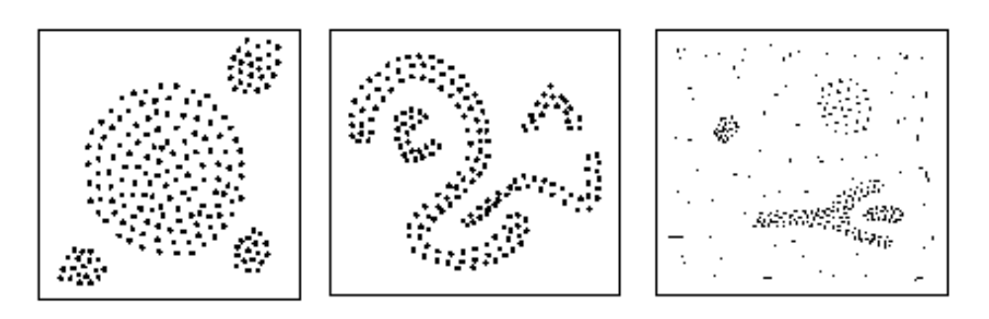
Density-Based Clustering Methods
Clustering based on density (local cluster criterion), such as density-connected points
Major features:
  Discover clusters of arbitrary shape
  Handle noise
  One scan
  Need density parameters as termination condition
Several interesting studies:
  DBSCAN: Ester, et al. (KDD’96)
  OPTICS: Ankerst, et al (SIGMOD’99).
  DENCLUE: Hinneburg & D. Keim (KDD’98)
  CLIQUE: Agrawal, et al. (SIGMOD’98) (more grid-based)

Slide 2
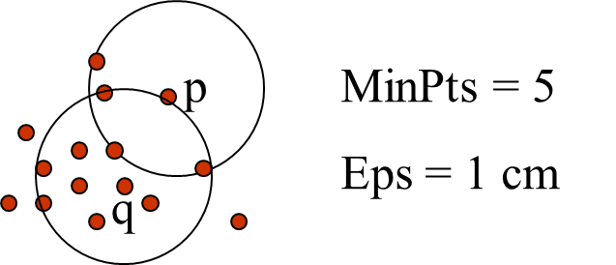
Density-Based Clustering: Basic Concepts
Two parameters:
  Eps: Maximum radius of the neighbourhood
  MinPts: Minimum number of points in an Eps-neighbourhood of that point
N_{Eps}(p): {q belongs to D | dist(p,q) ≤ Eps}
  core point condition:
  |N_{Eps} (q)| ≥ MinPts

Slide 3
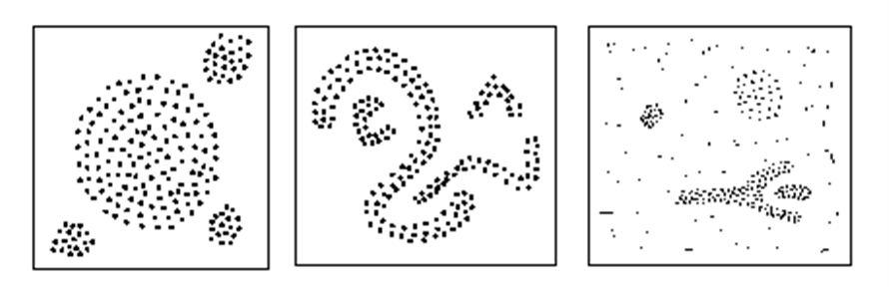
DBSCAN: Density-Based Spatial Clustering of Applications with Noise
Relies on a density-based notion of cluster: A cluster is defined as a maximal set of density-connected points
Discovers clusters of arbitrary shape in spatial databases with noise
Outlier
Border
Eps = 1cm
MinPts = 5
Core

Slide 4
Density-Based Clustering: Basic Concepts
Two parameters:
  Eps: Maximum radius of the neighbourhood
  MinPts: Minimum number of points in an Eps-neighbourhood of that point
N_{Eps}(p): {q belongs to D | dist(p,q) ≤ Eps}
Directly density-reachable: A point p is directly density-reachable from a point q w.r.t. Eps, MinPts if
  p belongs to N_{Eps}(q)
  core point condition:
  |N_{Eps} (q)| ≥ MinPts
p
MinPts = 5
Eps = 1 cm
q

Slide 5
Density-Reachable and Density-Connected
Density-reachable:
  A point p is density-reachable from a point q w.r.t. Eps, MinPts if there is a chain of points p₁, …, p_{n}, p₁ = q, p_{n} = p such that p_{i+1} is directly density-reachable from p_{i}
Density-connected
  A point p is density-connected to a point q w.r.t. Eps, MinPts if there is a point o such that both, p and q are density-reachable from o w.r.t. Eps and MinPts
p
p₁
q
p
q
o

Slide 6
DBSCAN: The Algorithm
Arbitrary select a point p
Retrieve all points density-reachable from p w.r.t. Eps and MinPts
If p is a core point, a cluster is formed
If p is a border point, no points are density-reachable from p and DBSCAN visits the next point of the database
Continue the process until all of the points have been processed

Slide 7
An Example
MinPts = 4
Eps=ε
ε
C₁
C₁
ε
ε
C₁

Slide 8
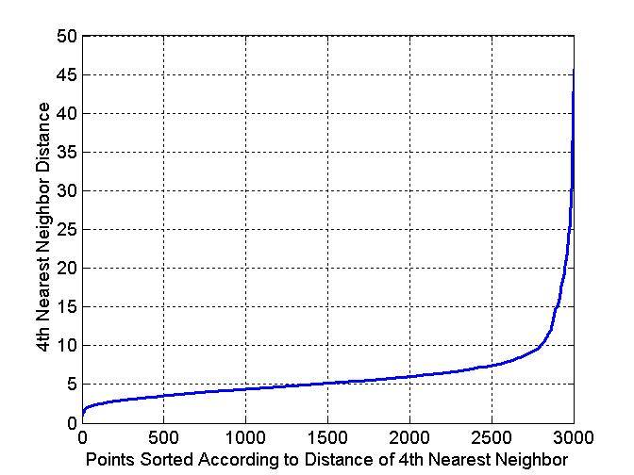
DBSCAN: Determining EPS and MinPts
Idea is that for points in a cluster, their k^{th} nearest neighbors are at roughly the same distance
Noise points have the k^{th} nearest neighbor at farther distance
So, plot sorted distance of every point to its k^{th} nearest neighbor
A sharp change at the value of k-dist that corresponds to suitable value of eps and the value of k as MinPts

Slide 9
DBSCAN: Determining EPS and MinPts
If k is too large=> small clusters (of size less than k) are likely to be labeled as noise
If k is too small=> Even a small number of closely spaced that are noise or outliers will be incorrectly labeled as clusters

Slide 10
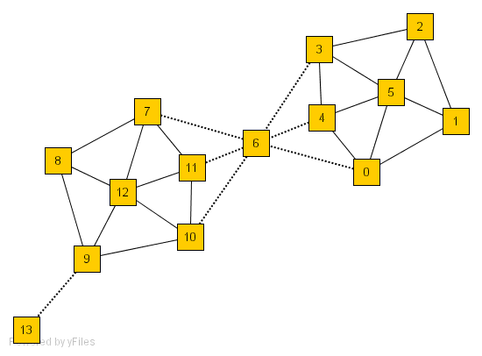
SCAN: Density-Based Clustering of Networks
How many clusters?
What size should they be?
What is the best partitioning?
Should some points be segregated?
  Search the graph to find well-connected components as clusters
An Example Network
Application: Given simply information of who associates with whom, could one identify clusters of individuals with common interests or special relationships (families, cliques, terrorist cells)?

Slide 11
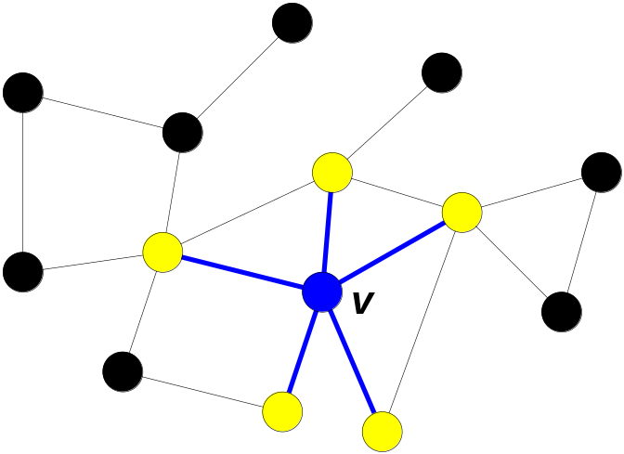
A Social Network Model
Cliques, hubs and outliers
  Individuals in a tight social group, or clique, know many of the same people, regardless of the size of the group
  Individuals who are hubs know many people in different groups but belong to no single group. Politicians, for example bridge multiple groups
  Individuals who are outliers reside at the margins of society. Hermits, for example, know few people and belong to no group
The Neighborhood of a Vertex
  Define Γ(ν) as the immediate neighborhood of a vertex (including v)
Γ(ν)

Slide 12
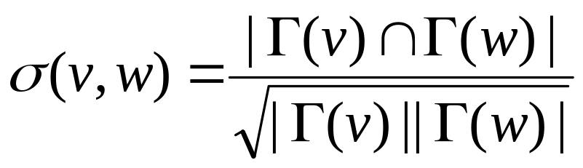
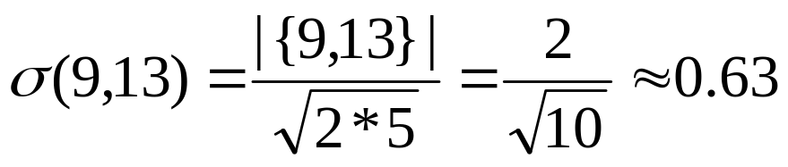
Structure Similarity
The desired features tend to be captured by a measure we call Structural Similarity
Structural similarity is large for members of a clique and small for hubs and outliers
Γ(13)={9,13}
Γ(9)={8,9,10,12,13}

Slide 13


Structural Connectivity [1]
ε-Neighborhood:
Core:
Direct structure reachable:
Structure reachable: transitive closure of direct structure reachability
Structure connected:
popularity
[1] M. Ester, H. P. Kriegel, J. Sander, & X. Xu (KDD'96) “A Density-Based Algorithm for Discovering Clusters in Large Spatial Databases

Slide 14

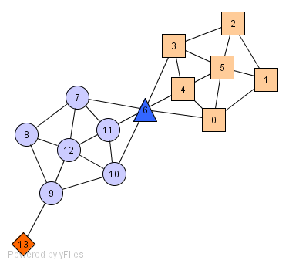
Structure-Connected Clusters
Structure-connected cluster C
  Connectivity:
  Maximality:
Hubs:
  Not belong to any cluster
  Bridge to many clusters
Outliers:
  Not belong to any cluster
  Connect to less clusters
hub
outlier

Slide 15
Algorithm
2
3
μ = 2
ε = 0.7
5
1
4
7
6
0
8
11
12
10
9
13

Slide 16
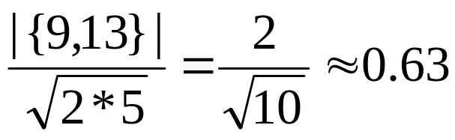
Algorithm
2
3
μ = 2
ε = 0.7
5
1
4
7
6
0
8
11
12
10
9
0.63
13

Slide 17
Algorithm
2
3
μ = 2
ε = 0.7
5
1
4
7
6
0.67
0
8
11
0.82
12
0.75
10
9
13

Slide 18
Algorithm
2
3
μ = 2
ε = 0.7
5
1
4
7
6
0
8
11
12
10
9
13

Slide 19
Algorithm
2
3
μ = 2
ε = 0.7
5
1
4
7
6
0
8
11
12
10
9
0.67
13

Slide 20
Algorithm
2
3
μ = 2
ε = 0.7
5
1
4
7
6
0
8
0.73
11
12
0.73
0.73
10
9
13

Slide 21
Algorithm
2
3
μ = 2
ε = 0.7
5
1
4
7
6
0
8
11
12
10
9
13

Slide 22
Algorithm
2
3
μ = 2
ε = 0.7
5
1
4
7
0.51
6
0
8
11
12
10
9
13

Slide 23
Algorithm
2
3
μ = 2
ε = 0.7
5
1
4
7
6
0
11
0.68
8
12
10
9
13

Slide 24
Algorithm
2
3
μ = 2
ε = 0.7
5
1
4
7
6
0
8
11
12
0.51
10
9
13

Slide 25
Algorithm
2
3
μ = 2
ε = 0.7
5
1
4
7
6
0
8
11
12
10
9
13

Slide 26
Algorithm
2
3
μ = 2
ε = 0.7
5
0.51
1
4
7
0.68
6
0
11
0.51
8
12
10
9
13

Slide 27
Algorithm
2
3
μ = 2
ε = 0.7
5
1
4
7
6
0
8
11
12
10
9
13

Slide 28

Assessing Clustering Tendency
Clustering requires nonuniform distribution of data!

Slide 29

Assess if non-random structure exists in the data by measuring the probability that the data is generated by a uniform data distribution
Test spatial randomness by statistic test: Hopkins Static
  This statistic examines whether objects in a data set differ significantly from the assumption that they are uniformly distributed in the multidimensional space.
  It compares the distances w_{i} between the real objects and their nearest neighbors to the distances q_{i} between artificial objects, uniformly generated over the data space, and their nearest real neighbors.
  The process is repeated several times for a fraction of the total population. After that, the H_{ind} statistic is computed as:

Slide 30
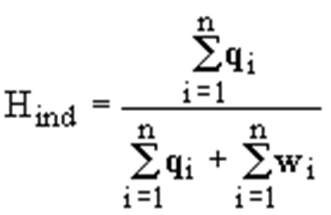
artificial
real
If objects are uniformly distributed, q_{i} and w_{i} will be similar, and the statistic will be close to 0.5.
If clustering are present, the distances for artificial objects will be larger than that for the real ones
  these artificial objects are homogeneously distributed whereas the real ones are grouped together, and the value of H_{ind} will increase.
  A value for H_{ind} higher than 0.75 indicates a clustering tendency at the 90% confidence level.

Slide 31
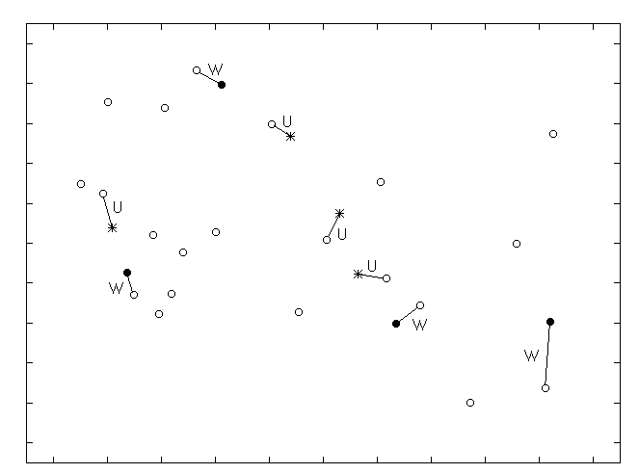
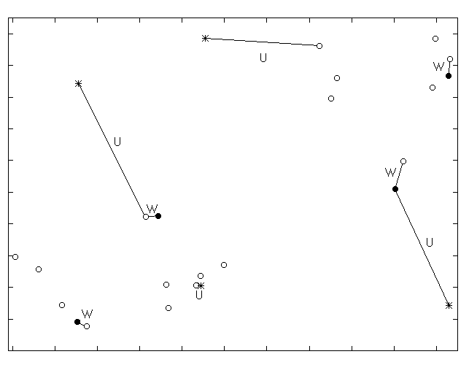
Hopkins statistics applied to two different data sets
Open circles represent real objects, closed circles selected real objects and asterisks represent artificial objects generated over the data space
H value = 0.49
H value = 0.73

Slide 32

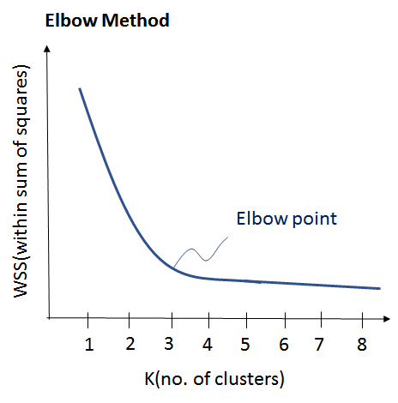
Determine the Number of Clusters
Empirical method
  # of clusters ≈ for a dataset of n points
Elbow method
  Use the turning point in the curve of sum of within cluster variance w.r.t the # of clusters

Slide 33
Summary
Cluster analysis groups objects based on their similarity and has wide applications
Measure of similarity can be computed for various types of data
Clustering algorithms can be categorized into partitioning methods, hierarchical methods, density-based methods, grid-based methods, and model-based methods
K-means and K-medoids algorithms are popular partitioning-based clustering algorithms
Hierarchical clustering algorithms
Density-based algorithms
Quality of clustering results can be evaluated in various ways

Slide 34
References (1)
R. Agrawal, J. Gehrke, D. Gunopulos, and P. Raghavan. Automatic subspace clustering of high dimensional data for data mining applications. SIGMOD'98
M. R. Anderberg. Cluster Analysis for Applications. Academic Press, 1973.
M. Ankerst, M. Breunig, H.-P. Kriegel, and J. Sander. Optics: Ordering points to identify the clustering structure, SIGMOD’99.
Beil F., Ester M., Xu X.: "Frequent Term-Based Text Clustering", KDD'02
M. M. Breunig, H.-P. Kriegel, R. Ng, J. Sander. LOF: Identifying Density-Based Local Outliers. SIGMOD 2000.
M. Ester, H.-P. Kriegel, J. Sander, and X. Xu. A density-based algorithm for discovering clusters in large spatial databases. KDD'96.
M. Ester, H.-P. Kriegel, and X. Xu. Knowledge discovery in large spatial databases: Focusing techniques for efficient class identification. SSD'95.
D. Fisher. Knowledge acquisition via incremental conceptual clustering. Machine Learning, 2:139-172, 1987.
D. Gibson, J. Kleinberg, and P. Raghavan. Clustering categorical data: An approach based on dynamic systems. VLDB’98.
V. Ganti, J. Gehrke, R. Ramakrishan. CACTUS Clustering Categorical Data Using Summaries. KDD'99.

Slide 35
References (2)
D. Gibson, J. Kleinberg, and P. Raghavan. Clustering categorical data: An approach based on dynamic systems. In Proc. VLDB’98.
S. Guha, R. Rastogi, and K. Shim. Cure: An efficient clustering algorithm for large databases. SIGMOD'98.
S. Guha, R. Rastogi, and K. Shim. ROCK: A robust clustering algorithm for categorical attributes. In ICDE'99, pp. 512-521, Sydney, Australia, March 1999.
A. Hinneburg, D.l A. Keim: An Efficient Approach to Clustering in Large Multimedia Databases with Noise. KDD’98.
A. K. Jain and R. C. Dubes. Algorithms for Clustering Data. Printice Hall, 1988.
G. Karypis, E.-H. Han, and V. Kumar. CHAMELEON: A Hierarchical Clustering Algorithm Using Dynamic Modeling. COMPUTER, 32(8): 68-75, 1999.
L. Kaufman and P. J. Rousseeuw. Finding Groups in Data: an Introduction to Cluster Analysis. John Wiley & Sons, 1990.
E. Knorr and R. Ng. Algorithms for mining distance-based outliers in large datasets. VLDB’98.

Slide 36
References (3)
G. J. McLachlan and K.E. Bkasford. Mixture Models: Inference and Applications to Clustering. John Wiley and Sons, 1988.
R. Ng and J. Han. Efficient and effective clustering method for spatial data mining. VLDB'94.
L. Parsons, E. Haque and H. Liu, Subspace Clustering for High Dimensional Data: A Review, SIGKDD Explorations, 6(1), June 2004
E. Schikuta. Grid clustering: An efficient hierarchical clustering method for very large data sets. Proc. 1996 Int. Conf. on Pattern Recognition
G. Sheikholeslami, S. Chatterjee, and A. Zhang. WaveCluster: A multi-resolution clustering approach for very large spatial databases. VLDB’98.
A. K. H. Tung, J. Han, L. V. S. Lakshmanan, and R. T. Ng. Constraint-Based Clustering in Large Databases, ICDT'01.
A. K. H. Tung, J. Hou, and J. Han. Spatial Clustering in the Presence of Obstacles, ICDE'01
H. Wang, W. Wang, J. Yang, and P.S. Yu. Clustering by pattern similarity in large data sets, SIGMOD’02
W. Wang, Yang, R. Muntz, STING: A Statistical Information grid Approach to Spatial Data Mining, VLDB’97
T. Zhang, R. Ramakrishnan, and M. Livny. BIRCH : An efficient data clustering method for very large databases. SIGMOD'96
X. Yin, J. Han, and P. S. Yu, “LinkClus: Efficient Clustering via Heterogeneous Semantic Links”, VLDB'06

