Slide 1
Data Mining:
Concepts and Techniques
(3rd ed.)
— Chapter 10 —
Jiawei Han, Micheline Kamber, and Jian Pei
University of Illinois at Urbana-Champaign &
Simon Fraser University
©2011 Han, Kamber & Pei. All rights reserved.

Slide 2
What is Cluster Analysis?
Cluster: A collection of data objects
  similar (or related) to one another within the same group
  dissimilar (or unrelated) to the objects in other groups
Cluster analysis (or clustering, data segmentation, …)
  Finding similarities between data according to the characteristics found in the data and grouping similar data objects into clusters
Unsupervised learning: no predefined classes (i.e., learning by observations vs. learning by examples: supervised)
Typical applications
  As a stand-alone tool to get insight into data distribution
  As a preprocessing step for other algorithms

Slide 3
Applications of Cluster Analysis
•Data reduction
  Summarization: Preprocessing for regression, PCA, classification, and association analysis
  Compression: Image processing: vector quantization
Finding K-nearest Neighbors
  Localizing search to one or a small number of clusters
Outlier detection: Outliers are often viewed as those “far away” from any cluster

Slide 4
Quality: What Is Good Clustering?
A good clustering method will produce high quality clusters
  high intra-class similarity: cohesive within clusters
  low inter-class similarity: distinctive between clusters

Slide 5
Clustering: Application Examples
Biology: taxonomy of living things
Information retrieval: document clustering
Land use: Identification of areas of similar land use in an earth observation database
Marketing: Help marketers discover distinct groups in their customer bases, and then use this knowledge to develop targeted marketing programs
City-planning: Identifying groups of houses according to their house type, value, and geographical location

Slide 6
Basic Steps to Develop a Clustering Task
Feature selection
  Select info concerning the task of interest
  Minimal information redundancy
Proximity measure
Clustering criterion
  Expressed via a cost function or some rules
Clustering algorithms
Validation of the results
  Validation test (also, clustering tendency test)
Interpretation of the results
  Integration with applications

Slide 7
Requirements and Challenges
Scalability
Ability to deal with different types of attributes
  Numerical, binary, categorical, ordinal, linked, and mixture of these
Interpretability and usability
Others
  Discovery of clusters with arbitrary shape
  Ability to deal with noisy data
  Incremental clustering and insensitivity to input order
  High dimensionality

Slide 8
Measure the Quality of Clustering
Dissimilarity/Similarity metric
  Similarity is expressed in terms of a distance function, typically metric: d(i, j)
  distance functions
    Binary
    Nominal
    Ordinal
    Numeric
    Vector variables
    Etc.
  Weights should be associated with different variables based on applications and data semantics

Slide 9
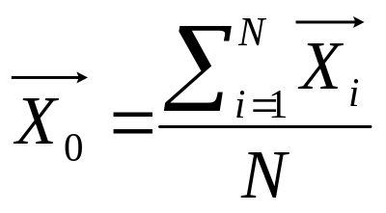
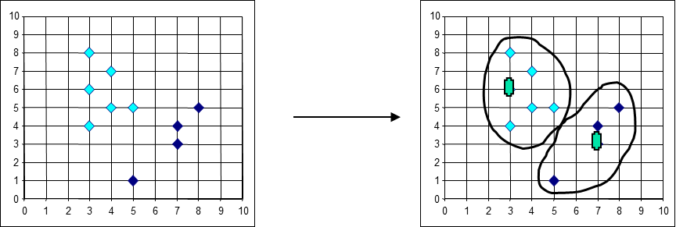
Centroid, Radius and Diameter of a Cluster (for numerical data sets)
Centroid: the “middle” of a cluster
Medoids: the most centrally located object in a cluster
X
二〇二六年十一月八日
Data Mining: Concepts and Techniques

Slide 10
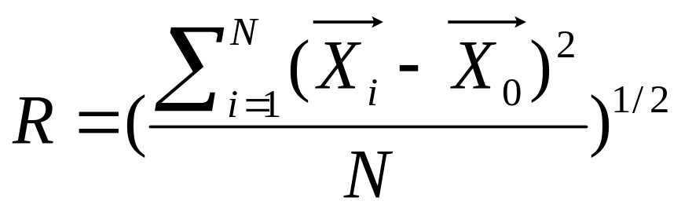
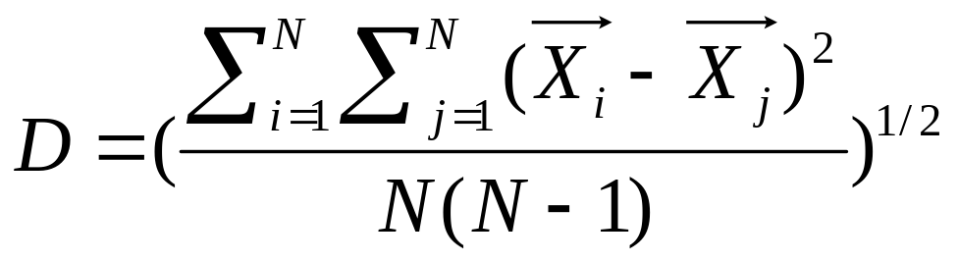
Centroid, Radius and Diameter of a Cluster (for numerical data sets)
Radius: square root of average distance from any point of the cluster to its centroid
Diameter: square root of average mean squared distance between all pairs of points in the cluster
X
X
二〇二六年十一月八日
Data Mining: Concepts and Techniques

Slide 11
Distance between Clusters
X
X
Single link: smallest distance between an element in one cluster and an element in the other, i.e., dist(K_{i}, K_{j}) = min(t_{ip}, t_{jq})
Complete link: largest distance between an element in one cluster and an element in the other, i.e., dist(K_{i}, K_{j}) = max(t_{ip}, t_{jq})
Average: avg distance between an element in one cluster and an element in the other, i.e., dist(K_{i}, K_{j}) = avg(t_{ip}, t_{jq})
Centroid: distance between the centroids of two clusters, i.e., dist(K_{i}, K_{j}) = dist(C_{i}, C_{j})
Medoid: distance between the medoids of two clusters, i.e., dist(K_{i}, K_{j}) = dist(M_{i}, M_{j})
  Medoid: a chosen, centrally located object in the cluster

Slide 12
Measure the Quality of Clustering
Quality of clustering:
  There is usually a separate “quality” function that measures the “goodness” of a cluster.
  It is hard to define “similar enough” or “good enough”
    The answer is typically highly subjective

