Slide 1
Major Clustering Approaches (I)
Partitioning approach:
  Construct various partitions and then evaluate them by some criterion, e.g., minimizing the sum of square errors
  Typical methods: k-means, k-medoids, CLARANS
Hierarchical approach:
  Create a hierarchical decomposition of the set of data (or objects) using some criterion
  Typical methods: Diana, Agnes, BIRCH, CAMELEON
Density-based approach:
  Based on connectivity and density functions
  Typical methods: DBSACN, OPTICS, DenClue
Grid-based approach:
  based on a multiple-level granularity structure
  Typical methods: STING, WaveCluster, CLIQUE

Slide 2
Major Clustering Approaches (II)
Frequent pattern-based:
  Based on the analysis of frequent patterns
  Typical methods: p-Cluster
Link-based clustering:
  Objects are often linked together in various ways
  Massive links can be used to cluster objects: SimRank, LinkClus

Slide 3
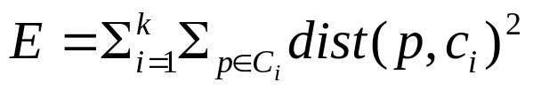
Partitioning Algorithms: Basic Concept
Partitioning method: Partitioning a database D of n objects into a set of k clusters, such that the sum of squared distances is minimized (where c_{i} is the centroid or medoid of cluster C_{i})
Given k, find a partition of k clusters that optimizes the chosen partitioning criterion
  Global optimal: exhaustively enumerate all partitions
  Heuristic methods: k-means and k-medoids algorithms
    k-means (MacQueen’67, Lloyd’57/’82): Each cluster is represented by the center of the cluster
    k-medoids or PAM (Partition around medoids) (Kaufman & Rousseeuw’87): Each cluster is represented by one of the objects in the cluster

Slide 4
K-means Algorithm
Given the cluster number K, the K-means algorithm is carried out in three steps after initialization:
Initialization: set seed points (randomly)
Assign each object to the cluster of the nearest seed point measured with a specific distance metric
Compute new seed points as the centroids of the clusters of the current partition (the centroid is the centre, i.e., mean point, of the cluster)
Go back to Step 1, stop when no more new assignment (i.e., membership in each cluster no longer changes)

Slide 5
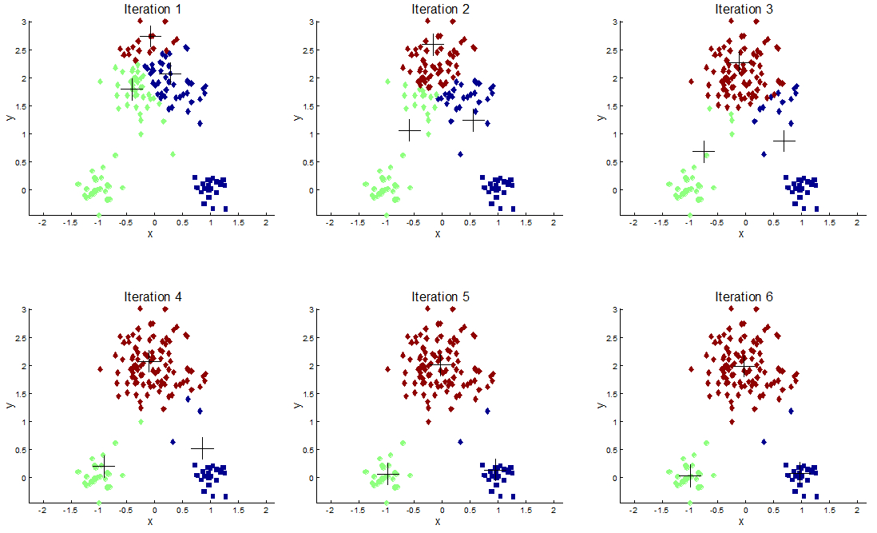

Slide 6
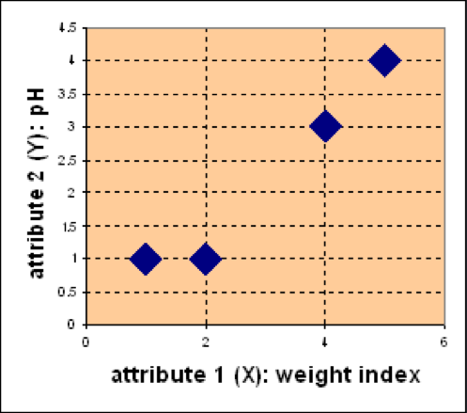
Example
Problem
Suppose we have 4 types of medicines and each has two attributes (pH and weight index). Our goal is to group these objects into K=2 group of medicine.
Medicine | Weight | pH-Index
A | 1 | 1
B | 2 | 1
C | 4 | 3
D | 5 | 4
D
C
A
B

Slide 7
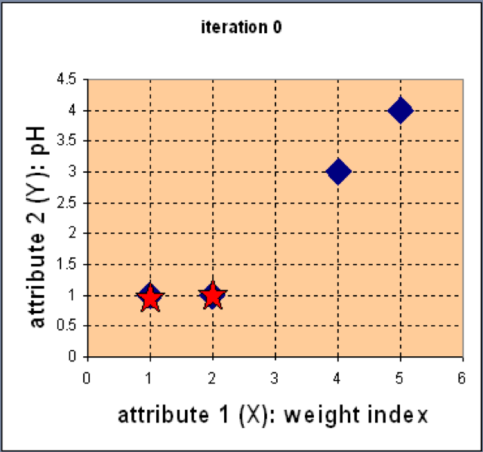

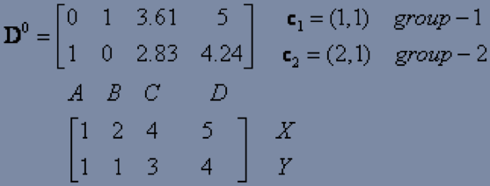
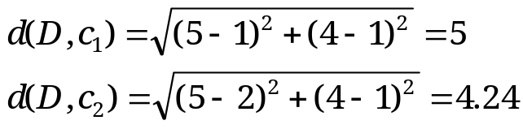
Example
Step 1: Use initial seed points for partitioning
D
C
A
B
Euclidean distance
Assign each object to the cluster
with the nearest seed point

Slide 8
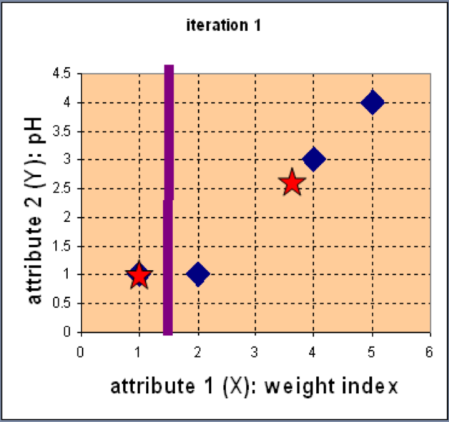
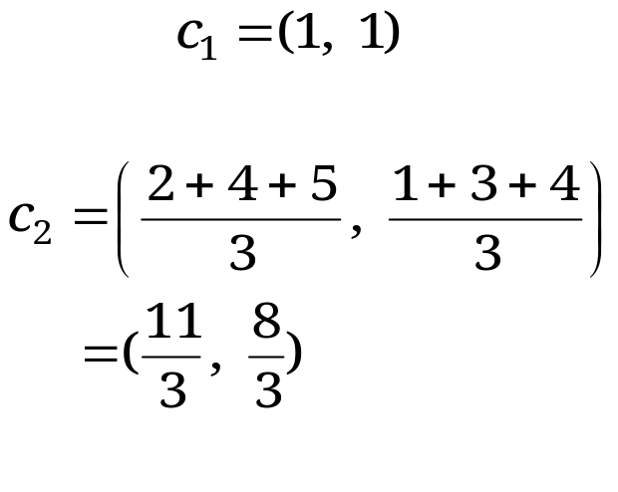
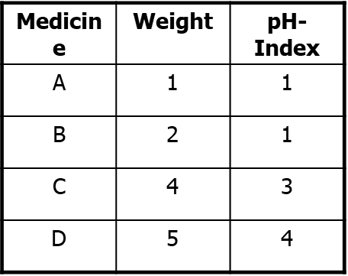
Example
Step 2: Compute new centroids of the current partition
Knowing the members of each
cluster, now we compute the new
centroid of each group based on
these new memberships.

Slide 9
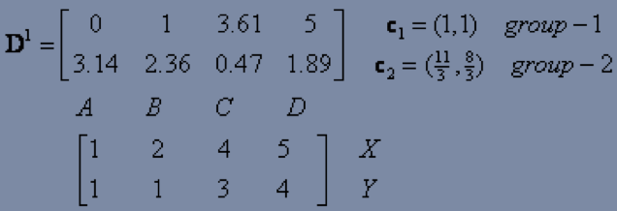
Example
Step 2: Renew membership based on new centroids
Compute the distance of all objects to the new centroids
Assign the membership to objects

Slide 10
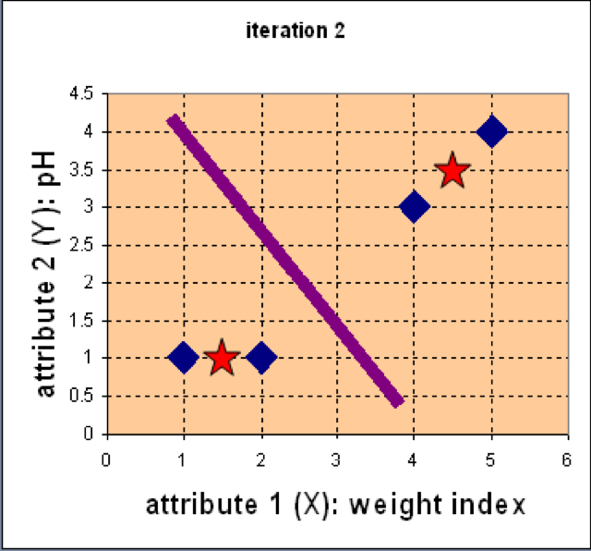
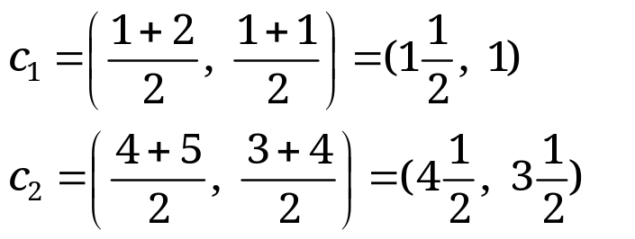
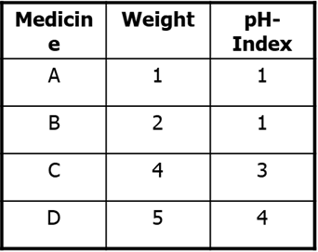
Example
Step 3: Repeat the first two steps until its convergence
Knowing the members of each
cluster, now we compute the new
centroid of each group based on
these new memberships.

Slide 11
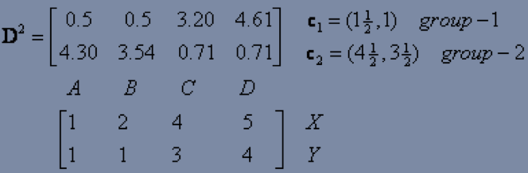
Example
Step 3: Repeat the first two steps until its convergence
Compute the distance of all objects to the new centroids
Stop due to no new assignment
Membership in each cluster no longer change

Slide 12
Exercise
For the medicine data set, use K-means with the Manhattan distance
metric for clustering analysis by setting K=2 and initialising seeds as
C1 = A and C2 = C. Answer three questions as follows:
How many steps are required for convergence?
What are memberships of two clusters after convergence?
What are centroids of two clusters after convergence?
Medicine | Weight | pH-Index
A | 1 | 1
B | 2 | 1
C | 4 | 3
D | 5 | 4
D
C
A
B

Slide 13
Comments on the K-Means Method
Strength: Efficient: O(tkn), where n is # objects, k is # clusters, and t is # iterations. Normally, k, t << n.
Comment: Often terminates at a local optimal.
Weakness
  Applicable only to objects in a continuous n-dimensional space
  Need to specify k, the number of clusters, in advance
  Sensitive to noisy data and outliers
  Not suitable to discover clusters with non-convex shapes

Slide 14
What Is the Problem of the K-Means Method?
The k-means algorithm is sensitive to outliers !
  Since an object with an extremely large value may substantially distort the distribution of the data
K-Medoids: Instead of taking the mean value of the object in a cluster as a reference point, medoids can be used, which is the most centrally located object in a cluster
10
10
9
9
8
8
7
7
6
6
5
5
4
4
3
3
2
2
1
1
0
0
1
2
3
4
5
6
7
8
9
10
0
0
1
2
3
4
5
6
7
8
9
10

Slide 15
Hierarchical Clustering
Use distance matrix as clustering criteria. This method does not require the number of clusters k as an input, but needs a termination condition
Step 0
Step 1
Step 2
Step 3
Step 4
agglomerative
(AGNES)
a
a b
b
a b c d e
c
c d e
d
d e
e
divisive
(DIANA)
Step 4
Step 3
Step 2
Step 1
Step 0

Slide 16

AGNES (Agglomerative Nesting)
Introduced in Kaufmann and Rousseeuw (1990)
Implemented in statistical packages, e.g., Splus
Use the single-link method and the dissimilarity matrix
Merge nodes that have the least dissimilarity
Go on in a non-descending fashion
Eventually all nodes belong to the same cluster

Slide 17
Example
Five objects : a, b, c, d, e
Distance matrix
a
b
c
d
e
 | a | b | c | d | e
a | 0
b | 12 | 0
c | 4 | 10 | 0
d | 15 | 6 | 12 | 0
e | 7 | 8 | 5 | 13 | 0
a
c
b
d
e

Slide 18
Example
Distance matrix
 | a | b | c | d | e
a | 0
b | 12 | 0
c | 4 | 10 | 0
d | 15 | 6 | 12 | 0
e | 7 | 8 | 5 | 13 | 0
a
c
b
d
e
After merging a and c
 | ac | b | d | e
ac | 0
b | 10 | 0
d | 12 | 6 | 0
e | 5 | 8 | 13 | 0
a
c
e
b
d

Slide 19
Example
After merging a and c
 | ac | b | d | e
ac | 0
b | 10 | 0
d | 12 | 6 | 0
e | 5 | 8 | 13 | 0
a
c
e
b
d
After merging ac and e
 | ace | b | d
ace | 0
b | 8 | 0
d | 12 | 6 | 0
a
c
e
b
d

Slide 20
dendrogram
  Decompose data objects into a several levels of nested partitioning, called a dendrogram
  Shows How Clusters are Merged
  A clustering of the data objects is obtained by cutting the dendrogram at the desired level, then each connected component forms a cluster
a
c
e
b
d

Slide 21
DIANA (Divisive Analysis)
Introduced in Kaufmann and Rousseeuw (1990)
Implemented in statistical analysis packages, e.g., Splus
Inverse order of AGNES
Eventually each node forms a cluster on its own

Slide 22
Hierarchical Clustering (Cont.)
Most hierarchical clustering algorithms are variants of the single-link, complete-link or average link.
Of these, single-link and complete link are most popular.
  In the single-link method, the distance between two clusters is the minimum of the distances between all pairs of patterns drawn one from each cluster.
  In the complete-link algorithm, the distance between two clusters is the maximum of all pairwise distances between pairs of patterns drawn one from each cluster.
  In the average-link algorithm, the distance between two clusters is the average of all pairwise distances between pairs of patterns drawn one from each cluster (which is the same as the distance between the means in the vector space case – easier to calculate).

Slide 23
Distance Between Clusters
Single Link: smallest distance between any pair of points from two clusters
Complete Link: largest distance between any pair of points from two clusters

Slide 24
Distance between Clusters (Cont.)
Average Link: average distance between points from two clusters
Centroid: distance between centroids of the two clusters

Slide 25
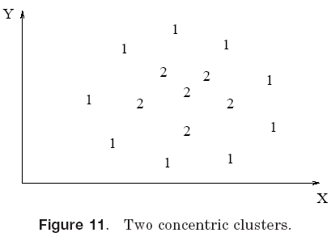
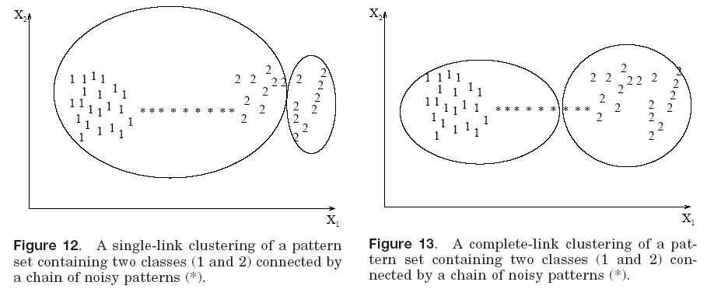
Single Link vs. Complete Link (Cont.)
Single link works but not complete link
Complete link works but not single link
Complete link works but not single link

Slide 26
Single Link vs. Complete Link (Cont.)
1
1
1
1
1
1
1
2
2
1
2
2
2
2
2
2
1
1
1
1
1
1
Single link works
Complete link doesn’t

Slide 27
Single Link vs. Complete Link (Cont.)
2
2
1
2
1
2
1
2
1
2
2
1
2
1
2
2
1
2
1
2
2
2
1-cluster noise 2-cluster
Single link doesn’t works
Complete link does

Slide 28
Hierarchical vs. Partitional
Hierarchical algorithms are more versatile than partitional algorithms.
  For example, the single-link clustering algorithm works well on data sets containing non-isotropic (non-roundish) clusters including well-separated, chain-like, and concentric clusters, whereas a typical partitional algorithm such as the k-means algorithm works well only on data sets having isotropic clusters.
On the other hand, the time and space complexities of the partitional algorithms are typically lower than those of the hierarchical algorithms.

Slide 29
More on Hierarchical Clustering Methods
Major weakness of agglomerative clustering methods
  do not scale well: time complexity of at least O(n²), where n is the number of total objects
  can never undo what was done previously (greedy algorithm)
Integration of hierarchical with distance-based clustering
  BIRCH (1996): uses Clustering Feature tree (CF-tree) and incrementally adjusts the quality of sub-clusters
  CURE (1998): selects well-scattered points from the cluster and then shrinks them towards the center of the cluster by a specified fraction
  CHAMELEON (1999): hierarchical clustering using dynamic modeling

Slide 30
BIRCH (Balanced Iterative Reducing and Clustering Using Hierarchies)
Zhang, Ramakrishnan & Livny, SIGMOD’96
Incrementally construct a CF (Clustering Feature) tree, a hierarchical data structure for multiphase clustering
  Phase 1: scan DB to build an initial in-memory CF tree (a multi-level compression of the data that tries to preserve the inherent clustering structure of the data)
  Phase 2: use an arbitrary clustering algorithm to cluster the leaf nodes of the CF-tree

Slide 31
The CF Tree Structure
Root
CF₁
CF₂
CF₃
CF₆
child₁
child₂
child₃
child₆
Non-leaf node
CF₁
CF₂
CF₃
CF₅
child₁
child₂
child₃
child₅
Leaf node
Leaf node
prev
CF₁
CF₂
CF₆
next
prev
CF₁
CF₂
CF₄
next

Slide 32
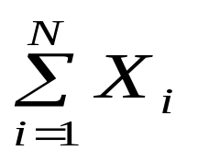
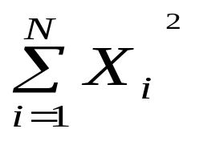
Clustering Feature Vector in BIRCH
Clustering Feature (CF): CF = (N, LS, SS)
N: Number of data points
LS: linear sum of N points:
SS: square sum of N points
CF = (5, (16,30),(54,190))
(3,4)
(2,6)
(4,5)
(4,7)
(3,8)

Slide 33
CF-Tree in BIRCH
Clustering feature:
  Summary of the statistics for a given subcluster: the 0-th, 1st, and 2nd moments of the subcluster from the statistical point of view
  Registers crucial measurements for computing cluster and utilizes storage efficiently

Slide 34

CF-Tree in BIRCH
A CF tree is a height-balanced tree that stores the clustering features for a hierarchical clustering
  A nonleaf node in a tree has descendants or “children”
  The nonleaf nodes store sums of the CFs of their children
A CF tree has two parameters
  Branching factor: max # of children
  Threshold: max diameter of sub-clusters stored at the leaf nodes

Slide 35
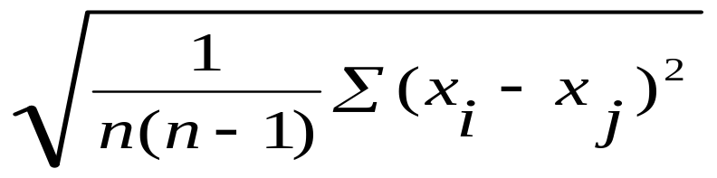
The Birch Algorithm
Cluster Diameter
For each point in the input
  Find closest leaf entry
  Add point to leaf entry and update CF
  If entry diameter > max_diameter, then split leaf, and possibly parents
Algorithm is O(n)
Concerns
  Sensitive to insertion order of data points
  Since we fix the size of leaf nodes, so clusters may not be so natural
  Clusters tend to be spherical given the radius and diameter measures

Slide 36
Example of BIRCH
New subcluster
sc8
sc3
sc1
sc4
sc5
sc6
sc7
sc2
LN2
LN3
Root
LN1
LN1
LN2
LN3
sc8
sc1
sc3
sc4
sc5
sc6
sc7
sc2

Slide 37
Insertion Operation in BIRCH
If the branching factor of a leaf node can not exceed 3, then LN1 is split.
sc8
sc3
sc1
sc4
sc5
sc6
sc7
sc2
LN1’
LN2
LN3
LN1”
Root
LN1’
LN2
LN3
LN1”
sc8
sc1
sc3
sc4
sc5
sc6
sc7
sc2

Slide 38
If the branching factor of a non-leaf node can not
exceed 3, then the root is split and the height of
the CF Tree increases by one.
sc8
sc3
sc1
sc4
sc5
sc6
sc7
sc2
LN1’
LN2
LN3
LN1”
Root
NLN1
NLN2
LN1’
LN2
LN3
LN1”
sc8
sc1
sc2
sc3
sc4
sc5
sc6
sc7

Slide 39
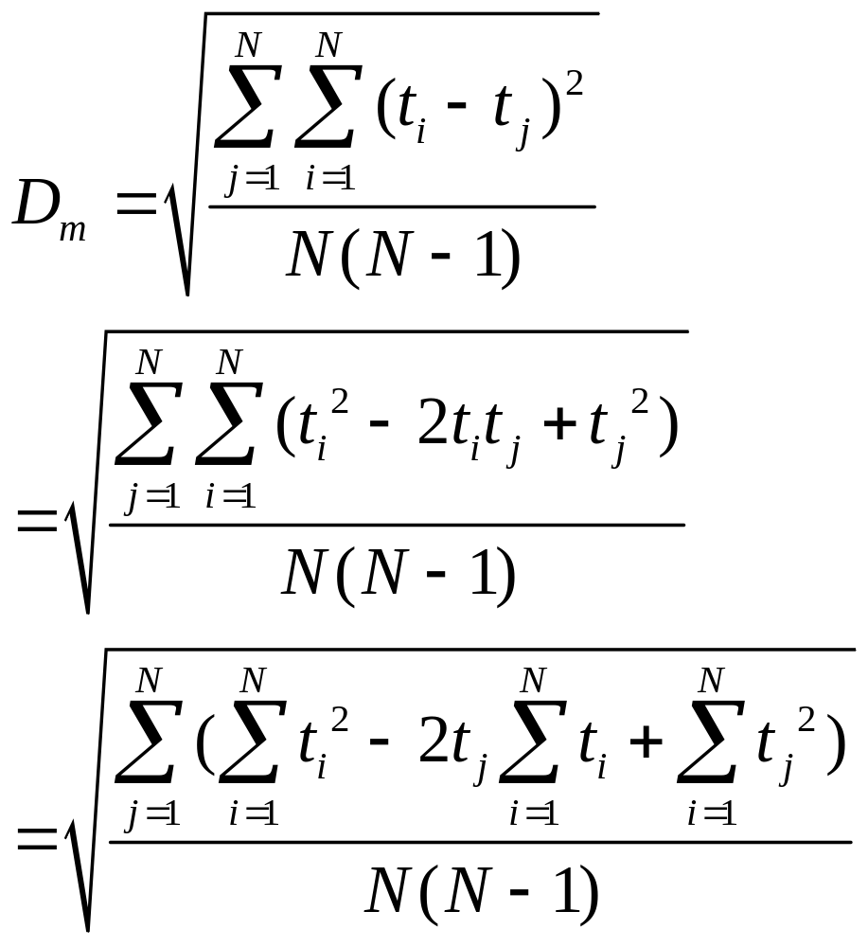
Property

Slide 40
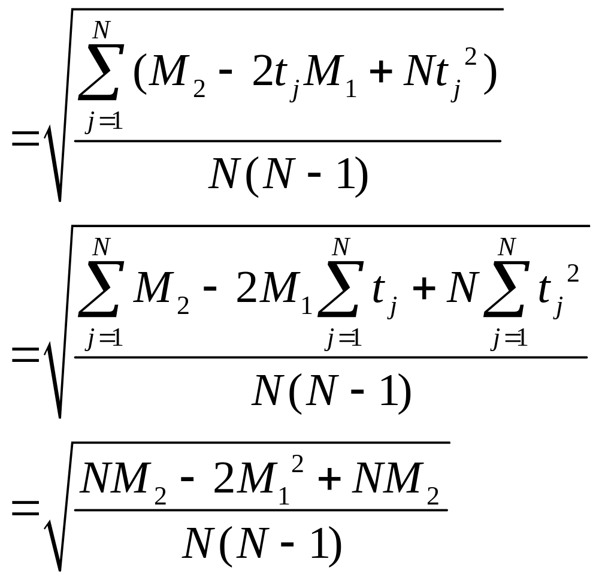
Property

Slide 41
N = n_{a} +n_{b}
M₁ = M_{a1} + M_{b1}
M₂ = M_{a2} + M_{b2}
Cluster C_{a}
CF_{a} = (n_{a}, M_{a1}, M_{a2})
Cluster C_{b}
CF_{b} = (n_{b}, N_{b1}, M_{b2})

Slide 42
BIRCH (Balanced Iterative Reducing and Clustering Using Hierarchies)
Scales linearly: finds a good clustering with a single scan and improves the quality with a few additional scans
Weakness: handles only numeric data, and sensitive to the order of the data record

