Slide 1
Clustering
Chris Manning, Pandu Nayak, and Prabhakar Raghavan

Slide 2
Today’s Topic: Clustering
Document clustering
  Motivations
  Document representations
  Success criteria
Clustering algorithms
  Partitional
  Hierarchical

Slide 3
What is clustering?
Ch. 16
Clustering: the process of grouping a set of objects into classes of similar objects
  Documents within a cluster should be similar.
  Documents from different clusters should be dissimilar.
The commonest form of unsupervised learning
    Unsupervised learning = learning from raw data, as opposed to supervised data where a classification of examples is given
  A common and important task that finds many applications in IR and other places

Slide 4
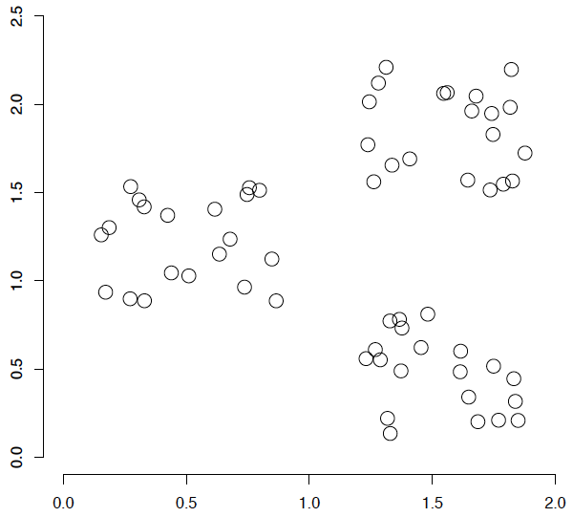
A data set with clear cluster structure
Ch. 16
How would you design an algorithm for finding the three clusters in this case?

Slide 5
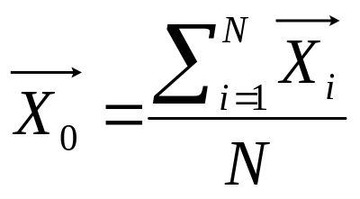
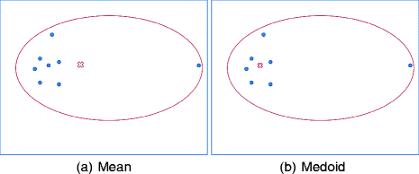
Centroidsand Medoids
Centroid: the “middle” of a cluster
<1,2> , <2,1>, <3,3>
<(1+2+3)/3,(2+1+3)/3> =<2, 2>
X
二〇二六年十一月八日
Data Mining: Concepts and Techniques

Slide 6
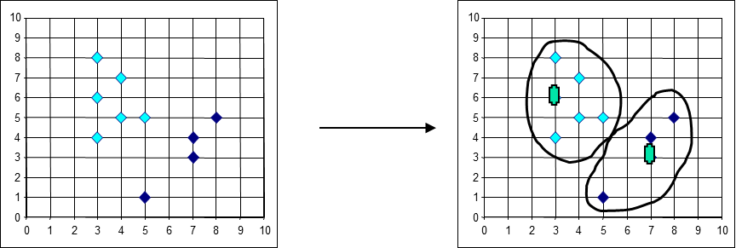
Centroidsand Medoids
Medoids: the most centrally located object in a cluster
二〇二六年十一月八日
Data Mining: Concepts and Techniques

Slide 7
Applications of clustering in IR
Sec. 16.1
Whole corpus analysis/navigation
  Better user interface: search without typing
For improving recall in search applications
  Better search results (like pseudo RF)
For better navigation of search results
  Effective “user recall” will be higher
For speeding up vector space retrieval
  Cluster-based retrieval gives faster search

Slide 8
Yahoo! Hierarchy isn’t clustering but is the kind of output you want from clustering
www.yahoo.com/Science
… (30)
agriculture
biology
physics
CS
space
...
...
...
...
...
dairy
crops
botany
cell
AI
courses
craft
magnetism
HCI
missions
forestry
agronomy
evolution
relativity
Notes:
Final data set:
Yahoo Science hierarchy, consisting of text of web pages pointed to by Yahoo, gathered summer of 1997.
264 classes, only sample shown here.

Slide 9
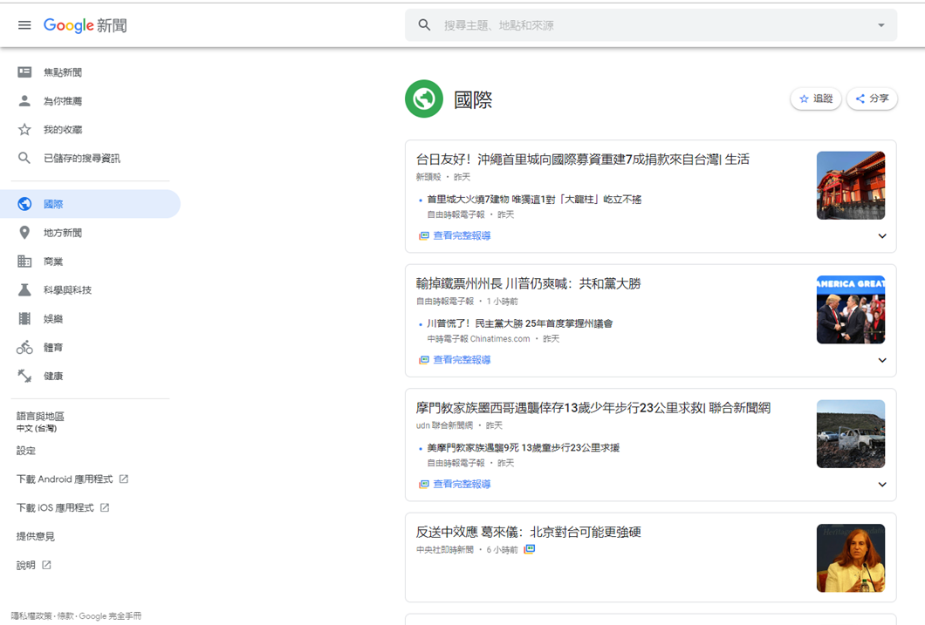
Google News: automatic clustering gives an effective news presentation metaphor

Slide 10


Slide 11
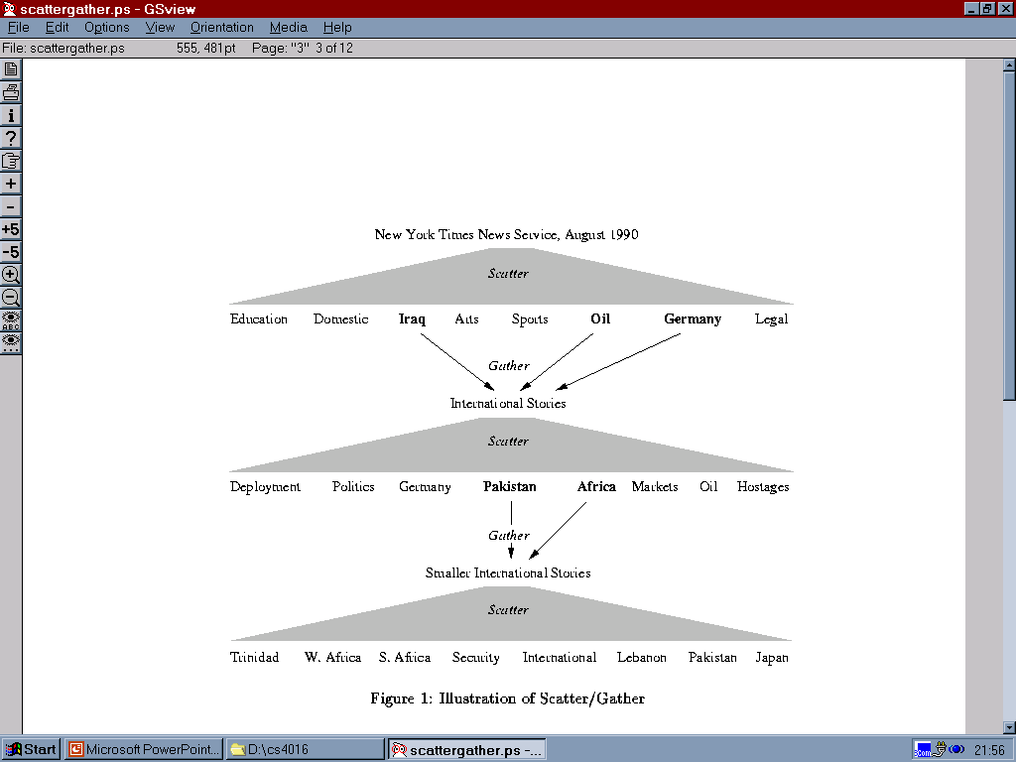
Scatter/Gather: Cutting, Karger, and Pedersen
Sec. 16.1
Cluster-based navigation is an interesting alternative to keyword searching
Scenarios
Users prefer browsing over searching because they are unsure about which search terms to use

Slide 12
Applications of clustering in IR
Sec. 16.1
Whole corpus analysis/navigation
  Better user interface: search without typing
For improving recall in search applications
  Better search results (like pseudo RF)
For better navigation of search results
  Effective “user recall” will be higher
For speeding up vector space retrieval
  Cluster-based retrieval gives faster search

Slide 13
For improving search recall
Sec. 16.1
Cluster hypothesis - Documents in the same cluster behave similarly with respect to relevance to information needs
Therefore, to improve search recall:
  Cluster docs in corpus a priori
  When a query matches a doc D, also return other docs in the cluster containing D
Hope if we do this: The query “car” will also return docs containing automobile
  Because clustering grouped together docs containing car with those containing automobile.
Why might this happen?

Slide 14
Applications of clustering in IR
Sec. 16.1
Whole corpus analysis/navigation
  Better user interface: search without typing
For improving recall in search applications
  Better search results (like pseudo RF)
For better navigation of search results
  Effective “user recall” will be higher
For speeding up vector space retrieval
  Cluster-based retrieval gives faster search

Slide 15
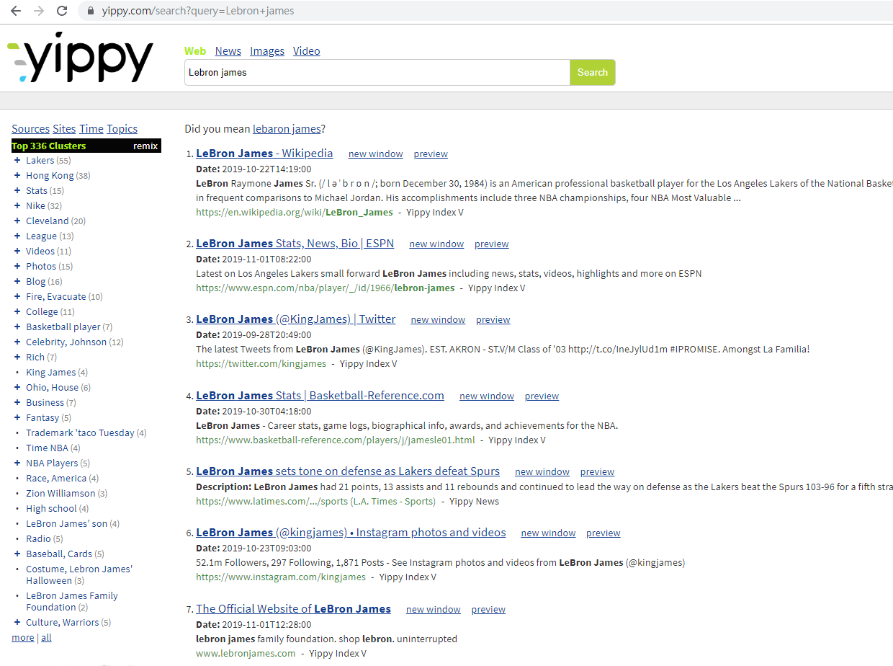

Slide 16
Applications of clustering in IR
Sec. 16.1
Whole corpus analysis/navigation
  Better user interface: search without typing
For improving recall in search applications
  Better search results (like pseudo RF)
For better navigation of search results
  Effective “user recall” will be higher
For speeding up vector space retrieval
  Cluster-based retrieval gives faster search

Slide 17
Query
Leader
Follower

Slide 18
Issues for clustering
Sec. 16.2
Representation for clustering
  Document representation
    Need a notion of similarity/distance
How many clusters?
  Fixed a priori?
  Completely data driven?
    Avoid “trivial” clusters - too large or small
      If a cluster's too large, then for navigation purposes you've wasted an extra user click without whittling down the set of documents much.

Slide 19
Notion of similarity/distance
Ideal: semantic similarity.
Practical: term-statistical similarity (docs as vectors)
  Cosine similarity
  For many algorithms, easier to think in terms of a distance (rather than similarity) between docs.
  We will mostly speak of Euclidean distance
    But real implementations use cosine similarity

Slide 20
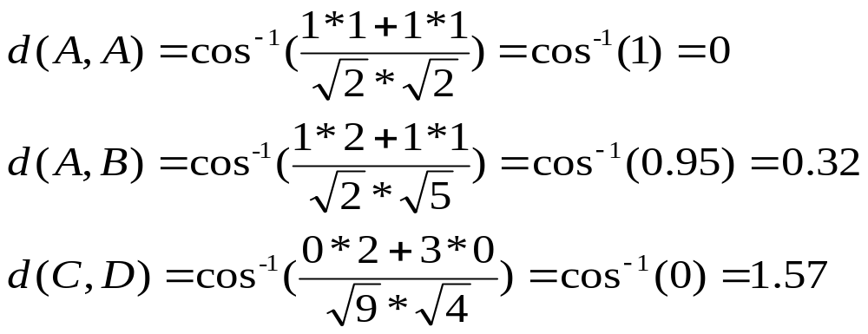
Example
document | KW₁ | KW₂
A | 1 | 1
B | 2 | 1
C | 0 | 3
D | 2 | 0

Slide 21
Hard vs. soft clustering
Hard clustering: Each document belongs to exactly one cluster
  More common and easier to do
Soft clustering: A document can belong to more than one cluster.
  Makes more sense for applications like creating browsable hierarchies
  You may want to put a pair of sneakers in two clusters: (i) sports apparel and (ii) shoes
  You can only do that with a soft clustering approach.

Slide 22
Clustering Algorithms
Flat algorithms
  Usually start with a random (partial) partitioning
  Refine it iteratively
    K means clustering
    (Model based clustering)
Hierarchical algorithms
  Bottom-up, agglomerative
  (Top-down, divisive)

Slide 23
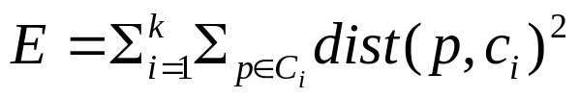
Partitioning Algorithms: Basic Concept
Partitioning method: Partitioning a database D of n objects into a set of k clusters, such that the sum of squared distances is minimized (where c_{i} is the centroid or medoid of cluster C_{i})
Residual Sum of Squares (RSS), a goodness measure of a cluster, is the sum of squared distances from the cluster centroid:
  RSS_{j} = Σ_{i} |d_{i} – c_{j}|² (sum over all d_{i} in cluster j)
RSS = Σ_{j} RSS_{j}

Slide 24
Partitioning Algorithms
Partitioning method: Construct a partition of n documents into a set of K clusters
Given: a set of documents and the number K
Find: a partition of K clusters that optimizes the chosen partitioning criterion
  Globally optimal
    exhaustively enumerate all partitions
  Effective heuristic methods
    K-means: Each cluster is represented by the center of the cluster
    K-medoids: Each cluster is represented by one of the objects in the cluster

Slide 25
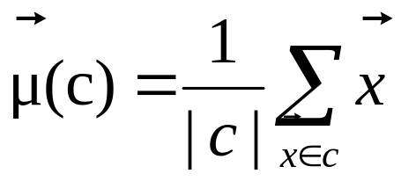
K-Means
Sec. 16.4
Assumes documents are real-valued vectors.
Clusters based on centroids (aka the center of gravity or mean) of points in a cluster, c:
Reassignment of instances to clusters is based on distance to the current cluster centroids.
  (Or one can equivalently phrase it in terms of similarities)

Slide 26
K-Means Algorithm
Sec. 16.4
Select K random docs {s₁, s₂,… s_{K}} as seeds.
Until clustering converges (or other stopping criterion):
For each doc d_{i}:
Assign d_{i} to the cluster c_{j} such that dist(x_{i}, s_{j}) is minimal.
(Next, update the seeds to the centroid of each cluster)
For each cluster c_{j}
s_{j} = μ(c_{j})

Slide 27
K Means Example
(K=2)
Sec. 16.4
Pick seeds
Reassign clusters
Compute centroids
Reassign clusters
x
x
x
Compute centroids
x
x
x
Reassign clusters
Converged!

Slide 28
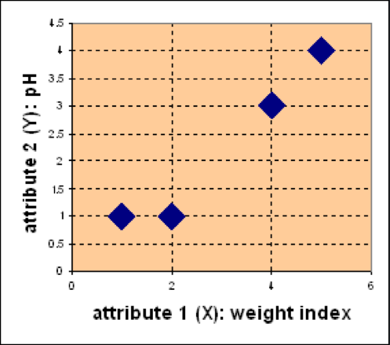
Example
Suppose we have 4 documents and each has two attributes (KW₁ and KW₂). Our goal is to group these objects into K=2 group of medicine.
D
C
document | KW₁ | KW₂
A | 1 | 1
B | 2 | 1
C | 4 | 3
D | 5 | 4
KW₂
A
B
KW₁

Slide 29

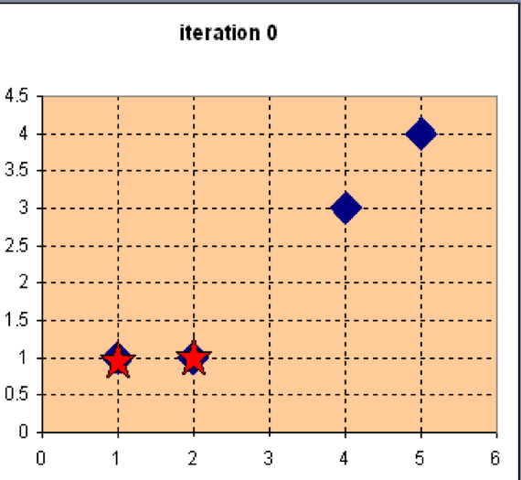
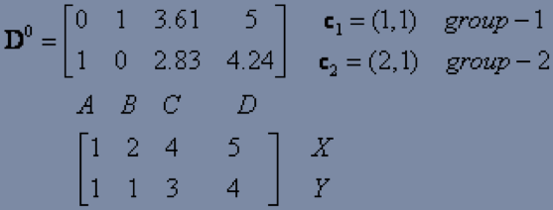
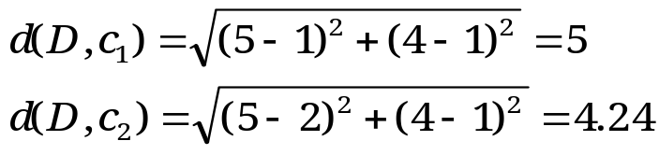
Example
Step 1: Use initial seed points for partitioning
Euclidean distance
D
C
A
B
Assign each object to the cluster
with the nearest seed point

Slide 30
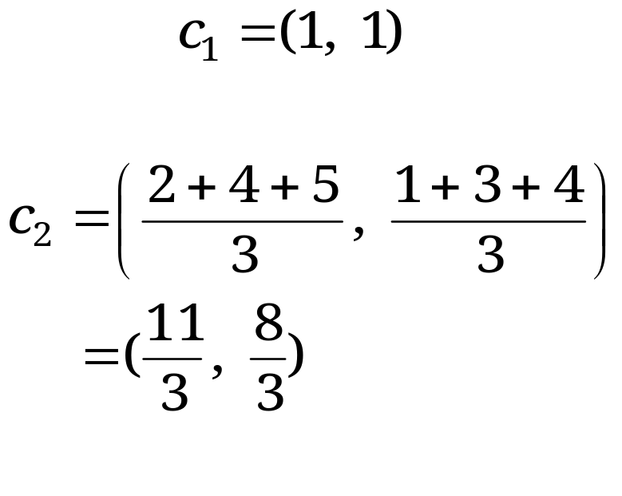
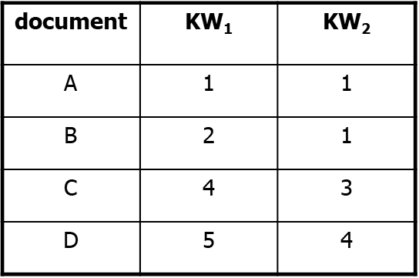
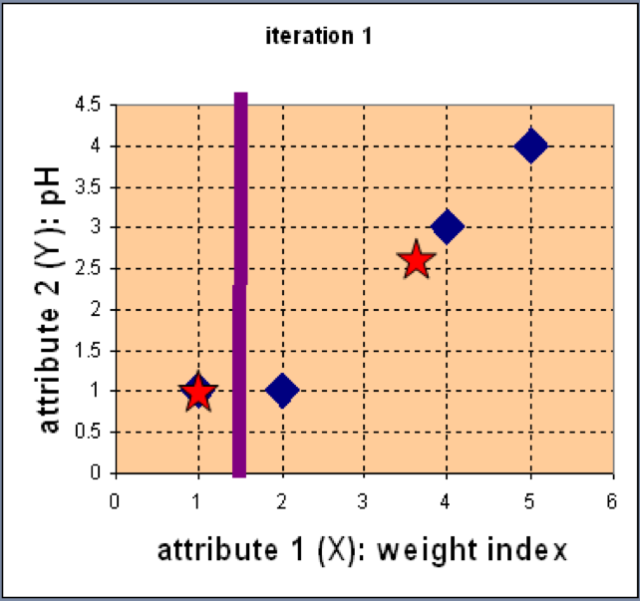
Example
Step 2: Compute new centroids of the current partition
Knowing the members of each cluster, now we compute the new centroid of each group based on these new memberships.

Slide 31
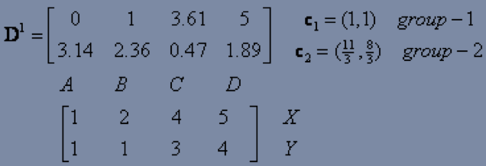
Example
Step 2: Renew membership based on new centroids
Compute the distance of all objects to the new centroids
Assign the membership to objects

Slide 32
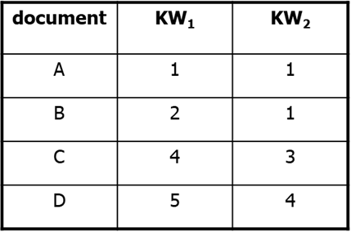
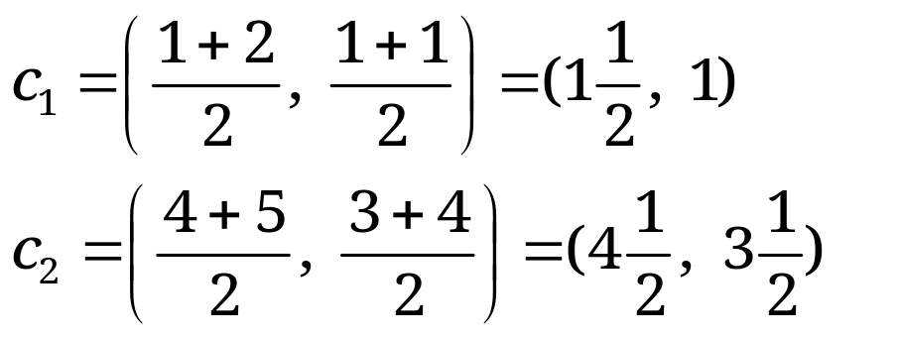
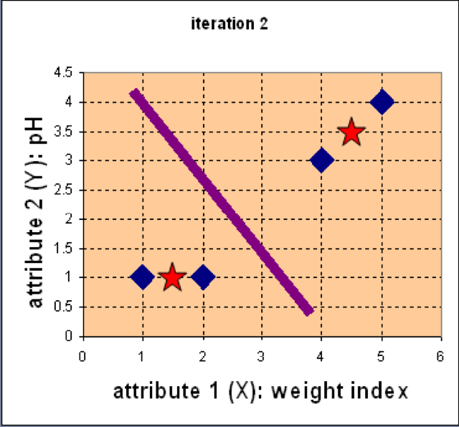
Example
Step 3: Repeat the first two steps until its convergence
Knowing the members of each cluster, now we compute the new centroid of each group based on these new memberships.

Slide 33
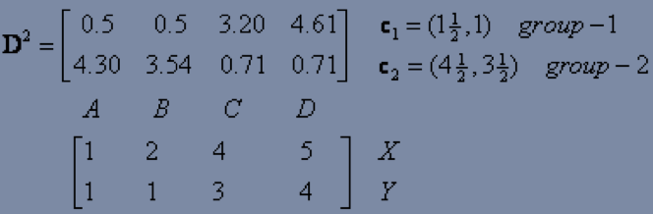
Example
Step 3: Repeat the first two steps until its convergence
Compute the distance of all objects to the new centroids
Stop due to no new assignment
Membership in each cluster no longer change

Slide 34
Exercise
For the data set, use K-means with the Manhattan distance
metric for clustering analysis by setting K=2 and initialising seeds as
C1 = C and C2 = D. Answer three questions as follows:
What are memberships of two clusters after convergence?
What are centroids of two clusters after convergence?
Document | KW₁ | KW₂
A | 2 | 2
B | 3 | 1
C | 4 | 3
D | 4 | 4

Slide 35
Termination conditions
Sec. 16.4
Several possibilities, e.g.,
  A fixed number of iterations.
  Doc partition unchanged.
  Centroid positions don’t change.
  RSS falls below a threshold.
  The decrease in RSS falls below a threshold.

Slide 36
Convergence
Sec. 16.4
Why should the K-means algorithm ever reach a fixed point?
  A state in which clusters don’t change.
K-means is a special case of a general procedure known as the Expectation Maximization (EM) algorithm.
  EM is known to converge.
  Number of iterations could be large.
      But in practice usually isn’t

Slide 37
Convergence of K-Means
Sec. 16.4
Residual Sum of Squares (RSS), a goodness measure of a cluster, is the sum of squared distances from the cluster centroid:
  RSS_{j} = Σ_{i} |d_{i} – c_{j}|² (sum over all d_{i} in cluster j)
RSS = Σ_{j} RSS_{j}
Reassignment monotonically decreases RSS since each vector is assigned to the closest centroid.
Recomputation also monotonically decreases each RSS_{j} because …

Slide 38
Cluster recomputation in K-means
Sec. 16.4
RSS_{j} = Σ_{i} |d_{i} – c_{j}|² = Σ_{i} Σ_{k} (d_{ik} – c_{jk})²
  i ranges over documents in cluster j
RSS_{j} reaches minimum when:
Σ_{i} –2(d_{ik} – c_{jk}) = 0 (for each c_{jk})
Σ_{i} c_{jk} = Σ_{i} d_{ik}
m_{j} c_{jk} = Σ_{i} d_{ik} (m_{j} is # of docs in cluster j)
c_{jk} = (1/ m_{j}) Σ_{i} d_{ik}
K-means typically converges quickly

Slide 39
Time Complexity
Sec. 16.4
Computing distance between two docs is O(M) where M is the dimensionality of the vectors.
Reassigning clusters: O(KN) distance computations, or O(KNM).
Computing centroids: Each doc gets added once to some centroid: O(NM).
Assume these two steps are each done once for I iterations: O(IKNM).

Slide 40

Seed Choice
Sec. 16.4
Results can vary based on random seed selection.
Some seeds can result in poor convergence rate, or convergence to sub-optimal clusterings.
  Select good seeds using a heuristic (e.g., doc least similar to any existing mean)
  Try out multiple starting points
  Initialize with the results of another method.
Example showing
sensitivity to seeds
In the above, if you start
with B and E as centroids
you converge to {A,B,C}
and {D,E,F}
If you start with D and F
you converge to
{A,B,D,E} {C,F}

Slide 41
K-means issues, variations, etc.
Sec. 16.4
Recomputing the centroid after every assignment (rather than after all points are re-assigned) can improve speed of convergence of K-means
Assumes clusters are spherical in vector space
Disjoint and exhaustive
  Doesn’t have a notion of “outliers” by default
  But can add outlier filtering

Slide 42
How Many Clusters?
Number of clusters K is given
  Partition n docs into predetermined number of clusters
Finding the “right” number of clusters is part of the problem
  Given docs, partition into an “appropriate” number of subsets.

Slide 43

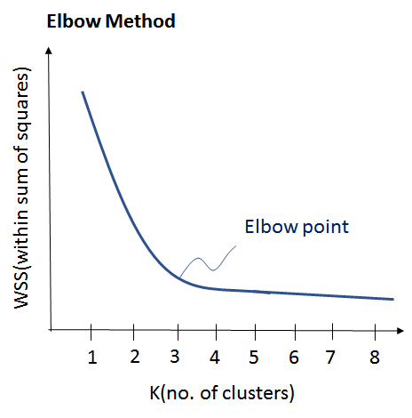
Determine the Number of Clusters
Empirical method
  # of clusters ≈ for a dataset of n points
Elbow method
  Use the turning point in the curve of sum of within cluster variance w.r.t the # of clusters

Slide 44
K not specified in advance
Say, the results of a query.
Solve an optimization problem: penalize having lots of clusters
  application dependent, e.g., compressed summary of search results list.
Tradeoff between having more clusters (better focus within each cluster) and having too many clusters

Slide 45
K not specified in advance
Given a clustering, define the Benefit for a doc to be the cosine similarity to its centroid
Define the Total Benefit to be the sum of the individual doc Benefits.

Slide 46
Penalize lots of clusters
For each cluster, we have a Cost C.
Thus for a clustering with K clusters, the Total Cost is KC.
Define the Value of a clustering to be =
  Total Benefit - Total Cost.
Find the clustering of highest value, over all choices of K.
  Total benefit increases with increasing K. But can stop when it doesn’t increase by “much”. The Cost term enforces this.

Slide 47
Hierarchical Clustering
Ch. 17
Build a tree-based hierarchical taxonomy (dendrogram) from a set of documents.
One approach: recursive application of a partitional clustering algorithm.
animal
vertebrate
invertebrate
fish reptile amphib. mammal worm insect crustacean

Slide 48
Dendrogram: Hierarchical Clustering
  Clustering obtained by cutting the dendrogram at a desired level: each connected component forms a cluster.

Slide 49
Hierarchical Agglomerative Clustering (HAC)
Sec. 17.1
Starts with each doc in a separate cluster
  then repeatedly joins the closest pair of clusters, until there is only one cluster.
The history of merging forms a binary tree or hierarchy.
Note: the resulting clusters are still “hard” and induce a partition

Slide 50
Closest pair of clusters
Sec. 17.2
Many variants to defining closest pair of clusters
Single-link
  Similarity of the most cosine-similar (single-link)
Complete-link
  Similarity of the “furthest” points, the least cosine-similar
Centroid
  Clusters whose centroids (centers of gravity) are the most cosine-similar
Average-link
  Average cosine between all pairs of elements

Slide 51
Distance Between Clusters
Single Link: smallest distance between any pair of points from two clusters
Complete Link: largest distance between any pair of points from two clusters

Slide 52
Distance between Clusters (Cont.)
Average Link: average distance between points from two clusters
Centroid: distance between centroids of the two clusters

Slide 53
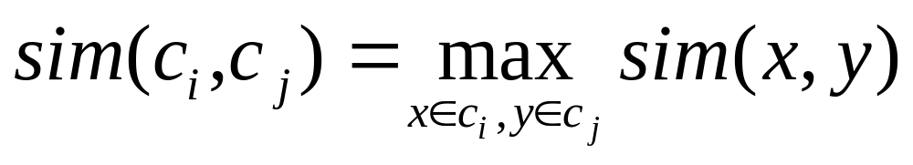
Single Link Agglomerative Clustering
Sec. 17.2
Use maximum similarity of pairs:
Can result in “straggly” (long and thin) clusters due to chaining effect.
After merging c_{i} and c_{j}, the similarity of the resulting cluster to another cluster, c_{k}, is:

Slide 54
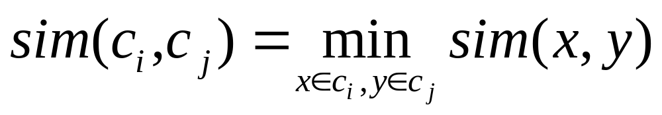
Complete Link
Sec. 17.2
Use minimum similarity of pairs:
Makes “tighter,” spherical clusters that are typically preferable.
After merging c_{i} and c_{j}, the similarity of the resulting cluster to another cluster, c_{k}, is:
C_{i}
C_{j}
C_{k}

Slide 55
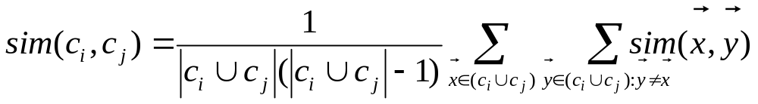
Group Average
Sec. 17.3
Similarity of two clusters = average similarity of all pairs within merged cluster.
Compromise between single and complete link.
Two options:
  Averaged across all ordered pairs in the merged cluster
  Averaged over all pairs between the two original clusters
No clear difference in efficacy

Slide 56

AGNES (Agglomerative Nesting)
Introduced in Kaufmann and Rousseeuw (1990)
Implemented in statistical packages, e.g., Splus
Use the single-link method and the dissimilarity matrix
Merge nodes that have the least dissimilarity
Go on in a non-descending fashion
Eventually all nodes belong to the same cluster

Slide 57
Example
Five objects : a, b, c, d, e
Distance matrix
a
b
c
d
e
 | a | b | c | d | e
a | 0
b | 12 | 0
c | 4 | 10 | 0
d | 15 | 6 | 12 | 0
e | 7 | 8 | 5 | 13 | 0
a
c
b
d
e

Slide 58
Example
Distance matrix
 | a | b | c | d | e
a | 0
b | 12 | 0
c | 4 | 10 | 0
d | 15 | 6 | 12 | 0
e | 7 | 8 | 5 | 13 | 0
a
c
b
d
e
After merging a and c
 | ac | b | d | e
ac | 0
b | 10 | 0
d | 12 | 6 | 0
e | 5 | 8 | 13 | 0
a
c
e
b
d

Slide 59
Example
After merging a and c
 | ac | b | d | e
ac | 0
b | 10 | 0
d | 12 | 6 | 0
e | 5 | 8 | 13 | 0
a
c
e
b
d
After merging ac and e
 | ace | b | d
ace | 0
b | 8 | 0
d | 12 | 6 | 0
a
c
e
b
d

Slide 60
dendrogram
  Decompose data objects into a several levels of nested partitioning, called a dendrogram
  Shows How Clusters are Merged
  A clustering of the data objects is obtained by cutting the dendrogram at the desired level, then each connected component forms a cluster
a
c
e
b
d

Slide 61
Exercise
Five objects : a, b, c, d, e
Distance matrix
Use the single-link method
 | a | b | c | d | e
a | 0
b | 2 | 0
c | 4 | 10 | 0
d | 11 | 6 | 12 | 0
e | 7 | 8 | 5 | 13 | 0

Slide 62
Exercise
Five objects : a, b, c, d, e
Distance matrix
Use the complete-link method
 | a | b | c | d | e
a | 0
b | 2 | 0
c | 4 | 10 | 0
d | 11 | 6 | 12 | 0
e | 7 | 8 | 5 | 13 | 0

Slide 63
General HAC algorithm and complexity
Compute similarity between all pairs of documents
Do N – 1 times
  Find closest pair of documents/clusters to merge
  Update similarity of all documents/clusters to new cluster
O(N²)
Naïve: O(N²)
Priority Queue: O(N)
Single link: O(N)
Best merge
persistent!
Naïve:
O(N)
Priority Queue:
O(N log N)
Single link:
O(N)

Slide 64
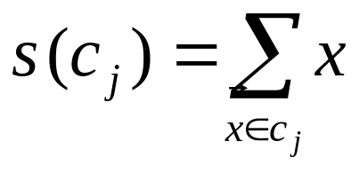
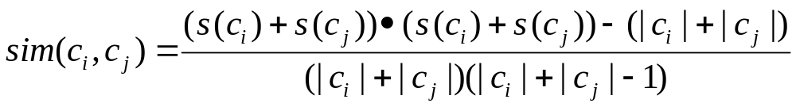
Computing Group Average Similarity
Sec. 17.3
Always maintain sum of vectors in each cluster.
Compute similarity of clusters in constant time:

Slide 65
Hierarchical Clustering (Cont.)
Most hierarchical clustering algorithms are variants of the single-link, complete-link or average link.
Of these, single-link and complete link are most popular.
  In the single-link method, the distance between two clusters is the minimum of the distances between all pairs of patterns drawn one from each cluster.
  In the complete-link algorithm, the distance between two clusters is the maximum of all pairwise distances between pairs of patterns drawn one from each cluster.
  In the average-link algorithm, the distance between two clusters is the average of all pairwise distances between pairs of patterns drawn one from each cluster (which is the same as the distance between the means in the vector space case – easier to calculate).

Slide 66
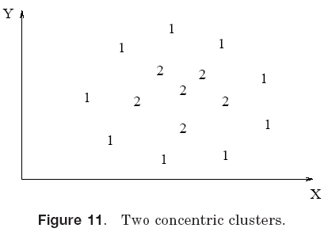
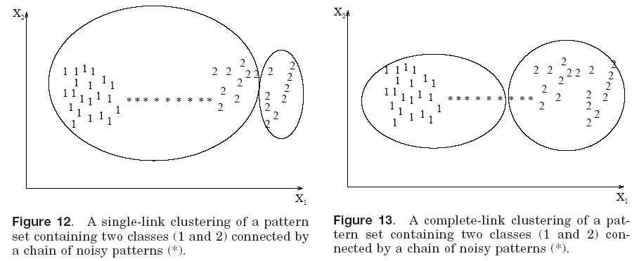
Single Link vs. Complete Link (Cont.)
Single link works but not complete link
Complete link works but not single link
Complete link works but not single link

Slide 67
Single Link vs. Complete Link (Cont.)
1
1
1
1
1
1
1
2
2
1
2
2
2
2
2
2
1
1
1
1
1
1
Single link works
Complete link doesn’t

Slide 68
Single Link vs. Complete Link (Cont.)
2
2
1
2
1
2
1
2
1
2
2
1
2
1
2
2
1
2
1
2
2
2
1-cluster noise 2-cluster
Single link doesn’t works
Complete link does

Slide 69
Hierarchical vs. Partitional
Hierarchical algorithms are more versatile than partitional algorithms.
  For example, the single-link clustering algorithm works well on data sets containing non-isotropic (non-roundish) clusters including well-separated, chain-like, and concentric clusters, whereas a typical partitional algorithm such as the k-means algorithm works well only on data sets having isotropic clusters.
On the other hand, the time and space complexities of the partitional algorithms are typically lower than those of the hierarchical algorithms.

Slide 70
What Is A Good Clustering?
Sec. 16.3
Internal criterion: A good clustering will produce high quality clusters in which:
  the intra-class (that is, intra-cluster) similarity is high
  the inter-class similarity is low
  The measured quality of a clustering depends on both the document representation and the similarity measure used

Slide 71
External criteria for clustering quality
Sec. 16.3
Quality measured by its ability to discover some or all of the hidden patterns or latent classes in gold standard data
Assesses a clustering with respect to ground truth … requires labeled data
Assume documents with C gold standard classes, while our clustering algorithms produce K clusters, ω₁, ω₂, …, ω_{K} with n_{i} members.

Slide 72
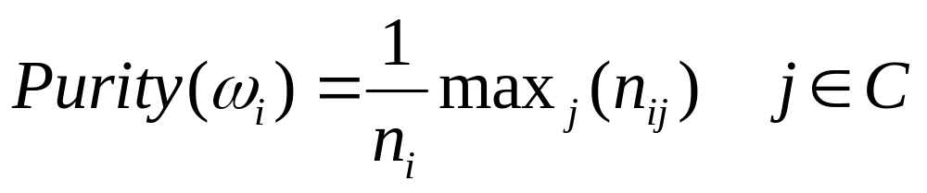
External Evaluation of Cluster Quality
Sec. 16.3
Simple measure: purity, the ratio between the dominant class in the cluster ω_{i} and the size of cluster ω_{i}
Biased because having n clusters maximizes purity
Others are entropy of classes in clusters (or mutual information between classes and clusters)

Slide 73
Purity example
Sec. 16.3
• •
• •
• •
• •
• •
• •
• •
• •
•
Cluster I
Cluster II
Cluster III
Cluster I: Purity = 1/6 (max(5, 1, 0)) = 5/6
Cluster II: Purity = 1/6 (max(1, 4, 1)) = 4/6
Cluster III: Purity = 1/5 (max(2, 0, 3)) = 3/5

Slide 74
Rand Index measures between pair decisions. Here RI = 0.68
Sec. 16.3
Number of point pairs | Same Cluster in clustering | Different Clusters in clustering
Same class in ground truth | 20 | 24
Different classes in ground truth | 20 | 72
TP
FN
FP
TN

Slide 75
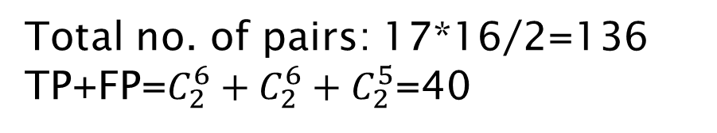
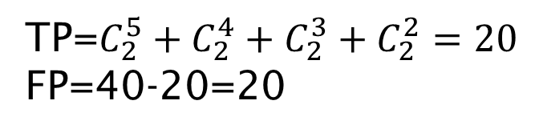
Example
Sec. 16.3
• •
• •
• •
• •
• •
• •
• •
• •
•
n=17
Cluster I
Cluster II
Cluster III
FN+TN=136-40=96
FN=(5*3+1*2)+(1*4)+(1*3)
=24
TN=96-24=72

Slide 76
Rand Index measures between pair decisions. Here RI = 0.68
Sec. 16.3
Number of point pairs | Same Cluster in clustering | Different Clusters in clustering
Same class in ground truth | 20 | 24
Different classes in ground truth | 20 | 72
TP (A)
FN (C)
FP (B)
TN (D)

Slide 77
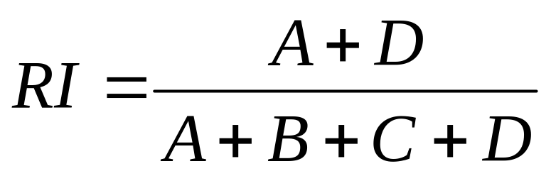
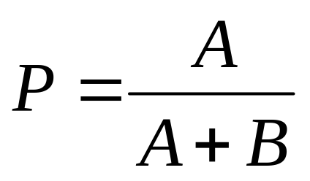
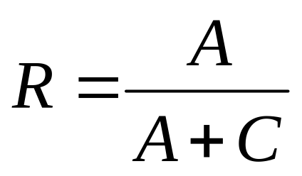
Rand index and Cluster F-measure
Sec. 16.3
Compare with standard Precision and Recall:
People also define and use a cluster F-measure, which is probably a better measure.

Slide 78
Final word and resources
In clustering, clusters are inferred from the data without human input (unsupervised learning)
However, in practice, it’s a bit less clear: there are many ways of influencing the outcome of clustering: number of clusters, similarity measure, representation of documents, . . .
Resources
  IIR 16 except 16.5
  IIR 17.1–17.3

