Slide 1
Introduction to
Information Retrieval
Text Classification;
The Naïve Bayes algorithm

Slide 2
Standing queries
The path from information retrieval to text classification:
  You have an information need
  You want to rerun an appropriate query periodically to find new news items on this topic
  You will be sent new documents that are found
    I.e., it’s classification not ranking
Such queries are called standing queries
  Long used by “information professionals”
  A modern mass instantiation is Google Alerts

Slide 3


Slide 4


Slide 5
Other applications
Market analysis
Detection of sexually explicit content
Email classification

Slide 6
Categorization/Classification
Given:
  A description of an instance, x ∈ X, where X is the instance language or instance space.
  A fixed set of classes:
  C = {c₁, c₂,…, c_{J}}
Determine:
  The category of x: c(x)∈C, where c(x) is a classification function whose domain is X and whose range is C.
    We want to know how to build classification functions (“classifiers”).

Slide 7
Classification Methods (1)
Manual classification
  Very accurate when job is done by experts
  Consistent when the problem size and team is small
  Difficult and expensive to scale
    Means we need automatic classification methods for big problems

Slide 8
Classification Methods (2)
Hand-coded rule-based systems
  Companies (Verity) provide “IDE” for writing such rules
    E.g., assign category if document contains a given boolean combination of words
  Accuracy is often very high if a rule has been carefully refined over time by a subject expert
    Building and maintaining these rules is expensive

Slide 9
Classification Methods (3)
Supervised learning of a document-label assignment function
  k-Nearest Neighbors (simple, powerful)
  Naive Bayes (simple, common method)
  Support-vector machines (new, more powerful)
No free lunch: requires hand-classified training data
Note that many commercial systems use a mixture of methods

Slide 10
Classification—A Two-Step Process
Model construction: describing a set of predetermined classes
  Each tuple/sample is assumed to belong to a predefined class, as determined by the class label attribute
  The set of tuples used for model construction is training set
  The model is represented as classification rules, decision trees, or mathematical formulae
Model usage: for classifying future or unknown objects
  Estimate accuracy of the model
    The known label of test sample is compared with the classified result from the model
    Accuracy rate is the percentage of test set samples that are correctly classified by the model
    Test set is independent of training set, otherwise over-fitting will occur
  If the accuracy is acceptable, use the model to classify data tuples whose class labels are not known

Slide 11



Process (1): Model Construction
Classification
Algorithms
Training
Data
Classifier
(Model)
IF rank = ‘professor’
OR years > 6
THEN tenured = ‘yes’

Slide 12




Process (2): Using the Model in Prediction
Classifier
Testing
Data
Unseen Data
(Jeff, Professor, 4)
Tenured?

Slide 13
Supervised vs. Unsupervised Learning
Supervised learning (classification)
  Supervision: The training data (observations, measurements, etc.) are accompanied by labels indicating the class of the observations
  New data is classified based on the training set
Unsupervised learning (clustering)
  The class labels of training data is unknown
  Given a set of measurements, observations, etc. with the aim of establishing the existence of classes or clusters in the data

Slide 14
Bayesian Methods
Learning and classification methods based on probability theory.
Bayes theorem plays a critical role in probabilistic learning and classification.
Build a generative model that approximates how data is produced
Uses prior probability of each category given no information about an item.
Categorization produces a posterior probability distribution over the possible categories given a description of an item.

Slide 15
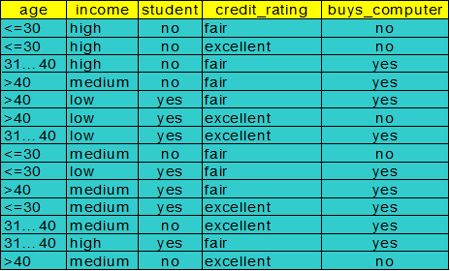
Bayesian Theorem: Basics
Let X be a data sample (“evidence”): class label is unknown
Let H be a hypothesis that X belongs to class C
Classification is to determine P(H|X), (posteriori probability), the probability that the hypothesis holds given the observed data sample X
P(yes|X) > P(no|X)
X => yes
P(yes|X) < P(no|X)
X => no

Slide 16
Bayesian Theorem: Basics
P(H) (prior probability), the initial probability
  E.g., X will buy computer, regardless of age, income, …
P(X): probability that sample data is observed
P(X|H) (likelyhood), the probability of observing the sample X, given that the hypothesis holds
  E.g., Given that X will buy computer, the prob. that X is 31..40, medium income

Slide 17
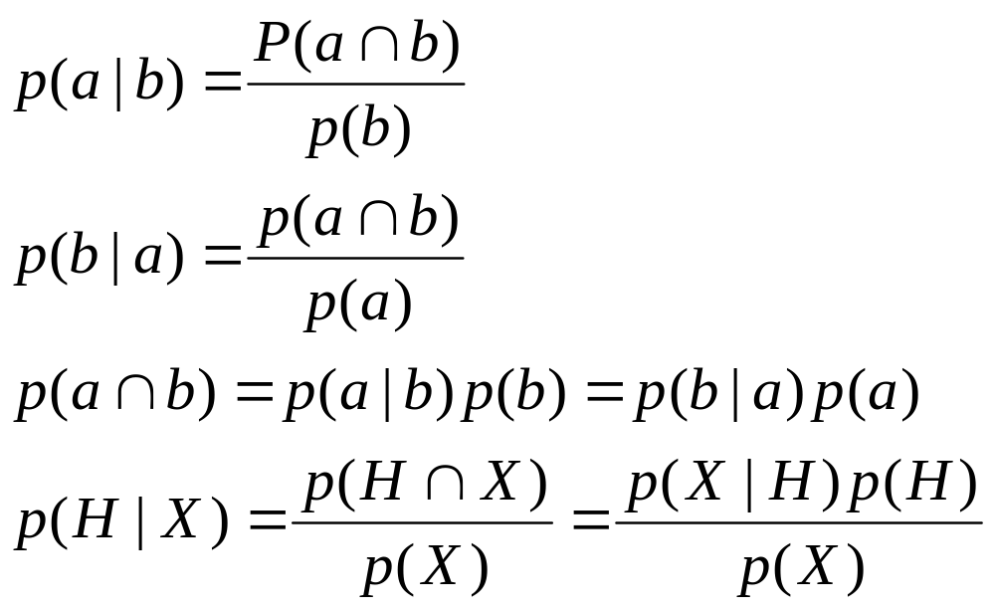
Recall a few probability basics
For events a and b:
Bayes’ Rule
Prior
Posterior
Likelihood

Slide 18

Bayesian Theorem
Given training data X, posteriori probability of a hypothesis H, P(H|X), follows the Bayes theorem
Informally, this can be written as
  posteriori = likelihood x prior/evidence
Predicts X belongs to C₂ iff the probability P(C_{i}|X) is the highest among all the P(C_{k}|X) for all the k classes
Practical difficulty: require initial knowledge of many probabilities, significant computational cost

Slide 19


Towards Naïve Bayesian Classifier
Let D be a training set of tuples and their associated class labels, and each tuple is represented by an n-D attribute vector X = (x₁, x₂, …, x_{n})
Suppose there are m classes C₁, C₂, …, C_{m}.
Classification is to derive the maximum posteriori, i.e., the maximal P(C_{i}|X)
This can be derived from Bayes’ theorem
Since P(X) is constant for all classes, only
  needs to be maximized

Slide 20


Derivation of Naïve Bayes Classifier
A simplified assumption: attributes are conditionally independent (i.e., no dependence relation between attributes):
MLE

Slide 21
Naïve Bayesian Classifier: Training Dataset
Class:
C1:buys_computer = ‘yes’
C2:buys_computer = ‘no’
Data sample
X = (age <=30,
Income = medium,
Student = yes
Credit_rating = Fair)

Slide 22

Naïve Bayesian Classifier: An Example
X = (age <=30, Income = medium, Student = yes, Credit_rating = Fair)
P(yes|X)
  P(yes) * P(age <=30|yes)*P(I=m|yes)*P(S=yes|yes)*P(CR=Fair|yes)
P(no|X)
  P(no) * P(age <=30|no)*P(I=m|no)*P(S=yes|no)*P(CR=Fair|no)

Slide 23
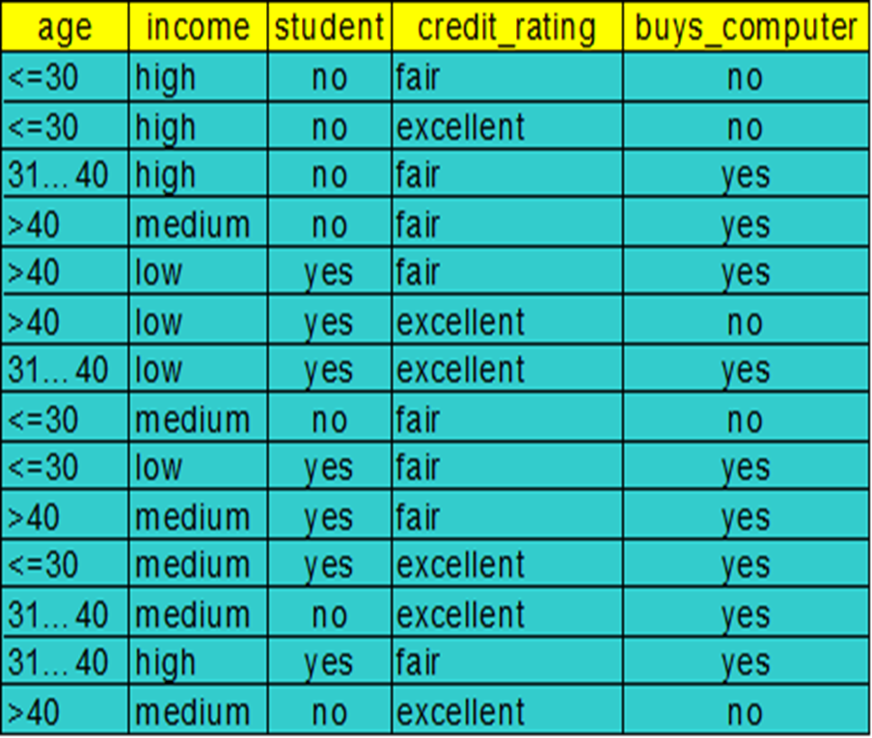
X = (age <=30, Income = medium, Student = yes, Credit_rating = Fair)
P(yes|X)
  P(yes) * P(age <=30|yes) *P(I=m|yes)*P(S=yes|yes)*P(CR=Fair|yes)
P(yes)=9/14=0.643
P(age<=30|yes)=2/9
  P(I=m|yes)=
  P(S=yes|yes)=
  P(CR=Fair|yes)=

Slide 24
Naïve Bayesian Classifier: An Example
P(C_{i}): P(buys_computer = “yes”) = 9/14 = 0.643
P(buys_computer = “no”) = 5/14= 0.357
Compute P(X|C_{i}) for each class
  P(age = “<=30” | buys_computer = “yes”) = 2/9 = 0.222
  P(age = “<= 30” | buys_computer = “no”) = 3/5 = 0.6
  P(income = “medium” | buys_computer = “yes”) = 4/9 = 0.444
  P(income = “medium” | buys_computer = “no”) = 2/5 = 0.4
  P(student = “yes” | buys_computer = “yes) = 6/9 = 0.667
  P(student = “yes” | buys_computer = “no”) = 1/5 = 0.2
  P(credit_rating = “fair” | buys_computer = “yes”) = 6/9 = 0.667
  P(credit_rating = “fair” | buys_computer = “no”) = 2/5 = 0.4
X = (age <= 30 , income = medium, student = yes, credit_rating = fair)
P(X|C_{i}) : P(X|buys_computer = “yes”) = 0.222 x 0.444 x 0.667 x 0.667 = 0.044
P(X|buys_computer = “no”) = 0.6 x 0.4 x 0.2 x 0.4 = 0.019
P(X|C_{i})*P(C_{i}) : P(X|buys_computer = “yes”) * P(buys_computer = “yes”) = 0.028
P(X|buys_computer = “no”) * P(buys_computer = “no”) = 0.007
Therefore, X belongs to class (“buys_computer = yes”)

Slide 25
Smoothing to Avoid Overfitting
To eliminate zeros, we use add-one or Laplace smoothing
Ex. Suppose a dataset with 1000 tuples, income=low (0), income= medium (990), and income = high (10)
Use Laplacian correction (or Laplacian estimator)
  Adding 1 to each case
    Prob(income = low) = 1/1003
    Prob(income = medium) = 991/1003
    Prob(income = high) = 11/1003

Slide 26
Smoothing to Avoid Overfitting
P(age<=30|yes)=(2+1)/(9+3)
  P(I=m|yes)=(4+1)/(9+3)
  P(S=yes|yes)=(6+1)/(9+2)
  P(CR=Fair|yes)=

Slide 27
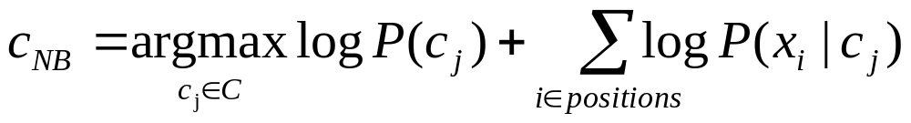
Underflow Prevention: log space
Multiplying lots of probabilities, which are between 0 and 1 by definition, can result in floating-point underflow.
Since log(xy) = log(x) + log(y), it is better to perform all computations by summing logs of probabilities rather than multiplying probabilities.
Class with highest final un-normalized log probability score is still the most probable.
Note that model is now just max of sum of weights…

Slide 28
Text classification
Model 1: Bernoulli
  One feature X_{w} for each word in dictionary
  X_{w} = true in document d if w appears in d
  Naive Bayes assumption:
    Given the document’s topic, appearance of one word in the document tells us nothing about chances that another word appears
This is the model used in the binary independence model in classic probabilistic relevance feedback in hand-classified data

Slide 29
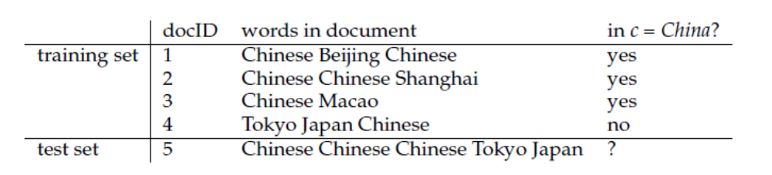
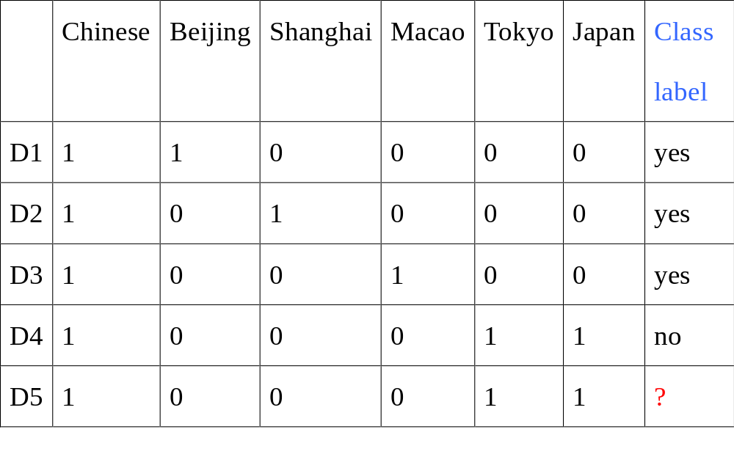
Example

Slide 30
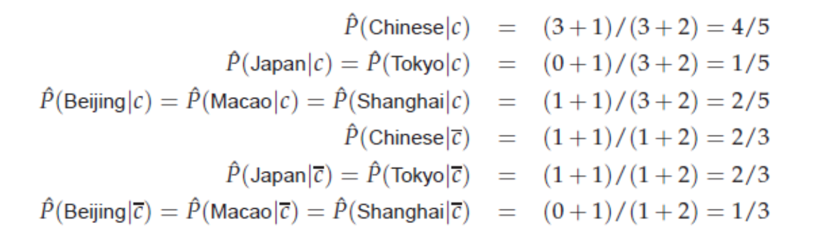

Slide 31
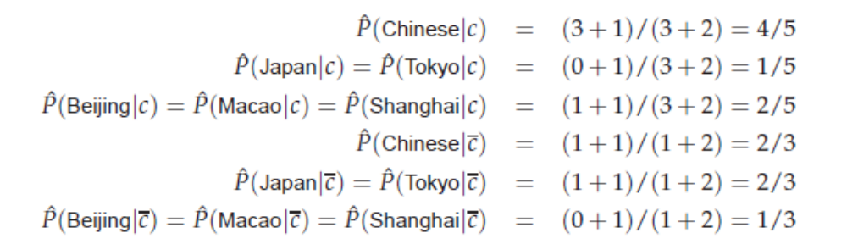
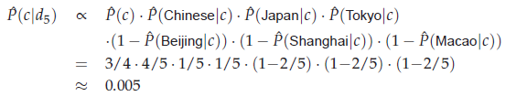

Slide 32

Text classification example(Bernoulli model)

Slide 33
Practice
 | docID | Words in document | Class label
Training set | 1 | cat cat dog cat cat cat | yes
 | 2 | dog mouse | yes
 | 3 | ant ant | yes
 | 4 | dog ant | no
Test set | 5 | cat cat cat ant | ?
Bernoulli

Slide 34
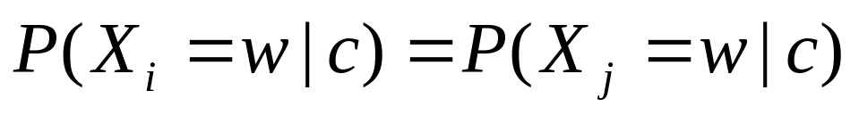
Text classification
Model 2: Multinomial = Class conditional unigram
  One feature X_{i} for each word pos in document
    feature’s values are all words in dictionary
  Value of X_{i} is the word in position i
  Naïve Bayes assumption:
    Given the document’s topic, word in one position in the document tells us nothing about words in other positions
    Word appearance does not depend on position
    Just have one multinomial feature predicting all words
for all positions i,j, word w, and class c

Slide 35
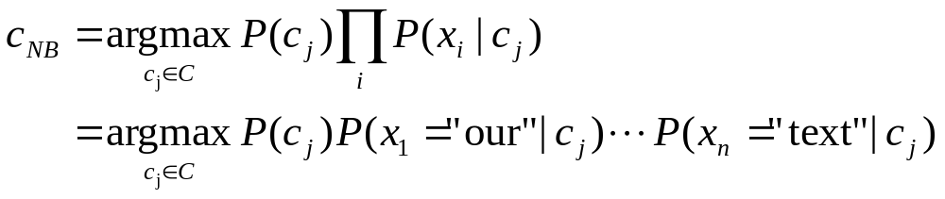
Using Multinomial Naive Bayes Classifiers to Classify Text: Basic method
Attributes are text positions, values are words.
Assume that classification is independent of the positions of the words
  Use same parameters for each position
  Result is bag of words model (over tokens not types)

Slide 36
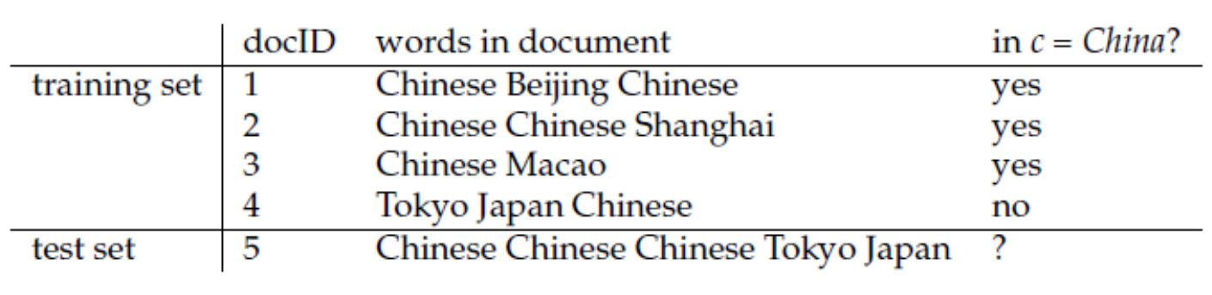
8
3
 | Beijing | Chinese | Macao | Japan | Tokyo | Shanghai
yes | 1 | 5 | 1 | 0 | 0 | 1
no | 0 | 1 | 0 | 1 | 1 | 0
P(c)=3/4, P(~c)=1/4
P(chinese|c)=(5+1)/(8+6)=3/7
P(Tokyo|c)=(0+1)/(8+6)=1/14
P(Japan|c)=(0+1)/(8+6)=1/14
P(chinese|~c)=(1+1)/(3+6)=2/9
P(tokyo|~c)=(1+1)/(3+6)=2/9
p(Japan|~c)=(1+1)/(3+6)=2/9
d5
  c : (3/4)*(3/7)³*(1/14)*(1/14)=0.0003
  ~c:(1/4)*(2/9)³*(2/9)*(2/9)=0.0001

Slide 37
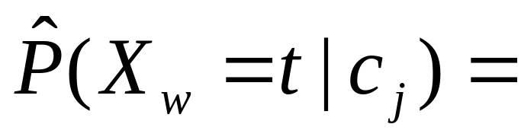
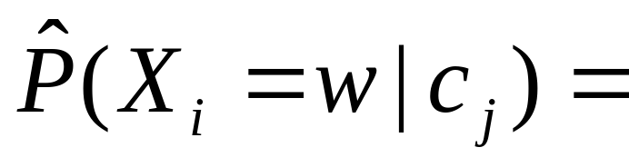
Parameter estimation
Bernoulli model:
Multinomial model:
  Can create a mega-document for topic j by concatenating all documents in this topic
  Use frequency of w in mega-document
fraction of documents of topic c_{j}
in which word w appears
fraction of times in which
word w appears
across all documents of topic c_{j}

Slide 38
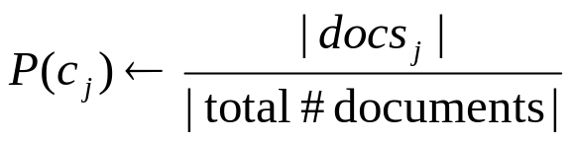
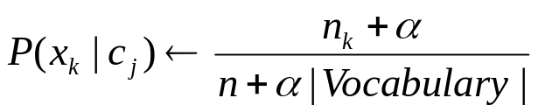
Naïve Bayes: Learning
From training corpus, extract Vocabulary
Calculate required P(c_{j}) and P(x_{k} | c_{j}) terms
  For each c_{j} in C do
    docs_{j} ← subset of documents for which the target class is c_{j}
    Text_{j} ← single document containing all docs_{j}
    for each word x_{k} in Vocabulary
      n_{k} ← number of occurrences of x_{k} in Text_{j}

Slide 39
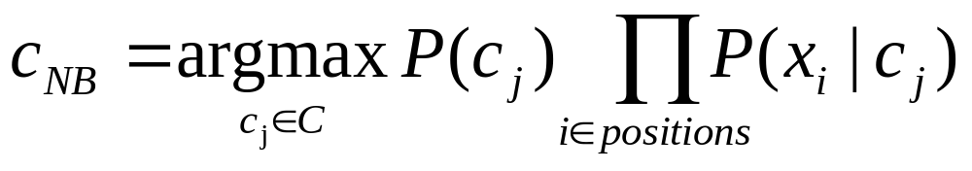
Naïve Bayes: Classifying
positions ← all word positions in current document which contain tokens found in Vocabulary
Return c_{NB}, where

Slide 40
Naive Bayes: Time Complexity
Training Time: O(|D|L_{d})
  where L_{d} is the average length of a document in D.
  Assumes V and all D_{i} , n_{i}, and n_{ij} pre-computed in O(|D|L_{d}) time during one pass through all of the data.
Test Time: O(|C| L_{t}) where L_{t} is the average length of a test document.
Very efficient overall, linearly proportional to the time needed to just read in all the data.

Slide 41
Discussion
Correct estimation implies accurate prediction, but accurate prediction does not imply correct estimation.
Assumptions
  Multinomial model makes assumption of positional independence
  Bernoulli model ignores positions in documents altogether
How can NB be a good text classifier when its model of NL is so oversimplified?
The winning class in NB classification usually has a much larger probability than the other classes.
The probability estimates of NB are of low quality, its classification decisions are surprisingly good.

Slide 42
Naive Bayes is Not So Naive
Very fast learning and testing (basically just count words)
Low storage requirements
More robust to irrelevant features than many learning methods
  Irrelevant features cancel out without affecting results

Slide 43
Naive Bayes is Not So Naive
More robust to concept drift (changing class definition over time)
Naive Bayes won 1st and 2nd place in KDD-CUP 97 competition out of 16 systems
  Goal: Financial services industry direct mail response prediction: Predict if the recipient of mail will actually respond to the advertisement – 750,000 records.
A good dependable baseline for text classification (but not the best)!

Slide 44
Stochastic Language Models
Models probability of generating strings (each word in turn) in the language (commonly all strings over ∑). E.g., unigram model
Model M
0.2 the
0.1 a
0.01 man
0.01 woman
0.03 said
0.02 likes
…
the
man
likes
the
woman
0.2
0.01
0.02
0.2
0.01
multiply
P(s | M) = 0.00000008
13.2.1

Slide 45
Stochastic Language Models
Model probability of generating any string
Model M1
Model M2
0.2 the
0.0001 class
0.03 sayst
0.02 pleaseth
0.1 yon
0.01 maiden
0.0001 woman
0.2 the
0.01 class
0.0001 sayst
0.0001 pleaseth
0.0001 yon
0.0005 maiden
0.01 woman
the
class
pleaseth
yon
maiden
0.2
0.01
0.0001
0.0001
0.0005
0.2
0.0001
0.02
0.1
0.01
P(s|M2) > P(s|M1)
13.2.1

Slide 46
Unigram and higher-order models
Unigram Language Models
Bigram (generally, n-gram) Language Models
Other Language Models
  Grammar-based models (PCFGs), etc.
    Probably not the first thing to try in IR
P ( )
= P ( )
P ( | )
P ( | )
P ( | )
Easy.
Effective!
P ( ) P ( ) P ( ) P ( )
P ( ) P ( | ) P ( | ) P ( | )
13.2.1

Slide 47
Classification
Multinomial vs Multivariate Bernoulli
Multinomial model is almost always more effective in text applications!
See IIR sections 13.2 and 13.3 for worked examples with each model

Slide 48
Feature Selection: Why?
Text collections have a large number of features
  10,000 – 1,000,000 unique words … and more
May make using a particular classifier feasible
  Some classifiers can’t deal with 100,000 of features
Reduces training time
  Training time for some methods is quadratic or worse in the number of features
Can improve performance
  Eliminates noise features
  Avoids overfitting

Slide 49
Basic feature selection algorithm
For a given class c, we compute a utility measure A(t,c) for each term of the vocabulary
Select the k terms that have the highest values of A(t,c)
SELECTFEATURES(D, c, k)
1 V ← EXTRACTVOCABULARY(D)
2 L ← []
3 for each t ∈ V
4 do A(t, c) ← COMPUTEFEATUREUTILITY(D, t, c)
5 APPEND(L, A(t, c), ti)
6 return FEATURESWITHLARGESTVALUES(L, k)

Slide 50
Feature selection: how?
Three utility measures:
  Information theory:
    How much information does the value of one categorical variable give you about the value of another
    Mutual information
  Hypothesis testing statistics:
    Are we confident that the value of one categorical variable is associated with the value of another
    Chi-square test
  Frequency

Slide 51
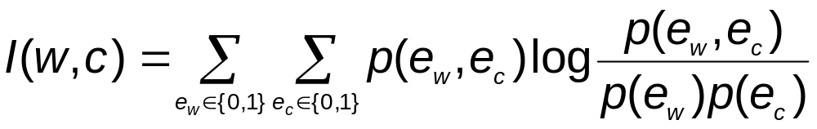
Feature selection via Mutual Information
In training set, choose k words which best discriminate (give most info on) the categories.
The Mutual Information between a word, class is:
  For each word w and each category c
For MLEs of the probabilities

Slide 52
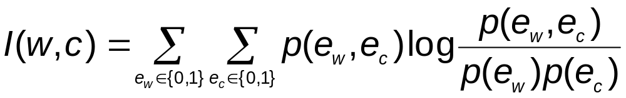
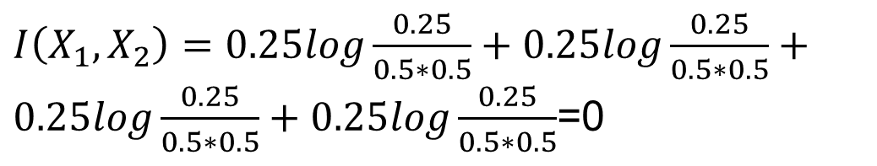
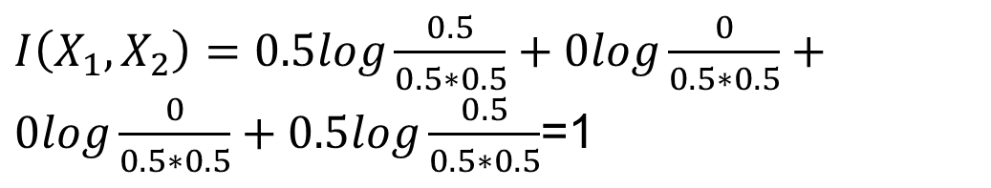
Mutual Information
 | X₁=0 | X₁=1
X₂=0 | 0.25 | 0.25
X₂=1 | 0.25 | 0.25
0.5
0.5
0.5
0.5
 | X₁=0 | X₁=1
X₂=0 | 0.5 | 0
X₂=1 | 0 | 0.5

Slide 53
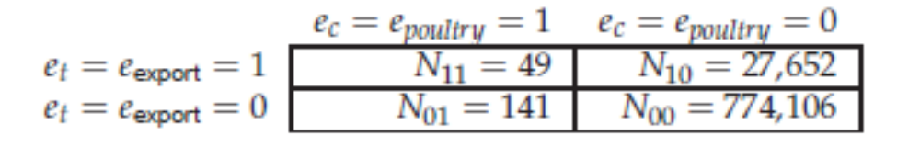
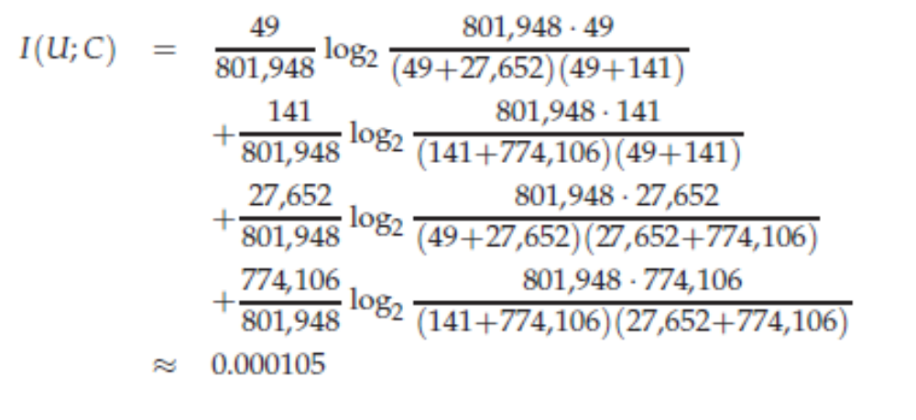
Feature selection via Mutual Information (example)

Slide 54
Feature selection via Mutual Information
Mutual information measures how much information – in the information theoretic sense
  If a term’s distribution is the same in the class as it is in the collection as a whole, then I(U; C) =0.
  MI reaches its maximum value if the term is a perfect indicator for class membership
    if the term is present in a document if and only if the document is in the class.

Slide 55
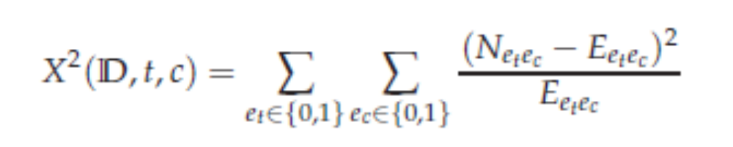
χ² statistic
In statistics, the χ2 test is applied to test the independence of two events.
In feature selection, the two events are occurrence of the term and occurrence of the class

Slide 56
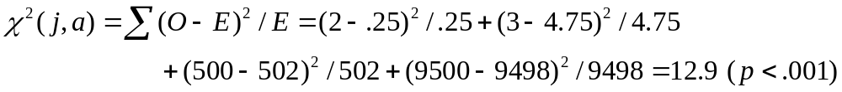
χ² statistic (CHI)
N=10005
p(class=auto)= 502/10005
p(term=jaguar)= 5/10005
E₁₁=10005*p(c=a)*p(t=j)=0.25
χ2 is interested in (fo – fe)²/fe summed over all table entries: is the observed number what you’d expect given the marginals?
The null hypothesis is rejected with confidence .999,
since 12.9 > 10.83 (the value for .999 confidence).
Term = jaguar
Term ≠ jaguar
expected: f_{e}
Class = auto
2
(0.25)
500
(502)
Class ≠ auto
3
(4.75)
9500
(9498)
observed: f_{o}

Slide 57
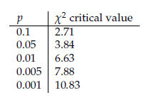
χ² statistic
χ² is a measure of how much expected counts E and observed counts N deviate from each other.
  A high value of χ² indicates that the hypothesis of independence is incorrect.

Slide 58
Frequency-based feature selection
Frequency-based feature selection
  Selecting the terms that are most common in the class
Frequency can be either
  document frequency (the number of documents in the class c that contain the term t)
  or as collection frequency (the number of tokens of t that occur in documents in c)

Slide 59
Frequency-based feature selection
Discussions
  Frequency-based feature selection selects some frequent terms that have no specific information about the class
    the days of the week (Monday, Tuesday, . . . ), which are frequent across classes in newswire text.
  When many thousands of features are selected, then frequency-based feature selection often does well.
  If suboptimal accuracy is acceptable, then frequency-based feature selection can be a good alternative to more complex methods.

Slide 60
Comparison of feature selection methods
 | C=0 | C=1
t=0 | 999999000 | 999
t=1 | 0 | 1
χ² selects more rare terms than mutual information
t will be selected by using χ²
A single occurrence is not very informative according to the information-theoretic definition of information

Slide 61
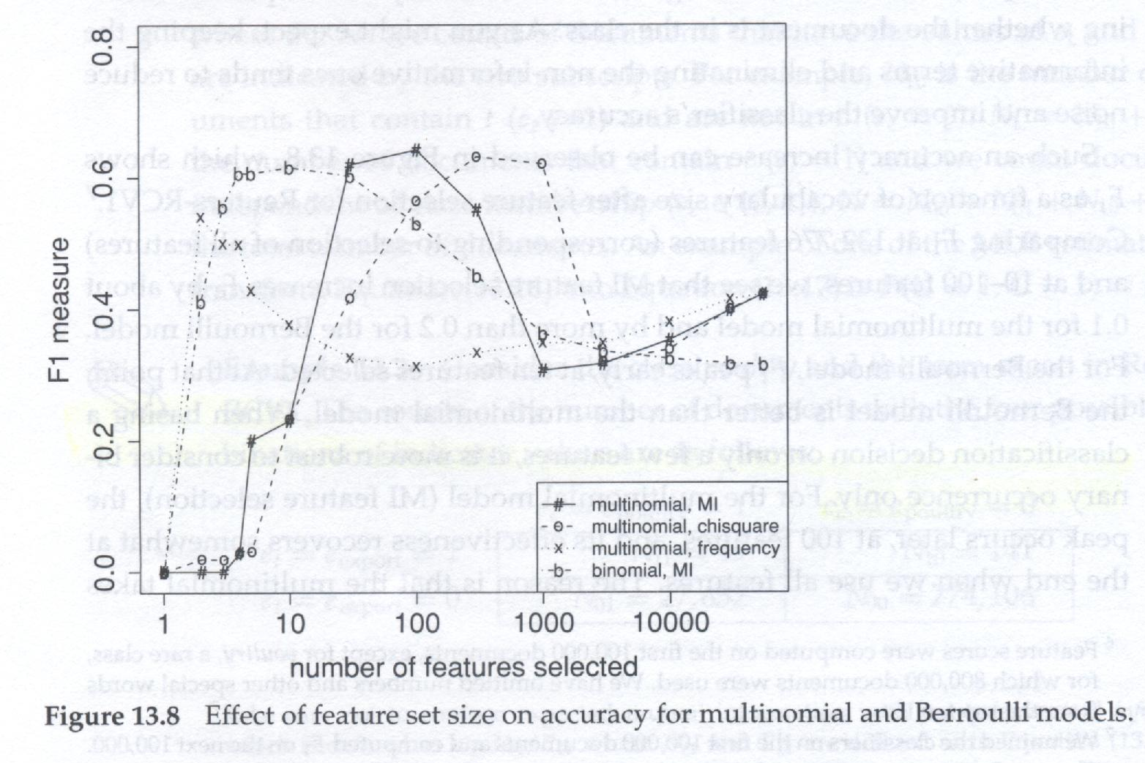
Comparison of feature selection methods
The classification accuracy of feature sets selected with χ² and MI does not seem to differ systematically
Text classification
  Few strong indicators
  Many weak indicators
Both method do this!
As long as all strong indicators and a large of weak indicators are selected, accuracy is expected to be good.

Slide 62
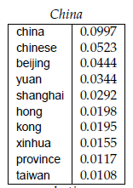
Comparison of feature selection methods
All three methods – MI, χ² and frequency-based– are greedy methods.

Slide 63
Feature selection for NB
In general feature selection is necessary for Bernoulli NB.
“Feature selection” really means something different for multinomial NB. It means dictionary truncation

Slide 64
k Nearest Neighbor Classification
Sec.14.3
kNN = k Nearest Neighbor
To classify a document d:
Define k-neighborhood as the k nearest neighbors of d
Pick the majority class label in the k-neighborhood

Slide 65
Test Document = Science
Sec.14.1
Government
Science
Arts
Voronoi diagram

Slide 66
Nearest-Neighbor Learning
Sec.14.3
Learning: just store the labeled training examples D
Testing instance x (under 1NN):
  Compute similarity between x and all examples in D.
  Assign x the category of the most similar example in D.
Does not compute anything beyond storing the examples
Also called:
  Case-based learning
  Memory-based learning
  Lazy learning

Slide 67
k Nearest Neighbor
Sec.14.3
Using only the closest example (1NN) subject to errors due to:
  A single atypical example.
  Noise (i.e., an error) in the category label of a single training example.
More robust: find the k examples and return the majority category of these k
k is typically odd to avoid ties; 3 and 5 are most common

Slide 68
Nearest Neighbor with Inverted Index
Sec.14.3
Naively finding nearest neighbors requires a linear search through |D| documents in collection
However,
  determining k nearest neighbors is the same as determining the k best retrievals using the test document as a query to a database of training documents.
  Use standard vector space inverted index methods to find the k nearest neighbors.
Testing Time: O(B|V_{t}|) where B is the average number of training documents in which a test-document word appears.
  Typically B << |D|

Slide 69
kNN: Discussion
Sec.14.3
No feature selection necessary
No training necessary
Scales well with large number of classes
  Don’t need to train n classifiers for n classes
Done naively, very expensive at test time
In most cases it’s more accurate than NB

Slide 70
Evaluating Categorization
Evaluation must be done on test data that are independent of the training data (usually a disjoint set of instances).
Classification accuracy: c/n where n is the total number of test instances and c is the number of test instances correctly classified by the system.
Results can vary based on sampling error due to different training and test sets.
13.6

Slide 71
Classifier Accuracy Measures
 | (classifier)C₁ | C₂
(true)C₁ | True positive | False negative
C₂ | False positive | True negative
prediction
 | buy_computer = yes | buy_computer = no | total | recognition(%)
buy_computer = yes | 6954 | 46 | 7000 | 99.34
buy_computer = no | 412 | 2588 | 3000 | 86.27
total | 7366 | 2634 | 10000 | 95.42
true
Accuracy of a classifier M, acc(M): percentage of test set tuples that are correctly classified by the model M
  Error rate (misclassification rate) of M = 1 – acc(M)
Alternative accuracy measures (e.g., for cancer diagnosis)
  sensitivity = t-pos/pos /* true positive recognition rate */
  specificity = t-neg/neg /* true negative recognition rate */
  precision = t-pos/(t-pos + f-pos)
  accuracy = sensitivity * pos/(pos + neg) + specificity * neg/(pos + neg)

Slide 72
Classifier Accuracy Measures
 | (classifier)C₁ | C₂
(true)C₁ | True positive | False negative
C₂ | False positive | True negative
prediction
 | buy_computer = yes | buy_computer = no | total | recognition(%)
buy_computer = yes | 6954 | 46 | 7000 | 99.34
buy_computer = no | 412 | 2588 | 3000 | 86.27
total | 7366 | 2634 | 10000 | 95.42
true
Accuracy of a classifier M, acc(M): percentage of test set tuples that are correctly classified by the model M
  Error rate (misclassification rate) of M = 1 – acc(M)
Alternative accuracy measures (e.g., for cancer diagnosis)
  sensitivity = t-pos/pos /* true positive recognition rate */
  specificity = t-neg/neg /* true negative recognition rate */
  precision = t-pos/(t-pos + f-pos)
  accuracy = sensitivity * pos/(pos + neg) + specificity * neg/(pos + neg)

Slide 73
Classifier Accuracy Measures
 | (classifier)C₁ | C₂
(true)C₁ | True positive | False negative
C₂ | False positive | True negative
prediction
 | buy_computer = yes | buy_computer = no | total | recognition(%)
buy_computer = yes | 6954 | 46 | 7000 | 99.34
buy_computer = no | 412 | 2588 | 3000 | 86.27
total | 7366 | 2634 | 10000 | 95.42
true
Accuracy of a classifier M, acc(M): percentage of test set tuples that are correctly classified by the model M
  Error rate (misclassification rate) of M = 1 – acc(M)
Alternative accuracy measures (e.g., for cancer diagnosis)
  sensitivity = t-pos/pos /* true positive recognition rate */
  specificity = t-neg/neg /* true negative recognition rate */
  precision = t-pos/(t-pos + f-pos)
  accuracy = sensitivity * pos/(pos + neg) + specificity * neg/(pos + neg)

Slide 74
Classifier Accuracy Measures
 | (classifier)C₁ | C₂
(true)C₁ | True positive | False negative
C₂ | False positive | True negative
prediction
 | buy_computer = yes | buy_computer = no | total | recognition(%)
buy_computer = yes | 6954 | 46 | 7000 | 99.34
buy_computer = no | 412 | 2588 | 3000 | 86.27
total | 7366 | 2634 | 10000 | 95.42
true
Accuracy of a classifier M, acc(M): percentage of test set tuples that are correctly classified by the model M
  Error rate (misclassification rate) of M = 1 – acc(M)
Alternative accuracy measures (e.g., for cancer diagnosis)
  sensitivity = t-pos/pos /* true positive recognition rate */
  specificity = t-neg/neg /* true negative recognition rate */
  precision = t-pos/(t-pos + f-pos)
  accuracy = sensitivity * pos/(pos + neg) + specificity * neg/(pos + neg)

Slide 75
Maximum Likelihood Estimation

Slide 76
Example
1, 0, 1, 0, 0, 0, 0, 0, 0, 1
Suppose observations are independent of one another.
The joint pmf evaluated at the observed X_{i}’s is
f (x₁, . . . , x₁₀; p) = p(1 – p)p . . . p = p³(1 – p)⁷

Slide 77
Example
f (x₁, . . . , x₁₀; p) = p(1 – p)p . . . p = p³(1 – p)⁷
Suppose that p = .25.
  The probability of observing the sample that we actually obtained is (.25)³(.75)⁷ = .002086.
If instead p = .50
  The probability is (.50)³(.50)⁷ = .000977.

Slide 78
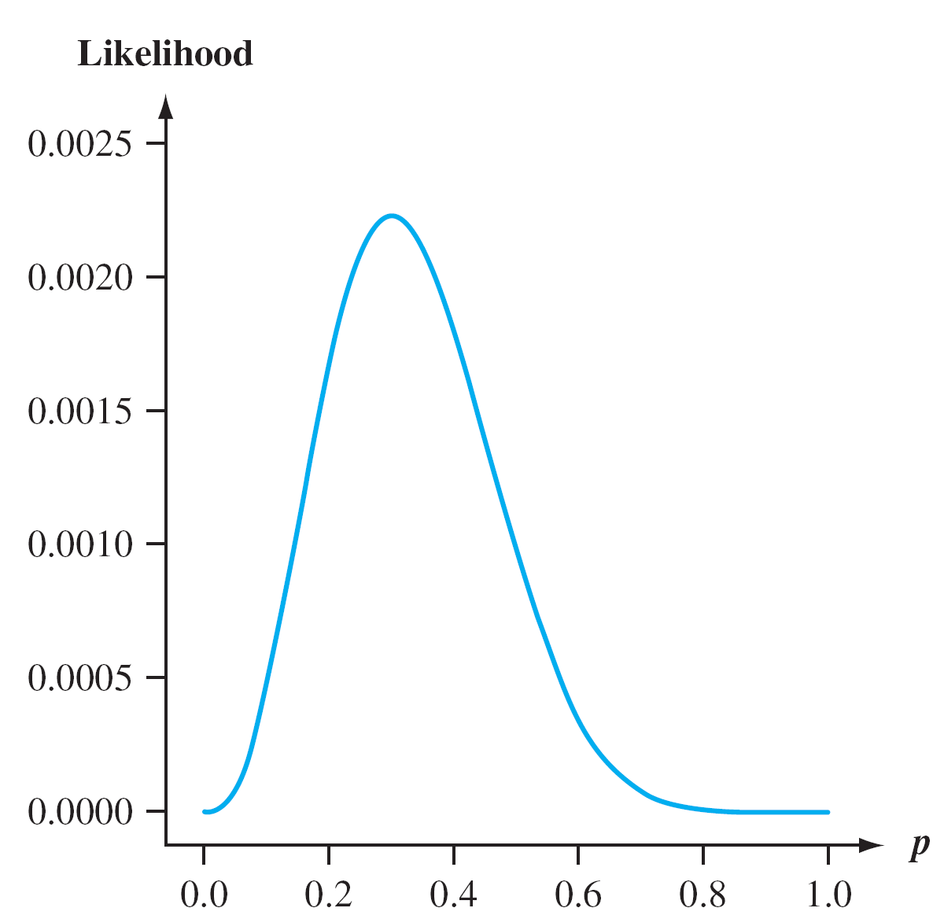
Example
It appears that the graph reaches its peak above p = .3
  The proportion of flawed helmets in the sample.
Graph of the likelihood (joint pmf)

Slide 79
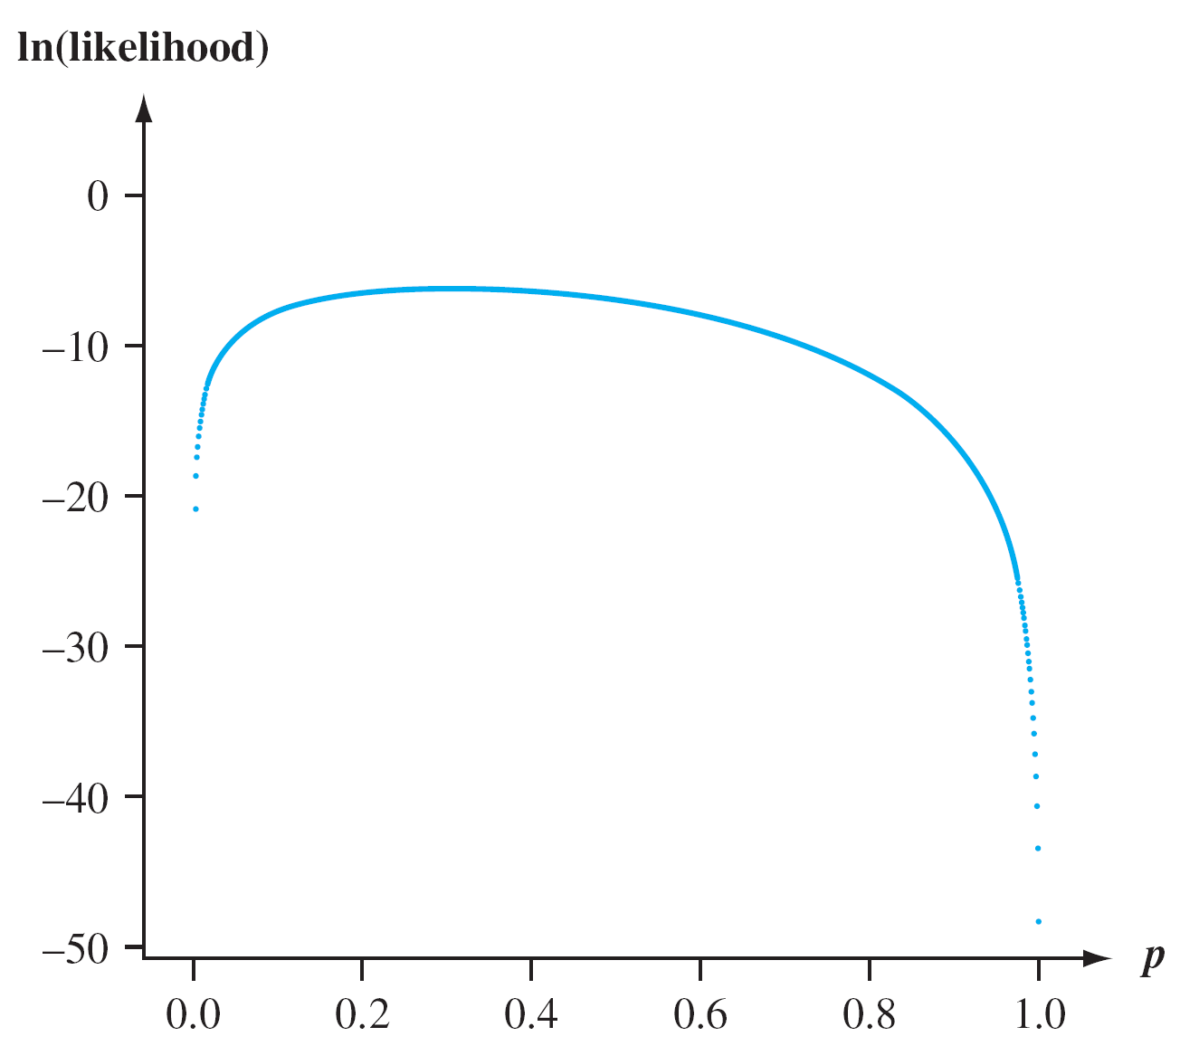
Example
ln[g(u)] is a strictly increasing function of g(u), finding u to maximize the function g(u) is the same as finding u to maximize ln[g(u)].
Graph of the natural logarithm of the likelihood

Slide 80
Example
Use calculus to find the value of p that maximizes the joint pmf
  Working with the natural log of the joint pmf is often easier than working with the joint pmf itself
    The joint pmf is typically a product so its logarithm will be a sum.
Here
ln[ f (x₁, . . . , x₁₀; p)] = ln[p³(1 – p)⁷] = 3ln(p) + 7ln(1 – p)

Slide 81
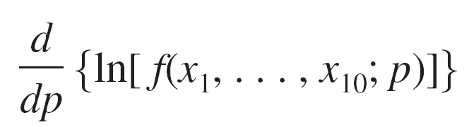
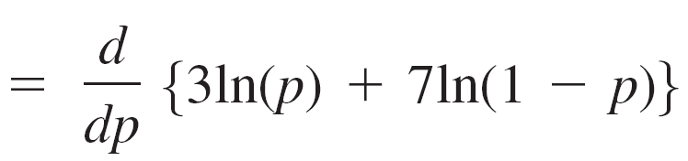
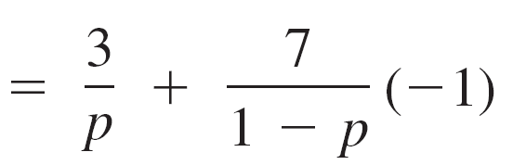
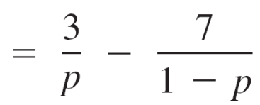
Example
Thus
Equating this derivative to 0 and solving for p gives 3(1 – p) = 7p, and so p = 3/10 = .30

