Slide 1
Dictionary
Ch. 3
Dictionary data structures
“Tolerant” retrieval
  Wild-card queries
  Spelling correction
  Soundex

Slide 2
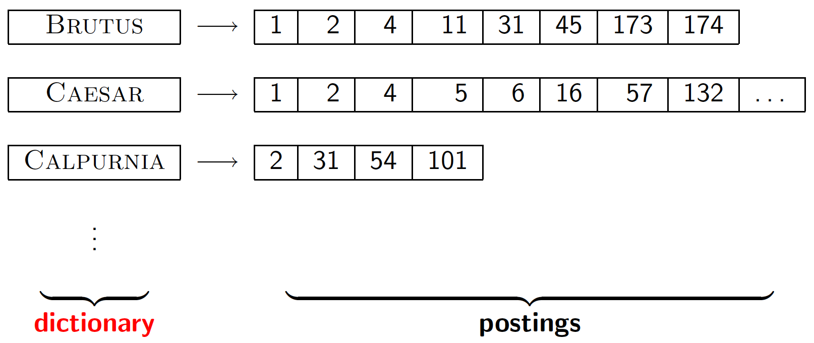
Dictionary data structures for inverted indexes
Sec. 3.1
The dictionary data structure stores the term vocabulary, document frequency, pointers to each postings list … in what data structure?

Slide 3
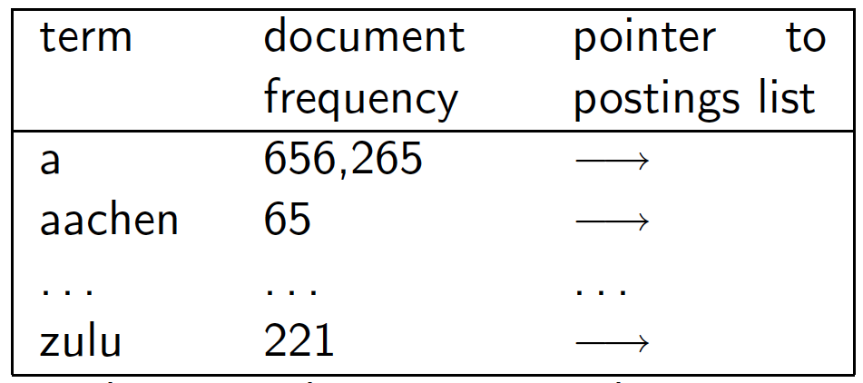
A naïve dictionary
Sec. 3.1
An array of struct:
char[20] int Postings *
20 bytes 4/8 bytes 4/8 bytes
How do we store a dictionary in memory efficiently?
How do we quickly look up elements at query time?

Slide 4
Sec. 3.1
An array of struct:
char[20] int Postings *
20 bytes 8 bytes 4 bytes
Assume
  Block size : 512 bytes
  1,000,000 terms
Without index
1,000,000*(20+8+4)/512=62500

Slide 5
Dictionary data structures
Sec. 3.1
Two main choices:
  Hashtables
  Trees
Some IR systems use hashtables, some trees

Slide 6
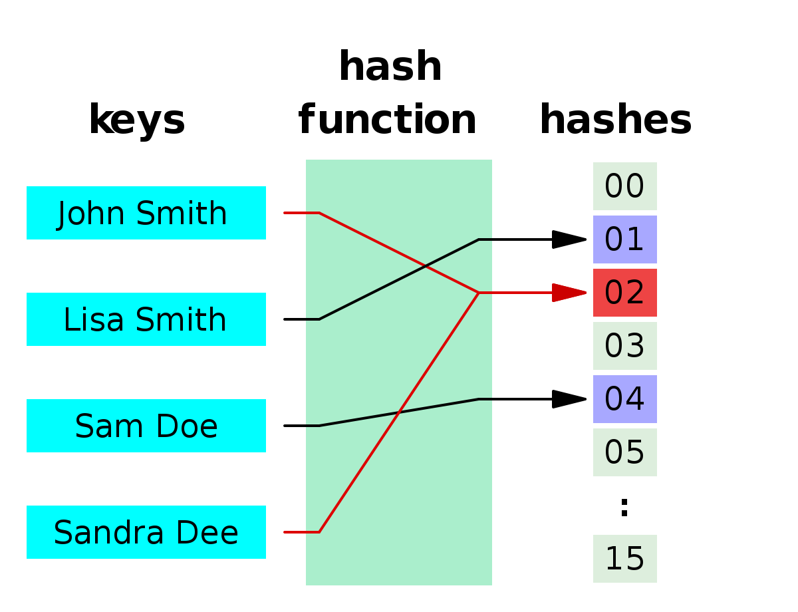

Slide 7
Hashtables
Sec. 3.1
Each vocabulary term is hashed to an integer
  (We assume you’ve seen hashtables before)
Pros:
  Lookup is faster than for a tree: O(1)
Cons:
  No easy way to find minor variants:
    judgment/judgement
  No prefix search [tolerant retrieval]
  If vocabulary keeps growing, need to occasionally do the expensive operation of rehashing everything

Slide 8
Tree: binary tree
Sec. 3.1
Root
a-m
n-z
a-hu
hy-m
n-sh
si-z
huygens
sickle
zygot
aardvark

Slide 9
Tree: B-tree
Sec. 3.1
a-hu
n-z
hv-m
  Definition: Every internal node has a number of children in the interval [a,b] where a, b are appropriate natural numbers, e.g., [2,4].

Slide 10
Trees
Sec. 3.1
Simplest: binary tree
More usual: B-trees / B+-tree
Trees require a standard ordering of characters and hence strings … but we typically have one
Pros:
  Solves the prefix problem (terms starting with hyp)
Cons:
  Slower: O(log M) [and this requires balanced tree]
  Rebalancing binary trees is expensive
    But B-trees mitigate the rebalancing problem

Slide 11
B+-tree
Records must be ordered over an attribute
Queries: exact match and range queries over the indexed attribute: “find the name of the student with ID=087-34-7892” or “find all students with gpa between 3.00 and 3.5”

Slide 12
B+-tree:properties
Insert/delete at log _{F} (N/B) cost; keep tree height-balanced. (F = fanout)
Two types of nodes: index nodes and data nodes; each node is 1 page (disk based method)

Slide 13
Index node
57
81
95
to keys to keys to keys to keys
< 57 57≤ k<81 81≤k<95 95≤

Slide 14
Data node
From non-leaf node
to next leaf
in sequence
57
81
95
To record
with key 57
To record
with key 81
To record
with key 85

Slide 15
EX: B+ Tree of order 3.
(a) Initial tree
60
Index level
20 , 40
80
5,10
20
40,50
60
80,100
Data level

Slide 16
Query Example
Root
100
Range[32, 160]
30
120
150
180
3
5
11
30
35
100
101
110
120
130
150
156
179
180
200

Slide 17
For more information
https://www.youtube.com/watch?v=C_q5ccN84C8
https://www.youtube.com/watch?v=aZjYr87r1b8

Slide 18
WILD-CARD QUERIES

Slide 19
Wild-card queries: *
Sec. 3.2
mon*: find all docs containing any word beginning with “mon”.
Easy with binary tree (or B-tree) lexicon: retrieve all words in range: mon ≤ w < moo
*mon: find words ending in “mon”: harder
  Maintain an additional B-tree for terms backwards.
  Can retrieve all words in range: nom ≤ w < non.
Exercise: from this, how can we enumerate all terms
meeting the wild-card query pro*cent ?

Slide 20
Query processing
Sec. 3.2
At this point, we have an enumeration of all terms in the dictionary that match the wild-card query.
We still have to look up the postings for each enumerated term.
E.g., consider the query:
se*ate AND fil*er
This may result in the execution of many Boolean AND queries.

Slide 21
B-trees handle *’s at the end of a query term
Sec. 3.2
How can we handle *’s in the middle of query term?
  co*tion
We could look up co* AND *tion in a B-tree and intersect the two term sets
  Expensive
The solution: transform wild-card queries so that the *’s occur at the end
This gives rise to the Permuterm Index.

Slide 22
Permuterm index
Sec. 3.2.1
For term hello, index under:
  hello$, ello$h, llo$he, lo$hel, o$hell, $hello
  where $ is a special symbol.
Queries:
  X lookup on X$ X* lookup on $X*
  *X lookup on X$* *X* lookup on X*
  X*Y lookup on Y$X*
Query = hel*o
X=hel, Y=o
Lookup o$hel*

Slide 23
Permuterm query processing
Sec. 3.2.1
Rotate query wild-card to the right
Now use B-tree lookup as before.
Permuterm problem: ≈ quadruples lexicon size
Empirical observation for English.

Slide 24
Exercise
1. What are the entries in the permuterm index dictionary that generated by the terms “advice” and “advisor”
2. If you want to search for *dvi* in a permuterm wildcard index, what key(s) would one do the lookup on?
3. If you want to search for a*ice in a permuterm wildcard index, what key(s) would one do the lookup on?

Slide 25
Bigram (k-gram) indexes
Sec. 3.2.2
Enumerate all k-grams (sequence of k chars) occurring in any term
e.g., from text “April is the cruelest month” we get the 2-grams (bigrams)
  $ is a special word boundary symbol
Maintain a second inverted index from bigrams to dictionary terms that match each bigram.
$a,ap,pr,ri,il,l$,$i,is,s$,$t,th,he,e$,$c,cr,ru,
ue,el,le,es,st,t$, $m,mo,on,nt,h$

Slide 26
Bigram index example
Sec. 3.2.2
The k-gram index finds terms based on a query consisting of k-grams (here k=2).
$m
mace
madden
mo
among
amortize
on
along
among

Slide 27
Processing wild-cards
Sec. 3.2.2
Query mon* can now be run as
  $m AND mo AND on
Gets terms that match AND version of our wildcard query.
But we’d enumerate moon.
  Must post-filter these terms against query.
Surviving enumerated terms are then looked up in the term-document inverted index.
Fast, space efficient (compared to permuterm).

Slide 28
Processing wild-card queries
Sec. 3.2.2
As before, we must execute a Boolean query for each enumerated, filtered term.
Wild-cards can result in expensive query execution (very large disjunctions…)
  pyth* AND prog*
If you encourage “laziness” people will respond!
Search
Type your search terms, use ‘*’ if you need to.
E.g., Alex* will match Alexander.

Slide 29
SPELLING CORRECTION

Slide 30
Spell correction
Sec. 3.3
Two principal uses
  Correcting document(s) being indexed
  Correcting user queries to retrieve “right” answers
Two main flavors:
  Isolated word
    Check each word on its own for misspelling
    Will not catch typos resulting in correctly spelled words
    e.g., from → form
  Context-sensitive
    Look at surrounding words,
    e.g., I flew form Heathrow to Narita.

Slide 31
Isolated word correction
Sec. 3.3.2
Given a lexicon and a character sequence Q, return the words in the lexicon closest to Q
What’s “closest”?
We’ll study several alternatives
  Edit distance (Levenshtein distance)
  Weighted edit distance
  n-gram overlap

Slide 32
Edit distance
Sec. 3.3.3
Given two strings S₁ and S₂, the minimum number of operations to convert one to the other
Operations are typically character-level
  Insert, Delete, Replace, (Transposition)
E.g., the edit distance from dof to dog is 1
  From cat to act is 2 (Just 1 with transpose.)
  from cat to dog is 3.
Generally found by dynamic programming.

Slide 33
Edit Distance
Levenshtein (1966) introduced edit distance between two strings as the minimum number of elementary operations (insertions, deletions, and substitutions) to transform one string into the other
d(v,w) = MIN number of elementary operations
to transform v → w

Slide 34
Edit Distance vs Hamming Distance
Hamming distance
always compares
i^{-th} letter of v with
i^{-th} letter of w
V = ATATATAT
W = TATATATA
Hamming distance:
d(v, w)=8
Computing Hamming distance
is a trivial task.

Slide 35
Edit Distance vs Hamming Distance
Hamming distance
always compares
i^{-th} letter of v with
i^{-th} letter of w
Edit distance
may compare
i^{-th} letter of v with
j^{-th} letter of w
V = ATATATAT
Just one shift
V = - ATATATAT
W = TATATATA
Make it all line up
W = TATATATA
Hamming distance: Edit distance:
d(v, w)=8 d(v, w)=2
Computing Hamming distance Computing edit distance
is a trivial task is a non-trivial task

Slide 36
Weighted edit distance
Sec. 3.3.3
As above, but the weight of an operation depends on the character(s) involved
  Meant to capture OCR or keyboard errors
  Example: m more likely to be mis-typed as n than as q
  Therefore, replacing m by n is a smaller edit distance than by q
  This may be formulated as a probability model
Requires weight matrix as input
Modify dynamic programming to handle weights

Slide 37
Edit distance to all dictionary terms?
Sec. 3.3.4
Given a (mis-spelled) query – do we compute its edit distance to every dictionary term?
  Expensive and slow
How do we cut the set of candidate dictionary terms?
  One possibility is to use n-gram overlap for this
  This can also be used by itself for spelling correction.
Notes:
Alternative is to generate everything up to edit distance k and then intersect. Fine for distance 1; okay for distance 2. This is generally enough (Norvig).

Slide 38
n-gram overlap
Sec. 3.3.4
Enumerate all the n-grams in the query string as well as in the lexicon
Use the n-gram index (recall wild-card search) to retrieve all lexicon terms matching any of the query n-grams
Threshold by number of matching n-grams
  Variants – weight by keyboard layout, etc.

Slide 39
Example with trigrams
Sec. 3.3.4
Suppose the text is november
  Trigrams are nov, ove, vem, emb, mbe, ber.
The query is december
  Trigrams are dec, ece, cem, emb, mbe, ber.
So 3 trigrams overlap (of 6 in each term)
How can we turn this into a normalized measure of overlap?

Slide 40
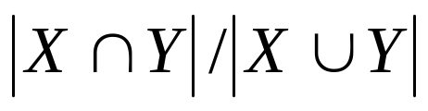
One option – Jaccard coefficient
Sec. 3.3.4
A commonly-used measure of overlap
Let X and Y be two sets; then the J.C. is
Equals 1 when X and Y have the same elements and zero when they are disjoint
X and Y don’t have to be of the same size
Always assigns a number between 0 and 1
  Now threshold to decide if you have a match
  E.g., if J.C. > 0.8, declare a match
november
Trigrams are
nov, ove, vem, emb, mbe, ber.
december
Trigrams are
dec, ece, cem, emb, mbe, ber.

Slide 41
Matching trigrams
Sec. 3.3.4
Consider the query lord – we wish to identify words matching 2 of its 3 bigrams (lo, or, rd)
lo
alone
lore
sloth
or
border
lore
morbid
rd
ardent
border
card
Standard postings “merge” will enumerate …
Adapt this to using Jaccard (or another) measure.

Slide 42
Exercise
Compute the Jaccard coefficients between the query bord and each of the following terms (bi-gram is used) : border, lord, and abound

Slide 43
Context-sensitive spell correction
Sec. 3.3.5
Text: I flew from Taiwan to Japan.
Consider the phrase query “flew form Taiwan”
We’d like to respond
Did you mean “flew from Taiwan”?
because no docs matched the query phrase.

Slide 44
Context-sensitive correction
Sec. 3.3.5
Need surrounding context to catch this.
First idea: retrieve dictionary terms close (in weighted edit distance) to each query term
Now try all possible resulting phrases with one word “fixed” at a time
  flew from Taiwan
  fled form Taiwan
  flea form Taiwan
Hit-based spelling correction: Suggest the alternative that has lots of hits.

Slide 45
Exercise
Sec. 3.3.5
Suppose that for “flew form taiwan” we have 7 alternatives for flew, 19 for form and 3 for taiwan.
How many “corrected” phrases will we enumerate in this scheme?

Slide 46
Another approach
Break phrase query into a conjunction of biwords (Lecture 2).
Look for biwords that need only one term corrected.
Enumerate phrase matches and … rank them!

Slide 47
General issues in spell correction
We enumerate multiple alternatives for “Did you mean?”
  Need to figure out which to present to the user
Use heuristics
  The alternative hitting most docs
  Query log
Spell-correction is computationally expensive
  Avoid running routinely on every query?
  Run only on queries that matched few docs

Slide 48
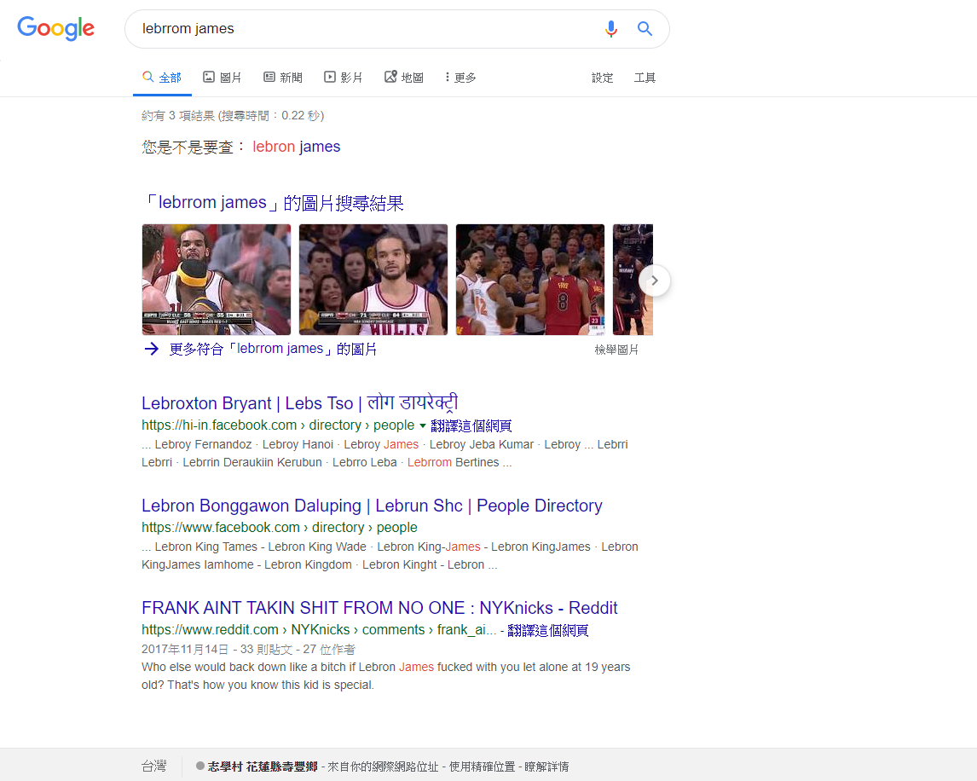

Slide 49
SOUNDEX

Slide 50
Soundex
Sec. 3.4
Class of heuristics to expand a query into phonetic equivalents
  Language specific – mainly for names
  E.g., chebyshev → tchebycheff
Invented for the U.S. census … in 1918

Slide 51
Soundex – typical algorithm
Sec. 3.4
Turn every token to be indexed into a 4-character reduced form
Do the same with query terms
Build and search an index on the reduced forms
  (when the query calls for a soundex match)
http://www.creativyst.com/Doc/Articles/SoundEx1/SoundEx1.htm#Top

Slide 52
Soundex – typical algorithm
Sec. 3.4
Retain the first letter of the word.
Change all occurrences of the following letters to '0' (zero):
'A', E', 'I', 'O', 'U', 'H', 'W', 'Y'.
Change letters to digits as follows:
B, F, P, V → 1
C, G, J, K, Q, S, X, Z → 2
D,T → 3
L → 4
M, N → 5
R → 6

Slide 53
Soundex continued
Sec. 3.4
Remove all pairs of consecutive digits.
Remove all zeros from the resulting string.
Pad the resulting string with trailing zeros and return the first four positions, which will be of the form <uppercase letter> <digit> <digit> <digit>.
E.g., Herman becomes H655.
Will hermann generate the same code?

Slide 54
Soundex
Sec. 3.4
Soundex is the classic algorithm, provided by most databases (Oracle, Microsoft, …)
How useful is soundex?
  Not very – for information retrieval
  Okay for “high recall” tasks (e.g., Interpol), though biased to names of certain nationalities

Slide 55
Exercise
What are the soundex codes of
  Liguannling
  Leekuanling

Slide 56
What queries can we process?
We have
  Wild-card index
  Spell-correction
  Soundex

Slide 57
Resources
Sec. 3.5
Efficient spell retrieval:
  K. Kukich. Techniques for automatically correcting words in text. ACM Computing Surveys 24(4), Dec 1992.
  J. Zobel and P. Dart. Finding approximate matches in large lexicons. Software - practice and experience 25(3), March 1995. http://citeseer.ist.psu.edu/zobel95finding.html
  Mikael Tillenius: Efficient Generation and Ranking of Spelling Error Corrections. Master’s thesis at Sweden’s Royal Institute of Technology. http://citeseer.ist.psu.edu/179155.html
Nice, easy reading on spell correction:
  Peter Norvig: How to write a spelling corrector
  http://norvig.com/spell-correct.html

Slide 58
Appendix

Slide 59
Dynamic Programming Algorithm
Problem:
  Find The Edit Distance Between Two Strings
Solutions:
  Brute Force – O(K^{N})
  Greedy – No Optimal Algorithms yet
  Divide & Conquer – None discovered yet
  Dynamic Programming – O(N²)

Slide 60
Edit Distance
How many edits are needed to exactly match the Target with the Pattern
Target: TCGACGTCA
Pattern: TGACGTGC

Slide 61
Edit Distance
How many edits are needed to exactly match the Target with the Pattern
Target: TCGACGT CA
Pattern: T GACGTGC
Three:
  By Deleting C and A from the target, and by Deleting G from the Pattern

Slide 62
Edit Distance
Applications:
  Approximate String Matching
  Spell checking
  Google – finding similar word variations
  DNA sequence comparison
  Pattern Recognition

Slide 63
Edit Distance – Dynamic Programming
T
C
G
A
Optimal edit distance for
TG and TCG
C
G
T
C
A
0
1
2
3
4
5
6
7
8
9
T
1
0
1
2
3
4
5
6
7
8
Optimal edit distance for
TG and TCGA
G
2
1
2
1
2
3
4
5
6
7
A
3
2
3
2
1
2
3
4
5
6
C
4
3
2
3
2
1
2
Optimal edit distance for TGA and TCGA
3
4
5
Optimal edit distance for
TGA and TCG
G
5
4
3
2
3
2
1
2
3
4
T
6
5
4
3
4
3
2
1
2
3
Final Answer
G
7
6
5
4
5
4
3
2
3
4
C
8
7
6
5
6
5
5
3
2
3

Slide 64
Edit Distance
int matrix[n+1][m+1];
for (x = 0; x <= n; x++) matrix[x][0] = x;
for (y = 1; y <= m; y++) matrix [0][y] = y;
for (x = 1; x <= n; x++)
for (y = 1; y <= m; y++)
if (seq1[x] == seq2[y])
matrix[x][y] = matrix[x-1][y-1];
else
matrix[x][y] = max(matrix[x][y-1] + 1,
matrix[x-1][y] + 1);
return matrix[n][m];
0
1
2
3
4
5
6
7
8
9
1
0
1
2
3
4
5
6
7
8
2
1
2
1
2
3
4
5
6
7
3
2
3
2
1
2
3
4
5
6
4
3
2
3
2
1
2
3
4
5
5
4
3
2
3
2
1
2
3
4
6
5
4
3
4
3
2
1
2
3
7
6
5
4
5
4
3
2
3
4
8
7
6
5
6
5
5
3
2
3

Slide 65
Edit Distance
How many times is this assignment performed?
How many times is this assignment performed?
int matrix[n+1][m+1];
for (x = 0; x <= n; x++) matrix[x][0] = x;
for (y = 0; y <= m; y++) matrix [0][y] = y;
for (x = 1; x <= n; x++)
for (y = 1; y <= m; y++)
if (seq1[x] == seq2[y])
matrix[x][y] = matrix[x-1][y-1];
else
matrix[x][y] = min(matrix[x][y-1] + 1,
matrix[x-1][y] + 1);
return matrix[n][m];
How many times is this comparison performed?
How many times is this assignment performed?

Slide 66
Edit Distance – Dynamic Programming
To derive this value 5,
we need to know that
we can match two G’s after already matching two C’s and previously matching two T’s
In the worst case,
this may take n comparisons
T
C
G
A
C
G
T
C
A
0
1
2
3
4
5
6
7
8
9
T
1
0
1
2
3
4
5
6
7
8
G
2
1
2
1
2
3
4
5
6
7
To derive the value 7,
we need to know that we can match two T’s
A
3
2
3
2
1
2
3
4
5
6
C
4
3
2
3
2
1
2
3
4
5
n=8
G
5
4
3
2
3
2
1
2
3
4
To derive the value 6,
we need to know that we can match two C’s after matching two T’s
T
6
5
4
3
4
3
2
1
2
3
G
7
6
5
4
5
4
3
2
3
4
C
8
7
6
5
6
5
5
3
2
3

Slide 67
Edit Distance – Dynamic Programming
T
C
G
A
C
G
T
C
A
0
1
2
3
4
5
6
7
8
9
T
1
0
1
2
3
4
5
6
7
8
Luckily, we can match these two C’s
But now we’ve matched the last symbol
We can’t do any more matching (period!)
G
2
1
2
1
2
3
4
5
6
7
A
3
2
3
2
1
2
3
4
5
6
C
4
3
Given our previous matches,
there is no way we can match two A’s
Thus, the edit distance is increased
2
3
2
1
2
3
4
5
G
5
4
3
2
3
2
1
2
3
4
T
6
5
4
3
4
3
2
1
2
3
G
7
6
5
4
5
4
3
2
3
4
C
8
7
6
5
6
5
5
3
2
3

