Slide 1
Plan
Last lecture:
  Dictionary data structures
  Tolerant retrieval
    Wildcards
    Spell correction
    Soundex
This time:
  Index construction
a-hu
hy-m
n-z
$m
mace
madden
mo
among
amortize
on
abandon
among

Slide 2
Index construction
How do we construct an index?
What strategies can we use with limited main memory?

Slide 3
Hardware basics
Many design decisions in information retrieval are based on the characteristics of hardware
We begin by reviewing hardware basics

Slide 4
Hardware basics
Access to data in memory is much faster than access to data on disk.
Disk seeks: No data is transferred from disk while the disk head is being positioned.
Therefore: Transferring one large chunk of data from disk to memory is faster than transferring many small chunks.
Disk I/O is block-based: Reading and writing of entire blocks (as opposed to smaller chunks).

Slide 5

A Reuters RCV1 document
Sec. 4.2

Slide 6
Reuters RCV1 statistics(part of 1995 and 1996)
Sec. 4.2
symbol statistic value
N documents 800,000
L avg. # tokens per doc 200
M terms (= word types) 400,000
avg. # bytes per term 7.5
T non-positional postings 100,000,000
M
T

Slide 7
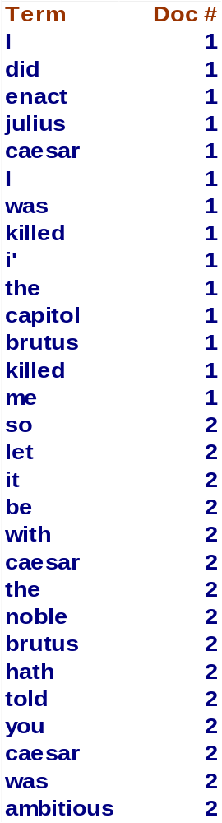
Recall IIR 1 index construction
Sec. 4.2
Documents are parsed to extract words and these are saved with the Document ID.
Doc 1
Doc 2
I did enact Julius
Caesar I was killed
i' the Capitol;
Brutus killed me.
So let it be with
Caesar. The noble
Brutus hath told you
Caesar was ambitious

Slide 8
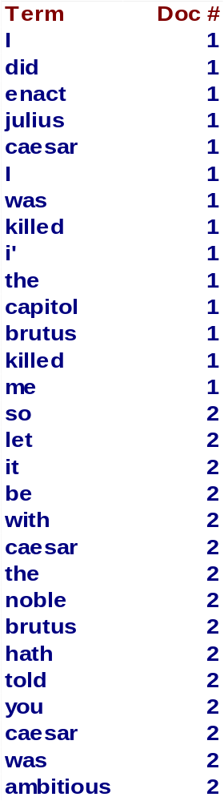
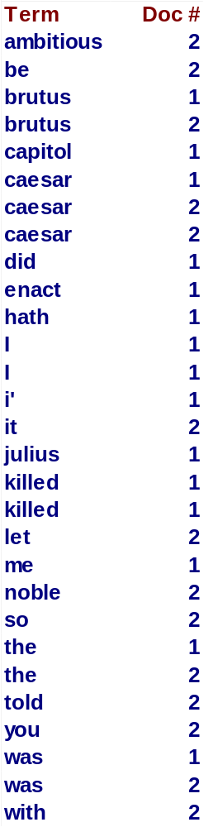
Key step
Sec. 4.2
After all documents have been parsed, the inverted file is sorted by terms.
We focus on this sort step.
We have 100M items to sort.

Slide 9
Sort using disk as “memory”?
Sec. 4.2
At 12 bytes per non-positional postings entry (term, doc, freq), demands a lot of space for large collections.
T = 100,000,000 in the case of RCV1
  we can do this in memory in 2009, but typical collections are much larger
Thus: We need to store intermediate results on disk.
Sorting T = 100,000,000 records on disk is too slow – too many disk seeks.
  external sorting algorithm.
12-byte (4+4+4) records (term, doc, freq).

Slide 10
Term | Term id
a | 1
abandon | 2
above | 3
back | 4
… | …
100M
to d1
be d1
or d1
not d1
to d1
be d1
not d2
to d2
…
Assume
termid 4bytes
token 24bytes
docid 4 bytes
freq 4 bytes
Bock 512 bytes
(term id, doc id, freq) 100M/(512/12) ≅2.4M
(term, doc id, freq) 100M/(512/32) ≅ 6.25M
symbol statistic value
N documents 800,000
L avg. # tokens per doc 200
M terms (= word types) 400,000
avg. # bytes per term 7.5
T non-positional postings 100,000,000

Slide 11
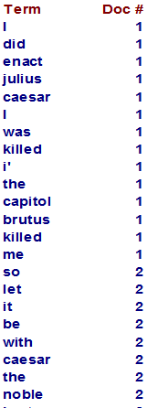
Bottleneck
Sec. 4.2
Parse and build postings entries one doc at a time
Now sort postings entries by term (then by doc within each term)
Doing this with random disk seeks would be too slow – must sort T=100M records
If every comparison took 2 disk seeks, and N items could be
sorted with N log₂N comparisons, how long would this take?
2*100M*log₂100M
≅5.3G disk seek !!

Slide 12
External Sorting
Notes:
1
The slides for this text are organized into chapters. This lecture covers Chapter 13, and discusses external sorting. Sorting is one of the most frequent database operations, and is optimized for I/O costs, leading to some interesting differences with in-memory sorting.
It should be covered after Chapter 8, which provides an overview of storage and indexing. At the instructor’s discretion, it can also be omitted without loss of continuity in other parts of the text. (In particular, Chapter 20 can be covered without covering this chapter.)
This chapter is most appropriate for a course with an implementation emphasis, and we suggest omitting it in a course with an applications emphasis.

Slide 13
Using secondary storage effectively
General Wisdom :
  I/O costs dominate
  Design algorithms to reduce I/O

Slide 14
Overview on Merge-Sort
Merge : Merge two sorted lists and repeatedly choose the smaller of the two “heads” of the lists
Merge Sort: Divide records into two parts; merge-sort those recursively, and then merge the lists.
81
94
11
96
12
35
17
99
81
94
11
96
12
35
17
99
Can recursively divide again and again
Sort
Sort
11
81
94
96
12
17
35
99

Slide 15
Overview on Merge-Sort (Cont’d)
Merge : Merge two sorted lists and repeatedly choose the smaller of the two “heads” of the lists
81
94
11
96
12
35
17
99
81
94
11
96
12
35
17
99
Can recursively divide again and again
Sort
Sort
11
81
94
96
12
17
35
99
Merge
11
12
17
35
81
94
96
99

Slide 16
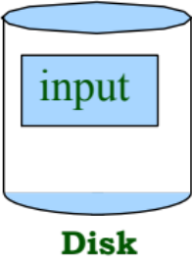

2-Way Sort: Requires 3 Buffers
Phase 1: PREPARE.
  Read a page, sort it, write it.
  only one buffer page is used
Phase 2, 3, …, etc.: MERGE:
  Three buffer pages used.
Main memory
1 buffer
INPUT 1
1 buffer
1 buffer
OUTPUT
INPUT 2
Main memory buffers
Disk
Disk
Notes:
5

Slide 17
Two-Way External Merge Sort
Idea: Divide and conquer: sort subfiles and merge into larger sorts
3,4
6,2
9,4
8,7
5,6
3,1
2
Input file
PASS 0
3,4
2,6
4,9
7,8
5,6
1,3
2
1-page runs
PASS 1
2,3
4,7
1,3
2-page runs
4,6
8,9
5,6
2
PASS 2
2,3
4,4
1,2
4-page runs
Pass 0 ➔ Only one memory block is needed
6,7
3,5
8,9
6
PASS 3
1,2
Pass I > 0 ➔ Only three memory blocks are needed
2,3
3,4
8-page runs
4,5
6,6
7,8
9
Notes:
6

Slide 18
Two-Way External Merge Sort
3,4
6,2
9,4
8,7
5,6
3,1
2
Input file
PASS 0
Costs for one pass:
all pages
# of passes :
height of tree
Total cost :
product of above
3,4
2,6
4,9
7,8
5,6
1,3
2
1-page runs
PASS 1
2,3
4,7
1,3
2-page runs
4,6
8,9
5,6
2
PASS 2
2,3
4,4
1,2
4-page runs
6,7
3,5
8,9
6
PASS 3
1,2
2,3
Notice: We ignored the CPU cost to sort a block in memory or merge two blocks
3,4
8-page runs
4,5
6,6
7,8
9
Notes:
6

Slide 19
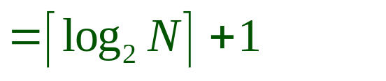
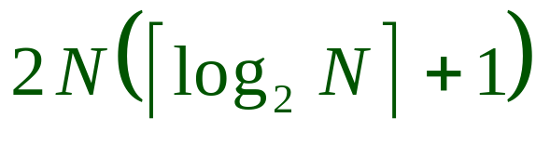
Two-Way External Merge Sort
Each pass we read + write each page in file.
N pages in file => 2N
Number of passes
So total cost is:
3,4
6,2
9,4
8,7
5,6
3,1
2
Input file
PASS 0
3,4
2,6
4,9
7,8
5,6
1,3
2
1-page runs
PASS 1
2,3
4,7
1,3
2-page runs
4,6
8,9
5,6
2
PASS 2
2,3
4,4
1,2
4-page runs
6,7
3,5
8,9
6
PASS 3
1,2
2,3
3,4
8-page runs
4,5
6,6
7,8
9
Notes:
6

Slide 20
External Merge Sort
What if we had more buffer pages?
How do we utilize them wisely ?
-→ Two main ideas !
Notes:
7

Slide 21
Phase 1 : Prepare
INPUT 1
. . .
INPUT 2
. . .
INPUT B
Disk
Disk
B Main memory buffers
Construct as large as possible starter lists.
➔ Will reduce the number of needed passes
Notes:
7

Slide 22
Phase 2 : Merge
INPUT 1
. . .
INPUT 2
. . .
OUTPUT
INPUT B-1
Disk
Disk
B Main memory buffers
Merge as many sorted sublists into one long sorted list.
Keep 1 buffer for the output
Use B-1 buffers to read from B-1 lists
Notes:
7

Slide 23
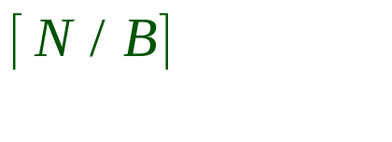
General External Merge Sort
How can we utilize more than 3 buffer pages?
To sort a file with N pages using B buffer pages:
  Pass 0: use B buffer pages. Produce sorted runs of B pages each.
  Pass 1, 2, …, etc.: merge B-1 runs.
INPUT 1
. . .
INPUT 2
. . .
. . .
OUTPUT
INPUT B-1
Disk
Disk
B Main memory buffers
Notes:
7

Slide 24
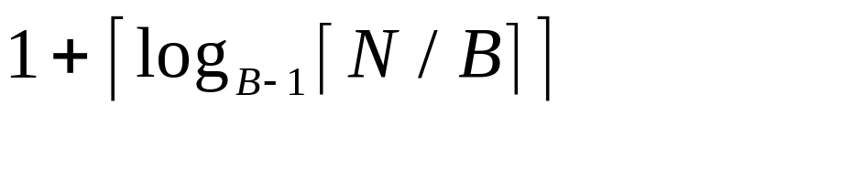
Cost of External Merge Sort
Number of passes:
Cost = 2N * (# of passes)
Notes:
8

Slide 25
Exercise
Buffer : with 5 buffer pages
File to sort : 108 pages
  Pass 0:
    Size of each run?
    Number of runs?
  Pass 1:
    Size of each run?
    Number of runs?
  Pass 2: ???
Notes:
8

Slide 26
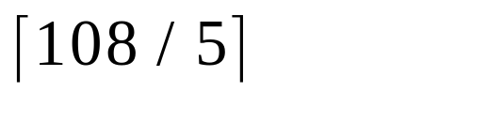
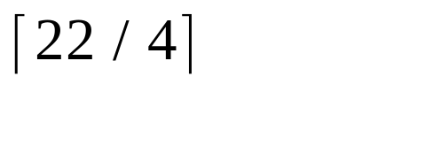
Exercise
Buffer : with 5 buffer pages
File to sort : 108 pages
  Pass 0: = 22 sorted runs of 5 pages each (last run is only 3 pages)
  Pass 1: = 6 sorted runs of 20 pages each (last run is only 8 pages)
  Pass 2: 2 sorted runs, 80 pages and 28 pages
  Pass 3: Sorted file of 108 pages
Total I/O costs: 2*N * (4 passes)
Notes:
8

Slide 27
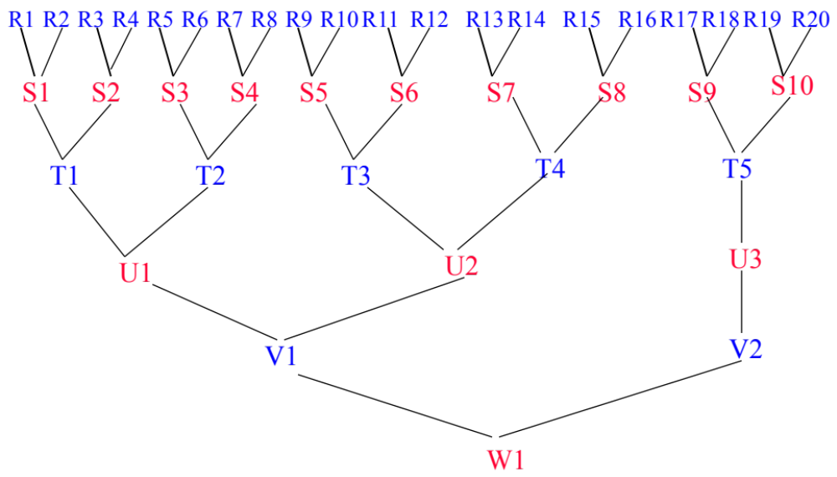
Example: 2-Way Merge for 20 Runs
Number of passes = 5 +1(initial pass)

Slide 28
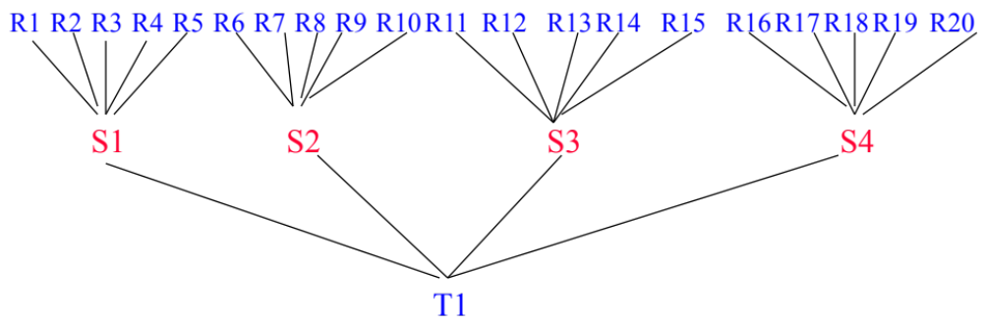
Example: 5-Way Merge for 20 Runs
Number of passes = 2
+1(initial pass)

Slide 29
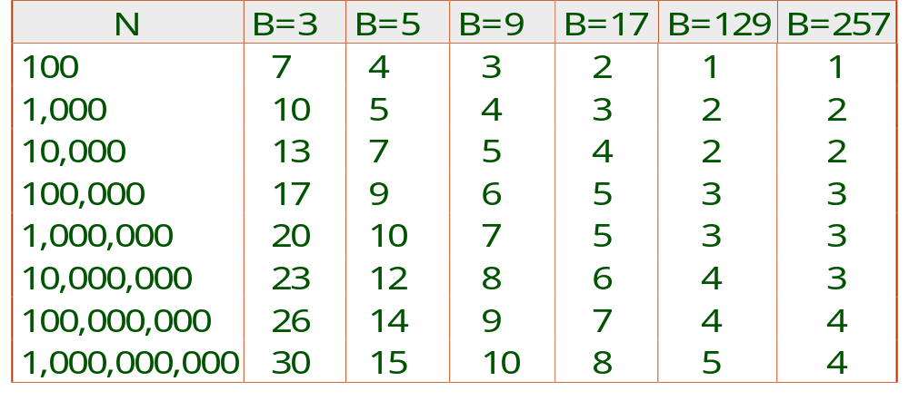
Number of Passes of External Sort
gain of utilizing all available buffers
importance of a high fan-in during merging
#Buffers available in main-memory
#Pages in File
Notes:
9

Slide 30
BSBI: Blocked sort-based Indexing (Sorting with fewer disk seeks)
Sec. 4.2
12-byte (4+4+4) records (term, doc, freq).
These are generated as we parse docs.
Must now sort 100M such 12-byte records by term.
Define a Block ~ 10M such records
  Can easily fit a couple into memory.
  Will have 10 such blocks to start with.
Basic idea of algorithm:
  Accumulate postings for each block, sort, write to disk.
  Then merge the blocks into one long sorted order.

Slide 31
Sorting 10 blocks of 10M records
Sec. 4.2
First, read each block and sort within:
  Quicksort takes O(N ln N) expected steps
  In our case (10M ln 10M) steps
10 times this estimate – gives us 10 sorted runs of 10M records each.
10M
10

Slide 32
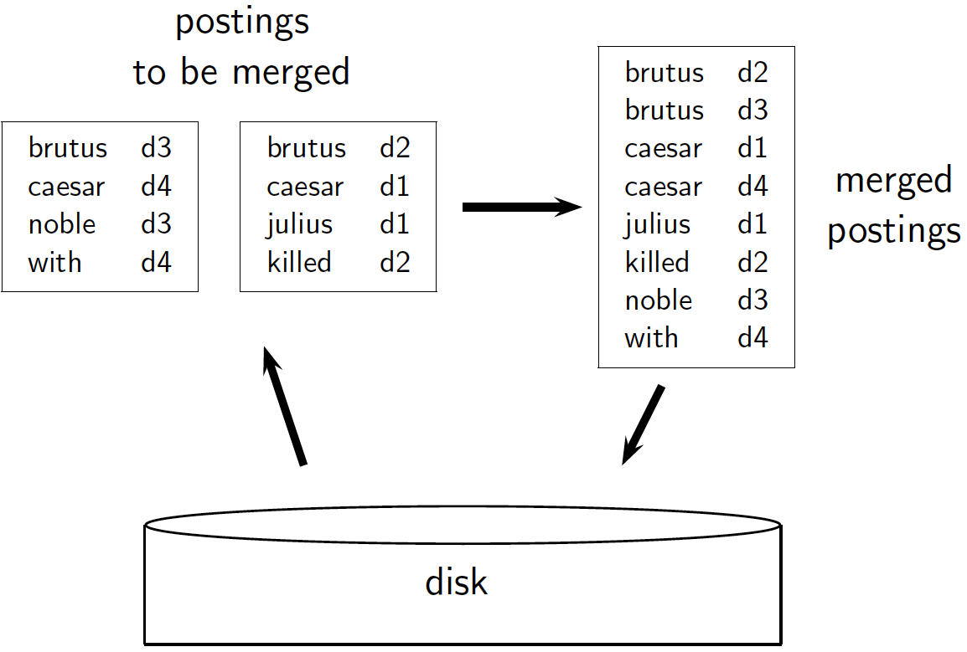
Sec. 4.2

Slide 33
disk
memory
d1: to be or not to be
d2: not to be outdone she try again
d3…
to d1
be d1
or d1
not d1
to d1
be d1
not d2
to d2
read
sort
to 2 | -> | d1 | 2 | d2 | 1
be 2 | -> | d1 | 2 | d2 | 1
or 1 | -> | d1 | 1
not 2 | -> | d1 | 1 | d2 | 1
write

Slide 34
Remaining problem with sort-based algorithm
Sec. 4.3
Our assumption was: we can keep the dictionary in memory.
We need the dictionary (which grows dynamically) in order to implement a term to termID mapping.
  Actually, we could work with term,docID postings instead of termID,docID postings . . .
  but then intermediate files become very large. (We would end up with a scalable, but very slow index construction method.)
12-byte (4+4+4) records (term, doc, freq).

Slide 35
SPIMI:
Single-pass in-memory indexing
Sec. 4.3
Key idea 1: Generate separate dictionaries for each.
Key idea 2: Don’t sort. Accumulate postings in postings lists as they occur.
With these two ideas we can generate a complete inverted index for each block.
These separate indexes can then be merged into one big index.

Slide 36
disk
memory
d1: to be or not to be
d2: not to be outdone she try again
d3…
to | -> | d1 | 2 | d2 | 1
be | -> | d1 | 2 | d2 | 1
or | -> | d1 | 1
not | -> | d1 | 1 | d2 | 1
read
full ->sort
be | -> | d1 | 2 | d2 | 1
not | -> | d1 | 1 | d2 | 1
or | -> | d1 | 1
to | -> | d1 | 2 | d2 | 1
write
Finally, merge the separate indexes into one big index

Slide 37
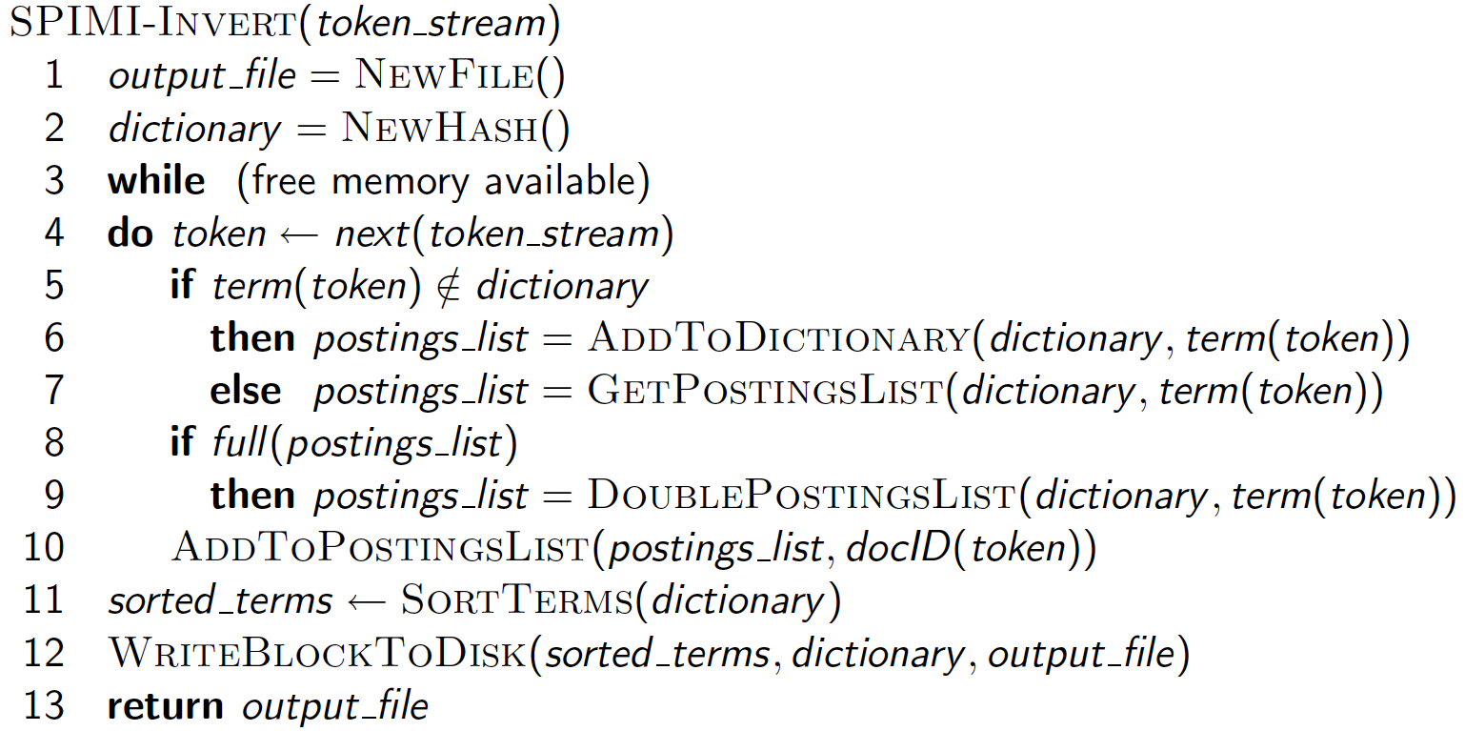
SPIMI-Invert
Sec. 4.3
Merging of blocks is analogous to BSBI.

Slide 38
Distributed indexing
Sec. 4.4
For web-scale indexing (don’t try this at home!):
  must use a distributed computing cluster
Maintain a master machine directing the indexing job – considered “safe”.
Break up indexing into sets of (parallel) tasks.
Master machine assigns each task to an idle machine from a pool.

Slide 39
Parallel tasks
Sec. 4.4
We will use two sets of parallel tasks
  Parsers
  Inverters
Break the input document collection into splits
Each split is a subset of documents (corresponding to blocks in BSBI/SPIMI)

Slide 40
Data flow
Sec. 4.4
assign
Master
assign
Postings
Parser
a-f
g-p
q-z
Inverter
a-f
Parser
a-f
g-p
q-z
Inverter
g-p
splits
Inverter
q-z
Parser
a-f
g-p
q-z
Map
phase
Reduce
phase
Segment files

Slide 41
MapReduce
Sec. 4.4
Index construction was just one phase.
Another phase: transforming a term-partitioned index into a document-partitioned index.
  Term-partitioned: one machine handles a subrange of terms
  Document-partitioned: one machine handles a subrange of documents
Most search engines use a document-partitioned index … better load balancing.
d_{1~k}
d_{k+1~m}
d_{m+1~z}

Slide 42
Dynamic indexing
Sec. 4.5
Up to now, we have assumed that collections are static.
They rarely are:
  Documents come in over time and need to be inserted.
  Documents are deleted and modified.
This means that the dictionary and postings lists have to be modified:
  Postings updates for terms already in dictionary
  New terms added to dictionary

Slide 43
Simplest approach
Sec. 4.5
Maintain “big” main index
New docs go into “small” auxiliary index
Search across both, merge results
Deletions
  Invalidation bit-vector for deleted docs
  Filter docs output on a search result by this invalidation bit-vector
Periodically, re-index into one main index
Problem of frequent merges?

Slide 44
Logarithmic merge
Sec. 4.5
Maintain a series of indexes, each twice as large as the previous one
  At any time, some of these powers of 2 are instantiated
Keep smallest (Z₀) in memory
Larger ones (I₀, I₁, …) on disk
If Z₀ gets too big (> n), write to disk as I₀
or merge with I₀ (if I₀ already exists) as Z₁
Either write merge Z₁ to disk as I₁ (if no I₁)
Or merge with I₁ to form Z₂

Slide 45
memory | disk
Z₀
 | l₀
Z₀ | l₀
 | l₁ (Z₀+l₀)
Z₀ | l₁
 | l₀ l₁
Z₀ | l₀ l₁
 | l₂ (Z₀+l₀->Z₁, Z₁+l₁->l₂)
Z₀ | l₂
 | l₀ l₂
Z₀ | l₀ l₂
 | l₁ l₂ (Z₀+l₀->l₁)
Z₀ | l₁ l₂
 | l₀ l₁ l₂
Z₀ gets too big
Z₀ gets too big
|Z₀|=|l₀|
|l₁|=2|l₀|
|l₂|=2|l₁|
Z₀ gets too big
Z₀ gets too big
Z₀ gets too big
Z₀ gets too big
Z₀ gets too big

Slide 46
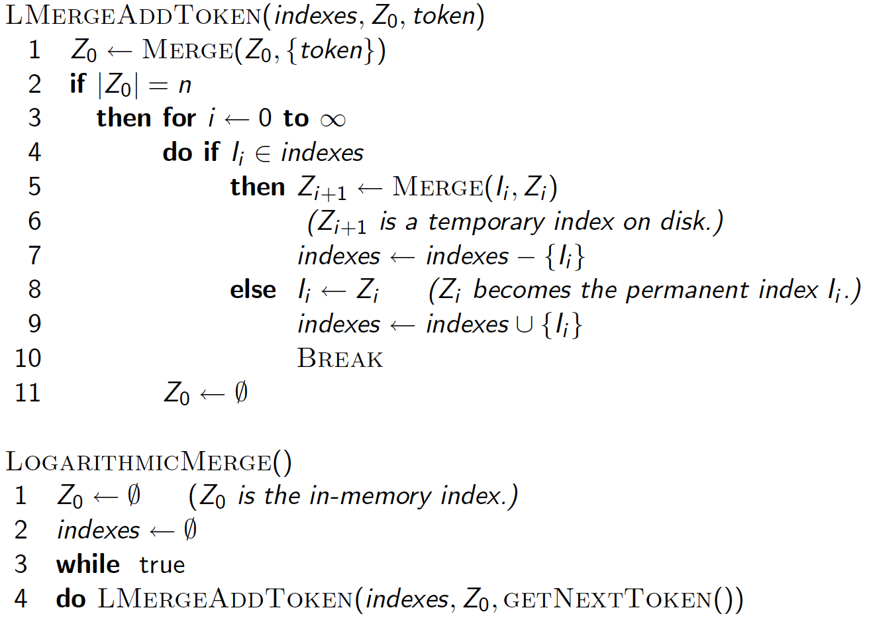
Sec. 4.5

Slide 47
Exercise
For n=2 (size of Z₀) and 1<=T<=16 (number of tokens), perform a step-by-step simulation of logarithmic merging. Create a table that shows, for each point in time at which T=2*tokens have been processed (1<=k<=8), which of the four indexes I₀, I₁, I₂，I₃ are in used. T first three lines of the table are given below.
 | I₃ | I₂ | I₁ | I₀
2 | 0 | 0 | 0 | 0
4 | 0 | 0 | 0 | 1
6 | 0 | 0 | 1 | 0

Slide 48
Logarithmic merge
Sec. 4.5
Auxiliary and main index: index construction time is O(T²) as each posting is touched in each merge.
Logarithmic merge: Each posting is merged O(log T) times, so complexity is O(T log T)
So logarithmic merge is much more efficient for index construction
But query processing now requires the merging of O(log T) indexes
  Whereas it is O(1) if you just have a main and auxiliary index

Slide 49
Further issues with multiple indexes
Sec. 4.5
Collection-wide statistics are hard to maintain
E.g., when we spoke of spell-correction: which of several corrected alternatives do we present to the user?
  We said, pick the one with the most hits
How do we maintain the top ones with multiple indexes and invalidation bit vectors?
  One possibility: ignore everything but the main index for such ordering

Slide 50
Dynamic indexing at search engines
Sec. 4.5
All the large search engines now do dynamic indexing
Their indices have frequent incremental changes
  News items, blogs, new topical web pages
    Sarah Palin, …
They also periodically reconstruct the index
  Query processing is then switched to the new index, and the old index is deleted

Slide 51
Other sorts of indexes
Sec. 4.5
Positional indexes
  Same sort of sorting problem … just larger
Building character n-gram indexes:
  As text is parsed, enumerate n-grams.
  For each n-gram, need pointers to all dictionary terms containing it – the “postings”.
  Note that the same “postings entry” will arise repeatedly in parsing the docs – need efficient hashing to keep track of this.
    E.g., that the trigram lie occurs in the term Hualien will be discovered on each text occurrence of Hualien
    Only need to process each term once

