Slide 1
Index conpression
Last lecture
  Index construction
    Doing sorting with limited main memory
    Parallel and distributed indexing
Today
  Index compression
    Space estimation
    Dictionary compression
    Postings compression

Slide 2
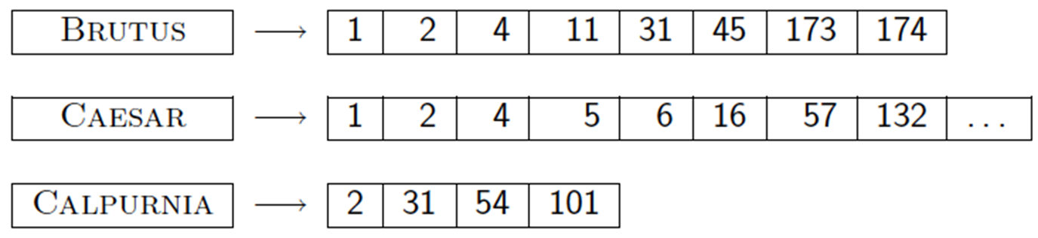
Index compression
Dictionary compression
Postings compression

Slide 3
Why compression (in general)?
Ch. 5
Use less disk space
  Saves a little money
Keep more stuff in memory
  Increases speed
Increase speed of data transfer from disk to memory
  [read compressed data | decompress] is faster than [read uncompressed data]
  Premise: Decompression algorithms are fast
    True of the decompression algorithms we use

Slide 4
Why compression for inverted indexes?
Ch. 5
Dictionary
  Make it small enough to keep in main memory
  Make it so small that you can keep some postings lists in main memory too
Postings file(s)
  Reduce disk space needed
  Decrease time needed to read postings lists from disk
  Large search engines keep a significant part of the postings in memory.
    Compression lets you keep more in memory
We will devise various IR-specific compression schemes

Slide 5
Recall Reuters RCV1
Sec. 5.1
symbol statistic value
N documents 800,000
L avg. # tokens per doc 200
M terms (= word types) ~400,000
avg. # bytes per term 7.5
non-positional postings 100,000,000

Slide 6
Index parameters vs. what we index (details IIR Table 5.1, p.80)
Sec. 5.1
size of | word types (terms) |  |  | non-positional postings |  |  | positional postings
 | dictionary |  |  | non-positional index |  |  | positional index
 | Size (K) | ∆% | cumul % | Size (K) | ∆ % | cumul % | Size (K) | ∆ % | cumul %
Unfiltered | 484 |  |  | 109,971 |  |  | 197,879
No numbers | 474 | -2 | -2 | 100,680 | -8 | -8 | 179,158 | -9 | -9
Case folding | 392 | -17 | -19 | 96,969 | -3 | -12 | 179,158 | 0 | -9
30 stopwords | 391 | -0 | -19 | 83,390 | -14 | -24 | 121,858 | -31 | -38
150 stopwords | 391 | -0 | -19 | 67,002 | -30 | -39 | 94,517 | -47 | -52
stemming | 322 | -17 | -33 | 63,812 | -4 | -42 | 94,517 | 0 | -52
Exercise: give intuitions for all the ‘0’ entries. Why do some zero entries correspond to big deltas in other columns?

Slide 7
Lossless vs. lossy compression
Sec. 5.1
Lossless compression: All information is preserved.
Lossy compression: Discard some information
  Several of the preprocessing steps can be viewed as lossy compression:
    case folding, stop words, stemming, number elimination.
Chap/Lecture 7: Prune postings entries that are unlikely to turn up in the top k list for any query.
  Almost no loss quality for top k list.

Slide 8
Vocabulary vs. collection size
Sec. 5.1
How big is the term vocabulary?
  That is, how many distinct words are there?
In practice, the vocabulary will keep growing with the collection size
Notes:
Also - the calculation "At least 7020 = 1037 different words of length 20" seems like a bit of a gross overestimate (and in any case, might be more useful to say it's 2 raised to some power rather than 10 raised to the power 37)

Slide 9
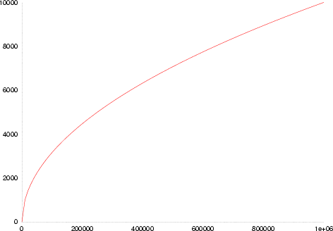
Vocabulary vs. collection size
Sec. 5.1
Heaps’ law: M = kT^{b}
M is the size of the vocabulary, T is the number of tokens in the collection
Typical values: 30 ≤ k ≤ 100 and b ≈ 0.5
An empirical finding (“empirical law”)
Depends on the collection
(1) The dictionary size continues to increase with more documents in the collection
(2) The size of the dictionary is quite large for large collections

Slide 10
Zipf’s law
Sec. 5.1
Brown corpus
the : 69971, of: 36411, and: 28852
6 : 3 : 2
Heaps’ law gives the vocabulary size in collections.
We also study the relative frequencies of terms.
In natural language, there are a few very frequent terms and very many very rare terms.
Zipf’s law: The ith most frequent term has frequency proportional to 1/i .
cf_{i} ∝ 1/i = K/i where K is a normalizing constant
  cf_{i} is collection frequency: the number of occurrences of the term t_{i} in the collection.

Slide 11
Zipf’s law
If the most frequent term (the) occurs cf₁ times,
  the second most frequent term (of) has half as many occurrences etc.
  he third most frequent term (and) has a third as many occurrences etc.
Equivalent: cf _{i} = ci ^{k} or log cf _{i} = log c + k log i (for k = −1)

Slide 12
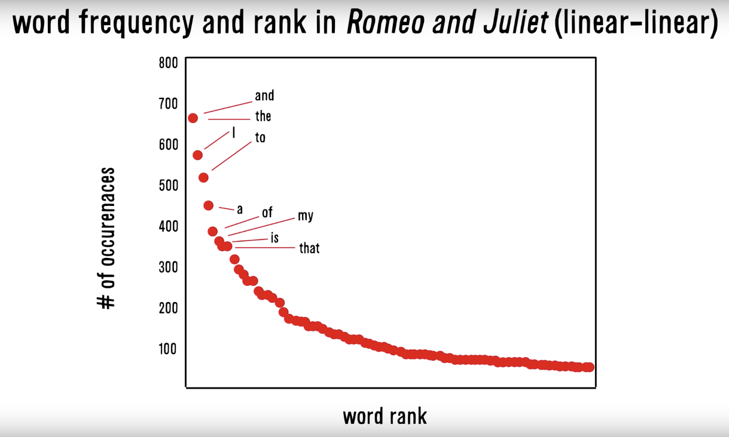
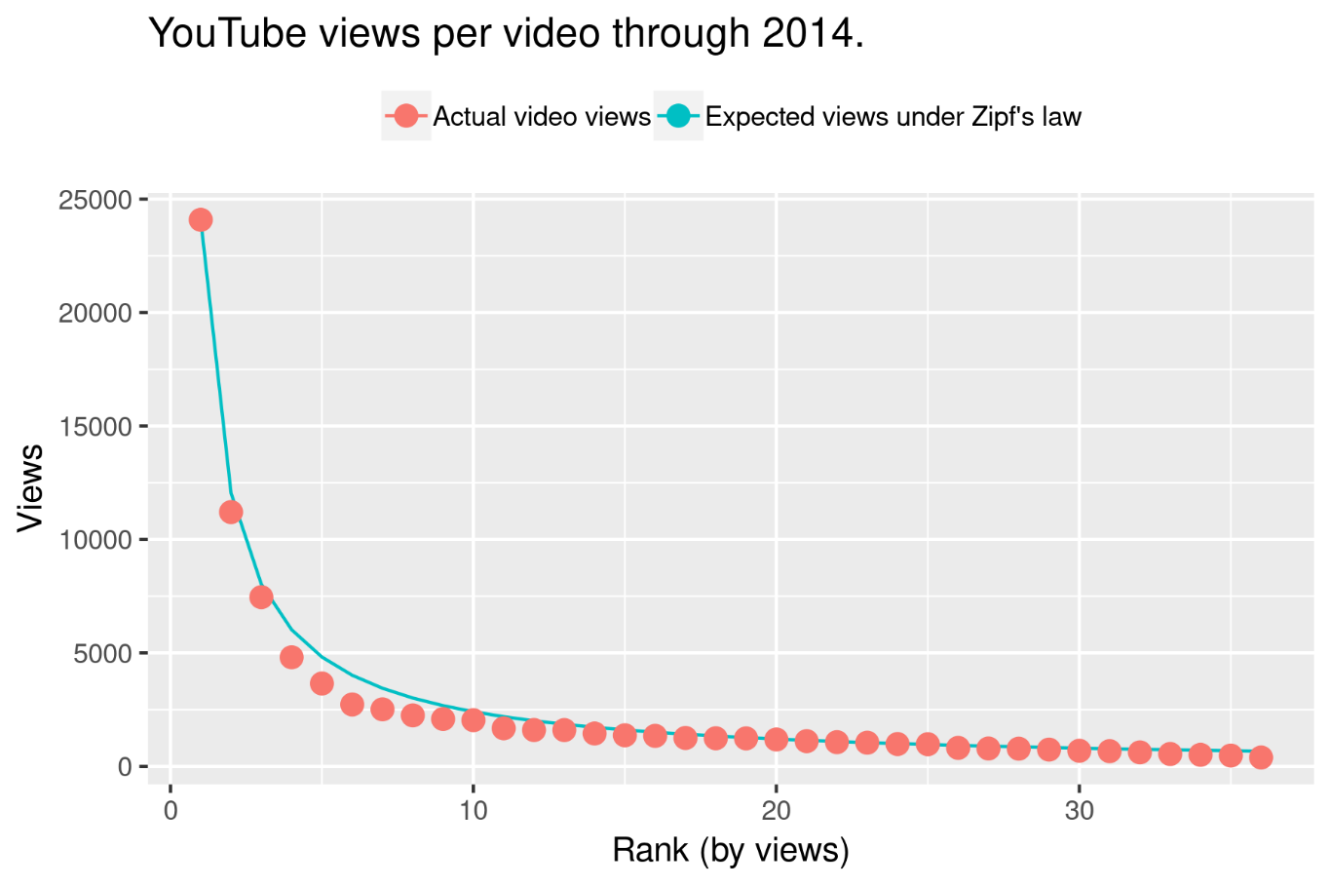

Slide 13
DICTIONARY COMPRESSION
Sec. 5.2

Slide 14
Why compress the dictionary?
Sec. 5.2
Search begins with the dictionary
We want to keep it in memory
Even if the dictionary isn’t in memory, we want it to be small for a fast search startup time
So, compressing the dictionary is important

Slide 15
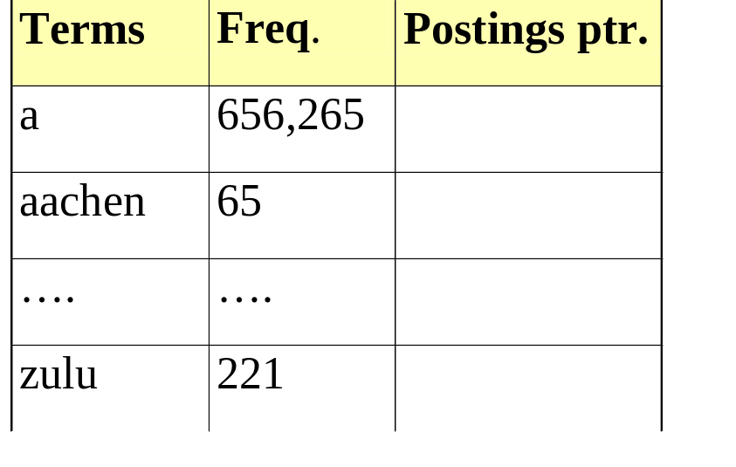
Dictionary storage - first cut
Sec. 5.2
Array of fixed-width entries
  ~400,000 terms; 28 bytes/term = 11.2 MB.
Dictionary search
structure
20 bytes
4 bytes each

Slide 16
Fixed-width terms are wasteful
Sec. 5.2
Most of the bytes in the Term column are wasted
  we allot 20 bytes for 1 letter terms.
  And we still can’t handle supercalifragilisticexpialidocious or hydrochlorofluorocarbons.
Written English averages ~4.5 characters/word.
  Exercise: Why is/isn’t this the number to use for estimating the dictionary size?
Ave. dictionary word in English: ~8 characters
  How do we use ~8 characters per dictionary term?
Short words dominate token counts but not type average.

Slide 17
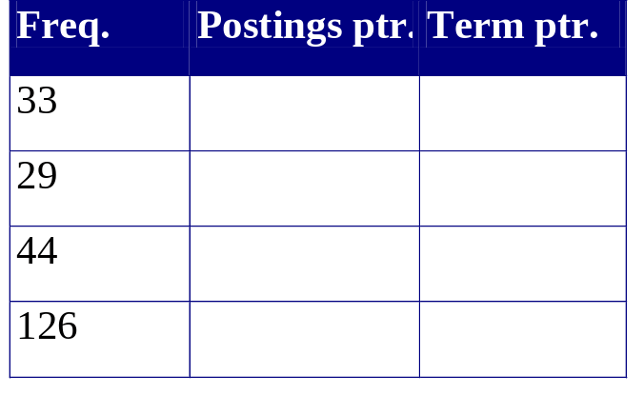
Compressing the term list:
Dictionary-as-a-String
Sec. 5.2
Store dictionary as a (long) string of characters:
  Pointer to next word shows end of current word
….systilesyzygeticsyzygialsyzygyszaibelyiteszczecinszomo….
Total string length =
400K x 8B = 3.2MB
Pointers resolve 3.2M
positions: log₂3.2M =
22bits = 3bytes

Slide 18
Space for dictionary as a string
Sec. 5.2
4 bytes per term for Freq.
4 bytes per term for pointer to Postings.
3 bytes per term pointer
Avg. 8 bytes per term in term string
400K terms x 19 ⇒ 7.6 MB (against 11.2MB for fixed width)
⎫ Now avg. 11
⎬ bytes/term,
⎭ not 20.

Slide 19
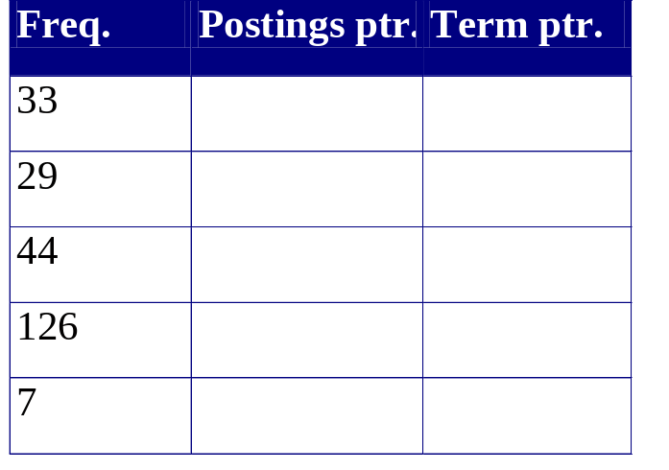
Blocking
Sec. 5.2
Store pointers to every kth term string.
  Example below: k=4.
Need to store term lengths (1 extra byte)
….7systile9syzygetic8syzygial6syzygy11szaibelyite8szczecin9szomo….
⎫ Save 9 bytes
⎬ on 3
⎭ pointers.
Lose 4 bytes on
term lengths.

Slide 20
Net
Sec. 5.2
Example for block size k = 4
Where we used 3 bytes/pointer without blocking
  3 x 4 = 12 bytes,
now we use 3 + 4 = 7 bytes.
pointer
integer
Shaved another ~0.5MB. ((400k/4)*(12-7))
This reduces the size of the dictionary from 7.6 MB to 7.1MB.
We can save more with larger k.
Why not go with larger k?

Slide 21
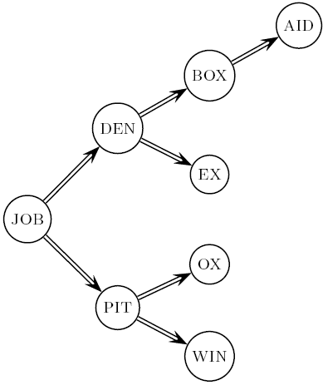
Dictionary search without blocking
Sec. 5.2
Assuming each dictionary term equally likely in query (not really so in practice!), average number of comparisons = (1+2∙2+4∙3+4)/8 ~2.6

Slide 22
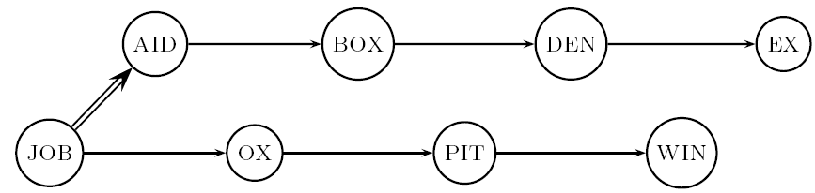
Dictionary search with blocking
Sec. 5.2
Binary search down to 4-term block;
  Then linear search through terms in block.
Blocks of 4 (binary tree), avg. = (1+2∙2+2∙3+2∙4+5)/8 = 3 compares

Slide 23
Front coding
Sec. 5.2
Front-coding:
  Sorted words commonly have long common prefix – store differences only
  (for last k-1 in a block of k)
  8automata8automate9automatic10automation
→8automat*a1◊e2◊ic3◊ion
Encodes automat
Extra length
beyond automat.
Begins to resemble general string compression.

Slide 24
RCV1 dictionary compression summary
Sec. 5.2
Technique | Size in MB
Fixed width | 11.2
Dictionary-as-String with pointers to every term | 7.6
Also, blocking k = 4 | 7.1
Also, Blocking + front coding | 5.9

Slide 25
POSTINGS COMPRESSION
Sec. 5.3

Slide 26
Postings compression
Sec. 5.3
The postings file is much larger than the dictionary, factor of at least 10.
A posting for our purposes is a docID.
For Reuters (800,000 documents), we would use 32 bits per docID when using 4-byte integers.
Alternatively, we can use log₂ 800,000 ≈ 20 bits per docID.
Our goal: use far fewer than 20 bits per docID.

Slide 27
Postings
Sec. 5.3
A term like arachnocentric occurs in maybe one doc out of a million – we would like to store this posting using log₂ 1M ~ 20 bits.
A term like the occurs in virtually every doc, so 20 bits/posting is too expensive.
  Prefer 0/1 bitmap vector in this case

Slide 28
Postings file entry
Sec. 5.3
We store the list of docs containing a term in increasing order of docID.
  computer: 33,47,154,159,202 …
Consequence: it suffices to store gaps.
  33,14,107,5,43 …
Hope: most gaps can be encoded/stored with far fewer than 20 bits.

Slide 29
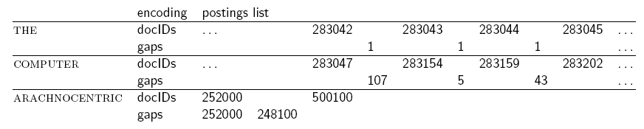
Three postings entries
Sec. 5.3

Slide 30
Variable length encoding
Sec. 5.3
Aim:
  For arachnocentric, we will use ~20 bits/gap entry.
  For the, we will use ~1 bit/gap entry.
Key challenge: encode every integer (gap) with about as few bits as needed for that integer.
This requires a variable length encoding
Variable length codes achieve this by using short codes for small numbers

Slide 31
Variable Byte (VB) codes
Sec. 5.3
For a gap value G, we want to use close to the fewest bytes needed to hold log₂ G bits
Begin with one byte to store G and dedicate 1 bit in it to be a continuation bit c
If G ≤127, binary-encode it in the 7 available bits and set c =1
Else encode G’s lower-order 7 bits and then use additional bytes to encode the higher order bits using the same algorithm
At the end set the continuation bit of the last byte to 1 (c =1) – and for the other bytes c = 0.

Slide 32
Example
Sec. 5.3
1100111000
docIDs | 824 | 829 | 215406
gaps |  | 5 | 214577
VB code | 00000110 10111000 | 10000101 | 00001101 00001100 10110001
Postings stored as the byte concatenation
000001101011100010000101000011010000110010110001
Key property: VB-encoded postings are
uniquely prefix-decodable.
For a small gap (5), VB
uses a whole byte.

Slide 33
Other variable unit codes
Sec. 5.3
Instead of bytes, we can also use a different “unit of alignment”: 32 bits (words), 16 bits, 4 bits (nibbles).
Variable byte alignment wastes space if you have many small gaps – nibbles do better in such cases.
Variable byte codes:
  Used by many commercial/research systems

Slide 34
Exercises
Compute variable byte codes for the postings list <23, 27, 39, 210>. Use gaps instead of docIDs. Write binary codes in 4-bit blocks.
From the following sequence of VB-coded gaps (4-bit blocks), reconstruct first the gap sequence and then the postings sequence.
0010 1011 1110 0100 0010 1011

Slide 35
Unary code
Represent n as n 1s with a final 0.
Unary code for 3 is 1110.
Unary code for 40 is
11111111111111111111111111111111111111110 .
Unary code for 80 is:
111111111111111111111111111111111111111111111111111111111111111111111111111111110
This doesn’t look promising, but….

Slide 36
Gamma codes
Sec. 5.3
We can compress better with bit-level codes
  The Gamma code is the best known of these.
Represent a gap G as a pair length and offset
offset is G in binary, with the leading bit cut off
  For example 13 → 1101 → 101
length is the length of offset
  For 13 (offset 101), this is 3.
We encode length with unary code: 1110.
Gamma code of 13 is the concatenation of length and offset: 1110101

Slide 37
Gamma code examples
Sec. 5.3
number | length | offset | γ-code
0 |  |  | none
1 | 0 |  | 0
2 | 10 | 0 | 10,0
3 | 10 | 1 | 10,1
4 | 110 | 00 | 110,00
9 | 1110 | 001 | 1110,001
13 | 1110 | 101 | 1110,101
24 | 11110 | 1000 | 11110,1000
511 | 111111110 | 11111111 | 111111110,11111111
1025 | 11111111110 | 0000000001 | 11111111110,0000000001

Slide 38
Exercises
Compute γ codes for the postings list <23, 27, 39, 210>. Use gaps instead of docIDs.
From the following sequence of γ−coded (4-bit blocks), reconstruct first the gap sequence and then the postings sequence.
1001110101011001111101101

Slide 39
Gamma code properties
Sec. 5.3
G is encoded using 2 ⎣log G⎦ + 1 bits
  Length of offset is ⎣log G⎦ bits
  Length of length is ⎣log G⎦ + 1 bits
All gamma codes have an odd number of bits
Almost within a factor of 2 of best possible, log₂ G

Slide 40
Gamma code: Properties
Gamma code is prefix-free.
Gamma code is parameter-free.
Encoding is optimal within a factor of 2
  This result is independent of distribution of gaps!
    We can use gamma codes for any distribution.
  Gamma code is universal!
    Within a factor of optimal for an arbitrary distribution

Slide 41
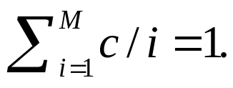
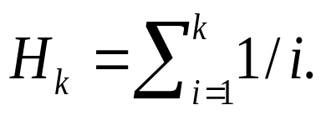
Rough analysis based on Zipf
The i th most frequent term has frequency proportional to 1/i
Let this frequency be c/i.
Then
The k th Harmonic number is
  ln (k+1) < H_{k} <= 1 + ln k.
Thus c = 1/H_{M} , which is ~ 1/(ln M) = 1/ln(400k) ~ 1/13.
So the i th most frequent term has frequency roughly 1/13i.
Notes:
Graph ln x and also use rectangles of area 1/I : Application of integration (area under the curve)

Slide 42
Postings analysis (contd.)
Expected number of occurrences of the i th most frequent term in a doc of length L is:
L*c/i ≈ L/13i ≈ 15/i for L=200.
Let Lc= 15
Then the Lc most frequent terms are likely to occur in every document.
Notes:
Then the most frequent term is likely to occur 76 times??

Slide 43


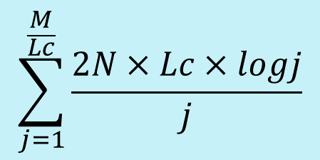
Rows by decreasing frequency
N docs
Lc most
frequent
terms.
2log1+1
N gaps of ‘1’ each.
Lc next most
frequent
terms.
2log2+1
N/2 gaps of ‘2’ each.
Lc next most
frequent
terms.
m
terms
2log3+1
N/3 gaps of ‘3’ each.
etc.

Slide 44

For Reuters-RCV1, M/Lc = 400000/15 =27000
960M -> 224M

Slide 45
Gamma seldom used in practice
Sec. 5.3
Machines have word boundaries – 8, 16, 32, 64 bits
  Operations that cross word boundaries are slower
Compressing and manipulating at the granularity of bits can be slow
Variable byte encoding is aligned and thus potentially more efficient
Query response time v.s. disk space

Slide 46
RCV1 compression
Sec. 5.3
Data structure | Size in MB
dictionary, fixed-width | 11.2
dictionary, term pointers into string | 7.6
with blocking, k = 4 | 7.1
with blocking & front coding | 5.9
collection (text, xml markup etc) | 3,600.0
collection (text) | 960.0
Term-doc incidence matrix | 40,000.0
postings, uncompressed (32-bit words) | 400.0
postings, uncompressed (20 bits) | 250.0
postings, variable byte encoded | 116.0
postings, γ−encoded | 101.0

