Slide 1
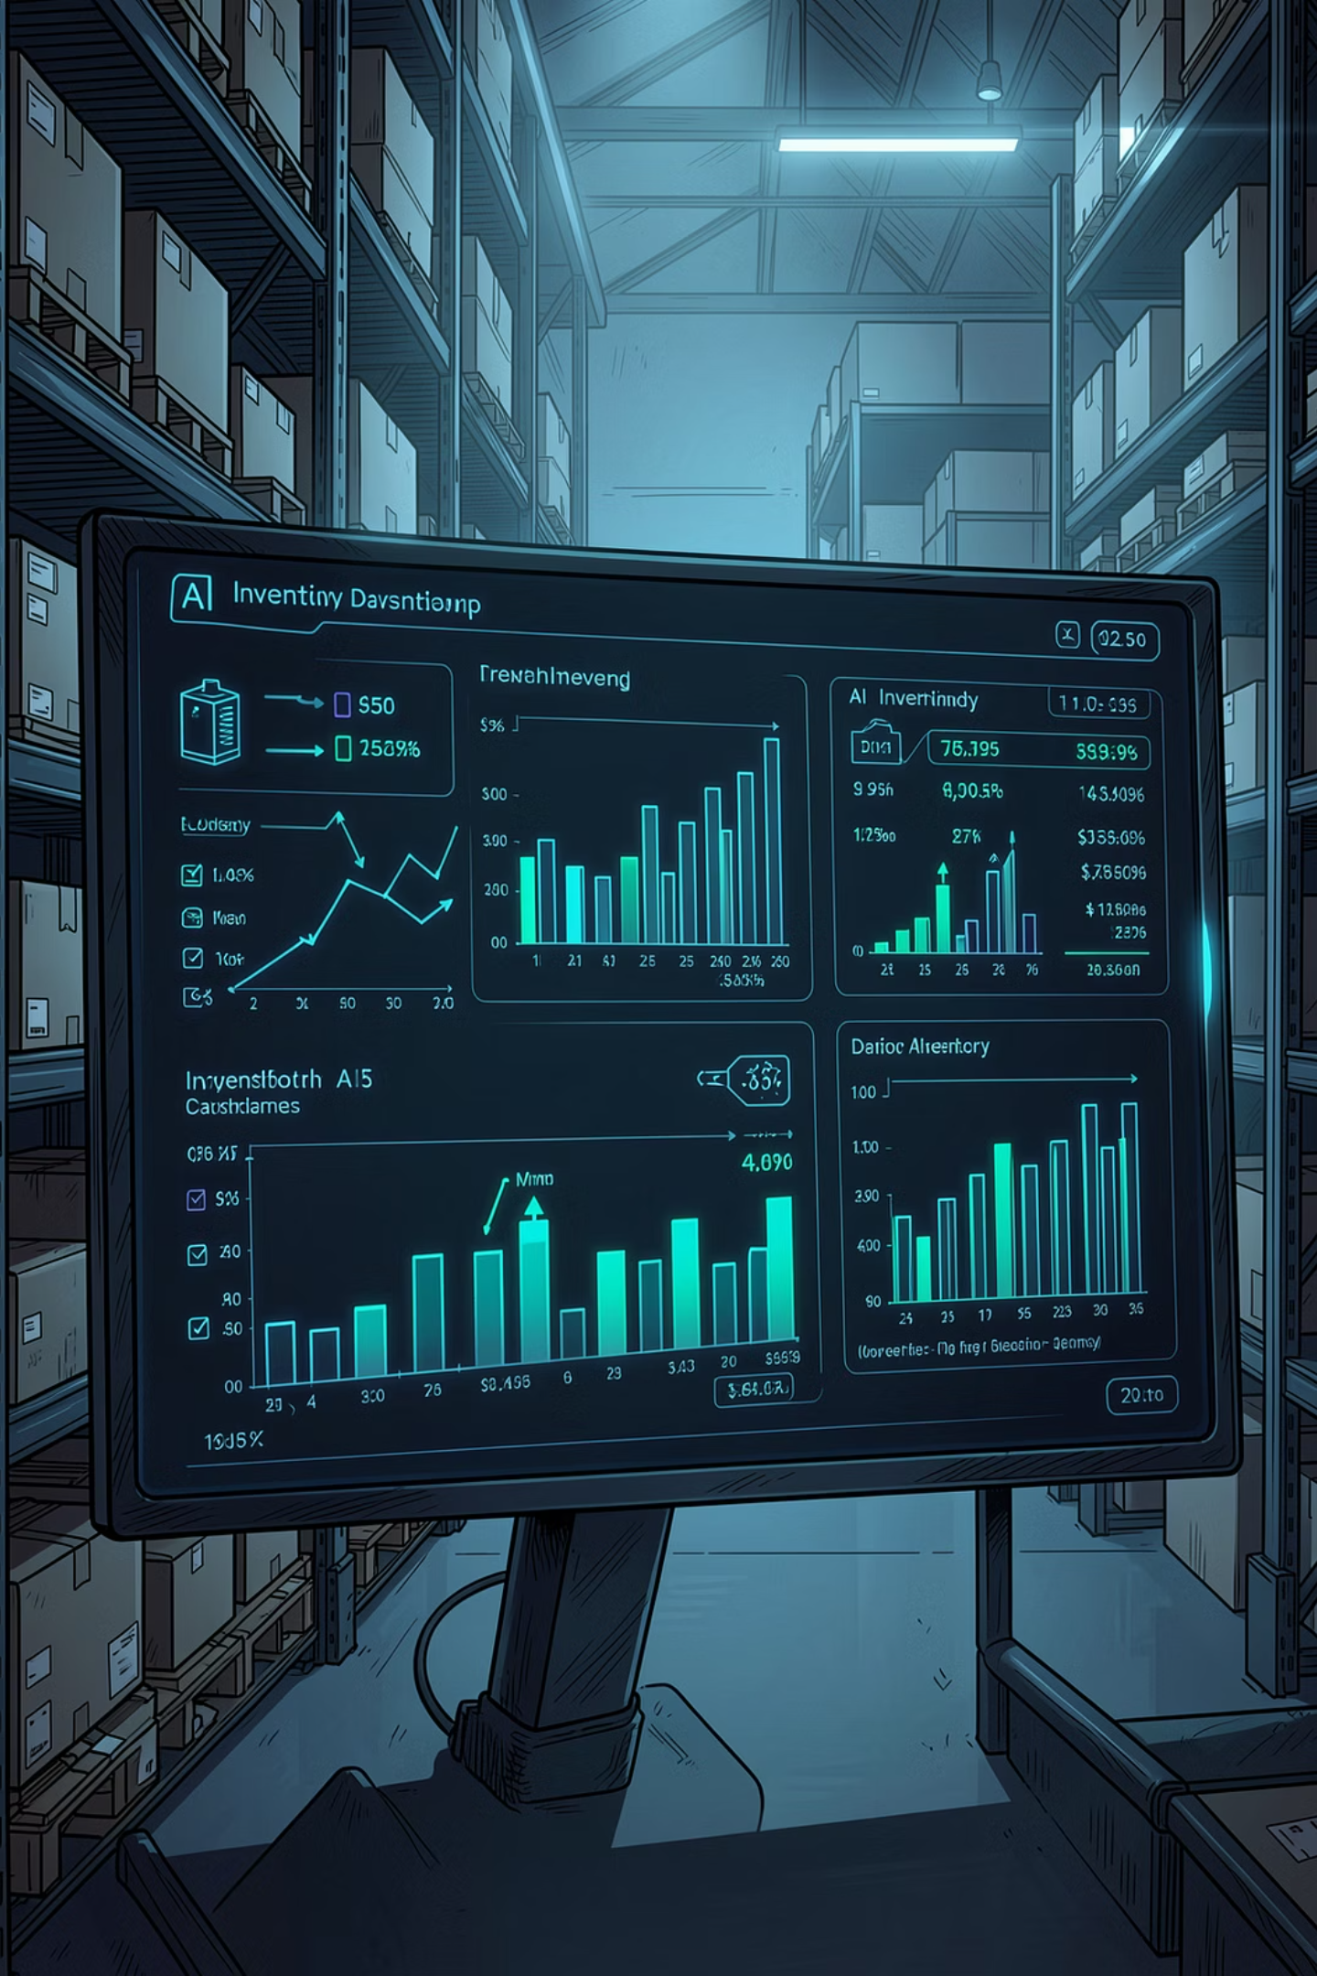
AI-Powered Inventory Forecasting & Decision Intelligence System
Using Pre-trained Machine Learning Models for Smart Inventory Decisions
"Turning demand signals into explainable business actions."
TEAM PROJECT SUBMISSION
AI/ML TRACK

Slide 2

The Inventory Management Crisis
Businesses lose billions annually to preventable inventory failures. Traditional systems rely on static rules, gut decisions, and reactive processes — leaving managers overwhelmed and operations exposed to constant risk.
Overstocking
Stockouts
Manual Decisions
Excess inventory ties up capital and increases storage costs, often leading to markdowns and waste.
Out-of-stock events cost retailers up to 4% of annual revenue and permanently damage customer trust.
Managers rely on spreadsheets and instinct, with no real-time data or predictive confidence to guide actions.
Alert Overload
Static Reorder Points
Unfiltered system alerts bury critical signals, causing decision fatigue and delayed responses to real threats.
Fixed thresholds ignore seasonality, trends, and external factors like weather — creating chronic misalignment.

Slide 3

Customer Requirements & Business Needs
Modern businesses don't just need data — they need explainable AI recommendations that non-technical managers can act on with confidence. These are the core requirements driving our system design.
Operational Needs
Intelligence & Usability
Real-time inventory monitoring across all SKUs
Automatic reorder recommendations with reasoning
Supplier delay handling and risk mitigation
Budget-aware inventory planning
Accurate demand forecasting with confidence scores
Risk alerts with clear, human-readable explanations
Easy dashboard designed for non-technical managers
Weather-aware demand prediction for seasonal accuracy
Businesses need AI that explains its reasoning — not just raw reports that require an analyst to interpret.

Slide 4
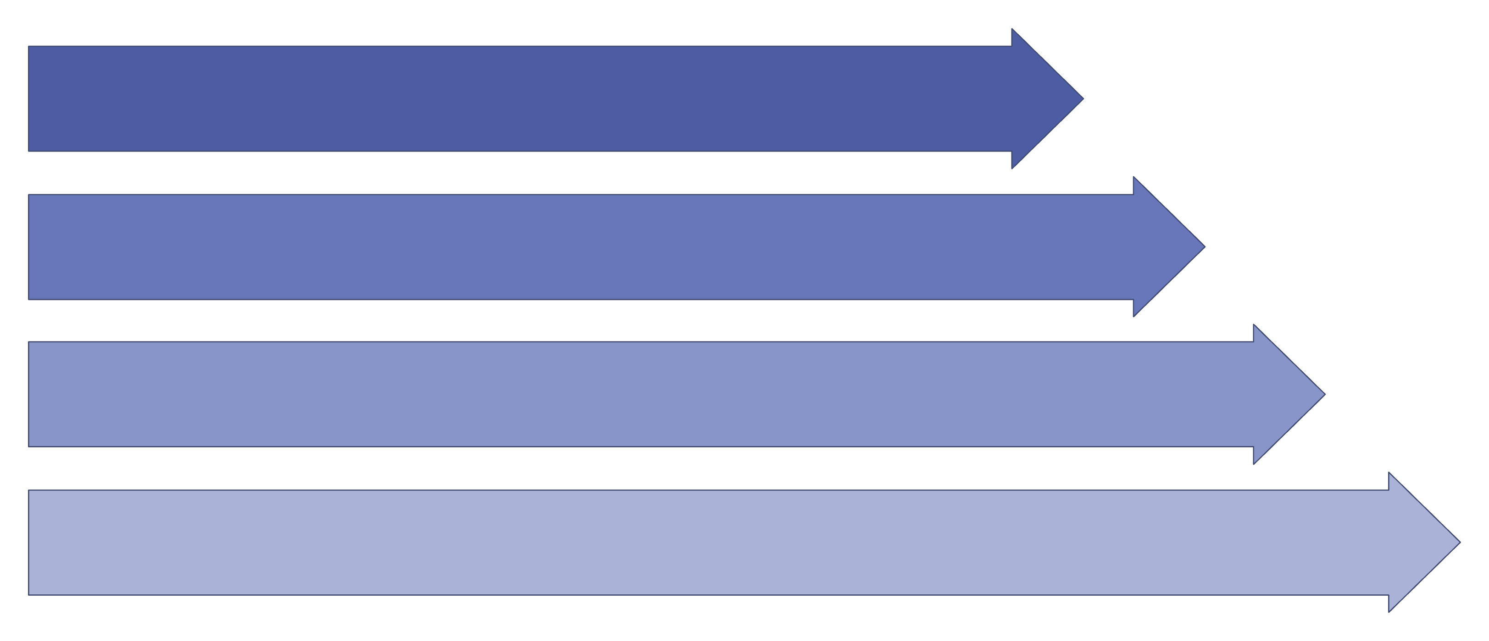
Our AI-Based Decision Intelligence Solution
Our system integrates live data streams, a pre-trained ML forecasting model, and an intelligent AI agent to deliver prioritized, explainable inventory decisions — automatically and continuously.
Input Sources
Pre-trained ML
AI Decision Agent
Decision Dashboard
Unlike static rule-based systems, our AI agent continuously monitors conditions and re-ranks actions based on urgency, forecast confidence, and business context — giving managers a clear, prioritized view of what to do next.

Slide 5
Technology Stack
Built on a modern, lightweight stack optimized for rapid deployment, reliable performance, and seamless AI integration across all layers of the application.
Frontend
Backend
HTML5 & CSS3
JavaScript (ES6+)
Interactive Charts & Analytics Dashboard
Flask / Django (Python)
RESTful API architecture
Weather API integration
Database
AI / ML
MySQL relational database
Structured inventory & sales records
Historical data for model input
Pre-trained Regression Models
Scikit-learn framework
Confidence scoring & anomaly detection

Slide 6


Pre-trained Machine Learning Model
Rather than training models from scratch — which requires massive datasets and long iteration cycles — our system leverages pre-trained regression models fine-tuned on historical sales, seasonal patterns, and real-time weather conditions.
Why Pre-trained?
Model Inputs
Faster implementation — deploy in days, not months
Higher accuracy — benefits from broad prior training
Easier scalability — extend to new SKUs without retraining
Historical sales data (rolling windows)
Seasonal trend indices
Live weather conditions via API
Supplier lead times and reorder history
Forecast confidence directly influences recommendation urgency — low-confidence predictions trigger alerts rather than auto-actions.

Slide 7
Core Intelligent Features
Eight purpose-built capabilities transform raw inventory data into intelligent, actionable business decisions — all explainable, all automated.
1
Decision Reasoning Engine
Every recommendation includes a plain-language explanation of why the action is needed.
2
Forecast Confidence Score
Each prediction is paired with a confidence rating to guide manager trust and urgency calibration.
3
Demand Anomaly Detection
Automatically flags unusual spikes or drops in demand before they cascade into stockouts or waste.
4
Weather-Based Demand Analysis
Live weather data feeds directly into demand predictions, accounting for climate-driven buying behavior.
5
Smart Reorder Recommendation
Dynamic reorder suggestions replace static thresholds, adapting to real-time forecast and supply signals.
6
Action Priority Queue
All system recommendations are ranked by urgency, business impact, and risk level for faster response.
7
What-If Scenario Simulator
Managers can model hypothetical scenarios — supplier delays, demand surges — before committing resources.
8
Self-Calibrating Reorder Points
Reorder thresholds automatically adjust over time as the model learns from new demand and outcome data.

Slide 8
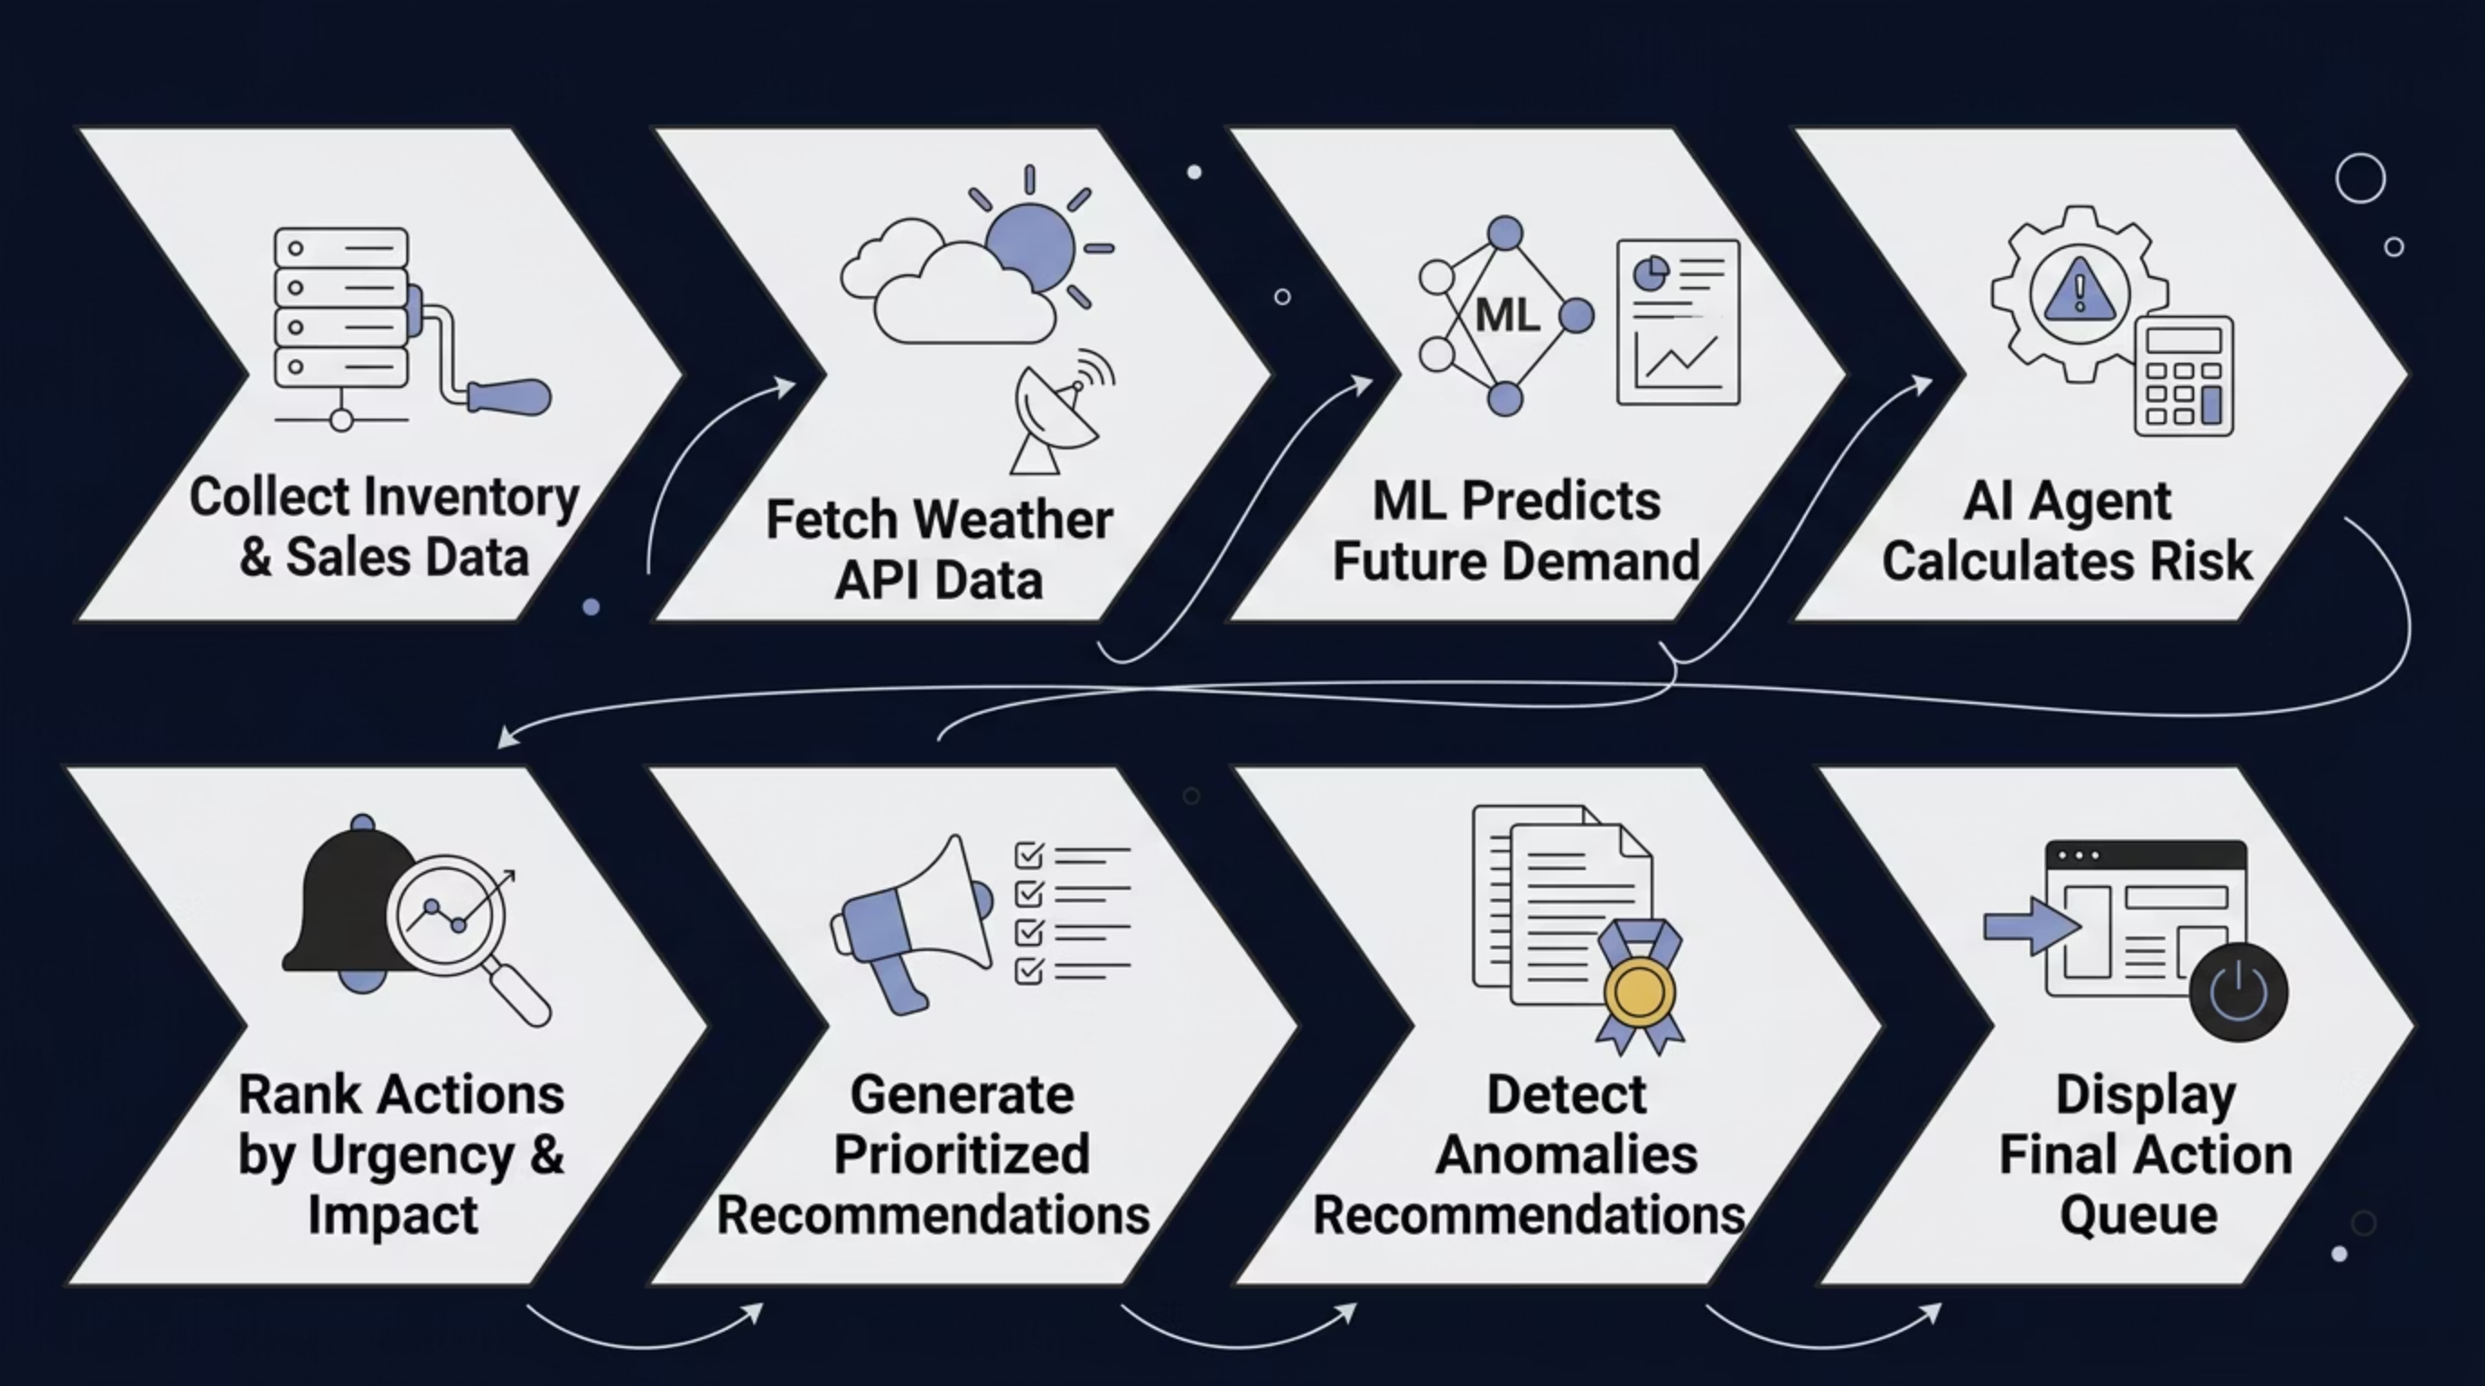

How the System Works
From raw data ingestion to dashboard-ready recommendations, our system follows a structured, intelligent pipeline that operates continuously and autonomously.
Each step in the pipeline is automated and auditable — giving operations teams both speed and full transparency into how every recommendation was generated.

Slide 9
Business Impact
Our system delivers measurable improvements across every dimension of inventory operations — from financial efficiency to team productivity.
35%
28%
Stockout Reduction
Overstock Reduction
Predictive reorder triggers prevent out-of-stock events before they impact revenue.
Demand-aligned ordering reduces excess inventory and carrying costs significantly.
60%
40%
Faster Decisions
Time Saved
Managers act on prioritized, explainable recommendations instead of raw data.
Automation eliminates manual monitoring and spreadsheet-driven reorder workflows.
Before
After
Static thresholds, manual reviews, reactive stockouts, unexplained alerts, and siloed data with no forecast confidence.
AI-driven forecasts, automated prioritization, explainable recommendations, proactive risk alerts, and self-calibrating reorder points.

Slide 10

Conclusion & Future Enhancements
Our AI-Powered Inventory Decision Intelligence System transforms reactive inventory management into a proactive, intelligent, and explainable operation — accessible to any business, regardless of technical expertise.
What We've Built
Future Roadmap
AI that explains every recommendation
Continuously self-calibrating forecasts
Operational risk reduction at scale
IoT sensor integration for real-time shelf data
Mobile app for on-the-go manager access
Multi-warehouse support and cross-location optimization
Deep learning model upgrades for higher accuracy
Real-time supplier tracking and delay prediction
Voice-based AI assistant for hands-free decisions

