Slide 1
SUMMER INTERNSHIP
Presented by:-
Name=Dinesh
Course=Btech-cs(3rd year)
Uni roll=2215000621
Submitted to:-
Ms. Anushka Shukla

Slide 2
PURPOSE AND OBJECTIVE
To take real time Experience of project building in IT Industries
I like problems solving so this is the main reason behind choosing programming field
The main objective is to develop skill ,strong resume

Slide 3
Company overview
AppSquadz Software Pvt Ltd.
Established on 2015
Situated at Noida, Secotr-63
Work on software and web solution

Slide 4
PROJECT OVERVIEW
CODING MONKEYS
it is a Ed-tech website
Helps to IT student to enhance their skill to complete their Coarse
After complete their coarse they get their completion Certificate
They also get doubt clearing support
And got chance to grab their Internship base on performance

Slide 5
PROJECT DURATION
Total 8 week and started from starch
1 week for familiar with HTML5
1 week for familiar with CSS
1 week for familiar with BOOTSTRAP
1 week for familiar with GIT&GITHUB
1 week for familiar with FIGMA&REVISION
1 week for project overview and create Home section
1 week for create about and our services section
1 week for create our services and footer section

Slide 6
S/W , TOOLS and technology USED
HTML5
CSS
BOOTSTRAP
GIT &GITHUB
FIGMA

Slide 7
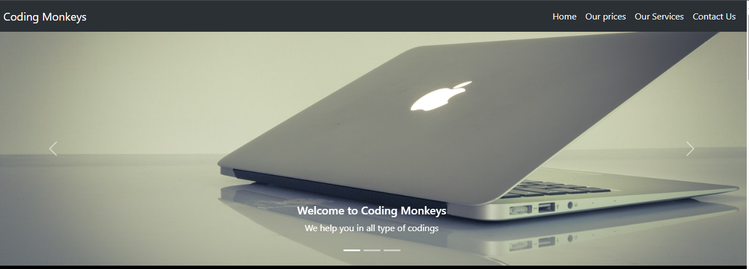

Slide 8
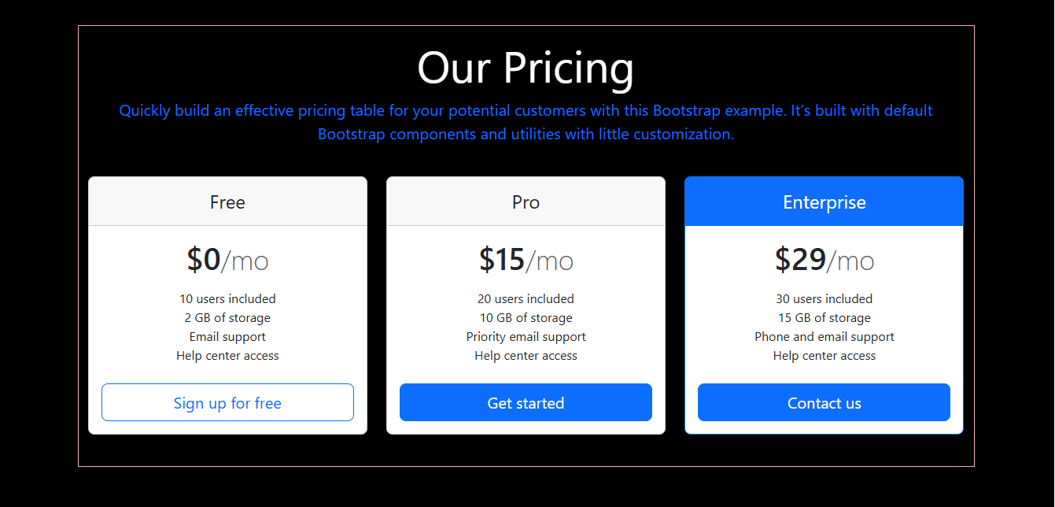

Slide 9
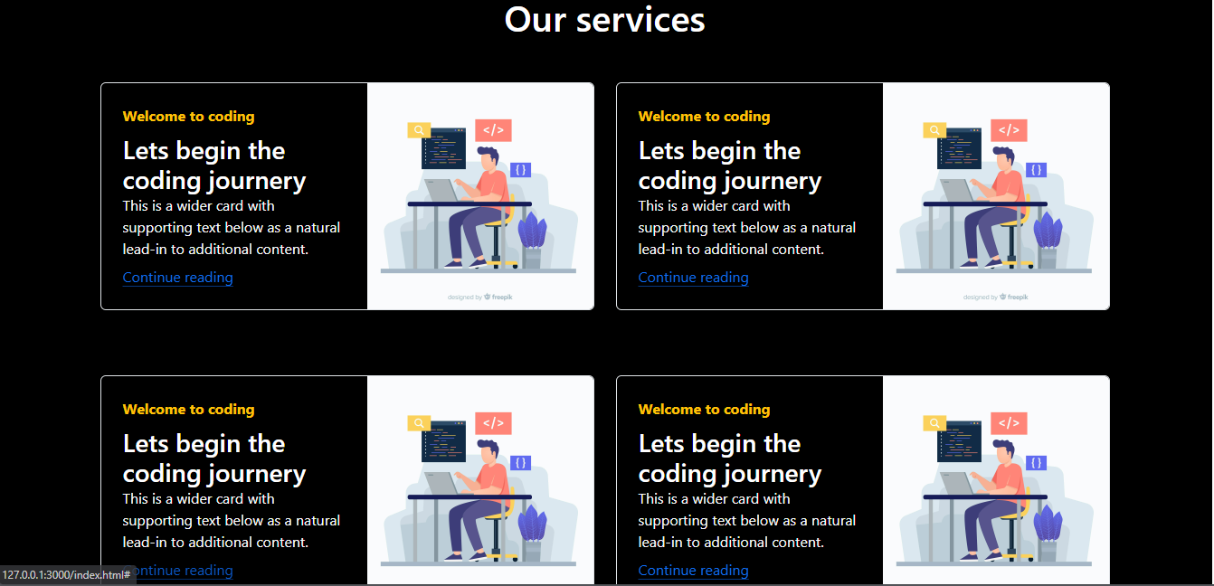

Slide 10
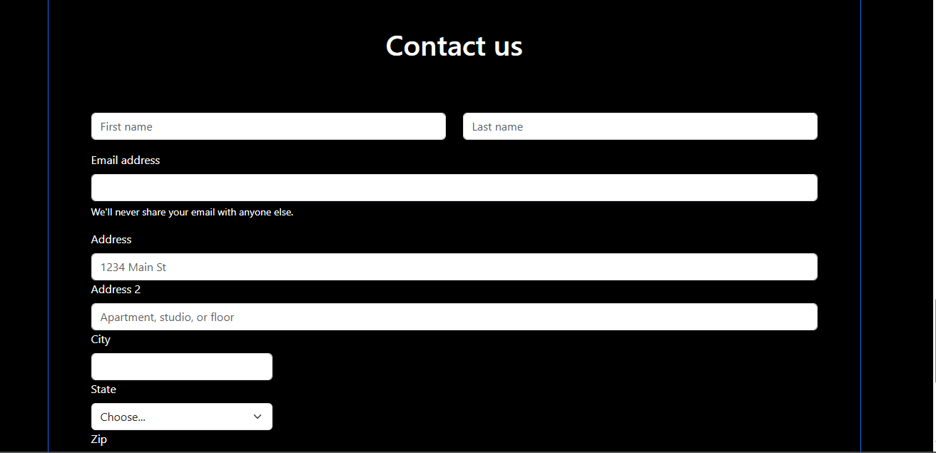

Slide 11


Slide 12
THANK YOU
The End

