Slide 1
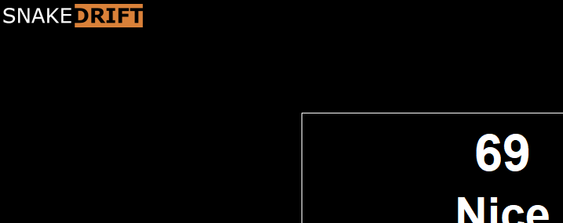
AKA: My horrible experience learning Java

Slide 2
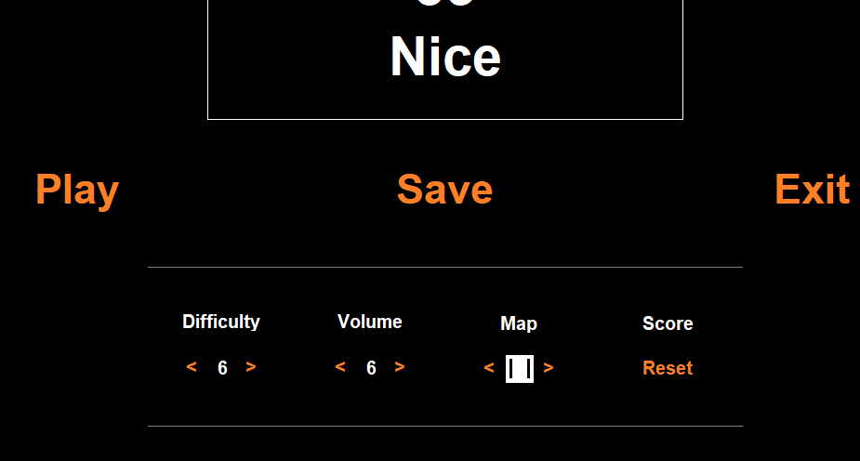
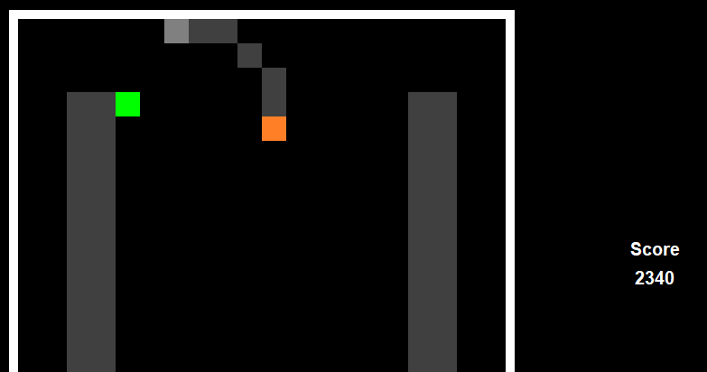
Design Decisions
Design decisions are broken into two parts:
Look and Feel (UI)
Game Design Decisions

Slide 3
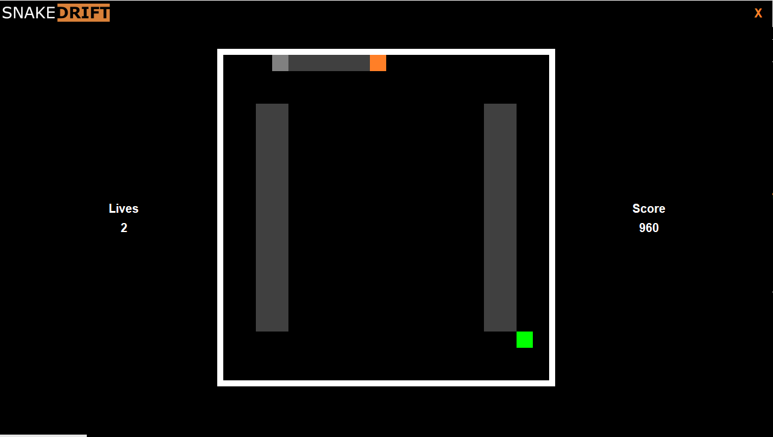
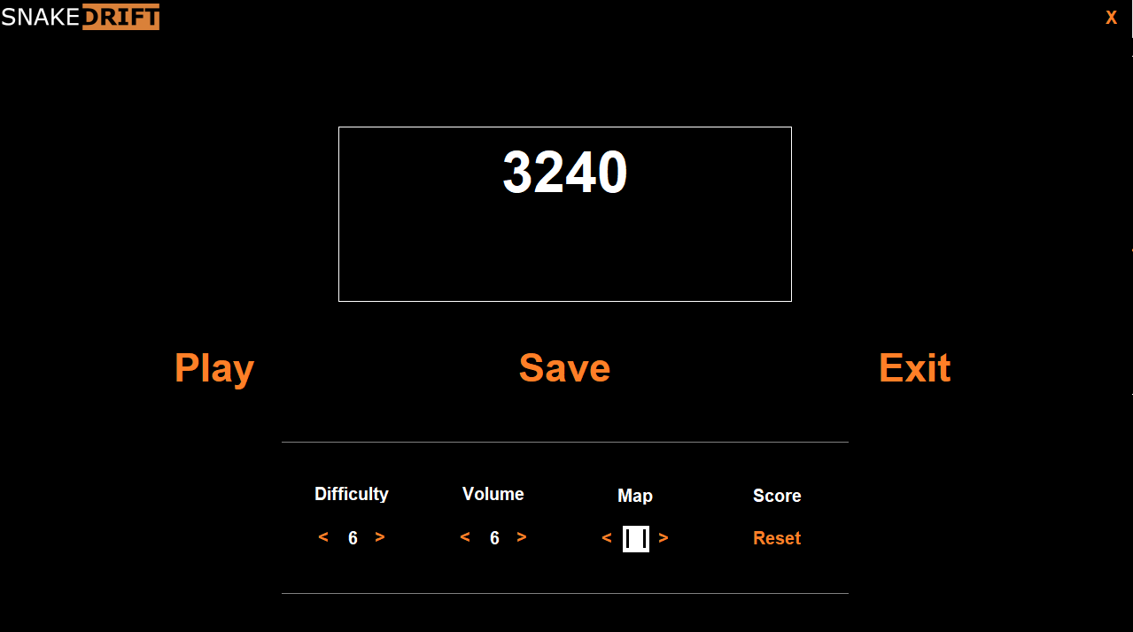
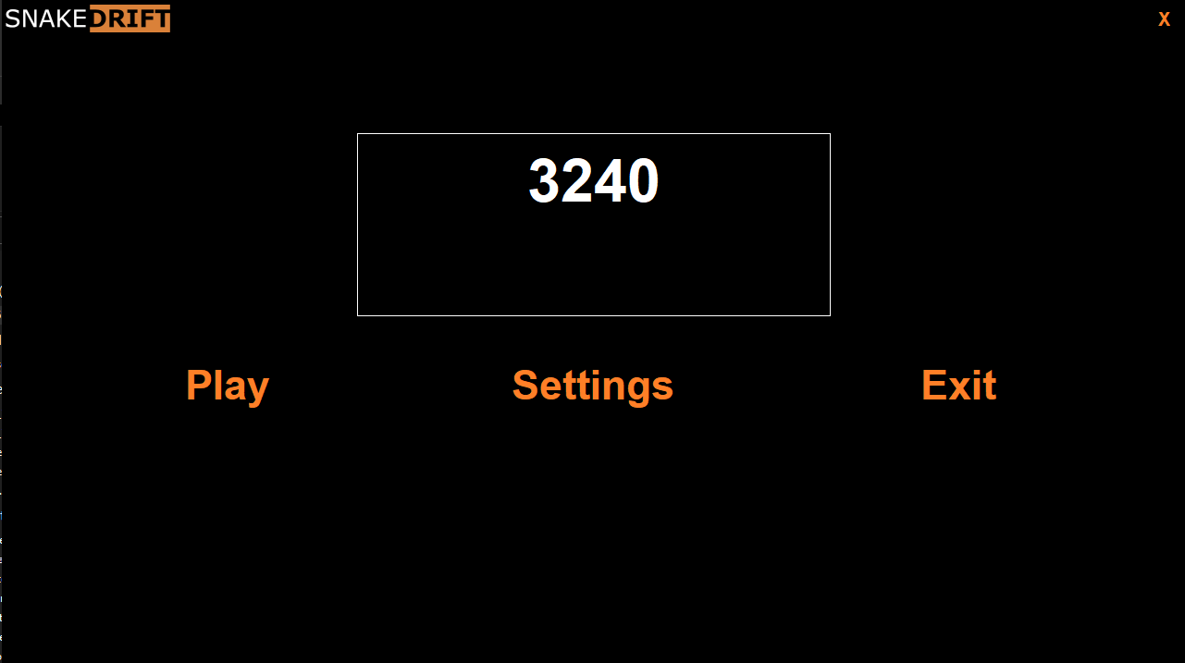
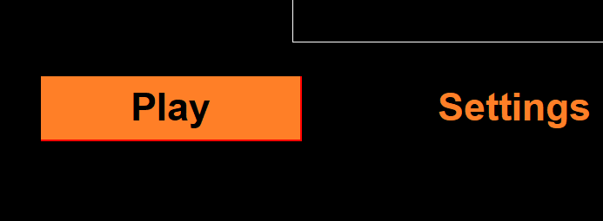
Design Decisions
Look and Feel:
High Contrast
Low “blare” and clutter
High Energy to it
Achieved by:
One colour
Colour offset
Uncluttered UI
Audio and Accent Colouring
Game Theme: Drifting

Slide 4
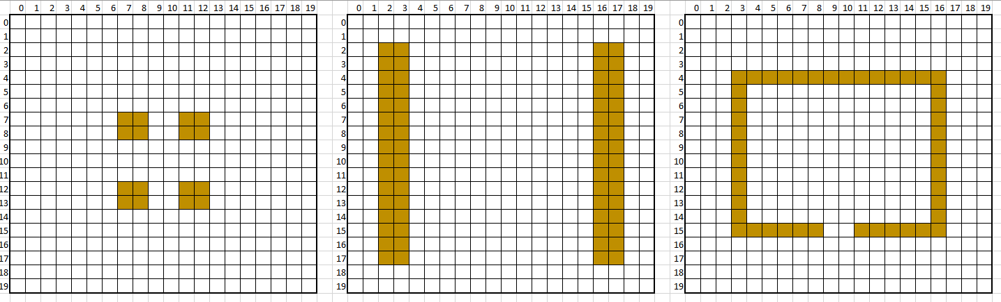
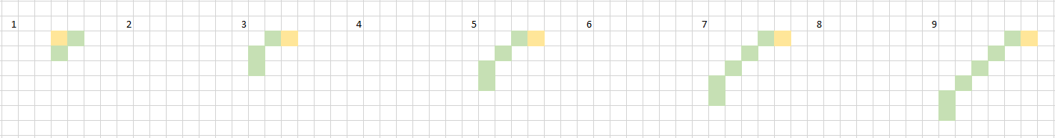
Design Decisions
Game Design:
High Energy
Difficult
Rewarding
Achieved by:
Drift increase
Big maps
Fast movement timer
Audio triggers

Slide 5
Game Structure
Horrible! Please don’t look at my code.
First time using Java
Second time building UI in object oriented code
Didn’t use the game engine
Why not?
Limited Audio Capabilities
Needed to learn Java for another paper

Slide 6
Game Structure
Game Layout:
Main created
Loading Splash
ADT Created (Swing JFrame)
ADT thread handles UI
ADT thread handles IO
Game thread runs the game
Known Issues:
- Input lag and missed IO
- ADT paint calls out of sync with game loop

Slide 7
Game Structure
Known Issues:
- Input lag and missed IO
- ADT paint calls out of sync with game loop
Work arounds:
Input lag
- Framerate capped at 30fps to free up Swing EDT
Paint Sync
- Triple buffer my painting

Slide 8
Class Structure
Main creates:
GameState (settings)
Player (audio control)
SaveInfo (saved data)

Slide 9
Class Structure
Main enters:
Player (audio control)
GameMenu (ADT)
GameState (settings)
MenuSpace
Play
Settings
Exit
GameSpace
Lives panel
Play panel
Score panel

Slide 10
Class Structure
MenuSpace becomes:
GameSpace (UI)
Game
Snake
GameThread
(game loop)
GameThread
(game loop)

Slide 11
Game Improvement
Broken into three stages:
1. Rewrite not using Swing
- Tidies up paint issues (Custom renderer)
- Removes input lag
2. “On-Press” path painter
- Shows drift path
- Set path on release
3. Path painter color code
Green OK
Red Collision!

Slide 12
Live Demo

