Slide 1
Games Programming - Assignment Two
Damien DeCourcy
19042551

Slide 2
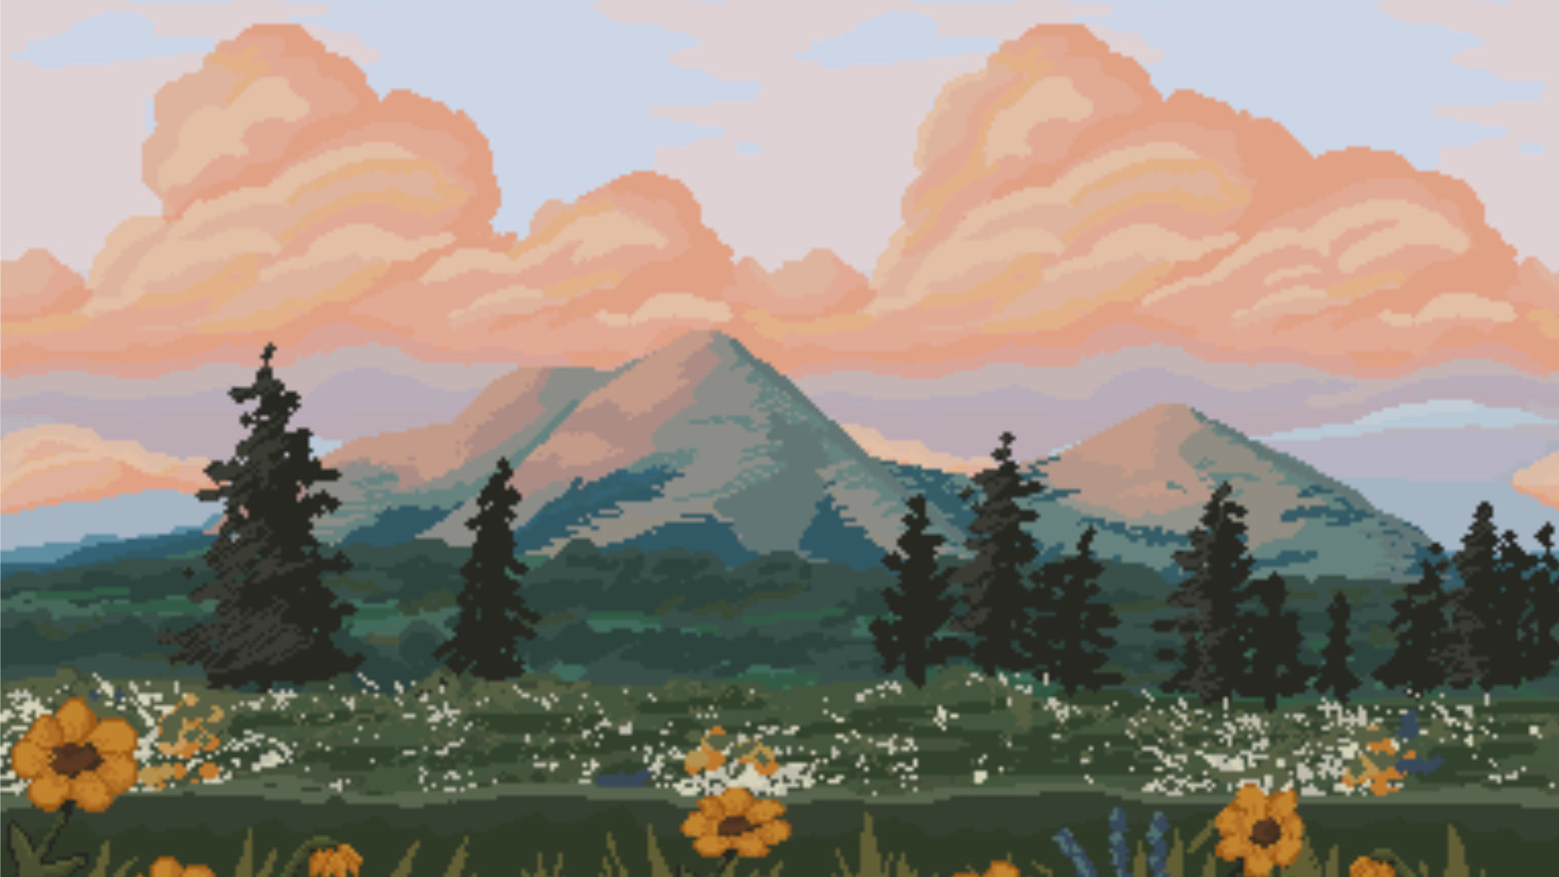



5000BC

Slide 3
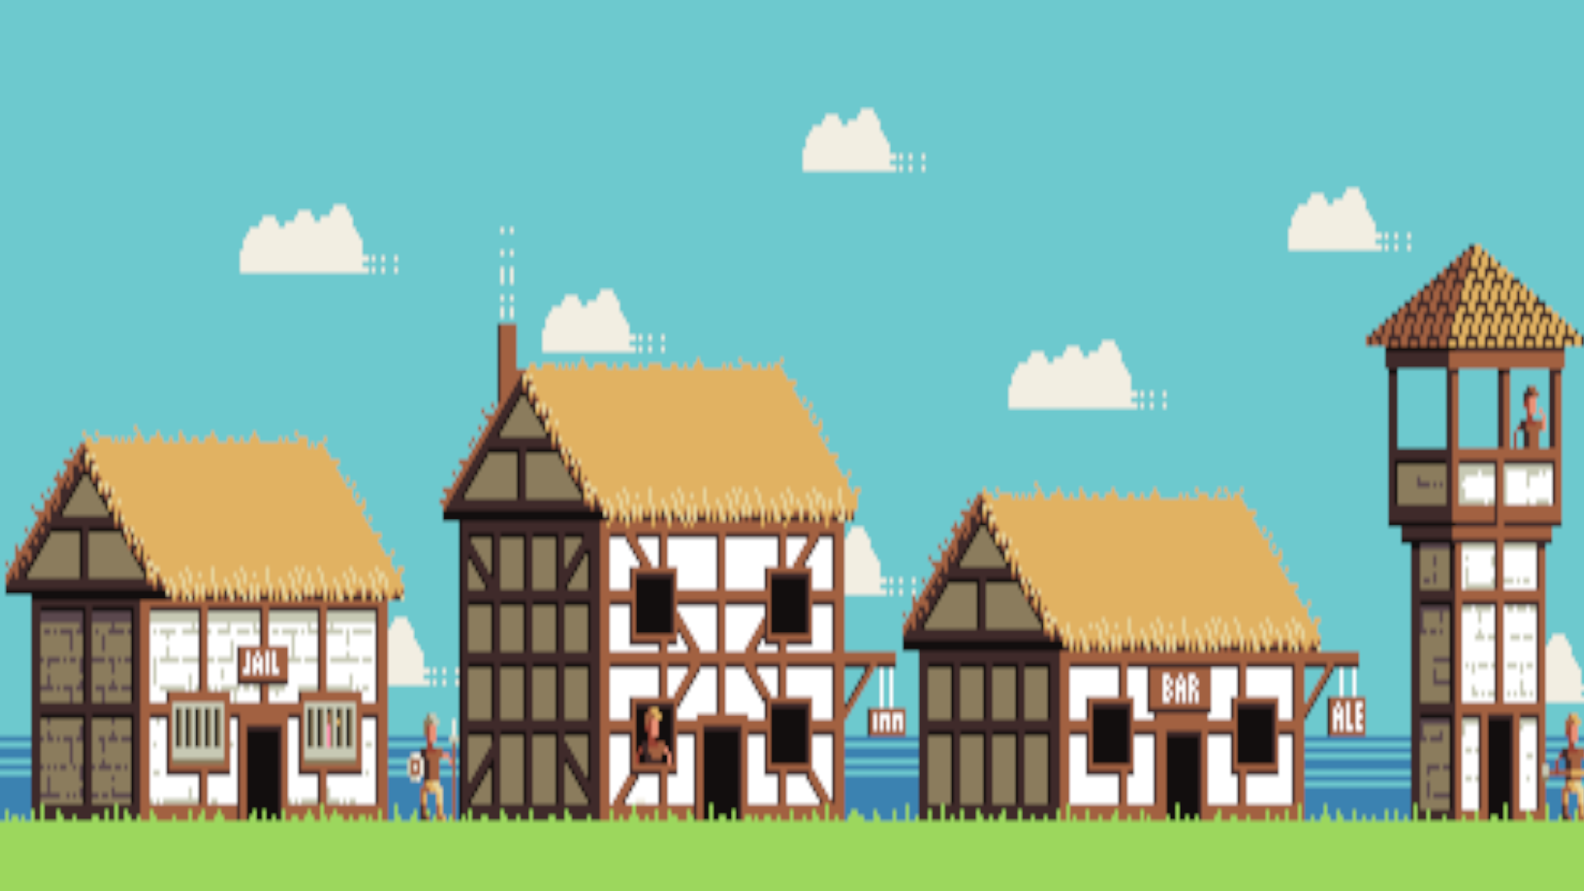

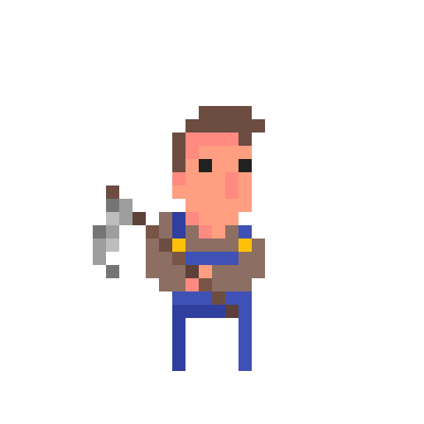
800AD

Slide 4



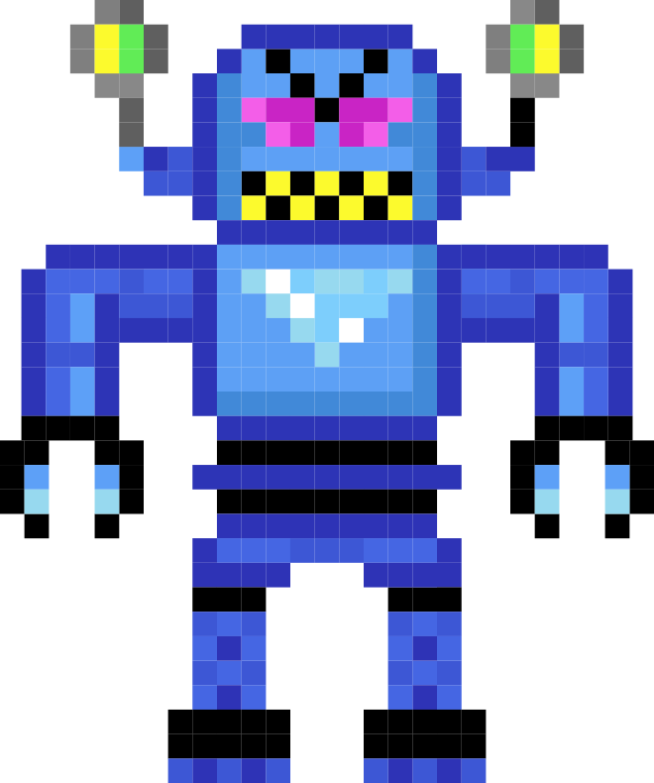
3000AD

Slide 5
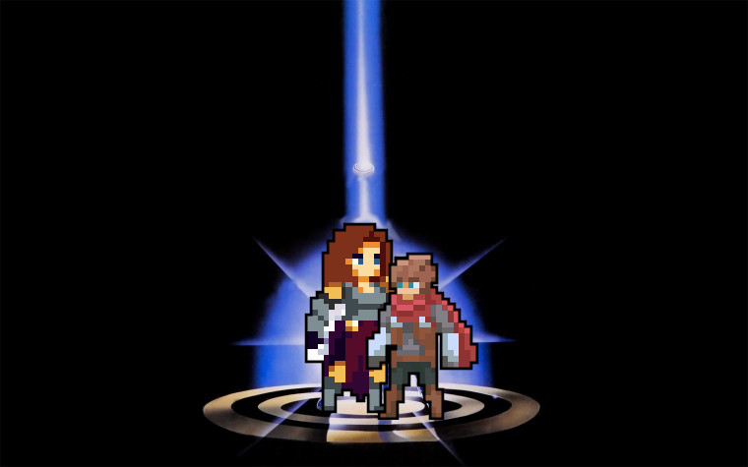
Djin
A powerful female warrior chosen by the god Jun to vanquish its foe, Churl, and Churl’s chosen champion
With the power of the gods bestowed upon them, Djin and Tye fight a battle outside the realms of human time. For humans, the fight may last a second, a week, a millennia. But for the two campions, it is but the blink of an eye that exists across multiple timelines.
.
Tye
A quick witted adventurer chosen by the god Churl to vanquish its foe, Jun, and its chosen champion

Slide 6

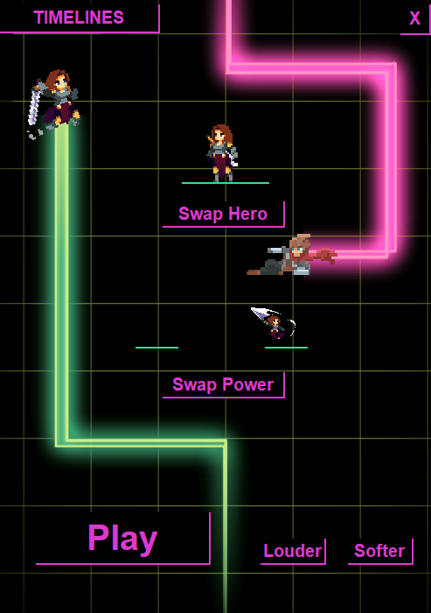

Timelines: A 2D, competitive pvp scroller game player via the internet.

Slide 7
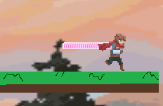
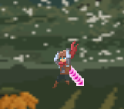
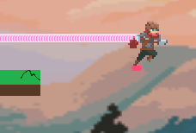
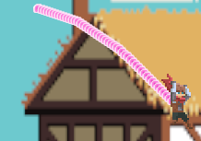

A Move left
D Move Right
SPACE Jump
Left Click Ability
Right Click Swap Timeline
Double Escape Exit game

Slide 8
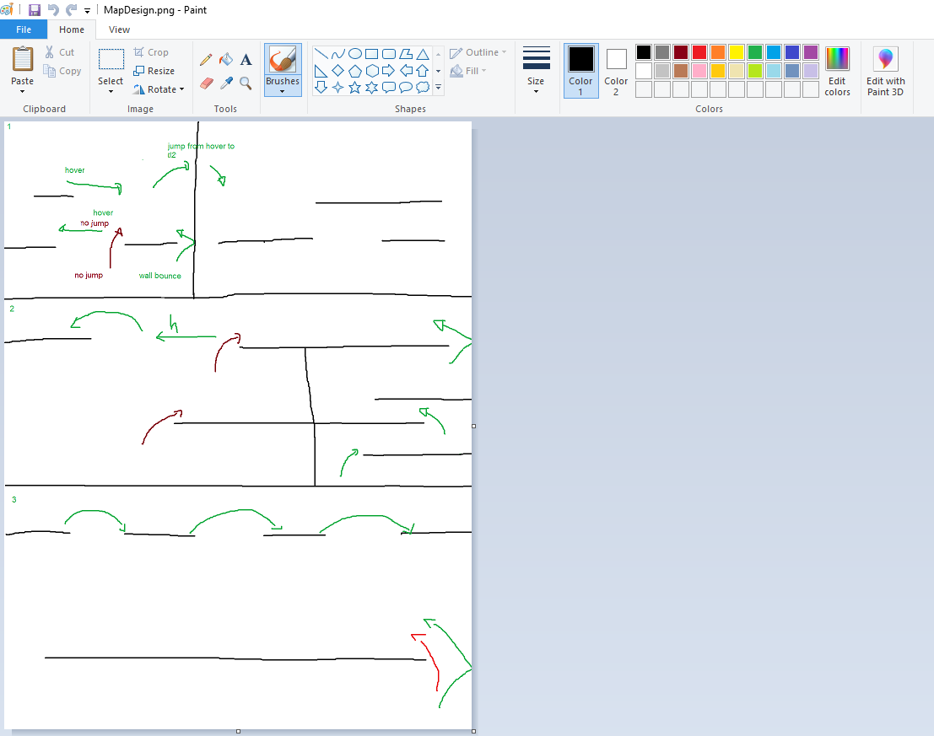

Game Design Map Making
Some locations only accessible by swapping timelines
Other locations accessible by movement mechanics
Some locations only accessible by power ups
All time lines interact well using the above

Slide 9

Game Design UI
Menu Engine
- Runs Java swings EDT, aka the “Main() thread”
- Uses a swing timer to repaint itself at 30 fps
Animator
- All animations are added to the animator
- Uses a worker thread to update each animation at its own framerate.
Builder
- Static class that builds and returns UI objects
Audio Mixer
- Holds audio clips
- Plays them in their own thread when requested
Settings
- Saves hero, power choice and volume to disk
- Loads from disk on create
Animation
- Saves hero, power choice and volume to disk
- Loads from disk on create
Animated JPanel
- Has animation pane
- Overrides paint method to paint an animations current frame

Slide 10
Game Design UI
Menu Engine
Builder
Animator
Animated JPanel
Worker Thread
Animation
Buttons
Animation
Buttons
Animation
Audio Mixer
Settings
Game

Slide 11
Game Design Game Itself
Game
- Runs Java swings EDT, aka the “Main() thread”
- Uses a swing timer to repaint itself at 30 fps
Animator
- All animations are added to the animator
- Uses a worker thread to update each animation at its own framerate.
TimeLine
- Uses a worker thread to update every 10ms
- Allows timelines to update regardless of player1 or player2 presence
Audio Mixer
- Pulled in from Menu
Settings
- Pulled in from menu
Animation
- Saves hero, power choice and volume to disk
- Loads from disk on create
Animated JPanel
- Has animation pane
- Overrides paint method to paint an animations current frame
Builder
- Static class that builds and returns UI objects
Player
- Player1 or Player2
- State machine based on key
Press, state updates and collisions
Physics Engine
- Provides physics objects and functions
GameObject
- Map items to stand on or collide with

Slide 12

Game Design Game Itself
Game
TimeLine
One
Animator
Animated JPanel
Player1
Player2
Player1 animation
Player2 animation
TimeLine
Two
Player1 trail
Player2 trail
Game Objects
TimeLine
Two
Background
Settings
Audio Mixer
Builder
Physics Engine
!?

Slide 13



TimeLine loop
while (mTimeLineActive)
{
double passedTime = measureTime();
double dt = passedTime / 1000.;
// Player in timeline
if (mPlayer != null)
{
// Move the player
if (mPlayerTrail.size() == 100)
{
mPlayerTrail.remove(0);
}
mPlayerTrail.add(new Point(mPlayer.mLocation.x + (mPlayer.mWidth / 2) - 5, mPlayer.mLocation.y + (mPlayer.mHeight / 2) - 5));
mPlayer.move(dt);
// Apply gravity
if (!mPlayer.mIsGrounded)
{
mPlayer.applyGravity(dt, mGravity);
}
// State update
mPlayer.stateUpdate(getTime(), mLastCollidedObject);
// Check death
checkDeath(mPlayer, false);
// Check collissions
checkCollissions(mPlayer);
}
// Repeat for the other player
// Sleep for a few milliseconds
}

Slide 14
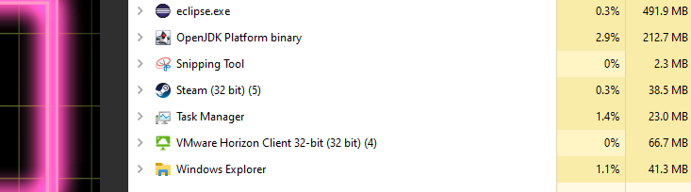

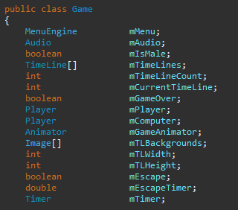



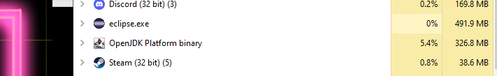

Known Issues
The Memory Leak
The Fix
Collision detection, clipping
Timelines create and remove based on player1. Subsequently the player2 can’t swap timelines.
Haven’t had time to implement multiplayer (code written for PVC).
Collision detection is Janky
Female clips through wall in some states
Memory leak (and I hate java)
Swapping Timelines
The Fix
Move the current timeline tracker into the player object.
Rewrite the timeline creation and swapper functions to use it in its new position.
Idle right
Run left

Slide 15


Future Updates
Fix collision detection
Fix clipping
Create multiplayer
More powerups
Fix memory leak
Finally, recreate from scratch in C++

Slide 16


Questions?
Also, thank you for listening
Victory

