Slide 1
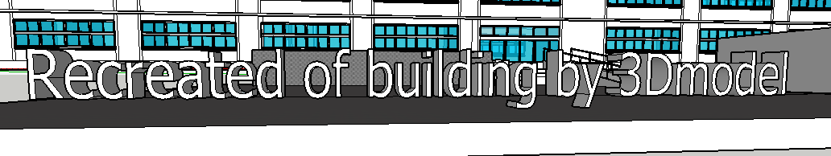

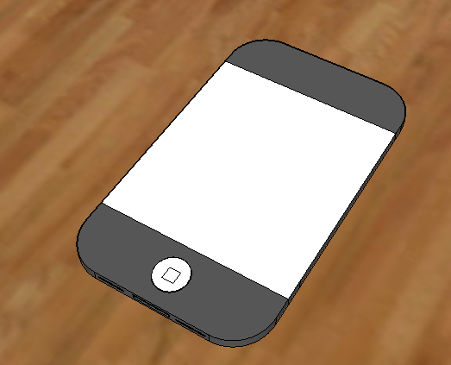
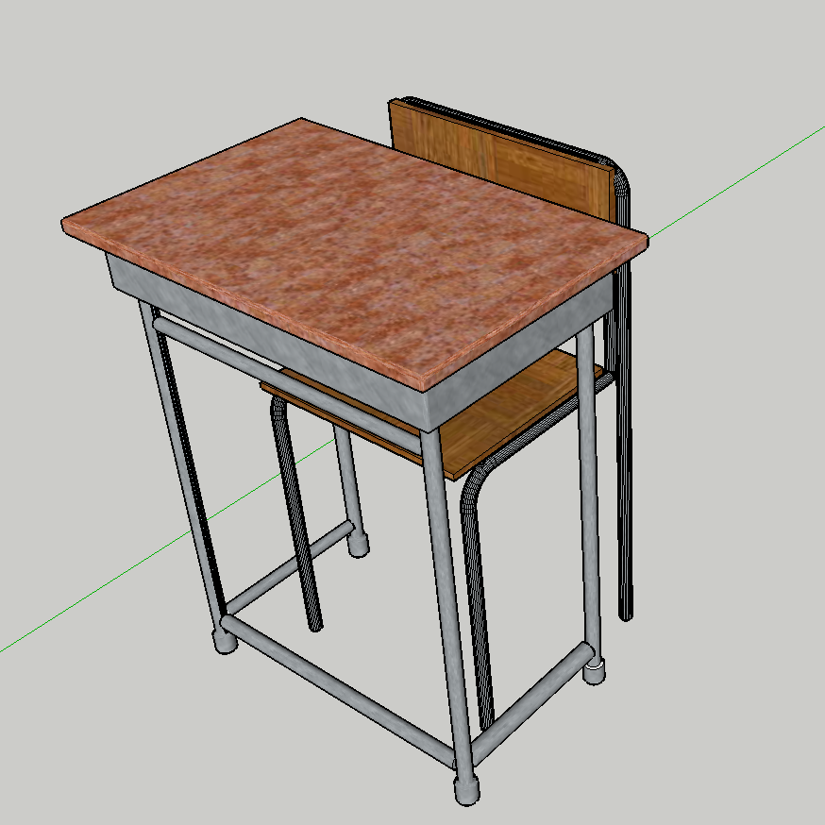
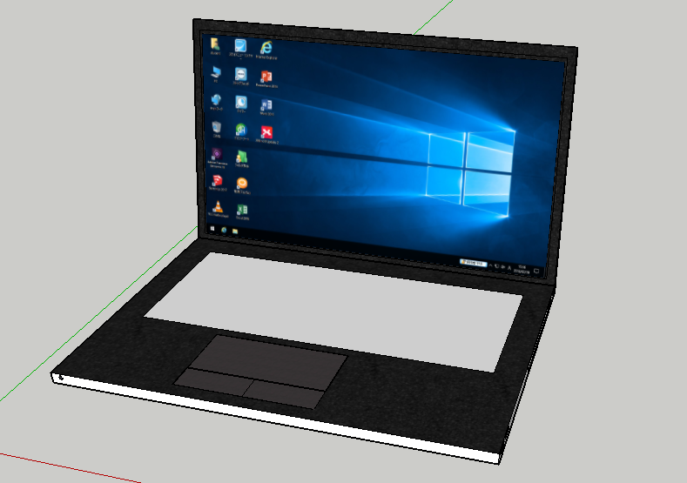
Daini high school 3-S Ryoga Minami Ryoto Oyamada
1. Abstract
In this study, a building which was destroyed by the Kumamoto Earthquake was recreated from designs using 3Dmodels.
There are plans to rebuild this building, so we made a 3D model to keep records.
We used SketchUp to recreate the building.
The 3D models will be shared at
"https://github.com/mirachan010/kanritou"
2. Purpose
We recreated a building which was destroy by
the Kumamoto Earthquake using 3Dmodels to keep records.
3. Preparation
What to use…Design drawing of our school,ruler,SketchUp
～What is SketchUp～
One of 3D model creation software. It is relatively easy to pull a straight line and raise the plane to 3D.
Example of creation
4. Production
Create 3D model based on design drawing.
However, since the sizes of the windows were unknown, we measured them in another school building created at the same time and created windows.
Works Cited
・第二高校設計図
・動画でわかるSketchUp最強バイブル
Author:佐藤正彦 Publication:エクスナレッジ
Acknowledgments
Thank you very much for teachers
who instructed me ,and
“第二高校コンピュータ同好会”

