Slide 1



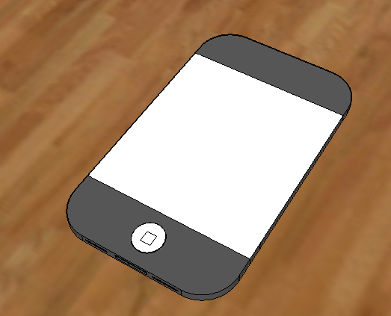
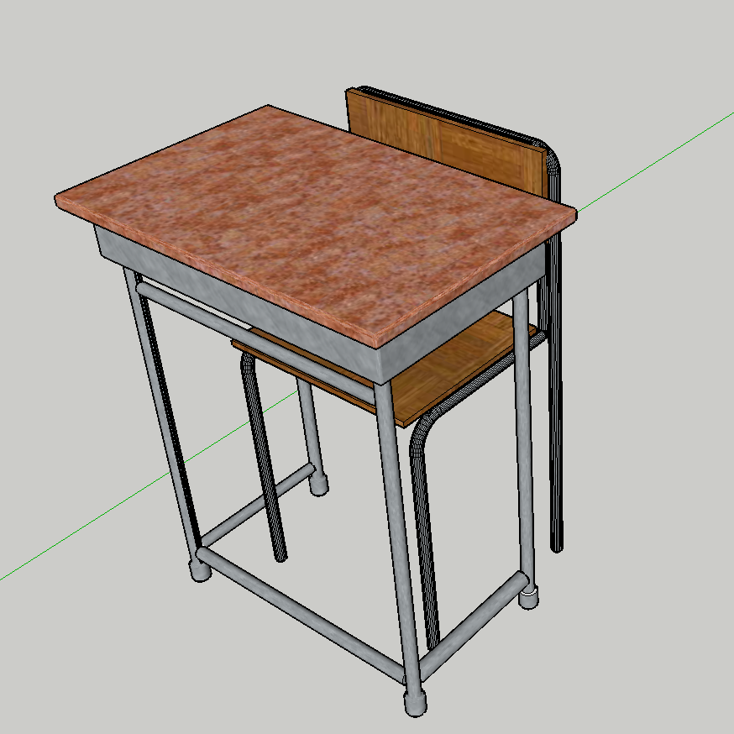
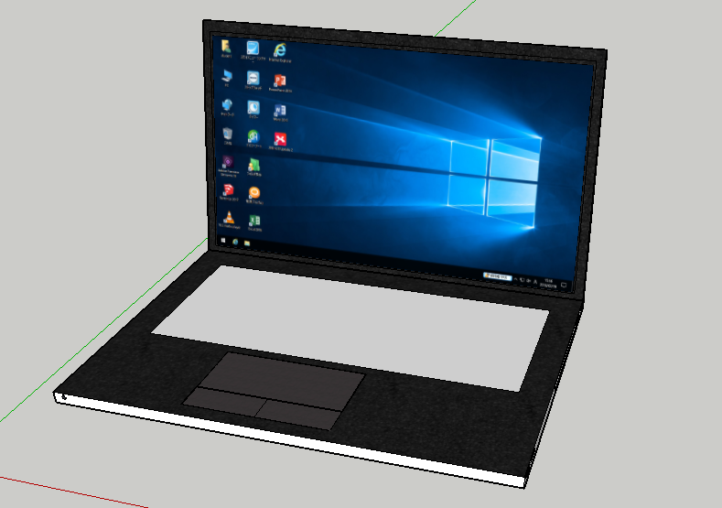
Daini High School 3-S Ryoga Minami and Ryoto Oyamada
Introduction
In this study, a building which was destroyed by the Kumamoto Earthquake was recreated from designs using 3Dmodels.
There are plans to rebuild this building, so we made a 3D model to keep records.
We used SketchUp to recreate the building.
The 3D models will be shared at
"https://github.com/D2IT2017/kanritou"
2. Preparation
Equipment used:
Daini High School floorplan
Ruler
SketchUp
～What is SketchUp～
It is a 3D model creation software. It is relatively easy to pull a straight line and raise the plane to 3D.
Example of Creations
3. Production
A 3D model based on the floor plan was created.
However, since the sizes of the windows were unknown, we measured them in another school building created at the same time and created windows.
5. Conclusion
We did it!! Please look our website.
・Daini High School floorplan
・Douga de wakaru SketchUp saikyou bible
Author: Masahiko Satou
Publication:X-Knowledge
Acknowledgments
Thank you very much to
Mr.Shinokura and the
Daini High School Computer Club
for their advice and support
Works Cited

