Slide 1



Searching and browsing through fragments of TED Talks
MARIELLA SABATINO – mariella.sabatino@eurecom.fr
GO!

Slide 2



TED Talks
TED is a global set of conferences, held throughout North America, Europe and Asia.
TED Talks address a wide range of topics within the research and practice of science and culture.
The speakers are given a maximum of 18 minutes to present their ideas in the most innovative and engaging way they can, often through storytelling.

Slide 3

Problem
Which are the fragments potentially relevant without having to watch the entire video?
Users are overwhelmed with audiovisual content
Users browse fast, looking for topic of interest
It is very difficult to find interesting documents

Slide 4
Research questions
HOW TO:
how to recommend related media fragments within the same video collection
1
2
3
recommend related media fragments within the same video collection?
design a web application that provides a rich environment for exploring a video collection?
detect segments of interest in a video?

Slide 5
HyperTED
Browsing and recommendation of Media Fragments of TED Talks based on entities extracted in the subtitles
Integration of the Media Fragments concept and the subtitles enrichment performed by NERD on a Node.js server

Slide 6
Research question 1
HOW TO:
how to recommend related media fragments within the same video collection
1
2
3
detect segments of interest in a video?
recommend related media fragments within the same video collection?
design a web application that provides a rich environment for exploring a video collection?

Slide 7
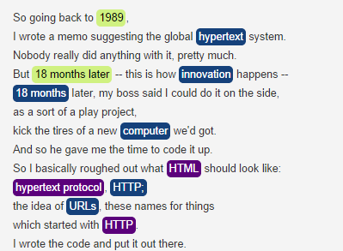
1
2
3
What is a NER task?
Named Entity Recognition (NER) aims to locate and classify elements of textual document into
pre-defined categories such as:
People names;
Organizations names;
Places;
Temporal and numerical expressions.
These elements and the categories take respectively the name of entities and ontologies.

Slide 8
1
2
3
For example…
“This is Nikita, a security guard from one of the bars in St. Petersburg.”
NER
“This is Nikita, a security guard from one of the bars in St. Petersburg.”
PERSON
Natural Language Processing (NPL) Task → disambiguating URL in a knowledge base.
E.g. http://dbpedia.org/resource/Saint_Petersburg.
Category:
type in the NER task.
FUNCTION
LOCATION
Example taken from the transcript of
https://www.ted.com/talks/2089

Slide 9










1
2
3
NER extractors
Web Tools that use NER algorithms.
Open APIs for research use.

Slide 10

1
2
3
NERD
Compare performance of NER tools available on web.
Unify the results of NER extractors in a common output.
http://nerd.eurecom.fr/

Slide 11
NER extractors evaluation
1
2
3
DOCUMENTS ANALYZED: 5 short TED Talks
NUMBER OF EVALUATORS: 1
STEPS OF EVALUATION:
Selection of the meaningful concepts on the subtitles;
Run of each extractor;
Comparison of the results.
PRECISION: the fraction of retrieved documents that are relevant
RECALL: is the fraction of relevant documents that are retrieved.
F-MEASURE: is the level of accuracy considering both the Precision and the Recall

Slide 12
NER extractors evaluation
1
2
3
EXTRACTOR | PRECISION | RECALL | F-MEASURE
AlchemyAPI | 0,15 | 0,03 | 0,05147488928
DataTXT | 0,21 | 0,36 | 0,2652521588
DBpedia Spotlight | 0,14 | 0,37 | 0,1994140988
Lupedia | 0,18 | 0,02 | 0,04389924763
OpenCalais | 0,27 | 0,09 | 0,1347540544
Saplo | 0,00 | 0,00 | 0
Textrazor | 0,17 | 0,40 | 0,2416065311
THD | 0,12 | 0,05 | 0,07485426603
Wikimeta | 0,13 | 0,08 | 0,09514781377
Yahoo! Content Analysis | 0,52 | 0,13 | 0,202927267
Zemanta | 0,44 | 0,18 | 0,2511994999
Combined | 0,11 | 0,54 | 0,1859774587

Slide 13
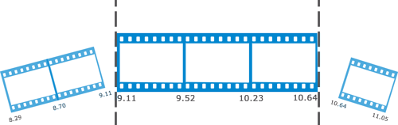
1
2
3
Media Fragments
A Media Fragment is a part of a multimedia object.
Temporal Fragments
sections along the time dimension of the media resource with a start and an end point.
http://www.w3.org/TR/media-frags/
http://www.w3.org/TR/media-frags/

Slide 14
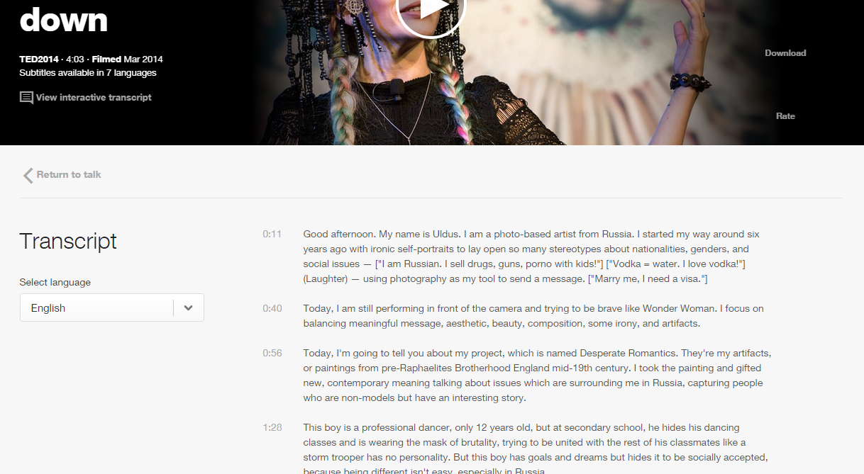
MF creation: chapters
1
2
3
TED Talks have paragraphs:
a human-made subdivision of subtitles.

Slide 15

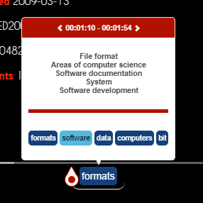
MF creation: hot spots
1
2
3
Extraction of topic from TextRazor and entities from NERD
Clustering of consecutive chapters which talks about similar topics
Filtering of those fragments based on annotation relevance
The Hot Spots are those fragments whose relative relevance falls under the first quarter of the final score distribution.

Slide 16
Research question 2
HOW TO:
how to recommend related media fragments within the same video collection
1
2
3
recommend related media fragments within the same video collection?
design a web application that provides a rich environment for exploring a video collection?
detect segments of interest in a video?

Slide 17
Search Engine indexing
1
2
3
A search engine is a system able to access to information previously stored and indexed.
The search engine indexing is the process of collecting, parsing and storing data to make searches faster.
We use it for indexing annotations in our database

Slide 18
1
2
3
Annotation based index
WHY ANNOTATIONS?
Because they “contain” the meaning of the talk
Because they contain some very useful attributes:
timing references (startNPT and endNPT);
uuid;
relevance references.
WHICH ANNOTATIONS?
Entities and Topics

Slide 19

1
2
3
ElasticSearch
ElasticSearch is an open-source search engine.
It uses Apache Lucene™ for indexing.
It aims to make full text search easy by hiding the complexities of Lucene behind a simple RESTful API.

Slide 20
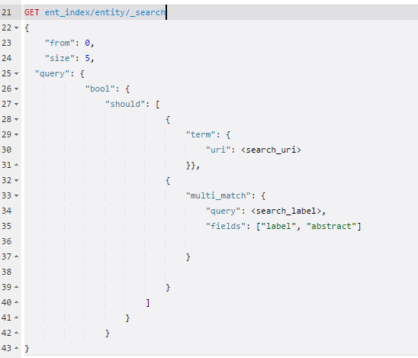
1
2
3
ElasticSearch
HOW TO MAKE A QUERY
ElasticSearch provides a full Query DSL based on JSON to define queries. In general, there are basic queries such as term or prefix.

Slide 21
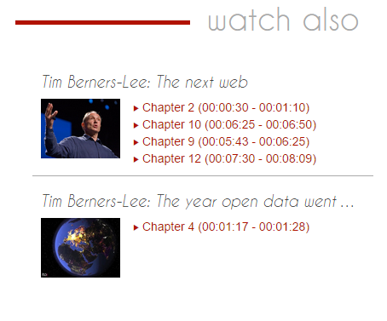
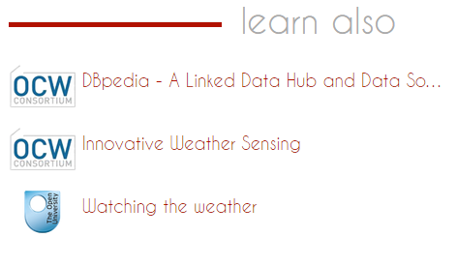
1
2
3
Recommendation
Interlinking through chapters and topic
Interlinking to openCourseware and openUniversity

Slide 22
Research question 3
HOW TO:
how to recommend related media fragments within the same video collection
1
2
3
design a web application that provides a rich environment for exploring a video collection?
recommend related media fragments within the same video collection?
detect segments of interest in a video?

Slide 23
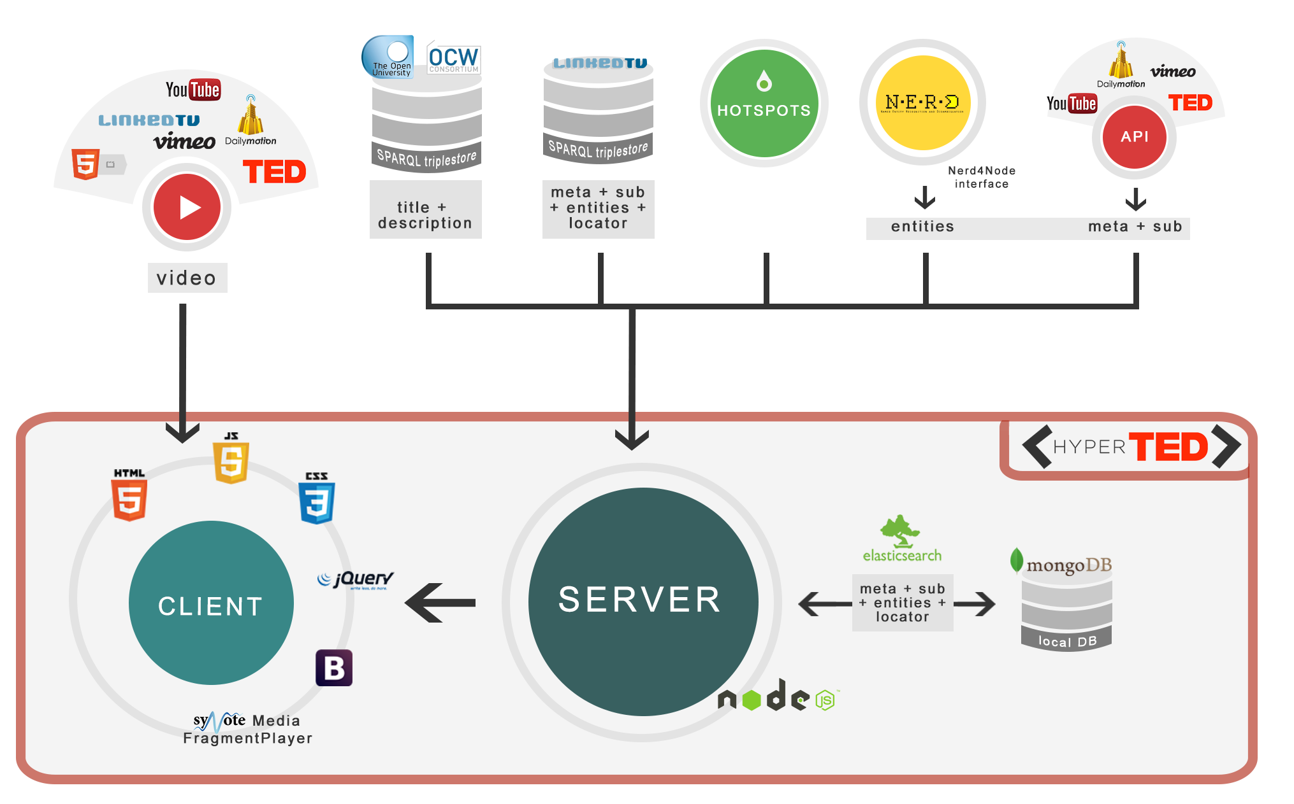
1
2
3
Architecture

Slide 24
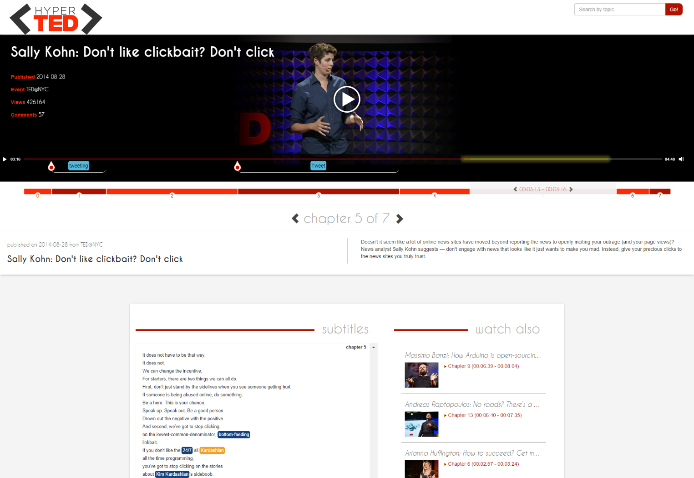
1
2
3
DEMO
http://linkedtv.eurecom.fr/mediafragmentplayer

Slide 25
Conclusions
Evaluation of NER tools in the context of TED Talks
HotSpot detection based on topics and entities
Recommendation algorithm, hyperlinks between fragment of TED talks + external education resources
Nice and responsive UI

Slide 26
Publications
HyperTED is one of the submitted app at the Challenge at LinkedUP - http://linkedup-challenge.org/
José Luis Redondo García, Mariella Sabatino, Pasquale Lisena and Raphaël Troncy.
Detecting Hot Spots in Web Videos. In International Semantic Web Conference (ISWC’14), Demo

