Slide 1
Sparse-Measurement Image Reconstruction
M.Tech in Computer Science & Engineering
St. Joseph’s College of Engineering & Technology, Palai
Guided by:
Rubin Jose Peter (Sc. ‘F’)
Presented by:
Aravind Ashok

Slide 2
Contents
Introduction
Problem Statement
Literature/reference paper studied
Initial Learning Stage
Learning About GAN
Software, Libraries and Functions
Dataset and Experimental Setup
Experimental Results

Slide 3
Introduction
Image reconstruction is the process of recovering an image from incomplete, compressed or limited information.
In this project, the objective is to reconstruct an image from a smaller number of measurements.
Instead of directly using all 784 pixels of an MNIST image, the image is converted into a lower-dimensional measurement.
A reconstruction model is then used to recover the original image.
The project focuses mainly on a GAN-based reconstruction approach.
Conventional methods such as LASSO and SBL are used for comparison.

Slide 4
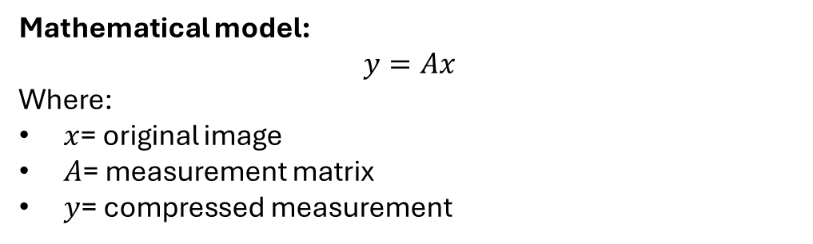
Problem Statement
A high-dimensional image contains a large number of pixel values.
Storing or processing all these values can require more information.
The project studies whether the original image can be reconstructed from a smaller set of measurements.
For MNIST:
  Image size = 28 × 28
  Total pixels = 784
  Measurement dimension used = 100
Therefore, the reconstruction model receives only 100 measurements instead of the original 784 pixel values.
Mathematical model:
$$y=Ax$$
Where:
$x$= original image
$A$= measurement matrix
$y$= compressed measurement

Slide 5
Literature/reference paper studied
No | Paper | Year | Authors | Key Finding | Gap
1 | Sparse Signal Recovery Using Deep Neural Networks (Main paper) | — | Rubin Jose Peter & Chandra R. Murthy | Uses DNN to recover signals from sparse measurements. | GAN-based reconstruction can be further investigated.
2 | Generative Adversarial Network with the Discriminator Using Measurements as an Auxiliary Input for Single-Pixel Imaging | 2024 | — | Uses measurements to guide GAN reconstruction and improve image details. | Focused on single-pixel imaging rather than your general sparse-image setup.

Slide 6
No. | Paper | Year | Authors | Key Finding | Gap
3 | Compressed Sensing Using a Deep Adaptive Perceptual Generative Adversarial Network for MRI Reconstruction from Undersampled K-Space Data | 2024 | Kun Wu, Yan Xia, Nishant Ravikumar & Alejandro F. Frangi | Uses GAN and compressed sensing to reconstruct images from highly undersampled measurements. | Designed specifically for MRI/k-space data.
4 | Ultra-Sparse View Lung CT Image Reconstruction Using Generative Adversarial Networks and Compressed Sensing | 2025 | Zhaoguang Li et al. | Combines compressed sensing and GAN for reconstruction under ultra-sparse measurements. | Focused specifically on lung CT reconstruction.

Slide 7
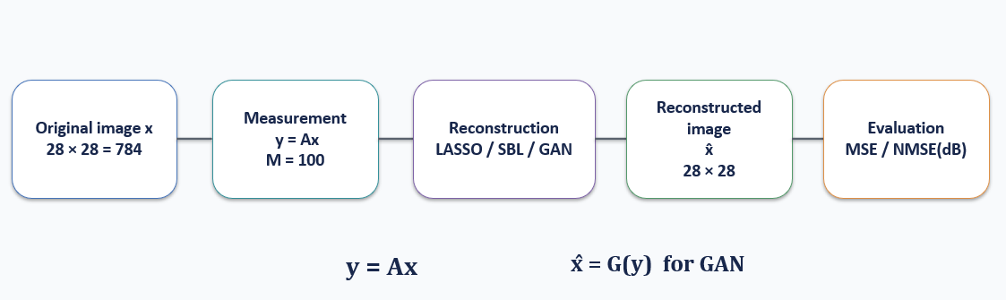
Overall Reconstruction Pipeline

Slide 8

Initial Learning Stage
Initial Learning: DNN
  At the beginning of the project, I studied the basic concepts of Deep Neural Networks.
Topics studied:
  Basic neural network structure
  Input, hidden and output layers
  Neurons and weights
  Activation functions
  Forward propagation
  Loss function
  Model training
  Image reconstruction using neural networks
Learning outcome:
I understood how a neural network can learn a relationship between an input and a desired output.

Slide 9
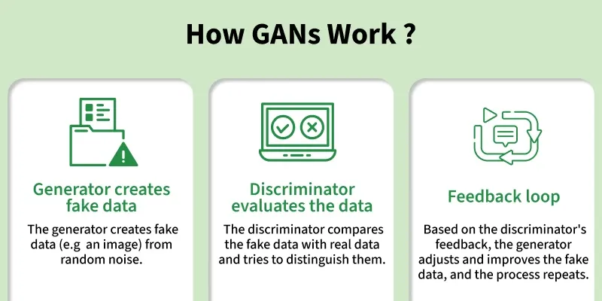
Learning About GAN

Slide 10

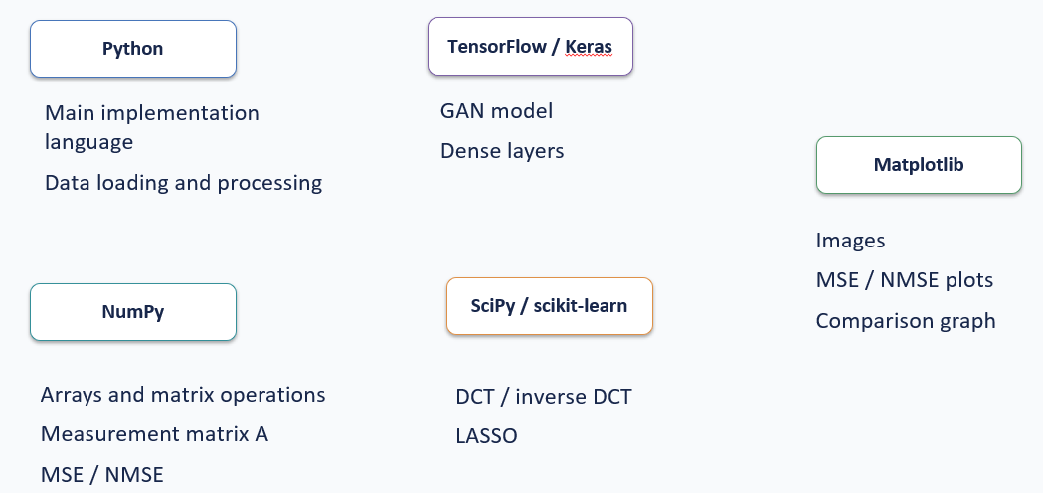



Software, Libraries and Functions

Slide 11
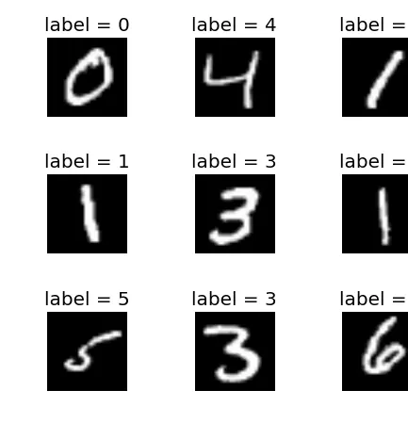
Dataset and Experimental Setup
Dataset: MNIST
Dataset used: MNIST handwritten digit dataset
Image size: 28 × 28 pixels
Number of image values: 784
Pixel values are normalized to the range 0–1.

Slide 12
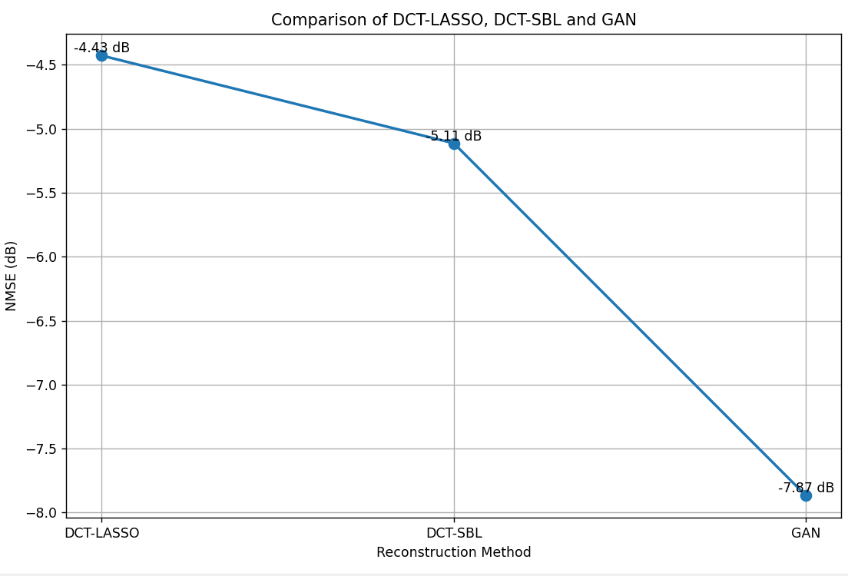
Present - Conventional Comparison
LASSO
Optimization-based sparse recovery method.
Uses L1 regularization.
Used as a conventional baseline.
SBL
Sparse Bayesian Learning.
Bayesian approach to sparse recovery.
Used as another conventional baseline.
Purpose:
The purpose is not to make LASSO or SBL the main project, but to provide reference points for comparing the GAN reconstruction.

Slide 13
Future Work
Planned work:
  Select additional image datasets apart from MNIST.
  Preprocess the new datasets.
  Generate compressed measurements using the same reconstruction framework.
  Test the existing GAN model.
  Test LASSO and SBL on the new datasets.
  Compare the reconstruction results.
  Study the effect of different measurement dimensions.
  Analyze the performance of the models for different types of images.
  MNIST → Additional Datasets → Model Testing → Comparison → Improvement

Slide 14
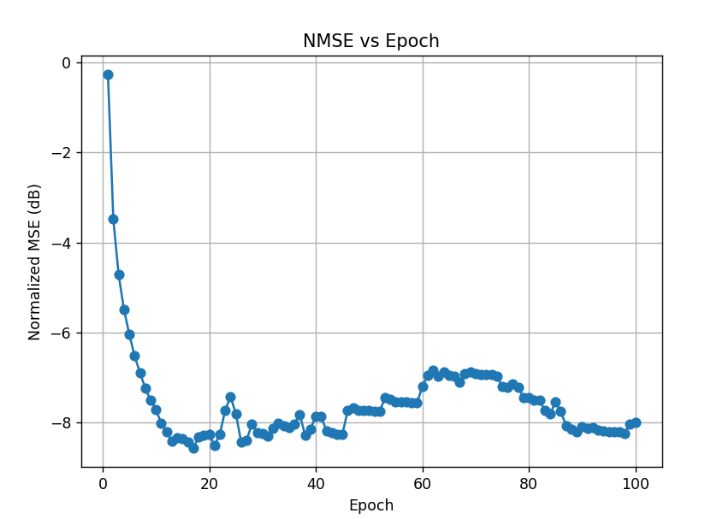
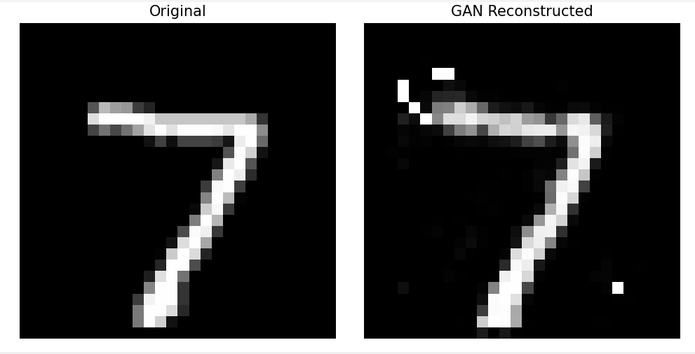
Experimental Results
Original vs Reconstructed MNIST images
N=784 →100
Normalized MSE: 0.12024844

Slide 15
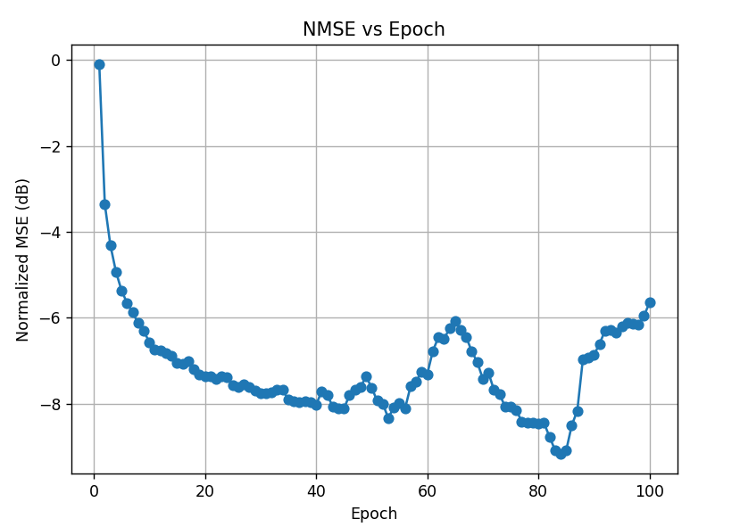
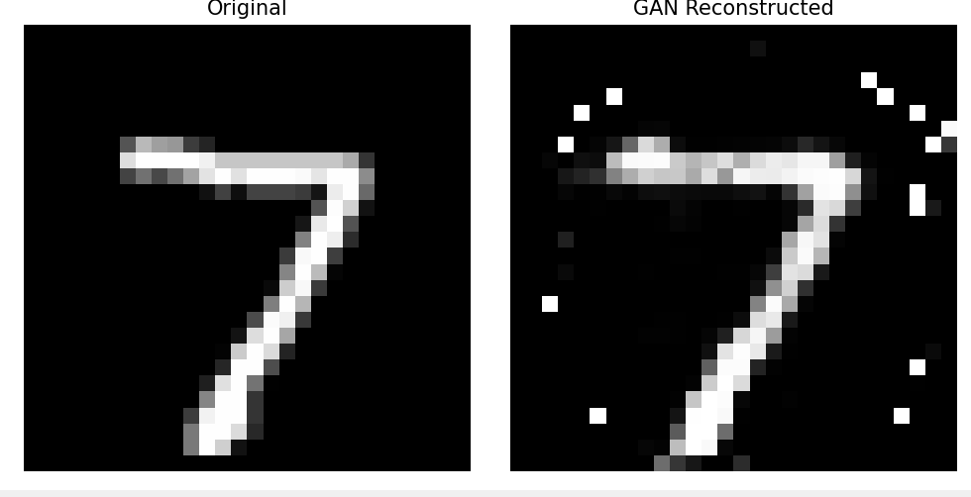
Experimental Results
N=784 →50
Normalized MSE: 0.30164862

Slide 16
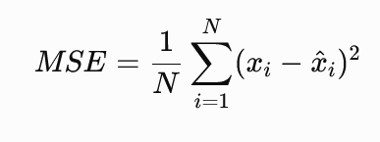
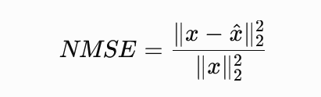

Performance Evaluation
1. Mean Squared Error
2. Normalized Mean Squared Error
3.NMSE in dB

Slide 17
Reference Paper
[1] R. J. Peter and C. R. Murthy, “Sparse Signal Recovery Using Deep Neural Networks.”
[2] Y. Sun, J. Chen, Q. Liu, and G. Liu, “Learning Image Compressed Sensing with Sub-pixel Convolutional Generative Adversarial Network,” Pattern Recognition, vol. 98, 2020.
[3] K. Wu, Y. Xia, N. Ravikumar, and A. F. Frangi, “Compressed Sensing Using a Deep Adaptive Perceptual Generative Adversarial Network for MRI Reconstruction from Undersampled K-space Data,” Biomedical Signal Processing and Control, vol. 96, 2024.
[4] Z. Li et al., “Ultra-Sparse View Lung CT Image Reconstruction Using Generative Adversarial Networks and Compressed Sensing,” Journal of X-Ray Science and Technology, vol. 33, no. 4, 2025.

Slide 18
