Slide 1


APPLE STOCK PRICE PREDICTION
Presented by:
VIDISHA DINESHKUMAR PARMAR
Deep Amish shah
Om RAKESHKUMAR GANDHI

Slide 2

Table of Content
1. Data Overview
~Import Libraries
~Loading Dataset
~Data Description
2. Data Preprocessing
~Data Cleaning
~Data Transformation
3. Exploratory Data Analysis
~Visualization of data
~Graph Analysis
4. Modelling
~Baseline Model
~ARIMA
~SARIMA
~LSTM
~XGBoost
5. Model Evaluation and Comparison
6. Conclusion

Slide 3
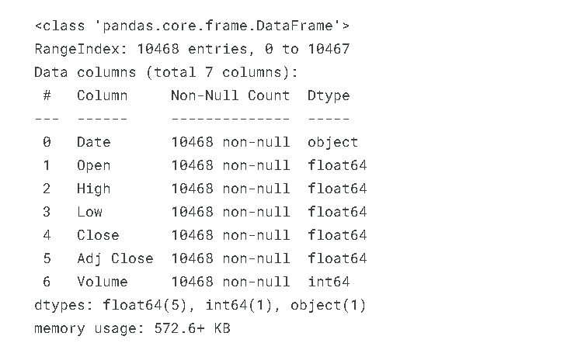
1. Data Overview
The source of the Dataset was from Kaggle. It contains 10467 rows X 7 Columns.
These were the initial features in the provided dataset :
1.Date 2.High 3.Low
4.Open 5.Close 6.Adj Close
7.Volume
The Apple Stock Price Prediction dataset is a collection of historical and relevant financial data designed for predicting the future stock prices of Apple Inc.

Slide 4
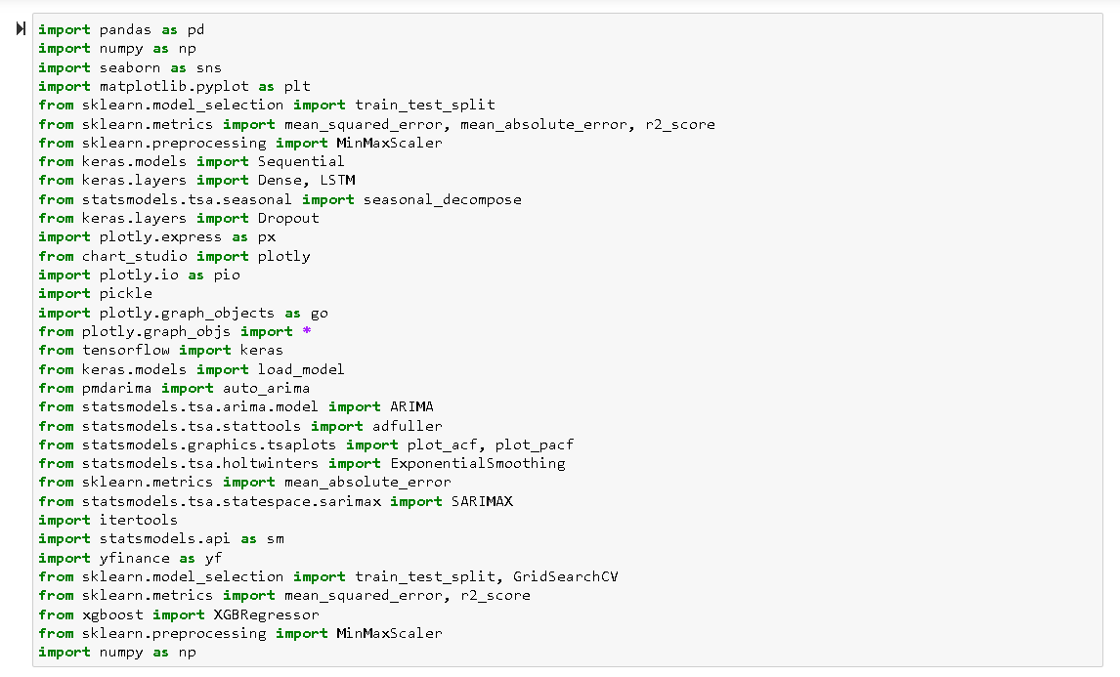
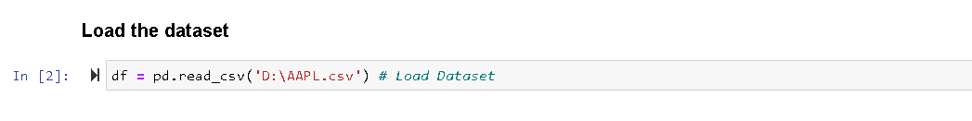
Data Description
Importing Libraries
1. There are 10,467 observations in the dataset.
2. The minimum and maximum values for Open, High, Low, Close, and Adj Close prices are significantly different, indicating a large range of values for these variables.
3. The standard deviation for each variable is also quite large, indicating a high degree of variability in the data.
4. The volume values in the dataset also have a large range of values, with a mean value of 3.3 billion. rephrase this
Loading of Dataset

Slide 5
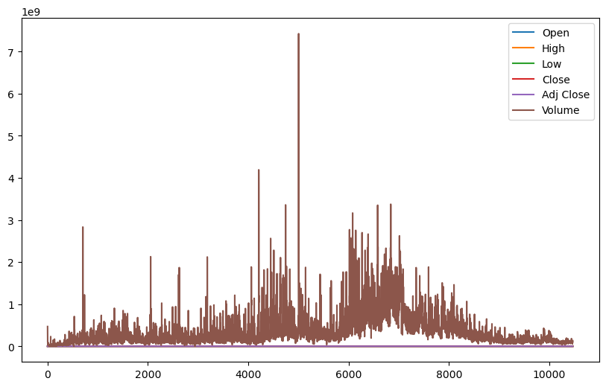
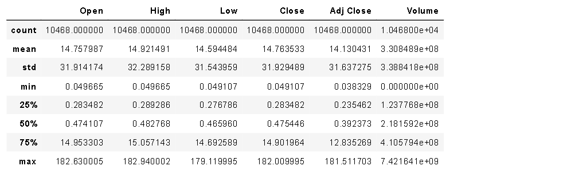
Data Statistics
The provided data summarizes financial market information for a dataset, including statistics such as mean, standard deviation, minimum, maximum, and quartiles for columns like Open, High, Low, Close, Adj Close, and Volume. It represents the statistical distribution of prices and trading volume for a financial instrument.
The standard deviation for each variable is substantial, indicating a high level of variability in the dataset.
The volume values display a wide range, with an average value of 3.3 billion, pointing to substantial variation in trading volumes.

Slide 6

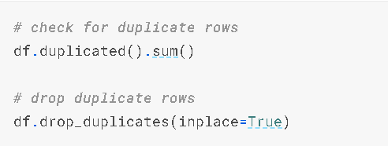
2. Data Preprocessing
1. Data Cleaning:
df.isnull().sum(): This command checks for missing values in each column of the DataFrame (df). The result shows the count of missing values for each column.
df.duplicated().sum(): This checks for duplicate rows in the DataFrame. If there are duplicates, they are dropped using df.drop_duplicates(inplace=True)

Slide 7

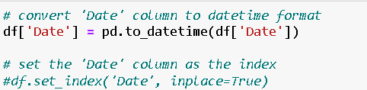
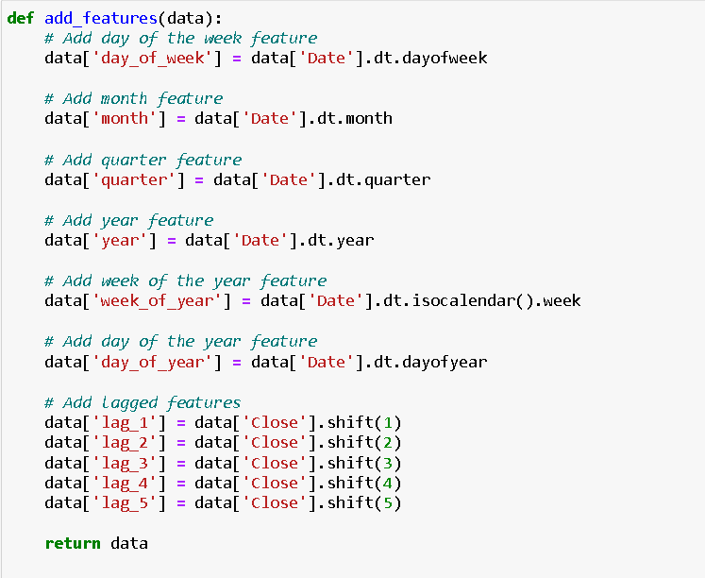
2.Data Transformation:
Result: The resulting DataFrame (df) now includes the added time-related features and has been cleaned of duplicates and missing values. The 'Date' column serves as the index, and additional features like day of the week, month, etc., have been incorporated. Lagged features represent historical values of the 'Close' column, and the DataFrame is ready for further analysis or modeling.
The function add_features(data) is defined to add additional time-related features to the DataFrame, such as day of the week, month, quarter, year, week of the year, day of the year, and lagged features (past values of the 'Close' column).
Checking the data types of columns using df.dtypes reveals that the 'Date' column is of type 'object'.

Slide 8
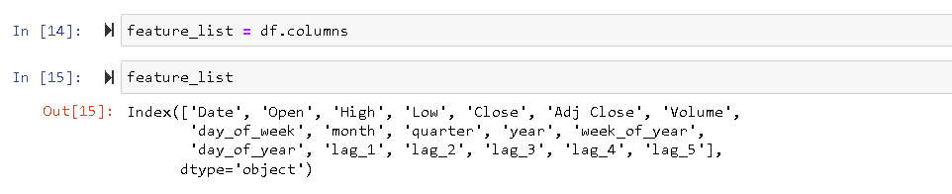
3.EXPLORATORY DATA ANALYSIS:
DATA ANALYSIS OF THE DATASET
List of Columns
Boxplots for Numeric Columns:
Scatter Plots for Numeric Columns:
Line Plots for Time Series Columns:
Correlation Heatmap:
Distribution and Line Plots for Close Prices:
1. List of Columns:
Exploratory Data Analysis involves conducting initial examinations of data to uncover patterns, identify anomalies, test hypotheses, and validate assumptions using summary statistics.
Generates a list containing the names of the columns in the DataFrame.

Slide 9
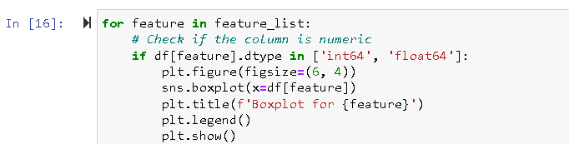
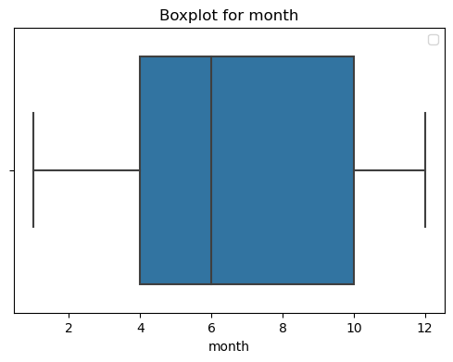
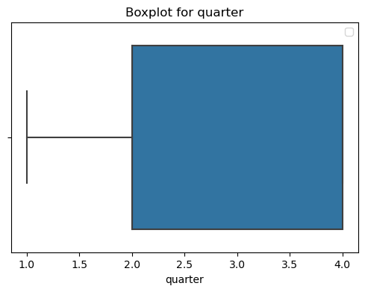
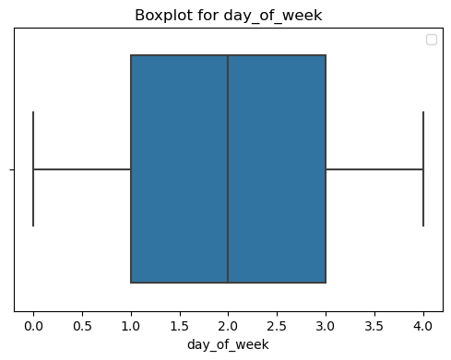
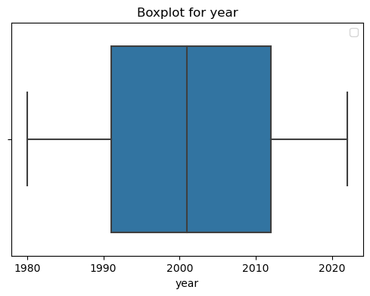
2.Boxplots for Numeric Columns:
These box plots provide a concise visual summary of the distribution of data, helping to identify central tendencies, spread, and potential outliers for each numeric column in the dataset.

Slide 10

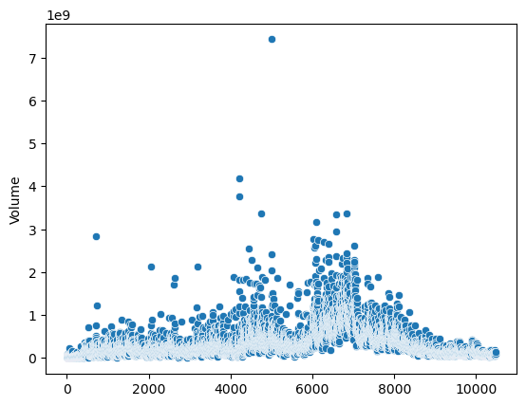
3. Scatter Plots for Numeric Columns:
X and Y Axes:
The x-axis represents the index of the DataFrame, indicating the position or order of data points.
The y-axis represents the values of the 'Volume' column, showing how the volume of trading changes over time.
Patterns and Trends:
This Scatter plot demonstrates trading volume patterns or trends.
Look for clusters, trends, or any noticeable changes in the spread of points. For example, sudden spikes in volume indicate significant trading activity on specific dates.
Outliers:
Outliers in the scatter plot represent days with unusually high or low trading volume. Identifying these outliers can be crucial for understanding exceptional market events.

Slide 11
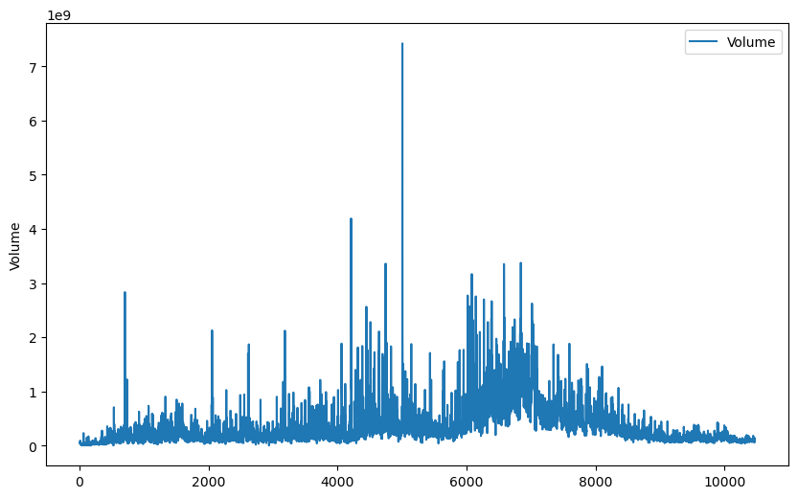
4.Line Plots for Time Series Columns:
x-axis (x=df.index): The index of the DataFrame is used as the x-axis, which often represents time for time-series data.
y-axis (y=df['Volume']): The values of the 'Volume' column are plotted along the y-axis, showing how the trading volume changes over time.
Interpretation:
The line plot provides a visual representation of how the trading volume ('Volume') fluctuates over the time span covered by the data frame.
Each point on the line corresponds to a specific date, and the line connects these points, allowing you to observe trends and patterns in the volume data.
Upward or downward trends in the line indicate periods of increasing or decreasing trading volume period

Slide 12
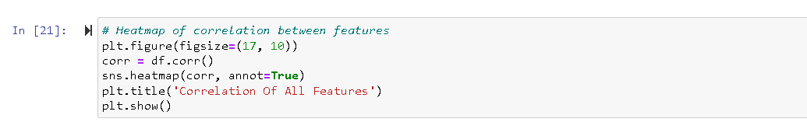
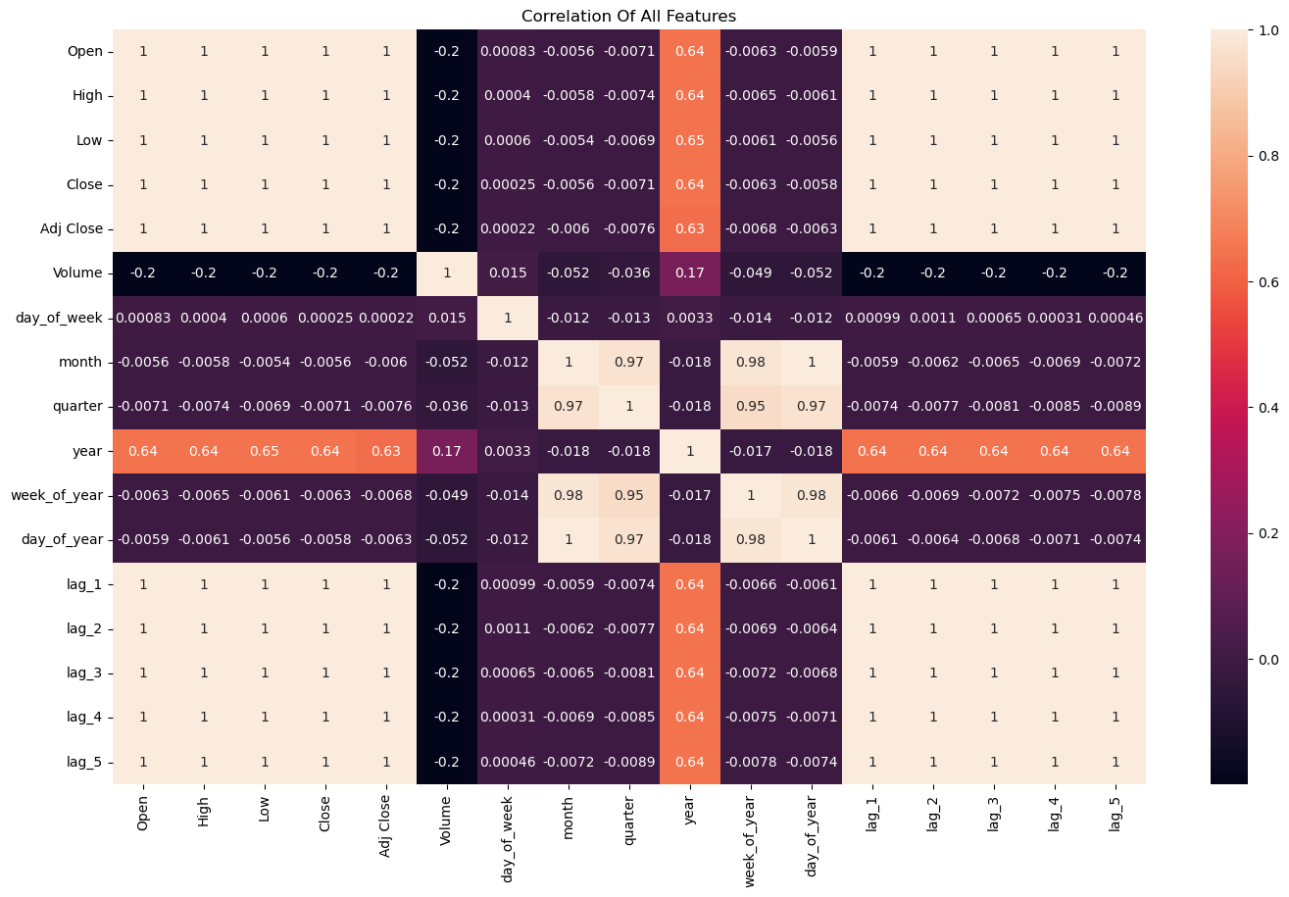
5.Correlation Heatmap:
Interpretation:
Correlation Strength:
This heatmap allows us to quickly identify which pairs of features have strong positive or negative correlations.
Patterns and Relationships:
Patterns in the heatmap help to relationships between different features. For example, if 'Open' and 'Close' columns have high positive correlation, it suggests a strong relationship between the opening and closing prices.
Multicollinearity:
High correlations between pairs of features might indicate multicollinearity, which is when two or more features are highly correlated. In regression analysis, multicollinearity can affect the stability and interpretability of the model.

Slide 13
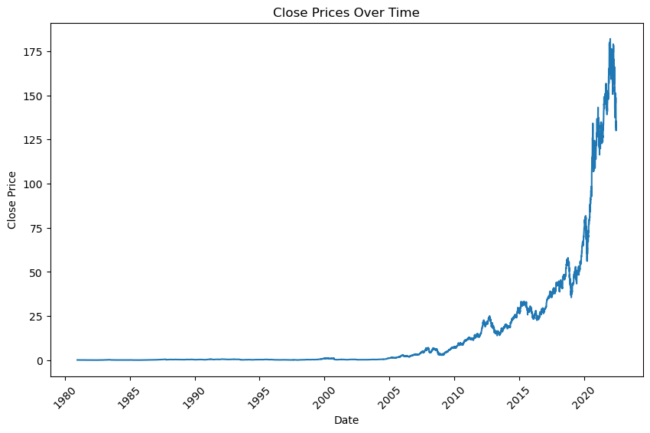
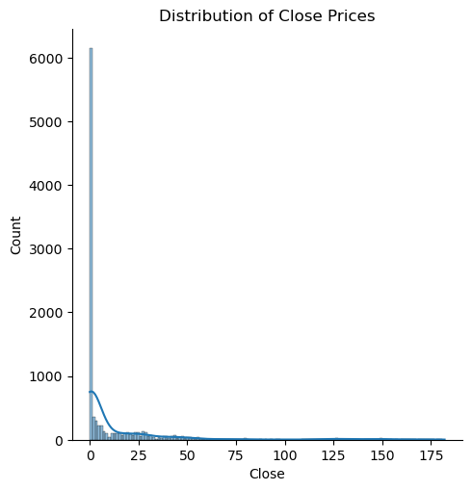
6.Distribution and Line Plots for Close Prices:
The distribution plot provides insights into the overall distribution of 'Close' prices
The line plot complements this by showing the temporal evolution of 'Close' prices, allowing for the identification of trends or patterns over time.
These visualizations help in understanding the central tendencies, distributions, and temporal patterns in the 'Close' prices of the dataset.

Slide 14
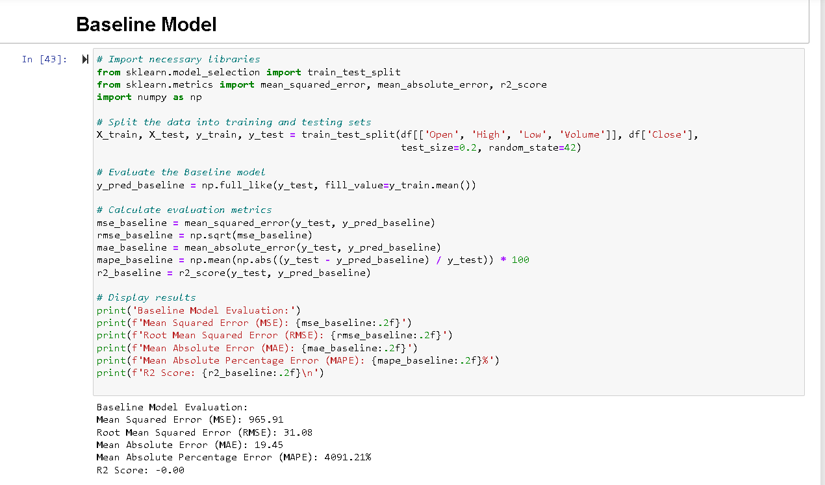
5. Modeling
1. Baseline Model
Base Line Model
AutoRegressive Integrated Moving Average Model (ARIMA)
SARIMA Model
Long Short-Term Memory Model (LSTM)
XGBoost Model

Slide 15
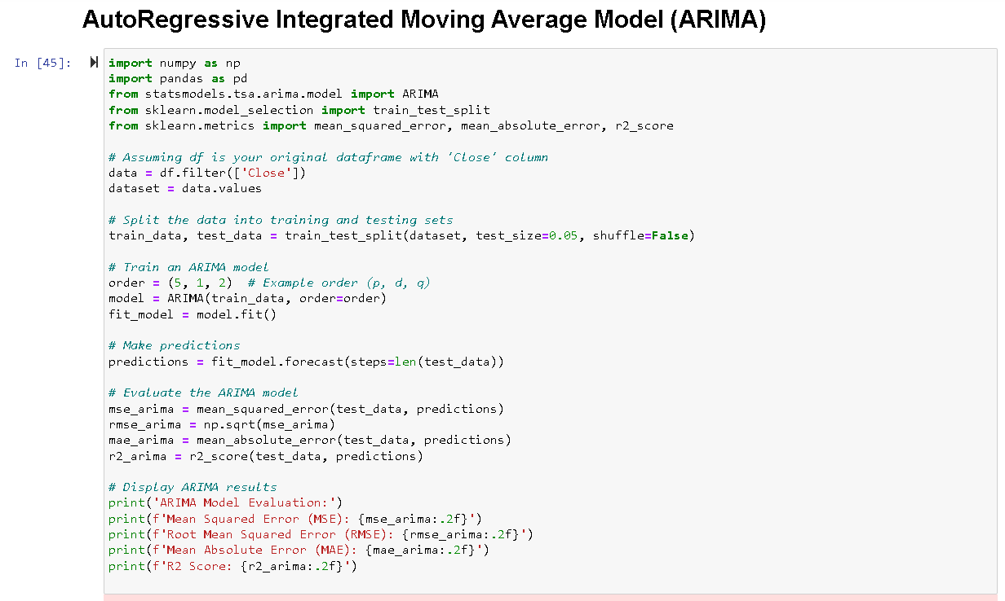
2.AutoRegressive Integrated Moving Average Model (ARIMA)

Slide 16
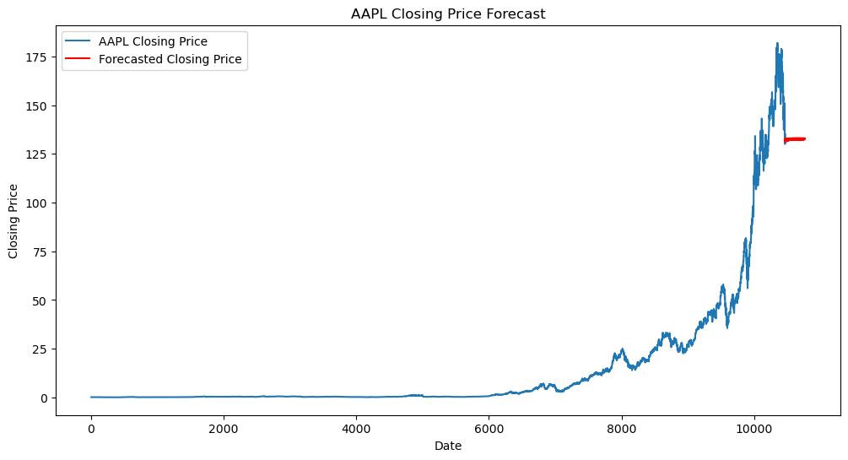
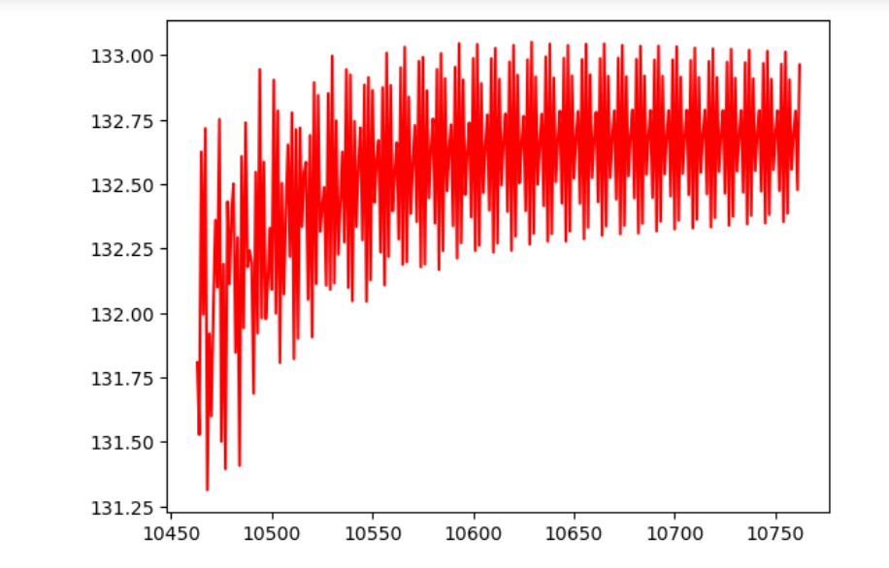

Slide 17
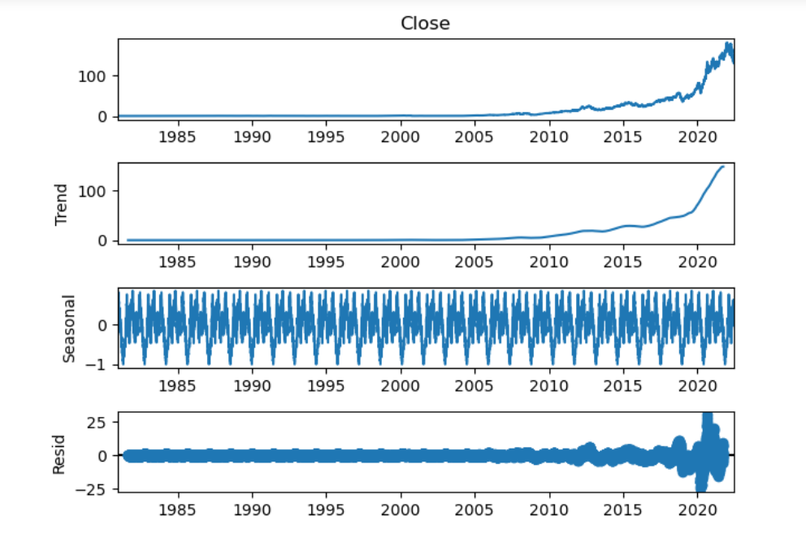

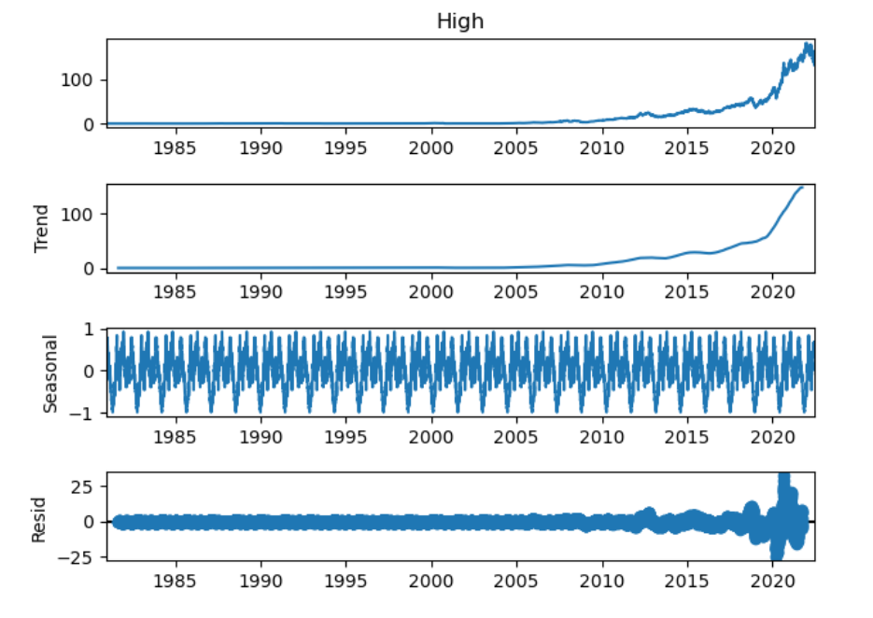
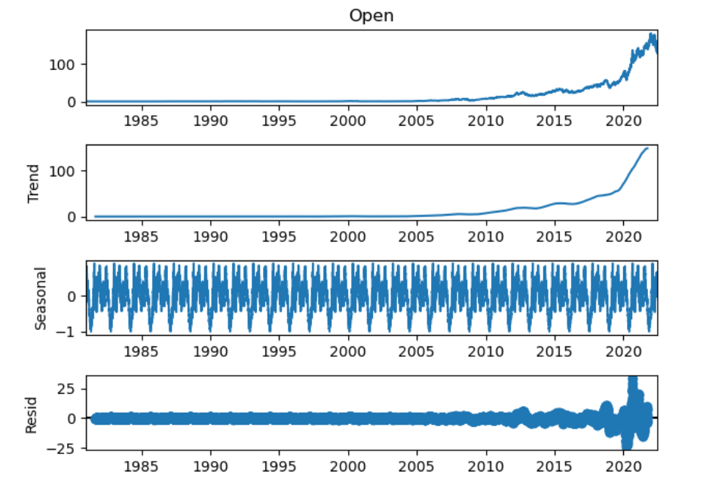

Slide 18
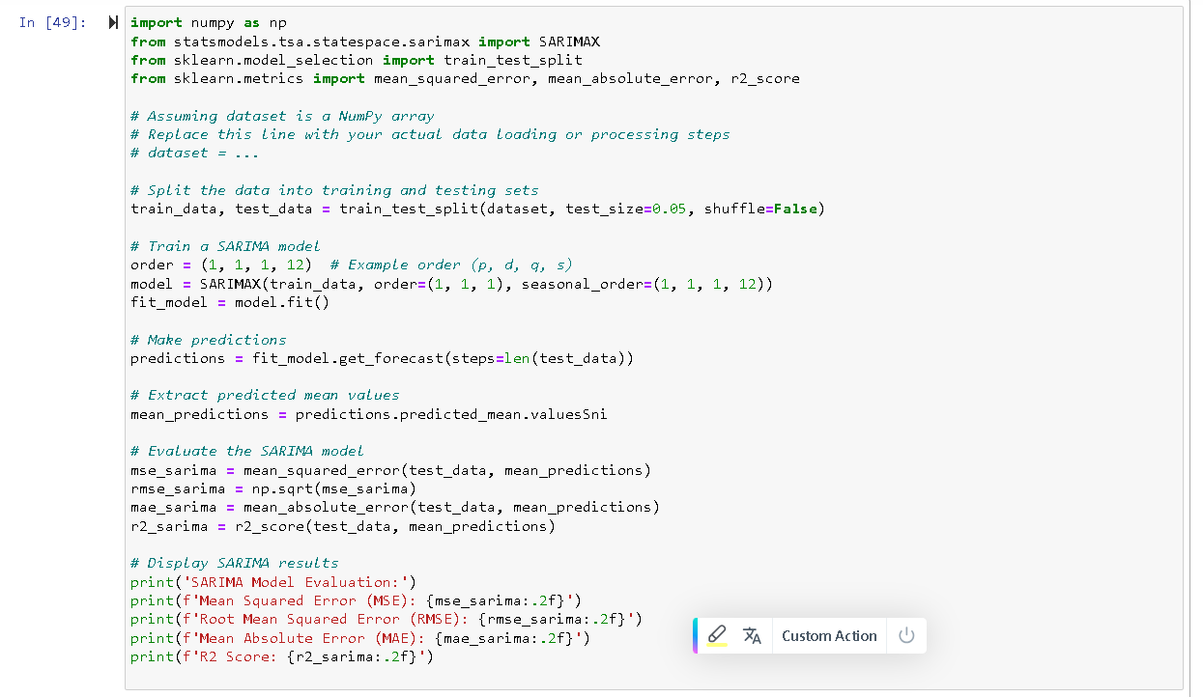
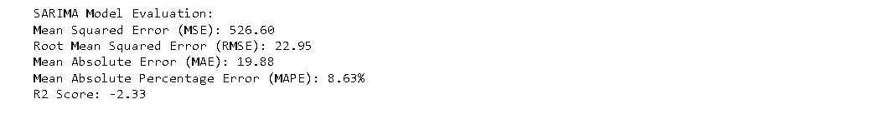
3.SARIMA Model

Slide 19
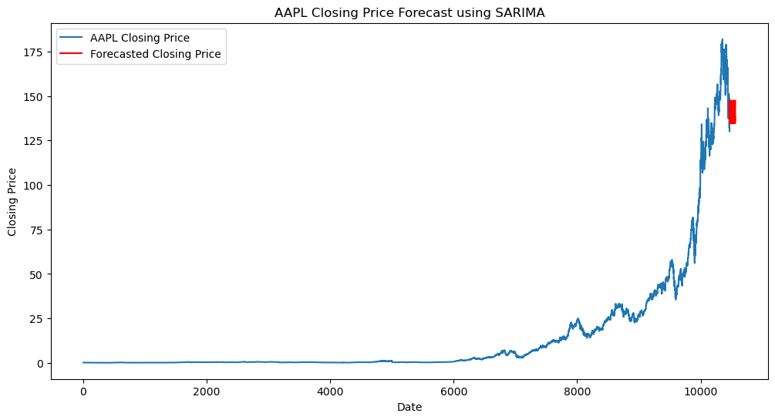
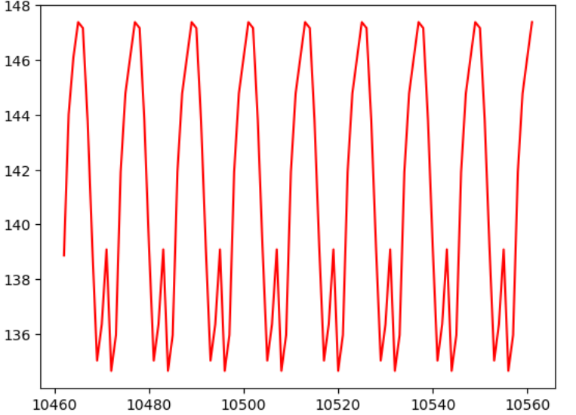

Slide 20
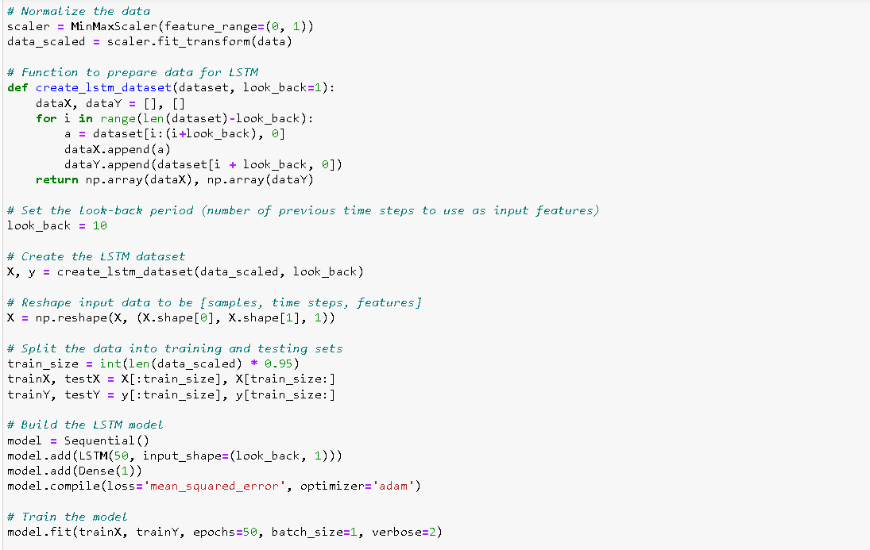
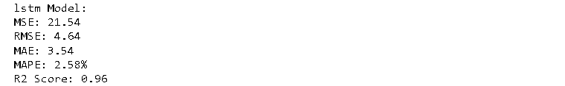
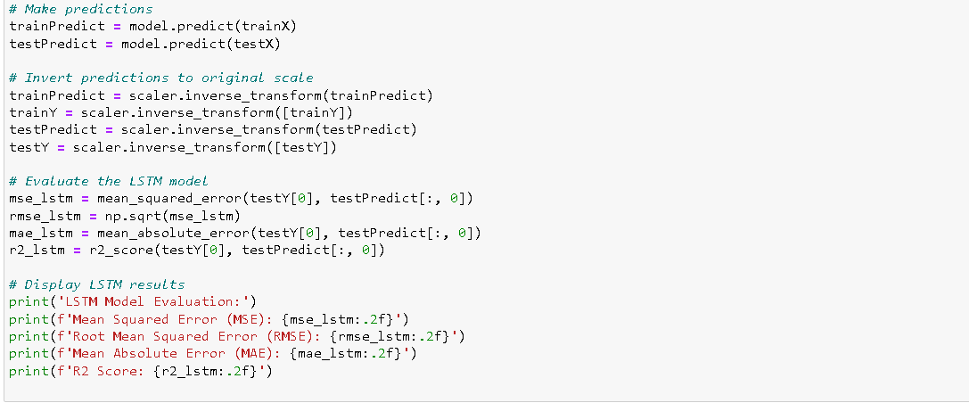
4.Long Short-Term Memory Model (LSTM)

Slide 21
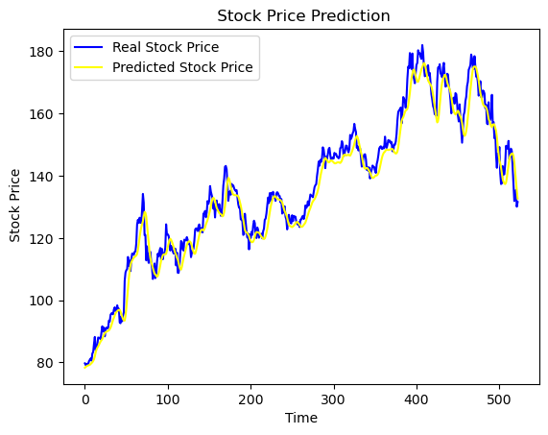

Slide 22
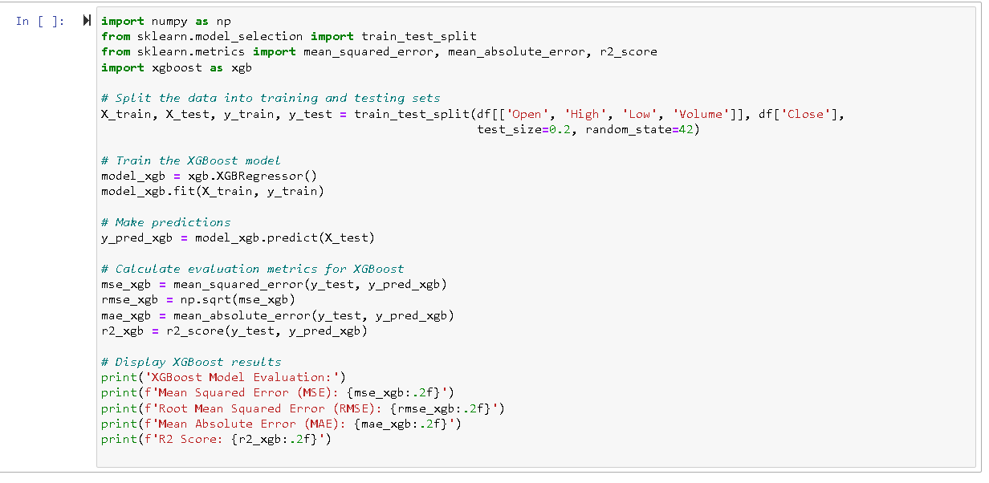
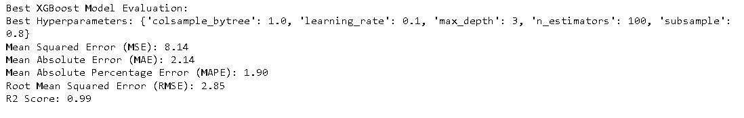
5.XGBoost Model

Slide 23
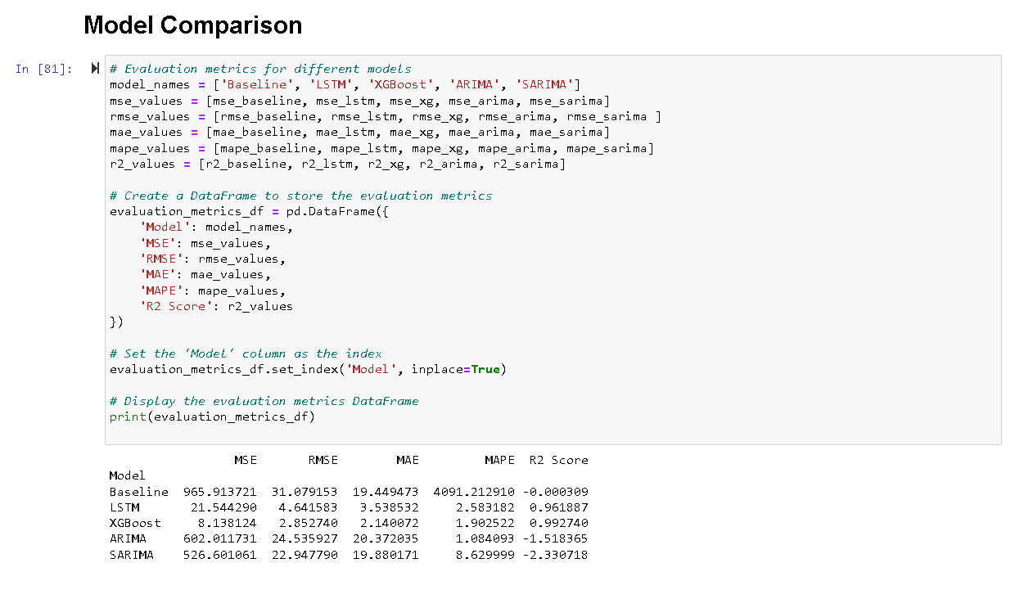
6.Model Comparison

Slide 24
7.Conclusion
In the course of this project, an examination and forecast of the stock prices of Apple Inc. were undertaken. The initiative commenced with the preprocessing of data, involving meticulous refinement, and the execution of feature engineering techniques to discern pertinent insights from the raw dataset. Following this, a thorough exploratory data analysis was conducted to illuminate valuable perspectives and elucidate the intricate relationships existing among diverse features and the ultimate target variable.
Subsequently, we constructed five distinct machine learning models aimed at forecasting stock prices. These models encompassed the Baseline Model, LSTM, ARIMA, XGBoost, and SARIMA Model. An exhaustive evaluation of their performance was conducted, employing a diverse set of metrics such as mean squared error, root mean squared error, mean absolute error, mean absolute percentage error, and R-squared score.
The outcomes of our analysis revealed that both the LSTM and XGBoost models exhibited the most favorable performance, characterized by the lowest mean squared error, mean absolute error, and mean absolute percentage error, along with the highest R-squared score. Notably, the SARIMA model demonstrated potential, suggesting that additional optimization and fine-tuning could potentially yield improved results in the future.

Slide 25

Thank you

