Slide 1
FUMG
Firefighter's Unknown Monster Grounds
Gotta Extinguish/Burn Them All
Made by:
Dinal Patel
Craig Justin Balibalos
Jonathan Dimitriu

Slide 2
Agenda
Game Story
Controls
Game Rules
Main Menu
Tutorial Level
Main Level
Assets
Road Blocks during Implementation

Slide 3

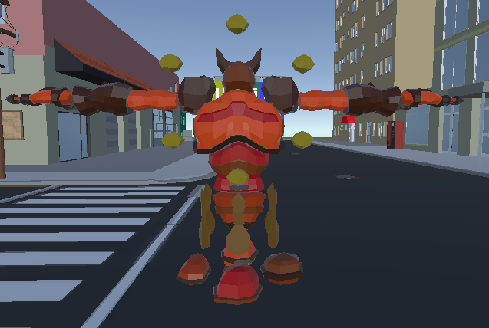
Game Story
Firefighters vs Hellbringers
Hellbringers come to take their land back but one firefighter was not going to let that happen.

Slide 4
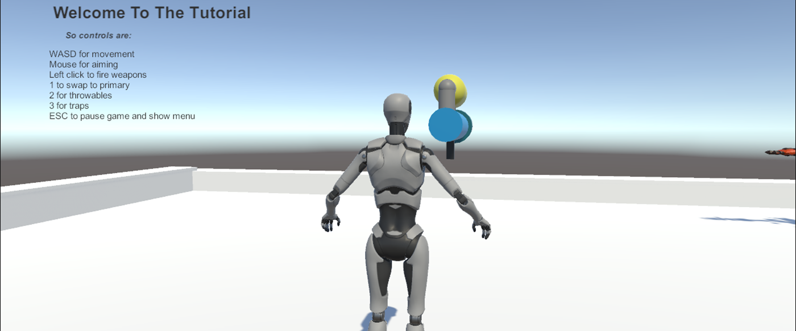
Controls

Slide 5
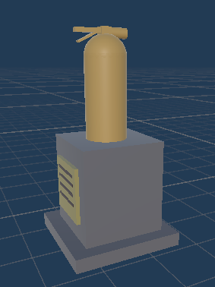
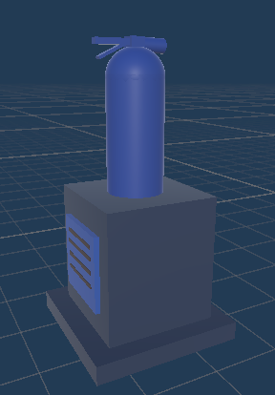
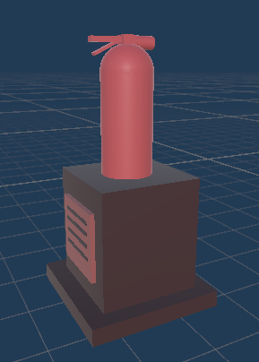
Game Rules
Find the objective and turn it blue.
You want to keep it blue until your score becomes 100.
Hellbringers will make it red and if they succeed to reach a score of 100, you lose.

Slide 6
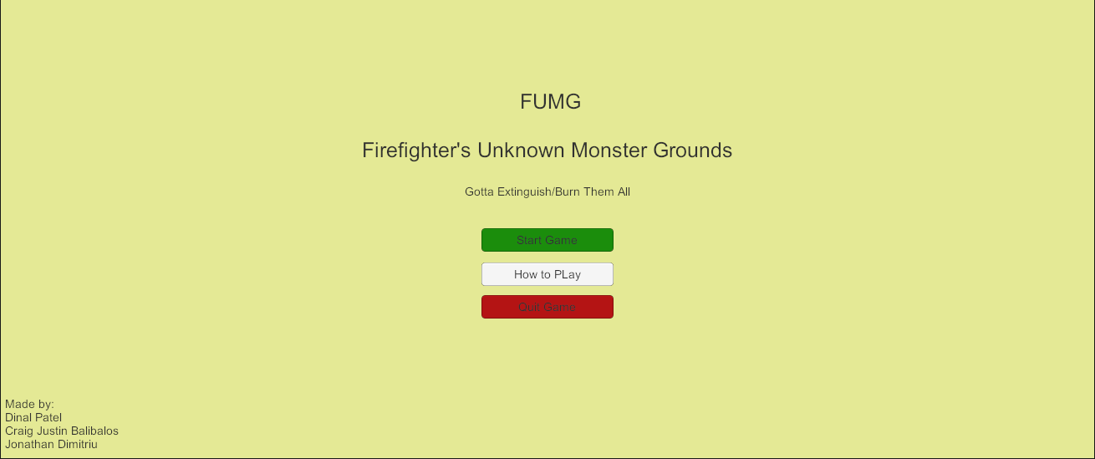
Main Menu
Responsible for welcoming end user to the game
Buttons to start game, start tutorial, and quit

Slide 7
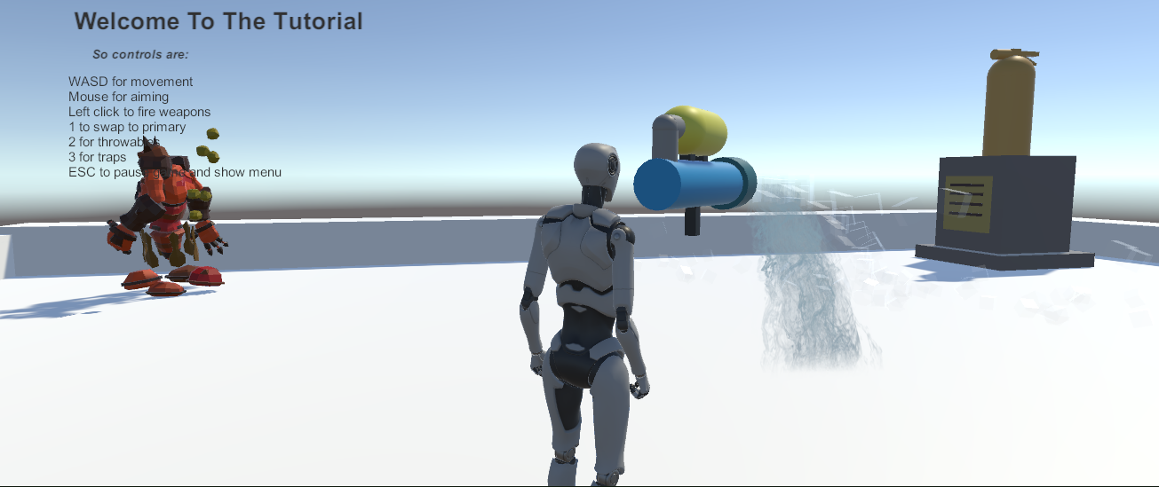
Tutorial level
Introduces the game mechanics. Shows how to play game
Introduces game on a small scale

Slide 8
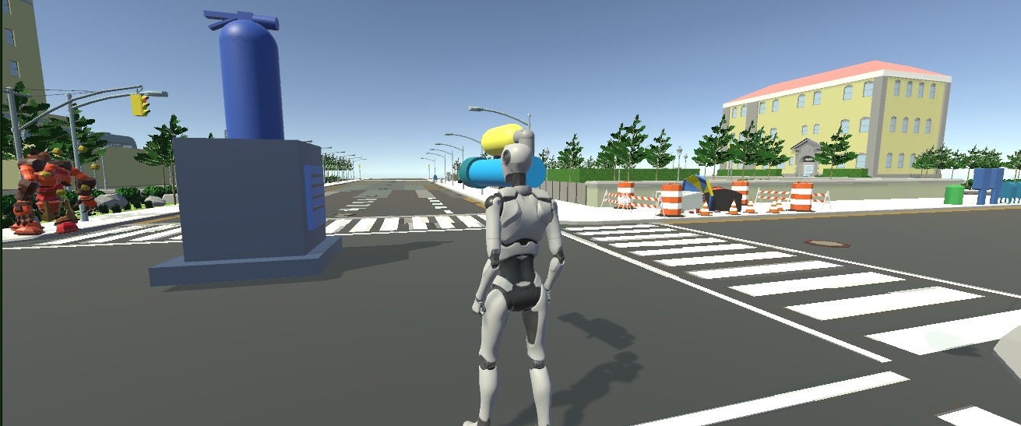
Main Level
In the city map
Hellbringer walks around freely trying to make objective red while player tries to make it blue.

Slide 9
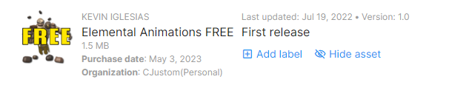
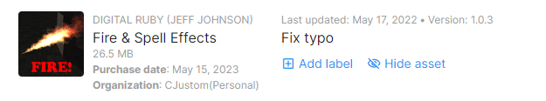
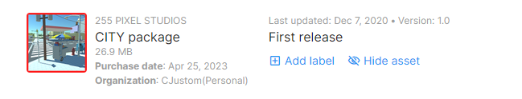
Assets
The City map, enemy models and effects are from the Unity Asset Stores.

Slide 10
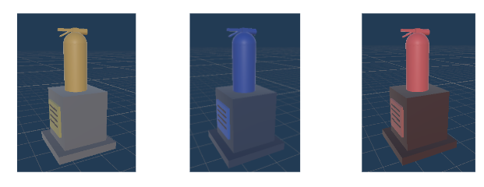
Assets (contd.)
The Objective Prefabs and most of the weapon prefabs are made in Unity

Slide 11
Road Blocks during Implementation
Difficulties Implementing
Player and Camera Movement
Objective Behaviour
Score Increase Logic
AI Script
Importing Assets
Scratched Features
Traps and Throwables
EXP function

Slide 12
Thank you
for
Listening
to our Presentation!

