Slide 1
Bulls and cows
a.k.a Mastermind

Slide 2
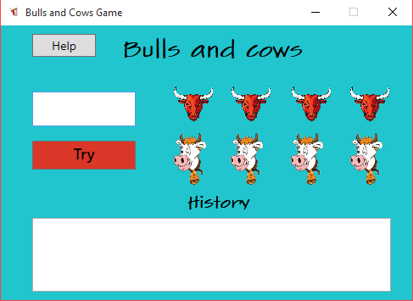
The main window

Slide 3
Rules!
Goal
To be the first player to successfully decode the computer's secret number.
Setup
The computer generates a four-digit number.
The digits must all be different. (For example, 4729 would be legal, but 4724 would not be legal.)
Gameplay
In turn, players try to guess the random number. The computer responds by announcing the number of matches.
A digit which is in the number but not announced in the correct position is a "cow." A digit which is in the number and is announced in the correct position is a "bull."
Winning
When the player reveals the computer’s secret number

Slide 4
How to play?
You have 4 bull pictures, 4 cow pictures, history box, 2 buttons and textbox.
You must enter your number into the textbox, and click the button that says “Try”, to check if you guessed correctly.
The cow images will tell you how many cows you have in your number
The bull images will tell you how many bulls you have in your number
The history box will save your previous inputs and the count of bulls and cows that you had with every number that you’ve tried.
The “Help” button will open Help window, which will give you the rules of the game, and tell you how to use the program. It won’t give you any tips for the secret number.

Slide 5
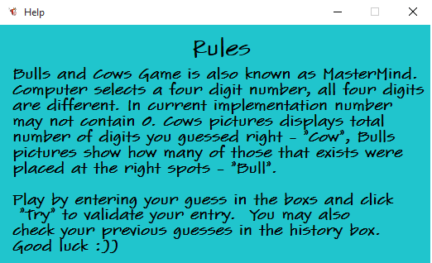
The help window

Slide 6
When will it end?
To put it simply… It won’t. You have unlimited tries to guess the number.
Why? Because we want you to have fun and try your best when playing, and not be pressured by turns or anything like that, certainly helps.
This is why we decided to give awards to everyone that completes the game. As of now there are 4 medals that you can get for beating the game. Which one you will get is based on how many turns you did.
Lucky medal – 1 turn
Gold medal – between 2 and 5 turns
Silver medal – between 6 and 10 turns
Bronze medal – more than 10 turns
After you guess the number right, you will get the Victory Window, which gives you your medal, and tells you in how many moves you’ve beaten the game.

Slide 7
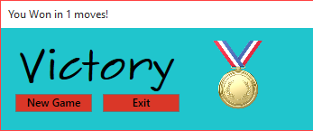
The Victory Window

Slide 8
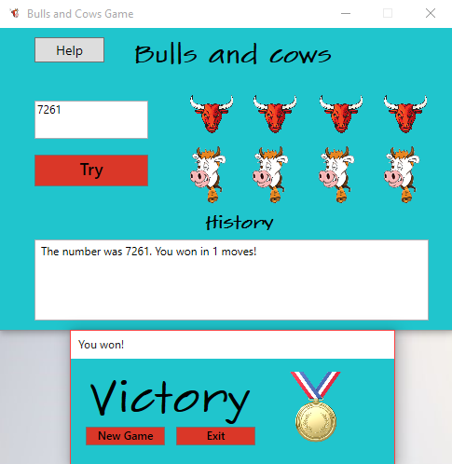
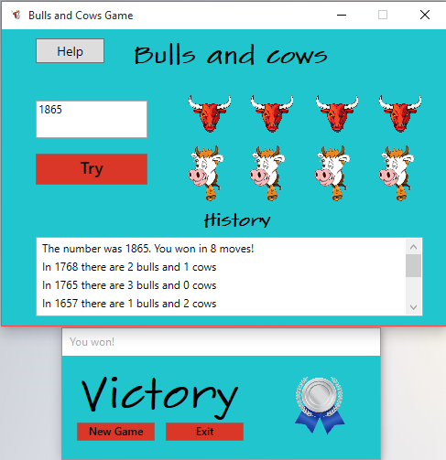
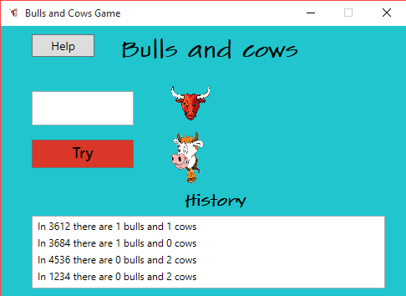
More pictures!

Slide 9
The team
Team Name – baldinvestir
Team Members:
simeon10
ipstoychev
anamaryat
stanimir.hadgistefanu
GitHub Project Link - Team-baldinvestir

Slide 10
Contributions of each team member:
We’ve all worked together in this project, so we can’t provide separate contributions. We’ve often worked on a single computer while talking through what we are doing and why are we doing it. We’ve helped each other in any possible way, explaining to each other why should we do something in certain way, etc. That way we were more confident that all of us are going to be on the same page, when it comes to the project. We didn’t need to check each others code, because when we are working together on it, there is no chance that we can make a mistake, without noticing it.

Slide 11
One more thing!
Good luck && Have Fun

