Slide 1
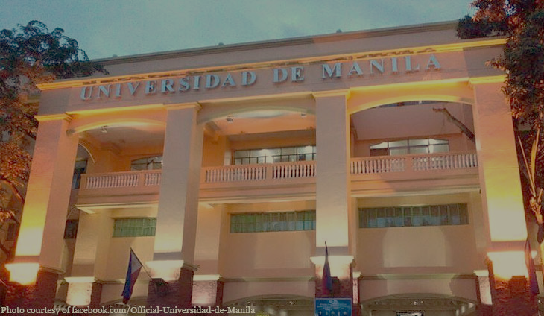



Universidad de Manila
SENIOR HIGH SCHOOL DEPARTMENT
Effectiveness of Using Broadcast Messaging for Information Dissemination in UDM-SHS
A Research Proposal Presented to
the Faculty Members of
Universidad De Manila - Senior High School Department
In Partial Fulfillment
of the Requirements for the Subject
Practical Research 2
By:
Viray, Kurt Germagne L.
Espejo, John Gabriel R.
Angeles, Jhay Cyrus J.
Balboa, Marc Jerome S.
Cruz, James T.
Miguel, James I.
Salcedo, Ray M.
Navarro, Emmanuel S.
Ortañez, John Khristoferson F.
Reyes, Jouland Cyrel G.
Barroga, Michael Daniel A.

Slide 2
Universidad de Manila
SENIOR HIGH SCHOOL DEPARTMENT
CHAPTER 1
THE PROBLEM AND ITS BACKGROUND
The method through which facts are made available to the general public is known as information dissemination (Best Communications Degrees, 2018). Block printing, invented in China during the T'ang dynasty, was the first widely used method of mechanically copying writings (618–907). Symbolic lettering and images were carved into wooden blocks, inked, and transcribed onto paper (Slamecka, 2018). Along with the development of civilizations, numerous ways for disseminating knowledge were developed from this point on. Modern technology was made possible by these breakthroughs. These technologies are now used as tools for disseminating information.
Text messaging, which is one of these technologies and is carried out by a wireless carrier, is the act of exchanging brief, alphanumeric communications between cellphones, pagers, or other handheld devices (Mathias, 2017). Texting, often referred to as short message service (SMS) or instant messaging, has overtaken phone calls and in-person interactions as the preferred method of communication among adolescents. According to estimates, approximately 66% to 80% of adolescents own cell phones (The Lawyers & Jurists, 2020). It also does not require Internet connectivity, making it a potential strategy for disseminating information.

Slide 3
Universidad de Manila
SENIOR HIGH SCHOOL DEPARTMENT
Another form of text messaging is broadcast messaging, wherein text messages are sent in bulk to a list of recipients all at once. It is often used by companies and organizations to easily disseminate information to the corresponding employees and staff. Similar to a mailing list to receive emails, the recipient must also agree first to receive the text messages, so the messages will not be sent to just anyone (Impactive, 2021). In an environment like a school that holds over a thousand constituents, broadcast messaging is capable of providing information to multiple individuals simultaneously. Together with all the factors mentioned about text messaging’s efficiency, it is safe to assume that broadcast messaging has potential when it comes to disseminating information effectively to a large group of people.
In the context of UDM-SHS, the only way the school disseminates information is through social media, specifically through a Facebook page moderated and managed by the school. On August 13, 2018, the "UDM SHS Student Council" Facebook page was established. Since then, informative news and announcements have been posted on the page to spread awareness and keep students and parents alike in the loop. The fact that the university possesses only one strategy for disseminating information is in itself a potential weakness and a vulnerable point in the school’s information network. Conducting this quasi-experimental research may help the university determine if adding another method of disseminating information is necessary and beneficial. Incorporating broadcast messaging could possibly help in improving the efficiency of the university’s senior high school department’s information dissemination.
The purpose of this research is to see if there will be a significant change if broadcast messaging is added along with social media as the current information dissemination strategy. It proposes a solution in order to enhance the current dissemination of information in the senior high school department of Universidad de Manila. It might benefit the students and faculty members to have more outlets to receive information from.

Slide 4
Universidad de Manila
SENIOR HIGH SCHOOL DEPARTMENT
THEORETICAL FRAMEWORK
This study is anchored on the "Unified Theory of Acceptance and Use of Technology" (UTAUT) (Venkatesh et al., 2003). According to the UTAUT theoretical paradigm, behavioral intention determines whether technology is actually used. The expected possibility of implementing the technology is directly influenced by performance expectancy, effort expectancy, social influence, and facilitating conditions. The influence of predictors is moderated by factors such as age, gender, experience, and willingness to use.
Performance expectancy is defined as "the degree to which an individual believes that using the system will help him or her to attain gains in job performance" (Venkatesh et al., 2003). It is the greatest predictor of use intention among the four components and is significant in both voluntary and obligatory situations.
Effort expectancy is defined as "the degree of ease associated with the use of the system" (Venkatesh et al., 2003). After prolonged technological use, its impact becomes negligible.

Slide 5
Universidad de Manila
SENIOR HIGH SCHOOL DEPARTMENT
Social influence is defined as "the degree to which an individual perceives that important others believe he or she should use the system" (Venkatesh et al., 2003). This implies that an individual’s behavior may be altered and adjusted according to the perceptions of others about them. When using technology is required, social influence has a significant impact (Venkatesh et al., 2003). People may use technology in a mandated situation because it is a requirement for conformity, but not out of personal inclination (Venkatesh & Davis, 2000).
The degree to which an individual believes that an organization's and technical infrastructure exist to support the use of the system is defined as facilitating conditions (Venkatesh et al., 2003).The intention to use is directly influenced by facilitating conditions, although the influence becomes minimal after the initial usage. As a result, the model suggests that facilitating conditions have a direct and significant impact on usage behavior (Venkatesh et al., 2003).
The strength of predictors on intention is defined by the moderating effects of age, gender, experience, and voluntary usage. All four predictors' effects are moderated by age. Relationships between effort expectancy, performance expectancy, and social influence are moderated by gender. The correlation between effort expectancy, social influence, and facilitating conditions is moderated by experience. Only the connection between social influence and behavioral intention is moderated by the voluntariness of usage (Venkatesh et al., 2003).

Slide 6
Universidad de Manila
SENIOR HIGH SCHOOL DEPARTMENT
In the context of this study, broadcast messaging is the technology that will be utilized by the target participants in the experiment. Furthermore, the four constructs of UTAUT will be the criteria for determining the effectiveness of broadcast messaging in diffusing information. In this study’s setting, performance expectancy refers to the perceived level of usefulness and utility that participants receive from SMS-based notifications on important information and announcements; effort expectancy refers to the perceived level of usability and user-friendliness that participants associate with acquiring information through broadcast messaging; social influence refers to the perceived level of social conformity that the participants have for the information dissemination method; and facilitating conditions refer to the level of the participants’ belief that the school approves this information dissemination strategy.
This theory will serve as the basis for the interpretation of this study’s results. Additionally, UTAUT is integral to this research as it helps in assigning specific criteria that will aid in ascertaining whether broadcast messaging is truly effective. Finally, the theory will assist in visualizing the connections between the variables and reinforcing the key concepts and ideas of this study.

Slide 7
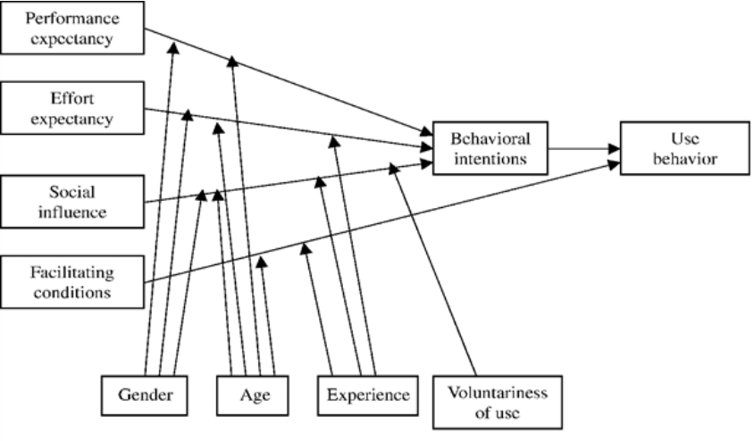
Universidad de Manila
SENIOR HIGH SCHOOL DEPARTMENT
RESEARCH PARADIGM
The connections and relationships between the predictors, moderating factors, behavioral intention, and actual use behavior of technology are depicted in this visual representation of the Unified Theory of Acceptance and Use of Technology.

Slide 8
Universidad de Manila
SENIOR HIGH SCHOOL DEPARTMENT
STATEMENT OF THE PROBLEM
This study aims to evaluate the level of effectiveness of broadcast messaging for disseminating information in UDM-SHS.
Moreover, it seeks to answer the following research questions:
What is the pre-assessment level of the control group and the experimental group?
What is the post-assessment level of the control group and the experimental group?
Is there a significant difference in the pre-assessment level and post-assessment level of the control group and experimental group?
Is there a significant difference in the post-assessment levels of the control group and experimental group?

Slide 9
Universidad de Manila
SENIOR HIGH SCHOOL DEPARTMENT
RESEARCH DESIGN
To determine the level of effectiveness of broadcast messaging for disseminating information in UDM-SHS, this study employs a quasi-experimental design with pre- and post-assessment methods of examination.

Slide 10
Universidad de Manila
SENIOR HIGH SCHOOL DEPARTMENT
RESEARCH SETTING AND PARTICIPANTS
The Senior High School of Universidad de Manila will be the site of this investigation. Participants in this study will be Grade 12 ICT students.

Slide 11
Universidad de Manila
SENIOR HIGH SCHOOL DEPARTMENT
SAMPLING TECHNIQUE
This study will use the propensity score matching (PSM) technique to keep the parameters of the sample in the control and experimental groups comparable in order to achieve objective and reliable results.

Slide 12
Universidad de Manila
SENIOR HIGH SCHOOL DEPARTMENT
POPULATION AND SAMPLE SIZE
The 174 ICT students in Grade 12 at UDM-SHS make up the study's population. A total of 60 ICT students in Grade 12 will comprise the sample.

Slide 13
Universidad de Manila
SENIOR HIGH SCHOOL DEPARTMENT
INSTRUMENT OF THE STUDY
The instrument of the study will be questionnaires, which will be provided to the participants via Google Forms. The questionnaire will ask for the respondents’ strand and section, age, perception on the information dissemination strategy’s usefulness, perception on the information dissemination strategy’s usability, perceived level of social conformity regarding utilizing the information dissemination strategy, and perception on the school’s support for the use of the information dissemination strategy.

