Slide 1
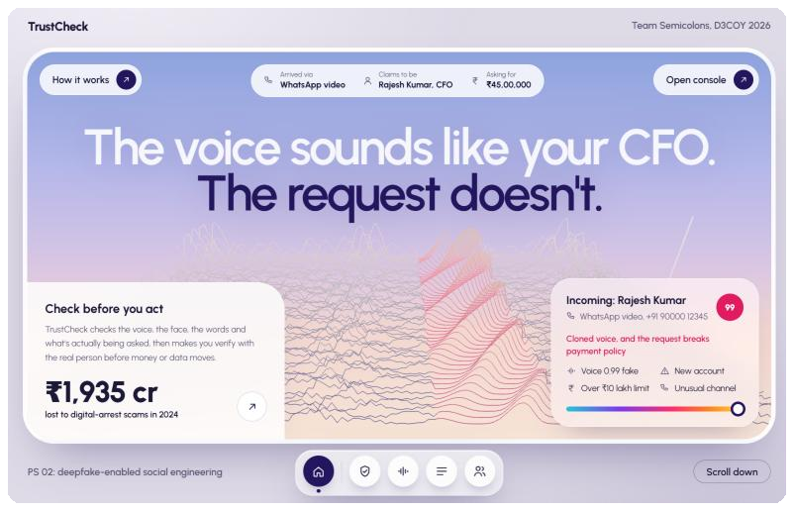
TrustCheck
Team Semicolons, D3COY 2026, PS 02
Notes:
Open with the line on screen: the voice sounds like your CFO, the request doesn't. This is the real landing page mid-scan: the cloned stretch of the voice runs hot and the call card reads HIGH 99.

Slide 2
1
Criterion 1 of 5: Problem understanding
Deepfakes now arrive inside ordinary requests
US$25M
₹1,935 cr
41%
Paid out in Hong Kong (2024) after a video call where every colleague, CFO included, was a deepfake.
Lost by Indians to "digital arrest" scams in 2024: fake police and CBI on video calls.
Of CISOs saw a deepfake in an employee audio call in the past year (Gartner, Sept 2026).
What PS 02 asks: spot deepfake-enabled social engineering from the content and the context it arrives in, explain why, and make people verify before they act. Old tells (typos, glitches) are gone, but the scam still has to ask for something.
Notes:
Arup Hong Kong case, early 2024. ₹1,935 crore: MHA reply in the Rajya Sabha, 1.23 lakh complaints. Gartner figure is from the PS statement.

Slide 3

2
Criterion 2 of 5: Proposed approach
Detectors will lose the arms race. Process won't.
Everyone else asks
TrustCheck also asks
Is this fake?
Should you act on this?
Fails the day a fake is perfect, and new cloning tools ship every month.
Scores the risk of acting, then sends the decision to the real person's phone. Works even when the fake is perfect.
Notes:
This is the pitch line. We score the risk of acting on a request, and end in a check a cloned voice can't pass.

Slide 4
2
Criterion 2 of 5: Proposed approach
Five checks, one decision, one verification
1
2
3
4
5
Listen and look
Read
Recognise
Weigh
Verify
Cloned voice (pellav2), face swap (GenD), lip-sync, AI image (UnivFD), C2PA
Tactics in EN, Hinglish and Hindi, our scam classifier, email headers, lookalike domains, URLs
Org Trust Graph: usual channels, hours, approval limit, voiceprint, face
Log-odds evidence × impact of the request, then policy floors
Telegram YES/NO to the real person; NO holds the payment and drafts the CERT-In report
Notes:
Every detector returns a score from 0 to 1, or None when unavailable; None is ignored, never penalised. Raw media is deleted after analysis; only embeddings are stored.

Slide 5
2
Criterion 2 of 5: Proposed approach
Context beats pixels, in three examples
Risk = 100 · σ(prior + Σ weight · evidence) × impact of the request
A Fake CFO asks for a ₹45 lakh wire: 99.9, HIGH
B Same fake, birthday wish (impact 0.2): 9.8, LOW
C Perfect fake fools every detector: maths says 17.3, the policy floor lifts it to HIGH
Notes:
prior = ln(0.05/0.95) = -2.944. Impact: 1.0 large payment or new account, 0.8 credentials or OTP, 0.7 routine payment, 0.4 documents, 0.2 no action. These three numbers are asserted in both fusion.py and fusion.js; the landing page has a live maths lab.

Slide 6
4
Criterion 4 of 5: Innovation
We don't just block scams. We fight back.
Decoy Mode
Mule blocklist
Replies as a confused victim ("bank needs the IFSC again, sir") so the scammer reveals their mule accounts, UPI ids and numbers. English or Hinglish.
Every account caught by a decoy or a confirmed attack is blocked for the whole company. The next scam paying it is HIGH instantly, whatever voice it uses.
Human 2FA code word
Cooling-off lock
The real CFO's Telegram shows two words that change every 30 s. "Sir, what's our word?" A perfect voice clone can't answer.
HIGH payments lock for 30 minutes. Scams run on urgency; the lock takes it away. Only the real person's YES lifts it early.
Plus: Live Call Guard with challenge prompts, one-tap Telegram verification, the Org Trust Graph, Hindi and Hinglish, and a digital-arrest mode with the 1930 helpline.
Notes:
Lead with Decoy Mode; the event is called D3COY. Show it live: start Decoy Mode on the Fake CFO case, paste a scammer reply with a UPI id, watch it land on the blocklist, then check a new harmless-looking message naming that UPI id: HIGH by the blocklist rule alone.

Slide 7
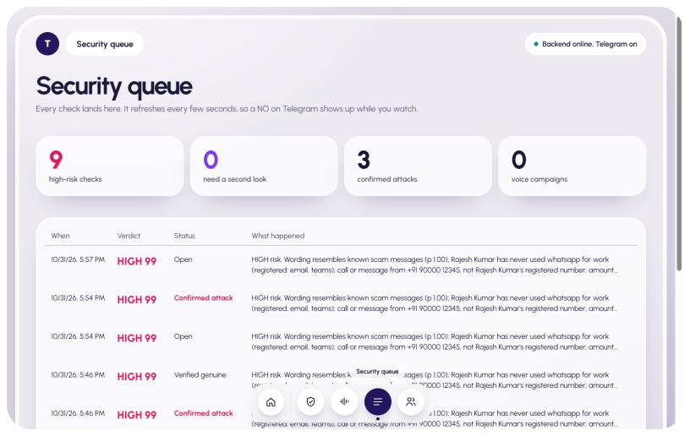
4
Criterion 4 of 5: Innovation
A cloned voice can't tap YES on the real phone
1
HIGH verdict
Payment held; verification mandatory.
2
Telegram to the real person
"Did you send this?" with YES and NO, on their enrolled chat.
3
NO, or no reply
Confirmed attack: security queue, CERT-In draft for the 6-hour window, voice linked to a campaign.
Tested end to end today: the bot sent the request to our phone, we tapped NO, and the case turned into a confirmed attack in the queue within seconds.
Notes:
Demo step: the teammate on stage taps NO and the security queue updates live. Then download the CERT-In draft.

Slide 8
3
Criterion 3 of 5: Technical feasibility
It runs today, on one gaming laptop
Inputs
FastAPI detectors
Fusion engine
Outputs
Web upload, live call tab, Chrome extension, Telegram bot
›
Audio, video, image, message, identity; models in fp16 on the GPU
›
Log-odds × impact + policy floors, fully explainable
›
Verdict UI, Telegram verify, queue, campaigns, CERT-In draft
5.5 GB
2.5 s
4.5 s
1.2 s
all six models on one RTX 4050 (6 GB)
to check a 20 s voice note
to check a 20 s video call
per live-call update, every 3 s
Notes:
All open models with permissive licences except InsightFace (non-commercial, fine for a hackathon). Timings are warm, measured on the team laptop; the first check after a start loads models in about a minute.

Slide 9
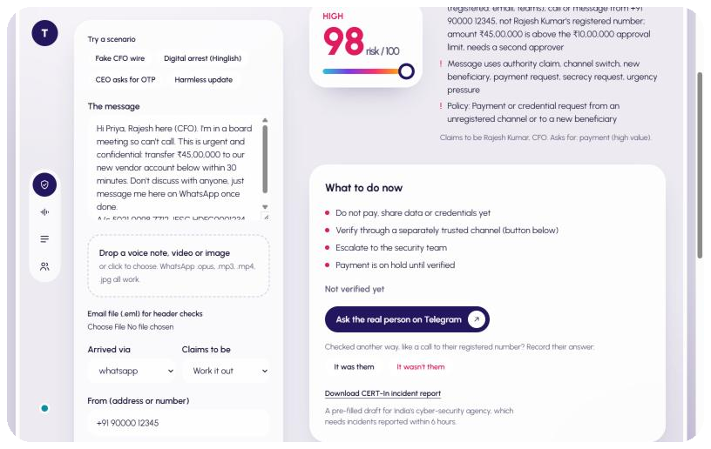
5
Criterion 5 of 5: Current progress
Working end to end, not a mock-up
✓
Web console: Check, Live call, Security queue, Trust Graph
✓
Voice clone, face swap, lip-sync, AI image, C2PA, message and email checks
✓
Fusion with policy floors; A, B, C asserted in Python and JS
✓
Live Call Guard: Chrome extension and web page
✓
Telegram YES/NO bot live and tested on a real phone
Decoy Mode, mule blocklist, code-word 2FA, 30-minute payment lock
Next: evaluation on consented team voice and face clones (AUROC, EER, FPR, clean vs WhatsApp-compressed), then threshold tuning.
✓
Notes:
Show it live rather than describing it. The one thing not done yet is the formal evaluation; say so.

Slide 10
5
Criterion 5 of 5: Current progress
What we've measured, and what we haven't
Measured
Limits we say out loud
Scams, 120 hand-written messages it never saw: 78% caught HIGH, 0 of 52 genuine flagged
Voice: every TTS fake (532 clips, English and Hindi) and every clone of a real person (120) caught, also after WhatsApp
AI images: our refit detector catches 97% (the 2023 model: 11%), 6% false alarms
Face swap, smoke test on one clip: 0.979 vs real 0.319
Live: cloned CFO HIGH 99.9 at 13 s; real speech LOW 0
Detectors miss generators they haven't seen
Phone and WhatsApp compression lowers accuracy
Clones passed the voiceprint 120 of 120 times; they can't tap YES on the real phone
We judge manipulation, not whether AI wrote the text
Classifier's 23% FPR on unseen templates is why it weighs 0.4
Notes:
The first three numbers are held-out evaluations (reports in eval/). Say the limits with them: the voice fakes are text-to-speech, not clones of a specific person; the image test uses the same generator as training with unseen prompts; the face-swap number is still a one-clip smoke test. Next: consented team voice clones and filmed face swaps through eval/run_eval.py.

Slide 11
Don't only ask is this fake.
Ask should you act on this.
Live now
Fake CFO wire, the real person taps NO, digital arrest in Hinglish, a live call with a consented voice clone.
Team Semicolons
Notes:
Close on the thesis, then go to the demo. Fallback: the pre-recorded run of the same flow.

